Slide 1
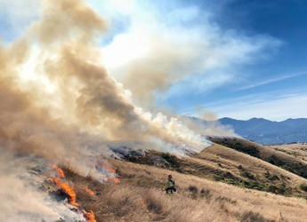

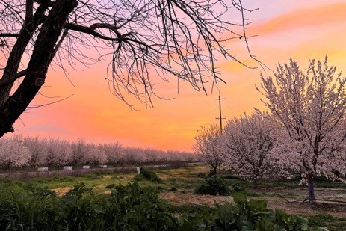
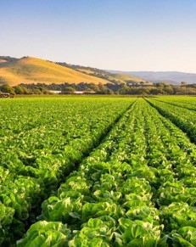
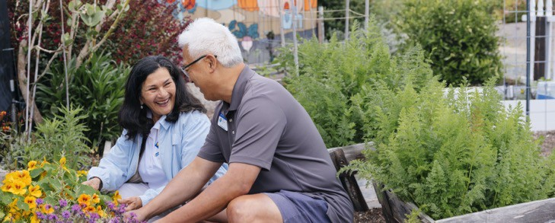

Bringing UC information and practices to local communities to improve lives and livelihoods

Slide 2
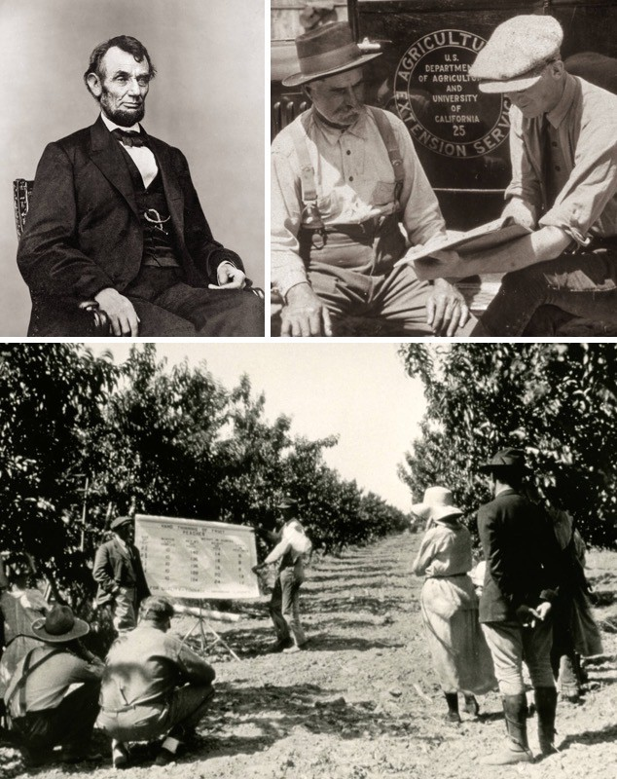
UC ANR Delivers California’s Land Grant Mission
Land Grant Universities established by Congress in 1862
The University of California created in 1868
Congress authorizes Agricultural Experiment Stations (AES) at Land Grants in 1887
Cooperative Extension established by Congress in 1914

Slide 3
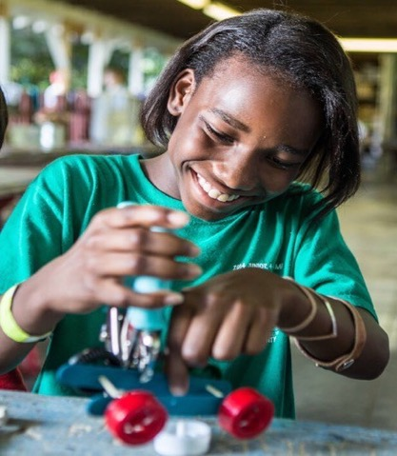
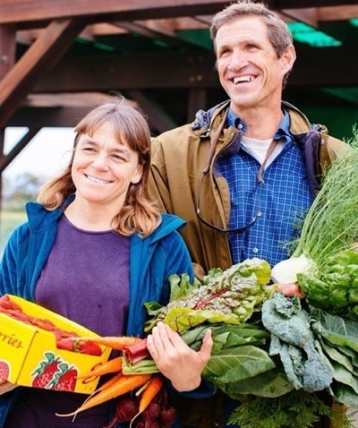
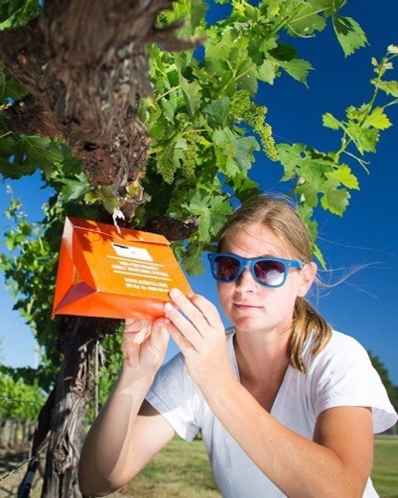


Bringing UC to Californians
UC ANR research & education programs support the following in all 58 counties:
Sustainable, safe, and nutritious food production and delivery
Economic success in a global economy
A sustainable, healthy, and productive environment
Science literacy and youth development

Slide 4
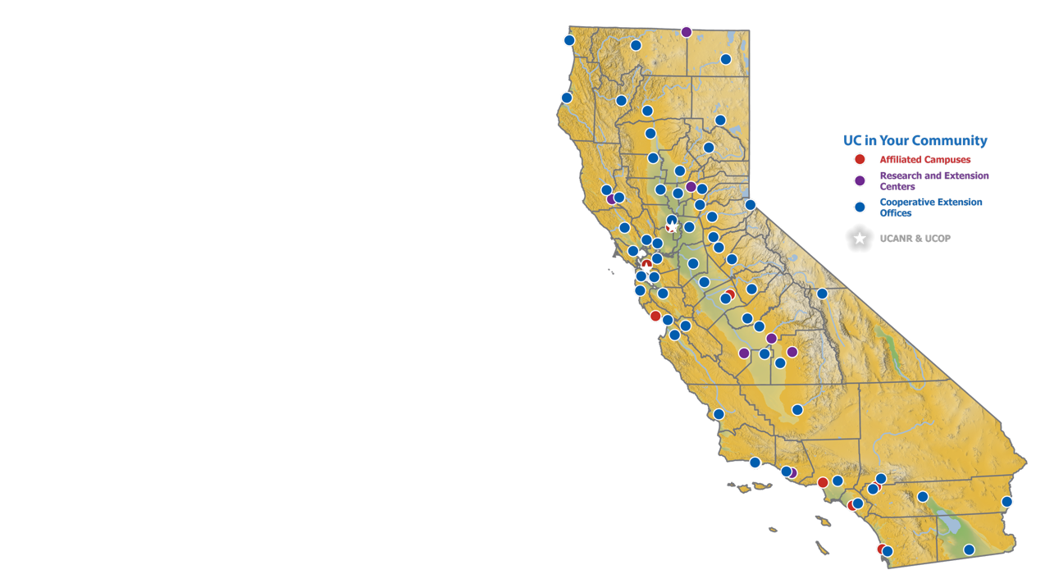

17 Statewide Programs and Institutes
UC Cooperative Extension
186 Advisors conduct research in local communities
311 Community Educators delivering programs
109 campus/county-based Specialists
4-H Youth Development
California Expanded Food and Nutrition Education
California Institute for Water Resources
Community Nutrition and Health
Informatics and GIS
Nutrition Policy Institute
UC ANR Fire Network
UC ANR Innovate
UC ANR Policy Institute
UC Environmental Stewards
UC Master Food Preserver
UC Master Gardener
UC Organic Agriculture Institute
UC Small Farms Network
UC Statewide Integrated Pest Management
UC Sustainable Agriculture Research and Education Program
Research and Extension Facilities
10 Research and Extension Centers
12,500+ acres
235 research projects
Agricultural Experiment Station
513 researchers on 5 campuses
800+ research projects in partnership with land-grant partner USDA NIFA
Over 19,000 volunteers contribute 1.2M hours in donated public service

Slide 5
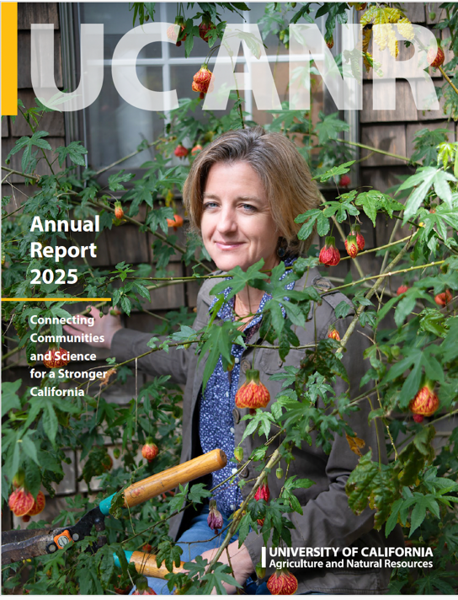






UC ANR Snapshot:
19,070 trained volunteers delivered 1.2 million hours of public service
13 novel ideas led to patents issued
$2M collectively saved on groceries by EFNEP graduates
1,495 policy engagement activities
671,979
adult and youth direct contacts/ educational exchanges
138,000 community members learned about critical need for shade in urban spaces from UCCE
1,895 publications and new educational materials produced

Slide 6
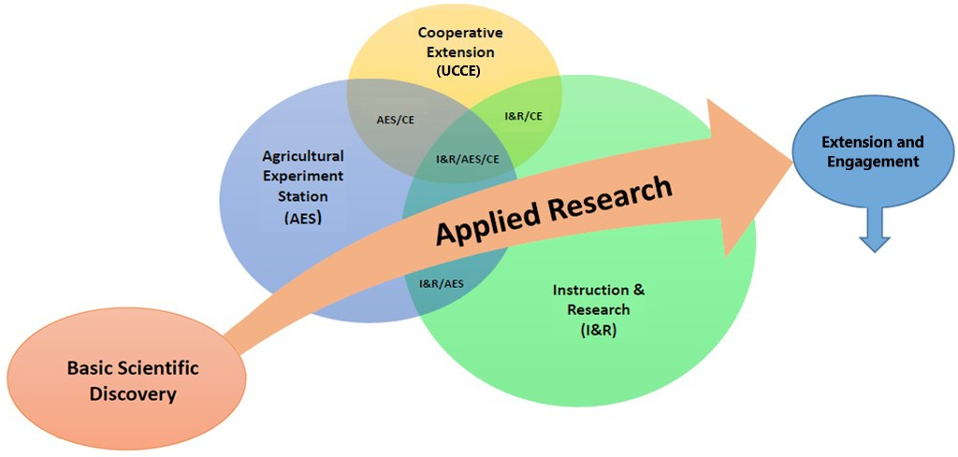
Enhance research excellence and ability to deliver science- based solutions through partnerships across UC system and beyond.
Translate mission- oriented research into policy and practice that solves community problems through stakeholder-driven and place-based collaborations.
Three academic mission areas working together
Leverages the mission-oriented research continuum
Transdisciplinary solutions to complex challenges

Slide 7
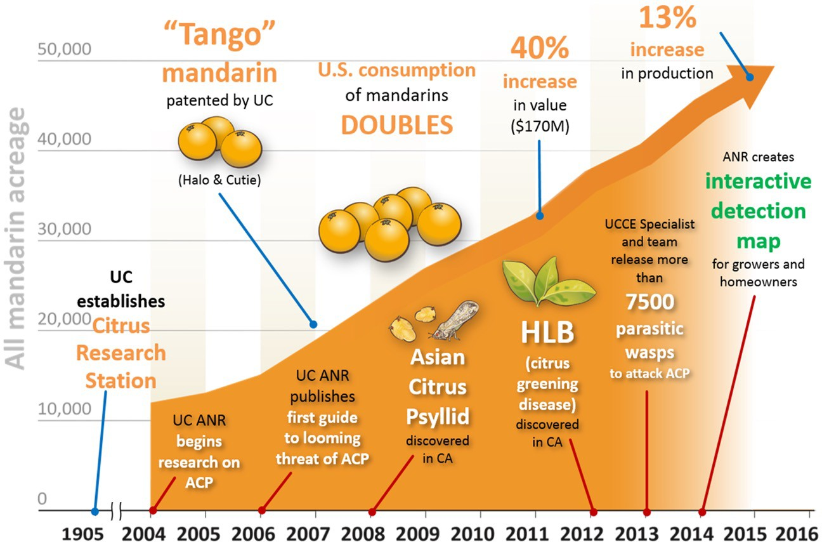
Example of Research and Extension: Fighting Huanglongbing
2018-2020
950% increased use of citrus materials tested by UC Citrus Clonal Protection Program
Developed antibody-based diagnosis using pathogen effectors as markers
Volunteers monitored IPM in 224 citrus orchards to reduce pest populations
Advanced usage of Citrus Under Protective Screens (CUPS) to minimize use of fertilizer, water & pesticides
7

Slide 8

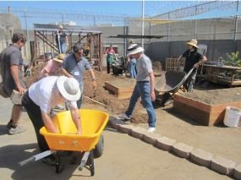
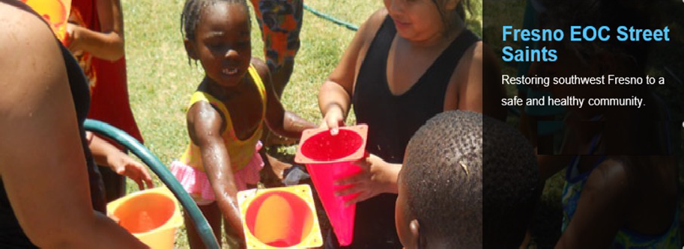

Example of Programs: Youth Development & Community Science
Engaging a diverse community to promote healthy communities, youth development and stewardship of California's natural resources through education and service.
Horticulture therapy program and Career Technical Education at Girls Rehabilitation Facility in San Diego

Slide 9







Supporting State Agency Missions through Partnerships
Joint research projects and subject matter experts
Training in pesticide safety, vegetation management, fire suppression, irrigation and more
Developing educational materials and programs
Mapping future fire probability under climate change scenarios to address public safety
Promoting use of agricultural lands for groundwater recharge and drought management
Providing evidence-based programs and teaching for SNAP-Ed and Women, Infants and Children (WIC)

Slide 10
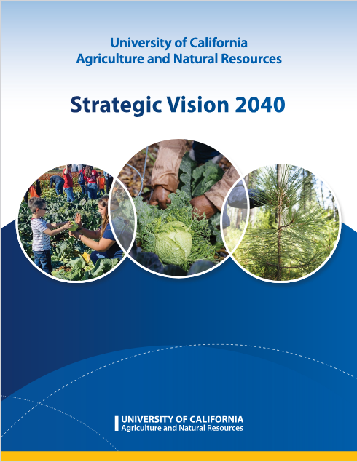
Strategic Vision 2040
A blueprint to guide our work, structure, and resource allocation.
Informed by feedback and insights from hundreds
of UC ANR personnel, external partners, and
clientele across the state.
The 2025-2030 UC ANR Strategic Plan details the specific goals, objectives, and metrics needed to realize the first 5 years of the strategic vision
Read the Strategic Vision
Read the Strategic Vision

Slide 11
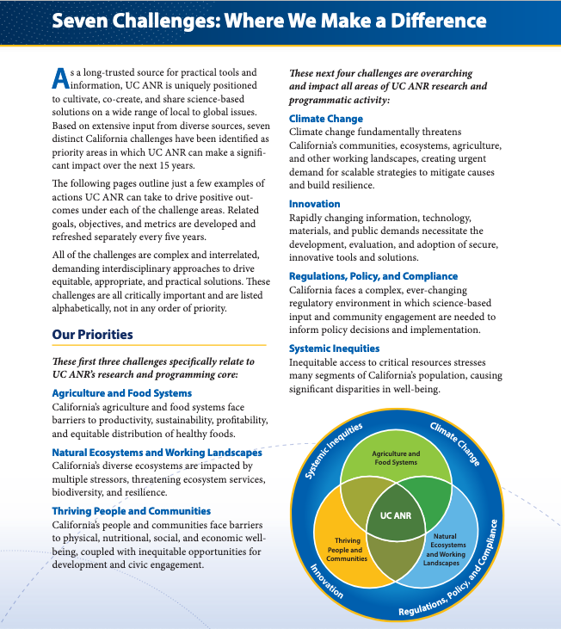
Challenges to be Addressed in 2025-2040 Strategic Plan
Agriculture and Food Systems
Natural Ecosystems and Working Landscapes
Thriving People and Communities
Climate Change
Innovation
Regulations, Policy, and Compliance
Systemic Inequities

Slide 12
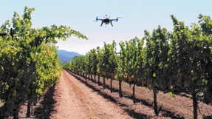
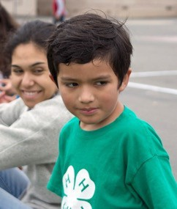
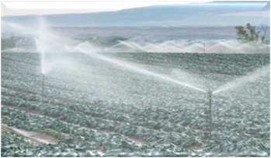
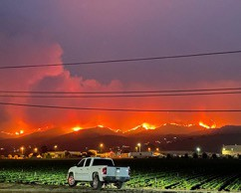

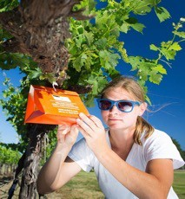
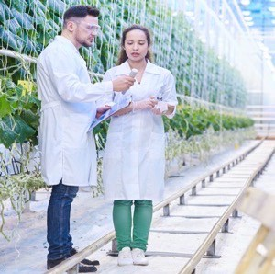
UC ANR Research & Extension Needed More than Ever
New technologies, crops and tools required
Food and nutrition systems are fragile
Climate change impacts
Economic disconnects
Disaster response
Need Solutions for:
  Worker and community well-being
Industry recovery, resiliency and compliance
Market competitiveness, growth and profitability

Slide 13
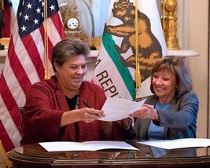
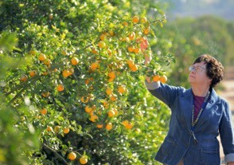
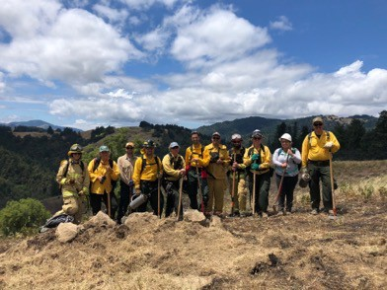


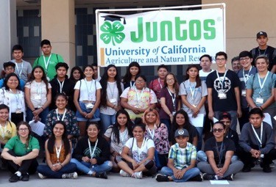
UC ANR Growing and Thriving in our Second Century
Develop new partners, non-traditional resources, improved visibility
Reach more Californians – expand number and diversity of audiences
Ensure delivery & services are relevant
Leverage new technology and methods; retool, recapitalize, reinvest in facilities and infrastructure
Deliver our mission – be a catalyst for positive change

