Slide 1
Reforestation Basics
How to Order Seedlings
Site Preparation
Planting Techniques
Mark A. Egbert
CPESC# 6350
El Dorado County RCD
Georgetown Divide RCD
Placerville Field Office
530-295-5630
Mark.Egbert@ca.usda.gov

Slide 2
Reforestation treatment needs have historically been closely associated with regeneration activities.
Utilize funds collected from timber sales
Reforestation could be planned to coincide with:
harvest activities
site prep
seed acquisition
sow & grow to specification
plant at the appropriate time

Slide 3
Much of this predictability is lost when the principal causal agent creating reforestation treatment needs is a natural disturbance event, particularly those on a catastrophic scale.
Since the location and magnitude of these events cannot be predicted from one year to the next, this dynamic makes the job of planning orderly programs of work to complete reforestation treatments more difficult.

Slide 4
Reforestation work is time-sensitive.
Without timely reforestation efforts, undesirable species can dominate, making establishment of desired tree species difficult.
Once undesirable species become established, decades may pass before sufficient numbers of appropriate tree seedlings occupy the site.

Slide 5
Reforestation work is time-sensitive.
Delays also increase the cost of reforestation work by necessitating expensive site preparation and may adversely affect meeting other resource objectives.

Slide 6
Field Level Circumstances & Challenges
Recovery Process.
Circumstances are unfortunate, unplanned, and immediate.
Diverse demands with immediate needs.
Limited available resources.
Sequence of events.
What level of planning and technical assistance do I need?

Slide 7

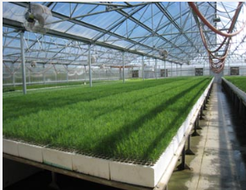
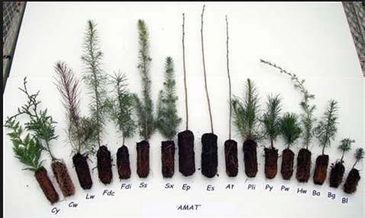
Ordering Seedlings
www.eldoradocountyrcd.org
530-295-5630

Slide 8
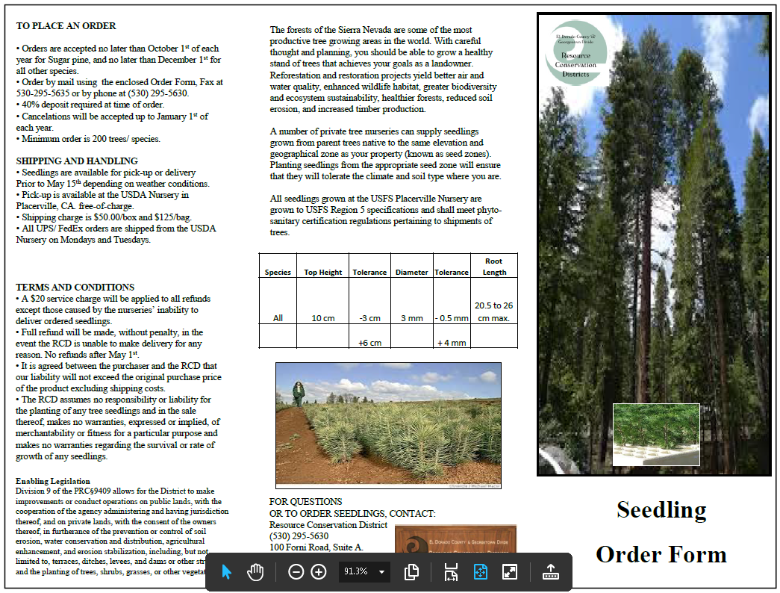

Slide 9
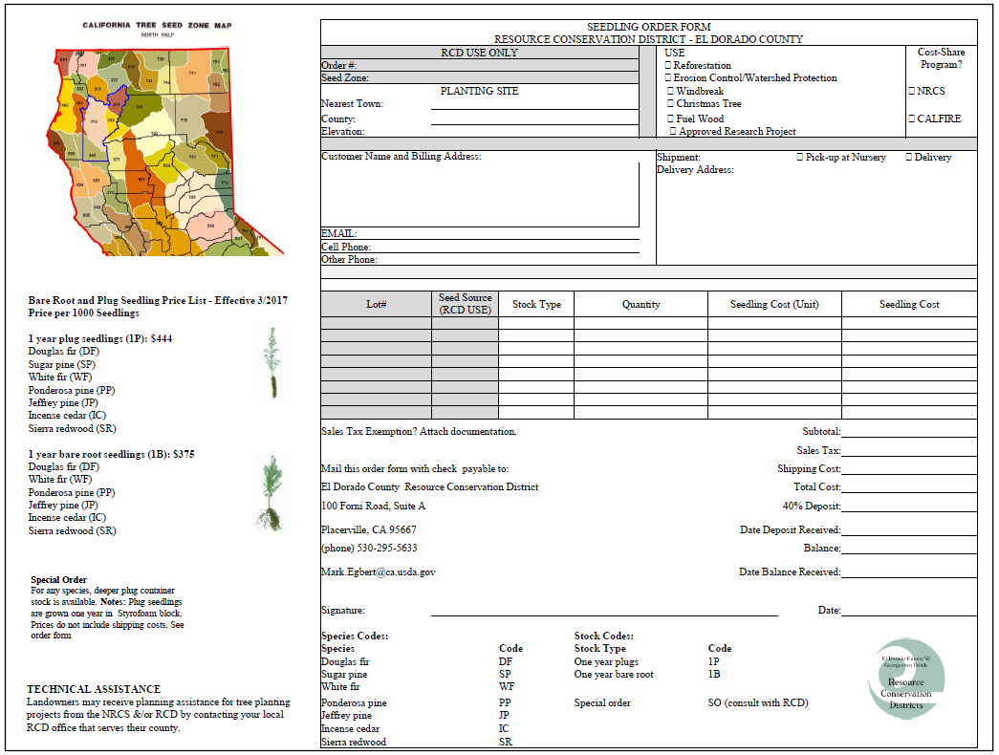

Slide 10
Sequence of Events
Site Prep

Slide 11
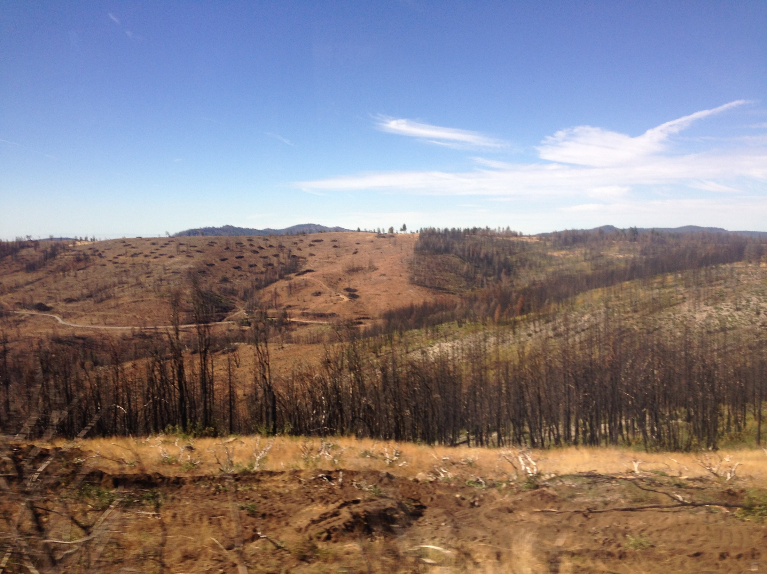

Slide 12
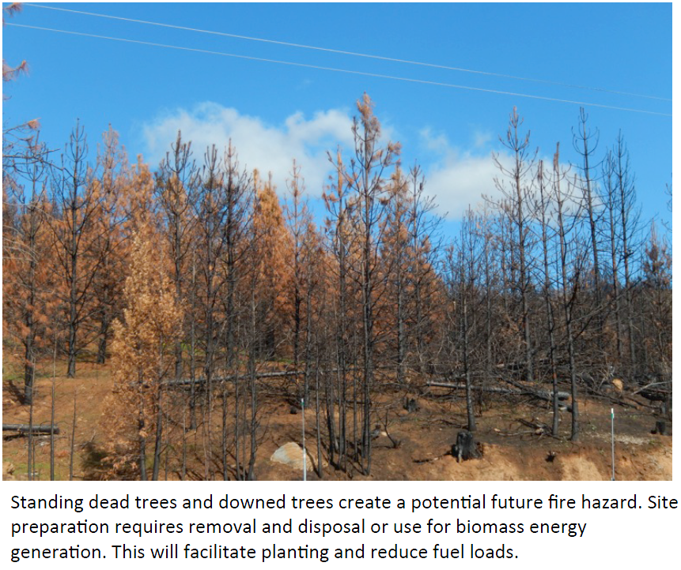

Slide 13
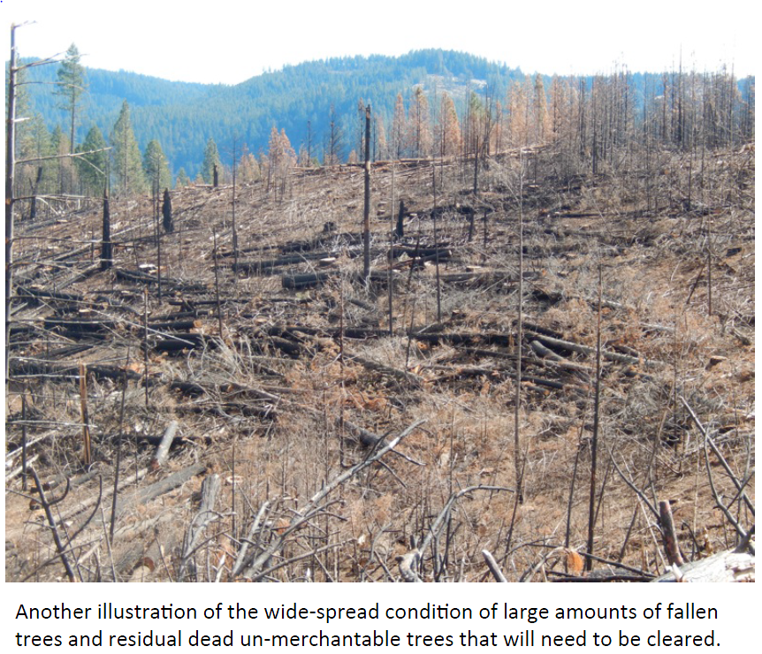

Slide 14
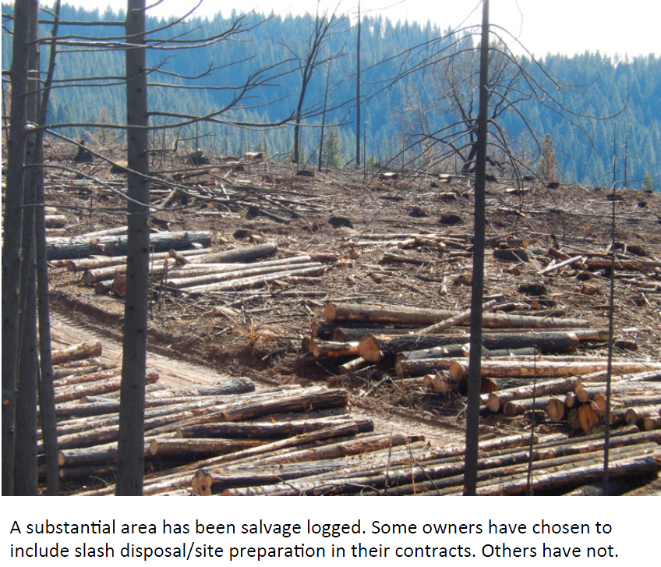

Slide 15
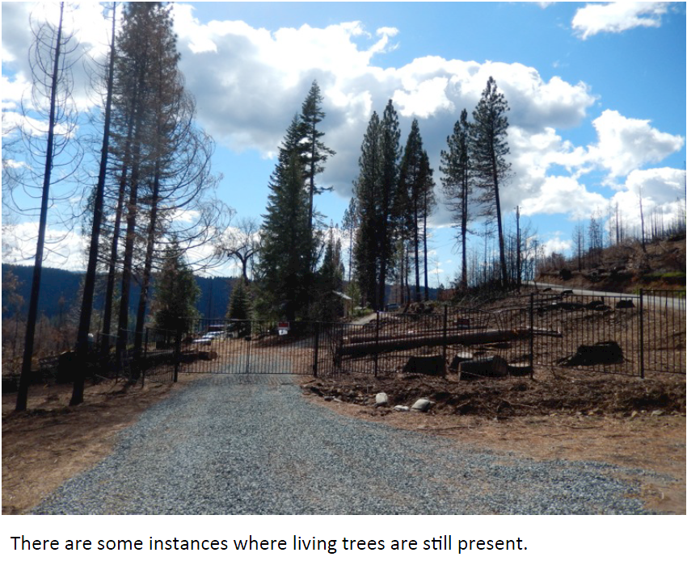

Slide 16
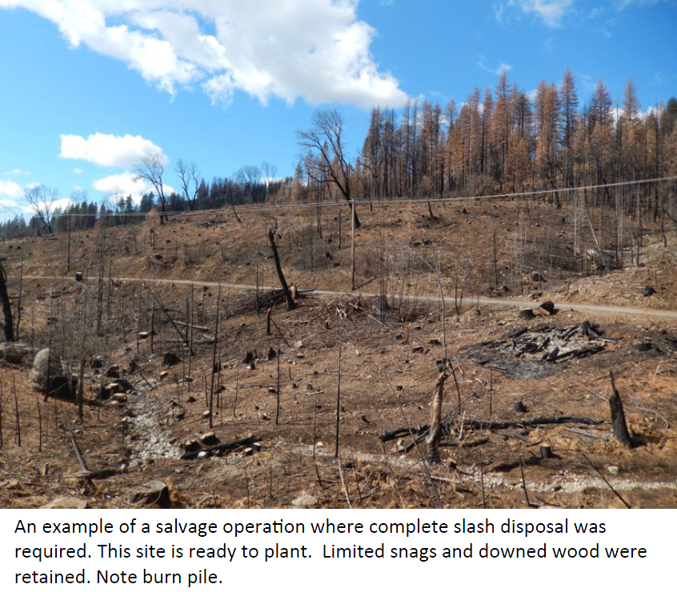

Slide 17
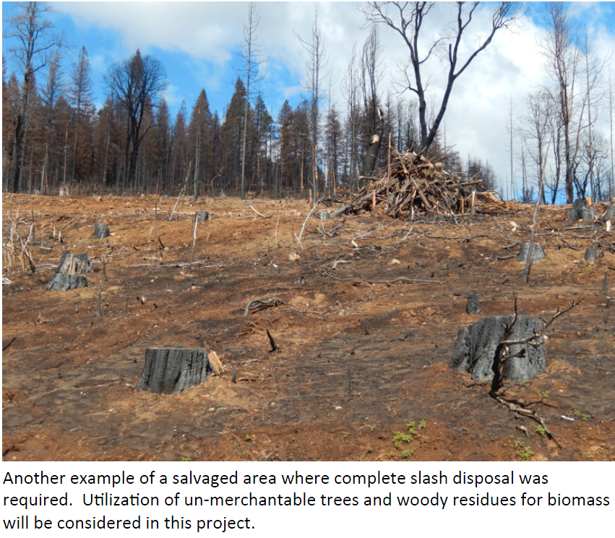

Slide 18
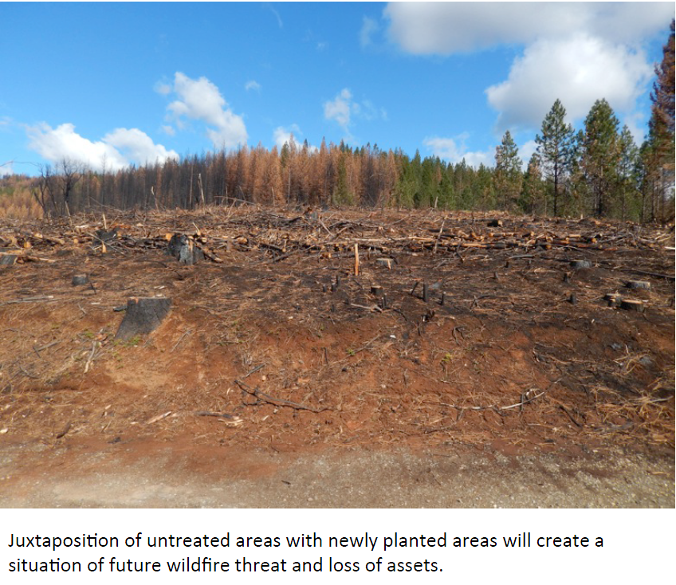

Slide 19
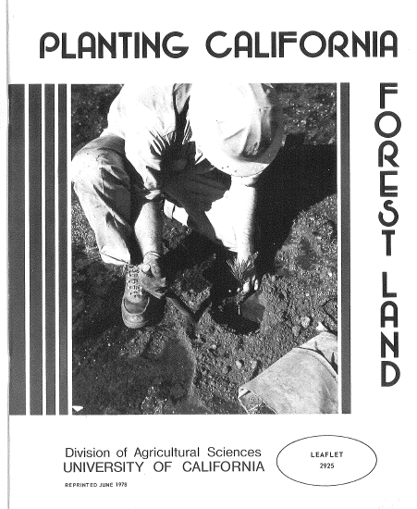
Planting Techniques

Slide 20
Planting
Seasons

Slide 21
Planting Techniques
Two main conditions determine the best planting time:
* growth stage of the seedling
* amount of soil moisture
* depth of > 1 foot.
Other conditions:
* South & West facing slopes dry out quicker
* high elevation may be effected by late snow fall
* dry winds and heat

Slide 22
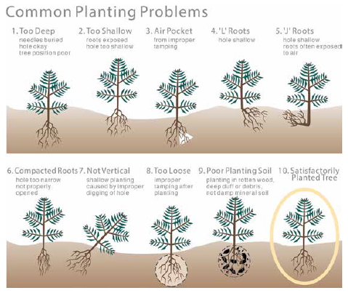
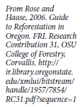

Slide 23
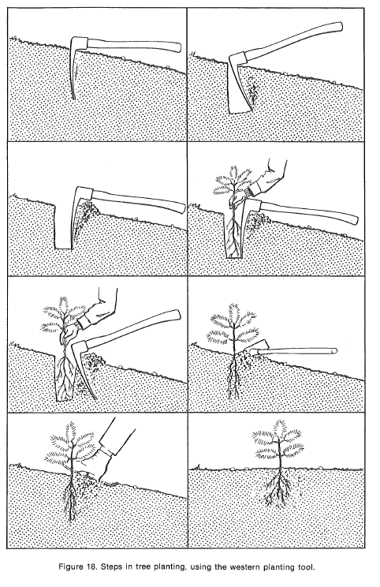

Slide 24
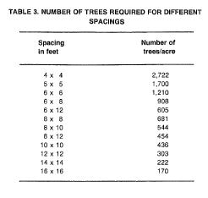

Slide 25
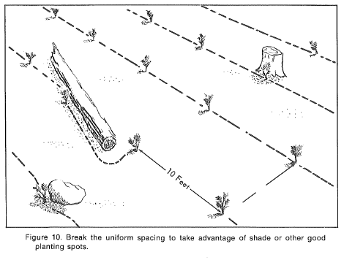

Slide 26
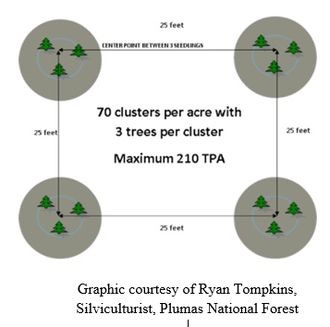

Slide 27
Get help!
USDA – NRCS
CALFIRE
RCD
Private Registered Professional Forester

Slide 28
Thank You
www.eldoradorcd.org
Mark A. Egbert
CPESC# 6350
El Dorado County RCD
Georgetown Divide RCD
Placerville Field Office
530-295-5630
Mark.Egbert@ca.usda.gov

