Slide 1
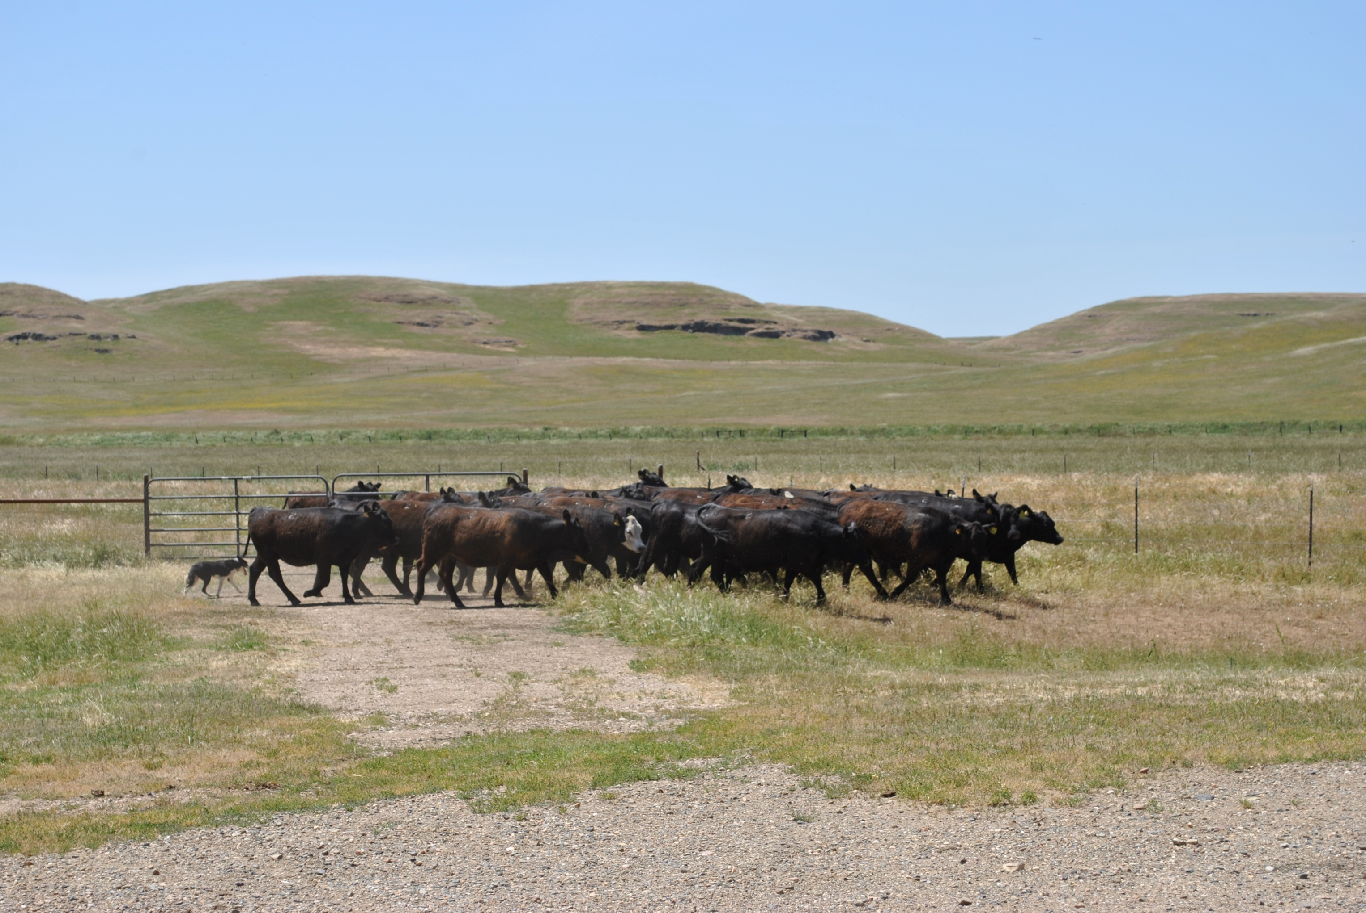
Beef Quality Assurance Certification
September 23, 2017

Slide 2
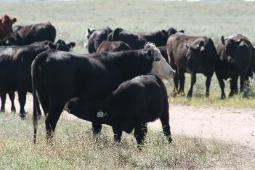
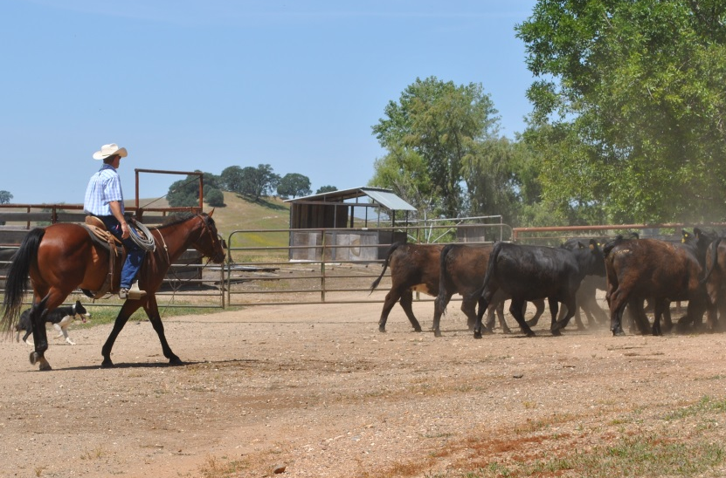
What is BQA?
Voluntary
Producer-driven
Quality control program
Educational training to build producer awareness
Based on recommended national guidelines and research
Protects consumer confidence in beef.

Slide 3
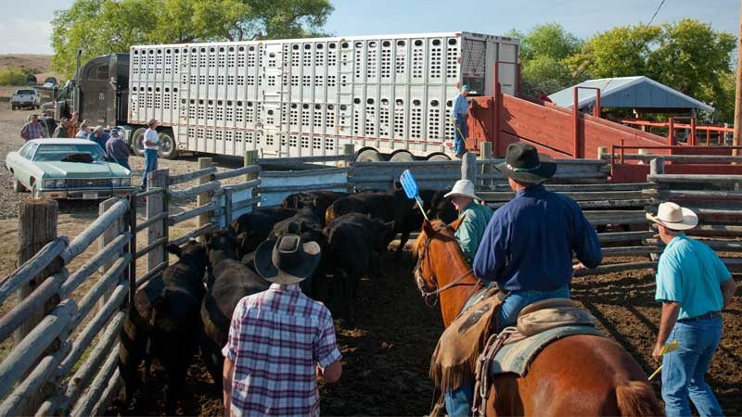
BQA Mission Statement
To maximize consumer confidence in and acceptance of beef by focusing the producer’s attention to daily production practices that influence the safety, wholesomeness and quality of beef and beef products.

Slide 4
BQA Mission Statement
To maximize consumer confidence in and acceptance of beef by focusing the producer’s attention to daily production practices that influence the safety, wholesomeness and quality of beef and beef products.

Slide 5
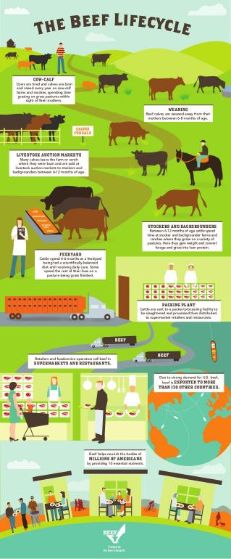
BQA Goals
Enhancing carcass quality
Preventing residues
Eliminating pathogen contamination
Avoiding carcass defects
Maximizing consumer confidence
Best Management Practices

Slide 6
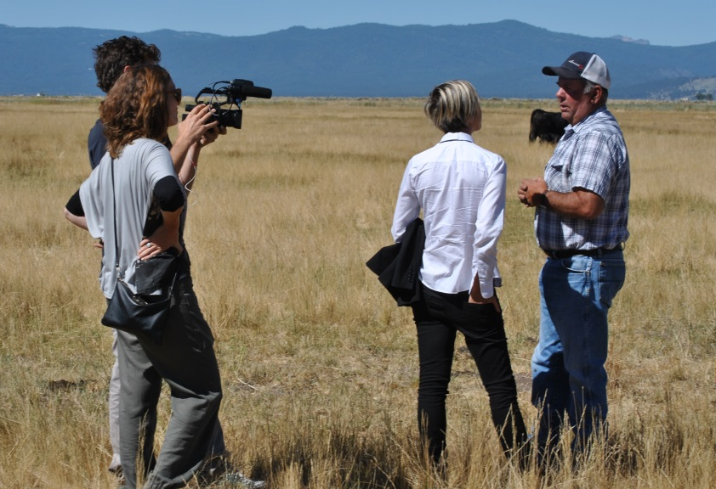
Why is BQA Important?
Demonstrates commitment to food safety and quality
Safeguards the public image of the beef and dairy industry
Upholds consumer confidence
Protects from governmental regulation
Improves sale value
Enhances herd profitability

Slide 7
What is Beef Quality?
“It doesn’t matter what our weights or yield grades are if we don’t have a consumer who will buy our products.”
– Cow Calf Producer, NBQA Strategy Workshop
In order to meet and exceed consumer expectations, we must have:
Product Integrity
Food safety, where cattle were raised, animal health, care, handling and wellbeing
Eating Satisfaction
Flavor profile, tenderness and juiciness

Slide 8
Measuring Quality: National Beef Quality Audits
BQA Success Story:
Injection Site Lesions
1991
22.3%
2001
<5%
Still a loss of $188 million dollars annually
Every 5 years National Beef Quality Audit (NBQA) is conducted:
Measure to manage
Benchmark to provide direction to improve quality
Identify shortfalls to allow greater profit through increasing demand
2016 BQA to be released next month!
Notes:
In 1991 Beef Quality Audit- found that over 20% of fed cattle had injection site blemishes.
And 5% of slaughter cows and bulls had injection site blemishes.
In 2001, the Beef Quality Audit reported that only 5% of fed cattle had injection site blemishes.
However, 20% of slaughter cows and bulls had injection site blemishes.
We need to really work hard on the slaughter cow sector on this issue and continue to improve on fed cattle as well.

Slide 9
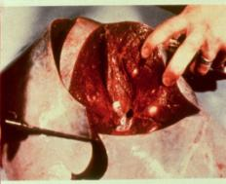
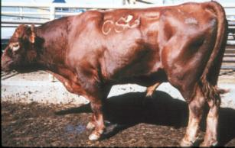
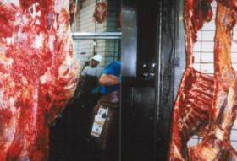
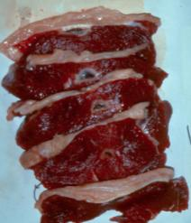
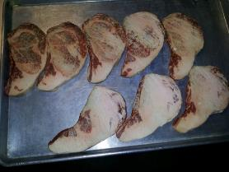
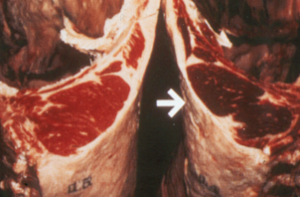
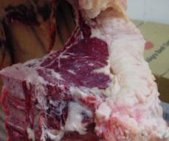
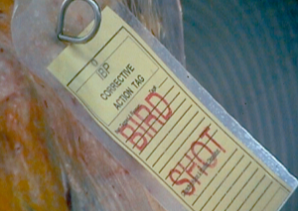
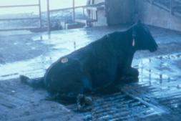
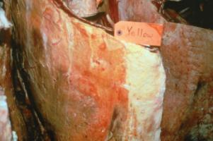
DEFECTS We can prevent these through BQA practices!

Slide 10
The audit is based upon the beliefs that:
only that which is measured can be managed
an industry-wide scorecard provides direction to decision makers to improve the quality and value of the beef supply
identifying and correcting quality shortfalls will lead to greater profitability through improved demand

Slide 11
Ranked Quality Challenges and Changes (1991 until 2011)
1991 | 1995 | 2000 | 2005 | 2011
External fat Seam fat Palatability Tenderness Cutability Marbling | Uniformity Palatability Marbling Tenderness External/seam fat Weights | Uniformity Carcass weight Tenderness Marbling Effects of implants External fat | Traceability Uniformity Instrument grading Market signals Segmentation Carcass weight | Food safety Eating satisfaction How and where cattle were raised Lean, fat and bone Weight and size Genetics

Slide 12
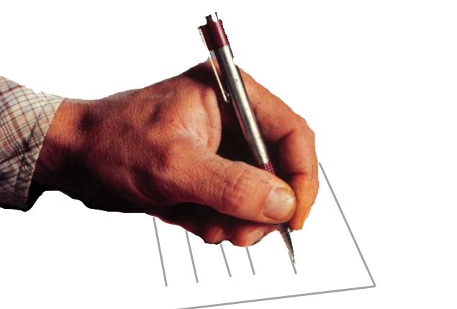
Label Information for Over The Counter Drugs
Diseases or Condition
Species
Dosage
Route of Administration
Frequency of Treatment
Duration of Treatment
Precautionary Statements
Warnings
Withdrawal Time

Slide 13
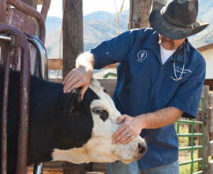
Veterinarian/Client/Patient Relationship--VCPR
A veterinarian has assumed responsibility for making medical judgments about the health of cattle, needs for treatment and the client has agreed to follow the instructions for the veterinarian
The vet has sufficient knowledge of the operation to diagnose and prescribe treatments
The vet is available for follow-up for adverse reactions or failure of therapy

Slide 14
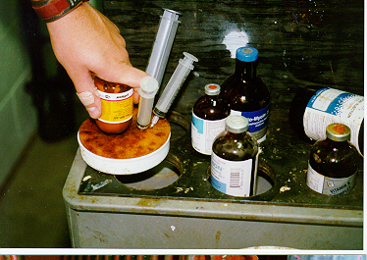
Extra Label Drugs Requirements
Veterinarian’s Rx—need for use other than on the label
Veterinarian Information (name, address, Phone, License Number)
Animal Identification
Plus the requirements
for an OTC Drug

Slide 15
Drugs Prohibited from Extralabel Use in Cattle
Chloramphenicol
Clenbuterol
Diethylstillbesterol
Dimetridazole, Ipronidazole, other nitroimidizoles
Furazolidone, Nitrofurazone
Sulfonamides in lactating dairy cows (approved sulfa drugs OK—sulfadimethoxine, etc)
Fluoroquinolones (Baytril, Saraflox)
Glycopeptides (Vancomycin)
Cephalosporings (not including cephapirin)
Drugs used as feed additives for cattle (chlortetracycline, bacitracin, Se, etc.)

Slide 16
Withdrawal Time
Hours or days after the last treatment before a drug is cleared from the animal
No violative residues in meat, milk, or other tissues

Slide 17
Withdrawal Times for Cattle
Ampicillin 6-9 days
Ceftiofur (Naxcel) 0 days
Enrofloxacin (Baytril) 28 days
Oxytetracycline 28 days
Florfenciol (Nuflor) 28 i.m. 38 s.c. days
Tilmicosin (Micotil) 28 days
Tylosin 21 days (0 in feed)
Tulathromycin (Draxxin) 18 days
Gentocin 18 months (E.L.)

Slide 18
Quality Assurance Focus
Eliminate Illegal Drug & Chemical Residues
Incidence of Residues in Fed Cattle Near Zero
Eliminating Violative residues in cull cows, cull bulls and calves

Slide 19
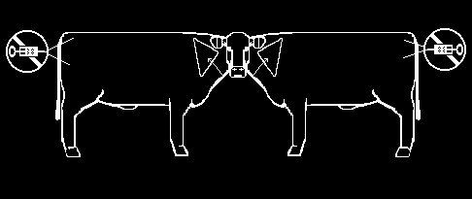
Health Records
Group Processing Records
Routine processing for the entire herd
Individual Health Records
This is for sick animals
Good records today could save you heartache tomorrow

Slide 20
Recordkeeping
Group Processing Records
Vaccines
Dewormers, other products
Date
Product names, labels, serial numbers
Expiration date
Who administered products
Animal ID, group number or individual ID
Individual animal treatment—same plus condition/disease being treated
Good records today could save you heartache tomorrow

Slide 21
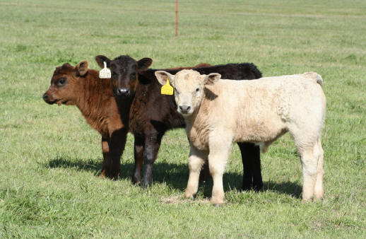
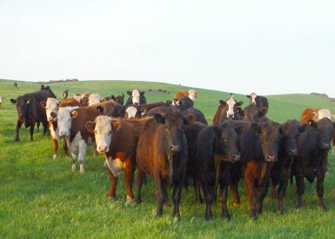


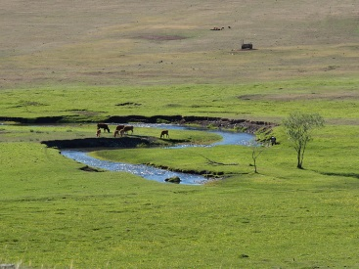
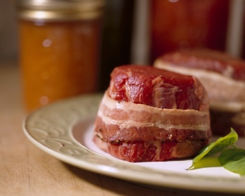
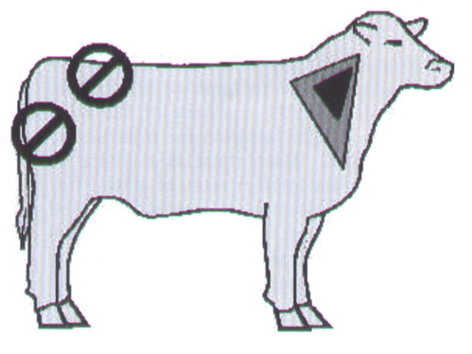
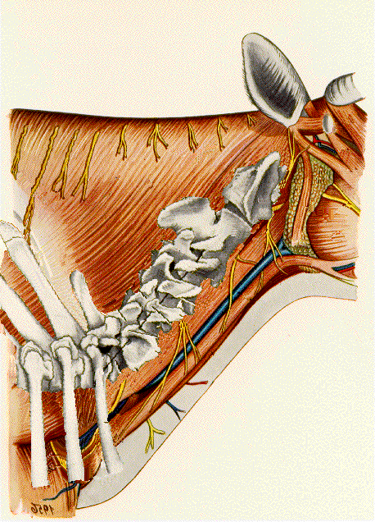
Proper Injection Site
N E C K O N L Y

Slide 22
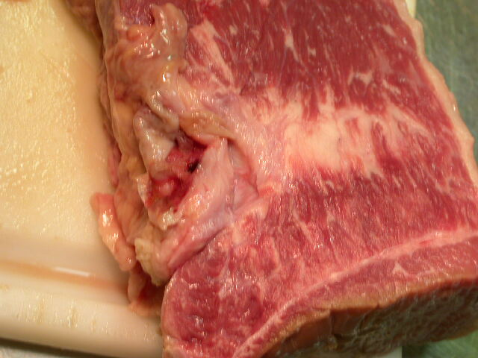
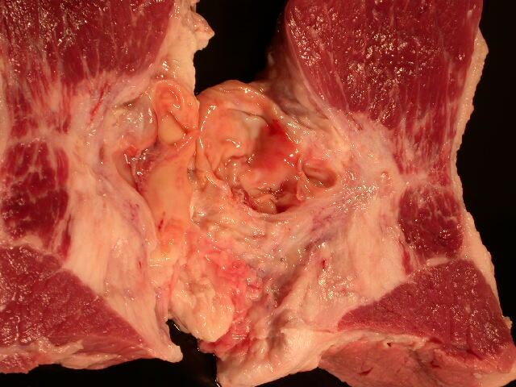
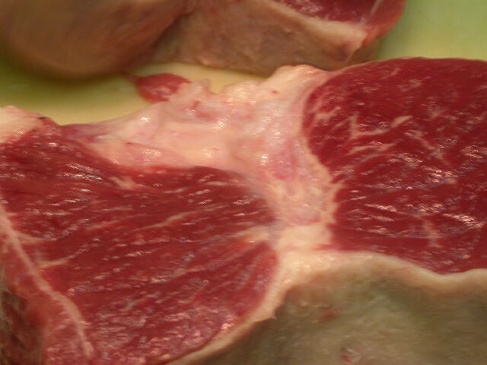
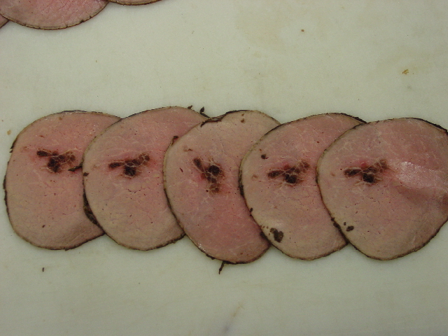
Injection site lesions

Slide 23
Administering Injections
Select appropriate needle size & length
Use new needles often—10 animals max
Discard bent, broken, dropped, dirty needles
Disinfectant for killed vaccines
Dispose of needles in “sharps container”
Keep tops of multiple dose vials clean/disinfected
Don’t inject through dirt/manure

Slide 24
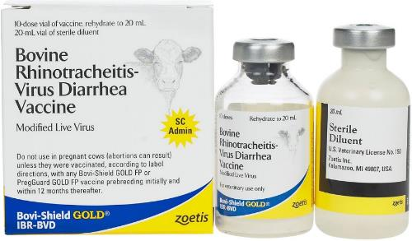
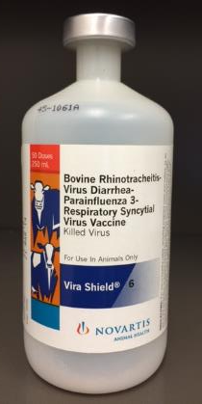
Vaccines
Modified Live
Killed
The vaccine contains a live pathogen for the target disease that has been altered to reduce its ability to cause disease.
The pathogen for the target disease is contained in the vaccine but is no longer living.
vs.

Slide 25
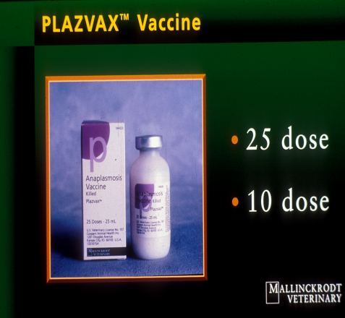
Handling Vaccines
Keep vaccines refrigerated—not frozen, in container for transport and storage
Keep vaccines cool while processing cattle
Keep vaccines out of sunlight and mix (gently) often
MLV vaccines: mix enough to last about 1 hour, keep syringes out of sunlight, don’t disinfect needles or use in syringes that have been chemically disinfected or exposed to soaps
Clean syringes in an approved manner—work with your veterinarian on this process

Slide 26
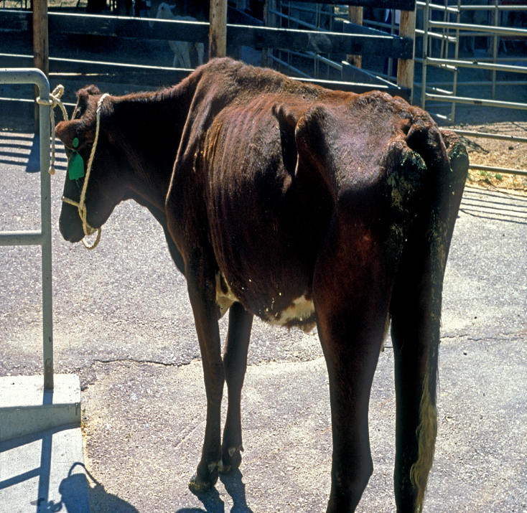
Factors that Affect Vaccine Effectiveness
Stress
Age
Nutrition: protein, Se, Cu
Products used
Vaccine handling
Previous vaccine history
Parasites
Pregnancy
Environmental stress

Slide 27
Reasons for Euthanasia
Make a prompt decision to treat
Segregate sick or injured animals from the herd
Fractures of the legs, hip or spine that are not repairable and result in immobility or inability to stand
Emergency medical conditions that result in excruciating pain that cannot be relieved by treatment
Animals that are too weak to be transported due to debilitation from disease or injury
Paralysis from traumatic injuries or disease that result in immobility
Disease conditions where no effective treatment is known, prognosis is terminal, or a significant threat to human health is present.

Slide 28
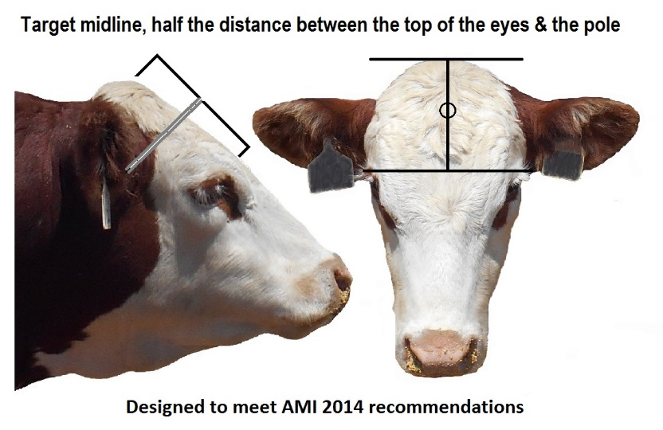
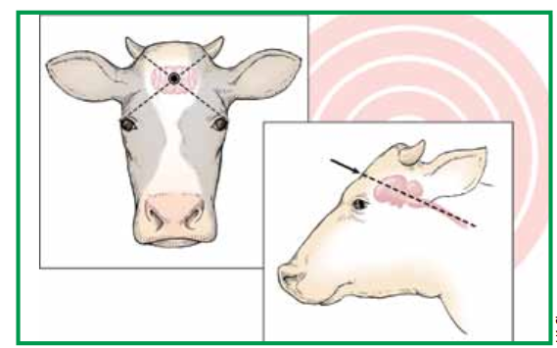
Proper Euthanasia Protocols

Slide 29
Handling, Facilities and Transportation

Slide 30
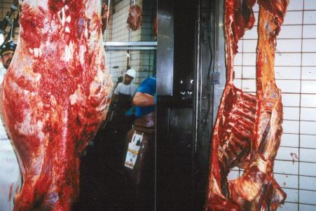
Cattle Handling
Stress reduces immune function
Bruising has cost the industry
$117 million in carcass trim
Emphasize low stress handling!

Slide 31
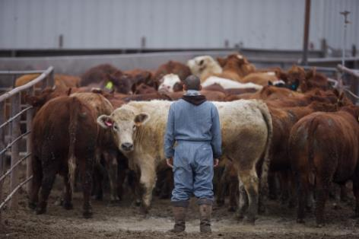
How to Reduce Stress?
Understand Cattle Behavior
Cattle want to see you
Cattle want to go around you
Cattle want to be with and go with other cattle
Cattle want to return to where they have been
Cattle can only process 1 main thought at a time

Slide 32
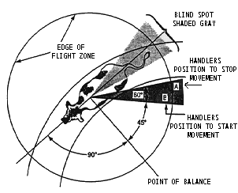
How to Reduce Stress?

Slide 33
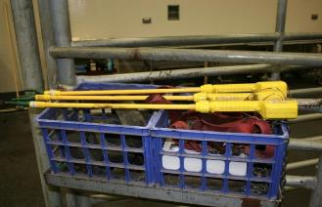
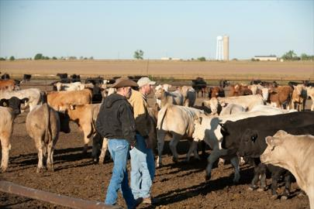
Cattle Handlers Should….
Work slowly – “The fastest way to work cattle is slow.”
Avoid shouting, running and waving their hands
Avoid working cattle on slippery surfaces
Appropriate use of handling devices– minimize use of electric prods
Rely on knowledge of cattle behavior – flight zone and point of balance
Abuse of cattle is not acceptable under any circumstances!
Notes:
Once agitated, it takes up to 20 minutes to for heart rate to go back to normal. Hands in pockets. Talk about Curt’s example of yelling from behind them.

Slide 34
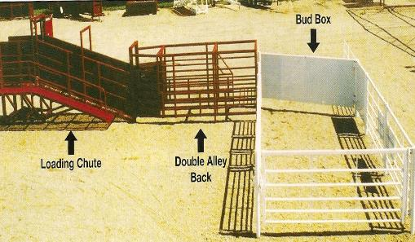
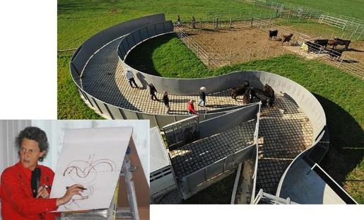
Consider Your Facilities
Squeeze chute
No wider than 28 in
Only trained personnel should operate
“Snake” or Alley
Solid or open sided
Crowding Pen or “Tub”
Circular with solid or open sides works best
Never fill more than half full
Notes:
Inspect regularly to ensure ease of handling and animal wellbeing. Keep facilities and handling tools clean – minimize contamination and improve health.

Slide 35
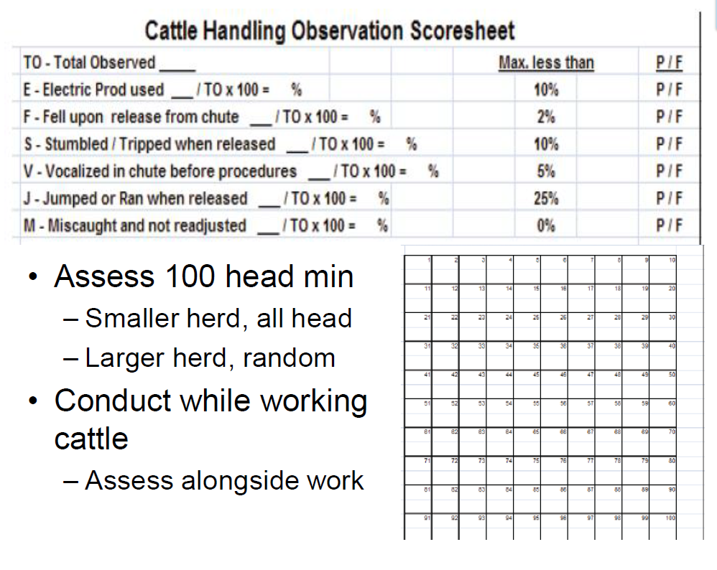

Slide 36
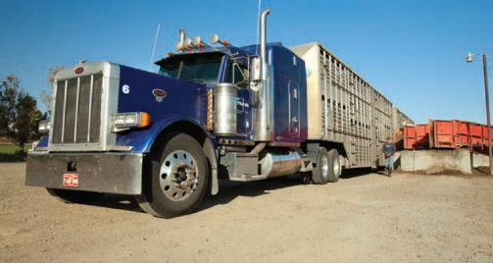
Transporting Cattle
Major cause of stress, injury & bruising
Excessive handling
Changing weather
Unfamiliar environment
Load-out ramp angle 25⁰ or less
Adhere to safe load levels

Slide 37
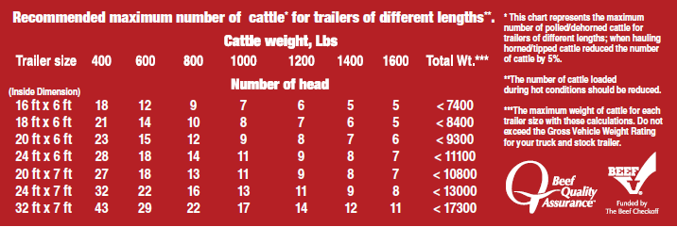
Trailer Weights
Notes:
Bovine Emergency Response Plan

Slide 38
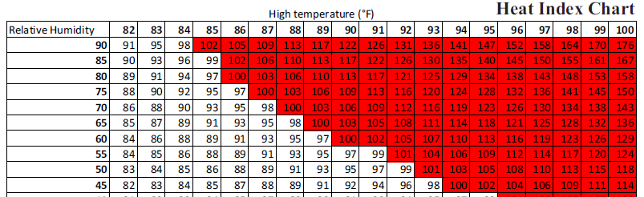
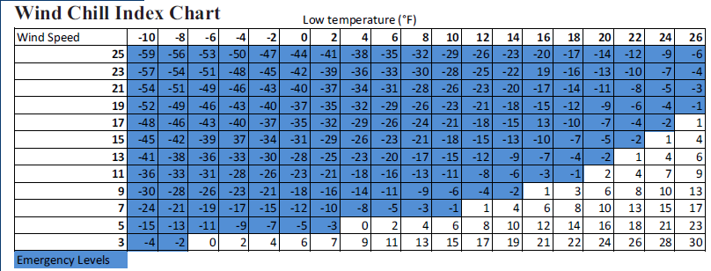
Avoid hauling between 11 a.m. and 4 p.m.
Avoid stopping
Short stops
Shaded areas
Cooler time of day
If cattle are wet, wind chill/cold stress danger is greater
Avoid stopping

