Slide 1
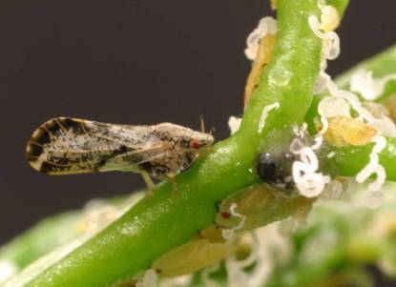
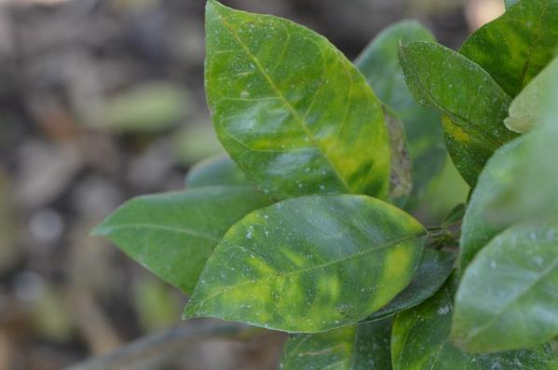
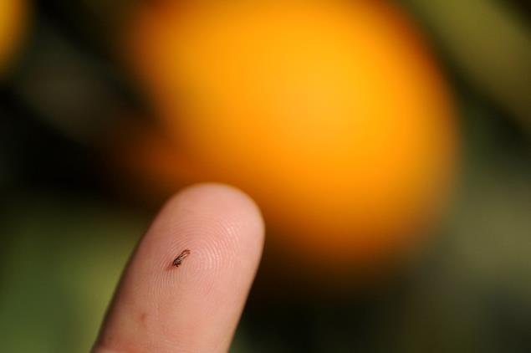
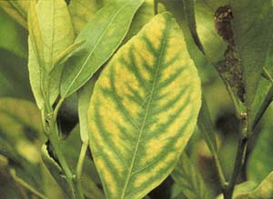
Asian Citrus Psyllid and the Citrus Disease Huanglongbing
ACP
HLB
The tiny Asian citrus psyllid can transmit a bacterium that causes the incurable disease huanglongbing in citrus. Early symptoms of the disease are blotchy mottle – asymmetrical yellowing versus the very symmetrical yellowing cause by zinc deficiency. Eventually the fruit becomes small, the juice bitter and the tree dies.
Zinc

Slide 2
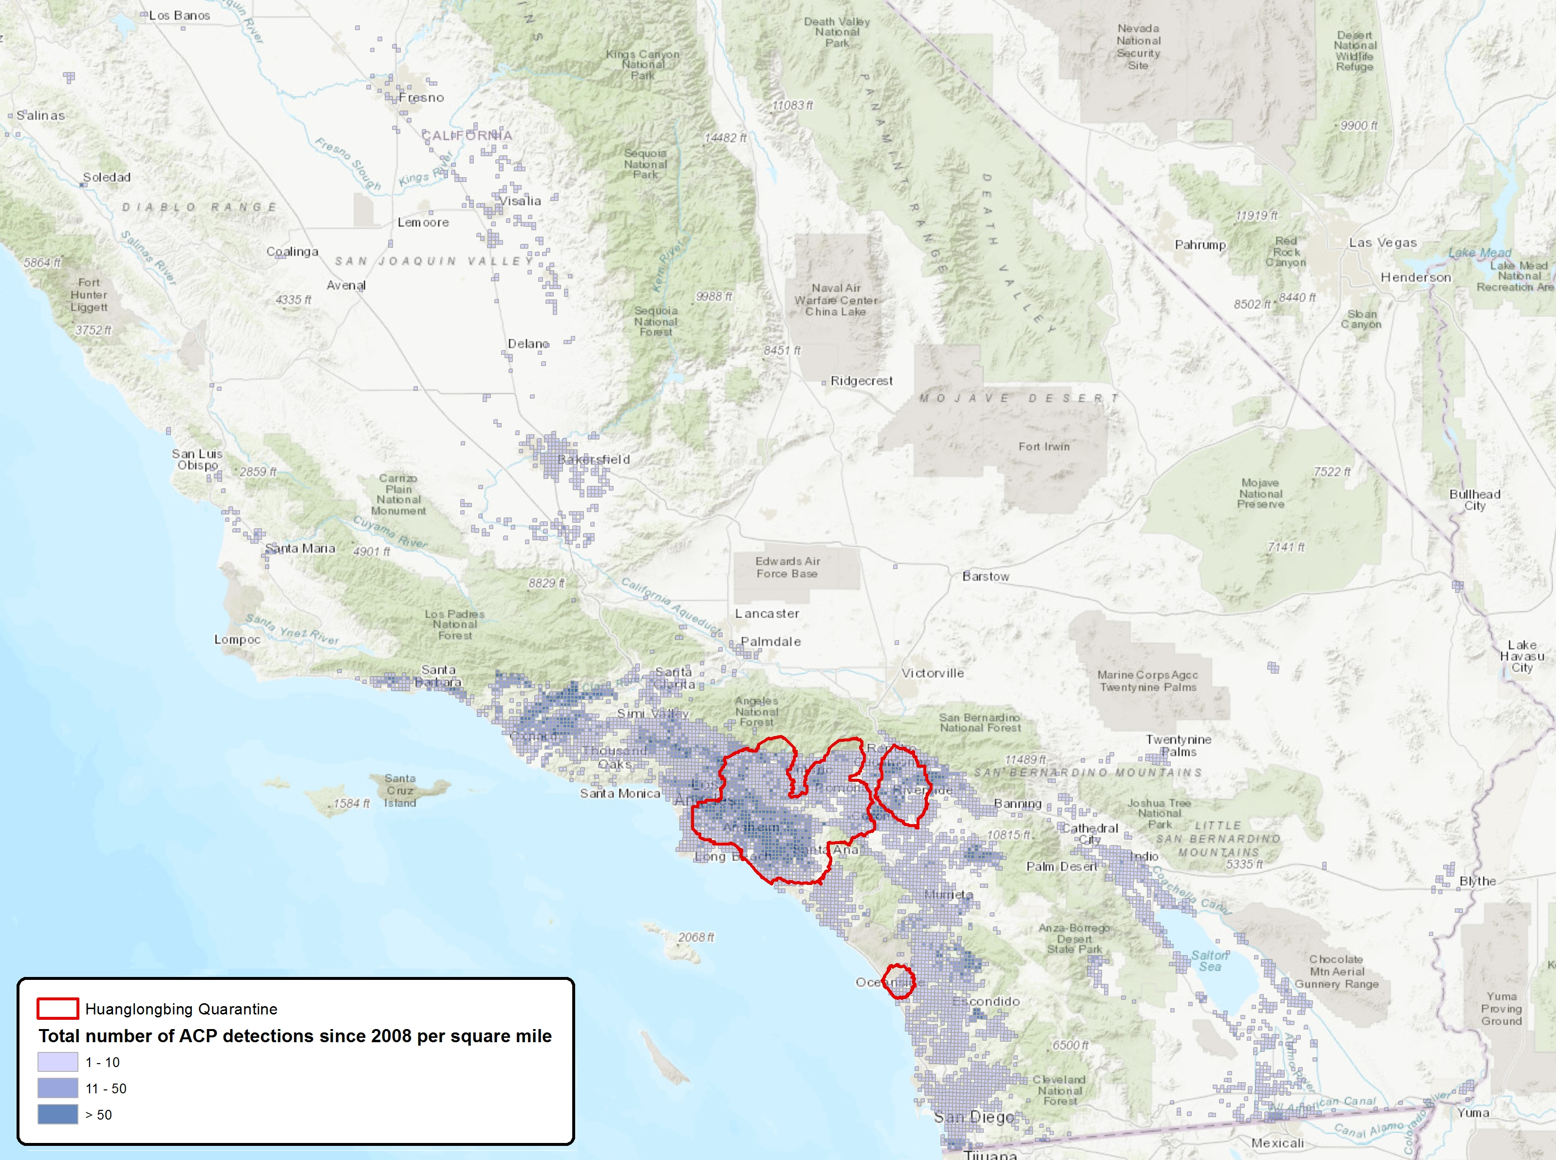
Status of ACP and HLB
www.ucanr.edu/ACP/
Northern and Central California
ACP: Occasional finds of psyllids on trap cards- eradicative treatments applied
HLB: none known
Southern California
ACP: spread throughout – parasite releases in urban areas and regular sprays of commercial citrus
HLB: found in LA, Orange, Riverside, San Diego counties in residential areas

Slide 3
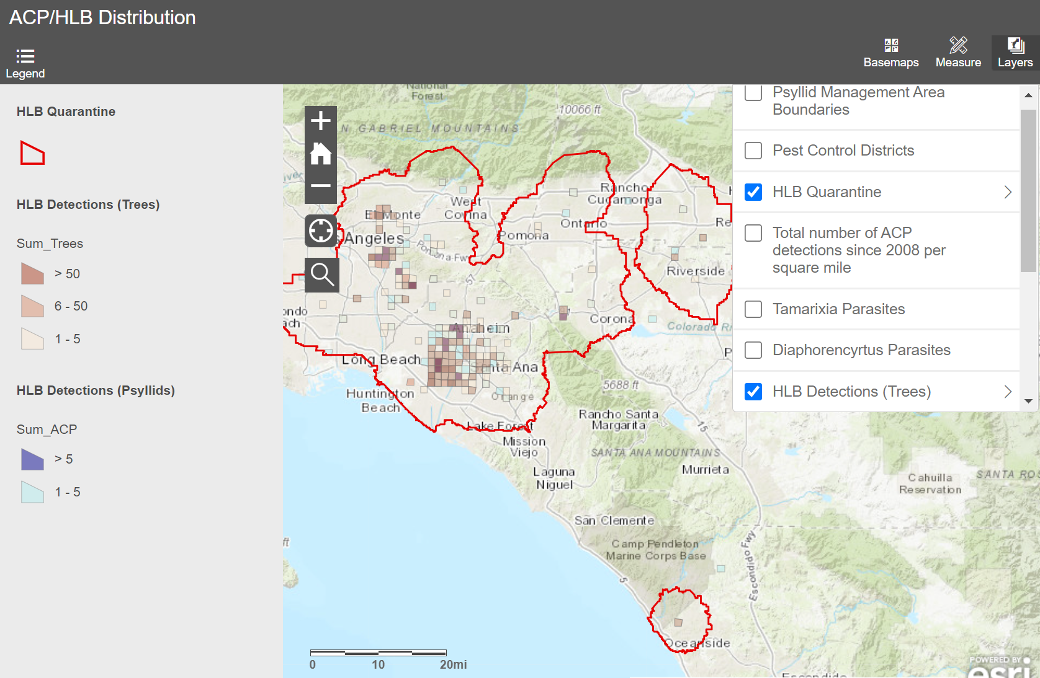
The current HLB situation in southern California
www.ucanr.edu/acp
More than 2500 infected trees removed as of Fall 2021
https://citrusinsider.org/maps/

Slide 4
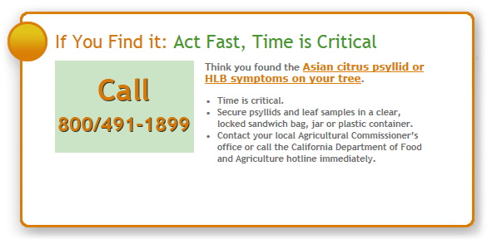
How to protect your citrus and help prevent HLB disease spread?
Plant only certified disease-free citrus plants (or graft budwood) obtained from a reputable nursery.
Do not move citrus trees around the state and before moving fruit wash it and remove stems and leaves that could harbor the psyllid.
Learn to recognize the pest and disease and know where it is in relation to your home.
Call the Department of Food and Agriculture hotline if you think you might have the psyllid (central and northern CA) or the disease (anywhere).
Control ants to help natural enemies control ACP
Be supportive of trapping and pesticide treatments for the psyllid and, if your trees are found to be diseased, support the mandatory tree removal
If HLB is found close to your home, consider removing your citrus trees because they are likely already infected!
All of these steps will protect your citrus tree and buy time for the scientists to find a cure for the disease!

