Slide 1
WCAG 2.1 Accessibility Compliance by April 24
Digital Accessibility Task Force meeting regularly to develop compliance strategy, recommend training opportunities, and provide guidance to leadership on funding/resource needs
DeQue providing training in document accessibility to 75 people and web content creation to 50 people; these trainees will share what they learn with their networks. Also developing a roadmap and providing strategic assistance in how to manage content remediation
IT is working to bring on a project manager and an accessibility expert to support the effort as well as ARIA video interpreting and Remediate for PDF remediation

Slide 2
Compliance by April 24 (continued)
5 templates in the communications toolkit have been remediated for WCAG 2.1 compliance. PowerPoints will be completed by February 25 and posters will be completed by March 3. It is critical to use the templates correctly to be compliant. Use the pre-set styles in the templates without altering them. Please reach out if you need support
Learning and Development is sending valuable weekly tips that take about five minutes to read
Siteimprove is available to all UC ANR employees to check the accessibility of websites. Submit a ticket to IT if you need access to Siteimprove
Notes:
posters will be converted to Word so that they will convert better to accessible pdfs.
Stop creating documents in PPT that are more complex than slides.

Slide 3
No new non-compliant content after March 15
Everyone who creates content is responsible for making it accessible. Numerous free resources have been collected by UCOP, UC ANR and other UC locations to assist
Leadership has mandated that no content can be published that is non-compliant after March 15. Content may be unpublished if it is not compliant
We understand this is time-intensive and will affect productivity in other areas of your work
Compliance policy applies to all assets produced on behalf of the university by employees, volunteers, contractors, partners, etc.

Slide 4
Employee Responsibilities (UCOP)
If you manage teams
Ensure that your team is aware of the requirements, outline expectations and responsibilities and create a plan for compliance
Evaluate your team’s web presence and digital properties, and consider if inaccessible, out-of-date materials can be decommissioned or archived
If you host Zoom meetings
Ensure your Zoom settings are updated for accessibility
If you use visual aids, ensure color contrast requirements are met and that visual information is equivalently conveyed through your talking points

Slide 5
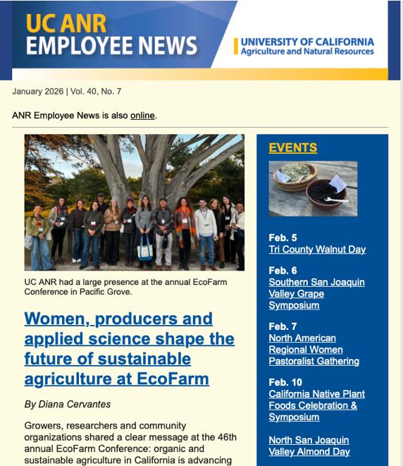
Digital content
If you create and/or distribute digital content
Learn how to achieve the WCAG 2.1 Level A and Level AA standards applicable to the content you manage and offer
Explore these quick reference accessibility guidelines and other content-specific resources and libraries available through the UC Electronic Accessibility Committee website, such as: Create Accessible PDFs, Transcripts & Captioning, eCourse Accessibility Checklist, Rich Text Editors

Slide 6
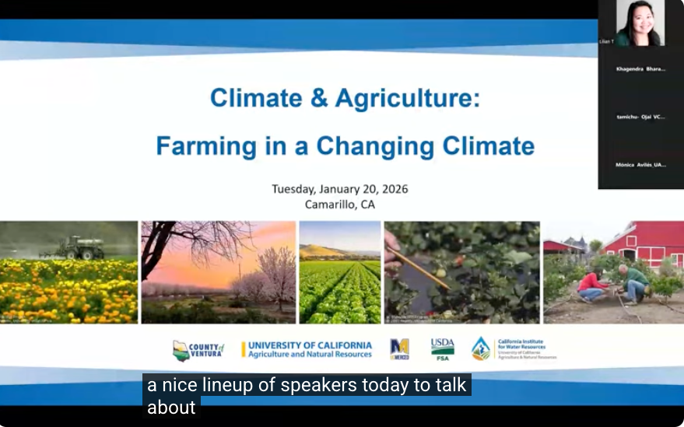
Videos
If you create or distribute videos
All pre-recorded videos need accurate captions. Closed captioning is preferred because it allows users to control the size and look of the captions, as well as whether they are displayed.
Pre-recorded (non-live) videos may need to include an audio description — additional narration that describes important visual details not conveyed by the main narration/dialogue alone. To help you understand why, here is an example YouTube video that needs an audio description, along with its audio description supplement.

Slide 7
Websites
If you’re a website developer or work with outside developers
Explore the resources available through the UC Electronic Accessibility Web Developers page
Check the websites you manage with Siteimprove and begin fixing identified issues
If you procure digital or mobile content or platforms from a vendor
Begin discussing web accessibility requirements with your vendor(s)
Explore the Electronic Accessibility Committee’s procurement guide (PDF) and procurement-related offerings
Ensure accessibility requirements are spoken to in contracts through UC’s standard Terms & Conditions

Slide 8
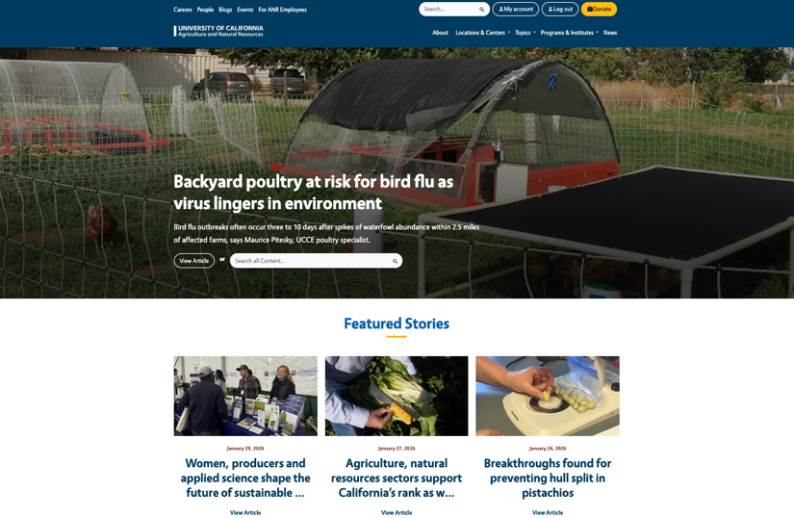
Recommended Training by Role
Web Developers | Designers
Comprehensive WebAIM Training (Semantic HTML5, CSS, Aria)
Headings, Alt Attributes, Descriptive Links, Color, Lists, Tables, and Closed Captions
Mobile Accessibility
Captioning and Alt Attributes for Images, Title (descriptive) attributes for iFrames | Video
PDF Accessibility

Slide 9
Recommended Training by Role (continued)
Content Creators
Web Design Accessibility
Writing Accessible Content
Captioning and Alt Attributes for Images, Title (descriptive) attributes for iFrames | Video
Video Closed Captions
PDF Accessibility
Admin Support
Microsoft Documents Accessibility
PDF Accessibility
Broad Overview of Digital Accessibility for Office Workers
Basic Web Accessibility
Accessible Forms

Slide 10
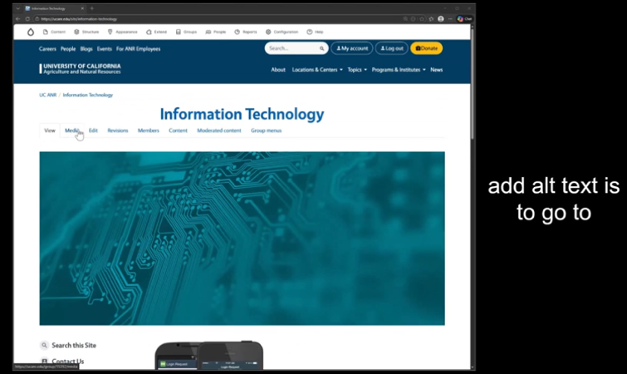
Explainer Videos
Two 10-minute videos are available on Box
3 Things to Improve Accessibility Now
How to Use Siteimprove
https://ucdavis.box.com/s/3c1o0cvneuoh30e3jvx3zjavxz123ucw

Slide 11
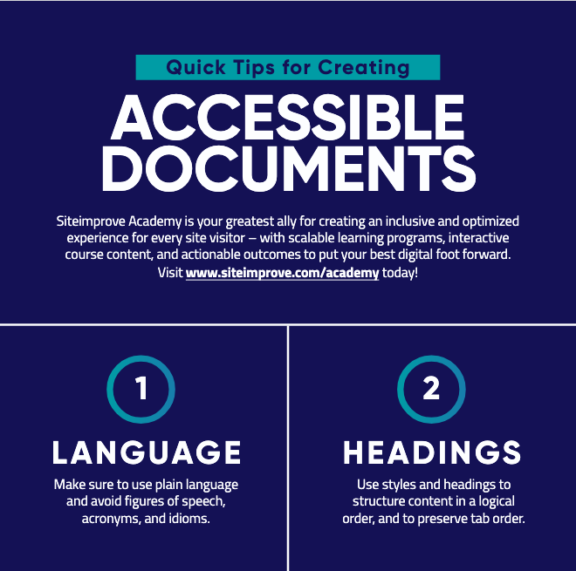
Helpful Siteimprove Tip Sheets
Quick Tips for Creating Accessible Documents (pdf)
Quick Tips for Creating Accessible Websites (pdf)
Quick Tips for Creating Accessible Videos (pdf)
Quick Tips for Creating Accessible Emails (pdf)
Quick Tips for Creating Accessible Social Posts (pdf)
Quick Tips for Creating Accessible Virtual Learning (pdf)

Slide 12
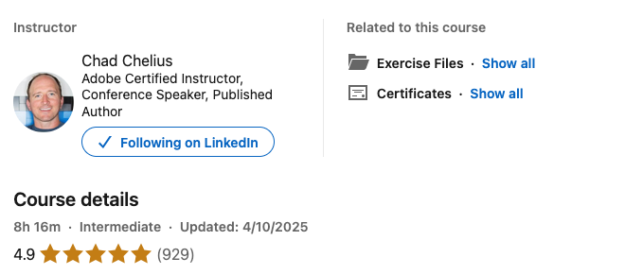
Highly Recommended PDF Training
LinkedIn Learning
Creating Accessible PDFs

Slide 13
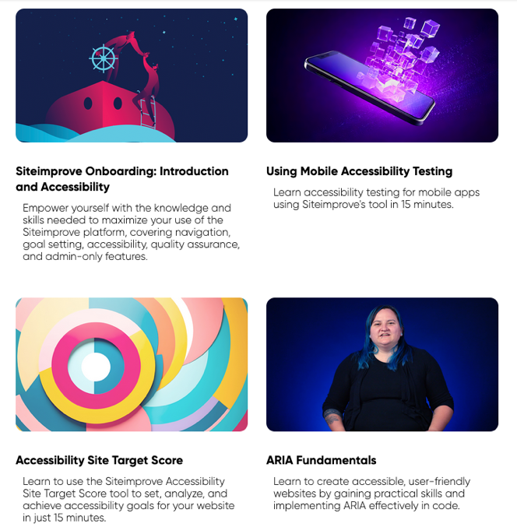
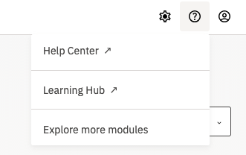
Siteimprove Training Modules
45 foundational courses
DATF recommended sessions
Fundamentals of Alt Text
Accessibility for Content Contributors
Onboarding: Introduction and Accessibility
Accessibility for Marketing Emails
Choose “Learning Hub” under the ? Menu

Slide 14

In Summary
We are all responsible for learning these new skills and making a good faith effort to comply with policy
Tools and resources are available to help us, and more are on the way
Do not create non-compliant content after March 15
Notes:
It is a best practice to include who to contact if someone if having difficulty accessing your content.

