Slide 1
New World Screwworm
Charles W Tobias DVM

Slide 2
New World Screwworm
Cochliomyia Hominivorax
Commonly known as primary screwworm or blowfly
There are over 1100 species of blowfly in the world
Most are secondary blowflies or those that only feed on dead
and necrotic material.
The NWS will only lay its eggs on living tissue.
The larvae (maggots) will only feed on live tissue of animals and birds
Thus, it is a threat to all livestock, birds and even humans

Slide 3
Adult Fly
The adult fly has large orange eyes, a blue/green metallic body and 3 black vertical stripes on the top of the thorax or back

Slide 4
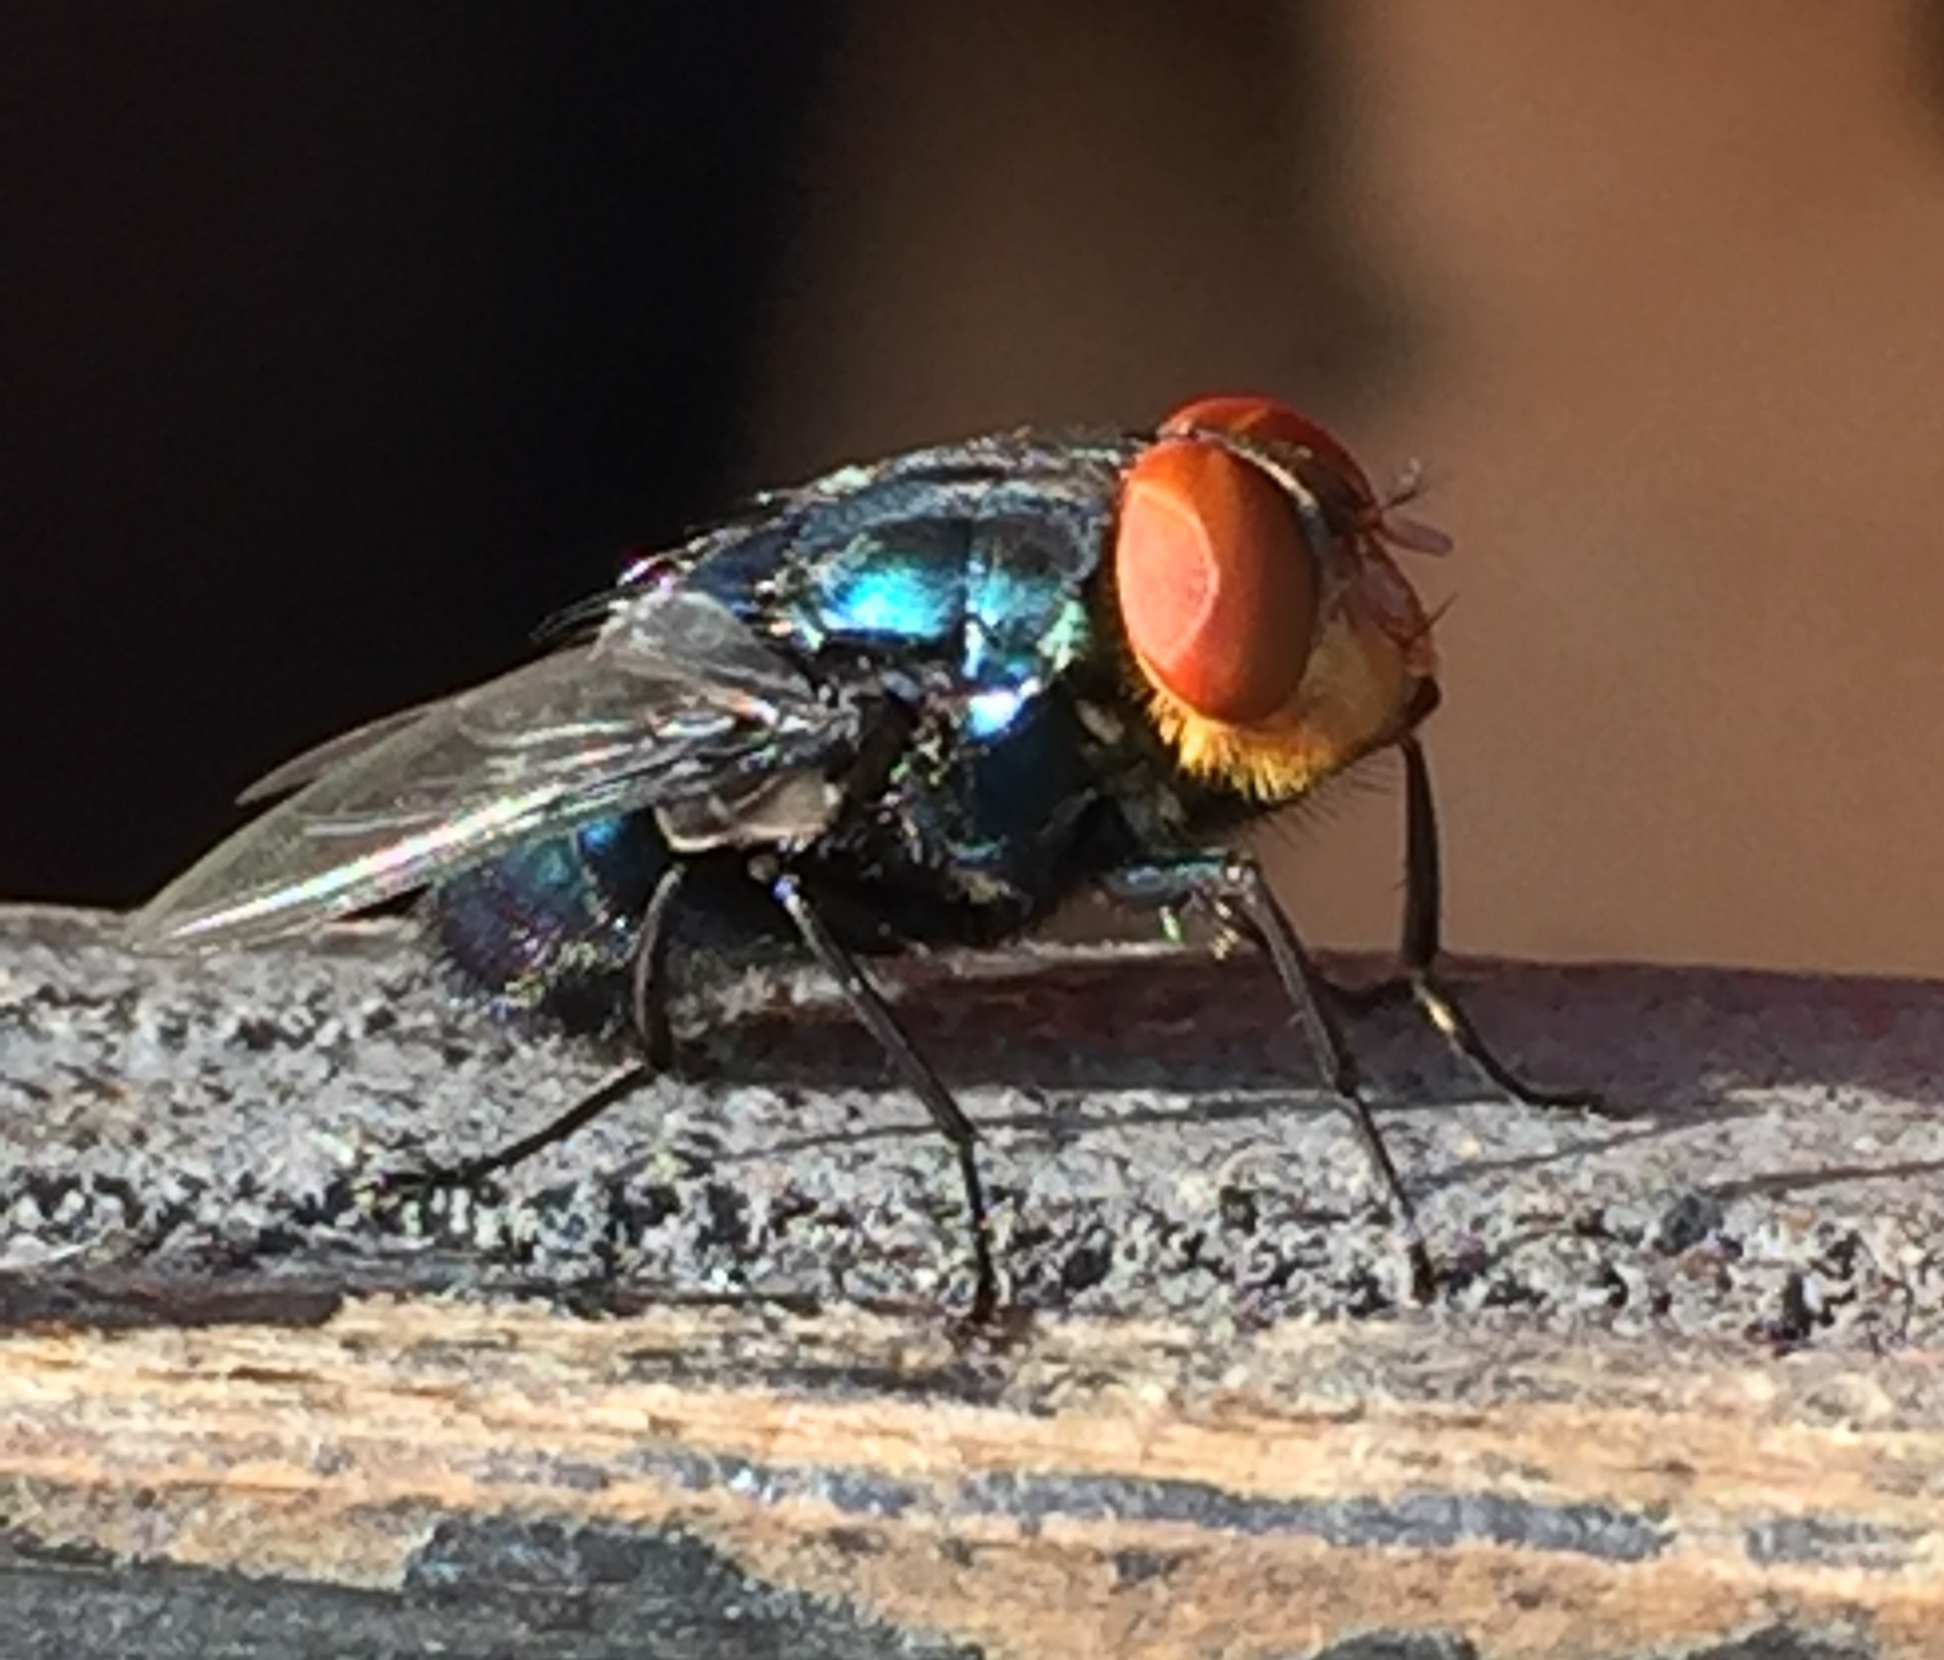
New World Screwworm

Slide 5
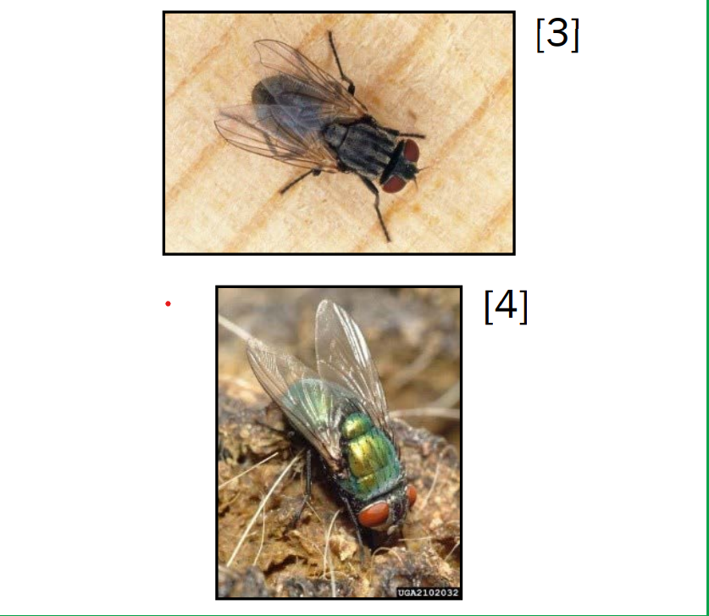
Common house fly and green blowfly

Slide 6
Larvae
The larvae have spines on their body hence the name screwworm
They also have sharp, dark mouth hooks used to tear the flesh of the host animal
Approximately 2/3 inch long

Slide 7
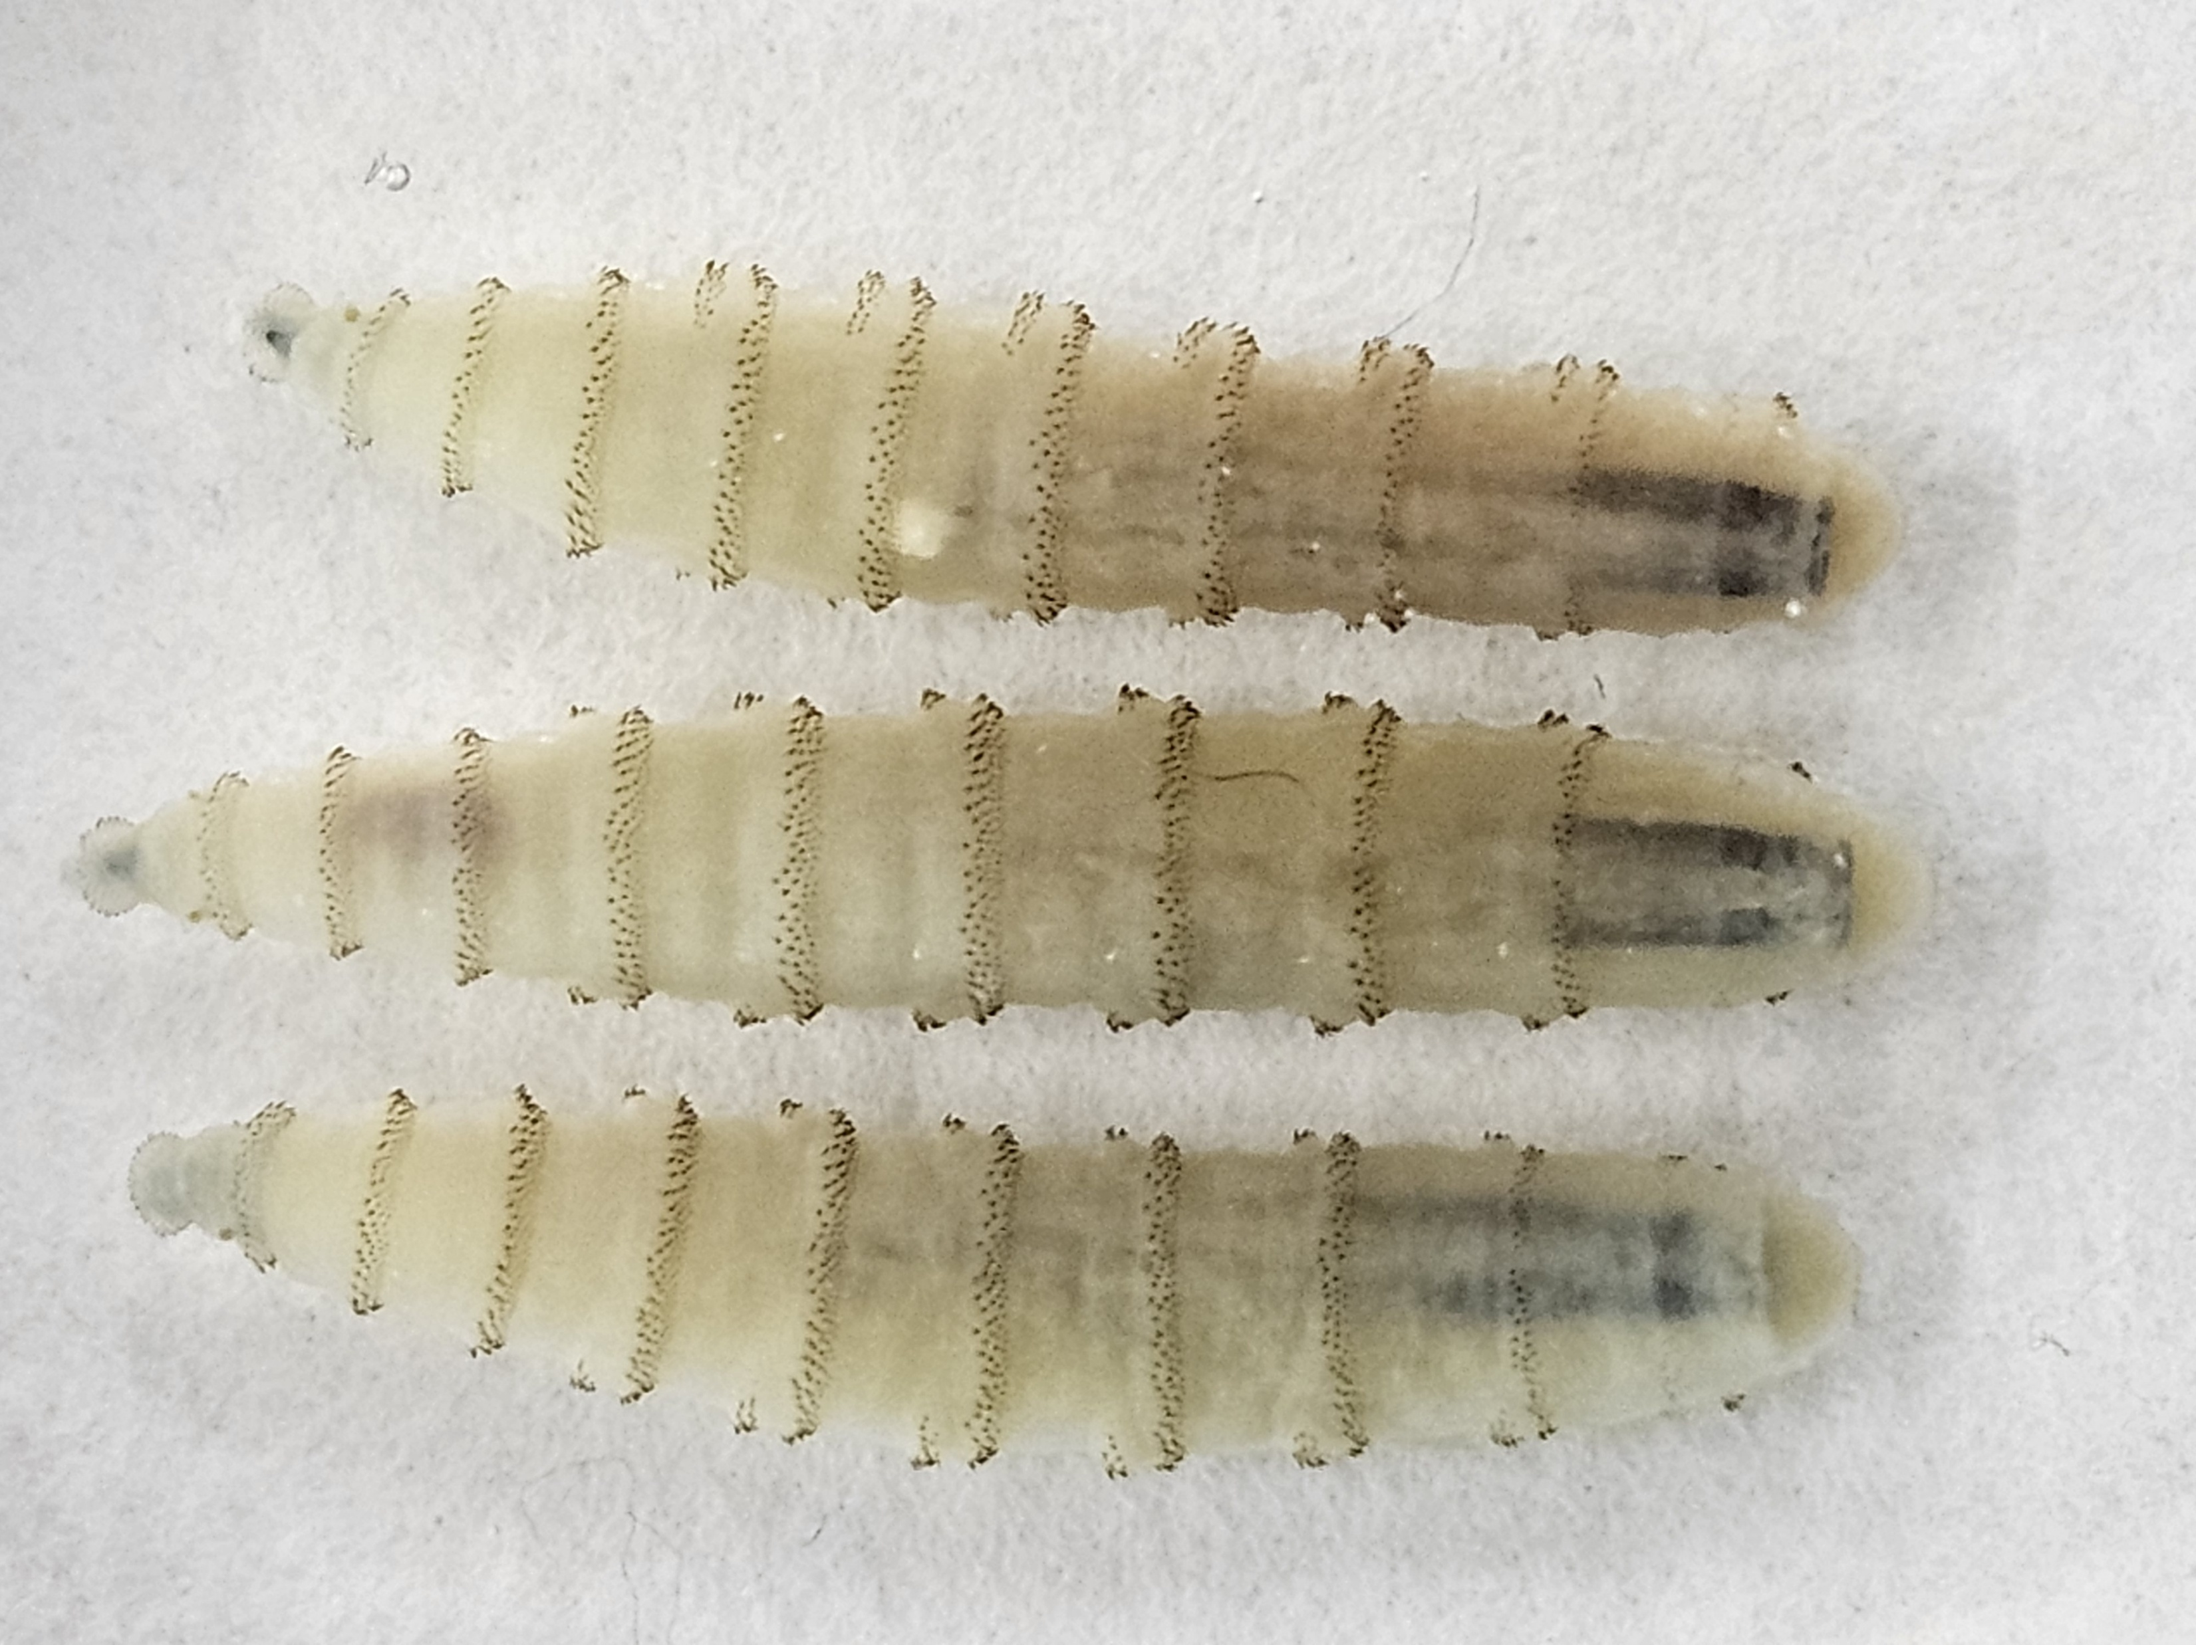

Slide 8
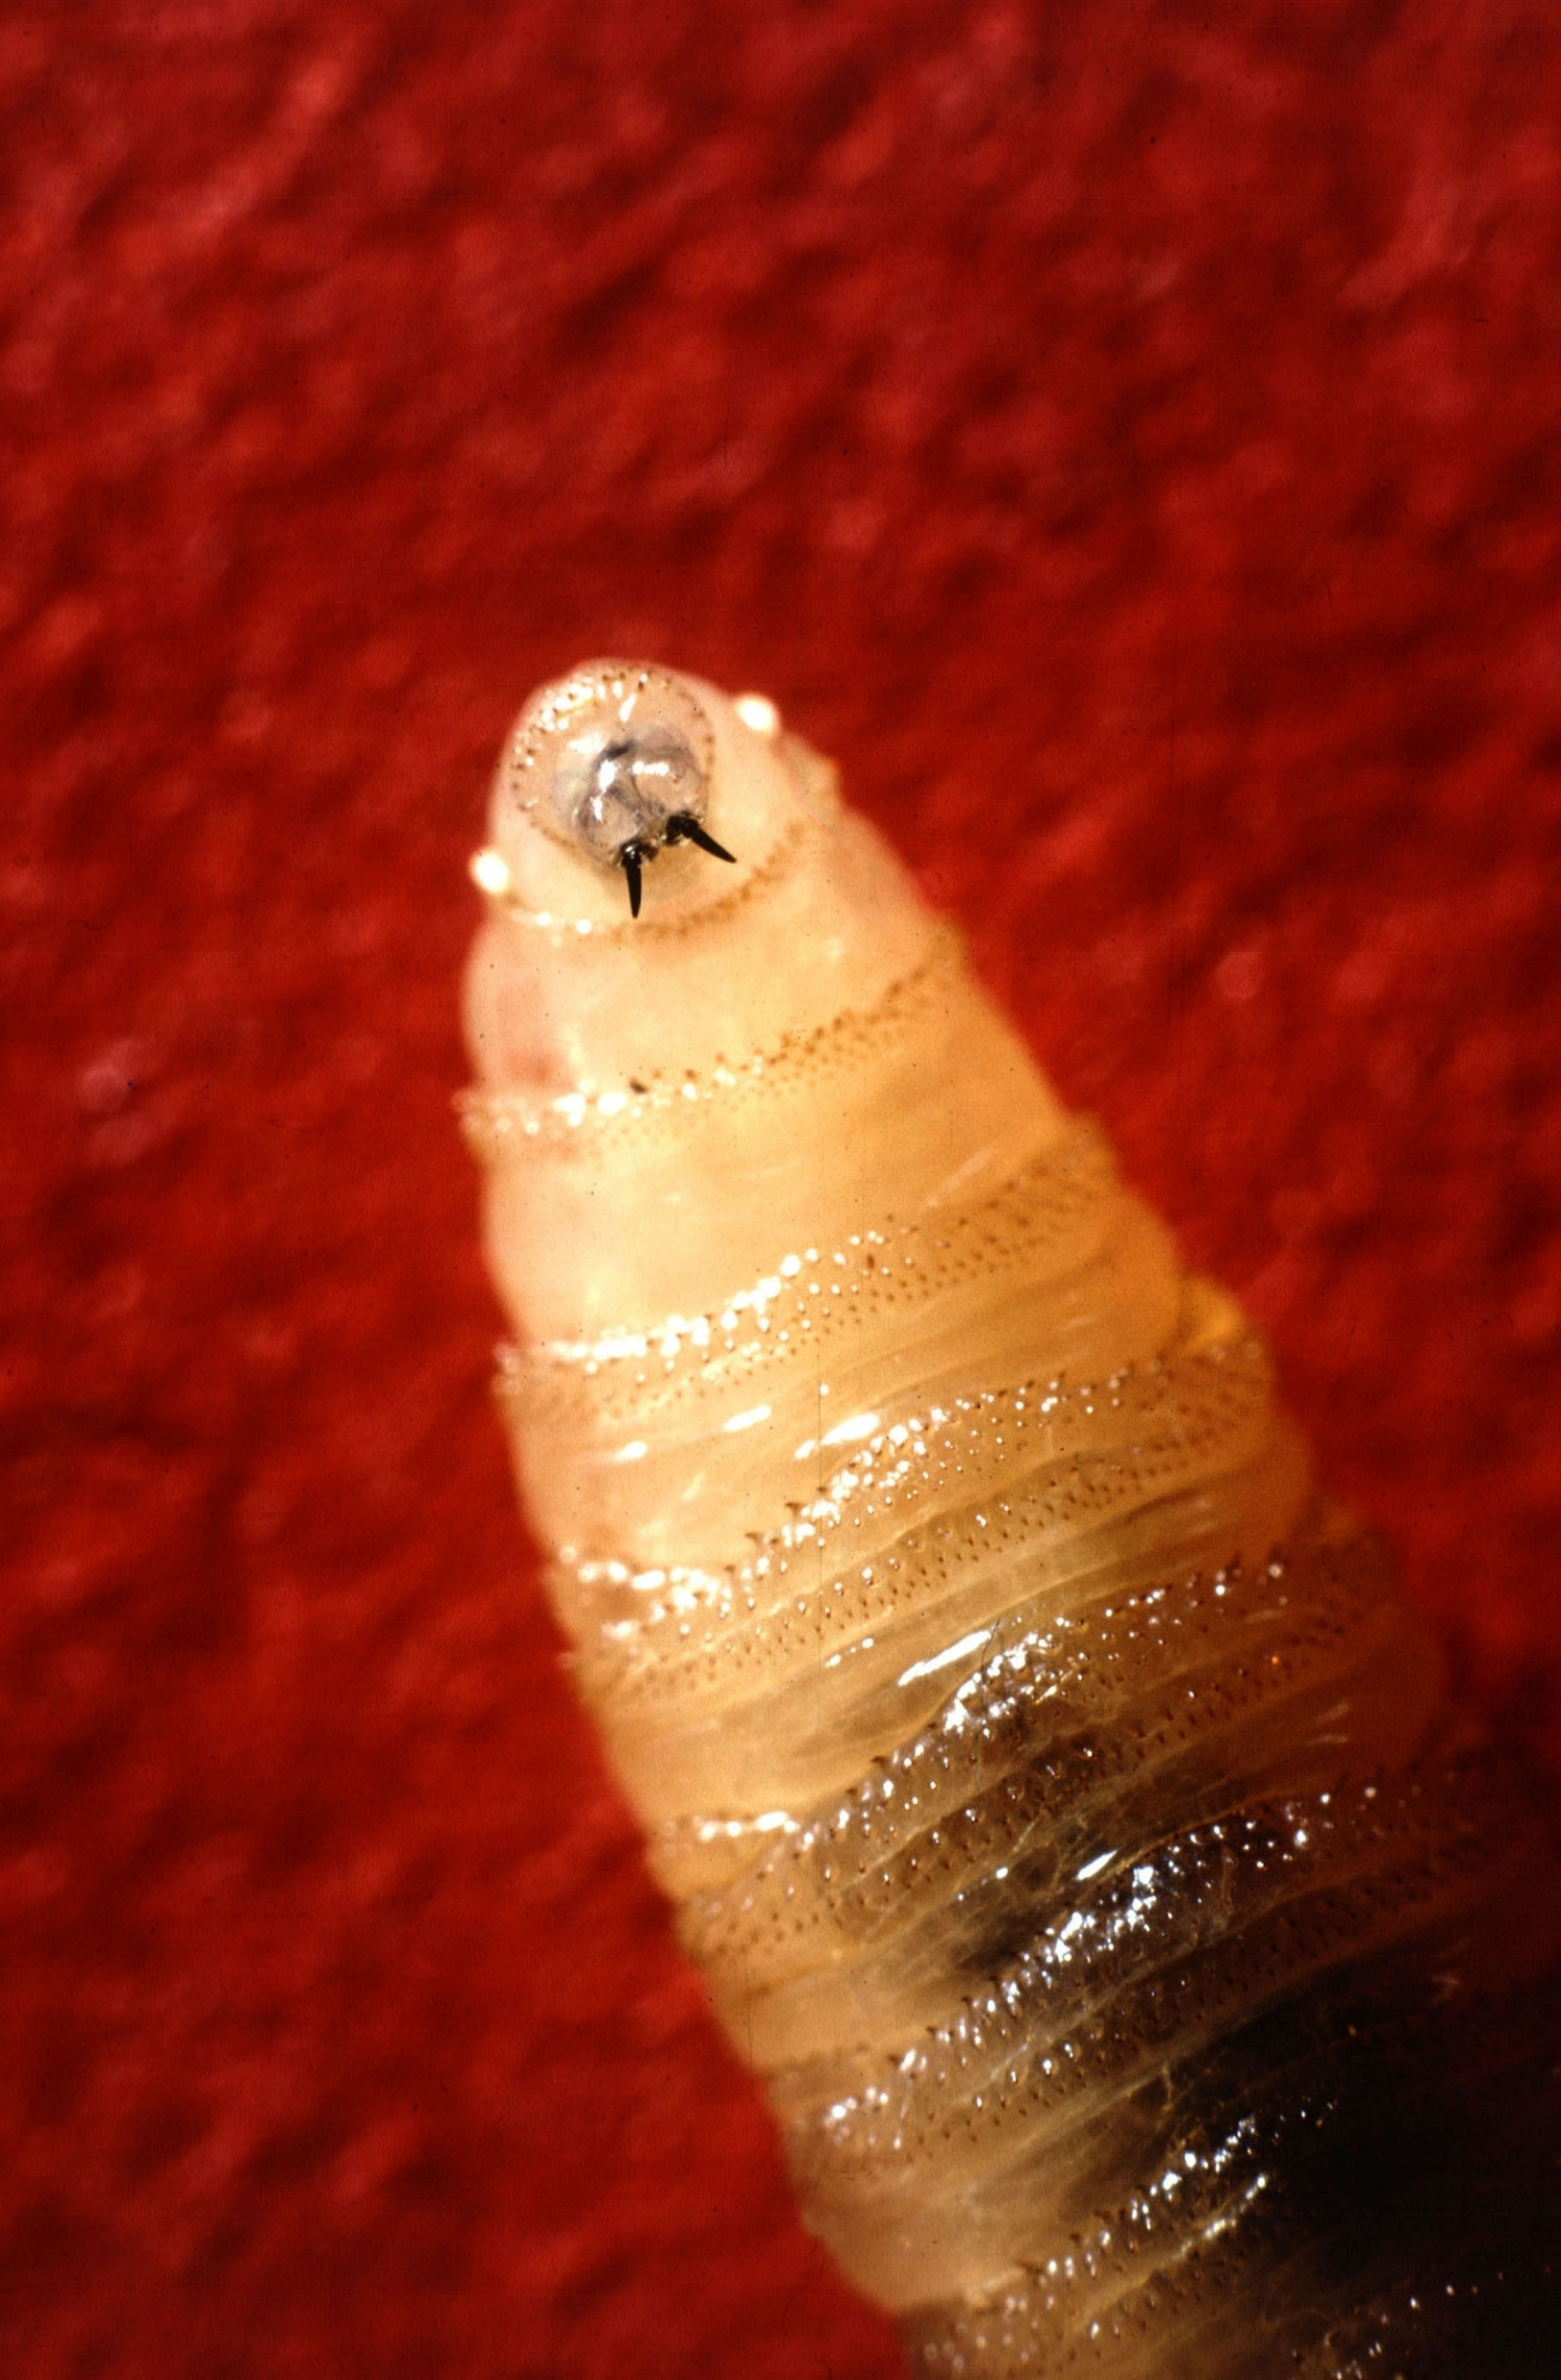

Slide 9
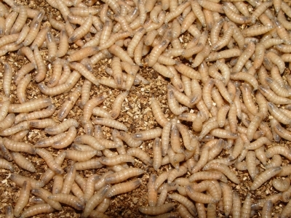

Slide 10
Historically the screwworm was eradicated from the United States in the 1960’s.
Sterile male fly release: female only mates one time in her life.
Through cooperation with Mexico and Central America, the fly was pushed south of the Darien Gap which is the narrowest part of Central America. It remains endemic in South America and portions of the Caribbean.
Over the past several years it has slowly been moving north again and reached within 70 miles of the Texas border through illegal animal movements.

Slide 11
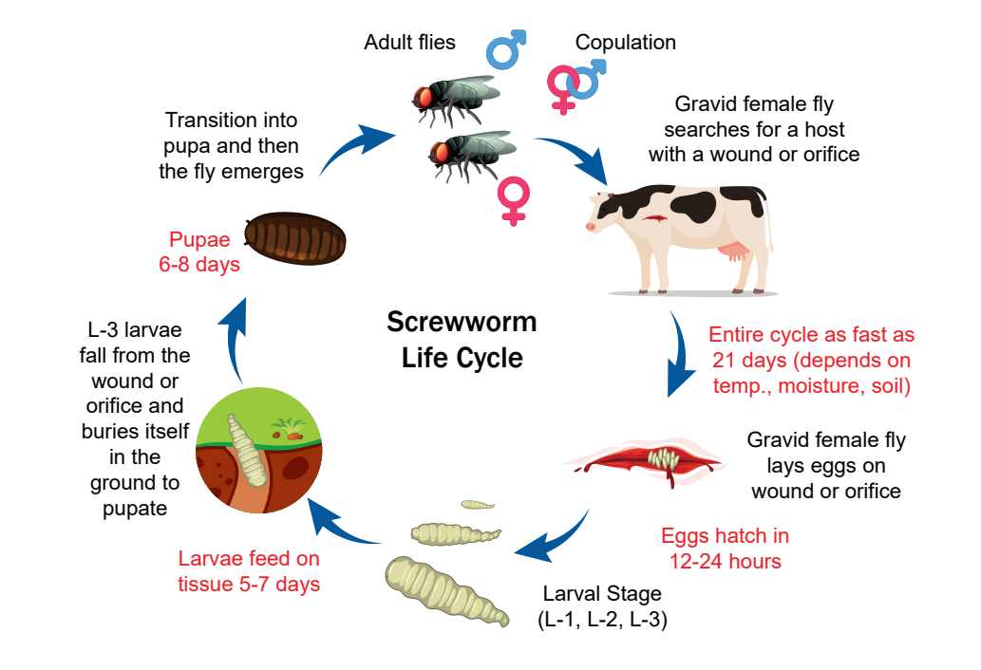
Life cycle of Screwworm

Slide 12
Myiasis: presence of larval infection
The adult female fly lays its eggs on any open wound or mucous membranes.
Tick bites
Castration site
Dehorning site
Ear tag wound
Umbilicus
Eyes, ears, oral cavity, genitalia

Slide 13
Once the eggs hatch, the larvae or maggots feed on living tissue causing tissue destruction and damage, and in some cases can eventually cause death to the host animal.
The eggs hatch in 8-24 hours
The larvae will pupate in 5-7 days
The pupae hatch to adult fly in 7-14 days.
Dependent on environmental temperatures and humidity

Slide 14
Impacts of NWS
Flies only live 10-14 days and may travel up to 8-10 miles.
Spread of the screwworm is primarily based on host movement.
Livestock that are imported from endemic areas or illegaly moved
due to financial markets.
Costs include prevention, surveillance, treatments, loss of condition,
or even death of the animal
Reduction of importation of cattle/livestock: typically USA imports upwards of 1 million
stocker cattle from Mexico each year. Last year just over 200,000 came in.
Border states are currently putting out fly traps to monitor for the
screwworm.
Reportable disease with CDFA and USDA

Slide 15
Symptoms of myiasis
Irritated behavior such as head shaking or leg stomping
Smell of decaying flesh
Presence of maggots in open wounds or membrane openings

Slide 16
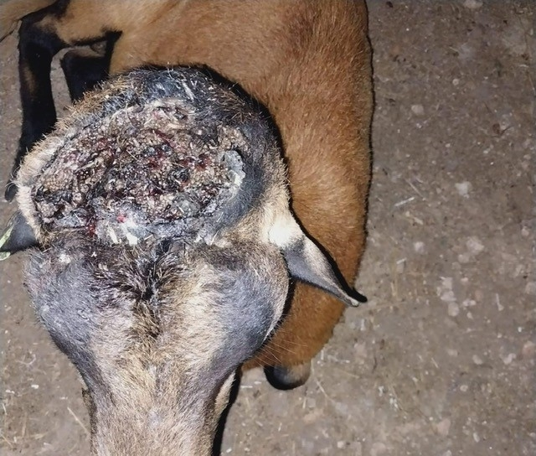
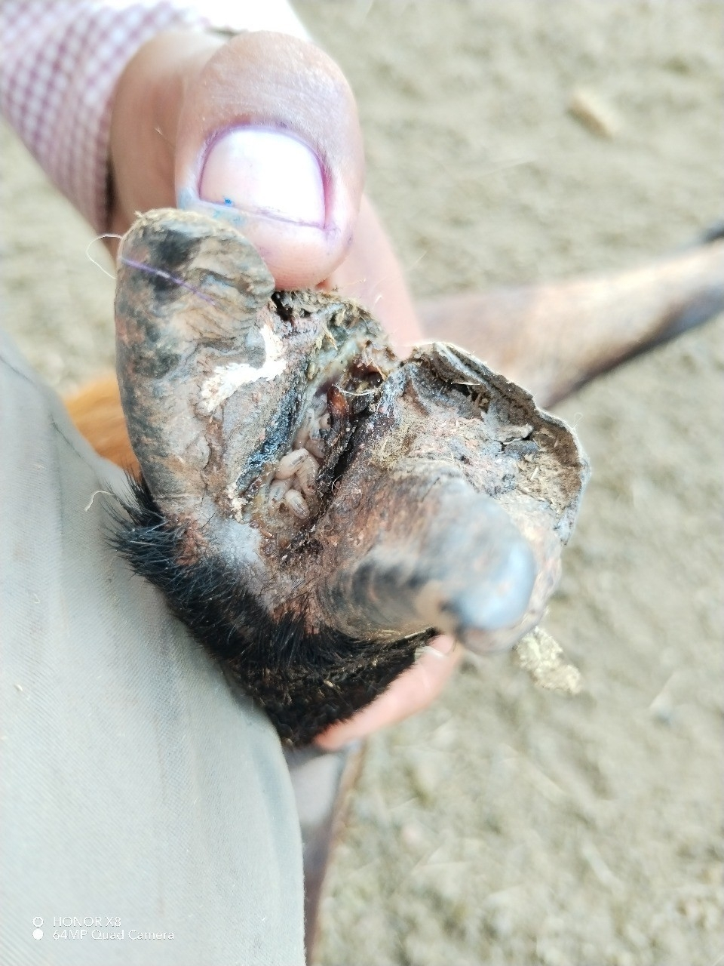

Slide 17
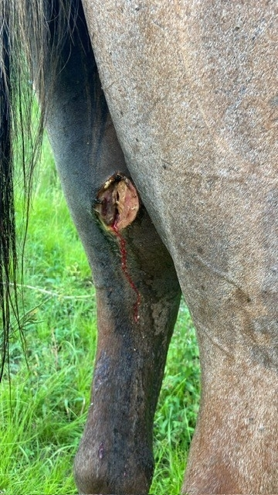

Slide 18
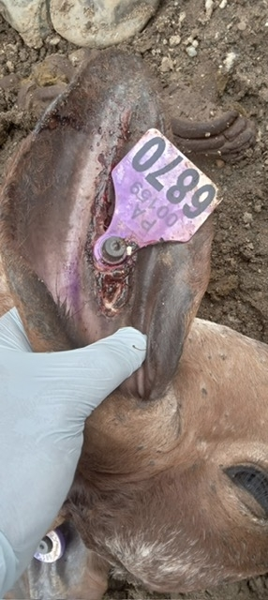

Slide 19
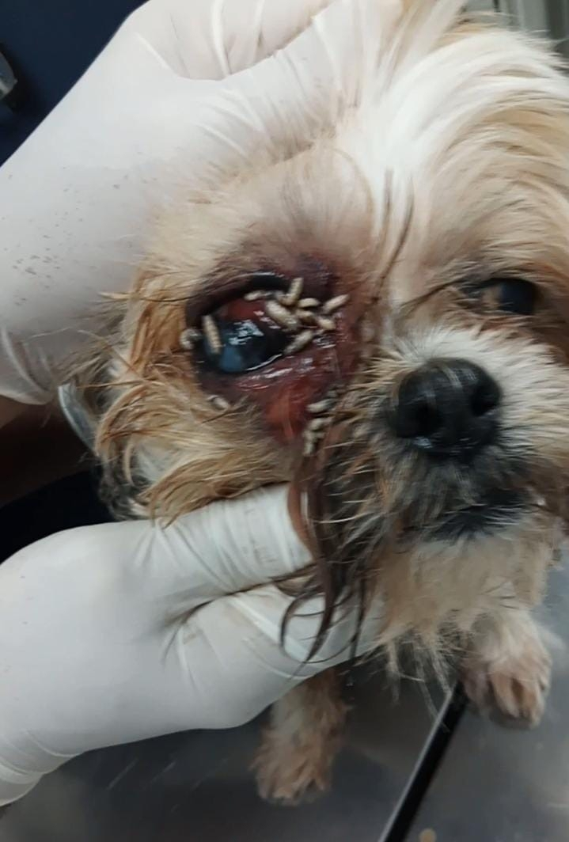

Slide 20
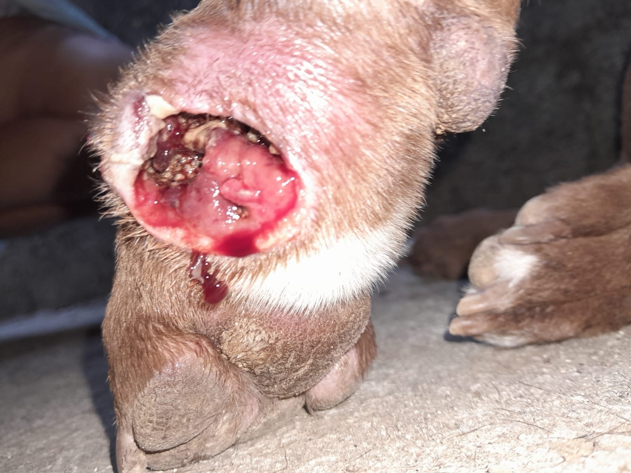

Slide 21
Control of NWS
Management of livestock based on weather and season
Try to only work livestock in colder seasons
Try to have young born in colder seasons
Surveillance of livestock for open wounds/infections
Sterile fly release: to eliminate matings and egg production.
Estimated to need to release 500 million sterile male flies/week
May take 2 years to build facility in Texas
Treatment: doramectin (dectomax), coumaphos, permectrins

Slide 22
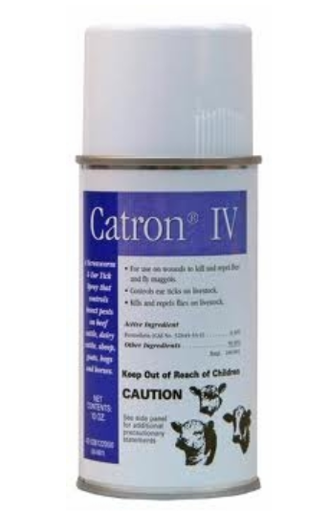

Slide 23
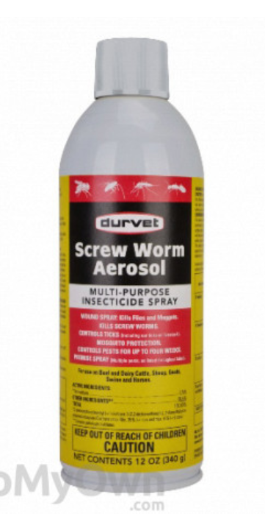

Slide 24
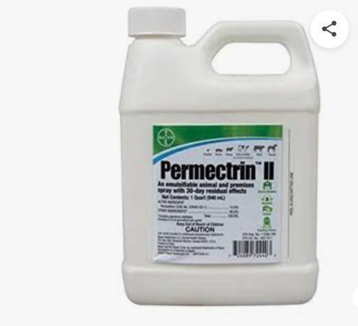

Slide 25
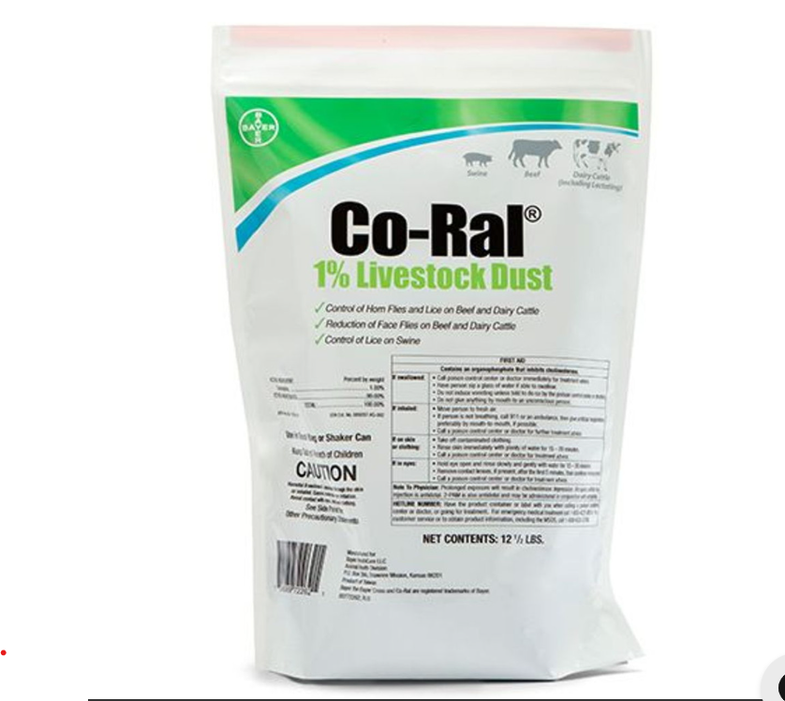

Slide 26


Slide 27
Questions?

