Slide 1
Program Review Questions & Answers
Presented by the Academic Assembly Personnel Committee
Mark Bolda, 2025-26 Chair
Aparna Gazula
**

Slide 2
Multiple Step Process
Merit
Promotion
AVP solicits 3-6 letters of evaluation due Jan 26
Peer Review Committee submit letter due Mar 17
Associate Vice President makes the decision in May
AD/CD/Supervisor submit letters of evaluation due Jan 26
Ad hoc review committees submit letter due Feb 9
Academic submits program review dossier by Dec. 8
Peer Review Committee submit letter due Mar 17
Associate Vice President makes the decision in May
AD/CD/Supervisor submit letters of evaluation by Jan 26
Academic submits program review dossier by Dec 8

Slide 3
What is the Peer Review Committee (PRC)?
18 PRC members appointed by the Associate Vice President for three years with overlapping terms.
Strives to reflect the breadth of UC ANR’s programmatic areas, title series, and administrative assignments.
Makes recommendation to the AVP

Slide 4
Purpose of the Peer Review Committee
Evaluate each academic’s performance as documented against the expectations for their requested advancement and position description.
Recommendations made by the peer review committee (and ad hoc committee if applicable) are a yes or no and are recorded for review by the AVP.
The peer review committee also provides a balanced written assessment. The written appraisal should be specific and analytical, based on the evidence presented in the dossier. The recommendations and written assessment are reviewed by the AVP and ultimately the candidate.

Slide 5
What are ad-hoc committees?
Anonymous review committees, generally made up of three peers across different disciplines.
Purpose: evaluate the academic’s performance as documented in the dossier and provide written assessment and recommendation to the PRC and AVP.
The review is made available to the candidate, but the composition of the committee is anonymous.

Slide 6
Evaluation criteria
Academics are evaluated against their position description and the advancement criteria as outlined in the Guidelines for Preparing the Thematic Program Review Dossier (eBook).
Recognize that as one’s career advances, one should be establishing BALANCE:
Four advancement criteria for CE Advisors*:
  applied research and creative activity
  extending knowledge and information
  professional competence and activity
  university and public service
Additional consideration: how you increased equitable opportunities for participation in your program and fostered UC ANR’s Principles of Community should be incorporated where appropriate in the PR.

Slide 7
Affirmative Action and civil rights compliance
While AA and civil rights compliance are not advancement criteria, they are critical to all parts of an academic’s program.
Project Board captures Affirmative Action and Civil Rights Compliance, but you should also reflect on these in your narrative.
This is the lens through which we do our work. It is about who we are or who we want to be as an organization.
  Your narrative should synthesize how you are being equitable and inclusive in your program delivery.
Do not neglect this section.

Slide 8
Elements of the Program Review dossier
Academics submit a Program Review dossier that summarizes their accomplishments and outcomes/impacts over the review period.
Required elements
Other elements
Position description
Cover page
Program summary narrative (Merit: 5 pages, Promotion: 8 pages)
Supporting documentation
Bibliography
Goals (optional to include in dossier)
Acceleration statement (if applicable)
Summary of publication examples (optional)
Sabbatical leave and report (if applicable)
Work plan (if applicable)
Notes:
Elements of the dossier will vary depending on the requested action (see Ebook pages 17-18). The PR dossier is described in more detail in other Personnel Committee trainings.

Slide 9
The purpose of the program review narrative is not to tell us how busy you are; it’s to tell us what impact you’re having or planning to have.

Slide 10
For each theme, narratives should include: outcomes
Outcomes – measurable change in:
clientele learning (knowledge, attitude/intent to change, skills)
clientele behavior/practices, and/or
policy/decision-making
  Quantified outcome indicators (how many individuals? how many acres?)
  Outcomes measured/observed during this review period that are the result of activities from past review periods may be included

Slide 11
For each theme, narratives should include: impact
Impact – broader effect on social, environmental, economic conditions that are aligned with the targeted clientele needs; and aligned with ANR’s articulated public value statements and condition changes.
  Evidence of impact or anticipated impact may be demonstrated through empirical data collected by the academic, workgroup projects, and/or inferred impact as shown through reasonable inferences from scholarly literature.
Notes:
The AVP made it clear that not everything that is called an outcome/impact is actually an outcome/impact.

Slide 12
Example of a Theme going from output to outcomes to impact
Soil pathology, theme is transition from chemical fumigation to an integrated approach to management of soil pathogens in the berries.
Output – field trials done and results received
Outcomes – people starting to implement some of the findings
Impact – areawide, regionwide or even statewide adoption of the practices.

Slide 13
Feedback from reviewers: Position Description
Position descriptions must be uploaded with the PR.
Plan ahead! Position descriptions require the signature and date of the academic, their immediate supervisor, their supervisor’s supervisor, and the Statewide Program Director (if applicable).
Use an addendum for short-term changes in responsibility.

Slide 14
Feedback from reviewers: writing a compelling narrative
The program narrative must convey clear themes, each focused on at least one impact (or anticipated impact)
Clearly relate your activities to your progress towards your intended outcomes, impacts, and condition changes
Tell the story at a higher level; avoid too many details
  Avoid literature review or project methods
Highlight your role

Slide 15
Feedback from reviewers: supporting documentation
Academics decide how to share their activities in a format to support their program summary narrative (e.g. tables, bulleted lists, C.V. or other method).
If using the Project Board output, review the exported files, and edit as needed.
Do not include required UC trainings (e.g., sexual harassment or cybersecurity)
Denote your level of support from grants, or in-kind support, in Project Summary
Only include activities from the current review in your supporting documentation

Slide 16
V. Supporting documentation: bibliography
Your bibliography should clearly describe peer reviewed and non-peer reviewed publications in separate sections.
  Peer reviewed publications are not an expectation in the lower ranks, but they are increasingly important as the academic progresses in their career.
Citations should be further identified using the letter designations in the eBook (see page 28).
Identify your activity/role in multi-author citations.
A hyperlink to the publication is recommended.
Notes:
Why should you organize it in this way? To be frank, it helps the peer reviewers know what you’ve done. Not using them has been a complaint among reviewers.

Slide 17
Questions from past sessions
Where does this item fit? Refer to ebook first, but always think of where it would fit within the theme.

Slide 18
Tips for preparing an effective program review
Develop a system of keeping track of your activities.
Start early!
Know your audience: supervisor, peer review committee, ad-hoc (if applicable), and Associate Vice President.
Make it readable; use lay terms; avoid acronyms.
Proofread. Then, have colleagues proofread, especially some from other disciplines.
Be concise. Avoid a literature review or explaining your methods. Emphasize outcomes and impacts (or anticipated impacts).
Acknowledge teamwork, but be specific about your role. Consider using active voice sentences.
Be accurate. Use up-to-date statistics.
Refer to your position description.
Include administrative accomplishments (where applicable).

Slide 19
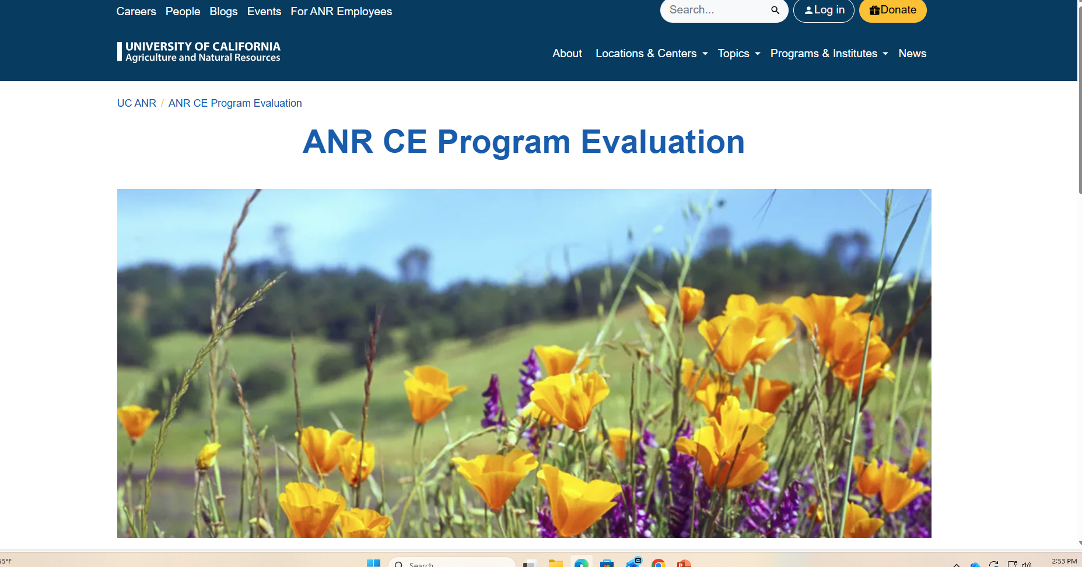
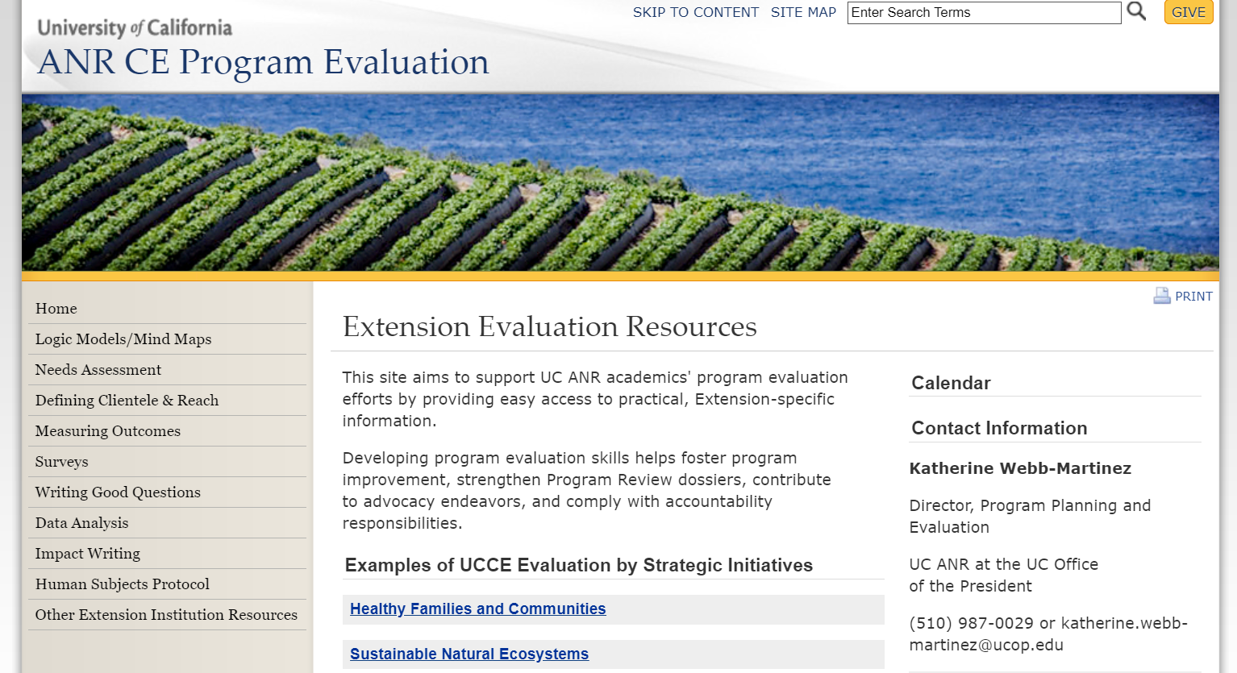
Program evaluation website is a great resource!
25CR02935
25CR02935

Slide 20
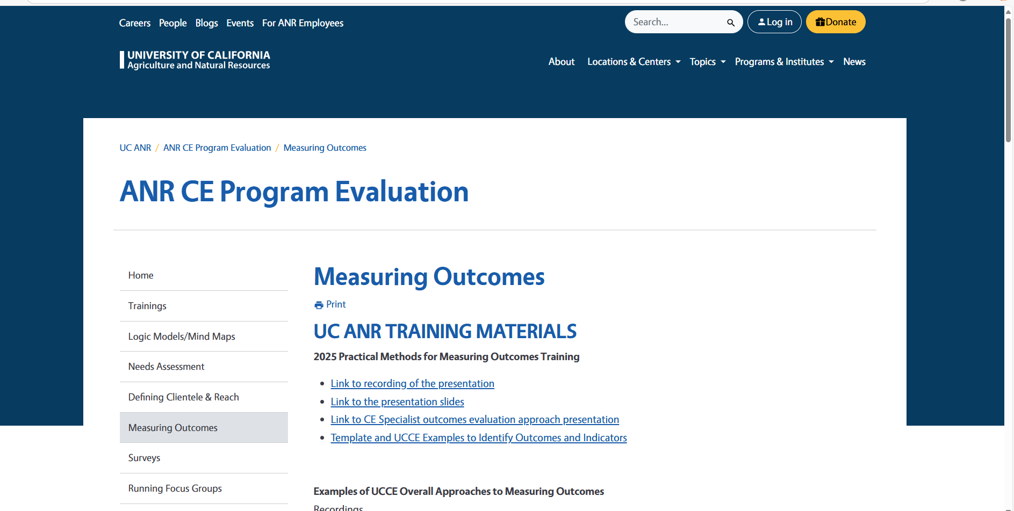
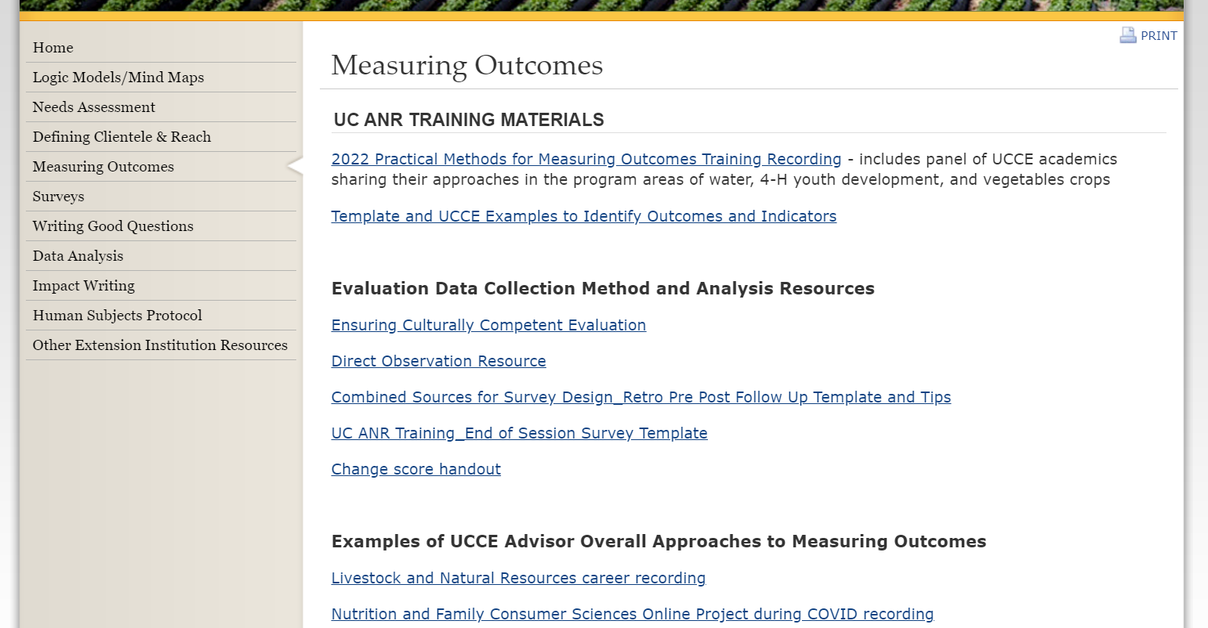
Resources for measuring outcomes
Notes:
Trainings and examples to help guide you on measuring outcomes.

Slide 21
Thank you for attending today’s training!
Questions?
Mark Bolda
Aparna Gazula
**
For questions on Project Board:
Kit Alviz, Kit.Alviz@ucop.edu

