Slide 1
Statement of Cash Collections (SCC)Training
August 28, 2025

Slide 2
Training Topics
Statement of Cash Collections Form (SCC)
  Deposit Types (Gift/Donation, Income, Reimbursement)
Donation Packet Documents
Additional Scenarios
Deposit Overview
  References and Links
Notes:
KAITLIN
SCC Form: https://ucanr.edu/sites/default/files/2025-01/406123.pdf
Forms Directory: https://ucanr.edu/site/uc-anr-business-operations-center/forms-instructional-guides
Fund Management menu -> Gift Processing Page (Tender of Gift packet instructions): https://ucanr.edu/site/uc-anr-business-operations-center/gift-processing
Purchasing Types: https://ucanr.edu/site/uc-anr-business-operations-center/purchasing-types
Gift/Donation: https://ucanr.edu/site/uc-anr-business-operations-center/purchasing-types#Gift
External Sponsorships: https://ucanr.edu/site/uc-anr-business-operations-center/purchasing-types#ExternalContributions

Slide 3
Statement of Cash Collections Form (SCC)
What is an SCC used for?
The purpose of this form is to act as a cover sheet for bank deposits that are submitted to the Business Operations Center (BOC) for entry into the Financial System
Please Separate SCCs:
Each deposit type (gift, income, reimbursement) must have its own SCC form
Multiple checks/payments going into the same account can be combined onto one SCC
Multiple accounts for the same type of deposit can be combined onto one SCC
Multiple gifts/donations can be combined onto one SCC, UNLESS they are going to different accounts, then we need a new SCC for each account. This is for optimal tracking purposes.

Slide 4
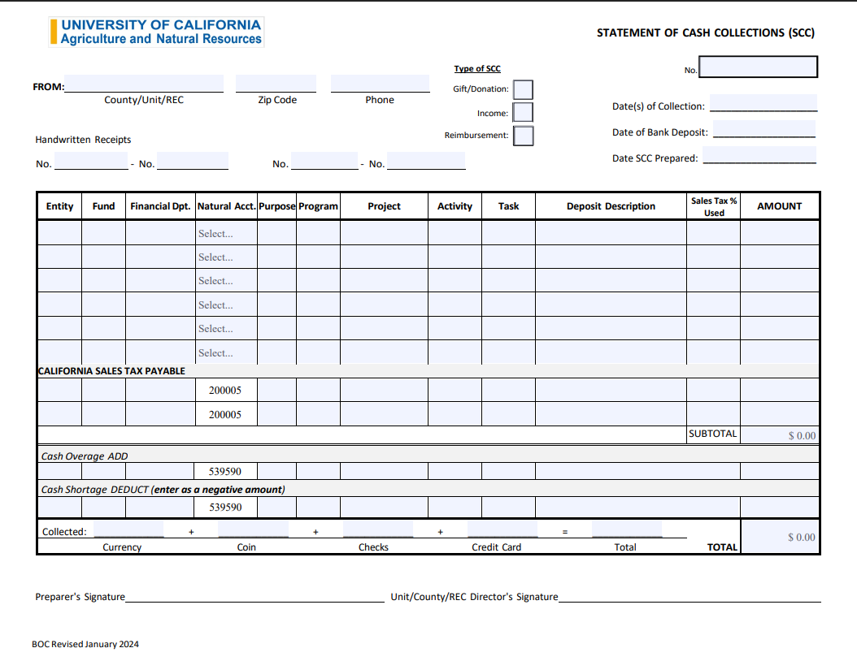
How to Fill Out an SCC Form

Slide 5
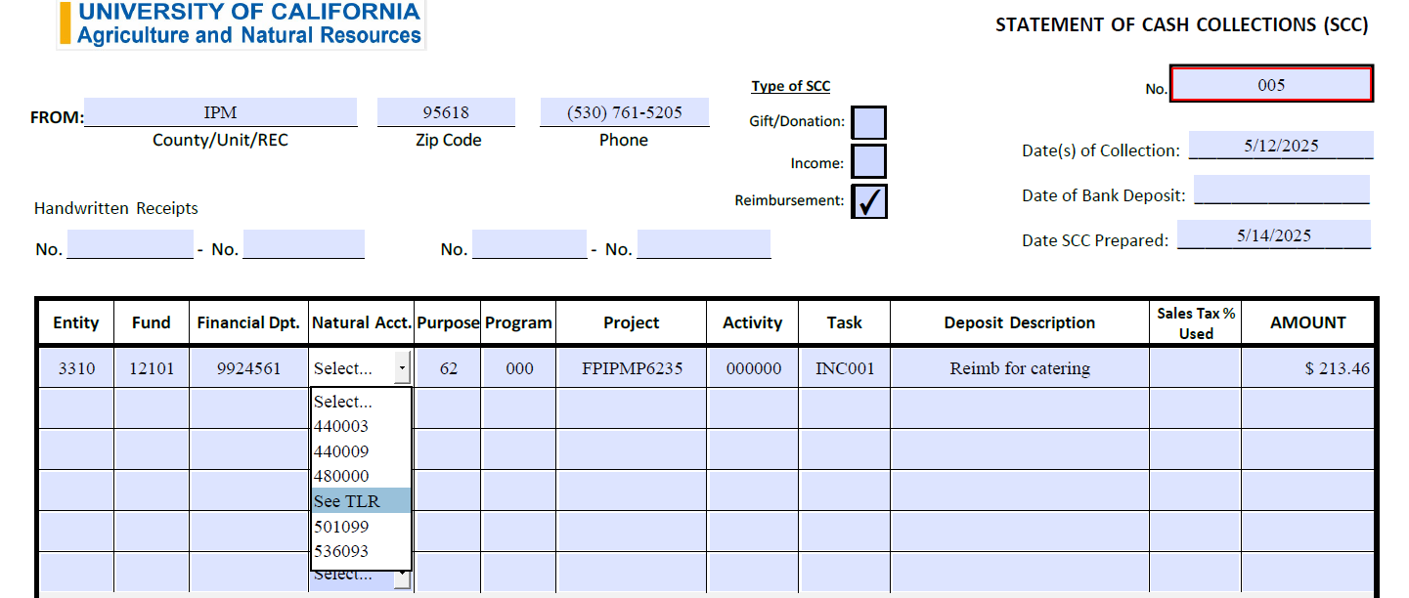
Document Tracking Header
Select deposit type
(one type per form)
Your Department/Unit info
Use SCC naming convention per next slides
Receipt# if applicable
When funds were received
Enter a value for every box
See next slide for more details on Natural Accounts

Slide 6
SCC Naming Convention
General Structure: All files and folders must follow the core format:
Location code: Each location has a 4 (four) letter acronym associated with the location. The acronym will clearly identify the originating department for each deposit. Using the acronym ensures all department can easily recognize the source of each deposit.
Year of deposit: a 2-digit year YY located after the acronym: For example: 2025 would be “25”, 2026 would be "26”
Hyphen after year: -a.(location acronym)(year of deposit) -
Month of deposit: in number format.
Month of deposit, not month of submission.
For example:
January 1 July 7
February 2 August 8
March 3 September 9
April 4 October 10
May 5 November 11
June 6 December 12

Slide 7
SCC Naming Convention continued
Sequential number: This number would be the number of deposits.
The first Statement of Cash Collections SCC of the month would be 01, second Statement of Cash Collections SCC of the month would be 02, etc. With a leading 0, if needed. For example:
i.01 – Transaction 1
ii.02 – Transaction 2
iii.03 – Transaction 3
iv.11- transaction 11
File Naming Structure: All SCCs files must follow this format:(Location acronym)(2-digit year) – (month in numeric form)(transaction number with leading zero if necessary)
Please note the spacing; There is NO spacing between acronym and year, and no spacing between month and transaction number.
Correct: ALAM26-0801
Incorrect: ALAM 26 – 08-01
Incorrect: 0801-ALAM202
Incorrect: ALAM260801
Incorrect: ALAM26-AUG01

Slide 8
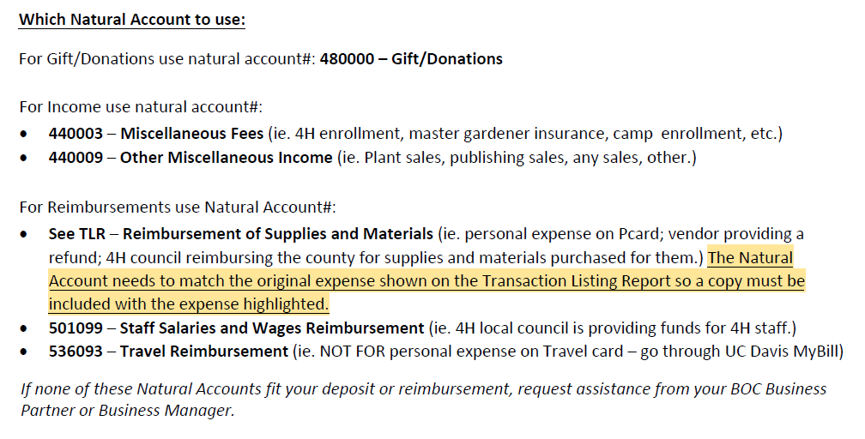
Natural Account Selection
.
See page 2 of SCC form for these instructions
See next slide

Slide 9
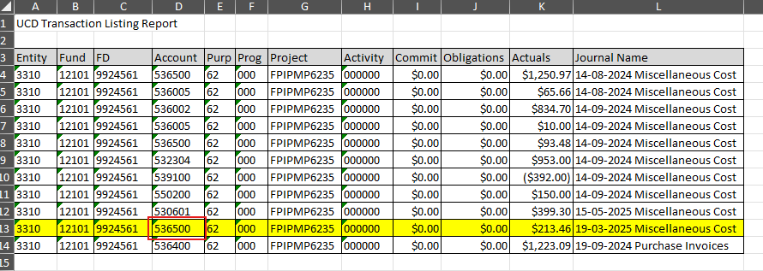
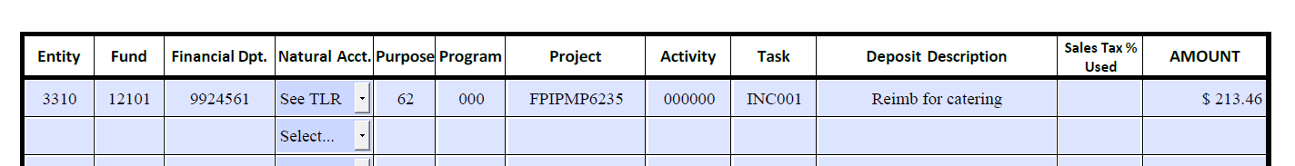
Transaction Listing Report (TLR) for Reimbursements

Slide 10
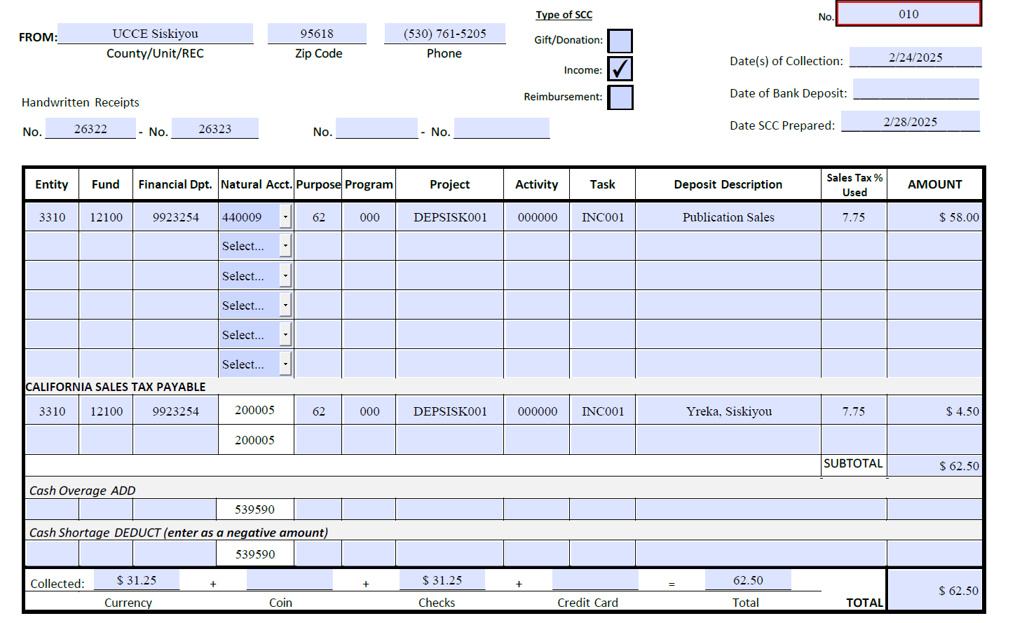
Sales Tax
Sales tax collected must be reflected on a separate line
Provide sales tax percentage used at point of sale for each applicable line
Deposit description: enter the CITY and COUNTY where the sales tax was collected. (ex. Davis, Yolo)
Record any shortages or overages in the same layout as the tax line for all applicable chart strings.
UC ANR is not exempt from paying state tax, so sales tax must be charged at the point of sale for all taxable sales. If not charged at the time of sale on taxable items, must be self-assessed when submitting the SCC.

Slide 11
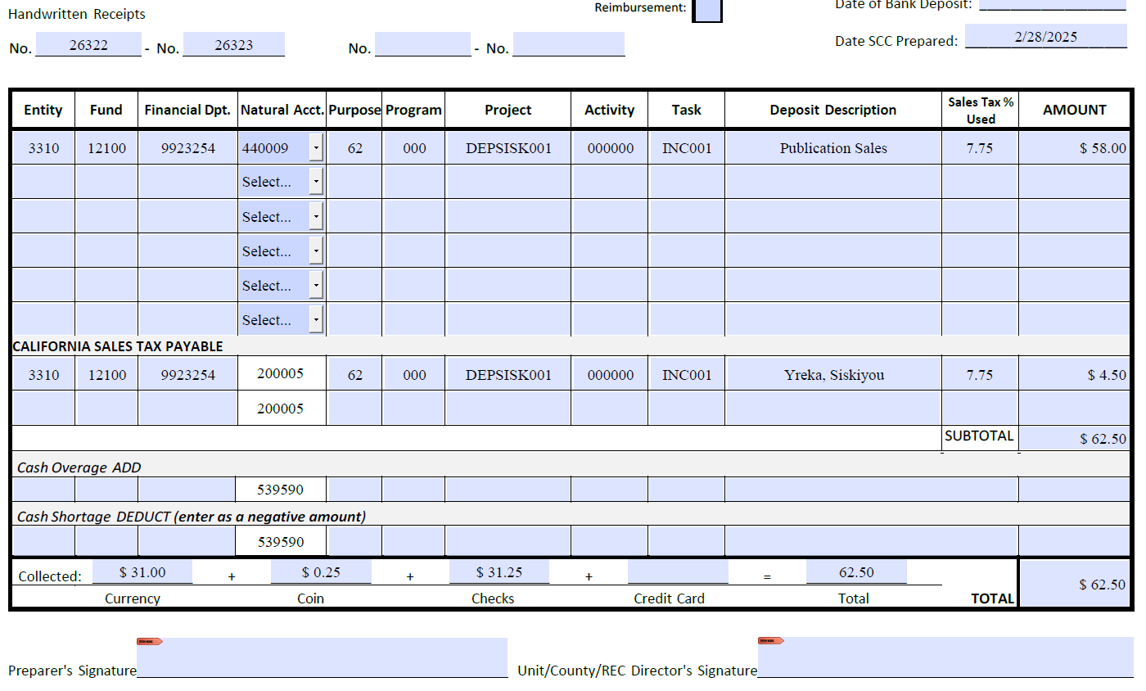
Verification and Signatures
Verify that all totals are accurate and match the deposit receipt provided by the bank at the time of deposit.
Obtain signatures of the Preparer and Director
If hand signing, please include date with signature.

Slide 12
Specific Types of Check
Contracts & Grants checks
  Attach a note with the award number to the check and give to the BOC.
  They will then work with Andrea Davis to get it deposited with CGA.
Aggie Enterprise Accounts Receivable (AR) Invoice checks
  Attach a copy of the AR invoice and give to the BOC.
  They will take the check to the Davis Cashier’s Office to be applied to the invoice.

Slide 13
Donation Packets
Statement of Cash Collections Form (SCC)
Tender of Gift Form
Official acceptance letter
Any backup paperwork from Donor
Copy of Check (redacted)
If Applicable:
700U form (for donations to research)
UDEV (individual donations for $5,000+)

Slide 14
Acceptance Letters
Must contain the following:
  Letter must be on official UC ANR letterhead with the Unit or Program Information
  The letter must state the gift has been “officially accepted” in the first paragraph of the letter, it can be an acceptance & thank letter all in one
  IRS tax statement (in letter or footnote)
  The letter must be signed by the Director (unless gift is over $20k – then Greg Gibbs must sign)
  Signatures on ALL forms must be actual (wet) signatures or Adobe signature with date/time stamp
  Development has a template available for everyone to use!
Notes:
KAITLIN
Project Manager will be the Fiscal Officer the Department.
Examples:
Alameda is Heather Waller
Marin is Veronica Geiger
Capitol Corridor is Yelena Suprun
Project Owning Organization will be the Unit: i.e. UCCE San Diego, UCCE Glenn
On the excel document, the search parameters you entered are listed in the top left corner of the report.
Budget is manually updated by members of the Aggie Enterprise team for Income and Gift accounts. Also applies to Awards/Grants- Contracts and Grants Accounting handles these.

Slide 15
Gift Processing Reminders
Receipt Date is the initial date the check comes into the possession of UC ANR (be it an advisor, or office staff). This date is when the asset was legally transferred from the donor to the Regents/ANR. For Year End checks the receipt date can be the date of the check.
Acceptance Date as noted in the body of the acceptance letter.
These dates are critical due to tax implications, UC ANR policy and UC Regent policy.
Notes:
KAITLIN
Project Manager will be the Fiscal Officer the Department.
Examples:
Alameda is Heather Waller
Marin is Veronica Geiger
Capitol Corridor is Yelena Suprun
Project Owning Organization will be the Unit: i.e. UCCE San Diego, UCCE Glenn
On the excel document, the search parameters you entered are listed in the top left corner of the report.
Budget is manually updated by members of the Aggie Enterprise team for Income and Gift accounts. Also applies to Awards/Grants- Contracts and Grants Accounting handles these.

Slide 16
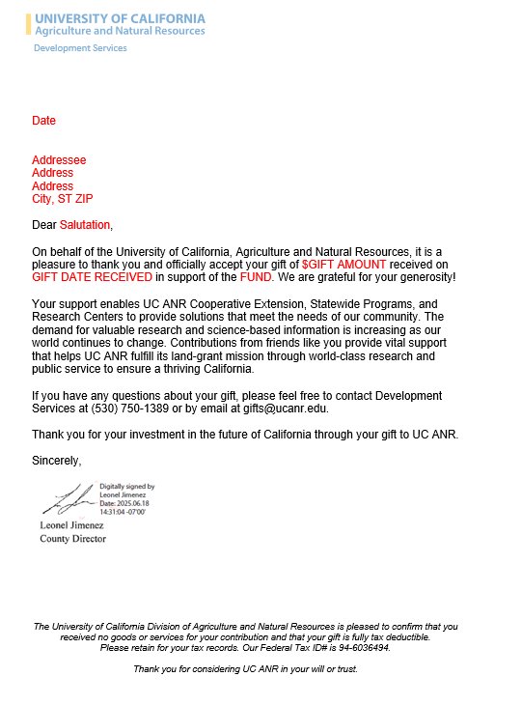
Acceptance Letter Example
Official acceptance
Appropriate signature
Tax statement

Slide 17
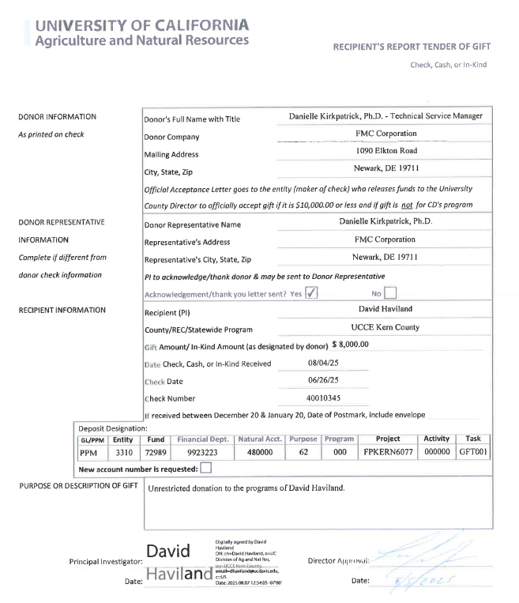
Tender of Gift Form
Please fill out form in its entirety
PI signature (only if applicable)
Notes:
KAITLIN
Project Manager will be the Fiscal Officer the Department.
Examples:
Alameda is Heather Waller
Marin is Veronica Geiger
Capitol Corridor is Yelena Suprun
Project Owning Organization will be the Unit: i.e. UCCE San Diego, UCCE Glenn
On the excel document, the search parameters you entered are listed in the top left corner of the report.
Budget is manually updated by members of the Aggie Enterprise team for Income and Gift accounts. Also applies to Awards/Grants- Contracts and Grants Accounting handles these.

Slide 18
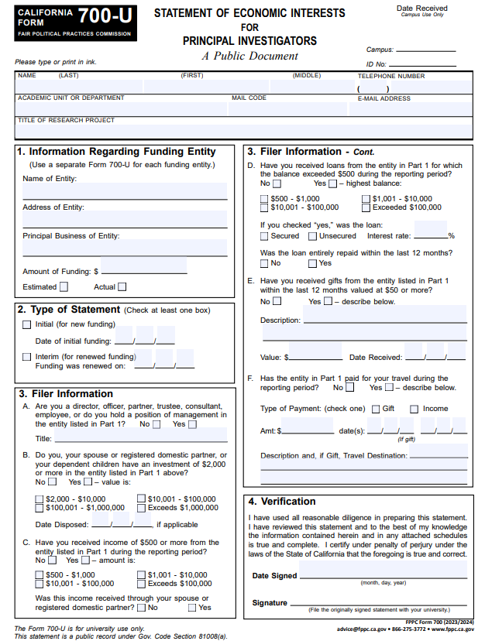
700U Form
700U form is required if the donation is to a PI’s specific research program
You will need to verify the most recent form is being submitted. (the date is at the bottom right of the page)
PI must use wet or date/time stamped signature on the form.
Notes:
KAITLIN
Project Manager will be the Fiscal Officer the Department.
Examples:
Alameda is Heather Waller
Marin is Veronica Geiger
Capitol Corridor is Yelena Suprun
Project Owning Organization will be the Unit: i.e. UCCE San Diego, UCCE Glenn
On the excel document, the search parameters you entered are listed in the top left corner of the report.
Budget is manually updated by members of the Aggie Enterprise team for Income and Gift accounts. Also applies to Awards/Grants- Contracts and Grants Accounting handles these.

Slide 19
Anonymous Donations
“Anonymous” donation just means they’re not publicly reported.
  If a donor issues a check but wants to be anonymous, an acceptance letter is still required.
  In the acceptance letter the county should include the following language
  “We accept and thank you for the anonymous donation in the amount of $xxx”
  **The only time an acceptance letter may be skipped is if the donor is actually unknown.**
Notes:
KAITLIN
Project Manager will be the Fiscal Officer the Department.
Examples:
Alameda is Heather Waller
Marin is Veronica Geiger
Capitol Corridor is Yelena Suprun
Project Owning Organization will be the Unit: i.e. UCCE San Diego, UCCE Glenn
On the excel document, the search parameters you entered are listed in the top left corner of the report.
Budget is manually updated by members of the Aggie Enterprise team for Income and Gift accounts. Also applies to Awards/Grants- Contracts and Grants Accounting handles these.

Slide 20
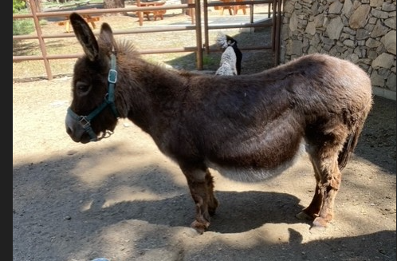
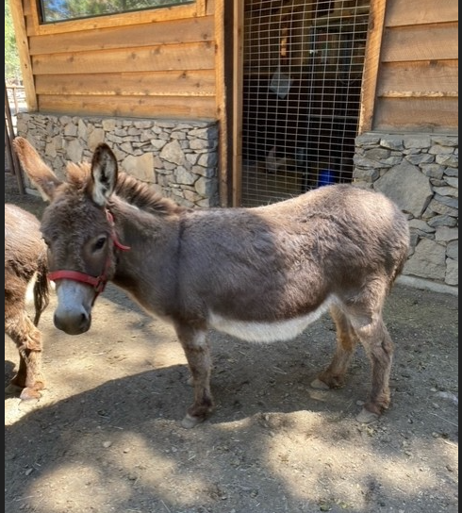
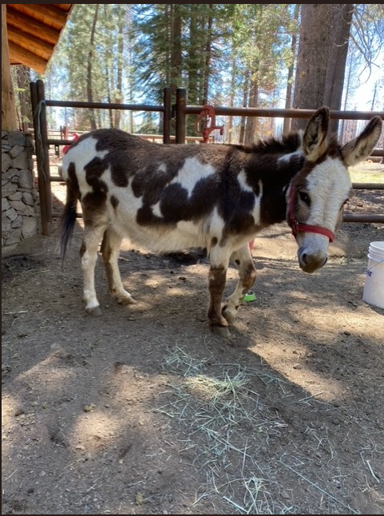
IN-KIND DONATIONS
In-kind gifts are donations of goods and services that support the county program
  Statement of Cash Collections (SCC) is required.
  Receipt or proof of the value of what is being donated
  Acceptance letter signed by the Director.
  To the right is an example of an In-kind
  Gift. We have Midnight (mom), Romeo (dad) and Coco (Baby)

Slide 21
Sponsorships
Sponsorships are a gift.
  What must be taken into consideration is what portion (if any) needs to be reported as income and what portion is the gift.
    Example:
      If the sponsorship check included a table at an event.
      The value of the table needs to be determined.
      The table portion is an income, and the balance is a gift.
      Your SCC document would need to have two lines – one for income and one for gift.
      The gift portion would need to then have the gift paperwork included.

Slide 22
Overview
Required document list per deposit type:
Gifts/Donations | Income | Reimbursement
Statement of Cash Collections (SCC) | Statement of Cash Collections (SCC) | Statement of Cash Collections (SCC)
Tender of Gift form | Receipts | Transaction Listing report w/ highlighted expense
Acceptance Letter (<$20k) | Invoices (if applicable)
Additional backup from Donor
700U form (if applicable)
UDEV ($5k)

Slide 23
LINKS to Forms
Statement of Cash Collections Form (SCC)
https://ucanr.edu/sites/default/files/2025-01/406123.pdf
Tender of Gift
https://ucanr.edu/sites/default/files/2025-01/406133.pdf
700U for research projects *if applicable
https://ucanr.edu/sites/default/files/2025-01/405986.pdf
BOC website
https://ucanr.edu/site/uc-anr-business-operations-center
Notes:
KAITLIN

Slide 24
Q & A
THANK YOU!

