Slide 1
Training for Brand New Academics
Finding success in the UC ANR Academic Advancement Process
Presented by the Academic Assembly Personnel Committee
Mark Bolda, 2024-25 Chair
Aparna Gazula
Marianne Bird

Slide 2
2024 Academic advancement process trainings
Wednesday, October 9, 2024 (10:00 -11:00 am)
Training for Brand New Academics. New to UC ANR? Welcome! Let the Personnel Committee help orient you on the alphabet soup of the advancement cycle. What’s an AE? What’s a PR? When are the deadlines, and what are the requirements? Come to this training to learn more.
Wednesday, October 23, 2024 (2:00 – 3:00 pm)
Training for first-time PR writers. You’ve written an Annual Evaluation, but now it’s time to tackle a Program Review dossier. Come to this training and take a deep dive into the Ebook – your guide to writing effective PRs.
Wednesday, November 6, 2024 (10—11 am) AND Wednesday, November 13, 1, 2023 (2- 3 pm)
Advancement Cycle Q&A Sessions. At these trainings, the Personnel Committee will provide a short presentation on Ebook updates, and then the floor will be opened to Q&A. The short presentation will be the same on both days. Please come with your questions!
Notes:
This is the first of a series of trainings that are being offered by the Personnel Committee. Because UC ANR has hired many new academics in recent years, the Committee, wanted to provide trainings specifically for new academics, and for academics writing their first program review. The Q&A sessions provided academics with opportunities to ask their questions about the process.

Slide 3
Overseeing the academic advancement process
Academic Assembly Personnel Committee
Reviews policies around appointments, evaluations, merit & promotions. Takes the lead in revising the eBook.
Academic HR (Anna Lee & Pam Tise)
Coordinates the advancement process, tracks academic’s advancement actions, administrative and logistical
Peer Review Committee (Vice Provost Daniel Obrist)
Reviews PR dossiers annually and makes a recommendation to the AVP.
Associate Vice President (AVP) Brent Hales
Makes the final decision on advancement requests.
Has delegated authority to establish all advancement procedures (APM 335)
Consists of 9 ANR academics, 3-year terms, appointed by the Academic Assembly Rules & Elections Committee
Notes:
The Personnel Committee annually provides trainings for academics on the advancement process because the Personnel Committee helps to oversee the process.
(Read from the slide)

Slide 4
Annual reporting requirements for academics
Organizational Reporting &
Civil Rights Compliance
Submitted in Project Board
Period: October 1 to September 30
Due December 9
FTE Reporting
Submitted in Project Board
Period: July 1 to June 30
Due July 1
Program Review
& Annual Evaluation
Uploaded through a workflow automation system, integrated with Project Board
Period: October 1 to September 30
Due December 9
Project Board: ANR's online system that integrates civil rights compliance and organizational reporting requirements. It also has an optional component to help academics organize information for program review and annual evaluation.
Project Board training video and slides available at https://ucanr.edu/sites/ProjectBoardHelp/
Notes:
Academics are required to do annual reporting related to civil right compliance, FTE reporting, and performance evaluation. All of this reporting in integrated in ANR’s online system called Project Board. Project Board is accessed through your ANR Portal. I will show some screenshots of Project Board in the next couple slides, but the primary purpose of this training is to focus on performance evaluation. There are separate trainings provided by the ANR Program Planning and Evaluation unit that can help guide you through using Project Board and civil rights compliance reporting. Project Board may also be used to organize your activities for performance evaluation, but academics are not required to use Project Board for that. We’ll talk more about the elements of performance evaluation and ways to organize your activities in a few slides.

Slide 5
Questions, comments, discussion…

Slide 6
Academic evaluation
All academic appointees are evaluated by their immediate and secondary supervisor (if applicable) on an annual basis, except for years in which the appointee seeks advancement by submitting a program review dossier.

Slide 7
The alphabet soup of academic evaluation
AE
Annual Evaluation
PR dossier
Program Review Dossier
eBook
Officially named Guidelines for UC ANR Academics Preparing the Thematic Program Review Dossier
Tells you what materials to submit for advancement
Completed in the years one does not submit a program review dossier.
Materials submitted to request advancement (e.g., merit, promotion)
AHR
Academic human resources
APM & PPM
Academic Personnel Manual (UC)
Policies and Procedures Manual (ANR)

Slide 8
Annual Evaluation and Program Review
Annual Evaluation
Program Review
(Merit & Promotion)
Purpose: Review of an academic appointee’s progress towards goals and review of planned goals.
Purpose: Evaluate the performance of an academic for advancement to the next step or rank.
Who? Between academic & supervisor only.
What? Bulleted lists. It is designed to be simple and useful; there is no narrative.
Who? Evaluated by supervisor, colleagues and clientele (for promotions), ad hoc review committee (for promotions), and the peer review committee, with a decision by the Associate Vice President.
What? Your dossier: Cover page, narrative, supporting documentation, and other elements.
See template on Academic Human Resources website.
When? Typically every two to three years
Submitted in years when one is not writing a Program Review

Slide 9
Newly appointed academics
Academics who have served more than 6 months (hired before April 1, 2024) submit a full AE.
Academics who have served less than 6 months (hired on or between April 1, 2024 and September 30, 2024) submit a partial AE
  Position Description
  Project Board Reporting
  Goals and Objectives for the Coming Year
Academics who began October 1, 2024 or after only complete Goals and Objectives for the Coming Year.

Slide 10
Annual evaluations are required for all ANR academics
The only reasons for not completing an AE:
  Submission of a Program Review dossier
  Sick or Family Medical Leave
  Sabbatical Leave
  Campus-based academics are evaluated by campus academic personnel procedures.

Slide 11
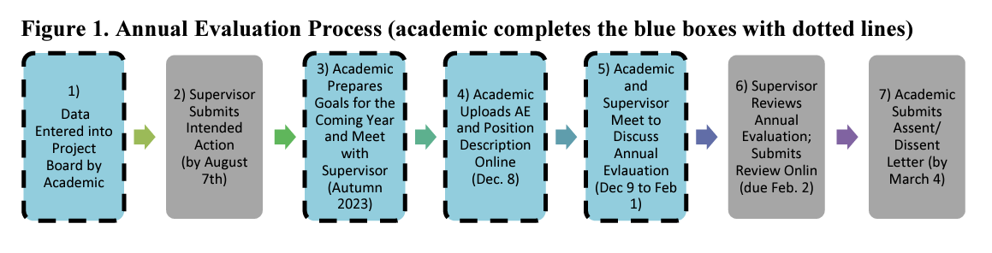
Annual evaluation timeline
Review cycle is October 1 to September 30.
AE is due December 9 via Project Board.
By July 29
Letter by Mar 17
Autumn 2024
By Dec 9
Dec 10 – Jan 26, 2025
Jan 27, 2025

Slide 12
Tips for preparing an effective annual evaluation
Write for the intended audience: County Director or immediate supervisor
Use a style handbook appropriate for your discipline, as a guide for all grammatical, punctuation, and bibliographic citations
Spell out acronyms because your supervisor may not be familiar with the acronyms commonly used in your work
Proofread
Upload documents in PDF format

Slide 13
Elements of the annual evaluation
Position description (PD): It is the academic’s responsibility to keep their PD up-to-date when there is a change in responsibility and/or reporting relationships.
Progress towards Last Year’s Goals and Objectives (table)
Barriers in Accomplishing your Goals (short narrative)
Project Board reporting (check boxes)
Goals and Objectives for the Coming Year (table)
  Anticipated Barriers
  Support from Supervisor
Sabbatical Leave Plan (if applicable)
Work Plan or Performance Improvement Plan (if applicable)
Notes:
There is a Position Description template on the AHR website. Keep in mind the template was developed for all academic titles. You may modify the template to suit your position and developing program.
Also, these are the current elements of the AE; however, the template may change in the coming year.
What has been recognized with both the PD and AE templates (as they currently are) is that neither reflect the academic review criteria (which, for advisors and specialists are research, extension, professional competency, and service).

Slide 14
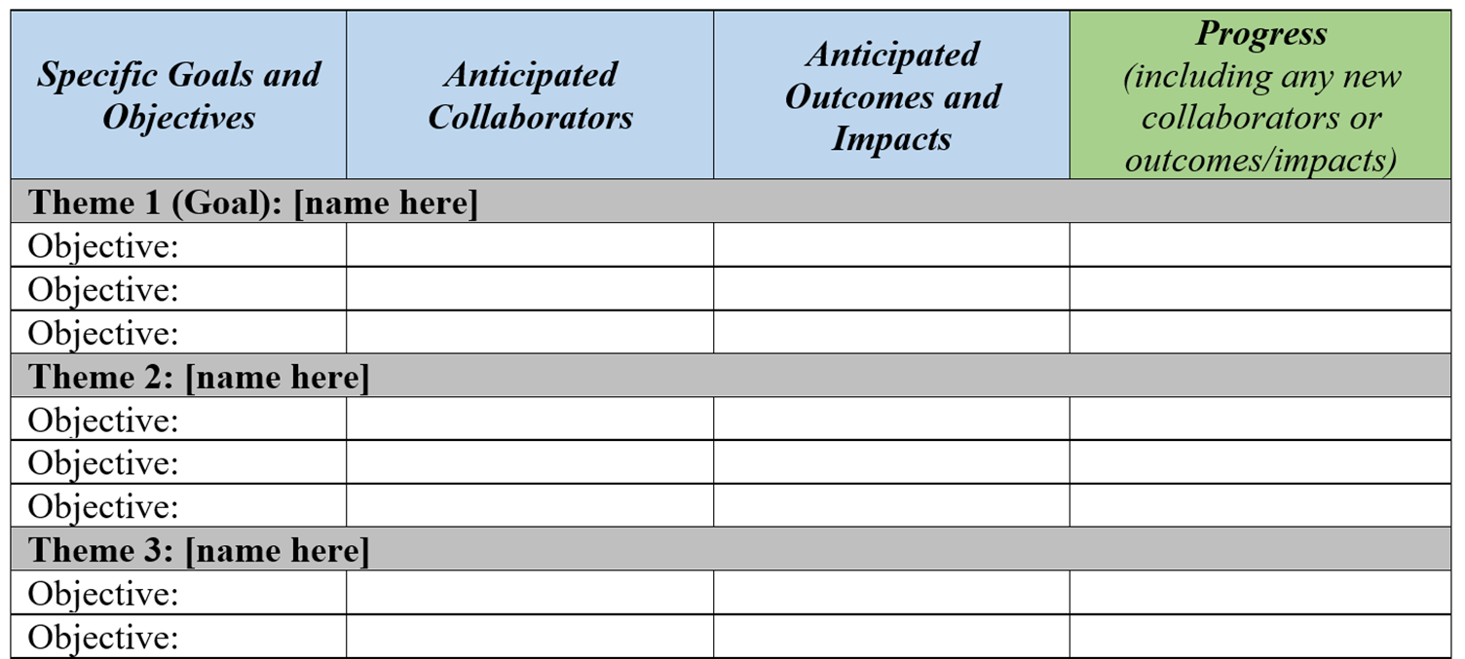
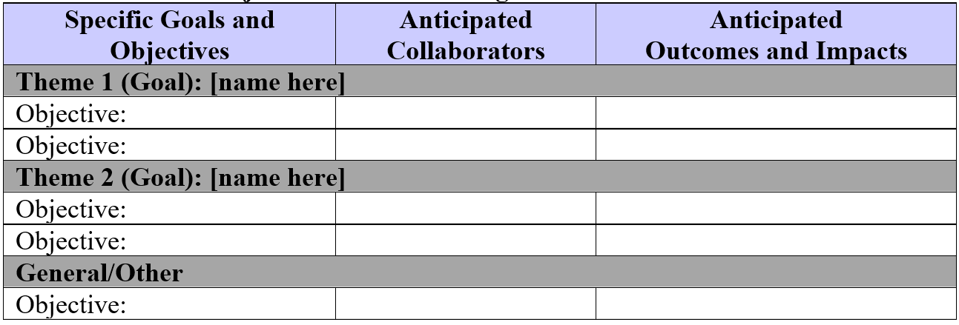
Annual evaluation template - tables

Slide 15
Goals versus objectives
Objectives fall under goals and are typically achievable within a year or two
Goals are long-term, often extending beyond 3 years
Contribute to an effective strategy for reducing strawberry loss to soil pathogens
Assess the effectiveness of steam in reducing soil pathogens.
Examples
Notes:
Under each theme you will want to develop your story around your goals. It is fitting that we review some example of goals and the difference between goals and objectives. For further training on developing your goals please see the training video on “goal setting”.
Goals are long-term often extending beyond three years. One example of a goal is “Contribute to an effective strategy for combating citrus greening in California”. As you can see this goal does not provide any detail of how it will be accomplished, nor will it likely be accomplished in a single year.
Objectives typically fall under your goals and ARE typically achievable within a year or two at the most. An example of an Objective that would fall under the above Goal of “Contribute to an effective strategy for combating citrus greening in California” is “Assess the effectiveness of dogs in identifying infected citrus trees”. The objective states your strategy and is achievable within 1-2 years.

Slide 16
Questions, comments, discussion…

Slide 17
Academic advancement
The purpose of academic review is to evaluate the performance of UC ANR academics for advancement, provide a record of the academic’s professional career in UC ANR, and assist academics with program planning.
Notes:
Overview to acquaint audience with the process; however, since this training is for brand new academics, I don’t want to get bogged down in details or ‘what makes a good PR’.

Slide 18
Case Types
Merit - advancement from one step to the next step. Dossiers highlight academic accomplishments since the last successful salary action.
Promotion – a career milestone advancement from one rank to the next rank, or from full title V to VI, or from full title IX to above scale. Dossiers highlight academic accomplishments for all years in current rank.
Term reviews seeking indefinite status (aka “third term reviews,” typically concurrent with another advancement type). Dossiers highlight academic accomplishments since hire.
Acceleration - a merit or promotion action that recognizes academics who perform at an exceptional level during a specific review period.
Notes:
Merits may occur every 2 years in the Assistant and Associate ranks, and every 3 years in Full Title. Promotions are the milestones from Assistant to Associate to Full Title.

Slide 19
Multiple Step Process
Merit
Promotion
Peer Review Committee submit letter
Associate Vice President makes the decision
CD/Supervisor submit letters of evaluation
Academic submits program review dossier
AVP solicits 3-6 letters of evaluation
Peer Review Committee submit letter
Associate Vice President makes the decision
CD/Supervisor submit letters of evaluation
Ad hoc review committees submit letter
Academic submits program review dossier

Slide 20
Definite status
At hire, academics have definite status; a definite “term” appointment is for a specific period and ends on a specified date.
A successful advancement action (i.e. merit or promotion) results in a new term end date; a negative action carries the possibility of non-reappointment.
Academics with definite term appointments are not eligible to defer a merit advancement that coincides with a term review, unless there are extenuating circumstances, reviewed on a case-by-base basis.
  Academic administrators and academic coordinators, as well as advisors and specialists with a 0% indefinite appointment, may have the option to defer, with the approval of their supervisor.
Notes:
Much of this is taken from the ANR Policy and Procedure Manual, Section 315, Advancement

Slide 21
Indefinite status
UC ANR academics do not earn tenure, but they may earn indefinite status.
An indefinite “term” appointment has no specified end date unless terminated by layoff, retirement, demotion, dismissal, resignation, separation, or death.
Advisors may seek indefinite status concurrent with their third program review (i.e. merit or promotion).
Specialists are considered for an indefinite appointment upon promotion to the Associate Rank.
Notes:
Much of this is taken from the ANR Policy and Procedure Manual, Section 315, Advancement

Slide 22
Evaluation criteria
Academics are evaluated against their position description and the advancement criteria as outlined in the Guidelines for Preparing the Thematic Program Review Dossier (eBook)
Four advancement criteria for CE Advisors*:
  applied research and creative activity
  extending knowledge and information
  professional competence and activity
  university and public service
  Additional consideration: affirmative action/civil rights compliance
* Differs for Academic Coordinators and Academic Administrators.
Notes:
The four advancement criteria are especially important to capture in the Program Review dossier, but they should also

Slide 23
Differentiating Activities
University service*: activity that helps University students, staff, or academics. If an academic is presenting to a University of California class or group, the activity would fall into this classification.
Public service: activities where the academic uses their professional expertise to benefit groups or activities outside the University of California.
Extension activities: targeted at one's defined clientele.
Professional competency: activity that reflects professional standing in your programmatic area.
* Academics with Restrictions on Advancement Criteria, see eBook pages 13-14. Restrictions are to be documented in one’s position description and in the narrative (in a “statement of special circumstances”).
Notes:
This is helpful information for Project Board too.

Slide 24
Peer review process
The peer review process provides an evaluation of academic accomplishments and impact, to support our colleagues in reaching their fullest potential, and thereby strengthening the UC ANR network to improve the lives of Californians.
Notes:
Overview to acquaint audience with the process.

Slide 25
Elements of the Program Review dossier
Academics submit a Program Review dossier that summarizes their accomplishments and outcomes/impacts over the review period.
Required elements
Other elements
Position description
Cover page
Program summary narrative
Supporting documentation
Bibliography
Goals (optional to include in dossier)
Acceleration statement (if applicable)
Summary of publication examples (optional)
Sabbatical leave and report (if applicable)
Work plan (if applicable)
Notes:
Elements of the dossier will vary depending on the requested action (see Ebook pages 17-18). The PR dossier is described in more detail in other Personnel Committee trainings.

Slide 26
Writing a thematic program review
Themes are the constructs for reporting goals, inputs, methods, efforts, outputs, outcomes, and impacts in the program summary narrative.
For each theme, speak to how your program is making a difference to your clientele.
  Outcomes are measurable changes in learning (knowledge, skills), behavior/practice, or policy/decision-making.
  Impacts are broader effects on social, environmental, economic conditions that are aligned with the targeted clientele needs; and aligned with ANR’s articulated public value statements and condition changes.
Notes:
Impacts take time to realize, and some anticipated impacts may not be realized over your career.

Slide 27
What is the Peer Review Committee (PRC)?
14 PRC members appointed by the Associate Vice President for three years with overlapping terms.
Strives to reflect the breadth of UC ANR’s programmatic areas, title series, and administrative assignments.
Makes recommendation to the AVP

Slide 28
What are ad-hoc committees?
Anonymous review committees, made up of peers.
Purpose: evaluate the academic’s performance as documented in the dossier, make a recommendation, and provide written assessment to the PRC and AVP.
The review is made available to the candidate, but the composition of the committee is anonymous.

Slide 29
Questions, comments, discussion…

Slide 30
Program planning
Available resources to help you develop a successful program

Slide 31
Program development and evaluation capacity building
Defining Clientele & Affirmative Action Planning
Improving All Reasonable Effort and Engagement with Diverse Audiences
Conducting a Needs Assessment
Practical Methods to Measuring Outcomes
Using Ripple Effects Mapping (REM) Method in Program Evaluation
Best Practices for Developing Surveys & Basics of Sampling Methods
Methods to Analyze Surveys:
  Part 1 Continuous Quantitative Data (Analyzing and Presenting Pre-Post Evaluation Survey Data)
  Part 2 Discrete Quantitative Data
  Part 3 Qualitative Data
Writing Strong Impact Statements
Notes:
Series of trainings put on by the Program Planning and Evaluation unit. These have already passed this year, but we recommend looking into these next year or reviewing the recordings from this year.

Slide 32
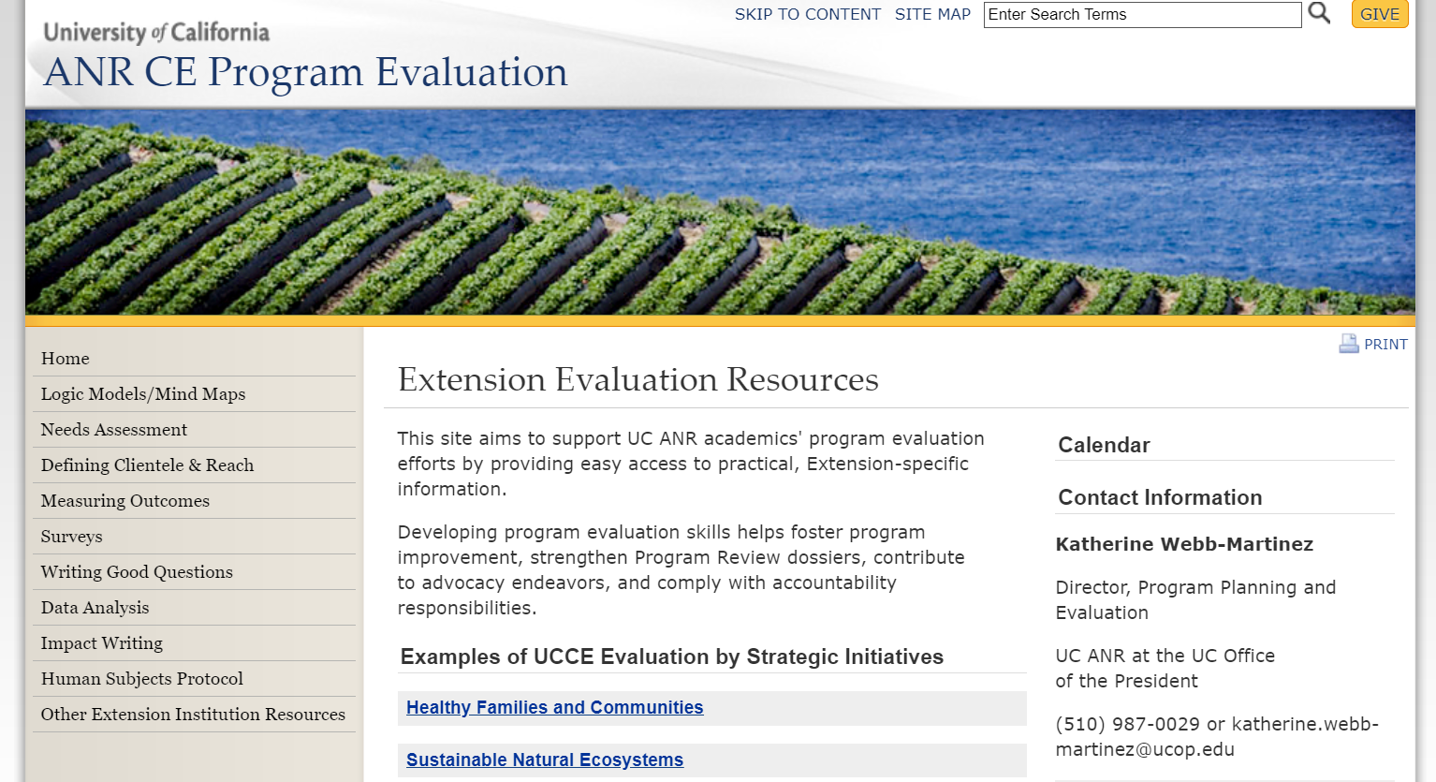
Program evaluation website is a great resource!

Slide 33
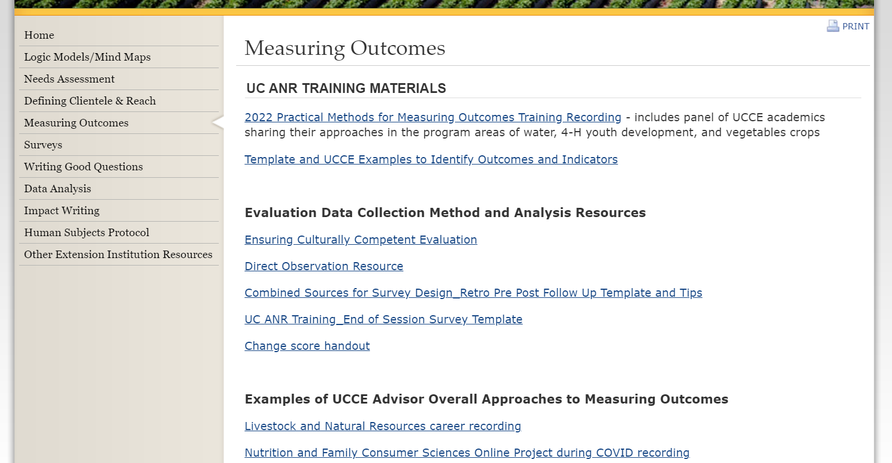
Resources for measuring outcomes
Notes:
Trainings and examples to help guide you on measuring outcomes.

Slide 34
Questions, comments, discussion…

Slide 35
Training for Brand New Academics
Thank you for attending today’s training!
Mark Bolda, mpbolda@ucanr.edu
Marianne Bird, mbird@ucanr.edu
Aparna Gazula, agazula@ucanr.edu
AHR website:
https://ucanr.edu/sites/anrstaff/Personnel_Benefits/Academic_Personnel/
For questions on Project Board:
Kit Alviz, kit.Alviz@ucop.edu

