Slide 1
UC ANR Academic Coordinator Academic Advancement Training
Daniel Obrist, Vice Provost Academic Affairs
Mark Bolda, Chair AAC Personnel Committee
Andy Lyons, Academic Coordinator III/PRC member
10/20/2025

Slide 2
Annual reporting requirements for academics
Organizational Reporting &
Civil Rights Compliance
Submitted in Project Board
Period: October 1 to September 30
Due December 8
FTE Reporting
Submitted in Project Board
Period: July 1 to June 30
Due July 1
Program Review
& Annual Evaluation
Uploaded through a workflow automation system, integrated with Project Board
Period: October 1 to September 30
Due December 8
Project Board: ANR's online system that integrates civil rights compliance and organizational reporting requirements. It also has an optional component to help academics organize information for program review and annual evaluation.
Project Board training video and slides available at https://ucanr.edu/sites/ProjectBoardHelp/
Notes:
Academics are required to do annual reporting related to civil right compliance, FTE reporting, and performance evaluation. All of this reporting in integrated in ANR’s online system called Project Board. There are separate trainings provided by the ANR Program Planning and Evaluation unit that can help guide you through using Project Board and civil rights compliance reporting. Project Board may also be used to organize your activities for performance evaluation using an export feature, but academics are not required to use Project Board for their performance evaluations.

Slide 3
The alphabet soup of academic evaluation
AE
Annual Evaluation
PR dossier
Program Review Dossier
eBook
Officially named Guidelines for UC ANR Academics Preparing the Thematic Program Review Dossier
Tells you what materials to submit for advancement
Completed in the years one does not submit a program review dossier.
Materials submitted to request advancement (e.g., merit, promotion)
AHR
Academic human resources
APM & PPM
Academic Personnel Manual (UC)
Policies and Procedures Manual (ANR)

Slide 4
Annual Evaluation and Program Review
Annual Evaluation
Program Review
(Merit & Promotion)
Purpose: Review of an academic appointee’s progress towards goals and review of planned goals.
Purpose: Evaluate the performance of an academic for advancement to the next step or rank.
Who? Between academic & supervisor only.
What? Bulleted lists. It is designed to be simple and useful; there is no narrative.
Who? Evaluated by supervisor, colleagues and clientele (for promotions), ad hoc review committee (for promotions), and the peer review committee, with a decision by the Associate Vice President.
What? Your dossier: Cover page, narrative, supporting documentation, and other elements.
See template on Academic Human Resources website.
Annually except when submitting a PR
When: Typically every two to three years

Slide 5
Case Types
Merit - advancement from one step to the next step. Dossiers highlight academic accomplishments since the last successful salary action.

Slide 6

Multiple Step Process
Merit
Peer Review Committee submit letter due Mar 17
Associate Vice President makes the decision in May
AD/CD/Supervisor submit letters of evaluation by Jan 26
Academic submits program review dossier by Dec 8

Slide 7
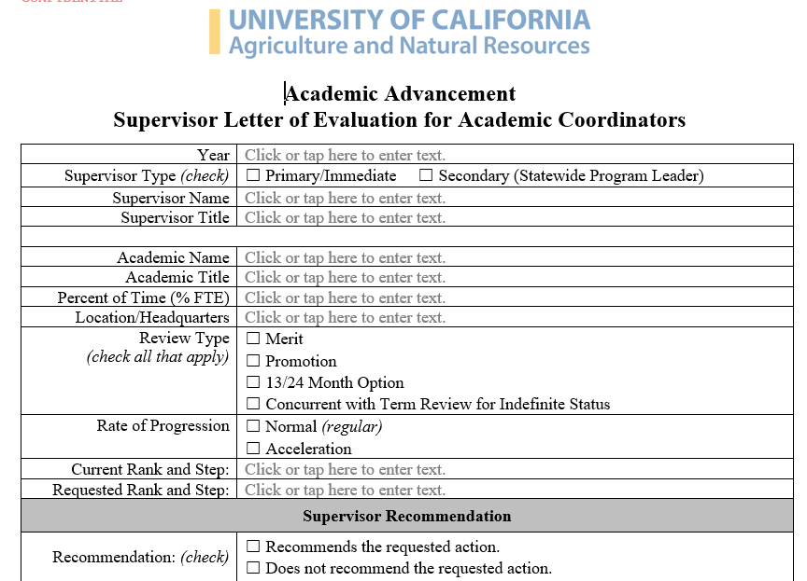
Supervisor Evaluation Letter Template
Supervisor letters:
Use AC template from https://ucanr.edu/site/uc-anr-human-resources/merit-and-promotion
Letters are not anonymous., will be posted on Project Board at the end of the M&P process
You don’t have to share letters with candidates before submitting (but can discuss your views during check-in meetings)

Slide 8
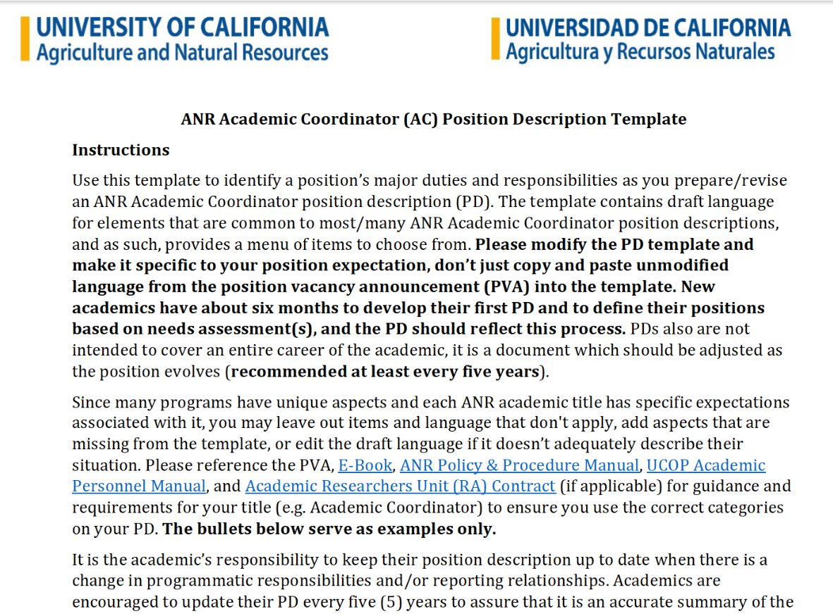
Reminder: specific AC Position Description Template
PD template and guidance:
Academic HR Position Description site: Position Description Guidance | UC Agriculture and Natural Resources
Template for Academic Coordinators Position Description:
https://view.officeapps.live.com/op/view.aspx?src=https%3A%2F%2Fucanr.edu%2Fsites%2Fdefault%2Ffiles%2F2025-01%2F406915.docx&wdOrigin=BROWSELINK
Guidance for Academic Coordinators Position Descriptions: Generic Position Description Elements for any/all UC ANR Advisors

Slide 9
First term action and 18/30-month option
First term academics may not submit an acceleration request for their first action.
First term academics usually complete at least two years for those in a two-year term cycle.
18/30-month option:
  The earliest a first-term academic may seek advancement is after at least eighteen (18) full months for those in a two-year term cycle (30 months for three-year cycles).The academic must show the equivalent of 24 (or 36) months of performance in the reduced review period.
  Discuss this option with your supervisor.
  Don’t just try and see what happens: negative decisions come with a cost! (If unsuccessful, one potential outcome is that the academic is not reappointed).

Slide 10
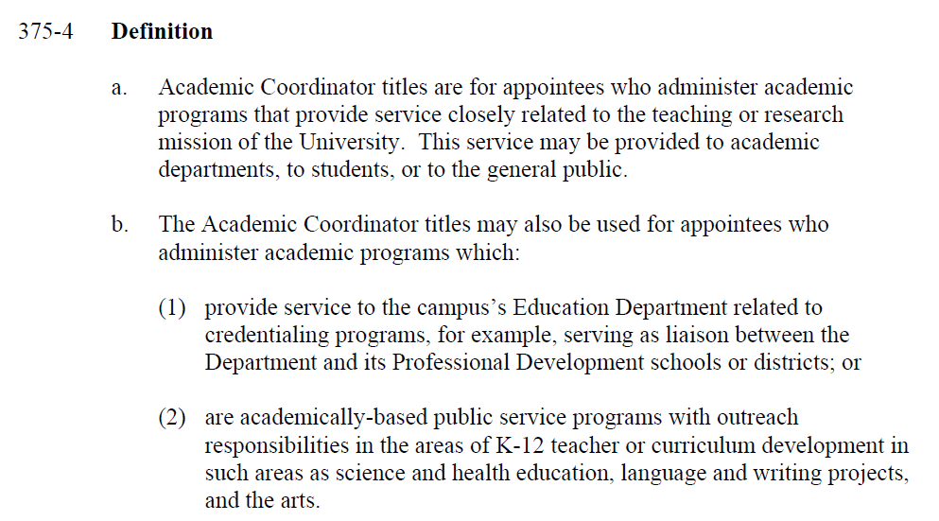
Academic Coordinator APM-375

Slide 11
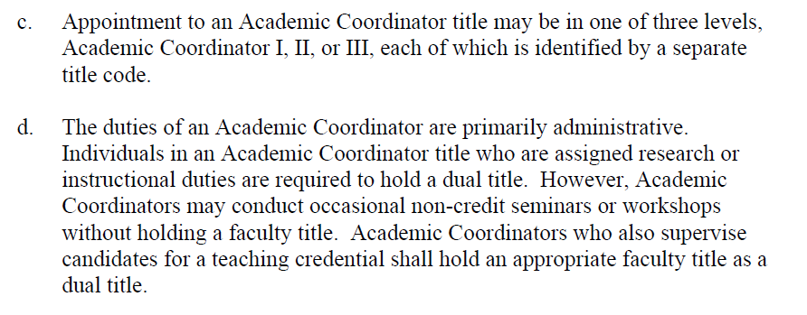
Academic Coordinator APM-375

Slide 12
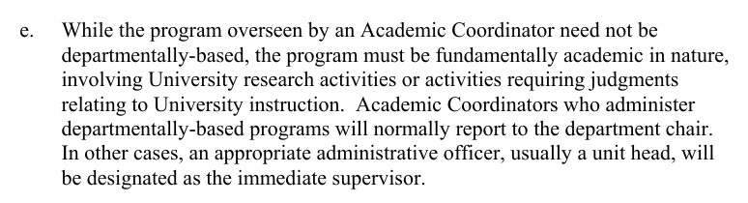
Academic Coordinator APM-375

Slide 13
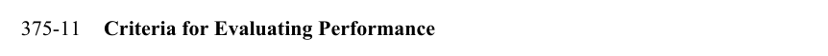

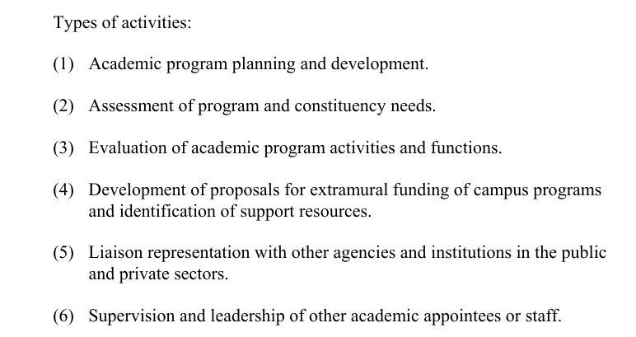
Academic Coordinator APM-375

Slide 14
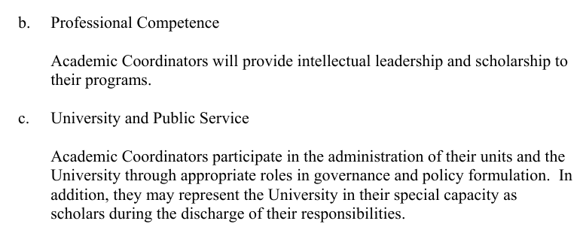
Academic Coordinator APM-375

Slide 15
Summary Academic Coordinator Review criteria
Coordination of Academic Programs
  Academic program planning and development.
  Assessment of program and constituency needs.
  Evaluation of academic program activities and functions.
  Development of proposals for extramural funding of campus programs and identification of support resources.
  Liaison representation with other agencies and institutions in the public and private sectors.
  Supervision and leadership of other academic appointees or staff.
Professional Competence
  Provide intellectual leadership and scholarship to their programs.
University and Public Service
  Participate in the administration of their units and the University through appropriate roles in governance and policy formulation.
  May represent the University in their special capacity as scholars during the discharge of their responsibilities.
  Additional consideration: Documentation of Civil Rights Compliance and Contributions to ANR’s Principles of Community.

Slide 16
eBook Language
For Academic Coordinators: Coordination of Academic Programs
For Academic Coordinators, this topic will often make up the bulk of the program summary narrative.
Highlight your major accomplishments and notable achievements since your last successful salary action and provide evidence of outcomes and/or impacts related to your academic program coordination since your last successful salary action.
When possible, report accomplishments under themes. (a) academic program planning and development; (b) assessment of program and constituency needs, (c) evaluation of academic program activity and functions; (d) development of proposals for extramural funding of campus programs and identification of support resources; (e) liaison representation with other agencies and institutions in the public and private sectors; (f) supervision and leadership of other academic appointees or staff.

Slide 17
eBook Language
Academic Coordinator I (2-year normal progression; Steps 1-15)
Academic Coordinator II (2-year normal progression; Steps 1-15)
Academic Coordinator III (3-year normal progression; Steps 1-9)
eBook Language:
Academic Coordinators have term appointments and are not eligible to defer advancement that coincides with a term review. However, certain extenuating circumstances may warrant the approval of a deferral and an appointment extension by the Associate Vice President. These situations will be evaluated upon receiving a written request.
Although Academic Coordinators and Academic Administrators do not have ranks, they are expected to continue to develop in all areas of their advancement criteria over time.
All academics are expected to have a positive trajectory of productivity and achievement as they advance in their career, demonstrating progress in achieving greater outcomes and impacts over time. Trajectory: i) increased competence, ii) deepened relationships with partners/networks, (iii) strengthened organizational/supervisorial resources; (iv) support clientele in achieving impacts.

Slide 18
Academic Coordinator Duties Clarifications
The AC title is used for a variety of programmatic positions; position description provides details on expectations and priorities; “not every position will be required to emphasize each of the performance objectives” - but need to meet APM-375 requirements.
Academic: Administer academic programs that provide services closely related to the teaching or research mission of the University. Duties are primarily administrative.
Research: APM-375: “Individuals in an Academic Coordinator title who are assigned research or instructional duties are required to hold a dual title.” No expectation of research publications, but expectations to “develop, contribute to, and publish evaluation reports” and “provide scholarship to their programs”. Research publications may count towards professional competence.
Extension: “APM-375: Academic Coordinators may conduct occasional non-credit seminars or workshops without holding a faculty title.” Can deliver academic programs (direct or indirect such as train the trainer programs) to clientele or partner organizations, but it is not the main duty of an AC. An expectation also is “Liaison representation with other agencies and institutions”.
Grantsmanship and supervision: APM-375: “Development of proposals for extramural funding of programs and identification of support resources” and “Supervision and leadership of other academic appointees or staff”.

Slide 19
PR Dossier Supporting Documentation: Optional AC table
E. Extension Activities or Coordination of Academic Program activities (as applicable)
  Currently, no Project Board table is available specifically for Coordination of Academic Programs.
  Academic Coordinators may choose (optional) to add a table with specific information following their review criteria (optional);
  Including activities related to:
    (a) academic program planning and development;
    (b) assessment of program and constituency needs;
    (c) evaluation of academic program activities and functions;
    (d) development of proposals for extramural funding of campus programs and identification of support resources;
    (e) liaison representation with other agencies and institutions in the public and private sectors;
    (f) supervision and leadership of other academic appointees or staff.
  The Project Board team is working to develop a separate reporting table for Coordination of Academic Programs for use in the subsequent (2026/27) Academic Advancement Review cycle, in consultation with the AAC-Academic Coordinator representative committee.

Slide 20
Peer Review Committee
  Committee of 18 academics across different titles, programs, and counties
  Mission
    review & discuss each PR
    make an advisory recommendation to the AVP
    prepare a letter for the candidate
  Each PR is read cover-to-cover by at least two PRC members
    some PRs are read by the whole committee
    lead reviewers facilitate a discussion with the entire committee
    vote (doesn’t have to be unanimous)
    prepare draft letter, circulate for comments, refine

Slide 21
Peer Review Committee
  Inputs
  Position Description
  Narrative
  Supporting tables
  Supervisor’s letter
  If required:
    Ad-hoc review
    committee letter
    Other letters
    Publication samples
  Outputs
  Vote on the requested action by the whole committee
  Letter to the candidate
  Summary of achievements
  Evaluative comments
  Suggestions for future success
  eBook!
  For ACs:
  Coordination of academic programs
  Professional Competence
  University and Public Service
  Affirmative Action and EDI activities
and nothing else!

Slide 22
Effective PRs
  Don’t assume the reader is from your field or knows your program.
  Summarize the rationale and goals of the program.
  Explain your role in activities.
  Include all sections of the Program Summary Narrative.
  Don’t simply summarize the tables in the Narrative.
  Highlight the positive, frame challenges as pivot points.
  Don’t exaggerate or mispresent performance.
  Don’t conflate outputs, outcomes, and impacts.
  Convey a sense that you’re evolving / growing / know where you’re going.
  Are not written at the l1th hour.

Slide 23
Common Questions from ACs
I ‘just’ coordinate. Can / should I report the
YES! Just be sure to note your role in the program (which
outcomes and impacts of my Program
might include documenting the outcomes and impacts).
May also include “internal” outcomes (e.g., team’s learning gain).
(which is mostly implemented by others)?
I supervise people. Can / should I report
See above.
their outcomes and impacts.
I do research. Am I allowed to report it?
YES! Just unpack what you mean by “do research” and help
us map it onto one of the AC categories (coordination of
academic programs, professional competence).
Outcomes are easy, but my program is too
Discuss anticipated impacts. Describe intermediate steps.
new, too small, or operates too far upstream
Describe how you’re laying the groundwork for evaluating
to have “impacts”. What do I do?
impact. Seek guidance from ANR’s PPE group.

Slide 24
Common Questions from ACs
Project board doesn’t have an activity for
Don’t rely on Project Board for everything! Keep your
“coordination”. How am I supposed to list my
own records and if needed add your own tables. (Don’t
coordination activities?
throw everything into Professional Competence).
My funding precludes me from doing university
Make sure this is noted in your Position Description,
and public service during working hours. What do
and add a sentence to your Narrative. Report anything
I do?
relevant in alignment with your funding.
Do I have to report Affirmative Action / Civil
If it’s in your Position Description, yes.
Rights compliance?
Five pages is just not enough for everything I’ve
Give yourself a quota for each section of the narrative.
done. What do I do?
Highlight the most important content for the goals of
this document
. Summarize achievements, let the tables
capture the details.

Slide 25
Academic Advancement Resource Page
UC APM (Academic Personnel Manuals): https://www.ucop.edu/academic-personnel-programs/academic-personnel-policy/index.html
  220 Professor Series: 220-80-c, 220-80-d, 220-80-e, 220-80-h, 220-80-i, 220-80-j, and 220-84-b, modified as appropriate.
  Specific sections for title series; e.g., 375 Academic Coordinators; 335 CE Advisors; 334 CE Specialist
ANR PPM 315 (Policy and Procedure Manual): Advancement: https://ucanrpolicy.ellucid.com/documents/view/122/active/
Guidelines for Preparing the Thematic Program Review Dossier for UC ANR Academics (aka eBook): https://ucanr.edu/sites/default/files/2025-01/406678.pdf
Academic HR merit and promotion process: https://ucanr.edu/site/uc-anr-human-resources/merit-and-promotion

