Slide 1
Improve Self-Service
UCPath Upgrade – Available July 14

Slide 2
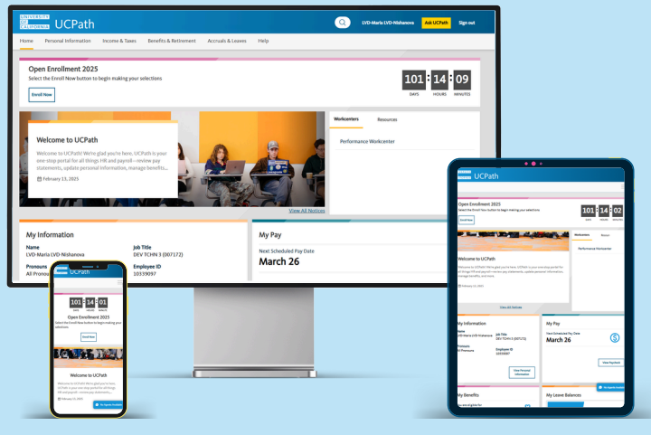
Improve Self Service
What: UCPath is getting a new modern and user-friendly landing page and is designed to:
  Easier to find the tools and information (ex. personal information, benefits, pay)
  Mobile responsive and accessible
  Improve self-service access for employees and managers
Why: Allows UCPath to reduce usability gaps and sets up the system to be updated and enhanced in the future with less customizations.

Slide 3
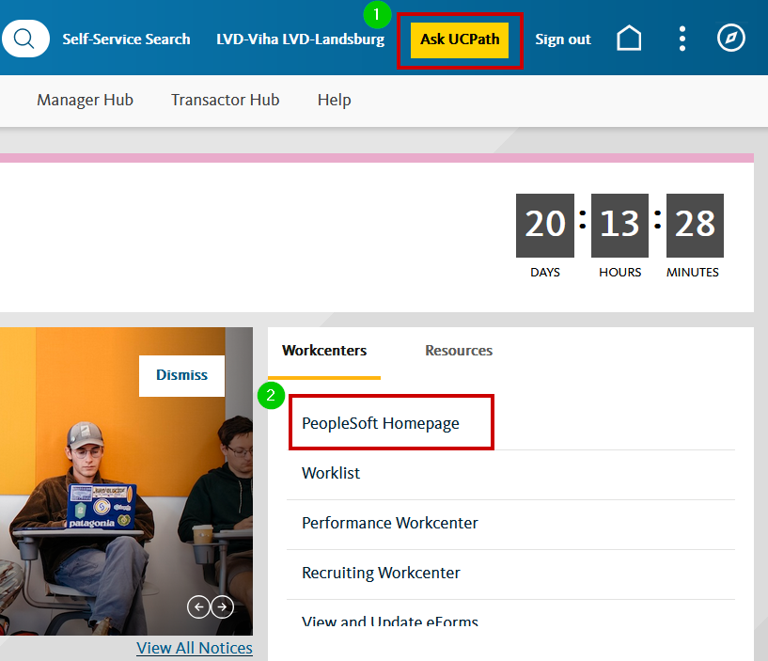
What's Not Changing
Several familiar features remain unchanged:
Login page and access method remain the same
Ask UCPath button location and design are consistent (1)
Retain easy access to the PeopleSoft Homepage (2)
Timeout: Remains at 60 minutes for “transactor” pages, ePerformance and Internal Candidate Gateway

Slide 4
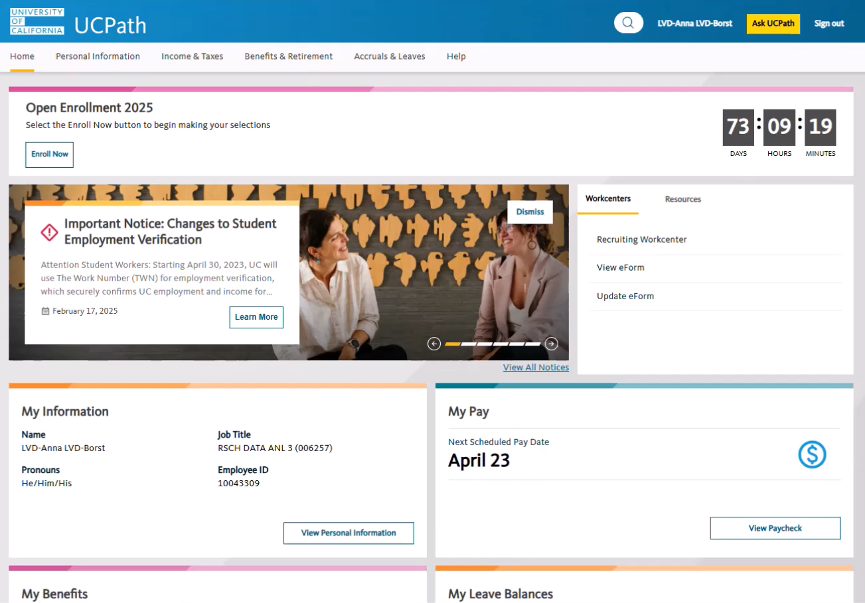
Employee’s
Preview
UC ANR employees will see new menu and navigations that includes:
Personal Information
Income & Taxes
Benefits & Retirement
Accruals & Leave
Help

Slide 5
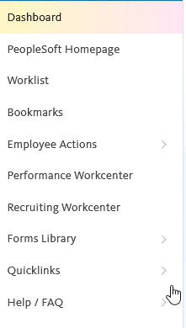
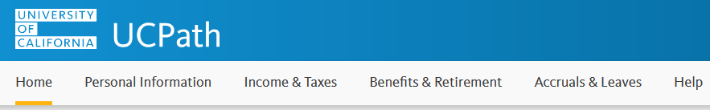
Navigation Changes
Current State: Left-hand menu with stacked links: Dashboard, Self Service, Forms Library
Future State: Replaced by top navigation bar with categories, Workcenter, Help

Slide 6
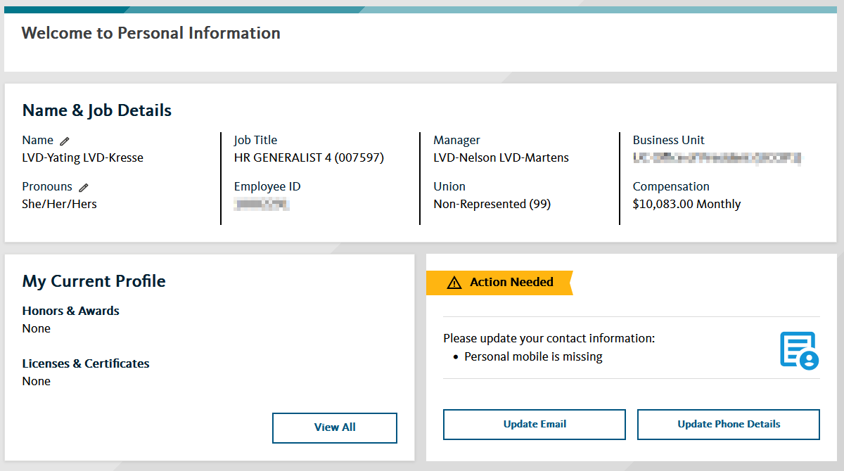
Personal Information Page
New Features:
Displays primary job compensation, manager information, and union code
Includes an Action Needed tile for missing personal information
Change Impact:
Employees are alerted to incomplete records
Reduces manual corrections and improves data accuracy

Slide 7
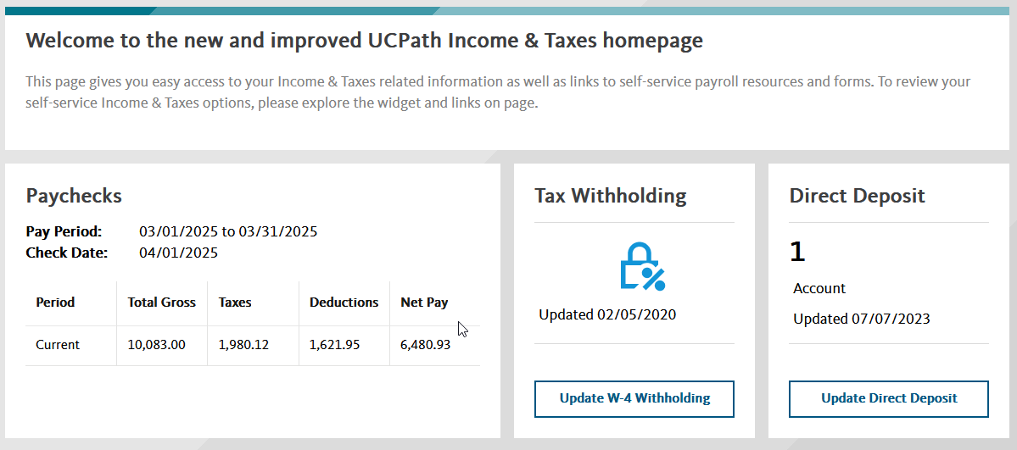
Income & Taxes Page
New Features:
Shows preview of most recent paycheck
Lists number of direct deposit accounts and last update date

Slide 8
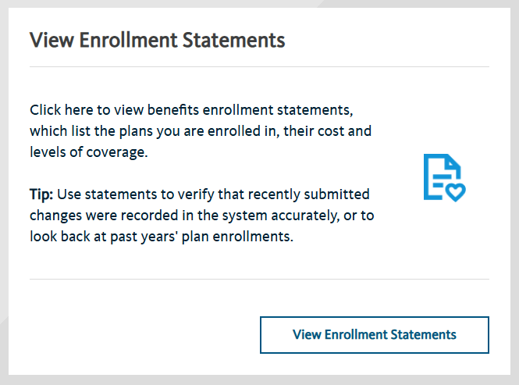
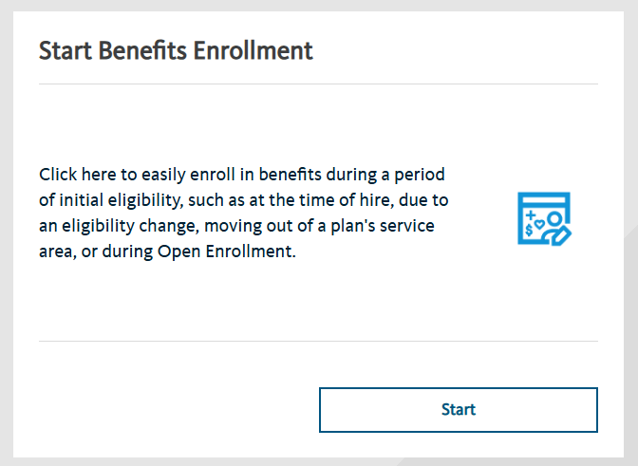
Benefits & Retirement Page
New Features:
View enrollment confirmation statements online
Submit benefit enrollments via new modern activity guide

Slide 9
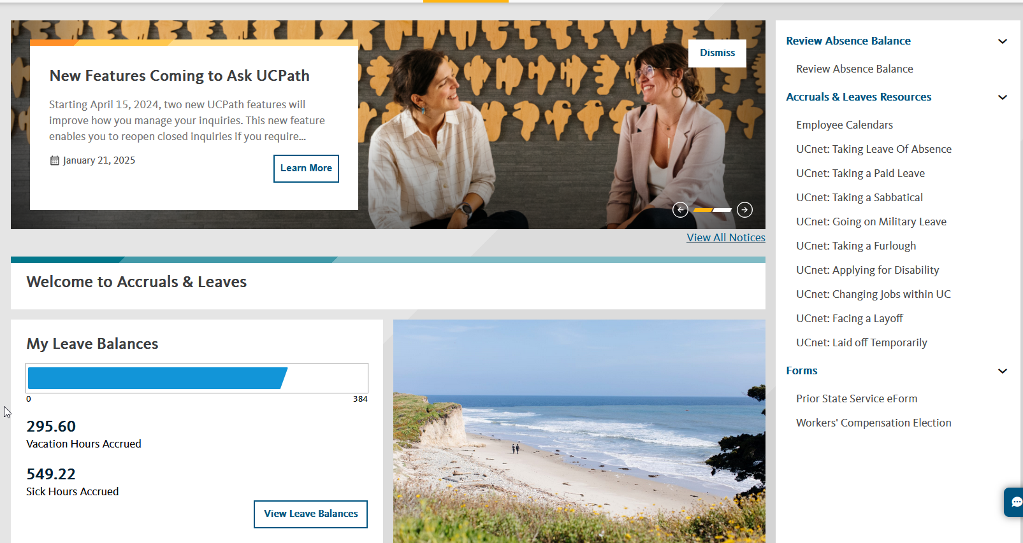
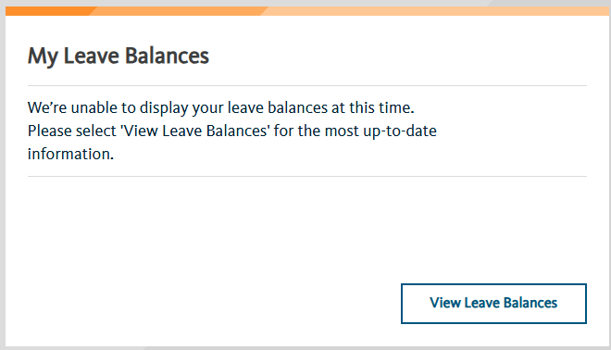
Accruals & Leave Page
New Features:
Includes new links to UCnet resources on various leave types

Slide 10
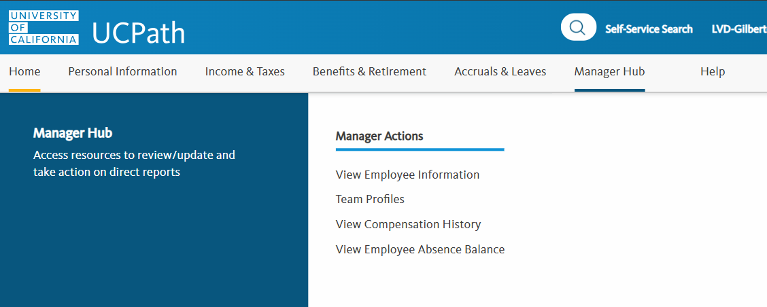
Manager’s
Preview
UC ANR managers will see new menu and navigations that includes:
Personal Information
Income & Taxes
Benefits & Retirement
Accruals & Leave
Manager Hub
Help

Slide 11
Improve Self Service
Will logging in change?
No, your login with your UC ANR credentials.
Will we still have security questions?
Yes, the security questions will still be in use.
Will there be training and more information?
More information will be communicated and shared in near future.
More information to be shared:
UC ANR - July 2025 Release

