Slide 1
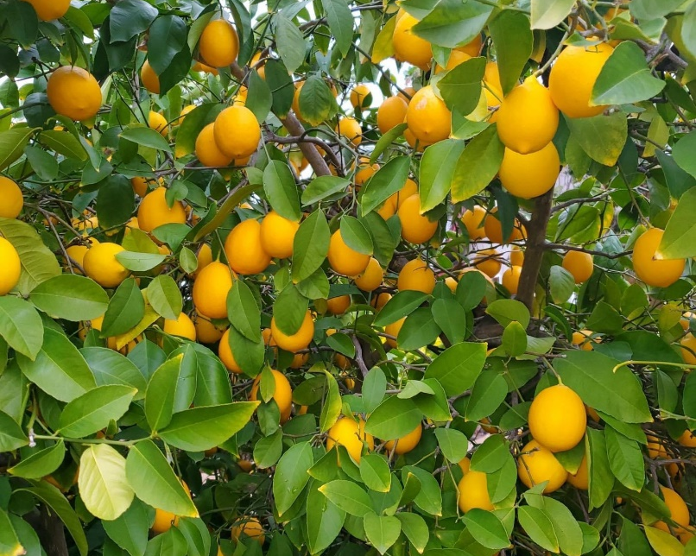
Growing Citrus in Placer County
Photo:D.B-Garrido
Notes:
Created: February 14, 2021
Created by: Sandi Fitzpatrick
Audience: New gardeners; those wanting to plant or grow citrus.
Publicity: Placer County is the perfect place to grow your own citrus. If the idea of picking a juicy orange off a tree in your own backyard appeals to you, you’ll want to attend “Growing Citrus in Placer County”. This workshop will describe the basics of selecting a tree, planting, irrigating, fertilizing, and pruning.
Update History: 3/11/2021 to alter planting instructions; replaced fruit tree graft union photo with one from a citrus tree; and added info to contact California Department of Food and Agriculture if a home owner is suspicious of ACP.
Updated again 3/21/2021 to include photo of Jan White and her kitchen counter covered with owari satsuma mandarins.
Updated again 1/17/2022 to change cover photo; new slide # 31 added to show weather damage caused by excessive wind or excessive water.

Slide 2
Who Are Master Gardeners?
Master Gardeners of Placer County
Extend research-based, sustainable gardening and composting information
Present accurate, impartial information to home gardeners
Encourage public to make informed gardening decisions
Notes:
1. Master Gardeners are trained volunteers offering research-based gardening information to home gardeners.

Slide 3
Who Are Master Gardeners?
Where to find us…
Online, in the Media, and Special Publications
Hotline: Call (530) 889-7388 or submit your questions online
Website: pcmg.ucanr.org
Facebook, Twitter, Instagram
Gold Country Media monthly column
Curious Gardener quarterly newsletter and on our website
Gardening Guide and Calendar
Notes:
1. Master Gardeners of Placer County offer information in a variety of ways – through our hotline, on our website, through social media, a quarterly newsletter your can subscribe to and our annual garden guide/calendar.

Slide 4
Who Are Master Gardeners?
Where to find us…
Workshops, Fairs and Festivals, and Special Events
Speakers by Request
Workshops (various venues, check website)
Farmers’ Markets (seasonal: Auburn, Roseville, Lincoln)
Fairs and Festivals Booths (varies)
Garden Faire (April)
Mother’s Day Garden Tour (May)
Notes:
1. Under normal circumstances you would find Master Gardeners at farmer’s markets, garden festivals or during our annual Mother’s Day Garden Tour.
2. Due to COVID-19 restrictions Master Gardeners are not able to participate at in-person events. We hope to be back with you soon.

Slide 5
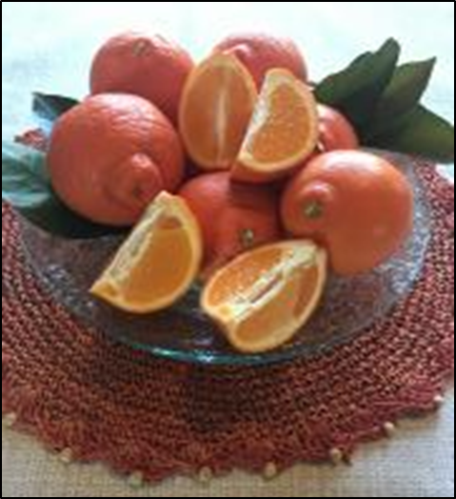
Today’s workshop will include:
Citrus Facts & History
Selecting Tree & Site
Planting
Irrigating/Fertilizing
Pest Management
Pruning/Thinning
Protecting
Photo: Minneola by S. Fitzpatrick
Notes:
Today’s workshop is intended to be a basic overview of Growing Citrus in Placer County including: citrus overview, plant/site selection, planting, irrigation, pruning and cold weather protection. A resource list provided at the end of the presentation will offer additional information on many of these topics.
Note: Minneola's are a combination of grapefruit and tangerine

Slide 6
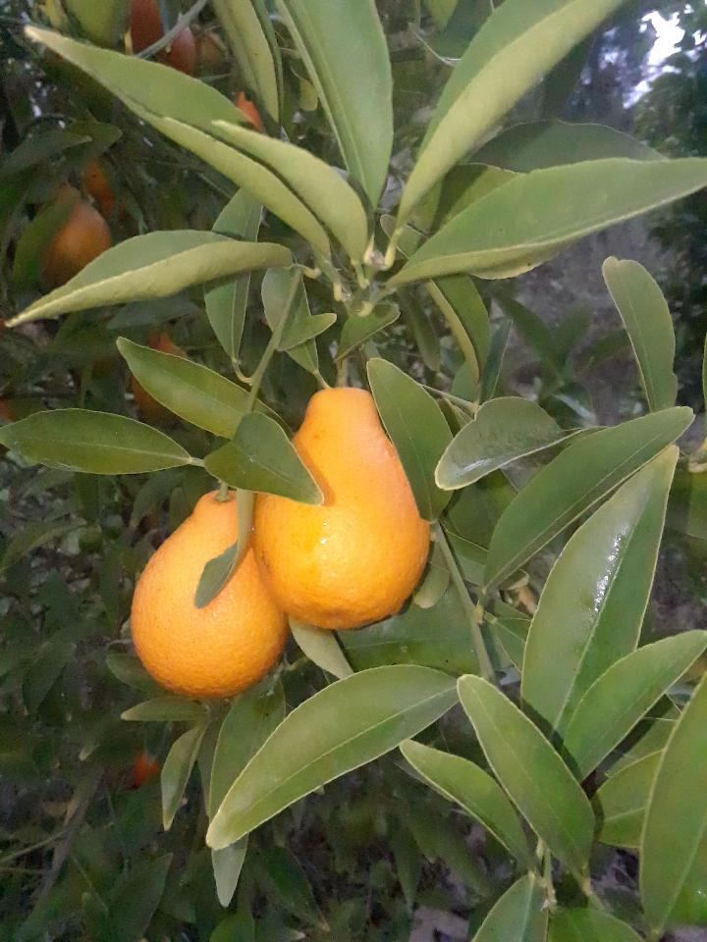
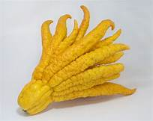
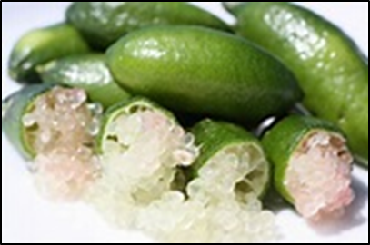
Citrus Facts
Genus of flowering trees/shrubs
Rue family, Rutaceae
Common & Unusual
Photo by Judith Myrick
Photos: UC ANR
Notes:
Citrus belongs to the genus of flowering trees and shrubs. It is in the Rue family, Rutaceae. (pronunciation: ru ta ce i)
2. Citrus fruits include oranges, lemons, limes, grapefruits and pomelos and more unusual varieties such as mandarinquats, budah;’s hand and Australian finger limes.

Slide 7
Citrus in California
Satsuma mandarins originated in Japan 700 years ago
CA mission gardens in the late 18th century
1880’s orange groves in LA
Today CA is leading supplier of fresh citrus
Commercially grown citrus = $7 billion in economic value
50% of all residences have a citrus tree *
When did mandarins come to Placer County?
*CA Pest & Disease Prevention Program data
Notes:
1. Satsuma Mandarins originated in Japan over 700 years ago.
2. The first citrus trees were planted in Southern California’s mission gardens in the late 18th century. By the 1880s, citrus trees were more prolific and orange groves existed in what is now Los Angeles.
3. Today California is the leading supplier of fresh lemons, oranges and mandarins.
4. Commercially grown citrus contributes $7 billion in economic value to California.
5. California’s Pest & Disease Prevention Program estimates that more than 50% of all California residences have a citrus tree on property.
6. When did mandarins come to Placer County? ( answer on next slide)

Slide 8
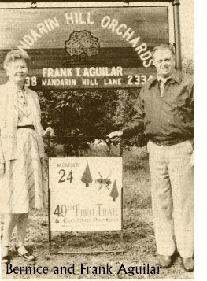
Placer County Citrus History
Satsuma mandarins have been farmed in Placer County for 125 years
Welsh settlers established Penryn (1880’s) and planted fruit orchards
Mid 20th century, Placer County was known as the “fruit basket of the nation”
When a disease took out the pear trees – the farmers turned to mandarins
Information & Photo used with permission of the Mountain Mandarin Grower’s Association
.
Notes:
Satsuma mandarins have been a farming tradition for more than 125 years in the fertile soils of the Placer County foothills.
Welsh settlers established the town of Penryn in the 1880s, and started planting orchards of pears, plums, peaches, oranges and mandarins.
3. By the mid twentieth century, Placer County became known as the fruit basket of the nation. Then a tree disease struck that killed pear trees all over the region. In just a few short days a healthy tree turned into a brown, wilted, dead tree, and there was no cure. Placer County farmers pulled up dead trees and burned them, hoping to arrest the disease.
4. With the pear trees gone, new crops needed to be planted. Penryn friends and farmers Frank Aguilar, Ed Pilz, and Harold Struble decided to plant more mandarin trees.
5. Together the trio purchased a sizing machine and began supplying fresh mandarins to local consumers and grocery stores. Boxed mandarins soon became a wonderful gift enjoyed by friends and family throughout the country, and many were sent to soldiers in foreign wars.

Slide 9
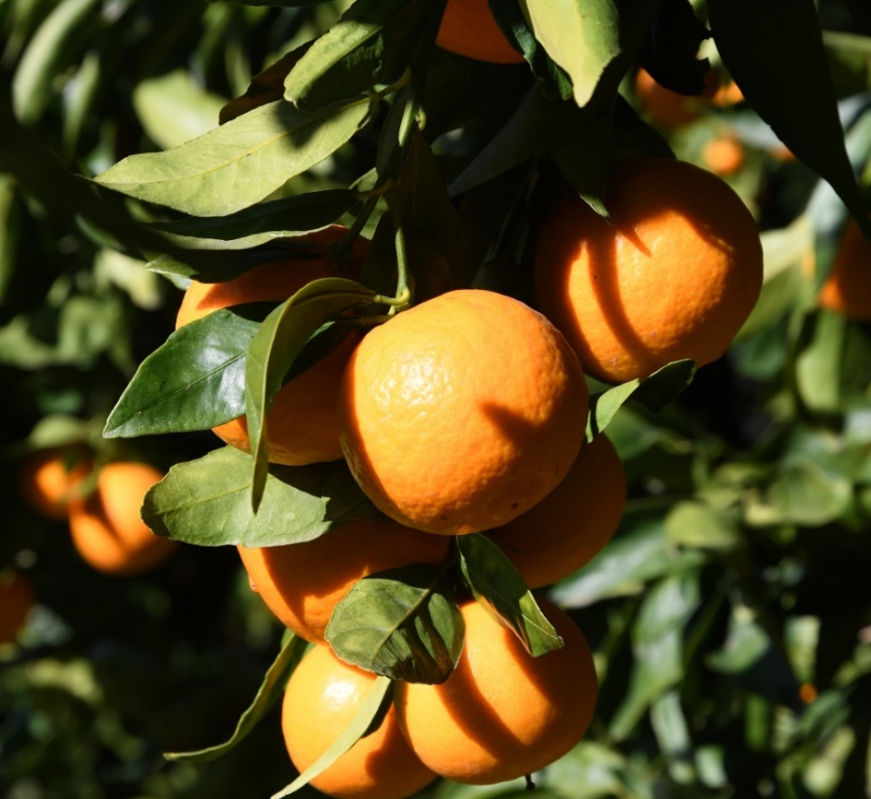
Why Grow Citrus?
Fresh, nutritious
1000 varieties
Plant what you like
Connection to food
Evergreen
Yum!
Nothing says winter like the smell and taste of fresh citrus!
Photo: Pixie Mandarin by Dale Kuroda
Notes:
We all want the best tasting and freshest citrus. Nothing says winter like the smell and taste of fresh citrus!
Grow your own food …. Plant your favorites.
There are more than 1,000 different varieties of Citrus and Citrus relatives. As Kevin Marini likes to say “plant what you will eat.”
Growing food give us an opportunity to teach our children or grandchildren where food comes from.
Evergreen makes the tree or shrub a good garden accent.
Besides tasting so good, it is satisfying to watch the tree progress each year and throughout the seasons.

Slide 10
Tree Selection
Long lived trees – 50+ years – Investment
IMPORTANT:
Certified citrus – reputable nursery: certified disease free and true-to-type
No citrus trees from other state or county
Quarantine laws protect the health of CA’s citrus !!!
Mandarins most popular citrus in the Sierra Nevada foothills
Notes:
Citrus are long lived trees, producing for 50 or more years. Therefore they are an investment.
IMPORTANT to buy certified citrus trees from a reputable nursery. These sell trees that are certified disease free and true-to-type.
Do NOT bring any citrus from another state or county. Quarantine laws protect the health of California’s citrus.
Mandarins are the most popular citrus of the Sierra Nevada foothills. Warm days and cool nights during the growing season are conducive to mandarins.
Mandarins are also most cold hardy, are easy to peel and taste oh so delicious.
Common varieties of mandarins grown in Placer County: owari satsuma mandarin, seedless kishu mandarin, miyagwa satsuma mandarin, okitsu wse satsuma mandarin, China S-9 satsuma mandarin, page mandarin, tango mandarin and pixie mandarin.

Slide 11
Rootstock
Graft union = crook in the trunk
Citrus trees have 2 parts: scion and rootstock which join at the graft union
Scion is above the graft union and determines the fruiting variety
Rootstock influences vigor, size, pest & disease resistance
Trifoliate rootstocks used for cold tolerance, fruit quality, disease resistance and semi-dwarfing qualities
Rich 16-6 and Rubidoux are adapted to the foothills
Flying dragon for contained citrus
Select appropriate rootstock for environment, soil conditions, and disease resistance
Photo: UC ANR
Notes:
1. When you look at a fruit tree, you will notice a crook in the trunk. The crook is called the graft union.
2. A citrus tree usually consists of two parts: the scion and the rootstock. The scion is above the graft union and comprises the main trunk, limbs, leaves, and fruit.
Below the graft union is the rootstock. The rootstock influences tree vigor, mature size, pest and disease resistance and susceptibility.
Trifoliate rootstocks are used for cold tolerance, fruit quality, disease resistance and semi-dwarfing qualities.
5. Two root stocks that are very well adapted to foothill conditions are Rich 16-6 and Rubidoux. Both of which provide cold hardiness and are semi-dwarf. Flying Dragon is well suited for contained citrus.
6. Select the appropriate rootstock for your environment and soil conditions as well as pest and disease resistance.

Slide 12
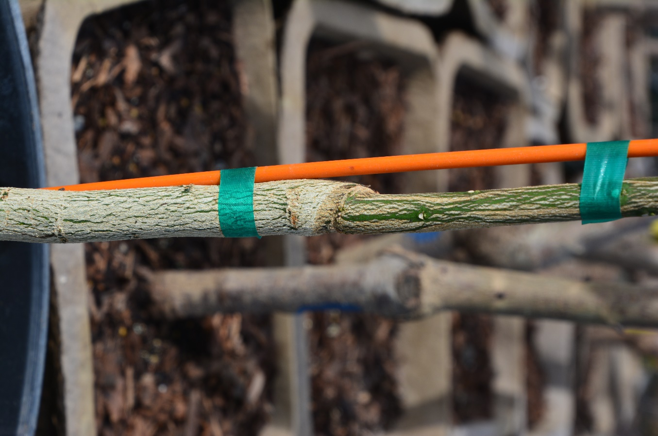
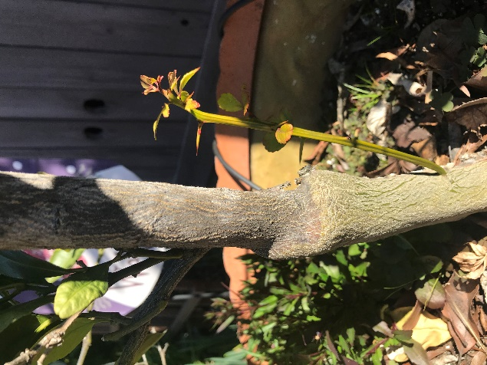
Graft Union Scion & Rootstock
Note: Any growth that appears below the graft should be removed
Photo by: Dale Kuroda
Photo: S. Fitzpatrick
Notes:
1. This photo show the graft union on a dwarf naval orange tree. This photo was taken of a containerized plant at a local nursery.
2. Home gardeners may find a vigorous spiny growth with no fruit. Check to see where the growth is coming form. Invariably it turns out the root stock has taken over.
3. Remove growth that sprouts below the graft union.

Slide 13
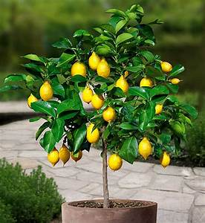
Site Selection
Right Plant – Right Place
Full sun (8 hrs.) for flowering & fruit production
South or southwest facing
Water source
Protected from strong winds
In marginal zones, consider container planting which can be moved to south facing walls or indoors
Upper limit of 1,200 feet
Photo: UC ANR
Notes:
Citrus requires full sun (8 hours) for flowering and fruit production.
The best site faces south or south-west with a water source.
Is the area protected from strong winds?
In marginal zones, consider containerizing trees which can be moved next to south facing walls or indoors for protection in cold weather. The upper limit is 1,200 feet.
5. 1,200 feet is the upper limit for successful growing of a citrus tree.

Slide 14
Planting Overview
Dig the hole as deep as root ball height and twice as wide
Plant in springtime (March-April)
Shallow rooted trees/Feeder roots in top 2 ‘
Most citrus is sold in containers – roots may be bound or kinked
Make a small mound in bottom of hole. Unwind roots and spread over mound, tips pointing downward.
Graft union is above ground
Back fill with natural soil (no amendments) and tamp down
Notes:
You have your tree and you know where you want to plant it …. so begin by digging a hole that is as deep as root ball height and twice as wide as root ball.
The best time to plant citrus is in the springtime, after danger of frost has passed, but well before hot weather. Planting in March/April, when the soil is moist, gives the tree an opportunity to establish roots before the heat of summer.
Citrus are shallow rooted trees with the feeder roots in top 2 feet.
Most citrus trees are sold in containers – rather than bareroot. If the trees have been in containers a long time, they may have circled or kinked roots. If that is the case, make a small mound in the bottom of the hole. Unwind the roots and spread them over the mound, ensuring that tips point downward. After planting, trees should not settle deeper than the level they grew in their containers at the nursery.
Be sure graft union is above ground.
6. Do not amend the soil as tree should become accustomed to native soil. Back fill with original soil and tamp well.
[Note from Lynn Merrick 2/19/202. “I reached out to Four Wind Growers, who is one of the premier citrus growers in N. Cal and a resource we are allowed to use on Hotline. I wanted to verify my comment about most citrus being container grown. I wasn’t as confident about what the online growers are doing vs what you find in nurseries. Here’s their very interesting reply:” “I don't know of any California citrus nurseries that still do ball and burlap. Almost everything has moved to container production and has been that way since about the 80s. Especially now with ACP/HLB restrictions. Almost all citrus production in CA is in greenhouse structures.”]

Slide 15
More Planting Tips
Top dress with a few inches of compost/cover with mulch
Leave 2-3 “ of bare soil next to the trunk
Water well after planting
Monitor newly planted trees. When soil feels dry in the top 6-8” – water.
Frequent watering for 1st year – moist, not wet
White wash trunk with 50/50 interior white latex paint/water
Elevations of 1,200 -1,500’ will have to protect from cold
Avoid planting in lawns Why?
Notes:
Top dress a few inches of compost and cover with coarse mulch like wood chips.
Leave 2-4 inches of bare soil next to the trunk. Water well after planting.
Monitor soil around newly planted trees. Check the soil in root ball for moisture by probing with a finger.
Frequent watering for 1st year – moist, not wet.
White wash the trunk with 50/50 interior latex white paint/water for sunburn protection.
Elevations of 1,200 -1,500’ will have to protect from cold – citrus is NOT advised at elevations above 1,500 feet.
7. Do not plant in lawns. Why? Too much water.

Slide 16
Irrigation
Correct watering leads to development of quality fruit and builds natural resistance to fungal disease
Frequency of irrigation is determined by soil type and weather conditions
Summer Stress – maintain adequate water
When high temperatures are predicted for several days, irrigate in advance of the heat
Notes:
Correct watering leads to development of quality fruit and builds natural resistance to fungal disease
Frequency of irrigation is determined by soil type and weather conditions.
Monitor the soil around newly planted trees to determine when water. When soil begins to dry in the top 6-8” trees need to be watered.
Check the soil in the root ball for moisture by probing with a finger. Young trees have a limited root volume. Irrigate often with small amounts of water.
Citrus trees can be stressed by hot, dry foothill summers. Keep trees adequately watered.
When high temperatures are predicted for several days, irrigate in advance of the heat. Keep root system moist but not saturated.

Slide 17
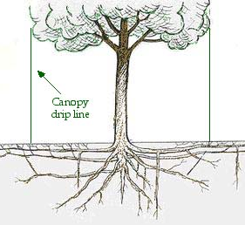
More about Irrigation
Initially have water source close to root ball – apply further out as tree becomes established
What happens with too much or too little water:
Under watering yields small fruit with sunburn tendency
Overwatering predisposes the tree to root and crown rots
Photo: UC ANR
Notes:
1. Watering correctly is critical to the development of good quality fruit and allows trees to preserve a natural resistance to fungal diseases.
2. Under watering produces fruit that is small, and fruit will tend to sunburn.
3. Over watering predisposes the tree to root and crown rots.
4. Initially the water source is close to the root ball. Apply water further from the trunk as the tree becomes established

Slide 18
Fertilizing
Typically most nutrients (except nitrogen) are available in local soil
In doubt – request a soil analysis (see resource list)
Mature citrus will require nitrogen: prior to bloom, then May-June, no later than August (may affect fruit quality)
Winter yellowing
Less fertilizer for dwarf or container trees
More is NOT better - over fertilization causes excessive new growth, makes tree susceptible to disorders such as bacterial blast
Notes:
1. Typically, most nutrients (other than nitrogen) are available in sufficient amounts in our soil. You can always request a soil analysis.
2. Most mature citrus will require regular fertilization with nitrogen. Nitrogen should be applied prior to bloom –usually January or February. A second application in May – June. Final application no later than August.
3. Avoid late season applications as it may affect fruit quality, delay coloring and make the rind rough.
4. Plants in containers with restricted roots may require less fertilizer.
5. Be careful not to over fertilize as this will cause excessive new growth, which makes trees susceptible to other disorders such as bacterial blast.

Slide 19
Fertilizer Smarts
Never add fertilizer to dry stressed plants which may damage or kill the plant
Always read and follow label directions:
Amount
Frequency
Precautions
Notes:
Fertilizer added to dry stressed plants may damage or kill the plant.
Always read the directions before using fertilizer. Follow directions.
Heed the precautions on the label.

Slide 20
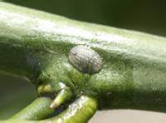
Occasional Pruning
Citrus are evergreen but do need occasional pruning
Keeps trees small to facilitate harvest & avoid ladders
Allows sunlight in to develop flavors and sugars
Dense canopy blocks sunlight and
prevents air circulation and
increases the risk of soft body
insects
Citricola scale - Photo: UCANR
Notes:
Citrus are evergreen but they do need occasional pruning.
Pruning will keep the trees small – the shorter the tree remains, the easier and safer it is to harvest the fruit.
Fruit needs sunlight to develop flavors and sugars. A dense canopy may not allow in enough sunlight. Prune crossing branches to get more light.
Soft body insects, such as scale, thrive in dense canopies.

Slide 21
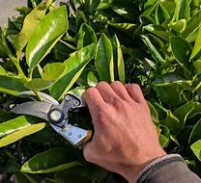
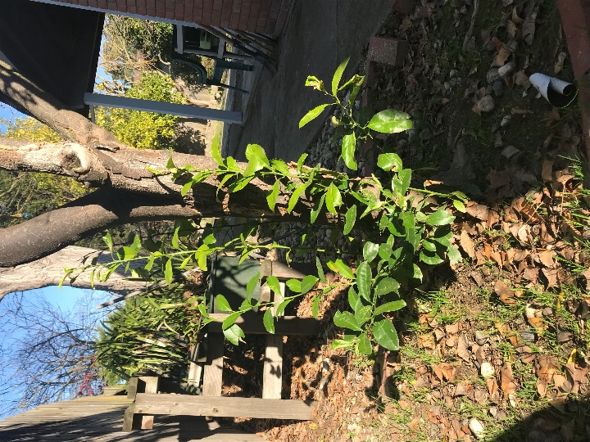
More About Pruning
Ideal time is just prior to bloom or just after fruit sets
Minor pruning can be done at any time - avoid late-season
Remove crossing branches
Prune suckers, water sprouts & dead wood anytime
Young trees
Prune frost damage in the spring
Photo: UC ANR
Photo: S. Fitzpatrick
Notes:
To ensure fruit production, the ideal time to prune is just prior to bloom or just after the fruit sets.
Minor pruning can be done anytime but avoid late season which can stimulate excessive tender growth that is likely to be injured by frost.
Remove crossing branches
Prune suckers which are a non-bearing wood and water sprouts. What is a water sprout? Water sprouts, are produced by dormant buds. They grow vigorously and vertically from the trunk or branch and will not bear fruit. They often produce long spikes.
Young trees do not require pruning.
Prune frost damage in the spring.

Slide 22
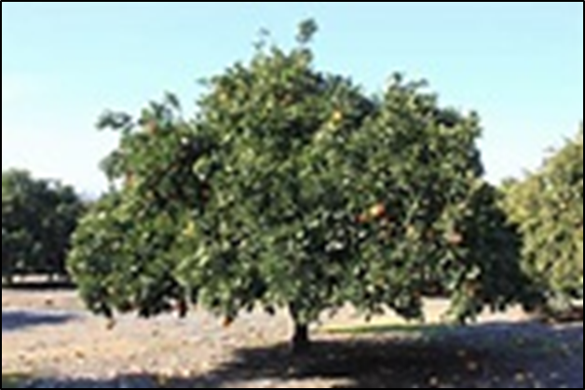
Skirt Pruning
Branches that hang to the ground can cause problems:
Impedes weeding, fertilization and compost application
Allows ants or soil borne pathogens that may cause plant disease
Skirt trees 1-2 feet above ground level
Photo: UCANR
Notes:
Skirt refers to branches that hang to the ground.
Skirts impedes weeding, fertilizing, and compost application.
With heavy fruit loads, branches bend and fruit touches the ground which allows ants to access the tree, may cause soil borne pathogens and may cause plant disease.
Skirt trees 50-75 cm above the ground.

Slide 23
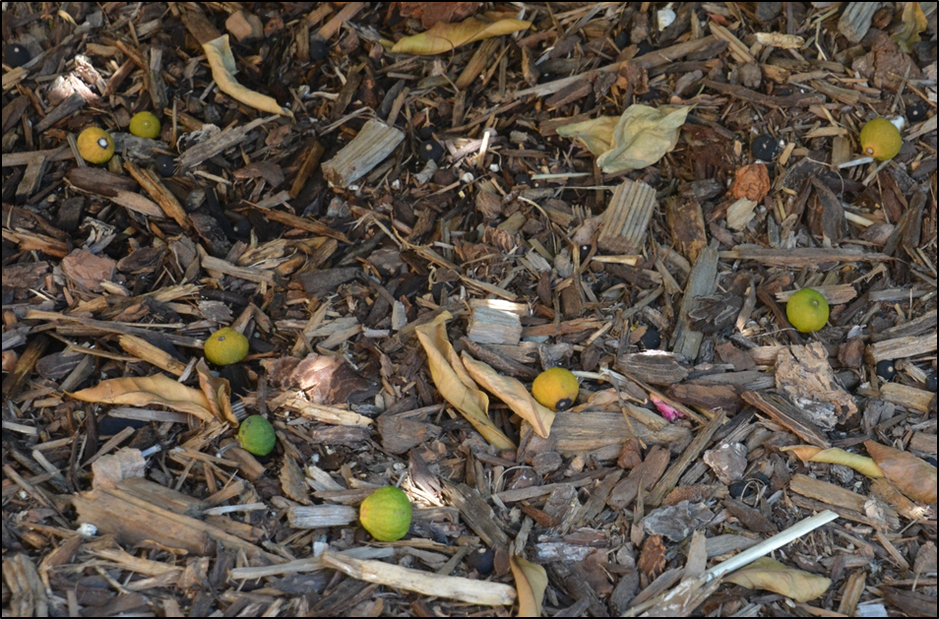
Fruit Thinning
Not necessary
Citrus naturally adjusts the amount of fruit it carries, so fruit drop early is normal
Excessive drop of older fruit may have several causes:
lack of water or fertilizer
heavy pruning
sudden temperature changes insect infestation
Photo: S. Fitzpatrick
Notes:
Fruit thinning is not required. Citrus naturally adjusts the amount of fruit carried on the tree, so some fruit drop is normal.
Excessive drop of older fruit may have several causes: lack of water or fertilizer, heavy pruning, sudden changes in temperature (especially sudden hot temperatures at fruit set or shortly after), or insect infestation.

Slide 24
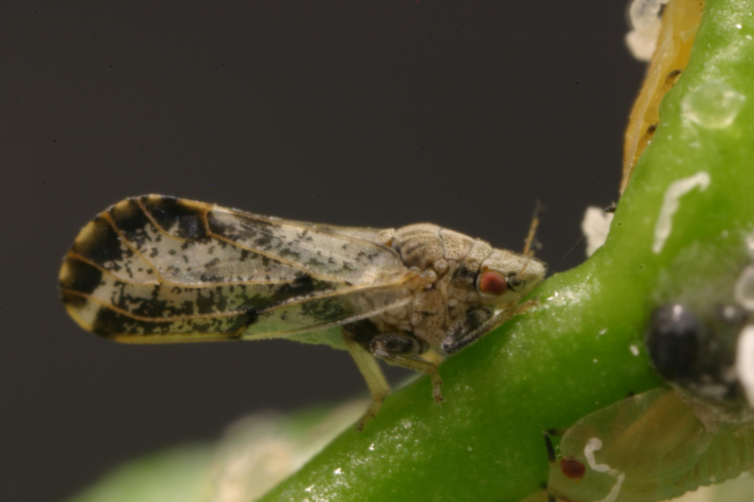
Asian Citrus Psyllid (ACP)
Adult & Nymph (under shoot)
Photo: UCANR
ACP is a tiny aphid sized insect, a winged invasive species.
First detected in 1998 Florida – in California a decade later.
Notes:
No presentation on citrus can leave out the Asian citrus psyllid. This photo is of an adult and nymph.
ACP is a tiny aphid sized insect, a winged invasive species, that was first detected in Florida in 1998 and then in California a decade later.

Slide 25
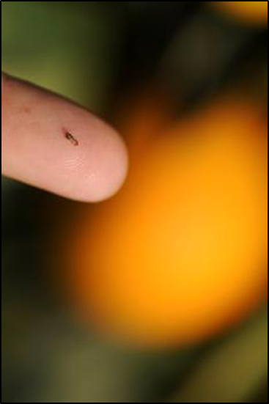
ACP & HLB
ACP found in Placer County in 2016
January 2018 - county quarantine for bulk citrus and nursery stock
ACP can damage trees by feeding but its major threat is that it carries Huanglongbing, (HLB) a disease that is deadly to citrus
Photo: UC ANR
Notes:
ACP was found in Placer County in 2016 and again in 2017 – resulting in a county quarantine for bulk citrus and nursey stock in January of 2018.
2. ACP can damage trees by feeding, but its major treat is that it carries Huanglongbing, a disease that is deadly to citrus.

Slide 26
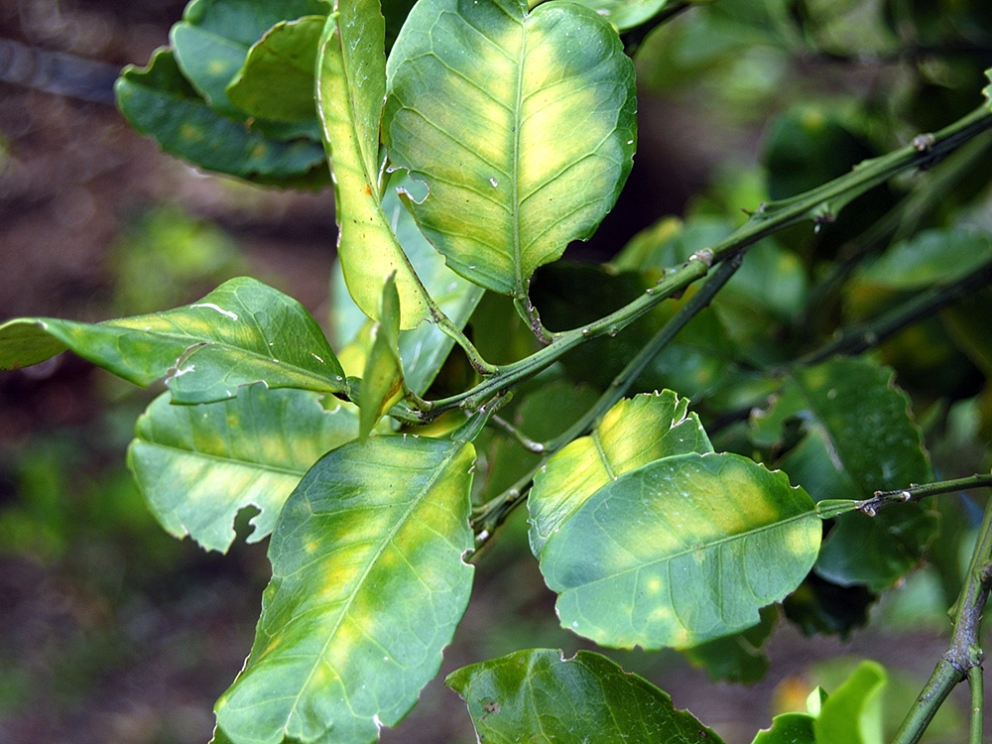
Huanglongbing (HLB) (Citrus Greening)
No known cure - can kill a tree in 5 years
Affects all commonly grown citrus varieties
Leaf symptoms: non-symmetrical leaf yellowing and splotchy yellow spots
Fruit symptoms: uneven ripening and bitter taste
The only way to protect trees is to prevent the spread of the HLB by controlling psyllid populations and destroying any infected trees.
Photo: UC ANR
Notes:
HLB can kill a citrus tree in as little as 5 years. There is no known cure or remedy. All commonly grown citrus varieties are susceptible to the pathogen.
HLB is transmitted to healthy fruit trees by the psyllid after it feeds on infected plant tissue.
Leaves with HLB disease have a blotchy yellow pattern that is not the same on both sides of the leaves. In general, look for splotchy yellow spots, leaf yellowing, bitter fruit or fruit that does not ripen evenly. Ultimately the tree dies.
4. The only way to protect trees is to prevent the spread of the HLB pathogen by controlling psyllid populations and destroying any infected trees.

Slide 27

Inspection & Reporting
Inspect trees monthly
Report suspicious leaves or fruit to California Department of Food and Agriculture –Pest Hotline
Pest Hotline
1-800-491-1899
Notes:
1. Learn to recognize the insect, and inspect your citrus trees monthly especially when growth is present.
2. Report suspicious leaves or fruit to CA Department of Food and Agriculture’s Pest Hotline 1-800-491-1899

Slide 28
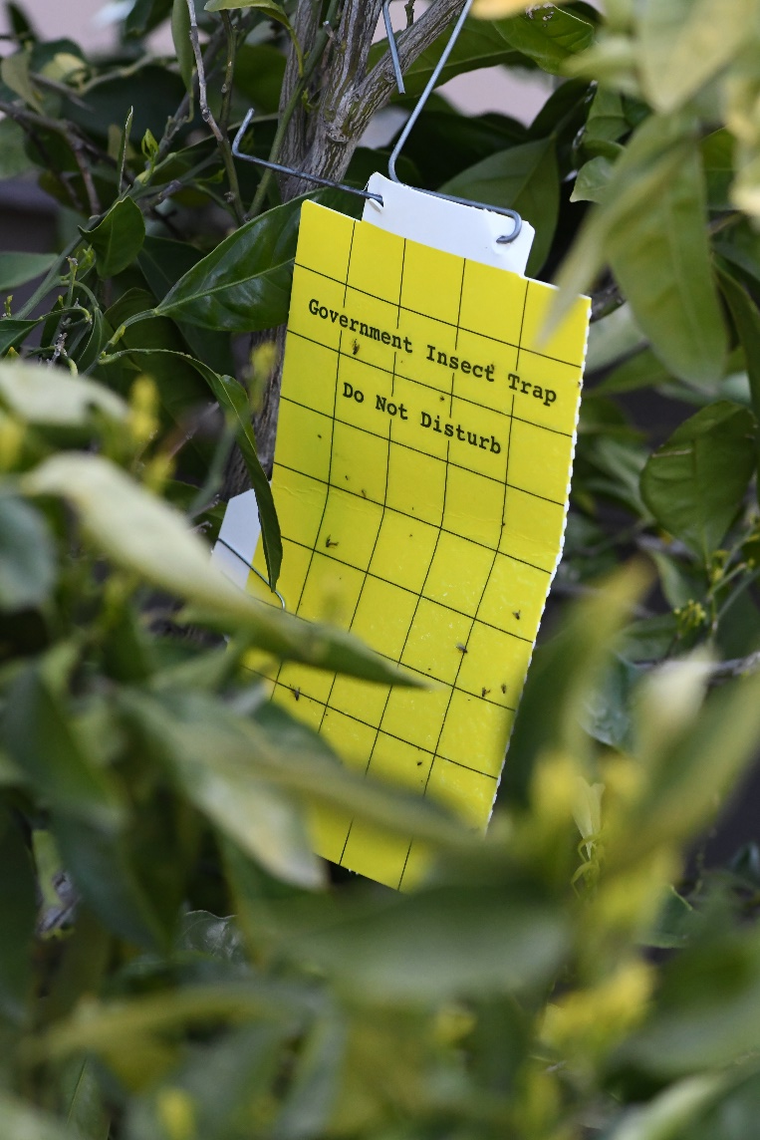
Placer County Insect Trapping
P.C. Dept. of Agriculture’s on-going insect trapping program
Will trap for ACP during the growing season
Traps will stay for 8 weeks
Photo: S. Fitzpatrick
Notes:
1. The Placer County Department of Agriculture and CA Dept. of Food and Agriculture conduct an ongoing insect trapping program.
2. During the citrus growing season, they traps are used to detect ACP.
3. Traps will stay for 8 weeks before being relocated.

Slide 29
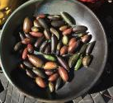
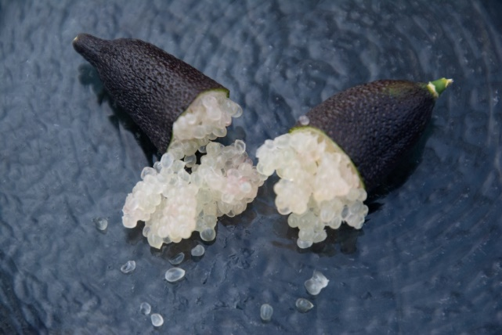
Perhaps some hope
Finger limes have natural immunity
Researchers have identified the gene that causes immunity and created an antibiotic that has killed the disease in a controlled environment
Finger limes, small elongated fruit
Grown in Placer County
“Caviar of fruit”
Photos: S. Fitzpatrick and Dale Kuroda
Notes:
Citrus trees may be saved thanks to natural immunities found in a rare and flavorful relative known as the Australian finger lime.
Scientists at UC Riverside have identified which gene in the finger lime causes that immunity and extracted it to create an antibiotic that has killed the disease in young trees raised in laboratories and controlled environment greenhouses. Unfortunately, we are still a long way from a cure.
Finger limes (top photo) are small, elongated fruits in the citrus family. The thin skin is semi-smooth with a leathery, pebbled texture, and can range in color. It has been nicknamed the “caviar of fruit”. The pulp consists of may small pearls (bottom photo) that when consumed create a popping sensation and a burst of sweet-tart flavors.
Finger limes are grown in Placer County, look for them at farmer’s market in late fall.

Slide 30
Pest Management
Foothill citrus are less prone to insect and disease pests
To learn about CA-specific citrus pest information the integrated pest management (IPM) link is included in the resource document
Avoid pest information from other states given CA’s restriction on the use of many pesticides
Use the MGPC hotline for specific questions as they arise (530) 889 - 7388
Healthy Trees, with good soil drainage, typically require no pest management
Notes:
We are fortunate to live in Placer County where citrus trees generally have fewer insect and disease pests. We already mentioned scale as one insect. Prevention includes removal of dense canopies.
However there are some key pests that affect citrus in California. To learn more on California-specific information look on the resource page for the integrated pest management (IPM) link. Do not use pest management information from other states due to other pests and California's restriction on the use of many pesticides.
One handout we have for you today is a quick guide to identifying pests on citrus trees.

Slide 31
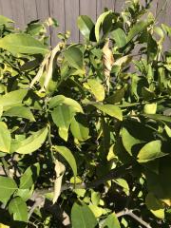
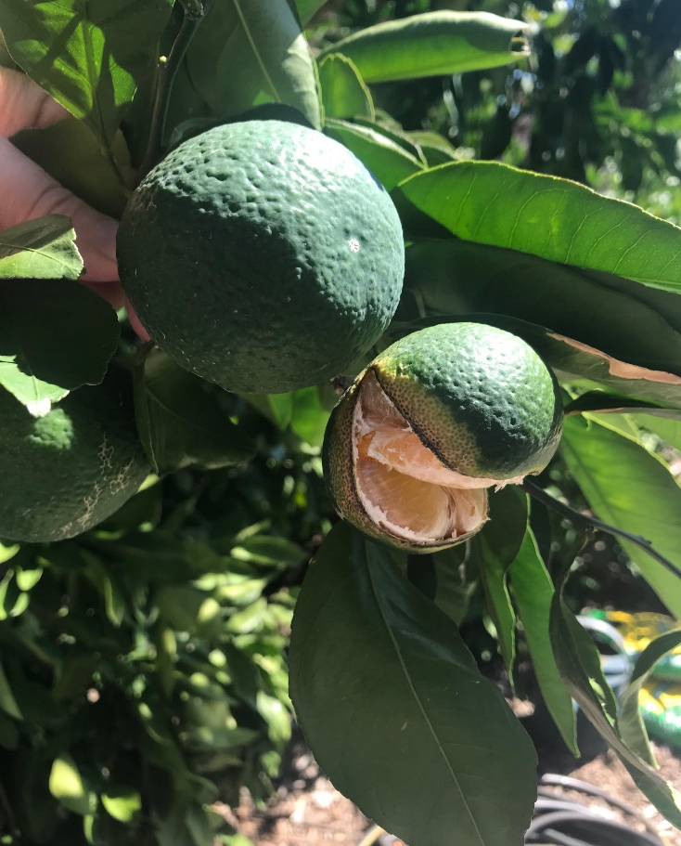
Weather Impacts
Photos: S. Fitzpatrick
Wind damage
February 2021
Excessive Rain
September 2021
Notes:
Sometimes weather conditions impact our trees and fruit. Here are 2 examples.
The picture on the left shows brown dried, curled leaves. Most likely caused by a wind storm a week ahead of the picture.
The picture on the right shows cracked immature mandarin fruit. Rinds split at the bottom of fruit after tree stress, such as extreme weather, inappropriate irrigation, and potassium deficiency.

Slide 32
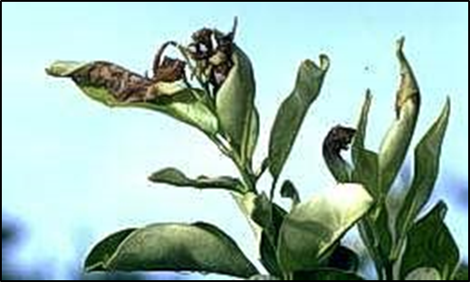
Low Temperature Tree Protection
Effect:
Freezing temperatures damage plants by causing ice crystals to form in their cells and vegetation withers and turns dark
Prevention:
Irrigate well prior to freeze as wet soil maintains temperature
Cover young trees with burlap or row cover (3 years)
Incandescent lights
Photo by: UC ANR
Notes:
Freezing temperatures damage plants by causing ice crystals to form in their cells.
2 Vegetation withers and will turn dark brown.
Irrigate well prior to frost. Wet soil maintains its temperature and moderates air temperature above it.
Cover young trees (at least for the first 3 years). Use burlap or row cover . Entirely cover the plant but do not touch the foliage. Touching the foliage may case more damage because of condensation. Remove cover after temperatures rise each morning.
Strings of small incandescent lights can be used to protect a single tree.

Slide 33
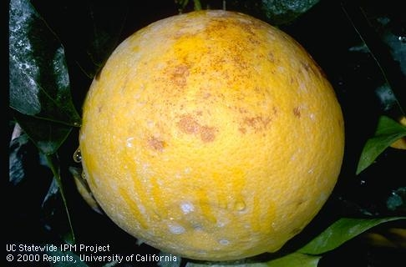
Low Temperature Fruit Protection
Effect:
Ice crystals form in fruit, causing juice vesicles to rupture and fruit to dry out
Fruit is edible after a freeze, but is susceptible to decay and will quickly become unusable
Prevention:
Leaves & fruit most sensitive
Trees with fruit less tolerant
Pick fruit before a freeze
Photo: UC ANR
Notes:
Fruits are more sensitive to cold than the wood or leaves. Ice crystals form in fruit, causing juice vesicles to rupture and fruit to dry out
Frost damage fruit is edible after the freeze but is susceptible to decay and will quickly become unusable.
Leaves, green wood and fruit are more frost sensitive than hard wood. Trees with fruit are less tolerant to frost than trees without fruit.
Picking fruit ahead of frost will not only save the fruit, but will help protect the entire tree as well.

Slide 34
Resource Links
Growing Citrus in the Sierra Nevada Foothills:
http://pcmg.ucanr.org/files/171585.pdf
Managing Pests:
http://ipm.ucanr.edu/PMG/GARDEN/FRUIT/citrus.html
Citrus Overview:
http://homeorchard.ucanr.edu/Fruits_&_Nuts/Citrus/
Diseases and Disorders of Leaves and Twigs:
http://ipm.ucanr.edu/PMG/C107/m107bpleaftwigdis.html
Huanglongbing or citrus greening:
https://www.placer.ca.gov/1554/Mandrin-Threat
Irrigation:
http://ipm.ucanr.edu/PMG/GARDEN/FRUIT/CULTURAL/citruswatering.html
Soil Testing Labs for the Home Gardener:
https://ucanr.edu/sites/ucmgplacer/files/262734.pdf
Notes:
1. This resource list provides additional information on many of the topics presented today and will be available on our website: pcmg.ucanr.org

Slide 35
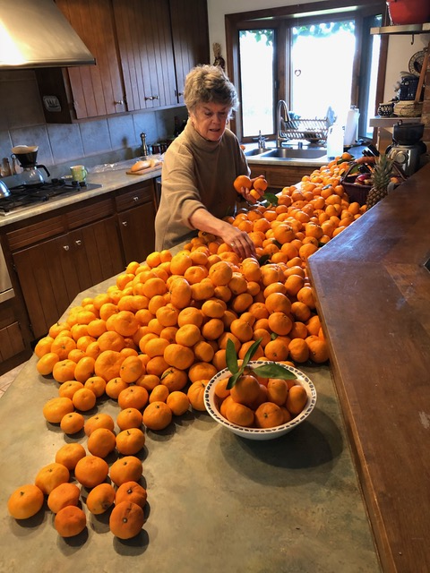
SUCCESS!
Jan with her bumper crop of owari satsuma mandarins!
Photo permission by Jan White
Notes:
This is a photo of master gardener Jan with her just harvested owari satsuma mandarins. I think most are going for juice.

Slide 36
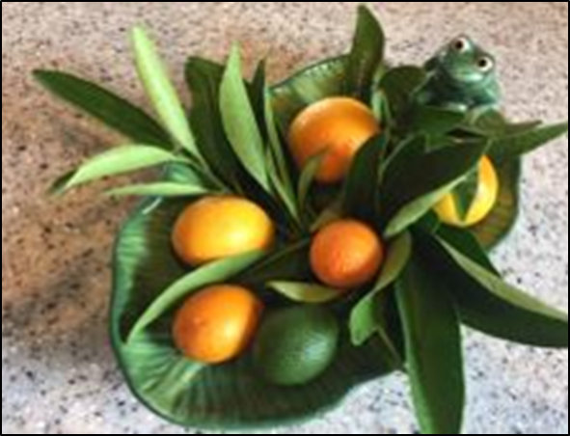
Tips for Successful Citrus Growing
Buy trees from local nurseries only
Select sunny location, plant and mulch
Adequate irrigation
Nitrogen application to encourage growth
Occasional pruning
Recognize signs of ACP/monitor monthly
Pest management resources/hotline
Frost protection
All that’s left is to let the tree provide you with the best fresh fruit, for picking and eating, fresh squeezed orange juice for breakfast, marmalade, jellies, perhaps limoncello and lemon nut bread for dessert.
Photo: Gail Fitzpatrick
Notes:
Let’s review the tips we discussed today for successfully growing citrus in Placer County.
And, now, what’s left is to let the tree provide you with the best fresh fruit, for picking and eating, fresh squeezed orange juice for breakfast, marmalade and jellies and lemon nut bread for dessert.

Slide 37
Thank You!
Any Questions?
Master Gardener Hotline: (530) 889-7388
Master Gardener Website: pcmg.ucanr.org

