Slide 1

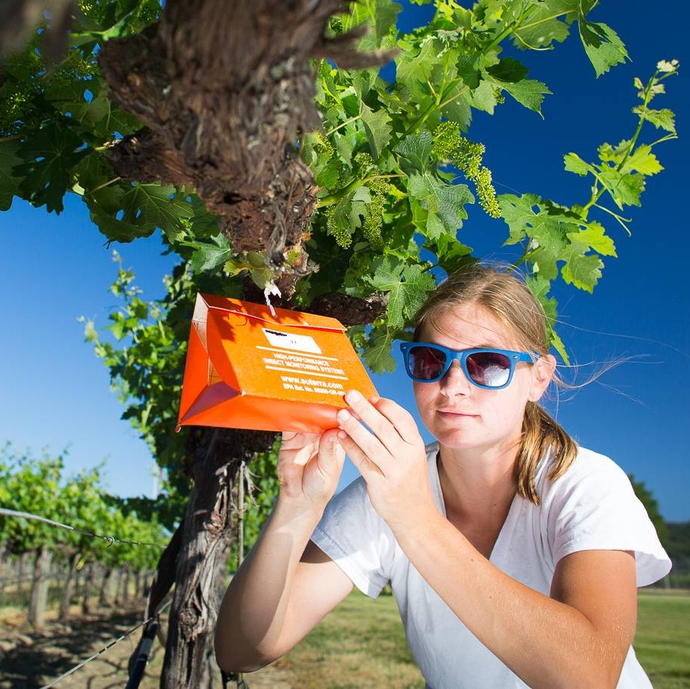


SITUATION ASSESSMENT
Where are we today?
UC ANR Strategic Planning Retreat
January 28, 2020

Slide 2




UC ANR Today
UC ANR brings the power of UC directly to Californians by serving communities in all 58 counties.
UC ANR research & education programs support:
Sustainable, safe, and nutritious food
production and delivery
Economic success in a global economy
A sustainable, healthy, and productive environment
Science literacy and youth development

Slide 3
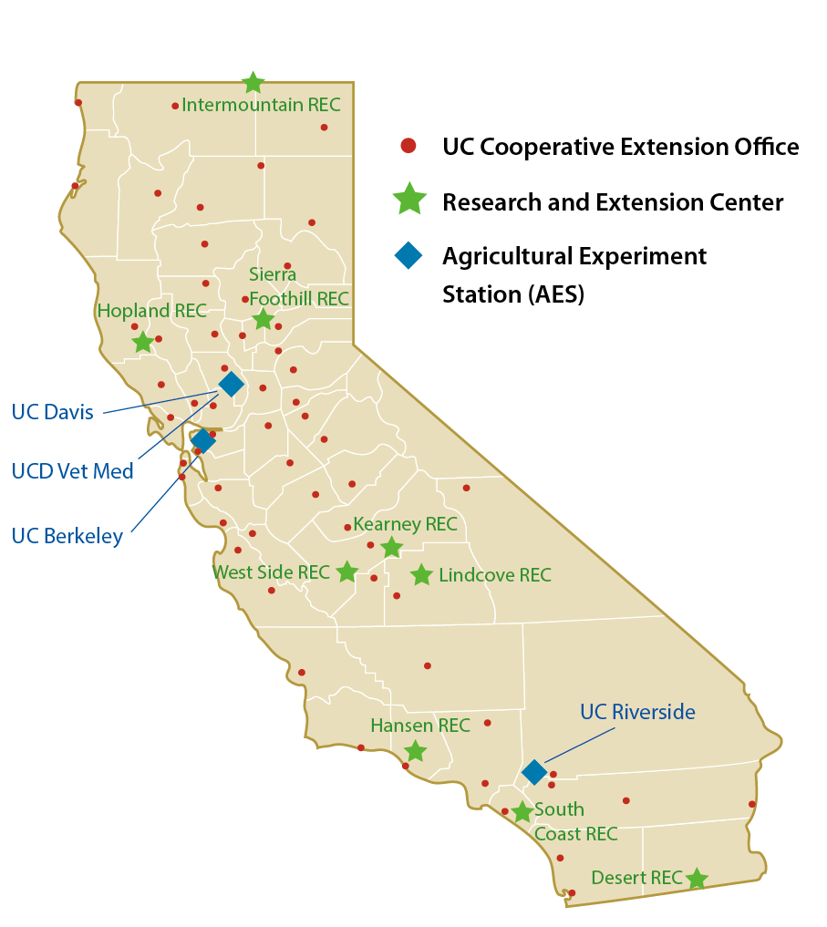
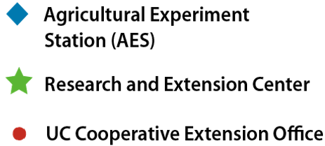
UC Cooperative Extension
175 Advisors who live and conduct research in the communities they serve
115 campus/county-based Specialists working with campus faculty
350 Community Educators sharing information and delivering programs
Programs are delivered in all 58 California counties
Research and Extension Center System
Nine locations statewide; 13,000 acres
Represents California’s diverse ecosystems
Over 375 research projects annually
Agricultural Experiment Station
600+ researchers located on three campuses
Over 1,300 research projects annually

Slide 4












UC ANR Statewide Programs & Institutes
Nutrition Policy Institute
Informatics & GIS
Agricultural Issues Center
CalFresh Healthy Living
Integrated Pest Management
CA Institute for Water Resources
Expanded Food & Nutrition Education
Sustainable Ag Research & Education
Statewide Programs Utilizing Volunteers
4-H Youth Development
Master Gardeners
California Naturalists
Master Food Preservers
Over 26,300 volunteers contribute 1,144 FTE — equivalent to $71.1 million in donated public service each year

Slide 5






UC ANR Snapshot: 2018 Overall Program Metrics
> 1,000 publications and new educational materials produced
18 novel ideas led to patent applications filed
820,000 adult and youth direct contacts/ educational exchanges
8.7 million web page views for UC IPM
> 100,000 classes, courses, workshops, and field days delivered throughout the state
Notes:
Glenda - from KWM regarding the 22 patent applications: We only have data for the lead inventor. None were invented by advisors or 100%
specialists. One was by a AES/CE Specialist split appointment (Georgios Vidalakis at UC Riverside)

Slide 6
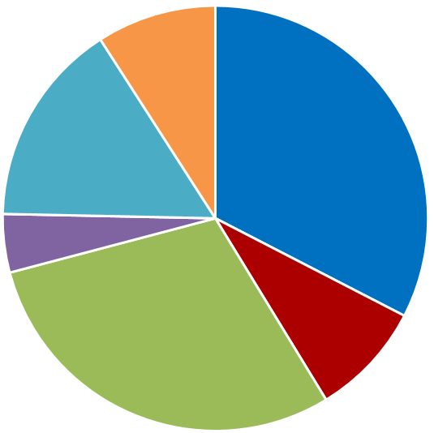
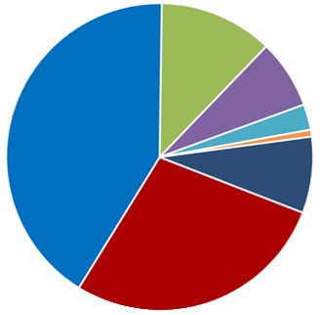
UC ANR BUDGET FY 2019-20 (in millions)
FUND SOURCES = $222.8M
FUND USES = $222.8M
County Funds
$20.3M
9%
Research &
Extension
Centers
$16.1M
7%
Statewide
Programs*
$26.7M
12%
Other
Sources*
$34.7M
15%
State Funds
$72.6M
33%
Endowment
Income
$9.5 M
4%
County-based Research & Extension
$92.2M
41%
Institutional
Support
$6.0 M
3%
Administration
$17.8M
8%
UCPath
$1.6 M
1%
Competitive Grants
& Extramural
$66.0M
30%
Federal
Funds
$19.4M
9%
Campus-based
Research & Extension
$62.3M
28%
*Other Sources
include: Private Gifts,
Sales & Services, Crop Income, Investment & Other Program Income.
*Statewide Programs include: 4-H & Youth Development, Agricultural Issues Center, California Naturalist, Expanded Food Nutrition Education, Integrated Pest Management, Informatics & Geographic Information Systems, Master Gardener, Master Food Preserver, Sustainable Agriculture Research Education Program, Nutrition Policy Institute, Water Resources Institute

Slide 7
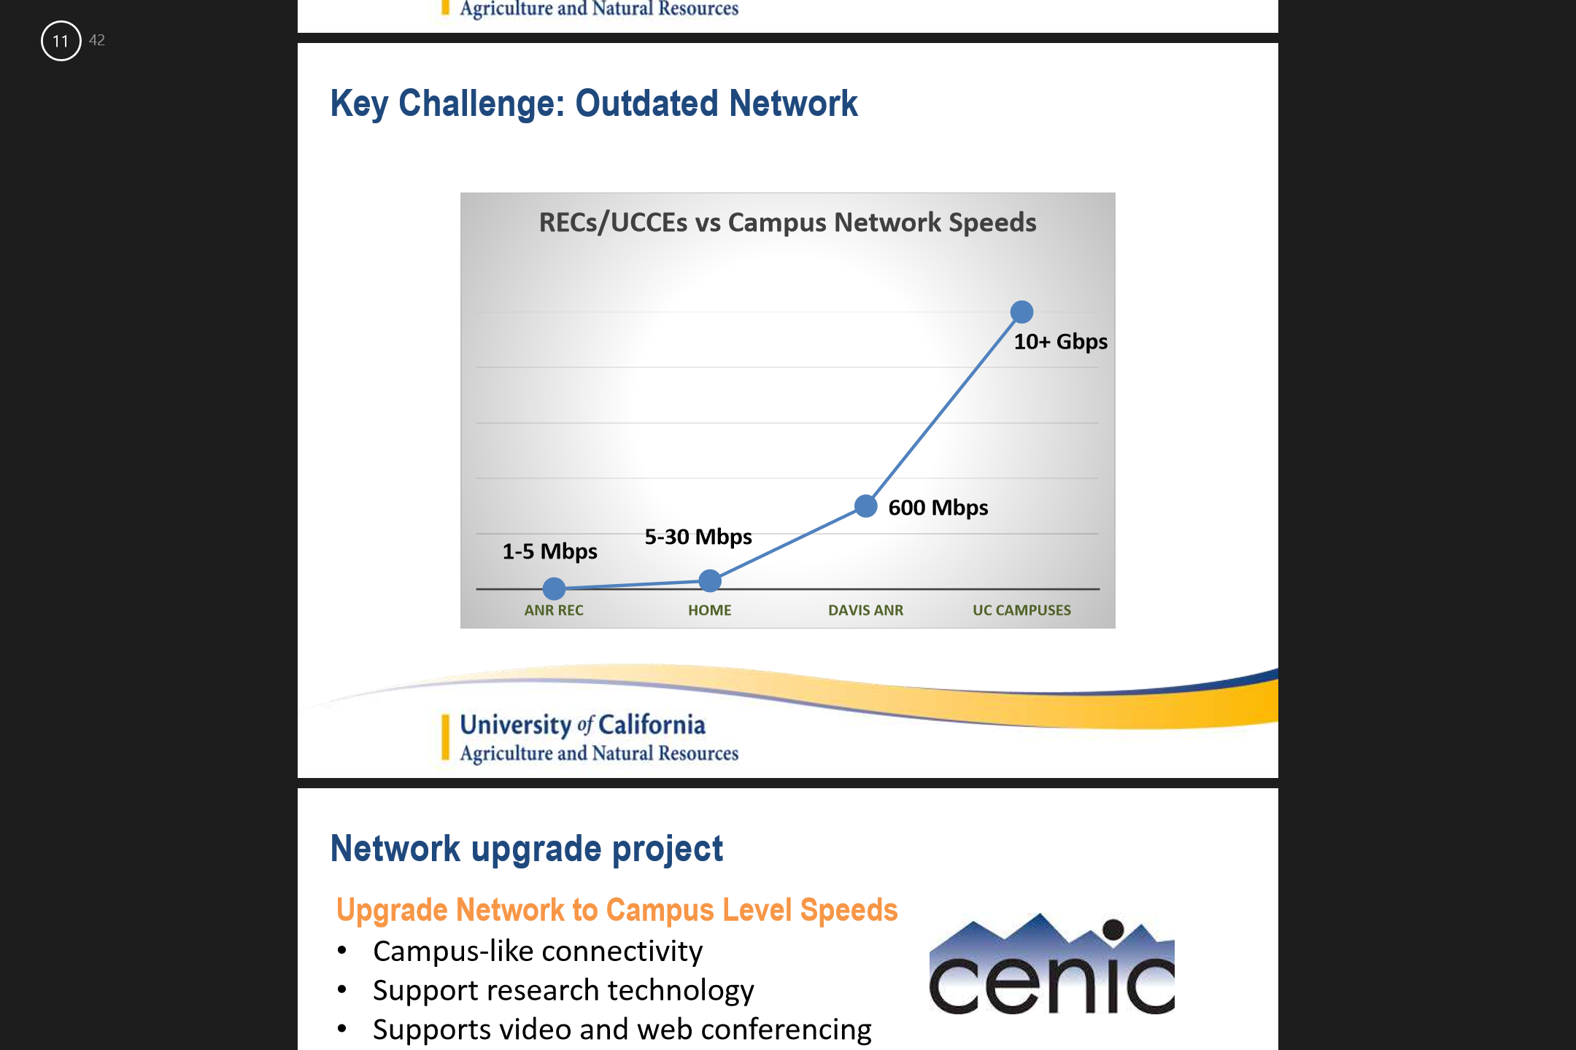
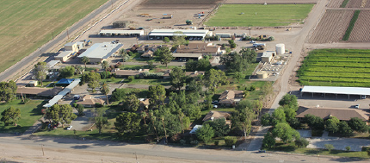
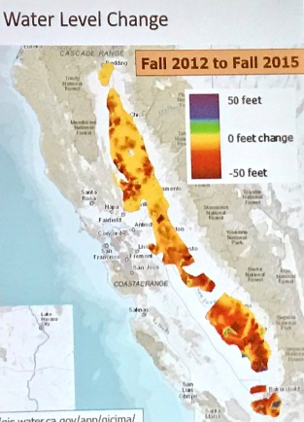

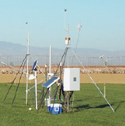
Where Were We in 2016?
20+ years of flat or declining budgets
Shrinking UCCE academic footprint
Decades of deferred maintenance
Need to diversify and expand funding sources
Lacking integrated planning process to support prioritizing investments across the Division
Increasing complex challenges facing California

Slide 8
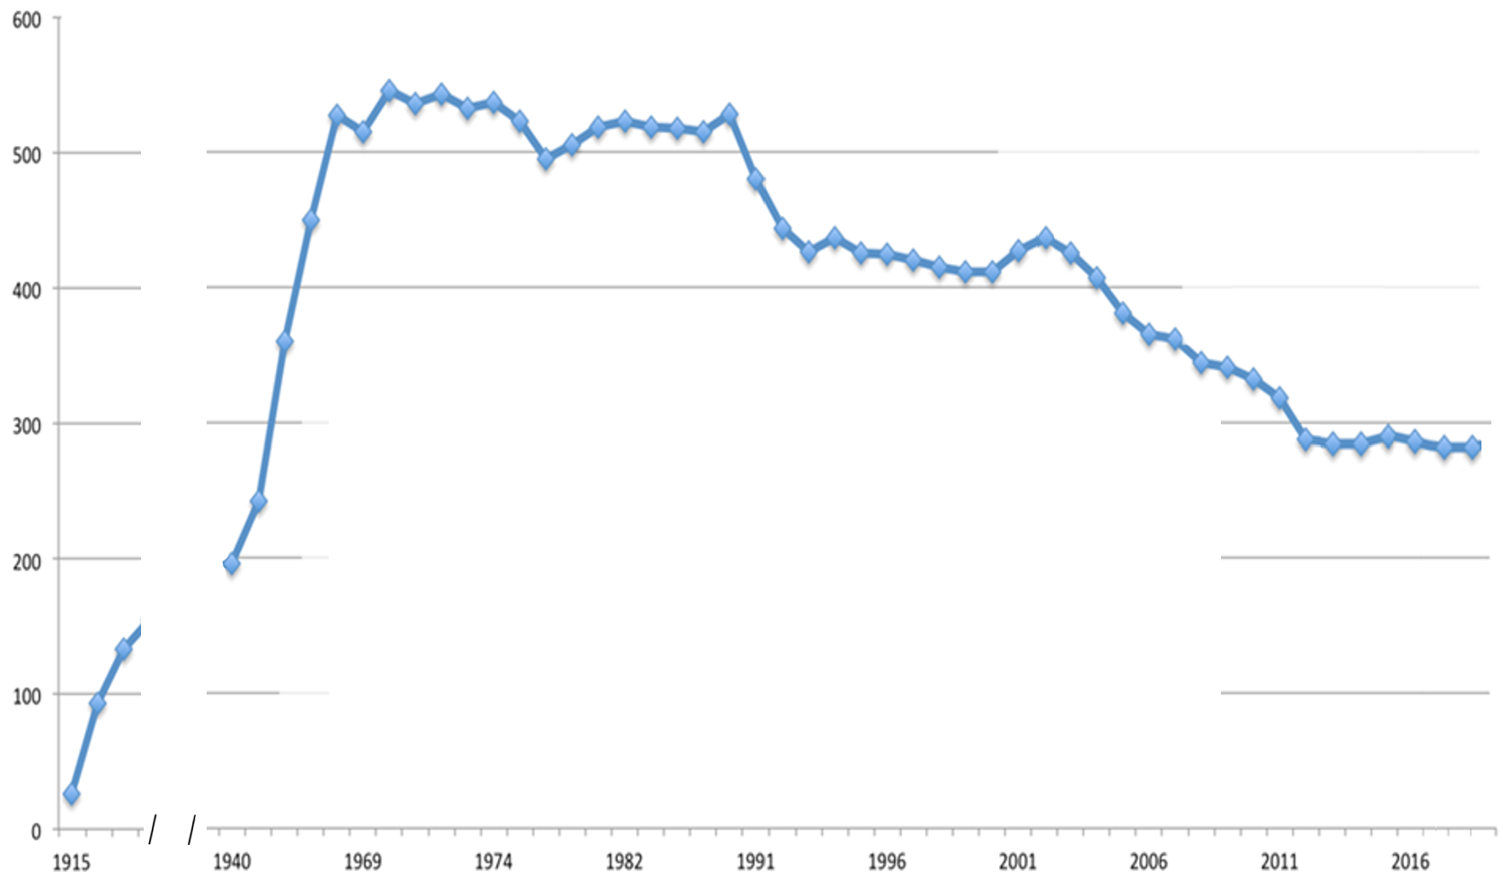

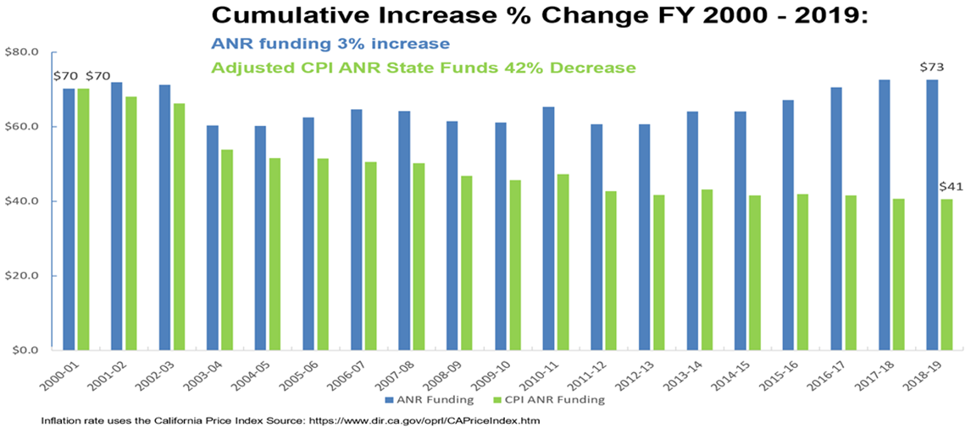
UCCE Academics in 1990
202 Specialists, 326 Advisors
UCCE in 2019
123 Specialists
164 Advisors
The 1914 Smith-Lever Act creates Cooperative Extension
Number of UCCE Academics
Academic counts are rounded

Slide 9

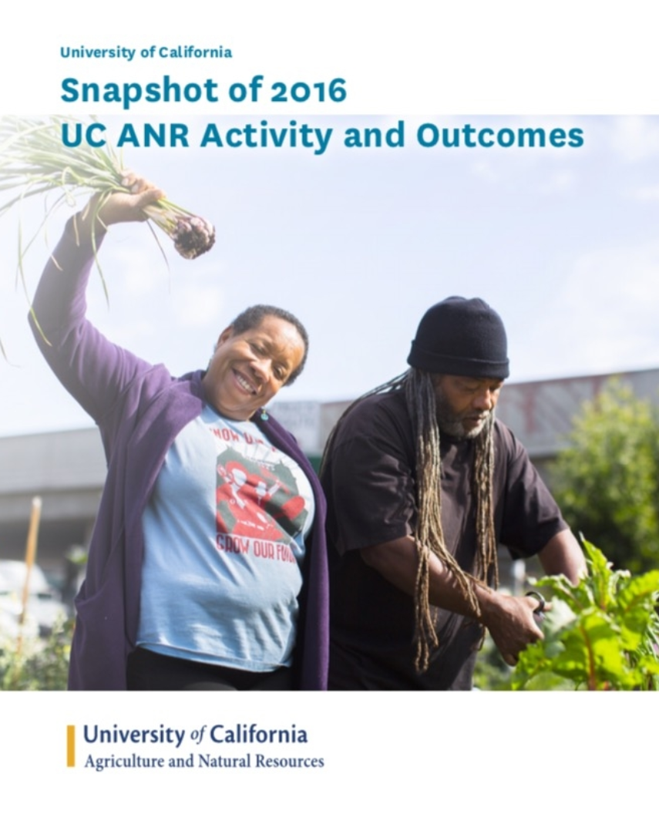
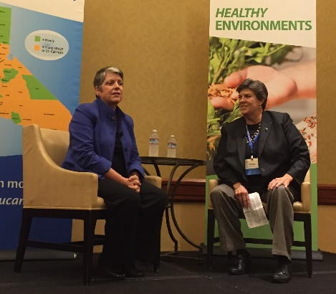
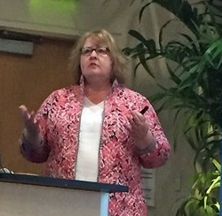
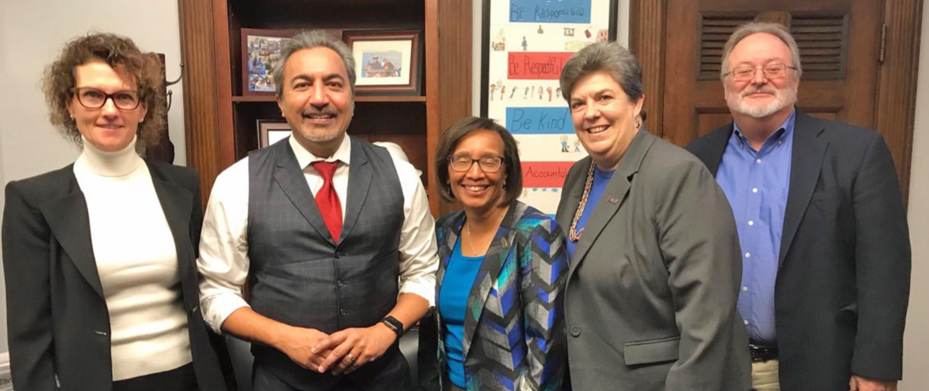

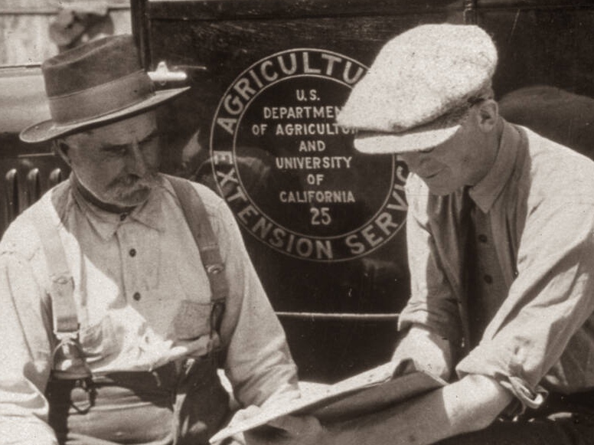
Where Were We in 2016?
Recent Changes in leadership at UC and UC ANR
Restructuring the UC ANR leadership structures
Expanding Development Services and Grants Support
Rebuilding relations with campuses: updated MOUs on processes and collaboration
Clarification on state funding model for UC ANR
Looking to the second century of UCCE!

Slide 10
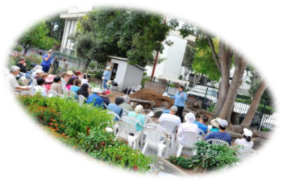
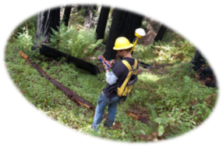


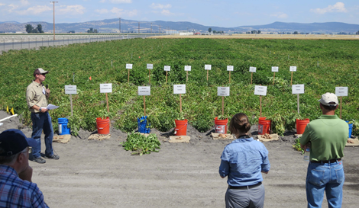

Opportunities Identified
New partners, non-traditional resources, improved visibility
Reach more Californians – expand number and diversity of audiences
Emerge as a single unified business unit; capitalize on new technology
Recapitalize, retool, reinvest in facilities and infrastructure
Ensure delivery and services are relevant
Remember our mission – be a catalyst

Slide 11

UC ANR Strategic Vision 2025
UC ANR Strategic Plan
2017 – 2022
Designed to enhance operations and delivery of the mission
Adopted in 2009 from field hearings and input from stakeholders
Five strategic initiatives for programs and research:
Research and Extension
People
Endemic and Invasive Pests and Diseases
Healthy Families and Communities
Sustainable Food Systems
Sustainable Natural Ecosystems
Water Quality, Quantity and Security
Financial Stability
Administrative Excellence
Value of UC ANR

Slide 12
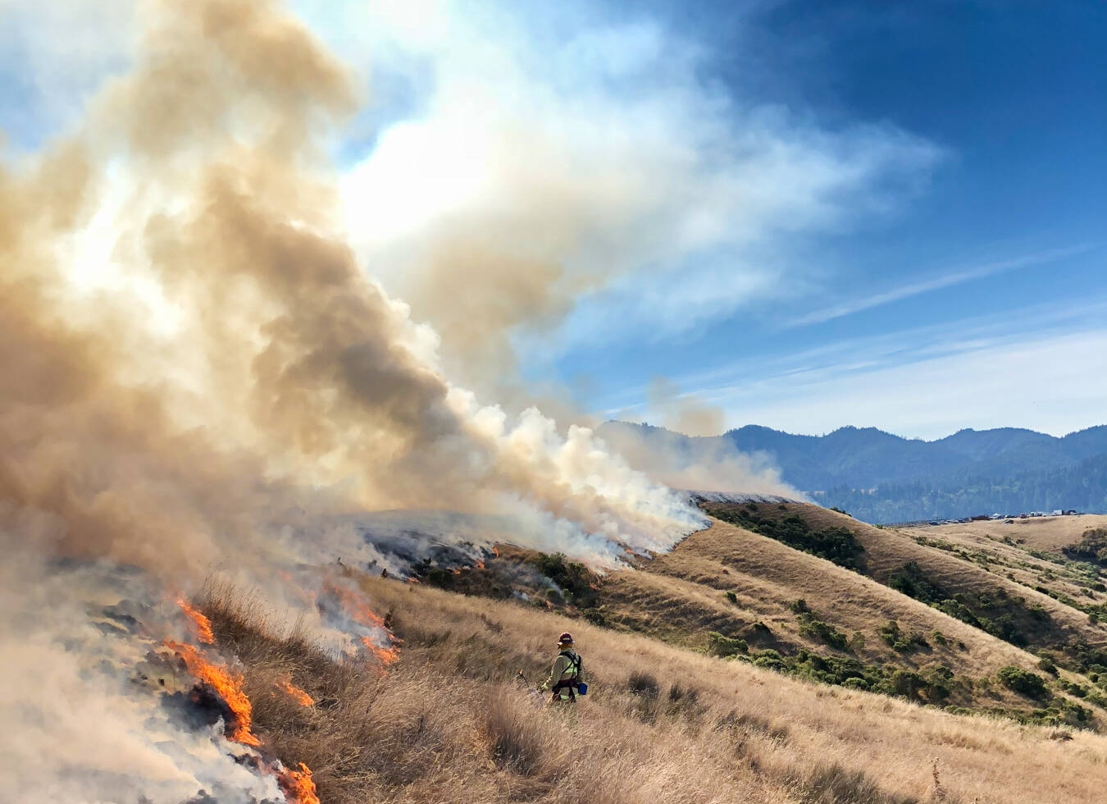
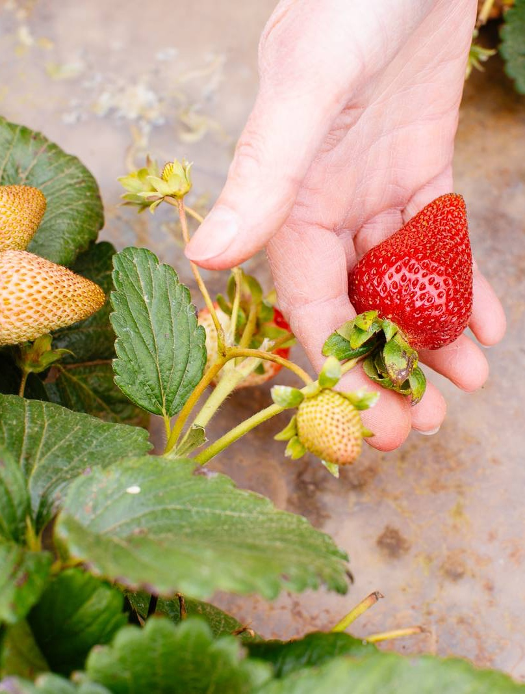
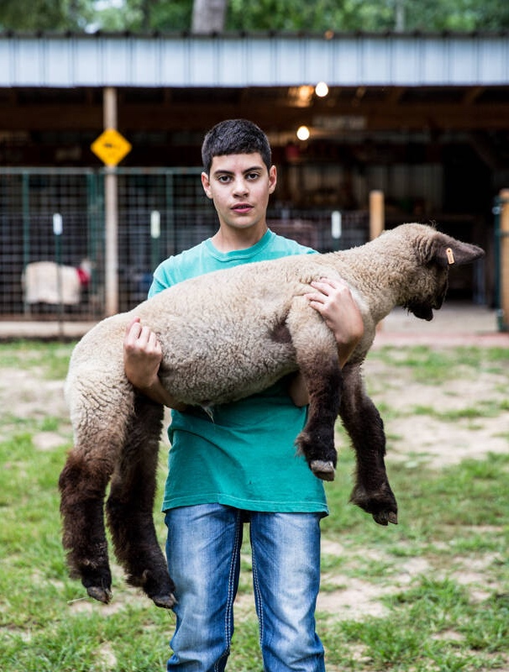
Steps to Handle FY 2016-20 Budget Cuts
Slowed hiring of UCCE Advisors & Specialists
Delay hiring of staff and equipment purchases
Statewide programs have reduced budgets
RECS reducing subsidy of research projects
ANR competitive grants program cancelled 2018 & 2020

Slide 13
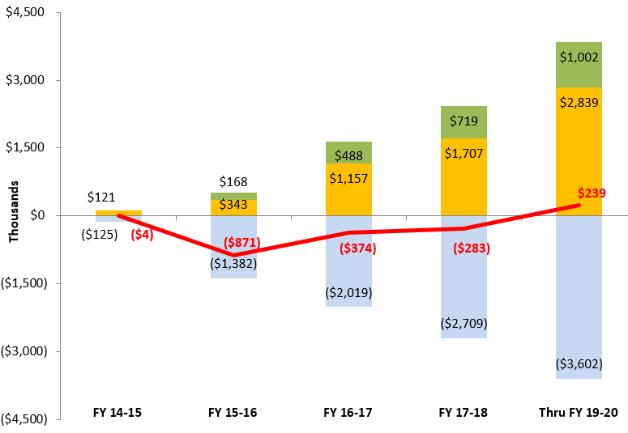
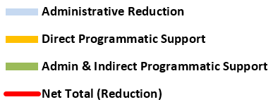
Administrative Efficiencies & Savings are Re-invested in Programmatic Support
TODAY:
Investment Strategies
Invest in advisor & staff compensation
Enable technology modernization
Increased support to UCCE research proposals
Cost Strategies
Reorganized units
Reengineered business processes
Consolidated functions
Reduced # of facilities
Notes:
Analysis summarizes the administrative effort to reduce permanent FTE (salary & benefits) or administrative efficiency and redirect the funding to programmatic support through the hiring of key programmatic positions.
In FY 15-16, CSIT Warehouse lay-off $479K, CSIT Web reorg $772K, Human Resources reorg $272K. Administrative efficiency was redirected to direct programmatic support $342K & $168K indirect programmatic/administration.
Examples of Direct Programmatic support include hiring of Vice Provost Cooperative Extension $221K, Vice Provost of Statewide Programs $211K, and Project Policy Analyst Kit Alviz $120K
Examples of indirect programmatic/administration include hiring of Analyst Vanity Campbell from Contracts & grants $122K and Analyst Kimberly Ingram from Academic personnel Office $45K.
In FY 17-18, Business Operation Center reorg $482K, CSIT Publication & Administration reorg $389K,
As part of their strategic plan, the REC system will return $354K of perm funds in FY 17-18 and $947K by FY 19-20.
The division invested in the academic advisory salary program starting in FY 16-17 $460K and will continue through FY 19-20 totaling $2.1M.
The division invested in the staff market based program starting in FY 16-17 $320K and will continue through FY 19-20 totaling $834K.

Slide 14

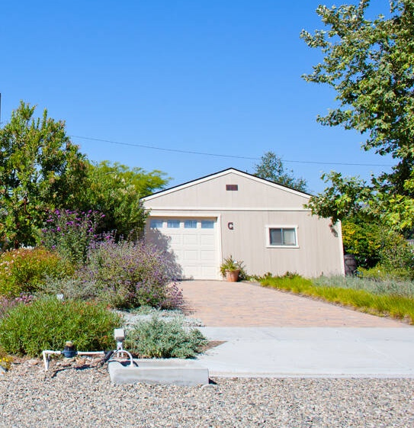
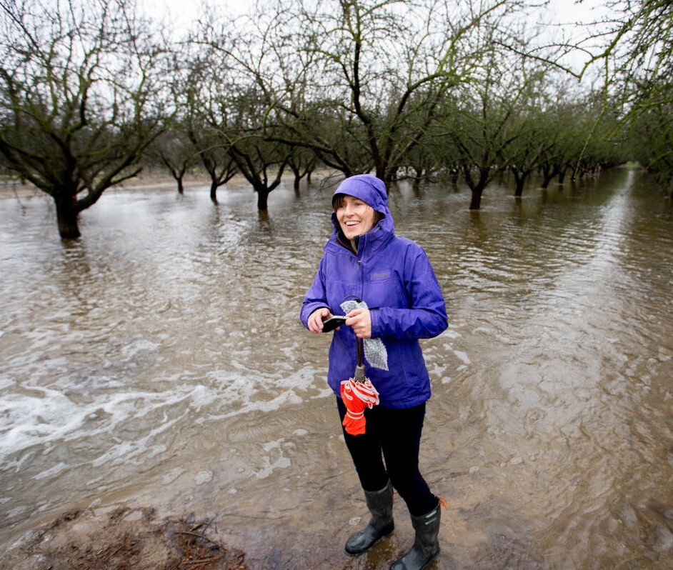
Steps to Expand Programs and Serve the Mission
Develop new sources of funding, expand partnerships and leverage resources:
Identify opportunities for Fee-for-Service
Seek partners to fund Shared Positions
Capture and grow Endowments
Design and implement New Events
Expand Contracts and Grants
Build support for Philanthropy

Slide 15
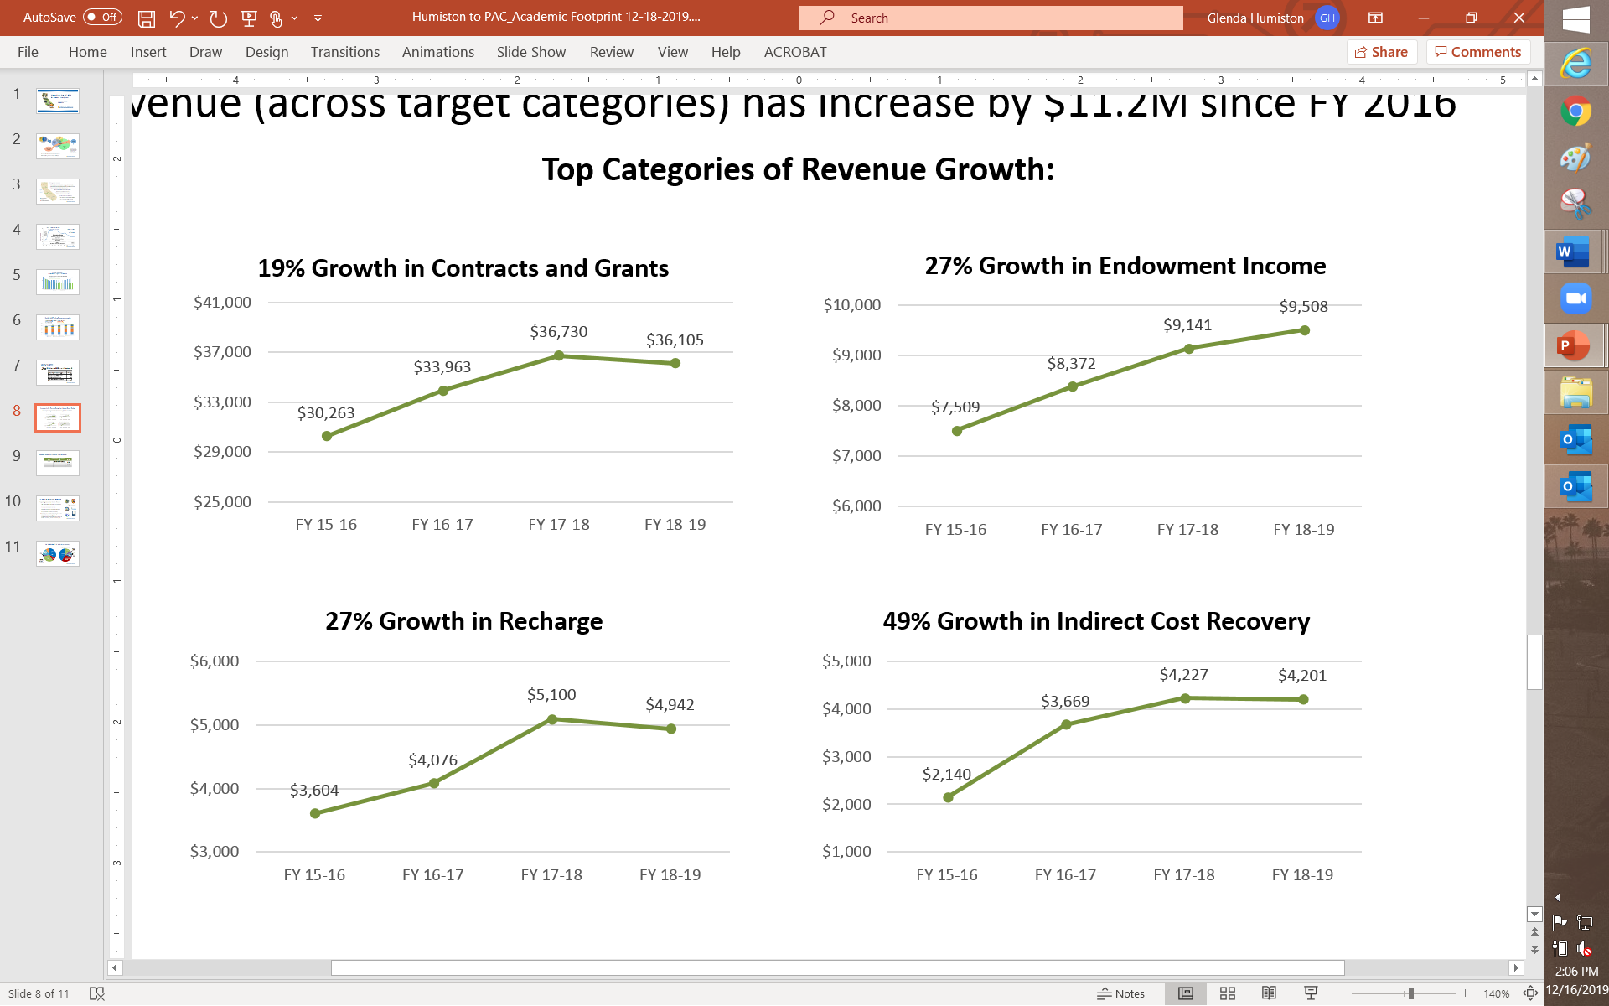
TODAY:
Increases in Key Revenue Categories Help the Overall Budget
Revenue (across target categories) has increased by $11.2M since FY 2016
1990’s
took
Cuts
1990’s
took
Cuts
Notes:
Sources: Science and Service: A History of the Land-Grant University and Agriculture in California; A F Scheruing
Academic Staff Activity By Program Area and Year doc; Management Information System
UC Corporate Staffing list and annual USDA Smith-Lever Budget report
Unfunded obligations include increased health care costs, pension liability, academic merit and promotion

Slide 16
TODAY:
Working to Decrease Reliance on Traditional Funding Sources
Non-traditionally Funded Positions 2017-19
Position | Funder | Salary Savings
9 Academics | CA Table Grapes Commission (2), CA NRCS (2), UC Merced (1), UC Santa Cruz (1), Santa Clara County (1), San Mateo County (1), Imperial County (1) | $700K per year for 5 years
14 Programmatic Staff Positions | California Department of Food & Agriculture | $2M per year for at least 3 years
22 Positions Total |  | $2.7M+ per year
1990’s
took
Cuts
1990’s
took
Cuts
Notes:
Sources: Science and Service: A History of the Land-Grant University and Agriculture in California; A F Scheruing
Academic Staff Activity By Program Area and Year doc; Management Information System
UC Corporate Staffing list and annual USDA Smith-Lever Budget report
Unfunded obligations include increased health care costs, pension liability, academic merit and promotion

Slide 17







TODAY:
Supporting State Agency Missions through Partnerships
Joint research projects and subject matter experts
Training in pesticide safety, vegetation management, fire suppression, irrigation and more
Developing educational materials and programs
Mapping future fire probability under climate change scenarios to address public safety
Promoting use of agricultural lands for groundwater recharge and drought management
Providing evidence-based programs and teaching for SNAP-Ed and Women, Infants and Children (WIC)

Slide 18
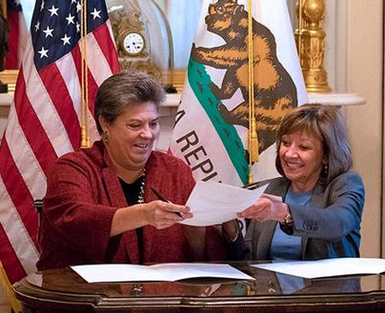
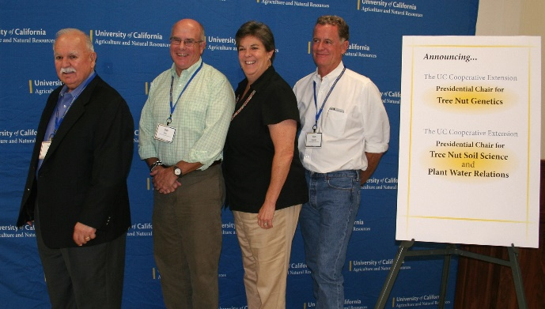
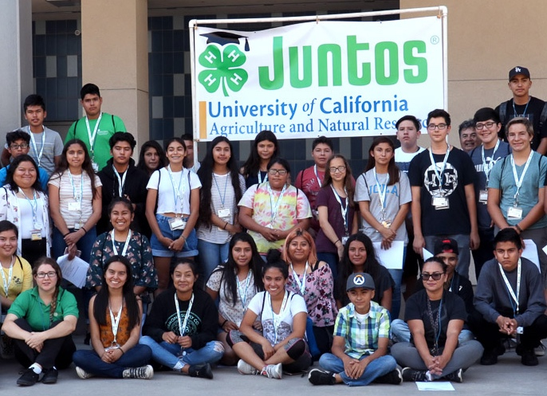
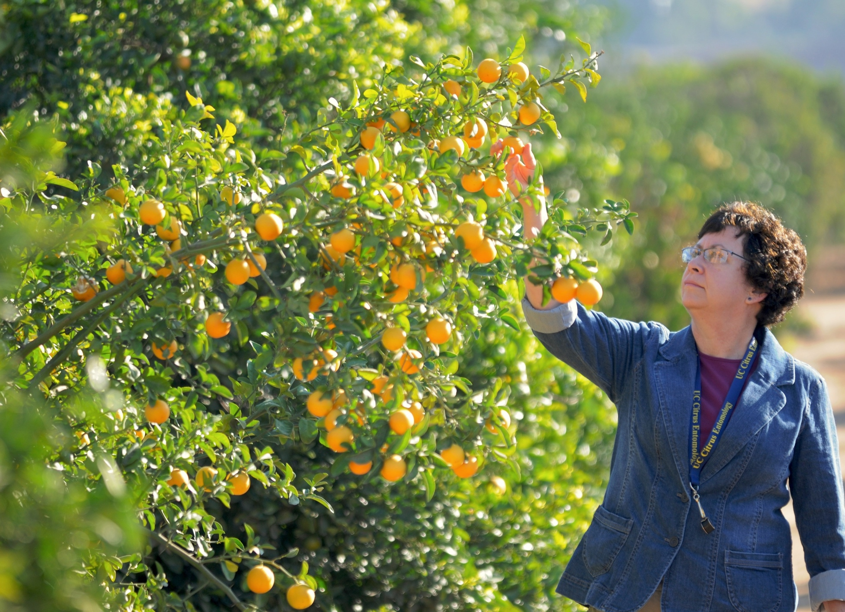

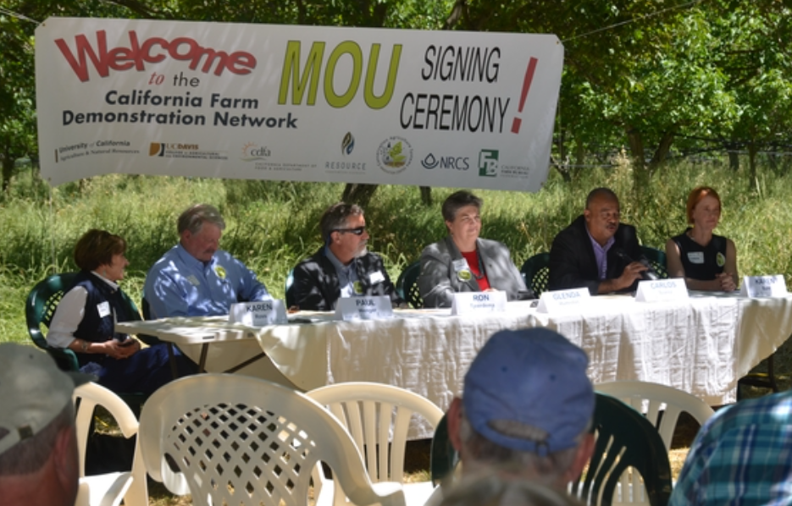
TODAY:
Substantial Progress on Many Goals and Initiatives
Public Value Statements developed, widely adopted and well received
Impact Reporting has greatly improved ability to message delivery of our mission
New partners seeking to work with UC ANR
Resources developed & trainings provided in Government Relations, Communications and Funds Development to staff and academics
Diversity and Outreach has improved across many programs and within personnel

Slide 19


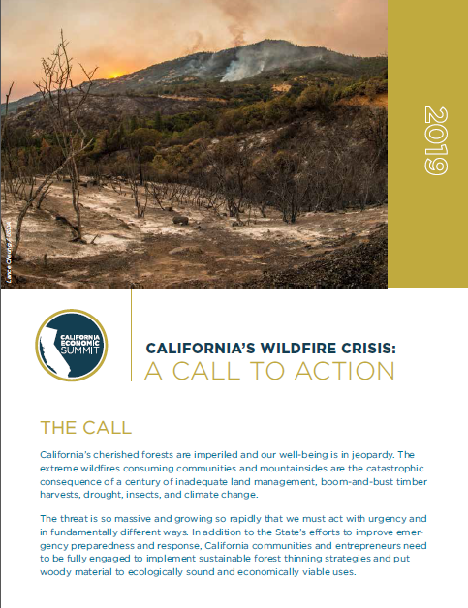

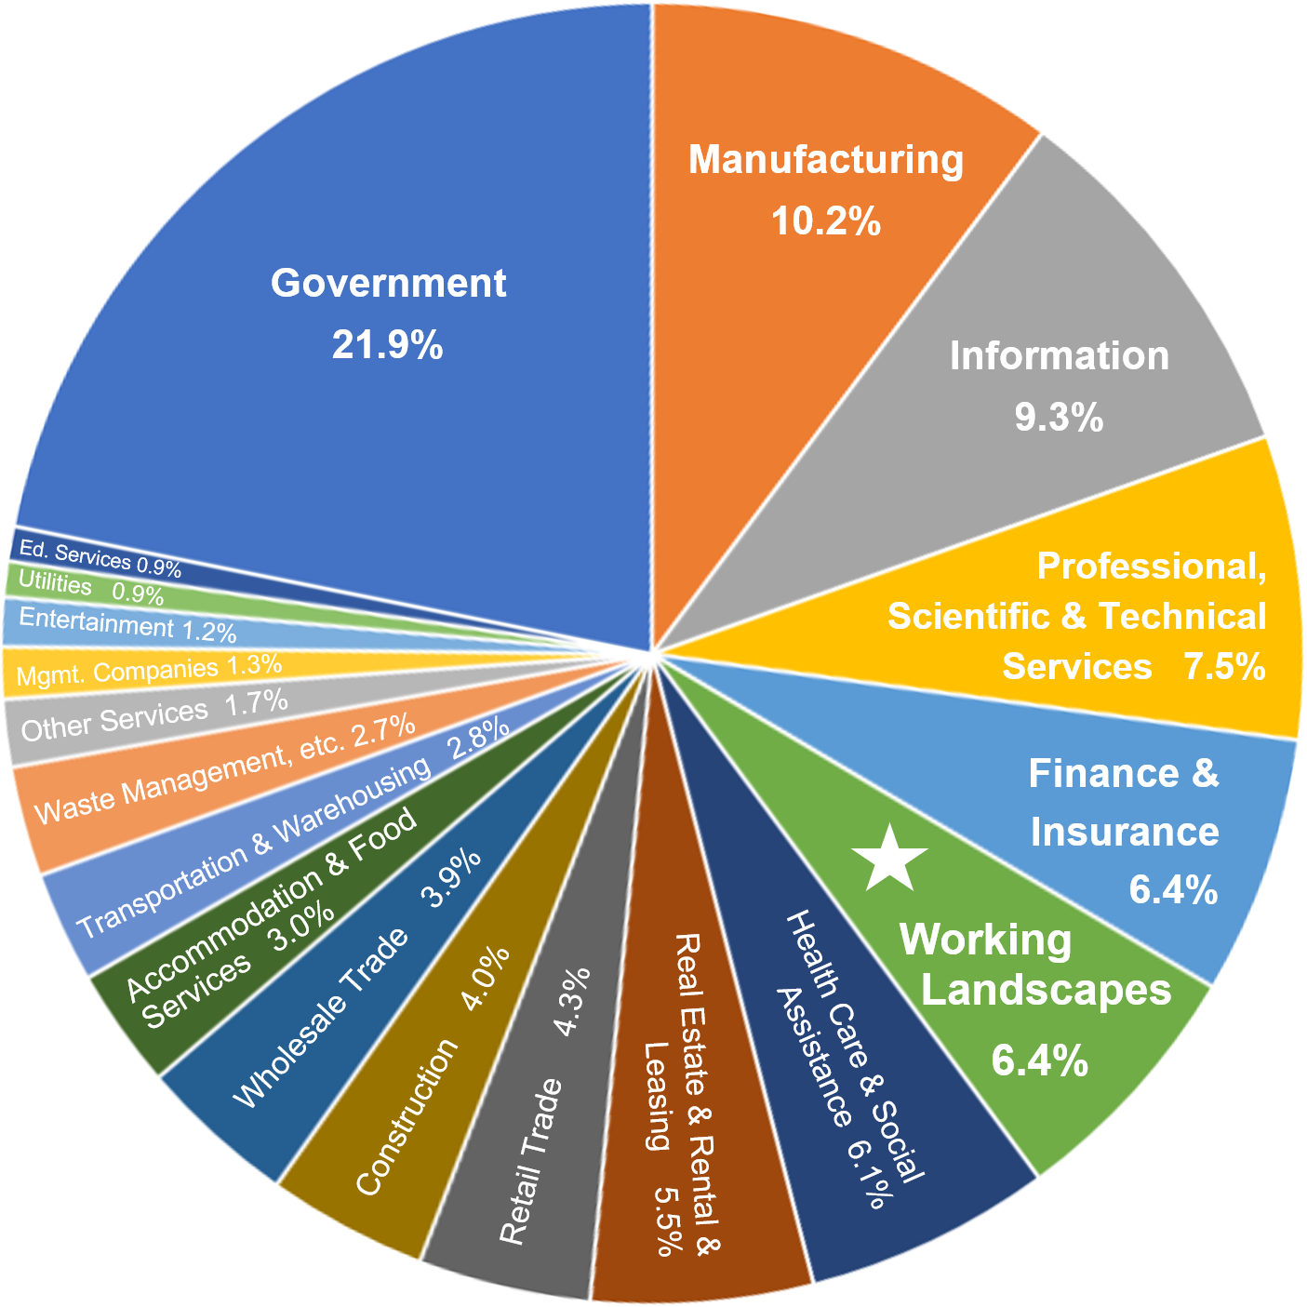
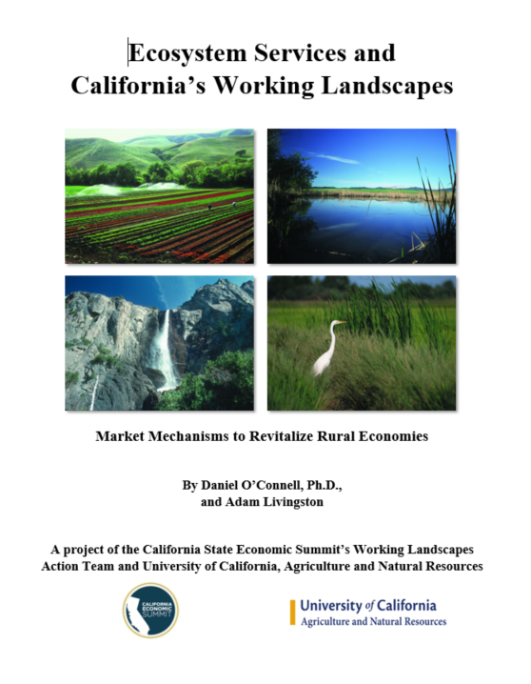

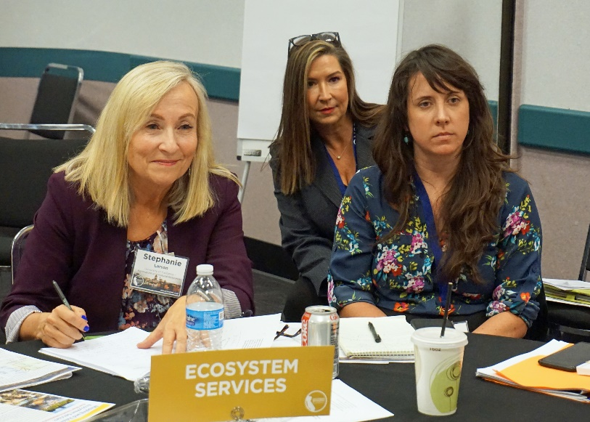


TODAY:
Providing Leadership to Elevate Rural California activities

Slide 20



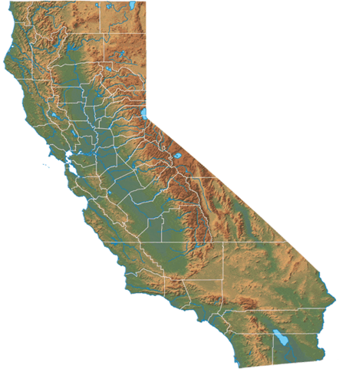












TODAY:
Catalyzing Ag + Food + Health Innovation Community
178 Cooperative Extension Researchers and Farm Advisors
in 57 counties
across the state
9 Research and Extension Centers spanning all relevant climate zones

Slide 21




Summary
UC ANR benefits all Californians statewide.
UC ANR collaborates with colleagues throughout the UC system.
UC ANR is increasing transparency & improving efficiency with enhanced business processes & UC financial systems.
UC ANR has been solving problems for over 100 years in California and will continue to develop and deliver strategic responses to current and future challenges.
ucanr.edu

