Slide 1

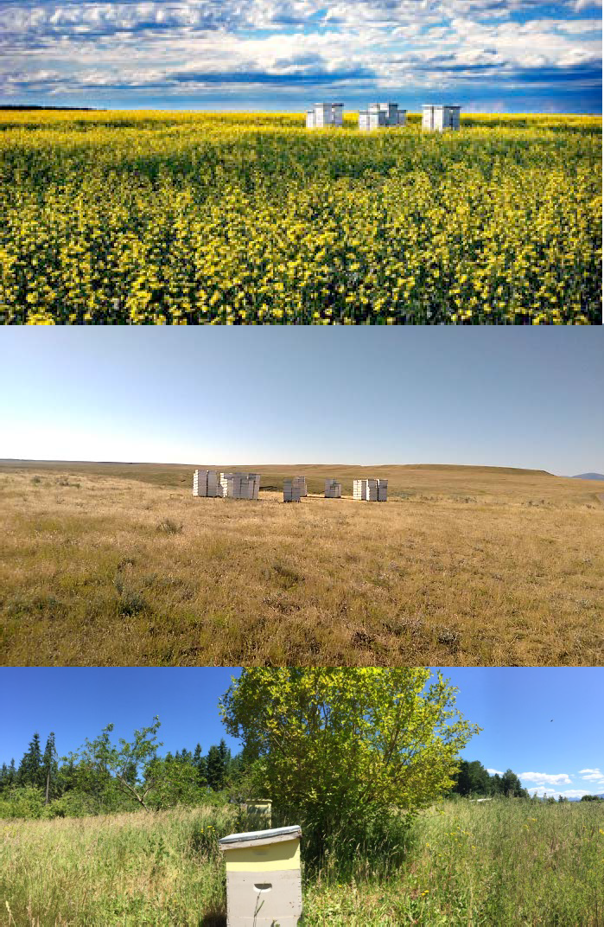



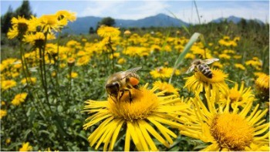
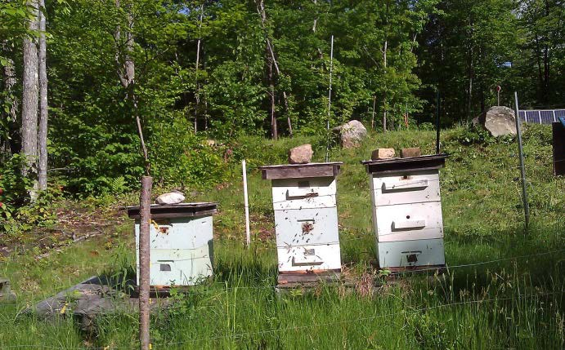

Slide 2
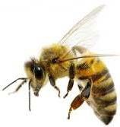
 Leave with an increased awareness of pollinator protection strategies
 Consider pollinator protection while evaluating sites when making pesticide use recommendations
 Realizing that your role is critical in the chain of communication of information!

Slide 3

 Importance of pollinators
 Causes of pollinator population decline
 2014 bee losses while in almond bloom in SJ Valley
 Government response
 New laws and regulations protecting bees

Slide 4
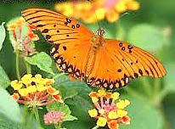

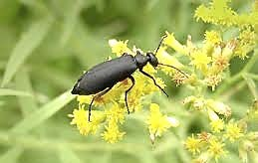
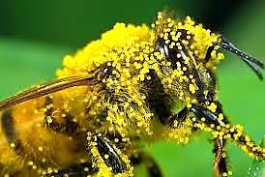
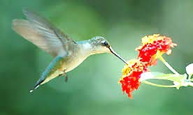
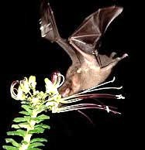
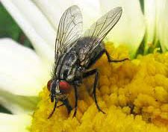
 Insect pollinators are important for pollinating wild plants, contributing a food source for wildlife.
 Bees are important pollinators in native plant communities, gardens, and in approximately 90 crops
 Insects pollinate a third of our food, including fruits and vegetables, nuts (almonds) and seed crops.
 Managed bee pollinators contribute a value of around $29 billion to our agricultural industry.

Slide 5
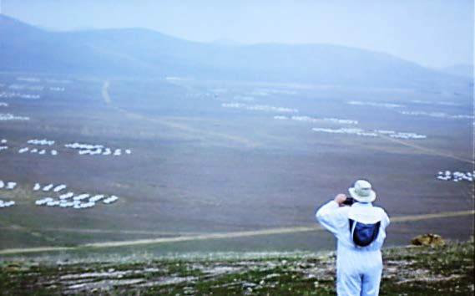

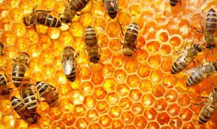
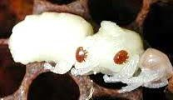
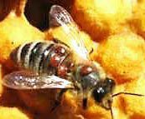
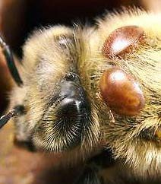
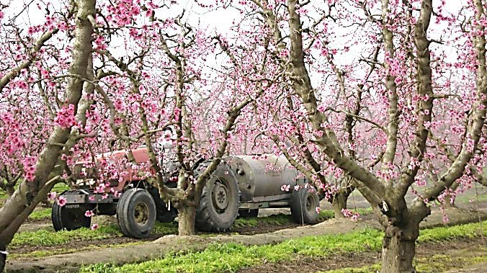
 Colony Collapse Disorder
 Bee Pests (parasites, viruses, etc..)
 Pesticides and bee incidents
 Crop Pollination
 Bee and environmental concerns

Slide 6










“The prevailing theory among scientists in EPA, USDA, and the global scientific and regulatory community is that the general declining health of honey bees is related to complex interactions among multiple stressors including:
Pests (e.g., varroa mite), pathogens (e.g., the bacterial disease American foulbrood) and viruses.
Poor nutrition (e.g., due to loss of foraging habitat and increased reliance on supplemental diets).
Pesticide exposure.
Bee management practices (e.g., long migratory routes to support pollination services).
Lack of genetic diversity.

Slide 7
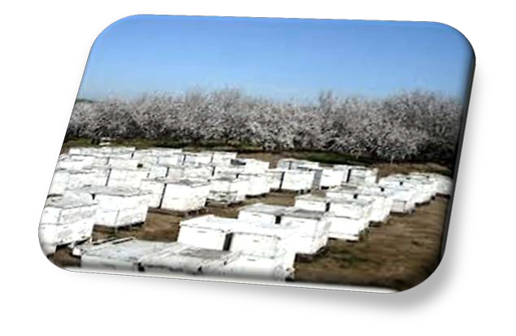
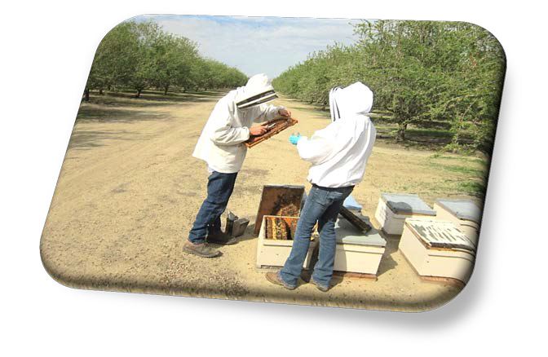
2014- 16 Reports of Loss Forms submitted by beekeepers to Central Valley CAC’s
Beekeepers claim of 80,000 colonies damaged or died during bloom
Stanislaus, Merced, San Joaquin, Madera, Fresno, and Kern
2016 Mariposa 100 hives lost

Slide 8

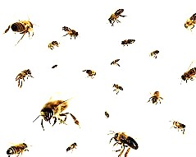
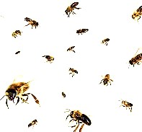

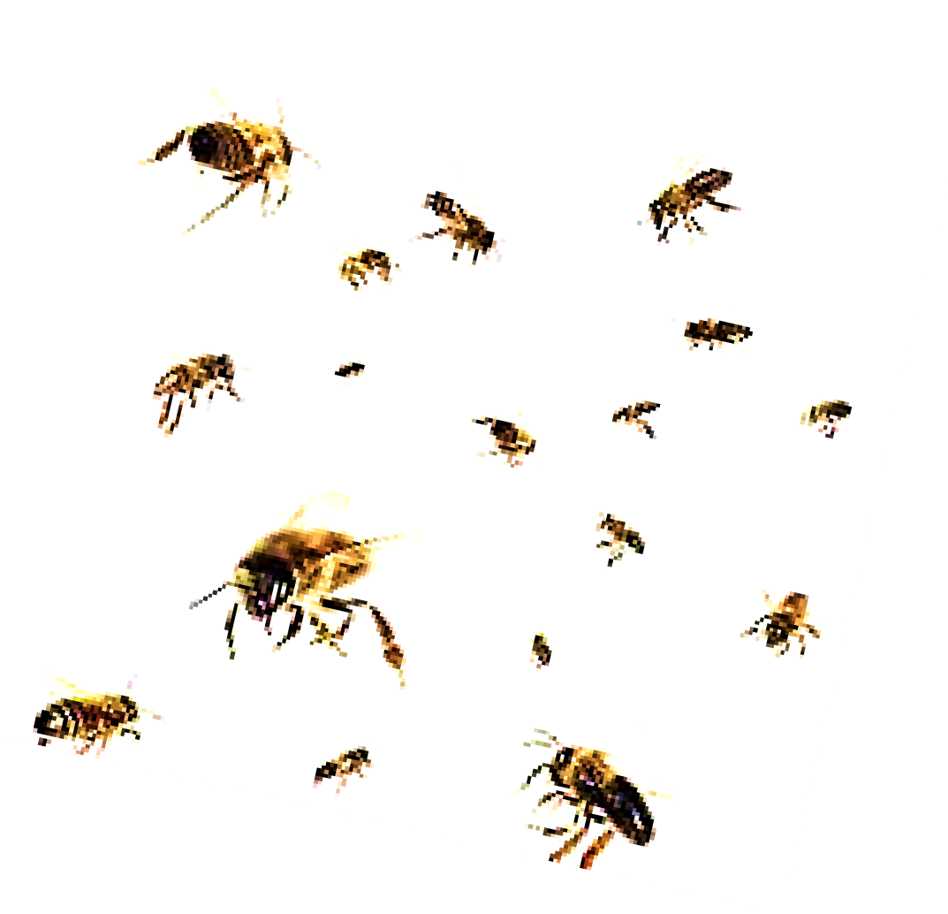
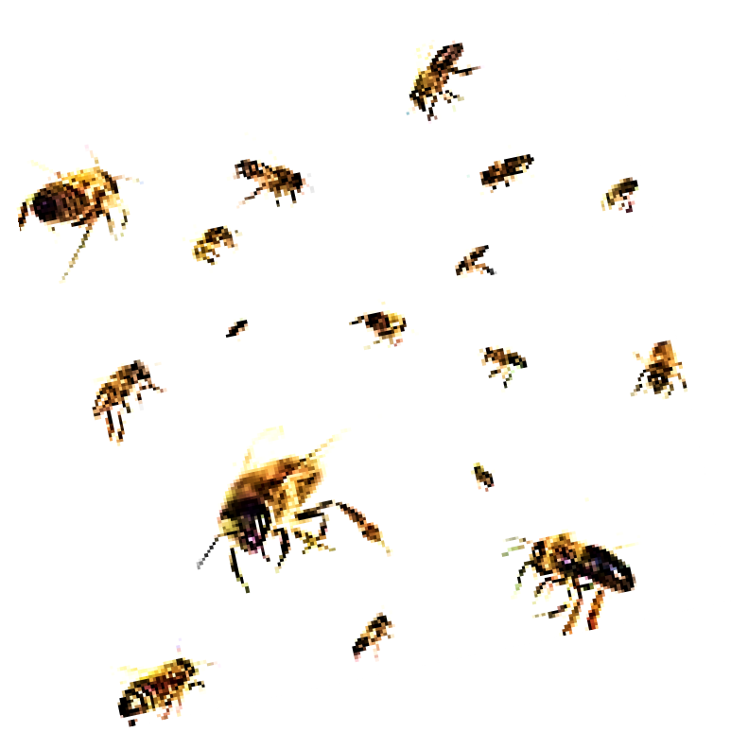
CAC Investigations
Media attention
Increased nationwide attention to pollinator protection issues
Fed EPA meeting with beekeepers 3/24/14 Los Banos
DPR Director meeting with beekeepers
CAC bee investigation training
Almond Board of California BMPs

Slide 9

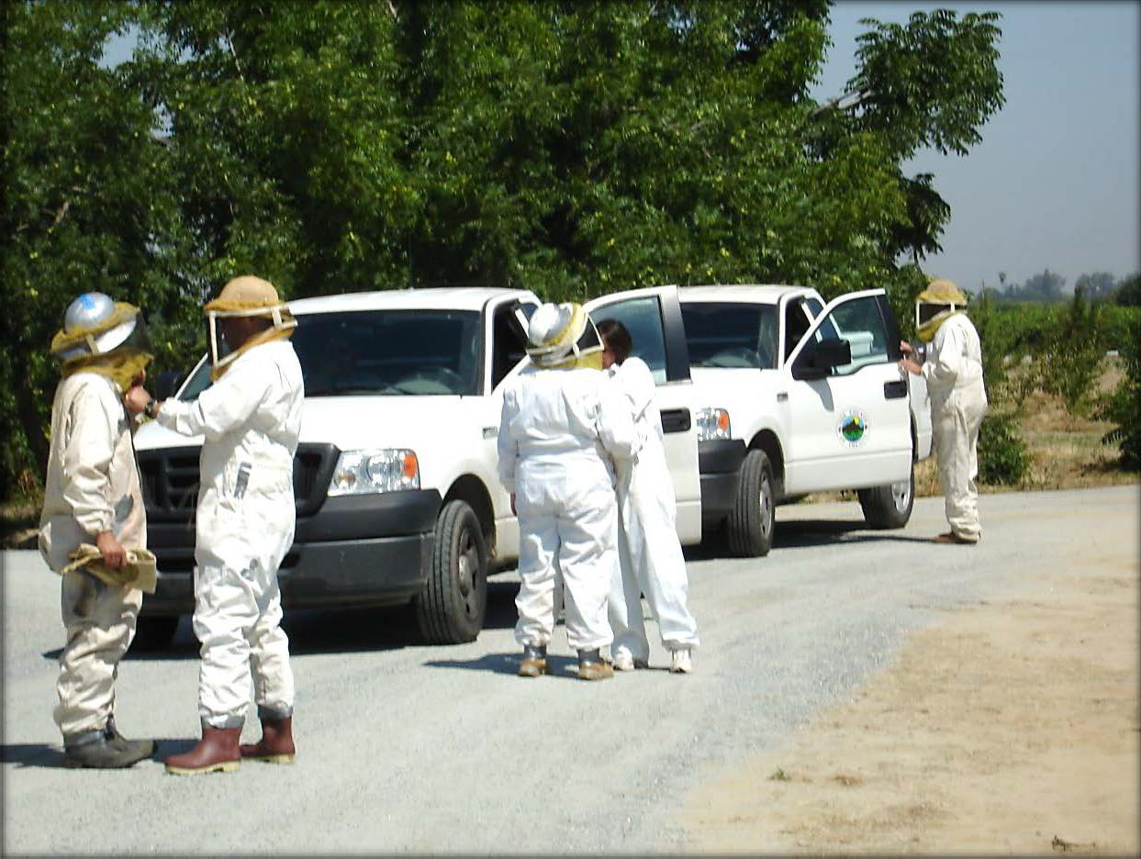

Slide 10
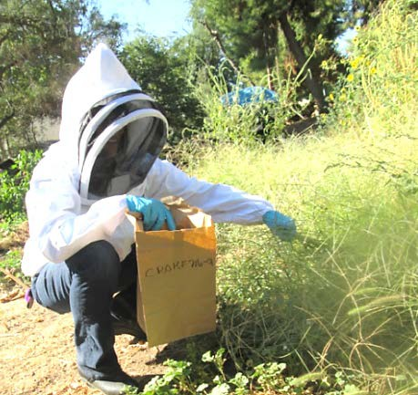


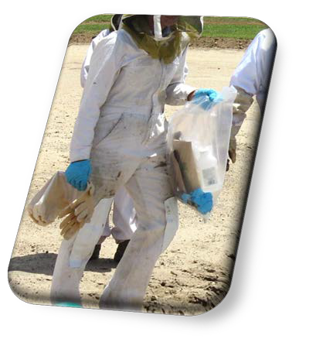
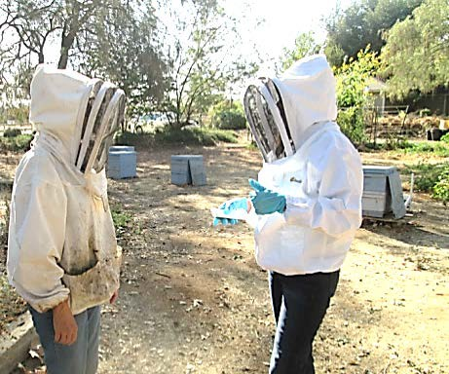
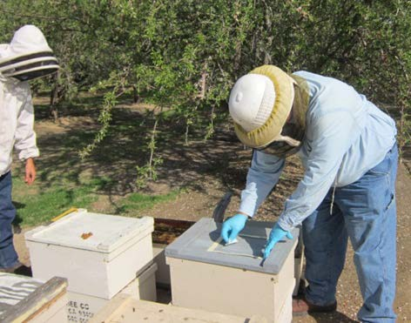
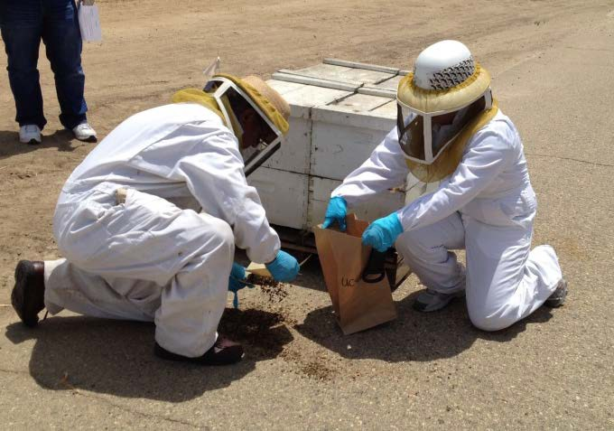
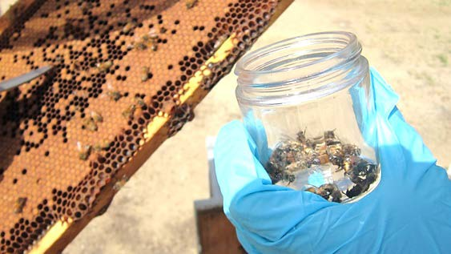
CAC’s response: conduct an investigation
Perform pesticide use report search for surrounding area
Perform Interviews
Perform pesticide label research
Foliage Samples
Interviews
Hive Swab Samples
Bee Samples
Pollen/Brood Sample

Slide 11
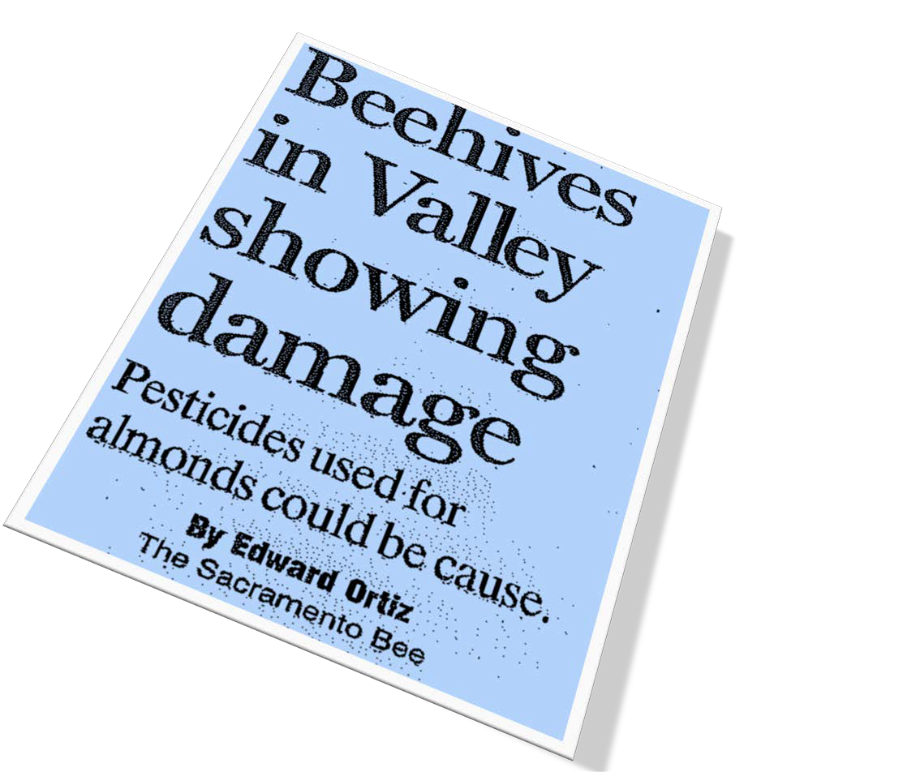
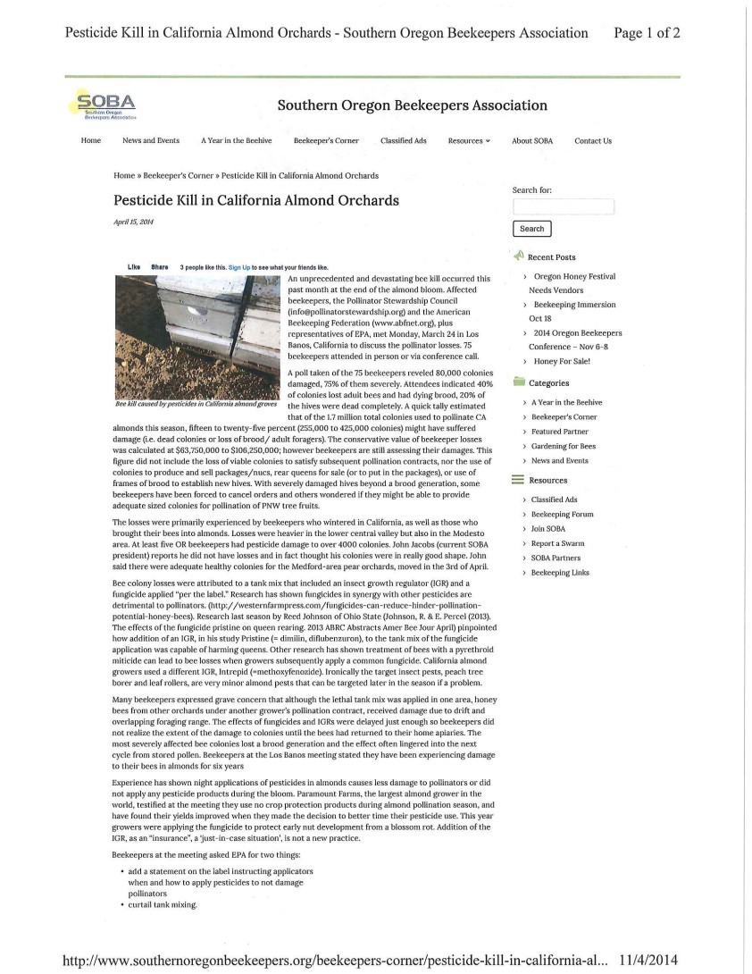
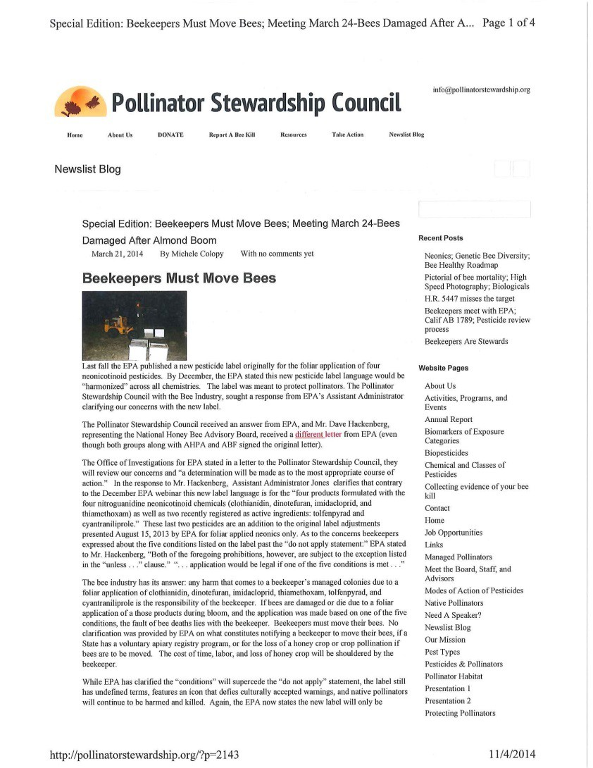

Slide 12
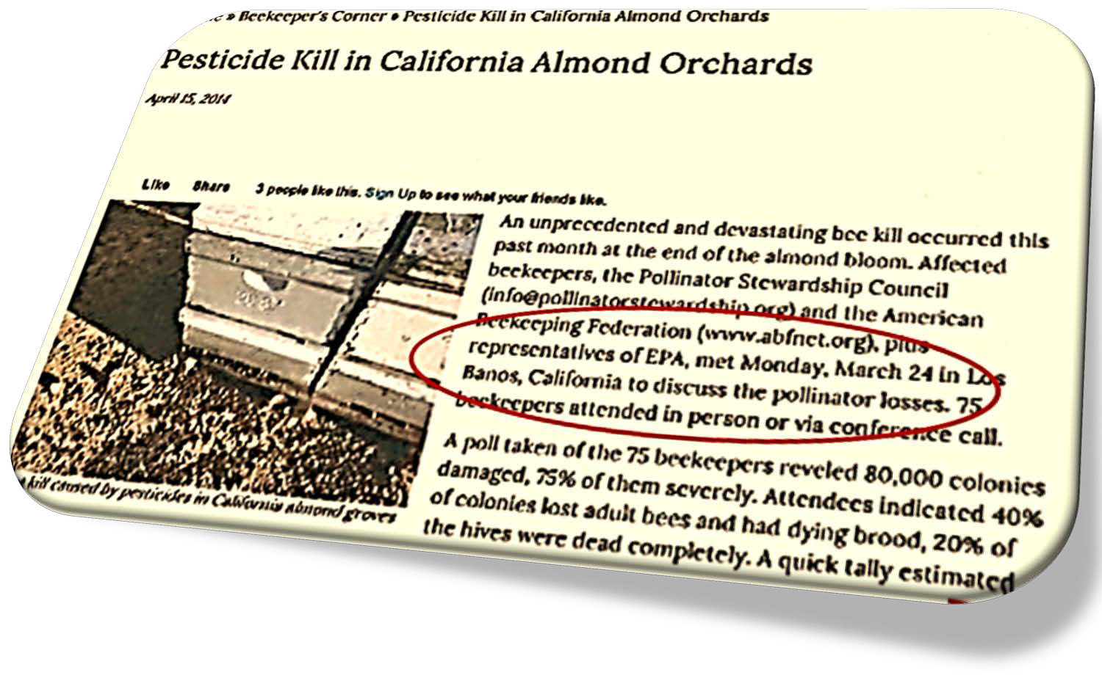
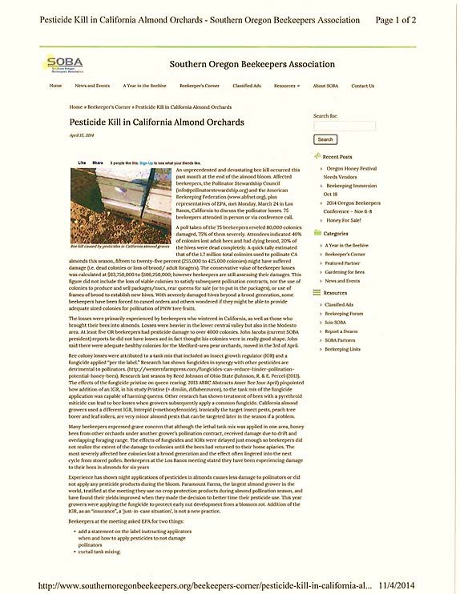
Claim of 80,000 hives damaged
15- 25% damaged
Estimated loss of $63,000-
$106,000
Loss attributed to tank mix of IGRs and fungicides (synergistic effect?)

Slide 13
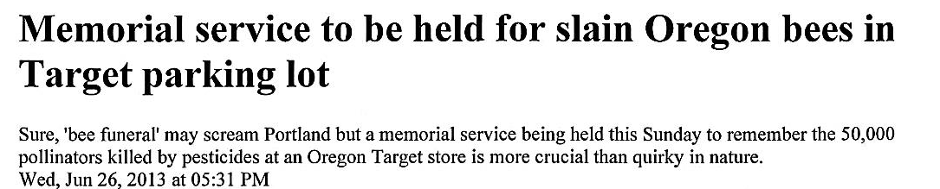
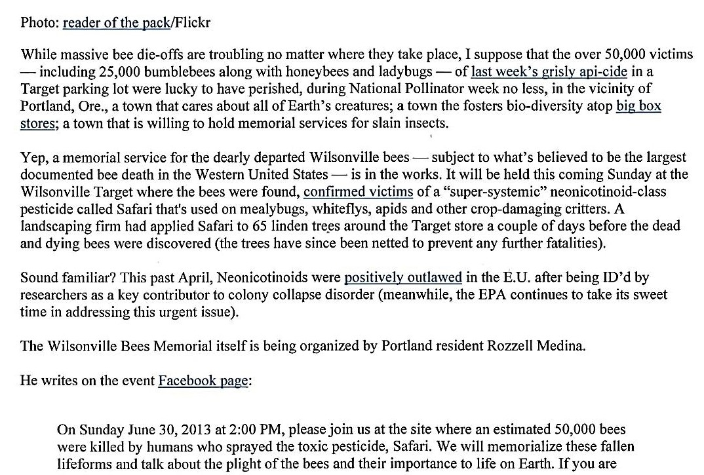
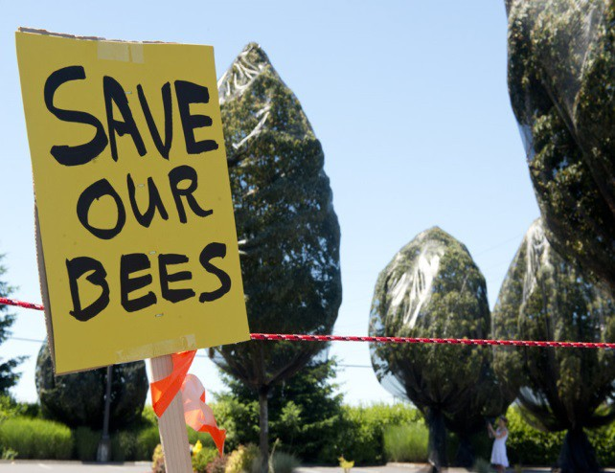

Slide 14
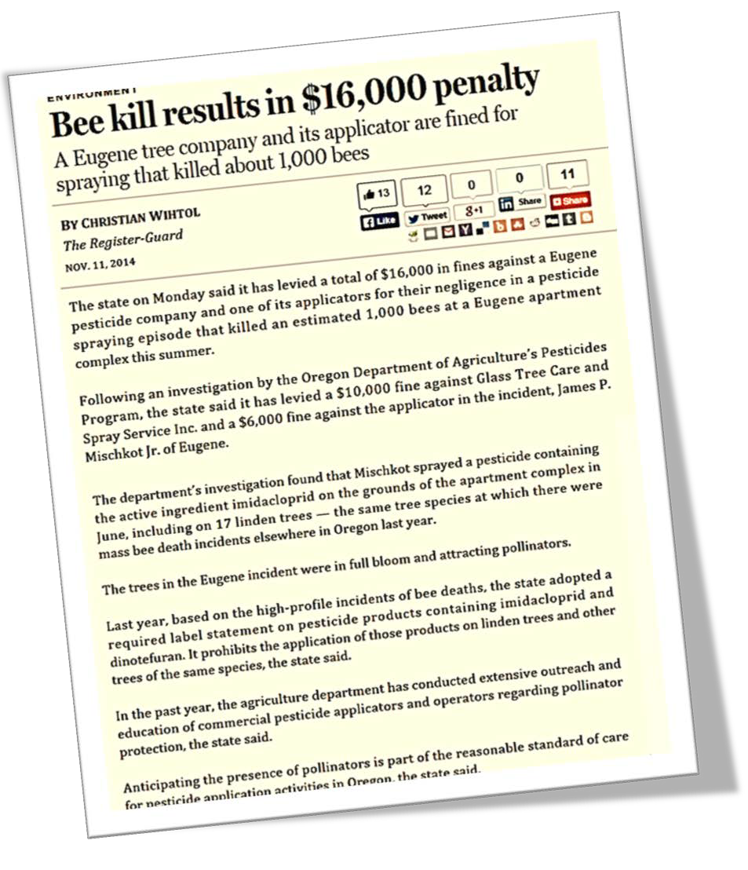
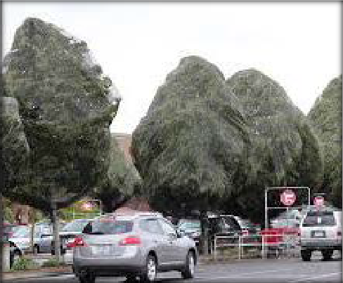
“The trees in the Eugene incident were in full bloom and attracting pollinators.”
“Anticipating the presence of pollinators is part of the reasonable standard of care for pesticide applications in Oregon, the state said.”

Slide 15









The president announced a federal strategy to promote the health of honey bees and other pollinators
Presidential Memorandum creating a federal strategy to promote the health of honey bees and other pollinators!

Slide 16
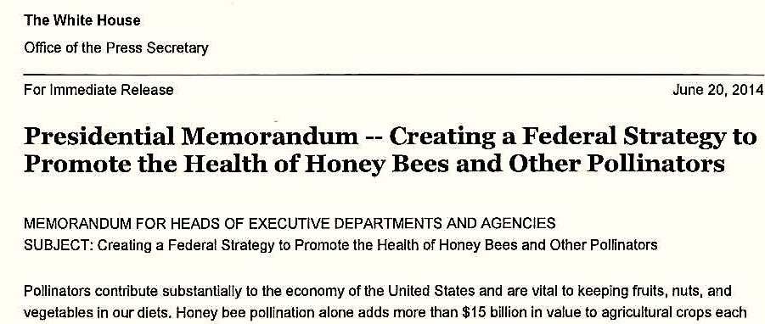
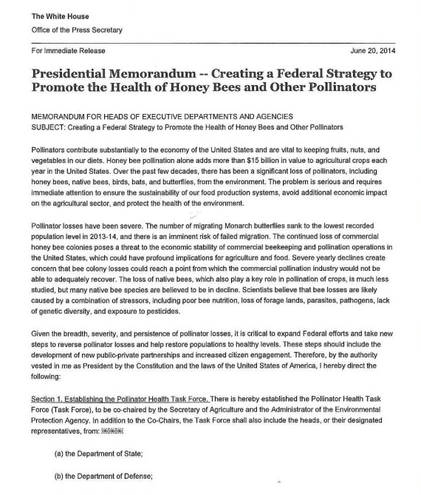
Pollinators contribute substantially to the economy of the US
Vital to keeping fruits, nuts, and vegetables in our diets
Honey pollination alone adds more than $15 billion in value to agricultural crops each year in US
Over the past 10 years there has been a significant loss of pollinators (honey bees, native bees, birds, bats and butterflies).

Slide 17


“Importance of Pollinators
Many types of plants, including fruit and vegetable crops, depend on animals for pollination. In addition to honey bees, many other types of animals pollinate crops and wildflowers, including:
Wild bees, Ants, Beetles, Wasps, Lizards, Birds, Bats, Butterflies,
We are concerned about declines in
pollinator health and are working to protect bees and other pollinators from pesticide risks.”

Slide 18



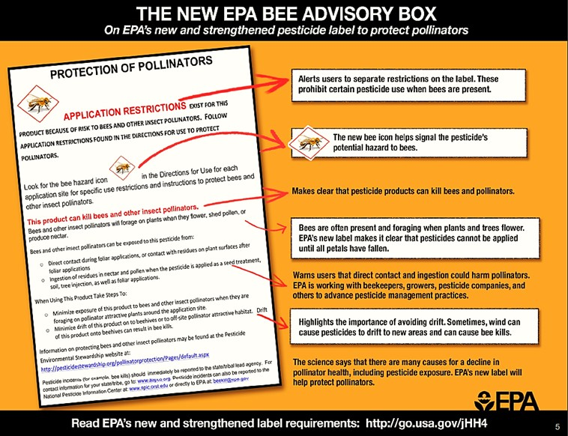
EPA Bee Advisory Box on pesticide labels
Ongoing effort to protect bees
Some labels prohibit use of some neonics where bees are present
- Neonicotinoids –
Imidacloprid, dinotefuran, clothianidin, thiamethoxam

Slide 19
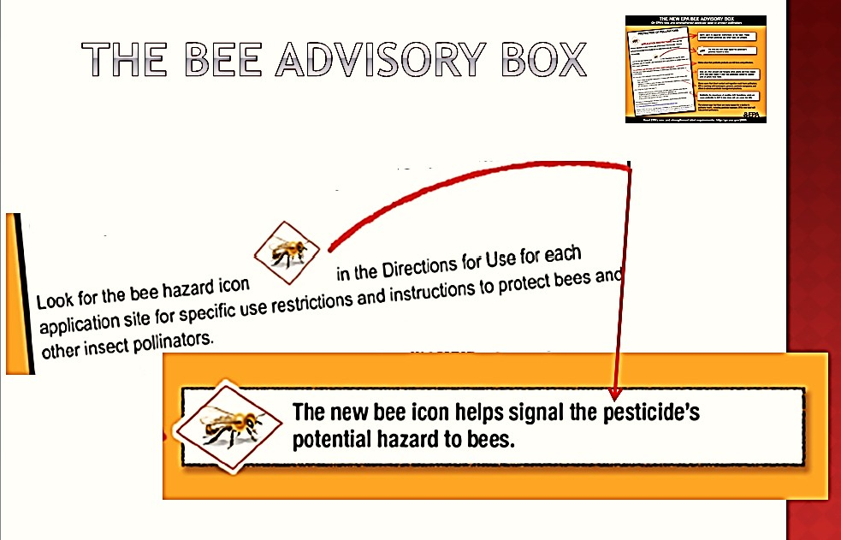

When you see the bee icon, be aware of a potential bee hazard

Slide 20
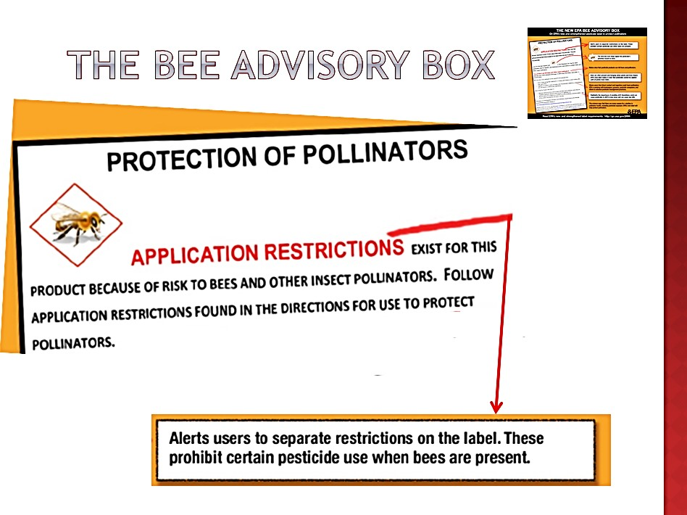

Slide 21
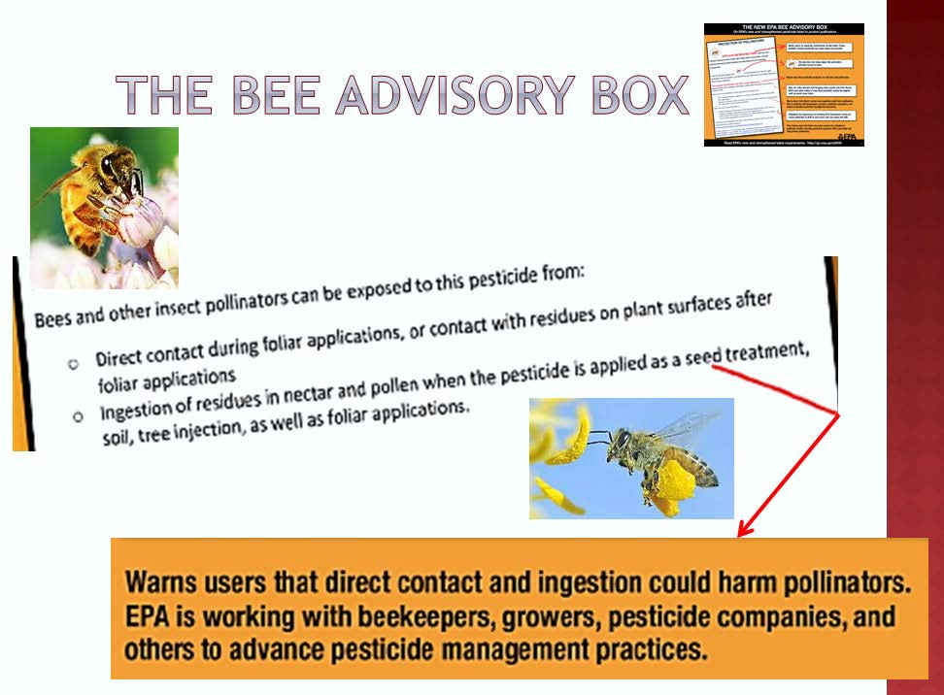

Slide 22
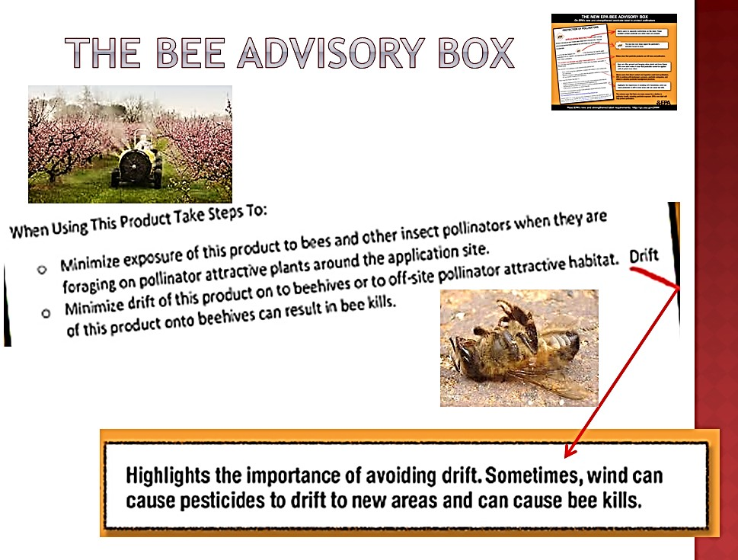


Slide 23
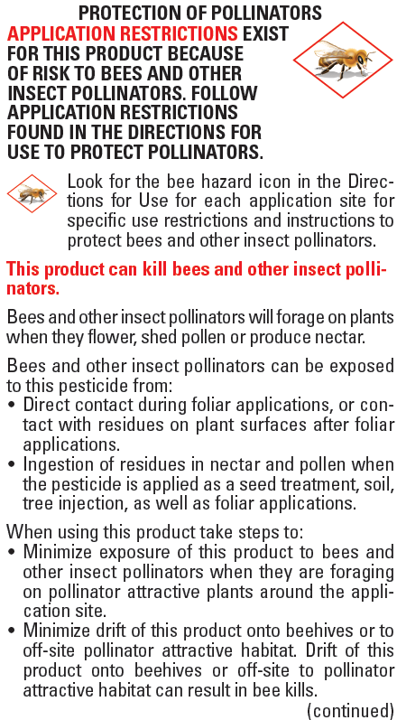

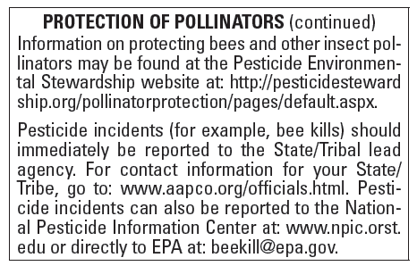
For products that pose risk to pollinators:
Look for Bee icon
Danger to bee statement
Exposure to direct application, treated surfaces or ingesting nectar or pollen with residues
Report bee pesticides incidents

Slide 24
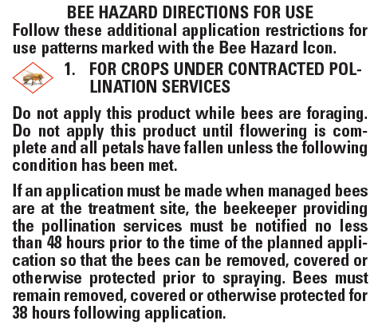

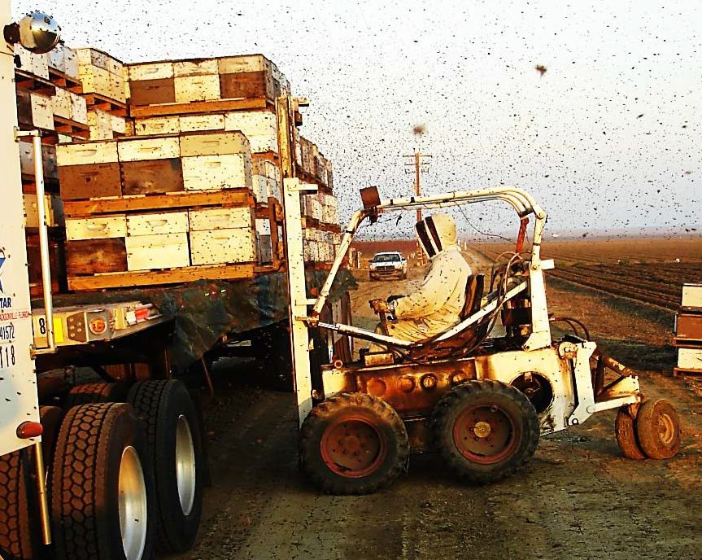
Contracted Pollination Services
Do Not Apply until flowering is complete and all petal have fallen
Provide 48 hr. notification to beekeeper before application
  Move bees
  Cover or protect bees for 38 hours

Slide 25




Crops that attract bees NOT under contacting services
Do not apply while bees are foraging
Product toxic to bees 38 hrs. after treatment
Do not apply to blooming, pollen or nectar shedding plants

Slide 26


A bee icon may also be found on the crops section of a label with further information

Slide 27

Pesticides toxic to bees
Apiary registration
Notification of pesticide application
Availability of Beekeeper

Slide 28






(a)Pesticides toxic to bees are those that include the words "toxic to bees" on the label. Regardless of modifying words on the label that state "highly" or "moderately.“
Dead Bumble Bees

Slide 29


Slide 30





The applicator provides the bee keeper with a 48hr notice prior to the application
The bee keeper may re-locate the bees, protect the bees or allow the application according to the label
What if the bee keeper does not want to move, cover, or protect his bees?

Slide 31













Failure of a beekeeper to remove
hives shall not prevent the application of pesticides to blossoming plants if the application is consistent with the pesticide's labeling and regulations. When the pesticide applicator has complied with the notification ,the applicator shall not be liable for injury to bees that enter the area treated during or after the application.
FAC 29103. Failure of a beekeeper to remove hives from a specific location, except during specific periods of time, as provided in subdivision (c) of Section 29102 after notification, shall not prevent the application of pesticides to blossoming plants if consistent with the pesticide's labeling and regulations. When the pesticide applicator has complied with the notification pursuant to subdivision (c) of Section 29102 the applicator shall not be liable for injury to bees that enter the area treated during or after the application.

Slide 32



Essentially, the applicator follows the pesticide label in regards to bees.
Extract from a pesticide label
Extract from a pesticide label

Slide 33

6614. Protection of Persons, Animals, and Property.
  An applicator prior to and while applying a pesticide shall evaluate the equipment to be used, meteorological conditions, the property to be treated, and surrounding properties to determine the likelihood of harm or damage.
  Notwithstanding that substantial drift would be prevented, no pesticide application shall be made or continued when:
    There is a reasonable possibility of contamination of the bodies or clothing of persons not involved in the application process;
    There is a reasonable possibility of damage to non- target crops, animals, or other public or private property;

Slide 34





6614 essentially means that the applicator, in regards to bees, should evaluate the application site for apiaries and not substantially drift onto apiaries which are near the application site and cause harm or damage.

Slide 35



Slide 36
3CCR 6654 Notification to Beekeepers
(a) Each person intending to apply any pesticide toxic to bees to a blossoming plant shall, prior to the application, inquire of the commissioner, or of a notification service designated by the commissioner, whether any beekeeper with apiaries within one mile of the application site has requested notice of such application.
(b) If the person performing pest control is advised of a request for notification, he or she shall notify the beekeeper, at least 48 hours in advance of the application, of the time and place the application is to be made, the crop and acreage to be treated, the method of application, the identity and dosage rate of the application to be applied, and how the person performing pest control may be contacted by the beekeeper. This time may be increased or decreased by the commissioner, or by an agreement of both the beekeeper and the person performing the pest control work.
(c) This section shall apply statewide. However, from March 15 through May 15 in a citrus/bee protection area, if there are conflicts between the provisions of this section and those of section 6656, section 6656 shall prevail.

Slide 37


Slide 38


Slide 39


Slide 40


Slide 41


Slide 42







The beekeeper who desires advance notice of applications of pesticides shall inform the commissioner of a two-hour period between 6 a.m. and 8 p.m. each day, during which time the beekeeper shall be available for contact to receive advance notice from persons intending to apply pesticide(s).

Slide 43


Honey bees are essential for a successful almond
crop!
About 1.6 million colonies of honey bees are placed in California almond orchards at the beginning of the bloom period to pollinate the crop. (Where do these bees go after pollination?)

Slide 44

Pollinators and managed bees are important for the production of many agricultural commodities.
Many organizations are very aware and concerned about the declining health of managed bees
Pesticide labels are becoming more specific with directions for use to protect bees
Government and industry strategies to “remedy” the concern until more is known
PCAs role is critical in fostering communication!

Slide 45
New Pollinator Protection Regulations Effective 01/01/2024
Title 3, Division 6, Chapter 4, Sub-Chapter 6- Article 2 Neonicotinoid Pesticide Exposure Protection
  3CCR 6990 though 6990.16
to limit neonicotinoid pesticide product use in the production of most food and feed crops.
apply to soil and foliar applications of products containing
the neonicotinoid active ingredients clothianidin, dinotefuran, imidacloprid, and thiamethoxam.
The regulations do not apply to neonicotinoid use in non-agricultural (e.g., structural or home use) or non-production agricultural (e.g., parks, cemeteries) settings, applications to nursery stock, or seed treatment applications.

Slide 46
Neonicotinoids are systemic pesticides.
They are absorbed into plants and distributed throughout plant tissues to the stems, leaves, roots, fruits, and flowers
Their residues can be present in the pollen and nectar consumed by bees and other pollinators.
The new regulations protect pollinator health by reducing the amount of neonicotinoid active ingredients that can be applied to most food and feed crops through application method and rate restrictions, application timing restrictions, and seasonal application rate caps.
For most crops “bloom” is defined as the period from the onset of flowering until petal fall is complete. In Fresno, Kern, and Tulare Counties, 3 CCR section 6984(b) specifically defines the citrus bloom period in those counties. Neonicotinoid use on food and feed crops covered by the regulations is prohibited during bloom.

Slide 47
Certain neonicotinoid applications are exempt from the regulations, including those:
  in enclosed spaces or insect exclusionary structures/netting,
  to control a quarantine pest (if the grower obtains a written recommendation), or
  under a FIFRA Section 18 Emergency Exemption.

