Slide 1
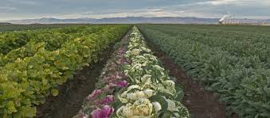
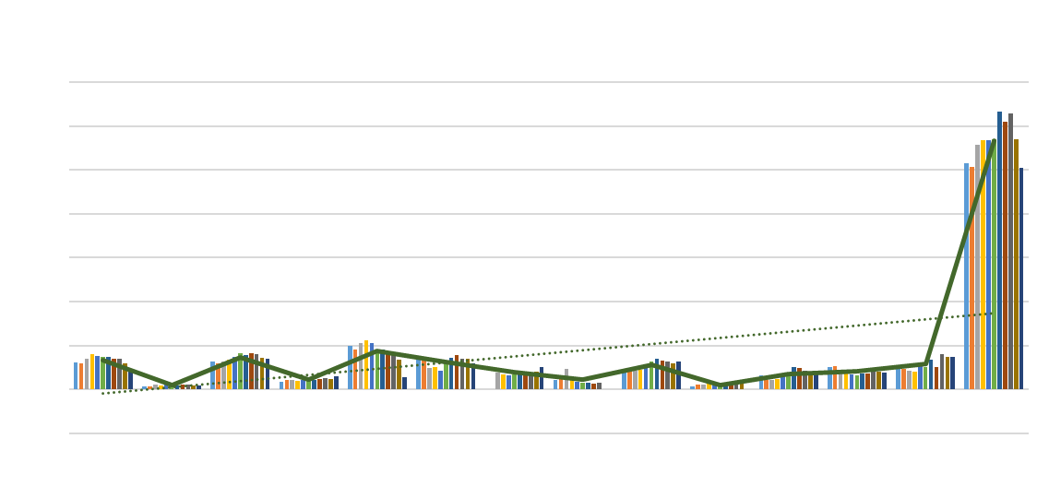
Economic Trends of Vegetable Crops Production and Sustainability in Imperial Valley
Etaferahu Takele
UCCE Area Farm Management Economist
3-10-22

Slide 2
Outline
  Purpose of Presentation
  Acreage Trends (Brief)
  Value Trends (Brief)
  The Pandemic Experiences
    Acreage
    Value
  Summary
  Factors That Support the Veg. Crops Production Sustainability
  Factors That May Challenge the Sustainability of Veg. Crop Production

Slide 3
Purpose of Presentation
The purpose of this presentation is:
  To glance over the acreage and value trends of vegetable crops production in Imperial County in this past decade
  View the historical data of acreage and value movements help us learn the ups and downs of the industry and also to have a perspective about the future of the industry.
  A special look in this presentation is the response of the industry to the COVID-19 pandemic, how the industry acreage and value movements were impacted.

Slide 4
How Has Vegetable Crops Production In Imperial Valley Been Sustainable and Prominent?
The Industry has been the source of winter vegetable supply to the US: that means the industry has a unique market or marketing niche to ensure demand.
The values of these crops bring millions of dollars to the County’s economy:
  For example in 2018:2021-Economic-Contribution-of-Imperial-County-Ag.pdf
  Vegetable crops together with melon crops (reports put them together) brought in direct Values of~$800 million ~40% of the $2.11 billion agricultural value in the County;
The value of the crops also bring additional economic impacts/ benefits:
in indirect values (business to business created economy) the value of these crops brought ~$234.7 million
in induced values (consumption by farmers and farm operators, etc., the values of these crops further created ~ $144.1 million in the economy.
So, total Economic Impact of these crops reach to over a billion dollar to the County:
Direct Values+ Indirect contribution+ Induced Values =$1.18 billion;
  accounting for ~40% of the total $3.15 billion agricultural economic value in the County.

Slide 5
From 2010-2020, Veg. crops harvested acreage averaged ~113,280.
Lettuce (sum of all varieties: head, leaf, romaine and spring mix (15%+11%+6%+3%, respectively), 35%;
Carrots Broccoli and Onions (13%+12%+10%, respectively), 35%;
Spinach, potatoes, sweet corn, cauliflower and cabbage (6%+ 2%+7%+4%+1%, respectively), 20%.
Miscellaneous (17 varieties) the remaining 10%;

Slide 6
Harvested acreage Trend Over 11 Years 2010 -2020
Over the 11 years, harvested acreage showed an upward (trend line).
Acreage statistics included:
  a low of 100,782 in 2020 to a high of 126,469 acres in 2016 with
  an average of 113,280 acres and a median of 113,658 acres.
There were two growth periods, first in 2012 with an increase of 10,000 harvested acres, a ~10% increase from the previous year; and then in 2016, an increase of ~12,000 harvested acres, a 9% increase from the previous year.

Slide 7
Total
In 2012 mainly lettuce particularly head lettuce and spring mix acreages increased;
In 2016, leaf lettuce, onions, carrots, broccoli and spinach and miscellaneous veg. crops.

Slide 8
Proportion of Vegetable Crops Value ($) Using the 2010-2020
Average, Imperial County
Average crop Value for the decade (2010-2020) was $796.12 million.
Major crops: Lettuce (including Romaine, leaf lettuce, head lettuce, spring mix and salad products accounted for 38% of the value (in acreage accounted for 35% of the average);
Broccoli, carrots, onions accounted for 29% of the value (in acreage accounted for 35% of the average).
Spinach, Cauliflower and sweet corn about 15% of the value (in acreage accounted for 15% of the average).
Misc. accounted for the remainder 18%.

Slide 9
Veg. Crop Value Trend Over 11 Years 2010-2020, millions of $
An upward (the dotted trend line) especially in the latter part of the decade, i.e. the three years before the pandemic (2016-2018).
The crop value ranged from a low of $613 million in 2010, to a high of ~$973.00 million in 2016, with an average of $796,12 million and a median value $762.68 million.

Slide 10


The Pandemic Experiences : 2019 and 2020
Challenges came in two ways:
On the demand side: The disruption of the main marketing channel of these crops, the restaurant businesses (via closure and then indoor seating restrictions, etc.) caused veg. crops demand decline to a large extent in 2019 and to some extent in 2020.
On the supply side:
  Crops with short shelf life lost values on shelf and even left unharvested in the field.
  In addition, health and wellness safety caused limitation on labor supply and especially harvest labor shortage causing crop left unharvested in the field.

Slide 11
Acreage response to Pandemic?
How did the industry respond in acreage management in light of both demand and supply challenges resulting from the pandemic situation?
Harvested acreage declined on average ~ 10% from 2018-2020; acreage harvested in 2020 was the lowest of the decade at 100,982.
The crops most impacted (declined)/or were most sensitive to the pandemic on average (two years decline 2019-20) :
  Head Lettuce, 33%;
  Broccoli, 19%
  Other crops dropped by 5%-10% include leaf lettuce, Cabbage, carrots, sweet corn

Slide 12
Crop Value responses to Pandemic?
Average crop value declined by ~6% from 2018-2020; average of the two years at $794.44 million;
The crops whose value most impacted
Head Lettuce declined by 29%; leaf lettuce by 6% ;
Broccoli, and onion by 19% each;
There were also crops whose value increased :
Carrots (6%), cauliflower (5.41%), Romaine lettuce 10%, sweet corn 28% and misc. vegs. 7%

Slide 13
Summary
Vegetable crops production in Imperial Valley is prominent, accounting approximately for a third of the direct agricultural value and about 40% of the economic impact of agriculture in Imperial Valley; 2021-Economic-Contribution-of-Imperial-County-Ag.pdf (melons included).
The average harvested acreage over an 11 year period ~113,280 (including the pandemic years) and 114,572 (excluding the pandemic years);
The average difference that the pandemic made =1,300 decline in harvested acreage.

Slide 14
Summary
The value of the crop over the decade averaged $791.66 million and $791.05 million without the pandemic years.
Therefore, the average crop value difference that the pandemic made is insignificant.
The impact of the pandemic was more evidenced in decline of harvested acreage.
In value, decline was more in 2019, but in 2020 the various ways of the market adjustment helped value to rise above the 2019 despite the fact that harvested acreage was less than 2019.

Slide 15
Factors that support the veg. crops sustainability
Diversification:
A valuable risk management tool—is a tool for income stability in the face of constantly changing situations; it helps to balance adversity, when some crops are impacted such as by weather, market or pandemic, other crops more resilient would help to combat the adversity.
Veg. crops production in Imperial County is a diversified industry with over 30 crops grown each year. We have seen crops with value increases even during the pandemic when others lost value.
Market Advantage:
The fact that Imperial Valley being the major supplier of winter veg. crops (it supplies 2/3 of the winter veg. consumption to the US), has a unique market or market window demand for its vegetable crops.

Slide 16
Factors that support the veg. crops sustainability
Climate and Water:
Suitable climate for production and irrigation water availability at relatively inexpensive prices have made production sustainable (in spite of issues related to water).
Eating Habit Changes and Health:
Nutrition education and wellness advancement guidance have helped increase eating vegetables and fruit. A study (though not very recent) showed that vegetable and fruit consumption increased, in fact veg. crops consumption increased more rapidly than fruit, rising 24 percent over a 20 year period (1977-1997), compared with 8 percent for fruit.

Slide 17
Factors that may challenge sustainability
Vegetable crops consumption from the County is mostly within the US; The market depending on retail stores and restaurants was the major reason for decline of demand, consumption and value of the crops when restaurant closed or reduced service during the pandemic.
Lettuce was most impacted.
Market diversification?
Shelf life:
Most vegetables are in 1-3 weeks shelf life SP768-F-shelf life of produce.pdf, therefore adversity weighs heavy in cases of pandemic; crops do go bad quickly. Post harvest research prospect!

Slide 18
Factors that may challenge sustainability
Labor availability and cost:
Cost of production:
Food safety issues:
Vegetable crops production is extremely labor intensive especially in harvest. Just to see a couple of crops: Broccoli more than 300 hours per acre; loose-leaf lettuce over 285 hours per acre. When cases such as the COVID pandemic happens and labor availability constrained by health and welfare reasons, it had huge impact on timely harvest of crops. Experience acquired may help future labor management?
will likely increase because of the minimum wage increase and overtime cut off at 40 hours instead of what used to be 60 hours. Calls for effective farm labor management strategies!
Costs to manage food safety including water quality, labor safety has in the past decade increased cost of production (not much). This is an advantage too, to avoid infestation and recalls.

Slide 19
References:
https://agcom.imperialcounty.org/wp-content/uploads/2021/08/2020-Crop-Report-v2.pdf
SP768-F-shelf life of produce.pdf,
https://www.ers.usda.gov/webdocs/outlooks/40303/14977_wrs011h_1_.pdf?v=5008.3

