Slide 1
Cucumber beetle biology and management in organic systems
Amber Vinchesi-Vahl, Ph.D.
UCCE Vegetable Crops Advisor
Colusa, Sutter and Yuba Counties
Notes:
Biology, identification, management
Mainly talk about cucumber beetles on cucurbits, especially melons, but applies to squash too
Most of the information presented today if from UC-IPM, Andrew Pederson’s thesis on cucumber beetles (student of Larry Godfreys (was the entomology specialist for vegetables and row crops), and from my own experience with cucumber beetles, though I mainly work with conventional fresh-market honeydew and cantaloupe

Slide 2
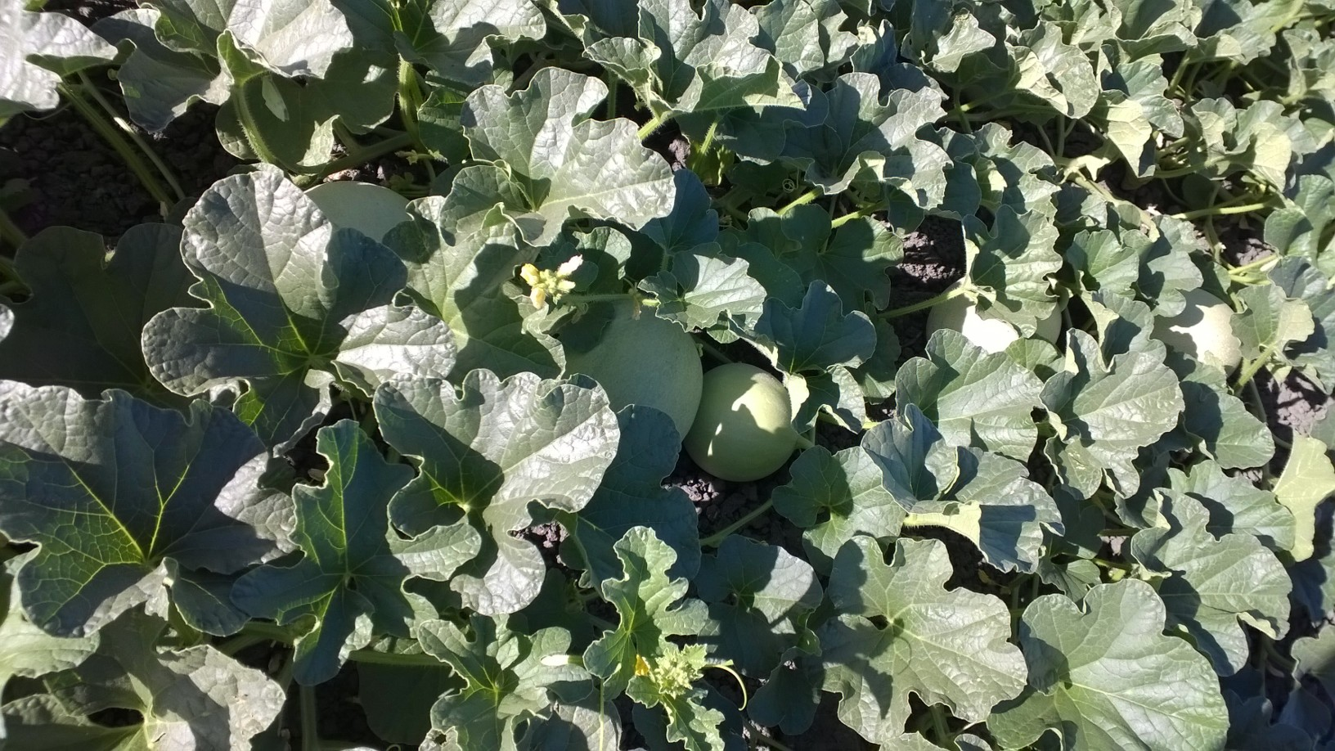
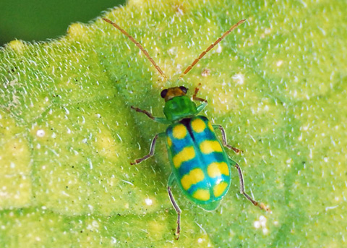
Introduction
Found throughout California and are major pests of cucurbits
Western spotted and western striped cucumber beetles
Banded cucumber beetle found only in southern California
Problem in the Sacramento Valley since 1980s
Male aggregation pheromone leads to rapid infestations
R. Hemberger: Natural History of Orange County

Slide 3
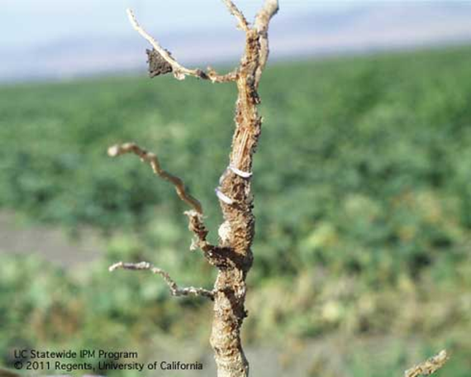
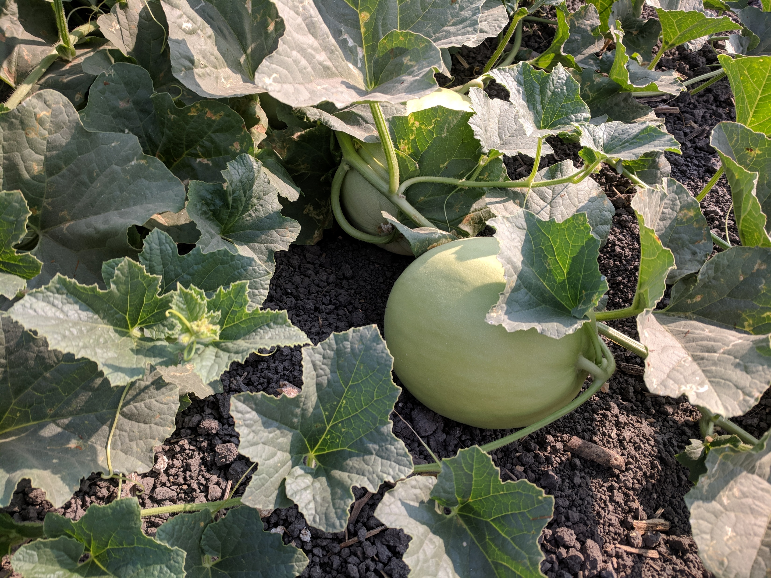
Life cycle
Overwinter as adults
  Black heads, long antennae, and about 1/4 inch long
Lay yellow-orange eggs at the base of plants or in soil cracks
Larvae feed on plant roots and complete development in soil
  Whitish and slender with three pairs of short legs
  Head and tip of the abdomen are darker
3 generations per year (4 population peaks)
UC-IPM
Notes:
Active in the spring when first melons are planted
Both species observed to overwinter in alfalfa
Feed on weeds when melons not flowering
Describe photos

Slide 4
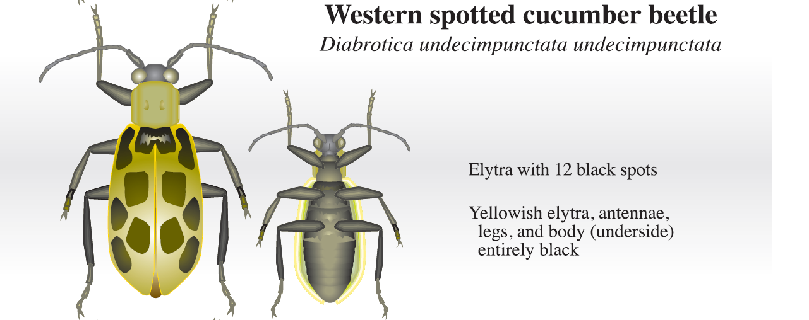
Western spotted cucumber beetle ID
Diabrotica undecimpunctata undecimpunctata
P. Goodell and P. Philips. A Field Key to the Cucumber Beetle Species Found in California. UC-IPM.
Notes:
Bigger than WStrCB
Elytra=wing covers

Slide 5
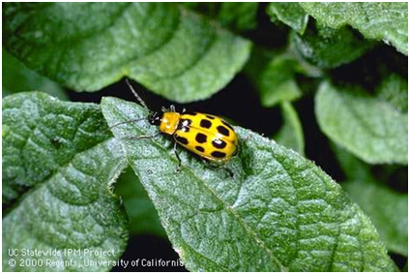
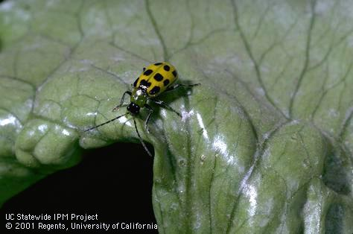
Western spotted cucumber beetle biology
Feed on small grains, legumes, grasses, cucurbits
  Pigweed, bindweed, black nightshade, common lambsquarter, velvetleaf
Develop on grasses or alfalfa
Adults most damaging→ seedlings, flowers, foliage
Can be very damaging to seedlings in just a few days time
Larvae feed on a wide variety of plants including grasses, corn, legumes
Photos: UC-IPM
Notes:
Legumes like beans and sweet pea
Migrate from weedy areas, corn or alfalfa fields
Migrations coincide with alfalfa cuttings
Alfalfa is a season long host for spotted in Sac Valley

Slide 6
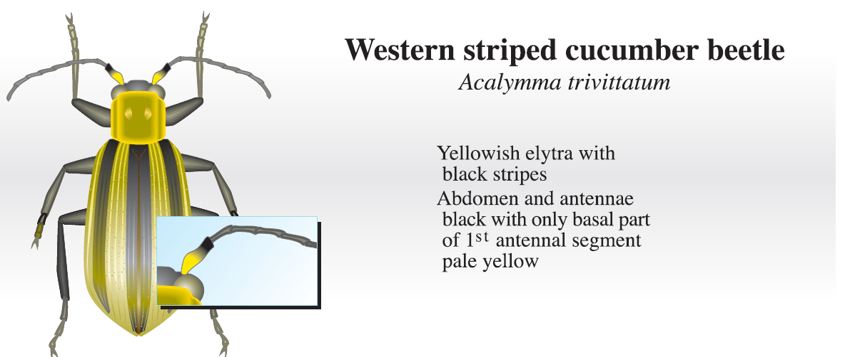
Western striped cucumber beetle ID
Acalymma trivittatum
P. Goodell and P. Philips. A Field Key to the Cucumber Beetle Species Found in California. UC-IPM.
Notes:
More damaging to cucurbits, smaller than WSpCB
Basal, bottom part

Slide 7
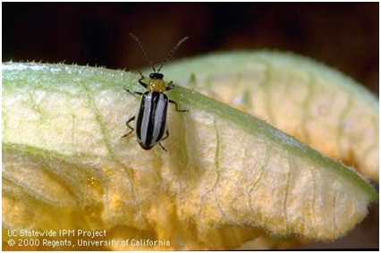
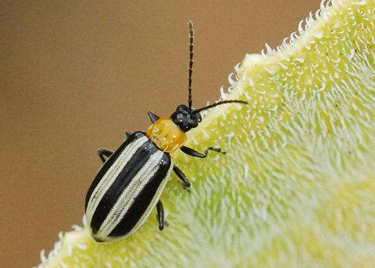
Western striped cucumber beetle biology
Develop and feed on cucurbits
  Pigweed, bindweed, burclover
Move in from weedy areas/leaf litter earlier in the spring than spotted
Adults most damaging-seedlings, flowers, foliage, FRUIT
Can be very damaging to seedlings
Feed on bottom of fruit→ scarring rind
Larvae feed exclusively on cucurbit roots
More damaging in cucurbit systems, especially melons
UC-IPM
R. Hemberger: Natural History of Orange County
Notes:
Large aggregations seen on burclover as early as February
Observed feeding on weeds when melons are not flowering
Seen in curcurbit fields almost a month before spotted in some years
More difficult to control

Slide 8
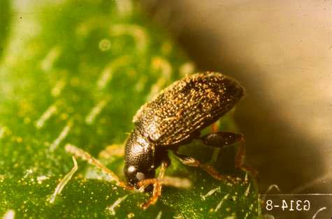
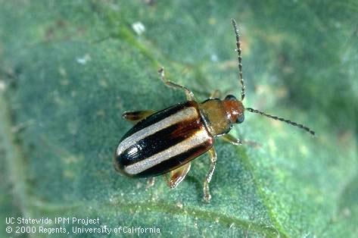
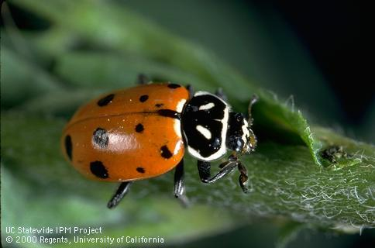
Cucumber beetle identification
Larger and more brightly colored than flea beetles
Lack enlarged hind legs found on flea beetles
Lady beetle antennae are short and stubby
Cucumber beetles are long and threadlike
Oregon State Extension Service
UC-IPM
UC-IPM
Notes:
How different from other beetles (flea beetles, ladybugs, etc.)?
Palestriped flea beetle, tuber flea beetle

Slide 9
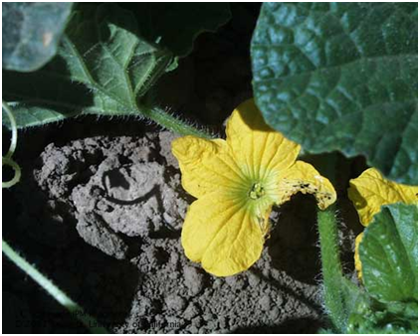
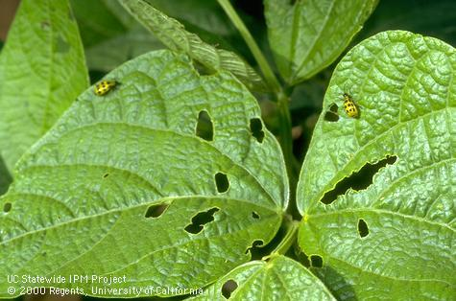
Cucumber beetle damage
Serious pests of smooth-skinned cucurbits
  Honeydew, crenshaw, and casaba melons
Prefer tender, succulent portions of plants-flowers, foliage, maturing fruit
Severe damage to seedlings→ stand reductions→ replanting
Larvae may cause serious injury to young plants by feeding on roots
Photos: UC-IPM

Slide 10
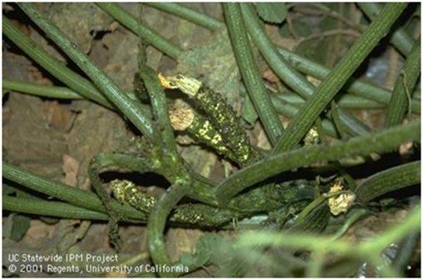
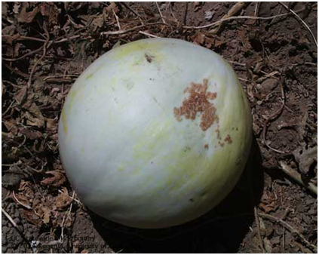
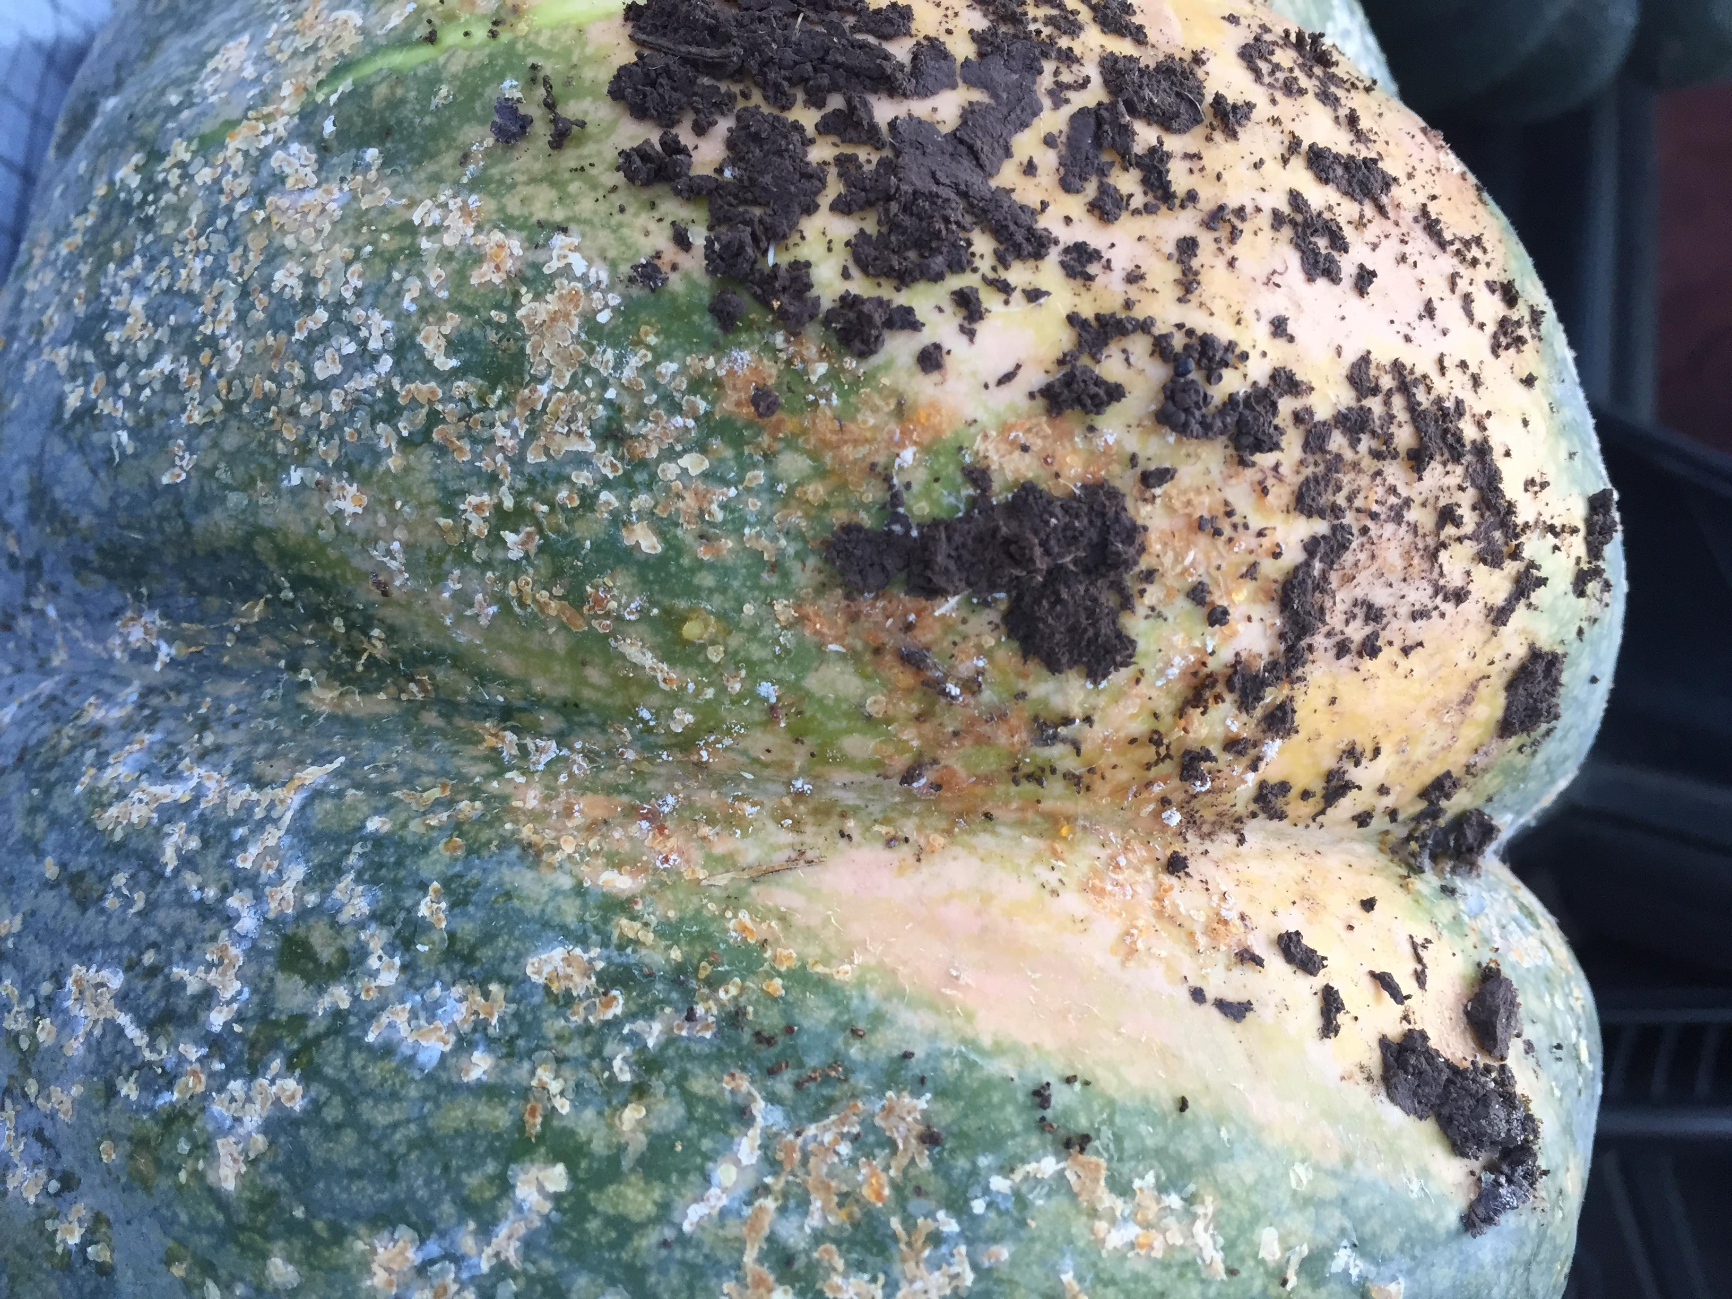
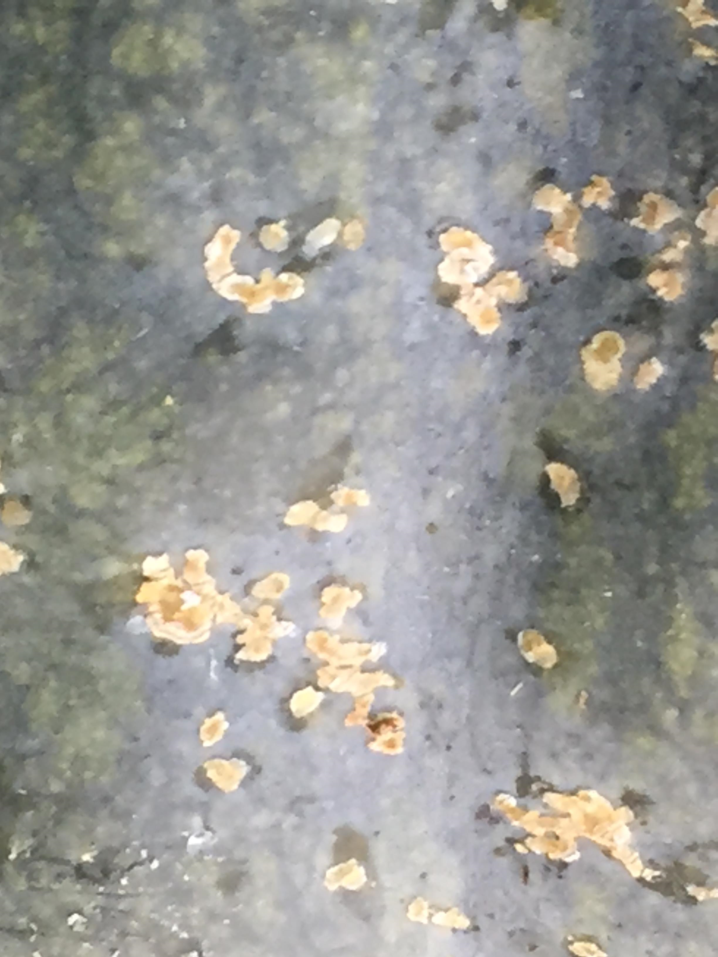
Damage to the surface of the melon reduces marketable yield
Once skin hardens, less prone to attack by beetles
Scarring in the crown of the plant is also typical of adult damage
UC-IPM
UC-IPM
O. Daugovish, UCCE
O. Daugovish, UCCE
Notes:
Zucchini with fruit feeding, melon scarring, pumpkin feeding damage

Slide 11
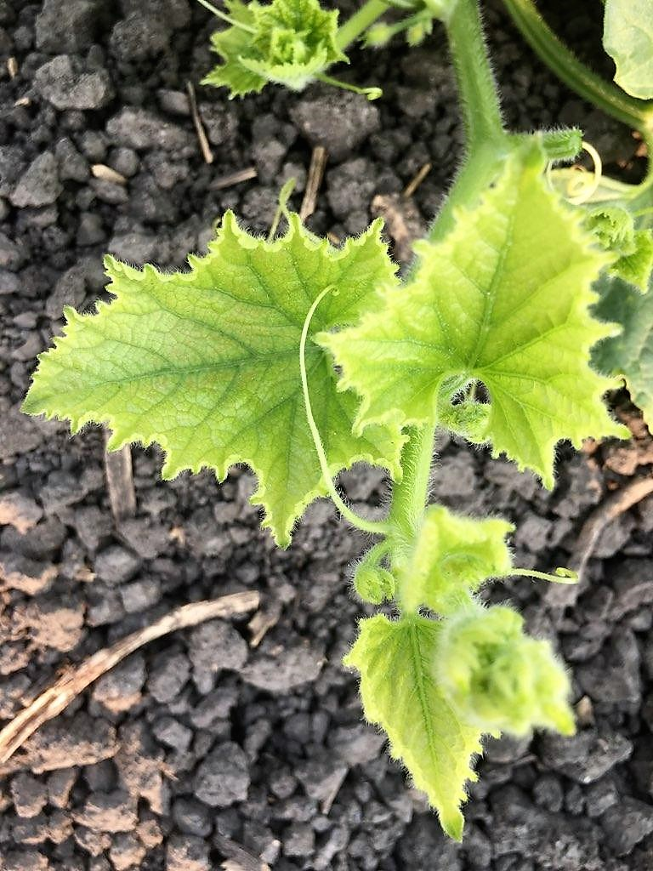
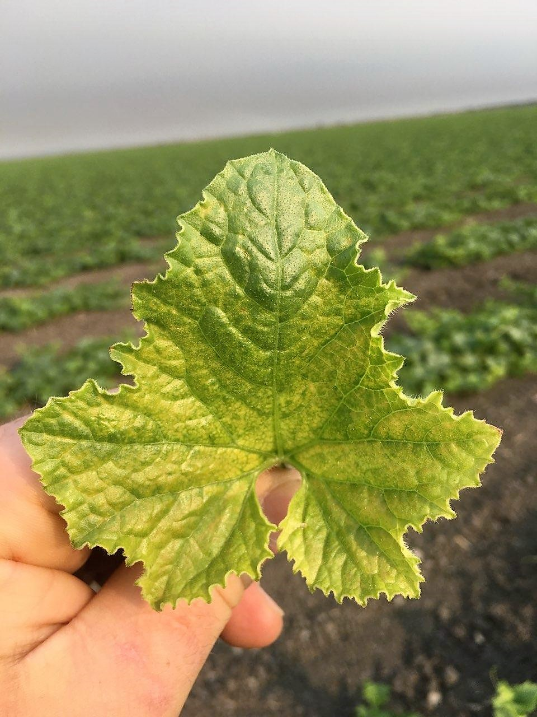
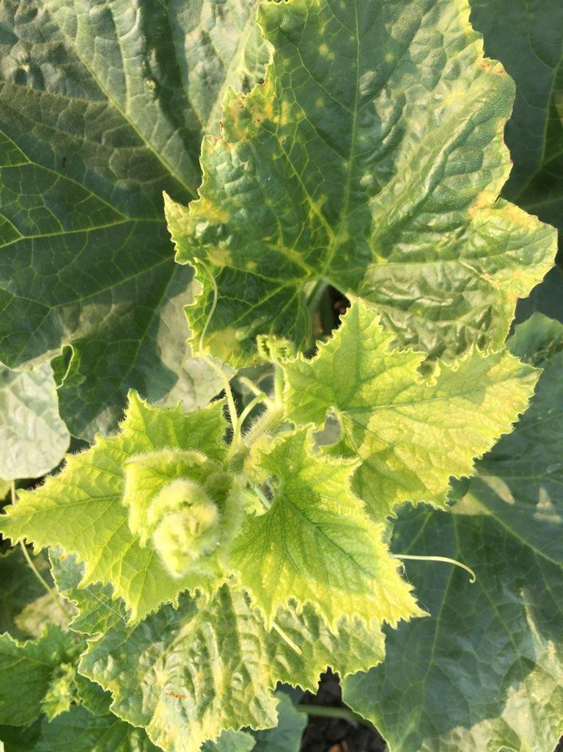
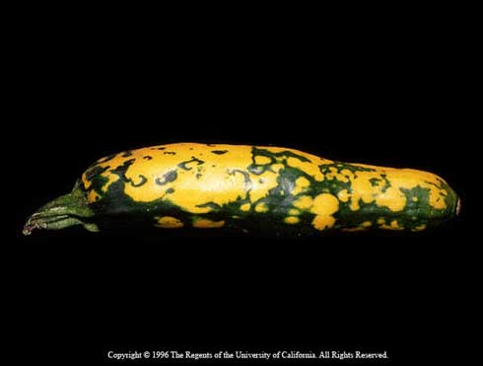
Squash Mosaic Virus
Transmitted by cucumber beetles and also seed-borne
Mosaic patterns and mottling of the leaf along with deformed fruit
Beetles keep the virus up to 20 days after feeding on an infected plant
Use virus-free seed to eliminate primary source of disease
UC-IPM
Photos: M. Lagorio

Slide 12
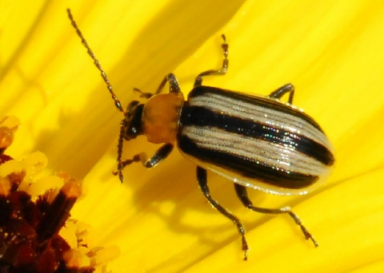
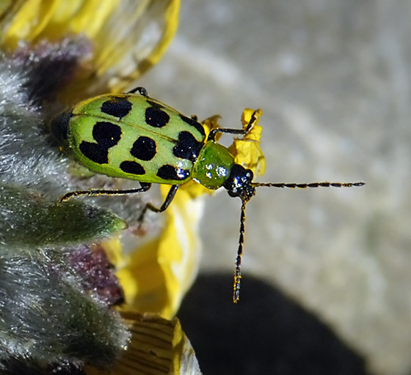
Monitoring cucumber beetles
Hard to find in winter
  Hide in leaf litter, near trees, shrubbery, fences, structures, weedy areas
Start after transplanting or when seedlings emerge
Continue through fruiting stage
Scouting is most effective
Less beetle damage seen between 4-leaf stage and flowering
R. Hemberger: Natural History of Orange County
BugGuide.net
Notes:
Scouting is the best way to monitory cucumber beetles—male aggregation pheromone
Unless severe year
No standardized way to monitor cucumber beetles in melons

Slide 13
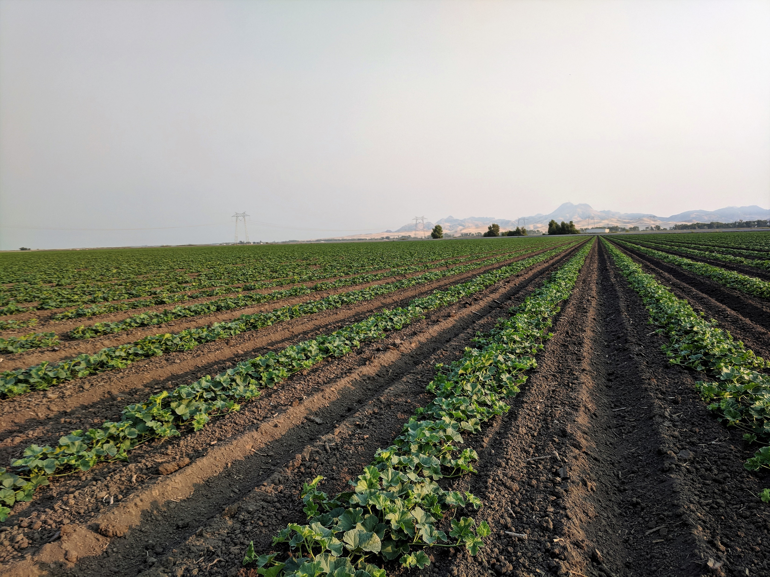
Management
Cucumber beetles are difficult to control
Multiple population peaks throughout the season
Late season infestations usually not as damaging as early season
Larger plants can tolerate damage
Biological, physical, cultural, chemical
Notes:
because numbers tend to be lower
Beetles like moisture and dislike heat
Melon fields attractive in hot weather during and after irrigations

Slide 14
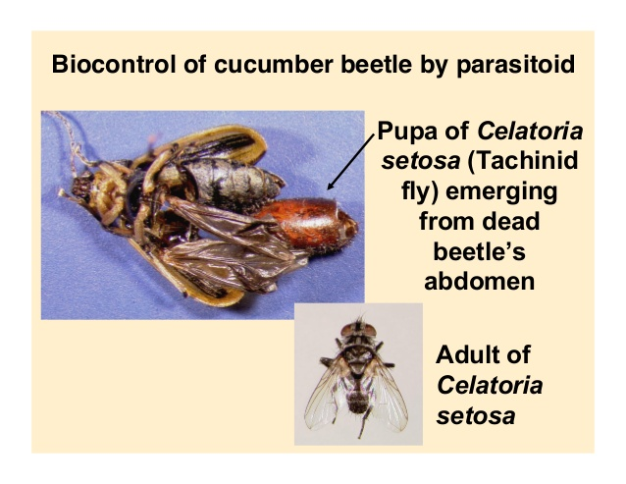
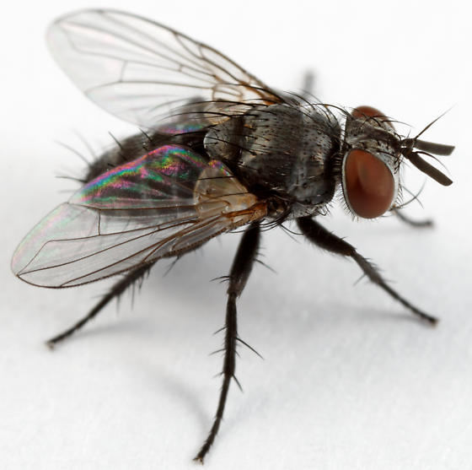
Biological control
Variety of natural enemies
  Lacewings, damsel bugs, assassin bugs, bigeyed bugs, minute pirate bugs, soldier beetles, ground beetles, and spiders
Parasitic tachinid fly, Celatoria spp.
C. setosa→ western striped
C. diabroticae→ western spotted
Rarely reduce populations below economically damaging levels
More parasitism in organic fields
Row Covers & Pest Control for Vegetable Gardens; Gardening Guidebook for Ohio
BugGuide.net
Notes:
Define biocontrol:
Especially in late summer-setosa
Fly deposits maggot under beetle elytra, feeds on beetle, pupates over winter and emerges killing host

Slide 15
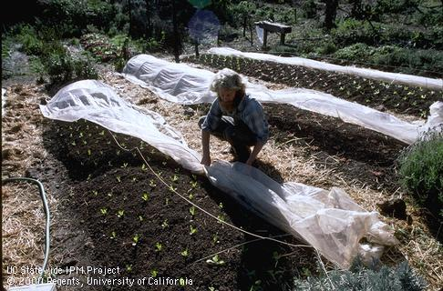
Physical control
Protect seedlings with covers or screens→ physical barrier
Place covers early so beetles and other pests cannot lay eggs under the cover
Remove once plants are large enough to tolerate damage
Can also help with sunlight and other environmental conditions
May limit ability to check plants or irrigate
Expensive for large areas
UC-IPM
Notes:
Various synthetic materials have become available, including vented polyethylene, spunbonded polyester, and woven plastics.
Among the easiest to use are the spunbonded or floating row covers that can either be placed on top of the bed with no frames or hoops or be placed over a dome structure.

Slide 16
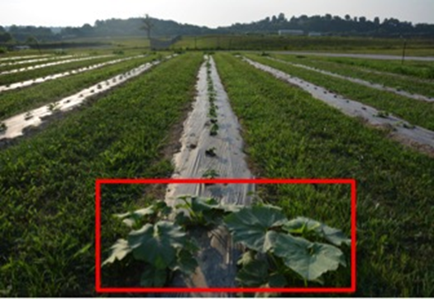
Cultural control
Remove weedy areas prior to planting
Plant larger transplants or extra seeds
Older plants can tolerate up to 25% defoliation without yield loss
Plant cucurbits as far from corn or other grasses as possible
Planting late spring may help avoid first striped beetle population peak
Trap crops (Blue Hubbard Squash) successful in MidWest
University of Missouri IPM
Notes:
Larger plants can better survive attack. Extra seeds means some plant loss can be tolerated
Reduce spotted CBs since the larvae develop on grasses
Trap crops-explain what they are
Blue Hubbard squash plants (larger plants) used as trap crops planted at both ends of each row.

Slide 17
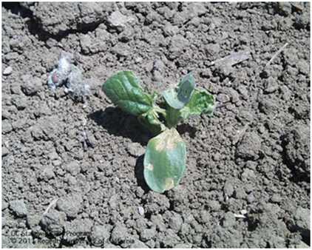
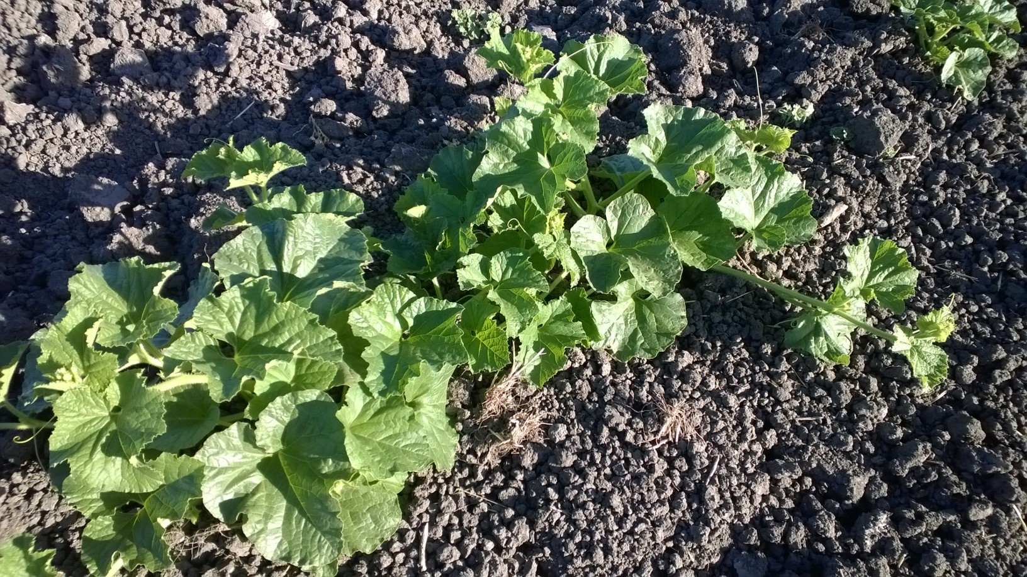
Chemical control
Directed at adult beetles
  Larvae of spotted develop outside of cucurbit fields
  Striped larvae are located on roots and cannot be reached with chemicals
No reversal of seedling damage
  Spot treat with Spinosad or soil-based botanicals on edge rows to reduce spread if detected early
UC-IPM
Notes:
Not very effective
Once seedlings are attacked, not much to do
Spinosad

Slide 18
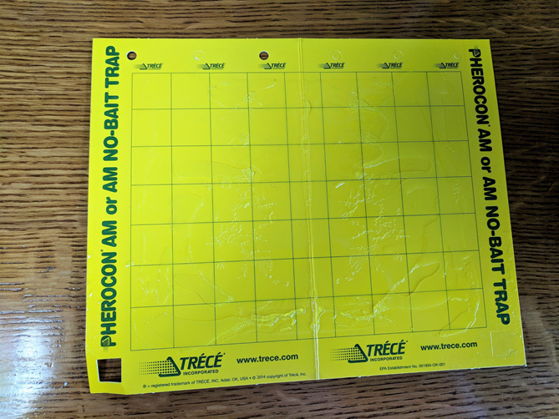
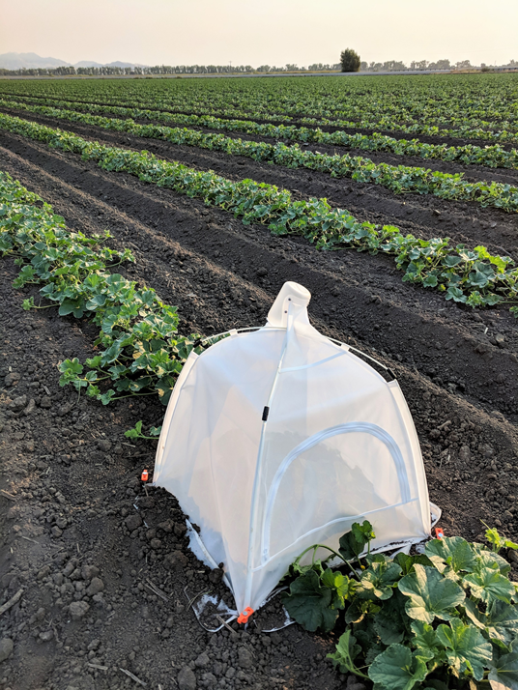
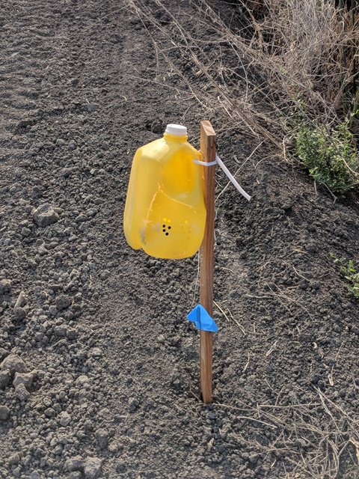
Cucumber beetle research
Sticky traps
Jug traps w/floral-lure/emergence traps
Testing 3 different traps in 2019 (in both organic and conventional)
  All with floral-lure
Notes:
Trapping studies and an insecticide evaluation in 2019
Tried sticky traps in 2017—top photo-yellow card attacked to stake and placed on edges of conventional melon fields-sticky substance to catch pests
Tried jug traps with floral lure and emergence traps in 2018-no success-based off of successful study in Missouri
Trying 3 different traps with floral lures to attract beetles in 2019 with Ian, Rachael and Margaret

Slide 19
Summary
Adult cucumber beetles cause most damage, especially to seedlings
Western striped cucumber beetles can be very damaging to melons, especially by scarring the fruit
Larvae only problem on melons (striped) or grasses/legumes (spotted)
Difficult to control
Older plants withstand more damage
Seedlings and maturing fruit are most vulnerable
Migrate in from alfalfa/weedy areas (spotted) or leaf litter/weedy areas (striped)
Remove weedy areas, plant away from corn or alfalfa, plant extra seeds
No standardized monitoring method
  Currently, scouting is most effective
Trapping studies ongoing

Slide 20
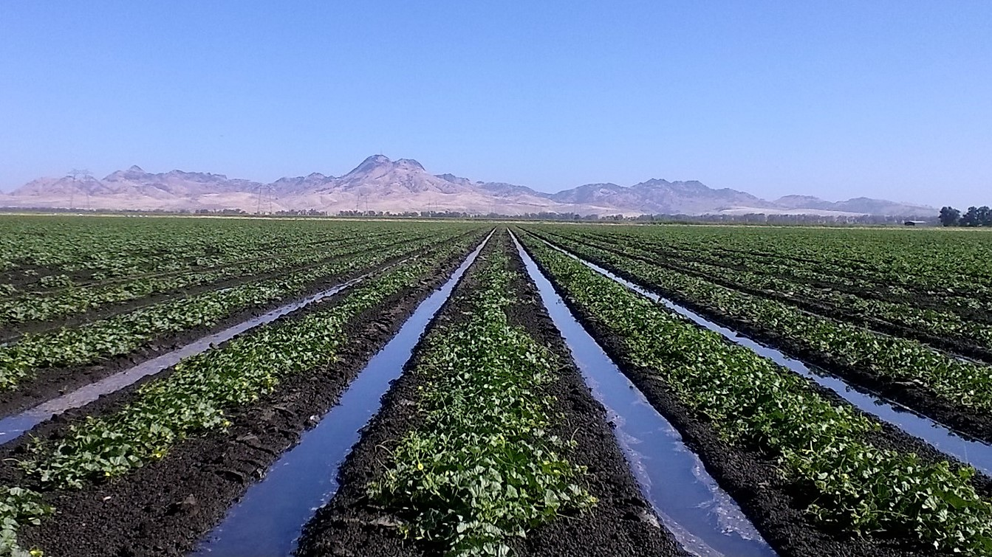
Questions?

Slide 21
References
Flint, M. L., A. Sutherland, and K. Windbiel-Rojas. 2018. Vegetable Pest Identification for Gardens and Small Farms. UC-IPM Pub. 3553.
Goodell, P. B. and P. A. Philips. A Field Key to the Cucumber Beetle Species Found in California. UC-ANR/UC-IPM
Pedersen, A. B. 2007. Improved Integrated Pest Management of Two Cucumber Beetle Species (Coleoptera: Chrysomelidae) in California Melon Agroecosystems. Thesis-University of California, Davis.
UC-IPM Pest Management Guidelines for Cucumber Beetles on Cucurbits. http://ipm.ucanr.edu/PMG/r116300511.html
UC-IPM Pests in Gardens & Landscapes: Cucumber Beetles. http://ipm.ucanr.edu/PMG/GARDEN/VEGES/PESTS/cucumberbeet.html
University of Missouri IPM. 2017. Controlling cucumber beetles and squash bugs in cucurbit crops. https://ipm.missouri.edu/MEG/2017/2/controlling_cucumber_beetles_and_squash_bugs_in_cucurbit_crops/

