Slide 1
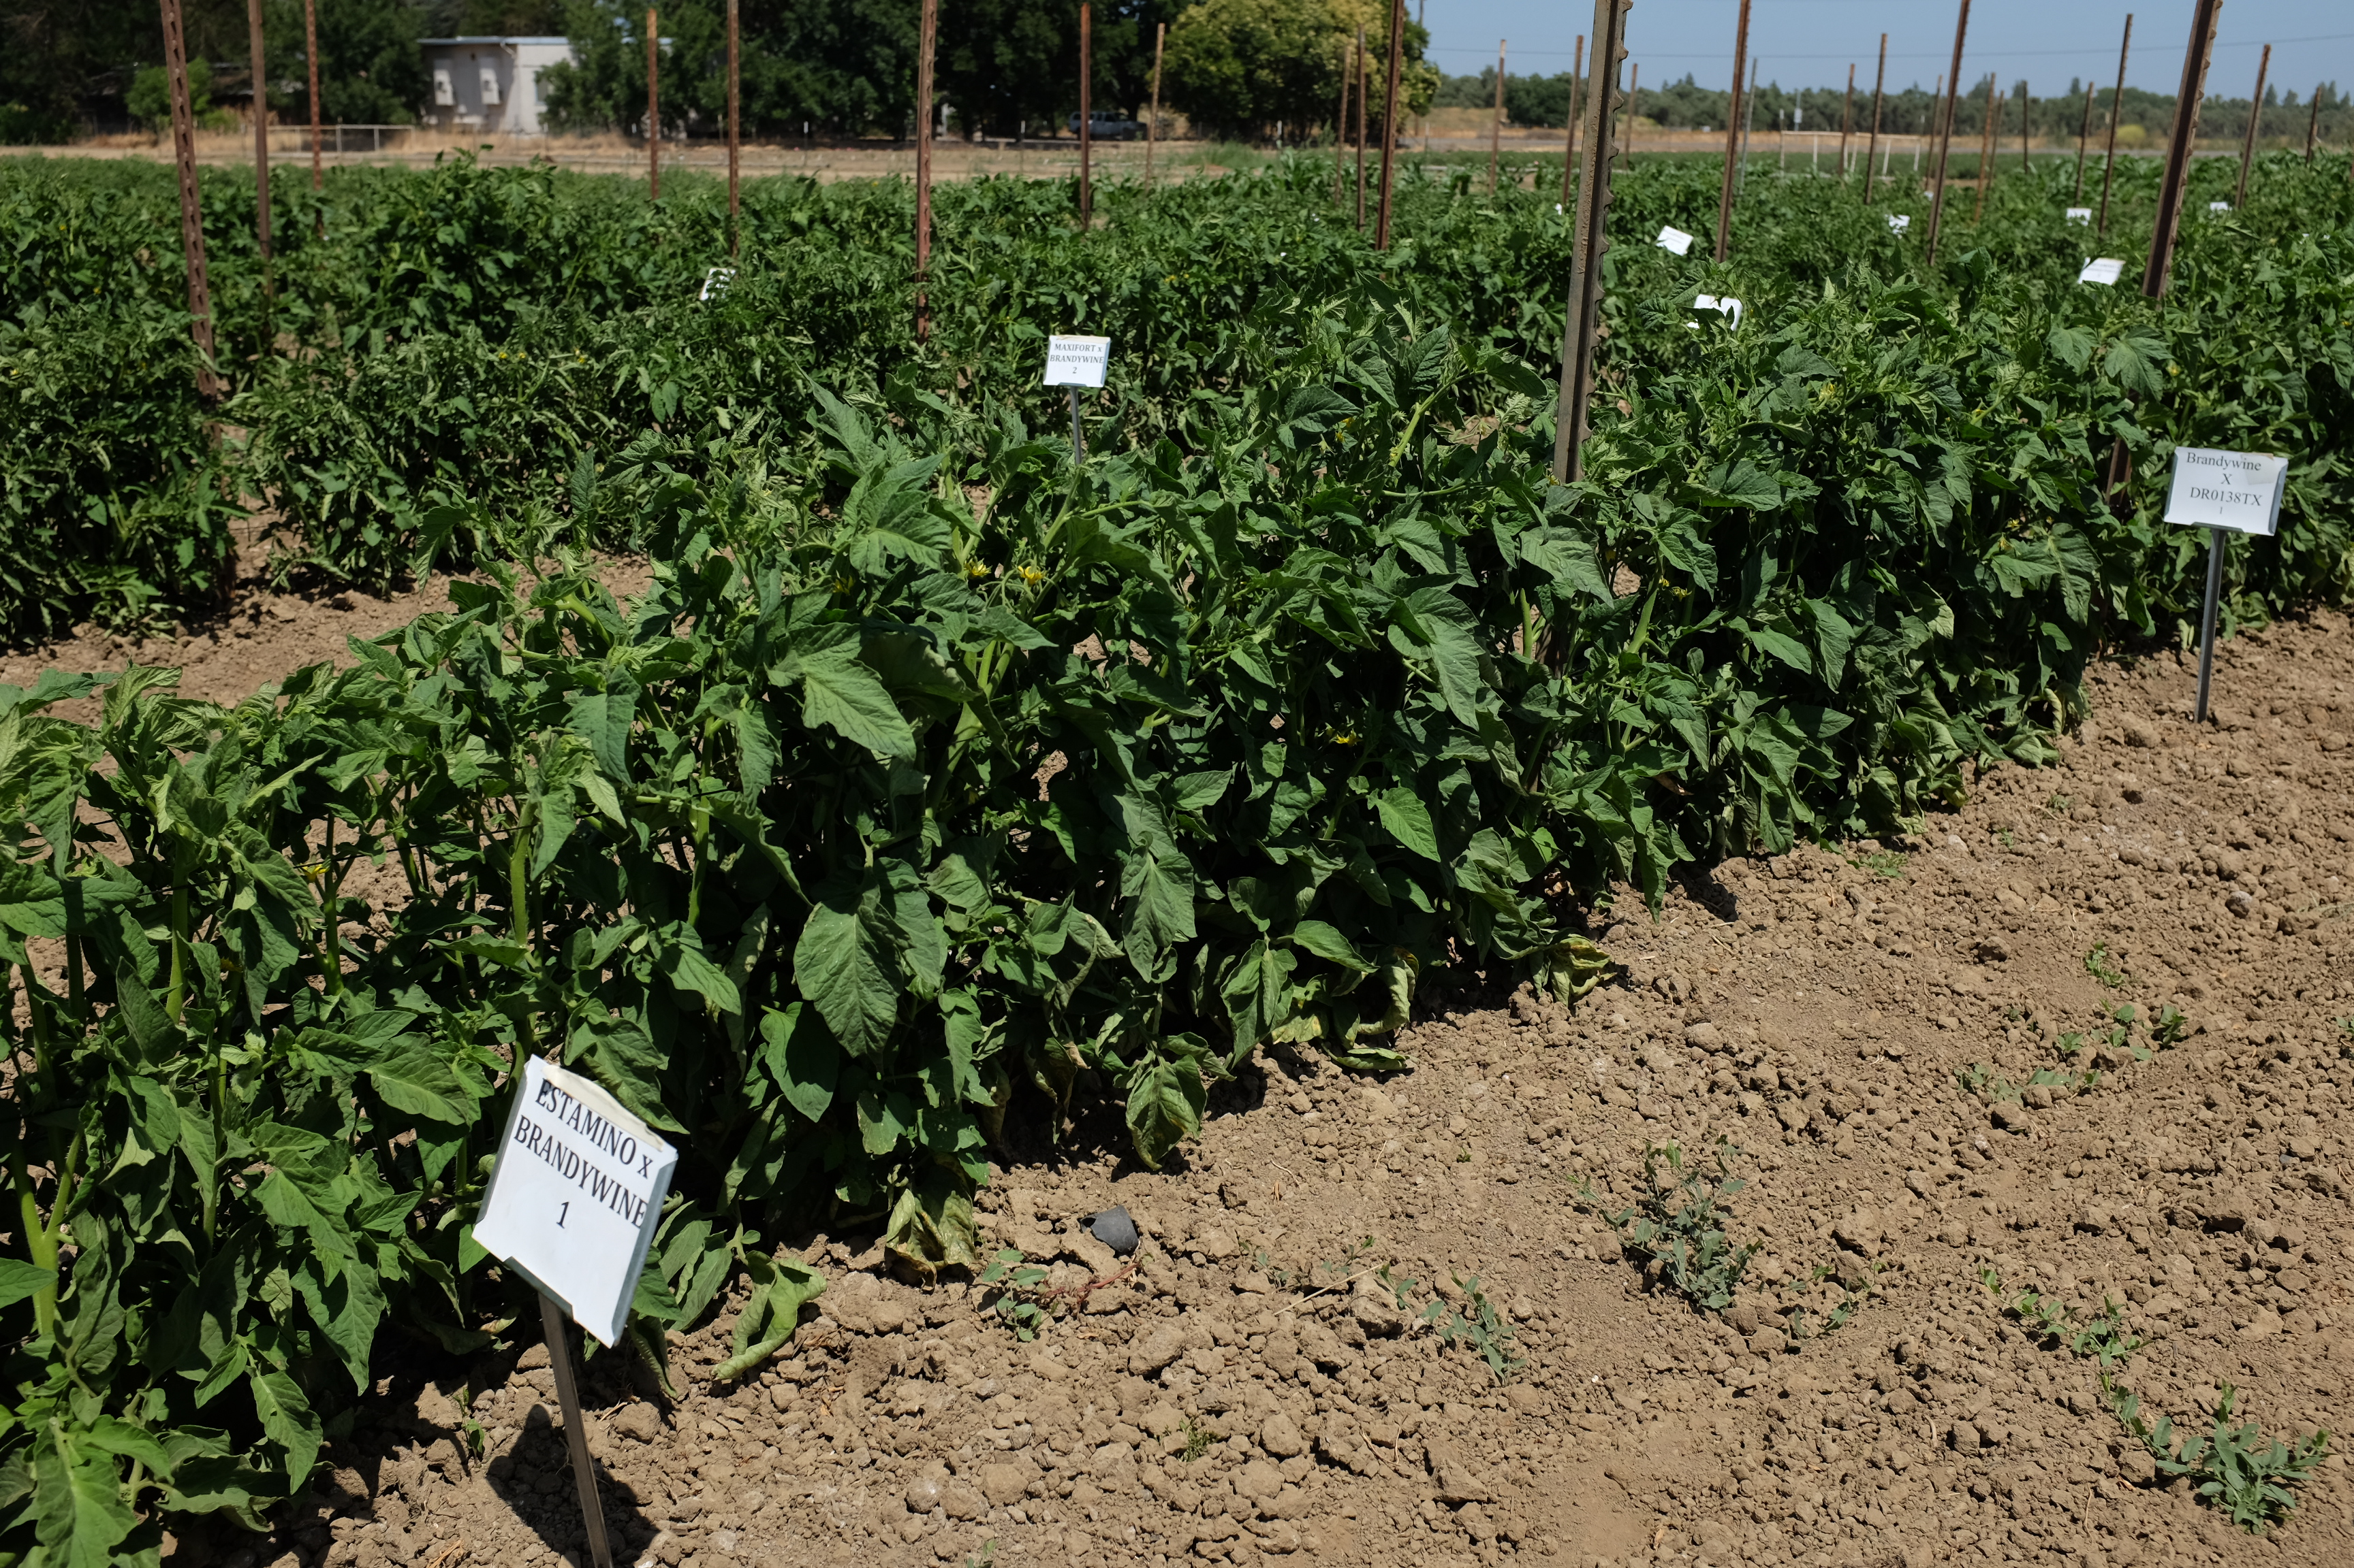

GRAFTING EXPERIENCE WITH OPEN-FIELD PRODUCTION OF HEIRLOOM TOMATOES
Margaret Lloyd
UCCE Small Farms Advisor
Yolo, Solano and Sacramento Counties
Organic Pest Management Workshop February 28, 2019

Slide 2
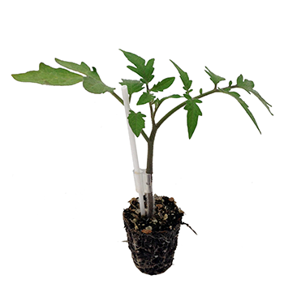
Why Graft?
Combine the features of two cultivars
Scion:Fruit traits desired by consumers
Rootstock: traits desired by the producers
  Resistance and/or tolerance to soil-borne disease and nematodes
  Increased abiotic stress tolerance
  Increased vigor & fruit size
  Fruiting over a longer period
  Mostly interspecific hybrids between cultivated tomato (Solanum lycopersicum) and wild species (typically S. habrochaites, less commonly S. peruvianum or S. cheesmaniae)
Source: www.mightymato.com (Plug Connection, Vista, CA)

Slide 3
Vine length: 30+ feet
Production: 8 to 10 months
Most tomato rootstocks have been bred for greenhouse production, where they allow longer production cycles and tolerance to variable conditions

Slide 4
1. Seeded 4 weeks before grafting
4. Rootstock and scion are clipped together
2. Splice graft: clipped at ~45⁰ angle
3. Clips are positioned

Slide 5
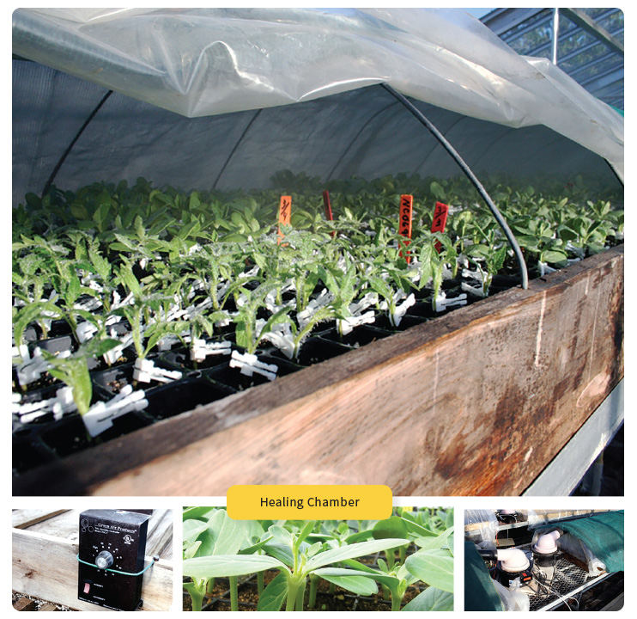
Healing Conditions
Temp: 28-29C (82-84F)
RH: 100%
Light 100 µmol/m^{2/}s
Tomatoes: 4 days

Slide 6
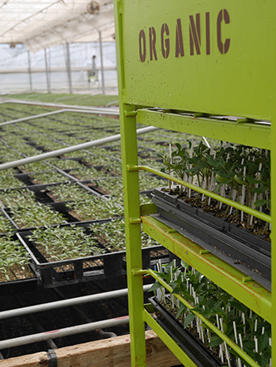
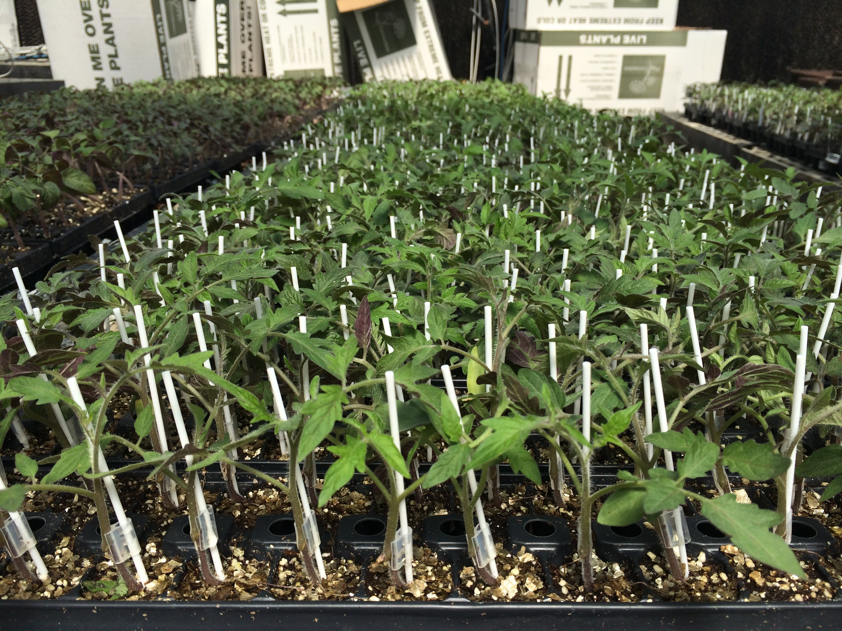
Plug Connection

Slide 7
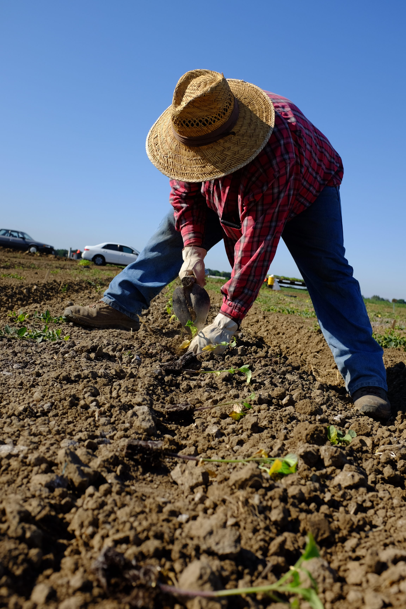
Effect of rootstocks on heirloom tomatoes, UC Davis Vegetable Crops Ranch, 2017-2018

Slide 8
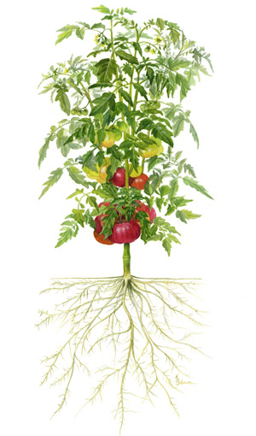
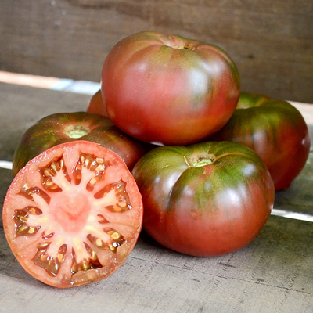
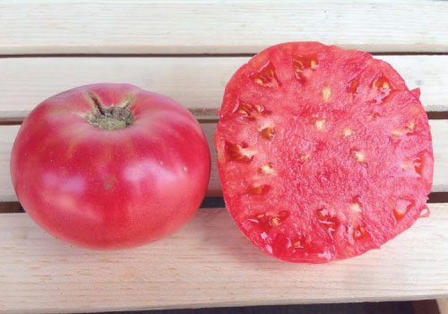
Scion
Cherokee Purple
Pink Brandywine
Maxifort | DeRuiter, Seminis
Multifort | DeRuiter, Seminis
DR0138TX | DeRuiter, Seminis
Estamino | Vitalis Organic Seeds, Enza Zaden
Fortamino | Vitalis Organic Seeds, Enza Zaden
Espartano | Vitalis Organic Seeds, Enza Zaden
Briomino | Vitalis Organic Seeds, Enza Zaden
E16R.40844 | Vitalis Organic Seeds, Enza Zaden
Rootstock

Slide 9
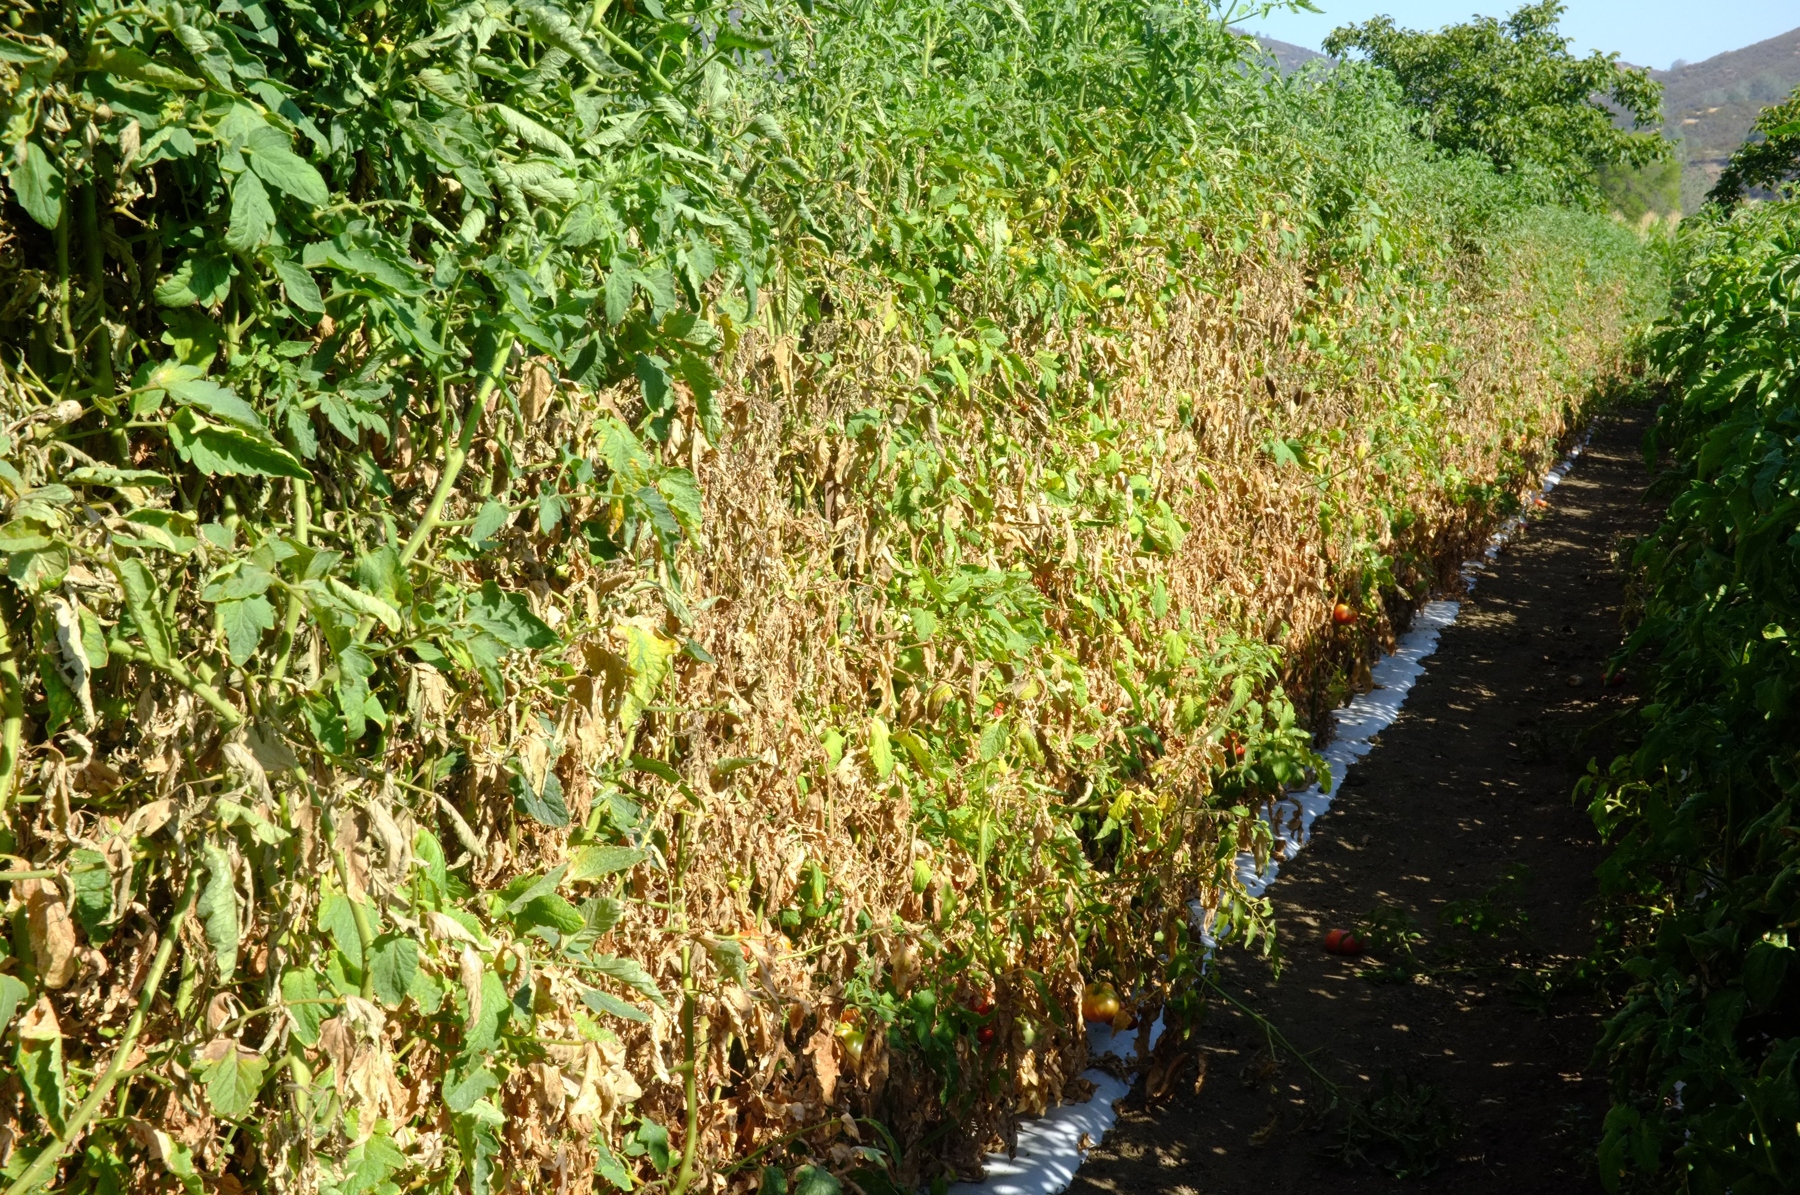
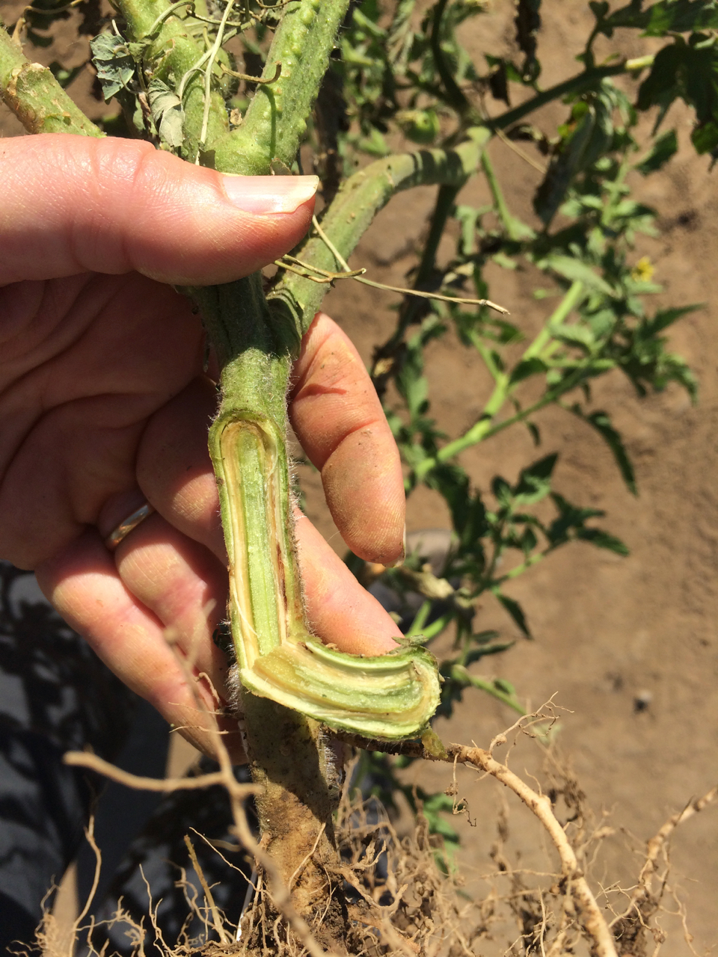
Heirloom tomatoes
Targeting vigor and reduced disease impact
Fusarium wilt

Slide 10
Disease ‘High Resistance’ Table
 | Tomato Mosaic Virus | Fusarium Wilt |  | Fusarium crown and root rot | Corky Root rot | Verticillium wilt
 | Race 0-2 | Race 1-2 | Race 3 |  |  | Race 1
DRO138TX | ✓ | ✓ |  | ✓ | ✓ | ✓
Multifort | ✓ | ✓ | ✓ | ✓ | ✓ | ✓
Maxifort | ✓ | ✓ |  | ✓ | ✓ | ✓
Estamino | ✓ | ✓ |  | ✓ |  | ✓
Fortamino | ✓ | ✓ |  | ✓ |  | ✓
Espartano | ✓ | ✓ |  | ✓ |  | ✓

Slide 11
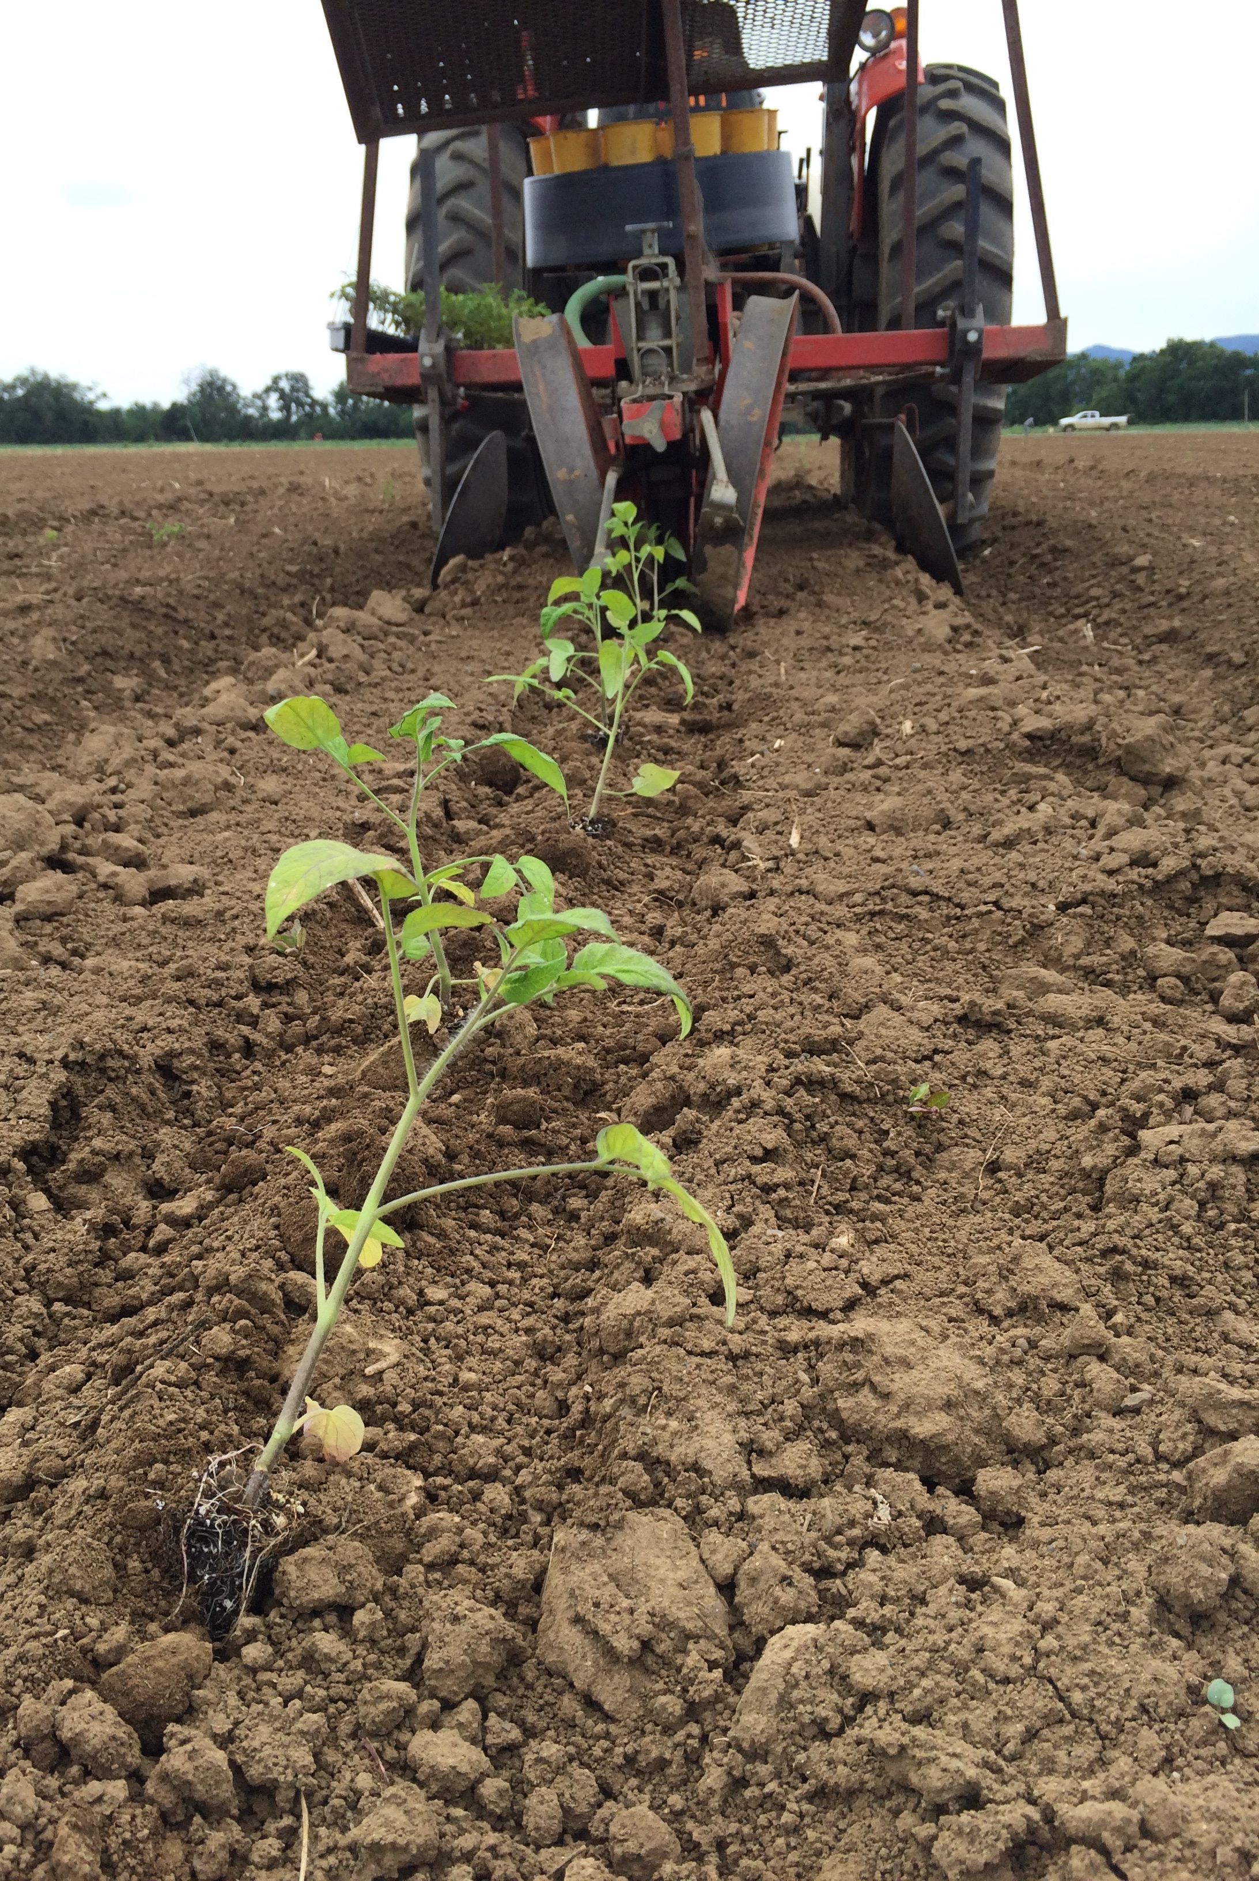
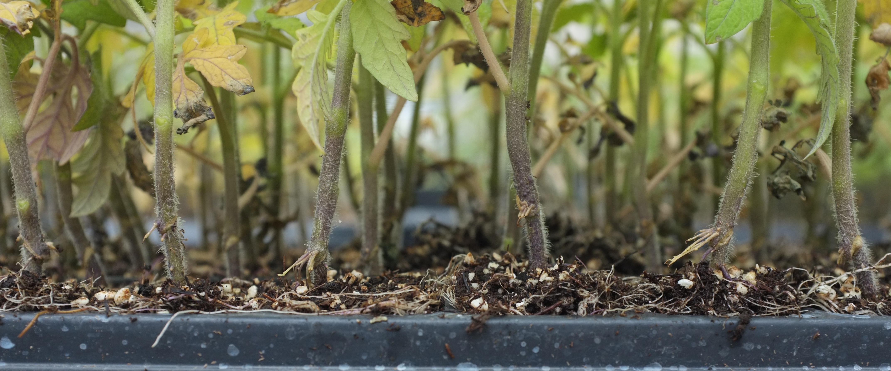
Disease resistance
Graft union location

Slide 12
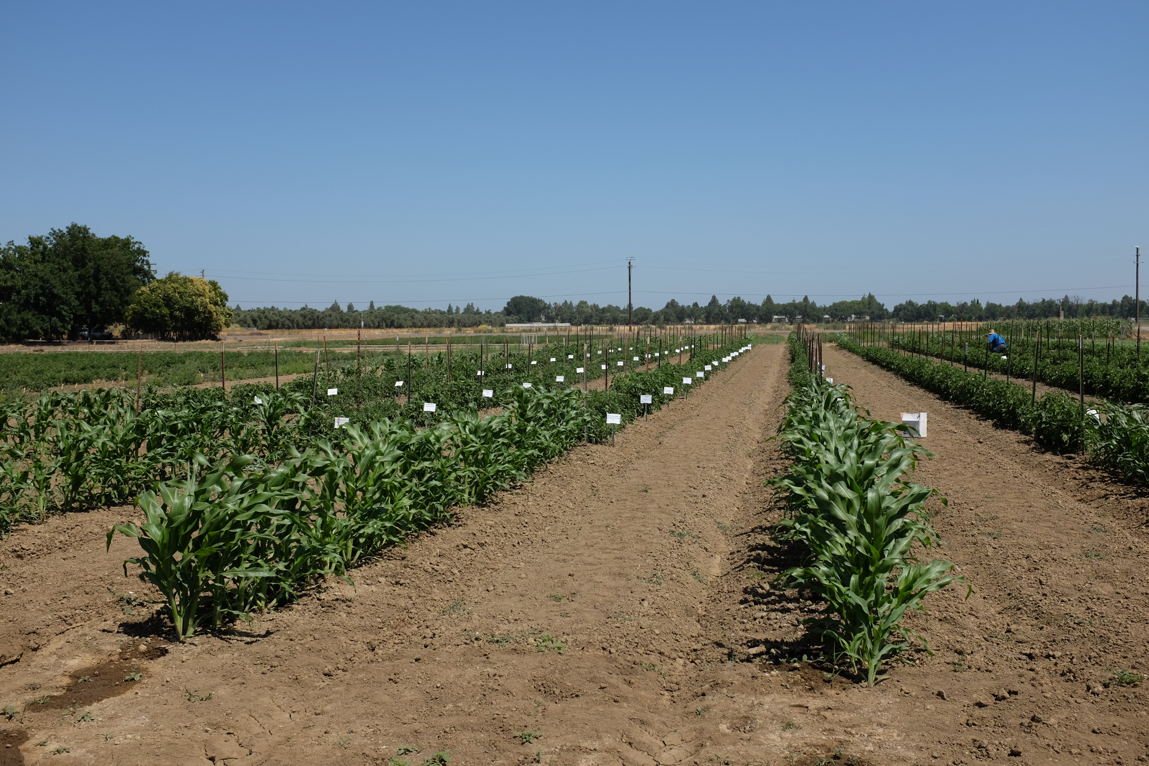
Field Experiment
Randomized complete block design
Plot size: 10’ long, single bed centered on 5’
Plant spacing: 12”, single plant line
Buried drip: 3-4”; sprinkle irrigated first 10 days
UC Davis Vegetable Field Crops Research Site (Hutchison Road)
Soilborne disease: Known incidence, limited knowledge, not a disease study
Managed organically, not certified or transitional

Slide 13
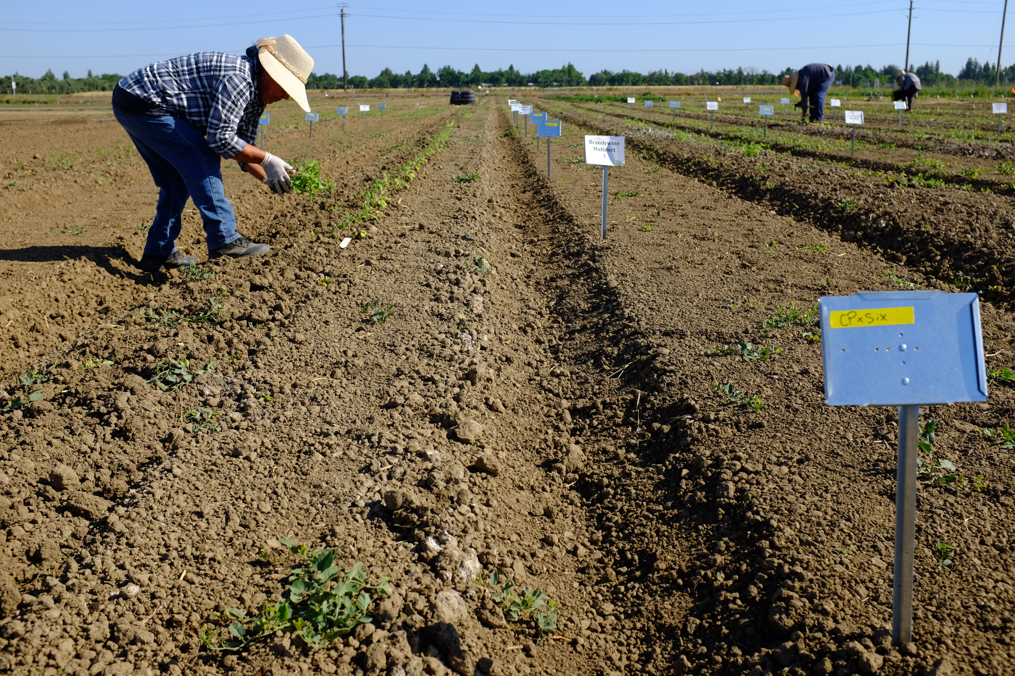
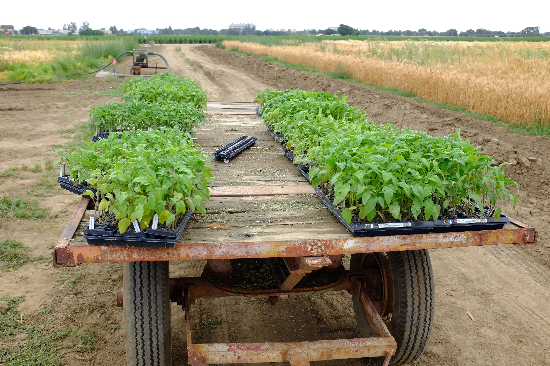

Slide 14
*
*
*
*
*p < 0.05

Slide 15
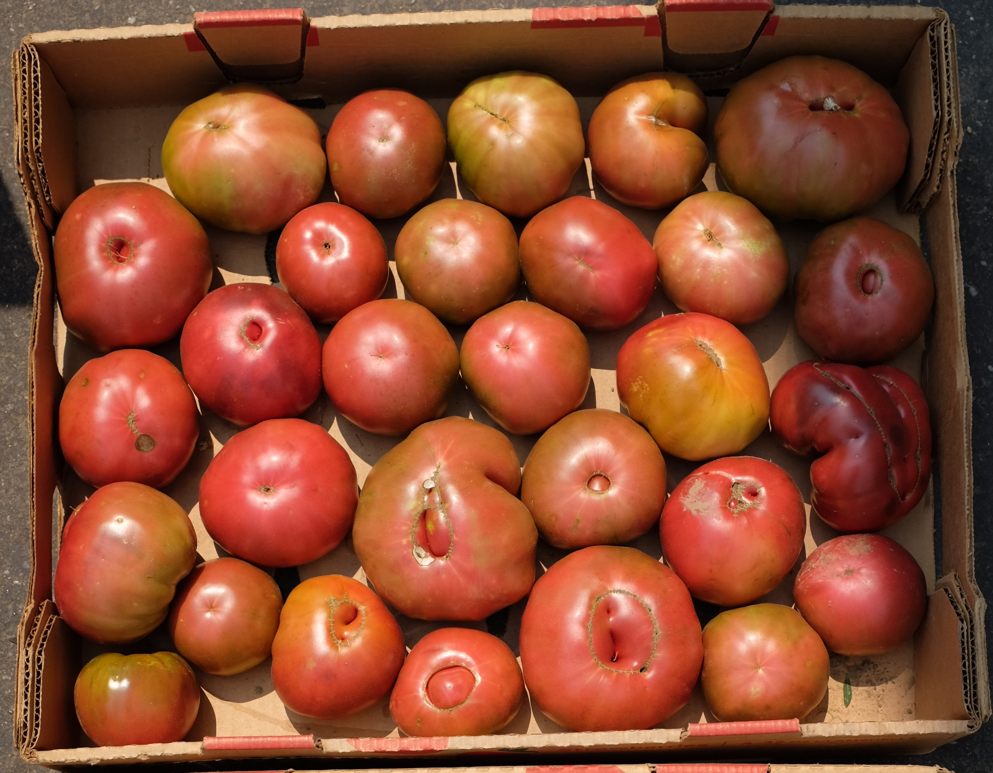
2017 Results
BRANDYWINE |  | ANOVA *p < 0.05
Non-grafted | 0%
Fortamino | -28%
Estamino | -48%
Briomino | -59%
DRO138TX | -65% | *
Multifort | -78% | *
Maxifort | -79% | *
Espartano | -82% | *

Slide 16
*
*
*
*
*
*
*
*p < 0.05

Slide 17
2017 Results
CHEROKEE PURPLE |  | ANOVA *p < 0.05
Non-grafted | 0%
Estamino | -49% | *
Fortamino | -59% | *
DRO138TX | -61% | *
Briomino | -66% | *
Maxifort | -83% | *
Espartano | -84% | *
Multifort | -88% | *

Slide 18
2017 Results
CHEROKEE PURPLE |  | ANOVA *p < 0.05
Non-grafted | 0%
Estamino | -49% | *
Fortamino | -59% | *
DRO138TX | -61% | *
Briomino | -66% | *
Maxifort | -83% | *
Espartano | -84% | *
Multifort | -88% | *
BRANDYWINE |  | ANOVA *p < 0.05
Non-grafted | 0%
Fortamino | -28%
Estamino | -48%
Briomino | -59%
DRO138TX | -65% | *
Multifort | -78% | *
Maxifort | -79% | *
Espartano | -82% | *

Slide 19
*p < 0.05

Slide 20
2018 Results
BRANDYWINE |  | ANOVA *p < 0.05
DRO138TX | +86% | ns
Multifort | +47% | ns
Maxifort | +37% | ns
Espartano | +24% | ns
Non-grafted | 0%
Fortamino | -10% | ns
Estamino | -58% | ns

Slide 21
*p < 0.05

Slide 22
2018 Results
CHEROKEE PURPLE |  | ANOVA *p < 0.05
Multifort | +42% | ns
Maxifort | +38% | ns
DRO138TX | +30% | ns
Espartano | +7% | ns
Non-grafted | 0% | ns
E16R.40844 | -21% | ns
Estamino | -44% | ns
Fortamino | -47% | ns

Slide 23
2018 Results
CHEROKEE PURPLE |  | ANOVA *p < 0.05
Multifort | +42% | ns
Maxifort | +38% | ns
DRO138TX | +30% | ns
Espartano | +7% | ns
Non-grafted | 0%
E16R.40844 | -21% | ns
Estamino | -44% | ns
Fortamino | -47% | ns
BRANDYWINE |  | ANOVA *p < 0.05
DRO138TX | +86% | ns
Multifort | +47% | ns
Maxifort | +37% | ns
Espartano | +24% | ns
Non-grafted | 0%
Fortamino | -10% | ns
Estamino | -58% | ns

Slide 24
Why the difference between 2017 and 2019?
Unclear
Inconsistency of heirlooms?
Environmental? 2017 hottest summer on record
Repeat in 2019

Slide 31
BRANDYWINE
DRO138TX | +86%
Multifort | +47%
Maxifort | +37%
Espartano | +24%
Non-grafted | 0%
Fortamino | -10%
Estamino | -58%
42%
45%
13%
17%
29%
0%
-9%

Slide 32
CHEROKEE PURPLE
Multifort | +42%
Maxifort | +38%
DRO138TX | +30%
Espartano | +7%
Non-grafted | 0%
E16R.40844 | -21%
Estamino | -44%
Fortamino | -47%
+12%
+12%
+19%
0%
+8%
+10%
-6%
-16%

Slide 33

COST
0.80 – 1.00 (not including seed)
$0.25 + over sow: $0.30-0.40 rootstock is consistent
$1.10-1.40 per seedling
Plug Connection, Vista, CA
102 cell pack
8 week from sowing to shipping
Certified organic

Slide 34
COST
Additional Costs for Grafting
Ex. 1000 plants
$1250 Grafted Seedlings ($1.25/plant)
- $ 225 Non-grafted seedlings ($40/200 tray)
$1025 additional cost
≅ $1 more per plant

Slide 35
Conclusions
Inconsistent and unpredictable. Heirloom tomato effect?
Growth habit is acceptable—not too large
Shift in fruit size distribution towards large, depending on scion and rootstock.
  DRO138TX did not increase fruit size as much as Maxifort and Multifort
  Brandywine had significantly larger fruit on Maxifort and Multifort
  Cherokee Purple fruits were not as impacted by rootstock
Potential shift in fruit production timing?
  DRO138TX widened the harvest window/peak harvest
*Disease resistance*

Slide 36
Conclusions, fresh market (green) trials, San Joaquin Co.
Higher vigor, better fruit cover at harvest, reduced sunburn
Shift in fruit size distribution towards large and extra large
No obvious visual problems with fruit quality
At three lower yielding sites, increase with grafting averaged 33% over three years
At three higher yielding sites, there was no advantage when averaged over the three years
Yield difference averaged over all six sites was 12%

Slide 37
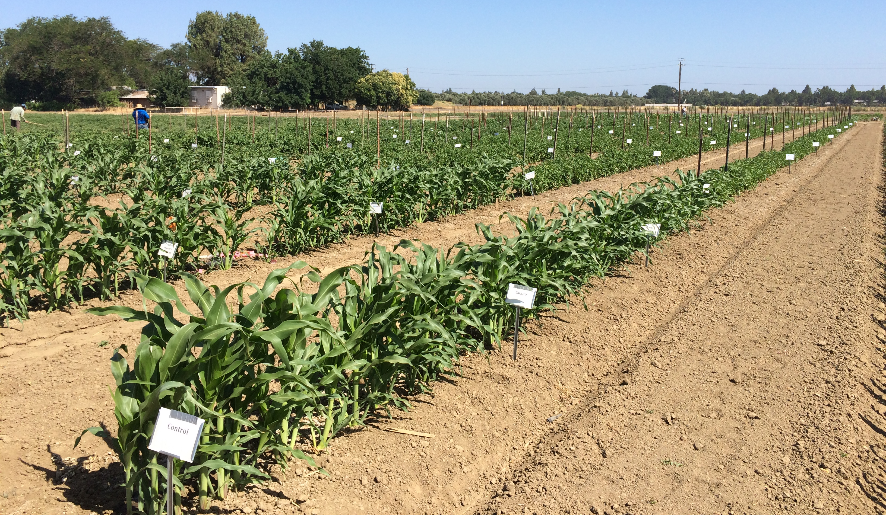
General Conclusions
Increase yield 10-30%
Increase fruit size
Alter fruit production timing, typically later
Disease resistance
Scion-Rootstock Interaction
Location specific

Slide 38
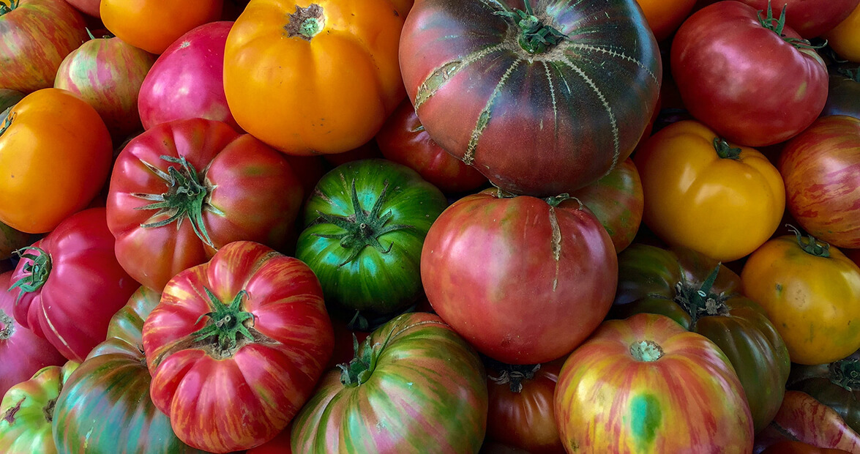
ACKNOWLEDGEMENTS
FIELD SUPPORT
UC Davis Vegetable Crops
Evie Smith
Patricia Lazicki
Jesus Martinez Rodriguez
Jasmine P Ramirez Bonilla
INDUSTRY SUPPORT
De Ruiters Seed
Enza Zaden/Vitalis Seed
Johnny’s Seed
Plug Connection
COLLEAGUES
Dr. Brenna Aegerter
Gene Miyao
Dr. Maegen Simmonds
Dr. Tom Gordon
USDA Grant # 2016-51181-25404

Slide 39
Thank you for your attention!
Questions?
Margaret Lloyd
UCCE Small Farms Advisor
Yolo, Solano, Sacramento Cos
mglloyd@ucanr.edu

