Slide 1
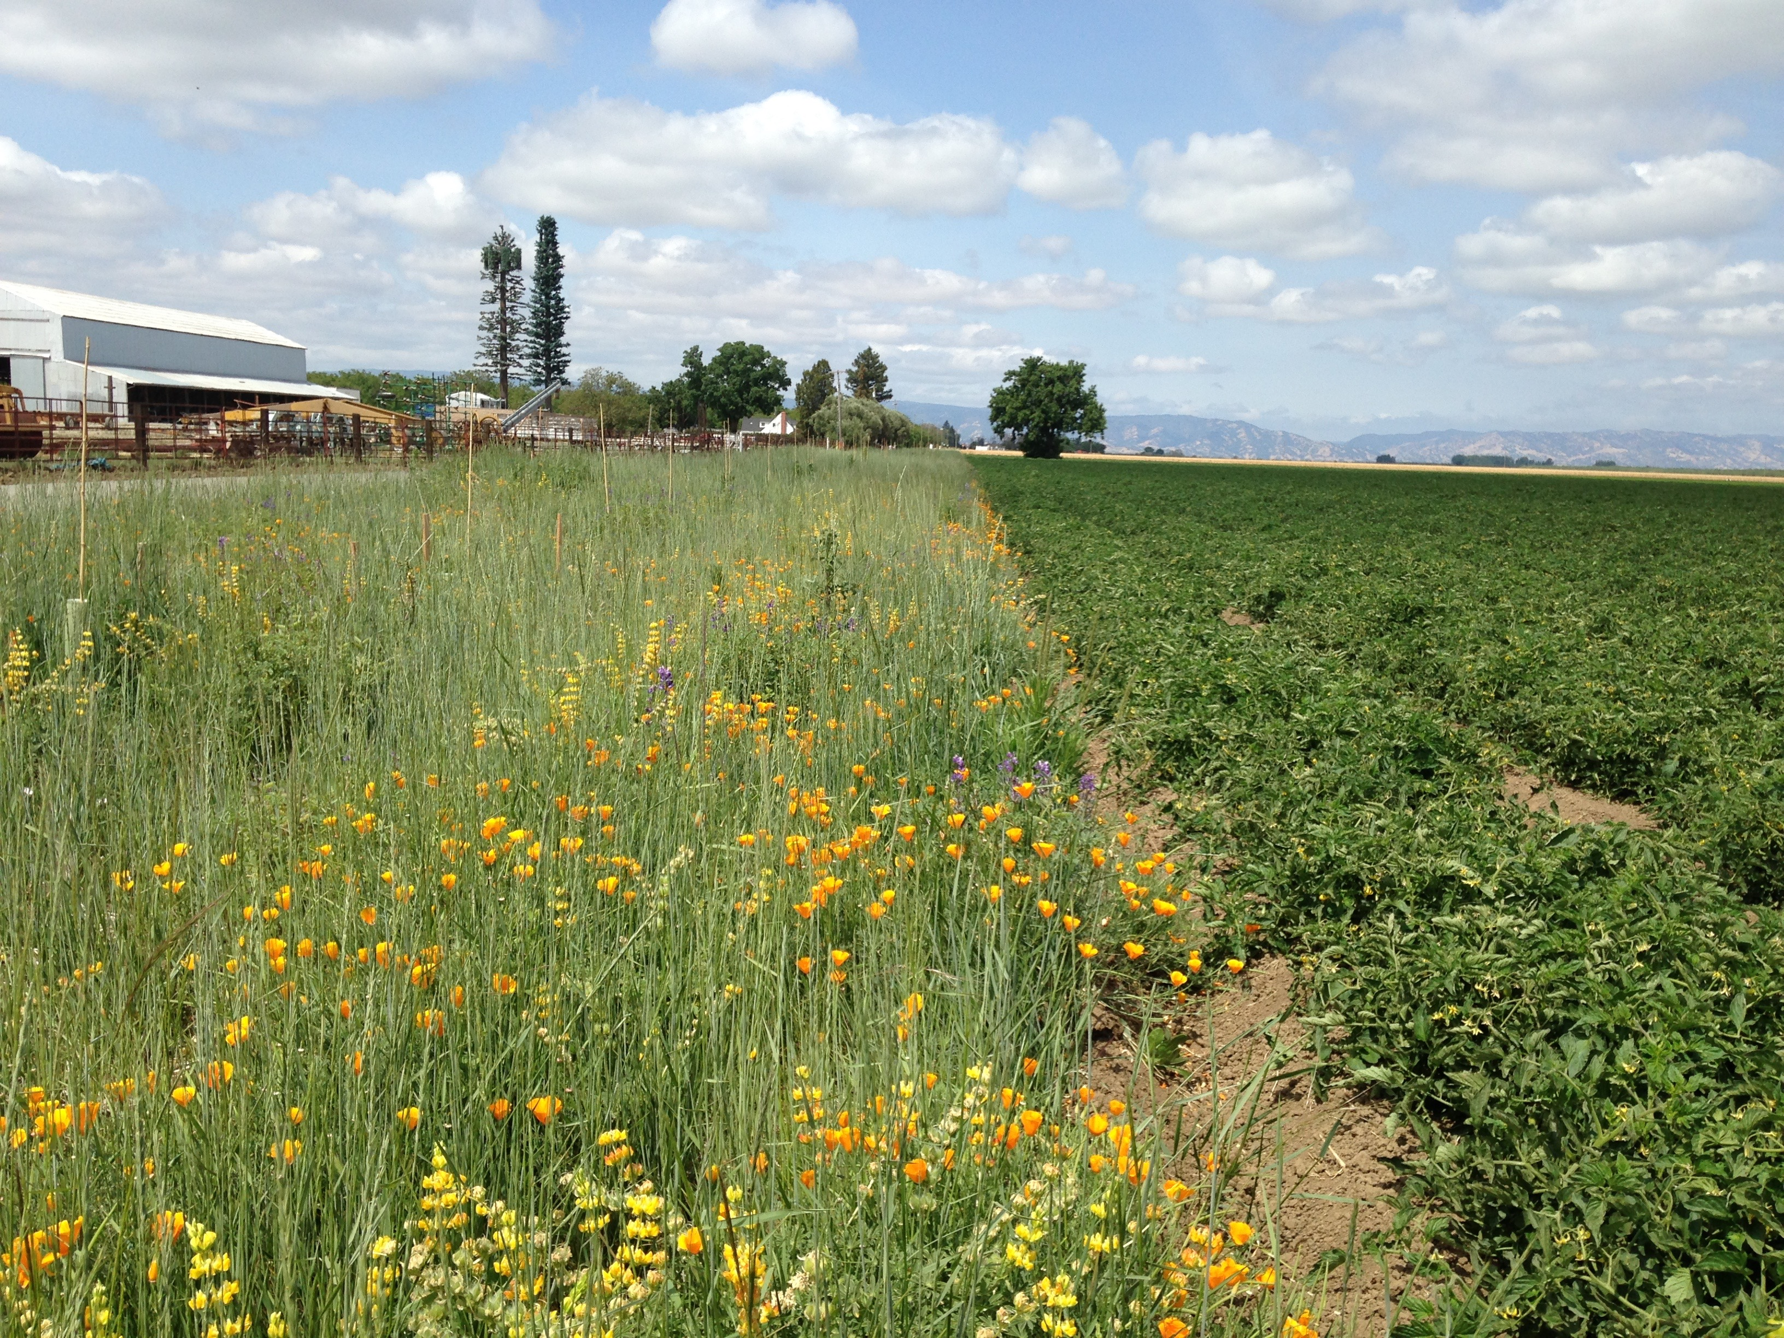
Managing insect pests in organic vegetable crop production
Rachael Long, Farm Advisor Yolo County

Slide 2
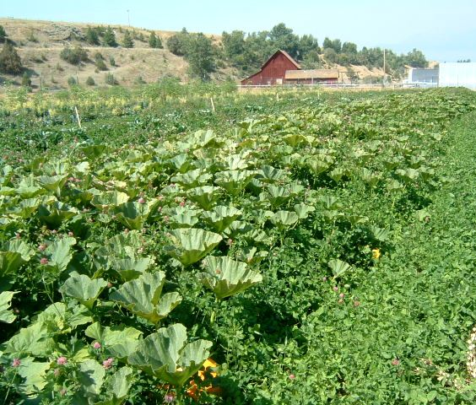
Common insect pests on farms
Caterpillar worms
Flea beetles
Aphids
Thrips
Seed corn maggot
Darkling beetles
Cucumber beetles
Stinkbugs

Slide 3
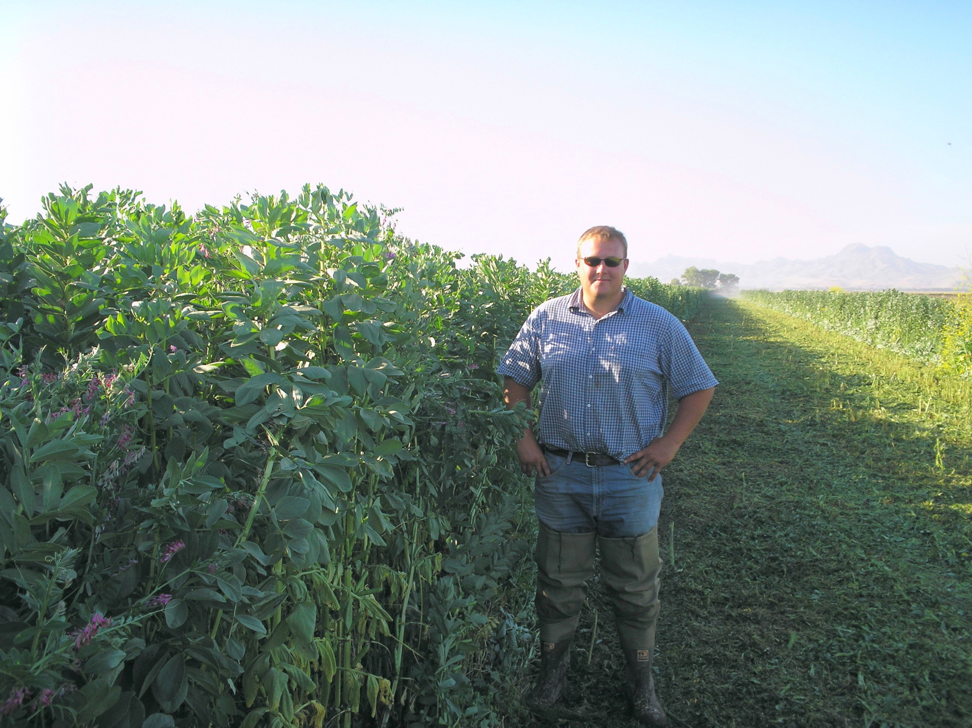
Importance of good Agronomic Practices in IPM
7C’s: Park Farming Organics leading to healthy soils and healthy plants
Cover crops
Conservation tillage
Crop rotation
Crop residue
Controlled traffic
Compost
Conserve inputs (N)
Notes:
As the tillage decreases, soil organic matter increases, nutrients/water, less soil compaction

Slide 4
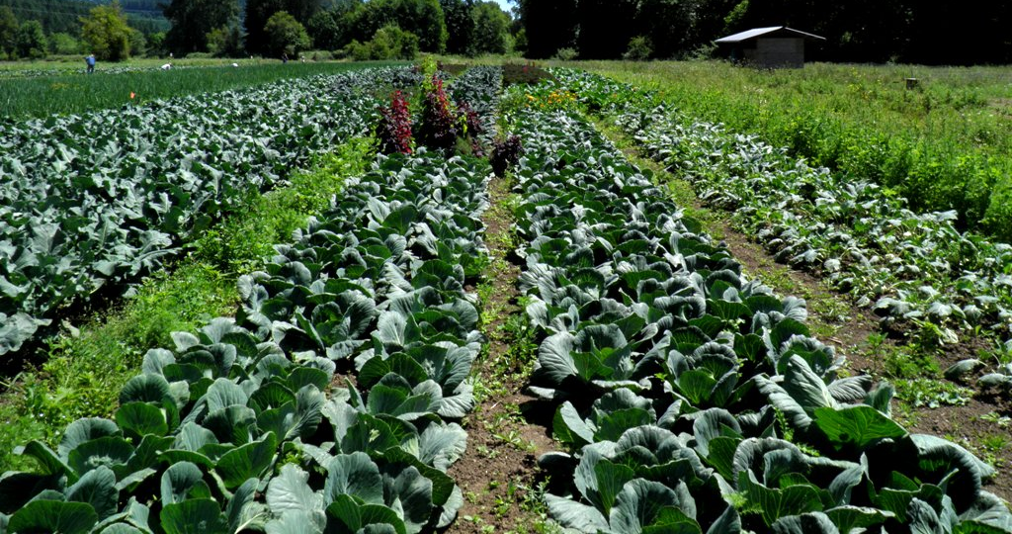
Know your pests: Insect identification in larval/immature stages
Caterpillar- pseudo-legs
Maggot, fly larva- no legs
Beetle larva-legs
Plant bugs (Lygus)

Slide 5
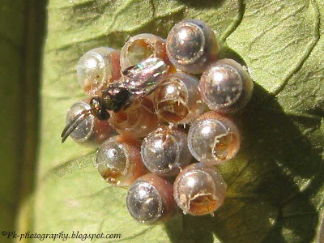
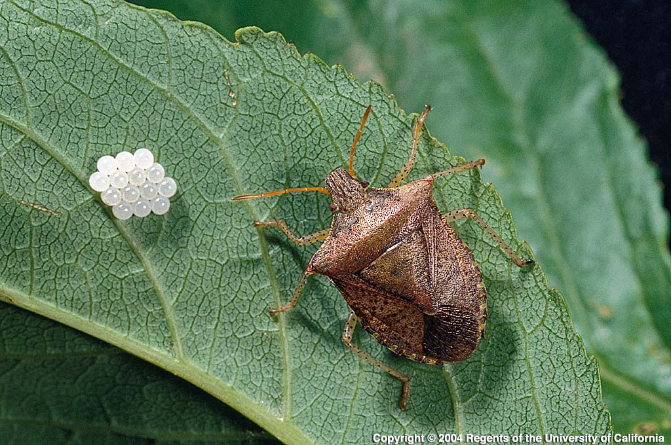
Know your beneficial insects
Parasitoid wasps (parasites)
Predators
Soldier beetle
Collops beetle

Slide 6
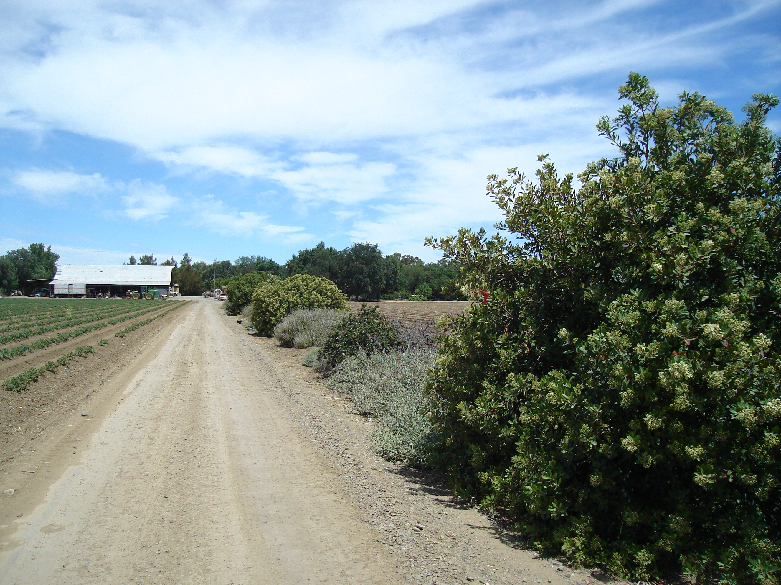
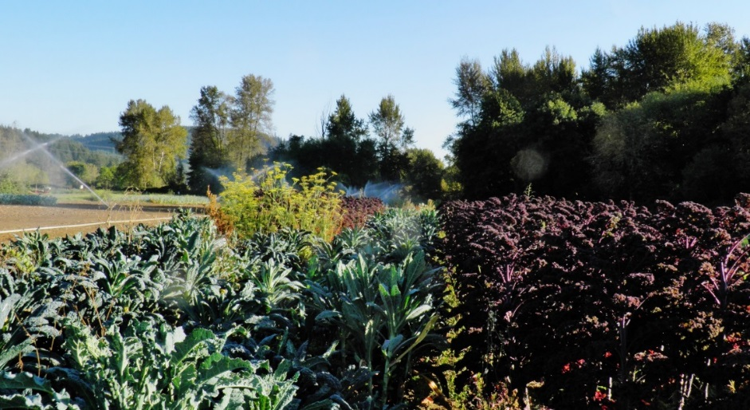
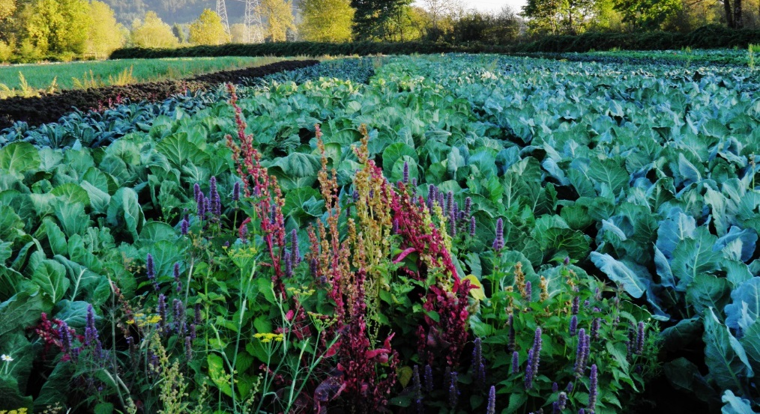
Habitat and floral resources for natural enemies

Slide 7
Caterpillar pests (worms)
Cabbage looper
Cutworms
Armyworms (western yellowstriped, beet)
Tomato fruitworm, corn earworm

Slide 8
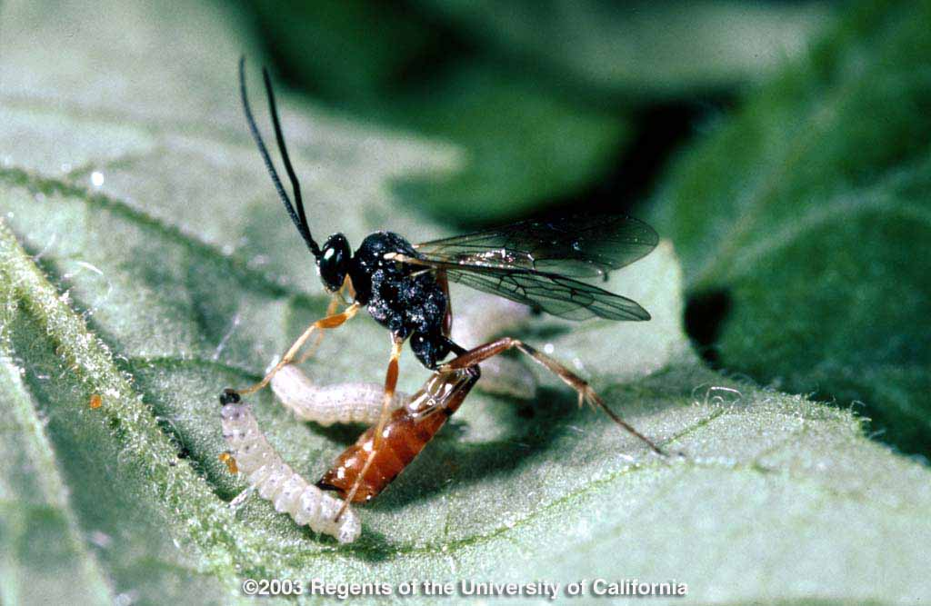
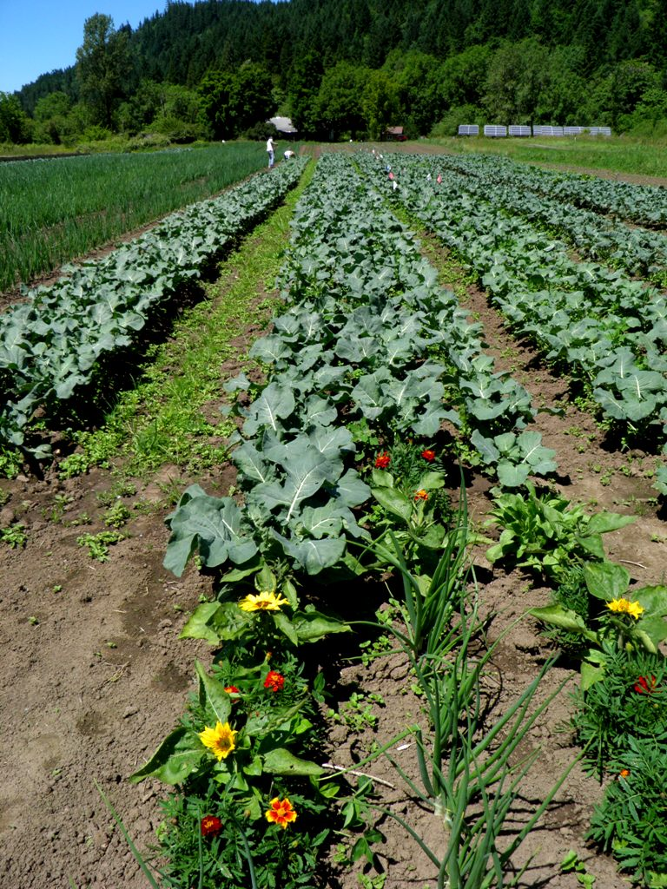
Management practices
Natural enemies, trichogramma and hyposoter wasps
Monitor and treatment thresholds (e.g. UC IPM guidelines tomatoes)
Insecticides: Microbials: Bacillus thuringiensis, Bt (e.g. Xentari). Most cost effective. Seduce (spinosad bait) for cutworms
Note: Entrust (spinosad) targeting thrips will also get worms, but not western yellowstriped armyworms

Slide 9
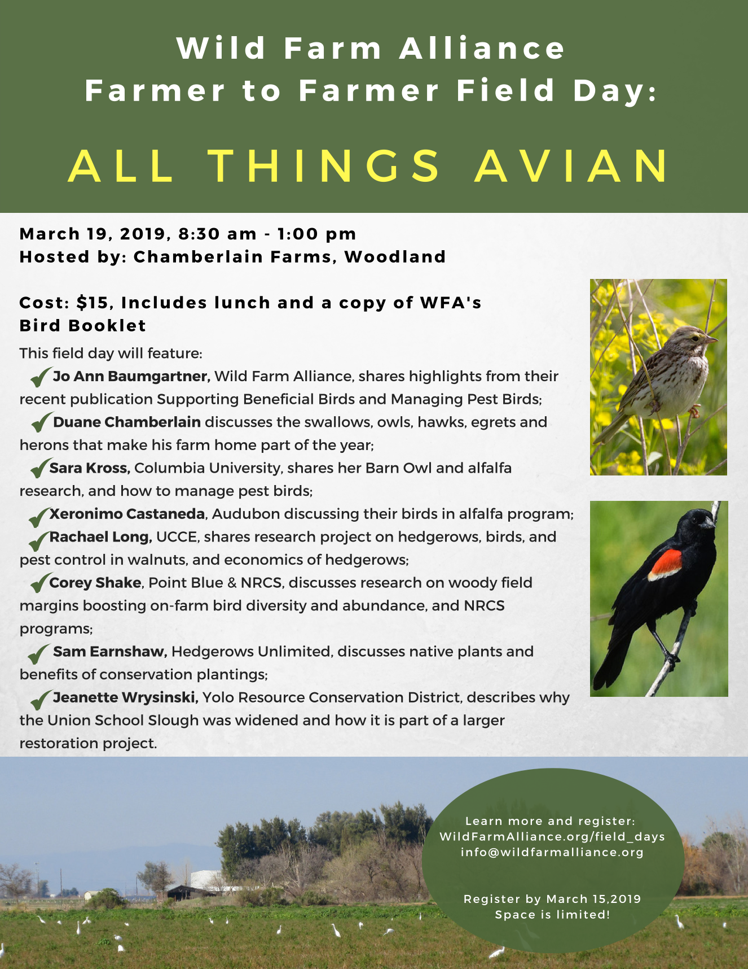
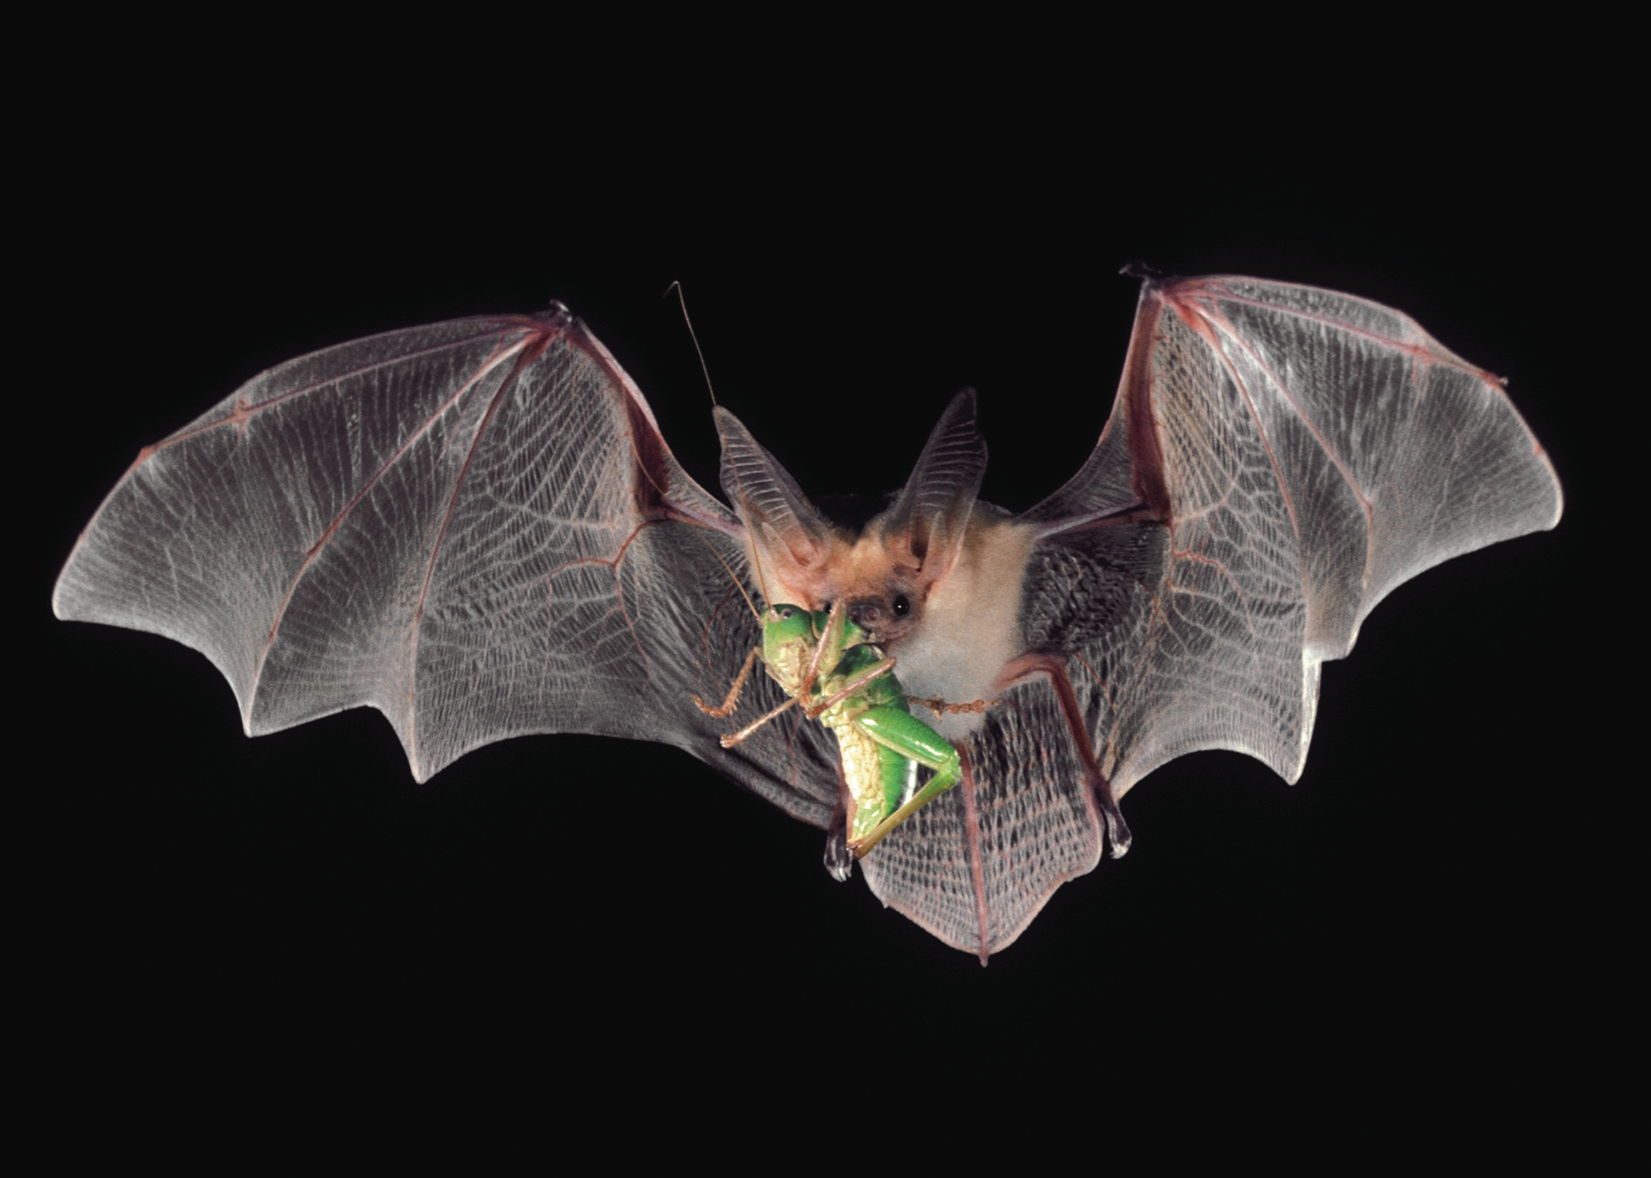
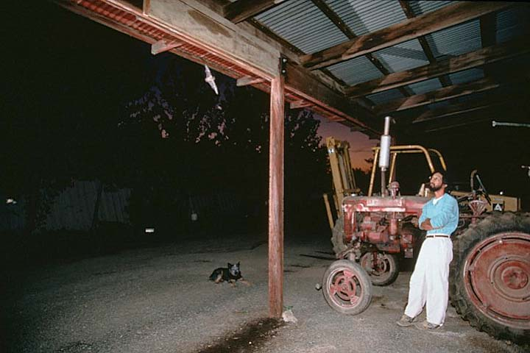

Slide 10
Common aphid pests in Vegetable Crops
Green peach aphid (spring, fall)
Cabbage aphid
Vegetables, flowers, fruit, vector viruses
Cole crops, brassicas
Melon (cotton) aphid
Spring, summer
Potato aphid (spring, summer)
Bean aphid
Vegetables
Legumes, flowers, ornamentals, bell beans
Vector viruses
Vegetables, citrus, flowers, ornamentals

Slide 11
Aphid Identification
Long legs, wings, no wings
Piercing sucking mouthpart (straw-like stylet)
Excrete honeydew
Cornicles: Emit pheromones or defensive secretions
Sedentary
Build up large colonies quickly (bare live young)
Primarily above ground (sometimes in roots)

Slide 12
Damage
Discoloration (bronzing, yellowing)
Distorted, curled leaves (toxins)
Honey dew excretion and sooty mold
Vector diseases (alfalfa mosaic virus)

Slide 13
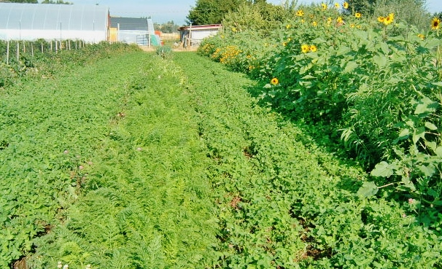
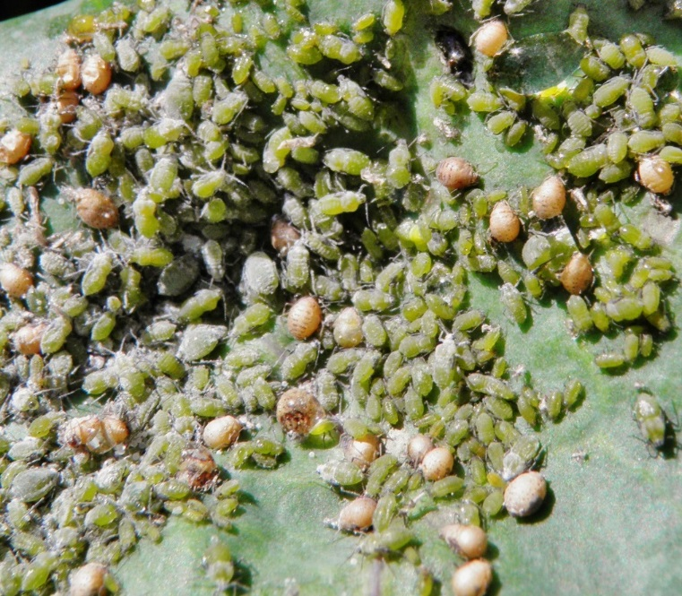
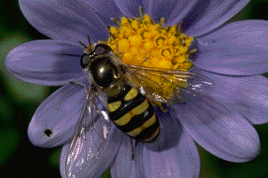
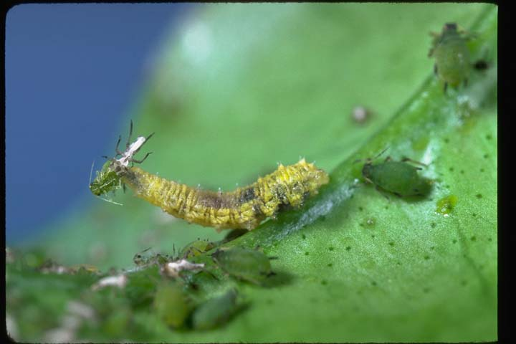
Protect and enhance natural enemies

Slide 14
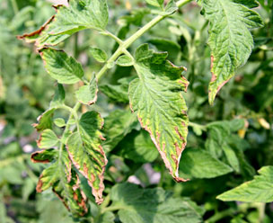
Aphid Control
Aphid resistant /tolerant plant varieties (romaine lettuce, tomatoes)
Watch for excess N and low K in plants
Avoid/remove virus reservoirs (esp. alfalfa)
Virus free/resistant planting stock
Control ants
Monitor & IPM thresholds: e.g. tomatoes, aphids: treat if 50-60% or more infested leaves.
Insecticides: PyGanic (pyrethroid) or Azera (pyrethroid+azadirachtin) + organic spray adjuvant. Microbials: Mycotrol or PFR-97 (fungi), need humidity (dew); apply late evening.

Slide 15
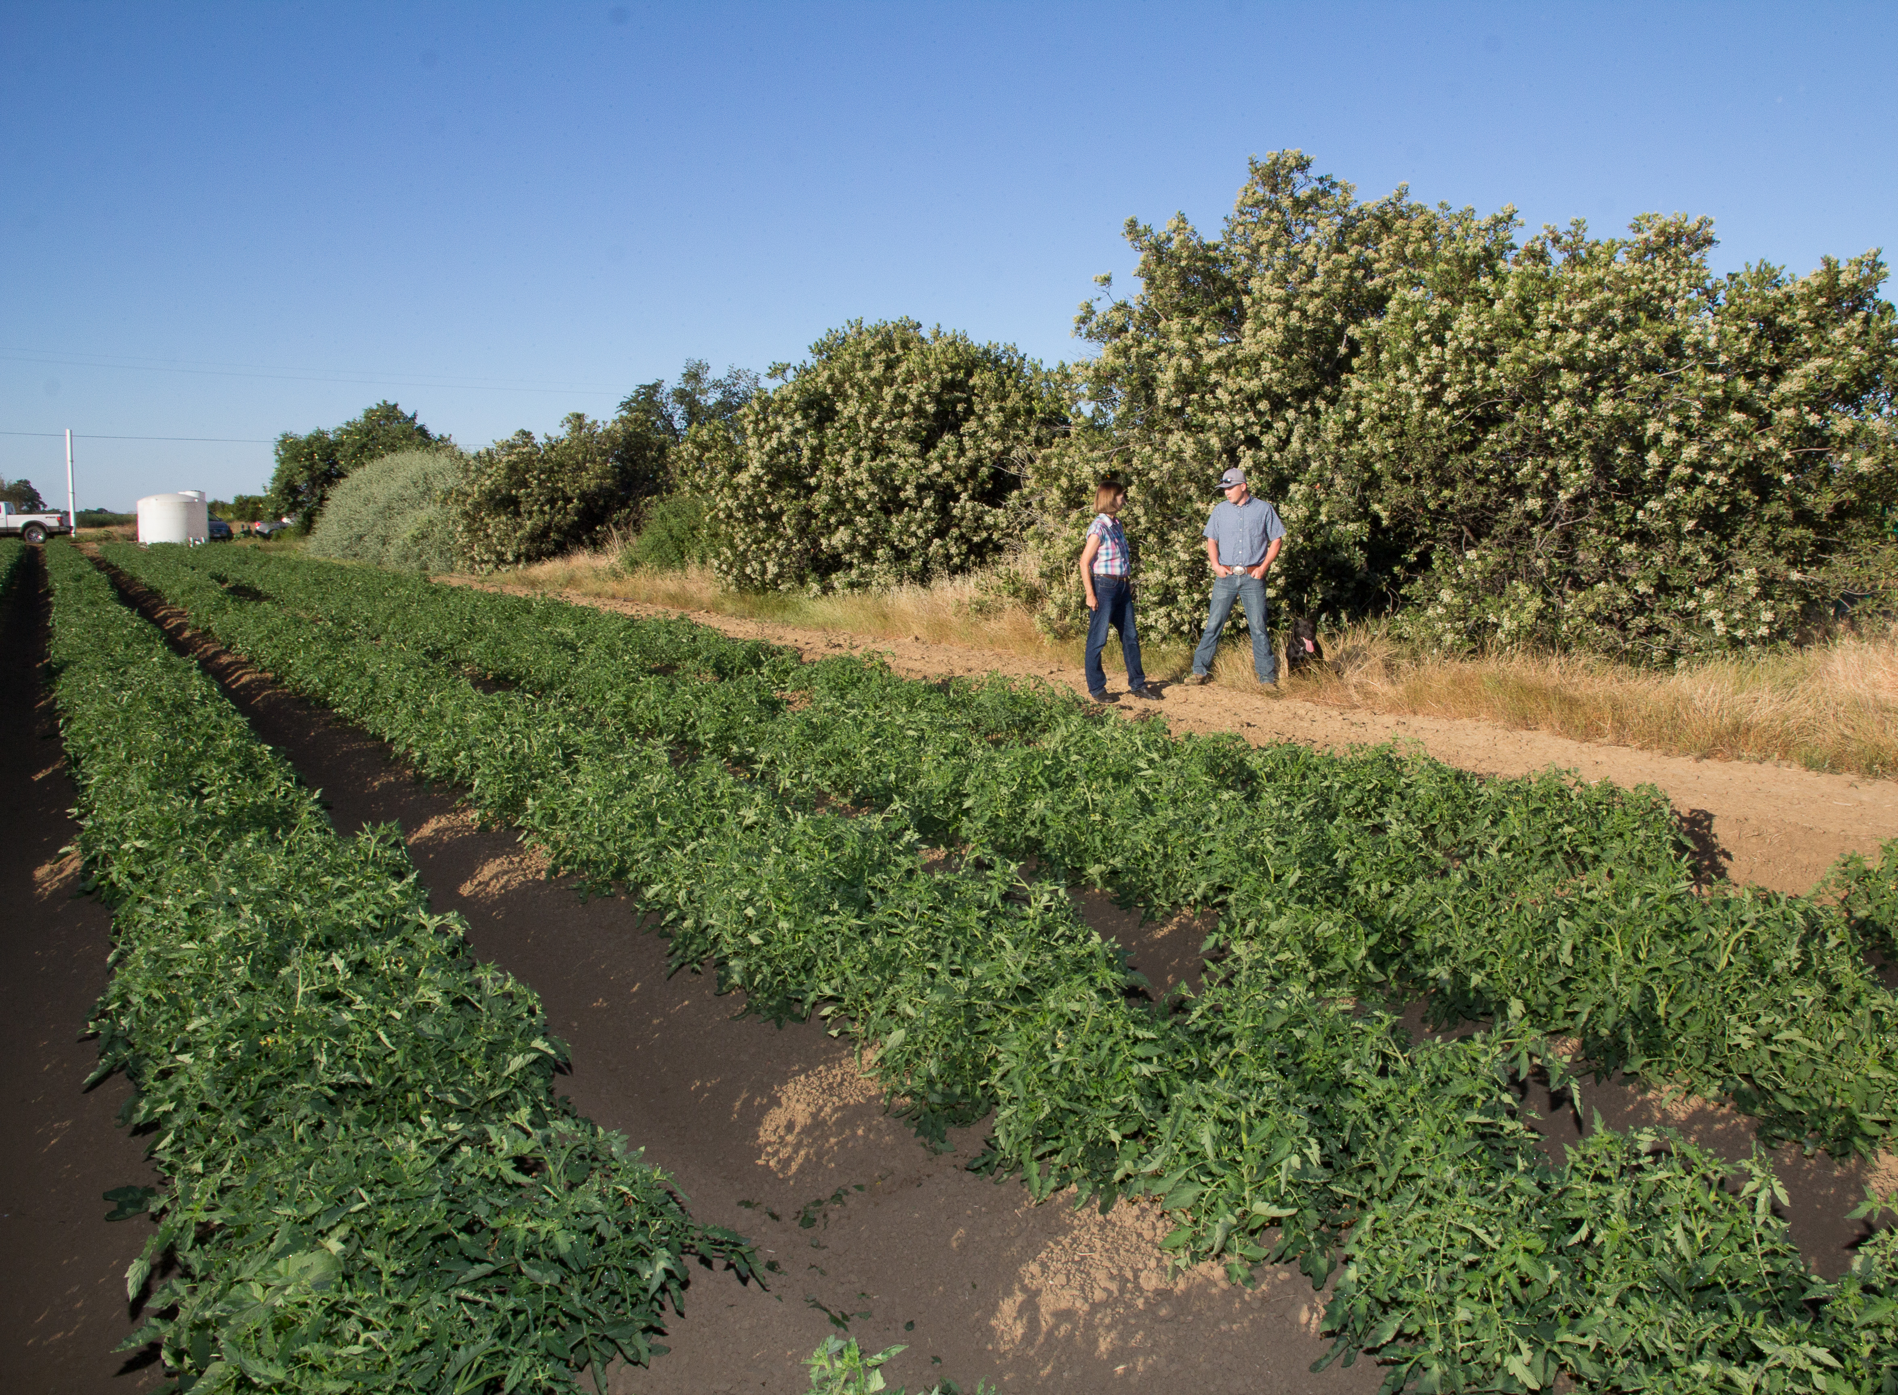
Pest control and pollination benefits of hedgerows

Slide 16
Thrips (western flower, onion)
Chewing mouthparts, damage/distort plant tissue
Scaring
Vector diseases

Slide 17
Diseases vectored by thrips:
Tomato spotted wilt virus (TSWV), Iris yellow spot virus (IYSV)
Plant resistant varieties (tomatoes)
Control TSWV hosts: Prickly lettuce, cheeseweed (Malva), sow thistle, bell beans, spiny buttercup

Slide 18
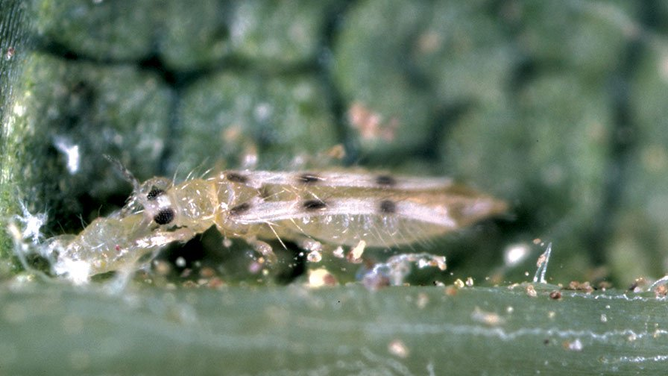
Minute pirate bug
Thrips Control
Natural enemies
Insecticide: Entrust (spinosad)
Six spotted thrips predator
Bean thrips (pest)
Big-eyed bug

Slide 19
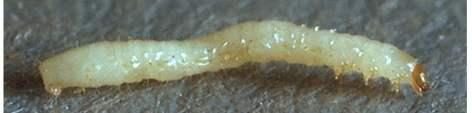
Flea beetles (pale striped, potato, tuber, brassica)
Difficult to manage pests of eggplant and cole crops
Older plants rarely suffer economic damage; by 5th leaf stage resilient.
Defoliate and kill seedling plants
Other hosts include potatoes, tomatoes, peppers

Slide 20
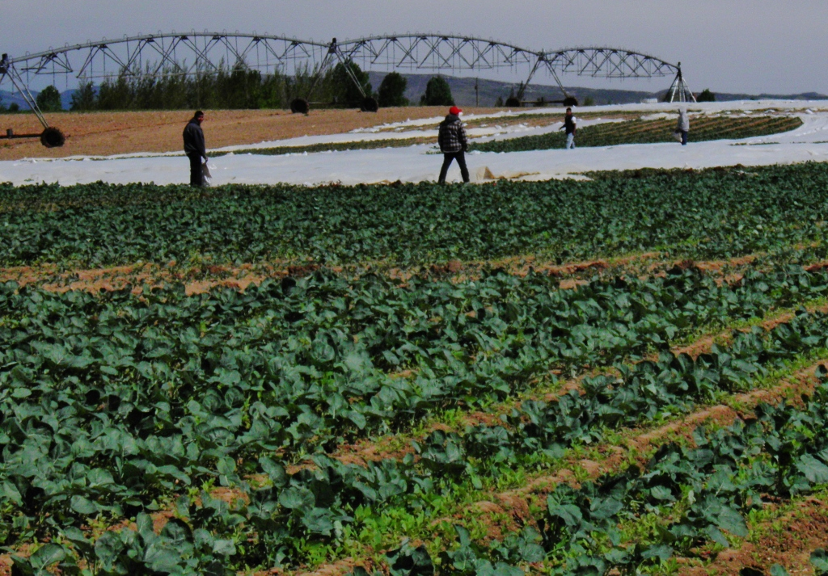
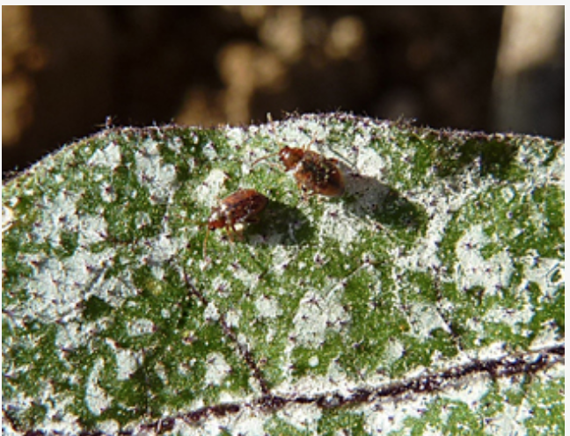
Flea beetle control
Row covers
Disk in crop residue where flea beetle adults overwinter.
Insecticide: Surround (kaolin, clay mineral, feeding deterrent) or Celite (diatomaceous earth), for protection in seedling stage (to 5th leaf).
Pale striped flea beetle
Western striped cucumber beetle

Slide 21
Seed corn maggot
Prefer cooler temperatures (spring and fall during rainy years)
Seed corn maggot control
Incorporate residues from a previous crop, destroy weed growth.
Wait several weeks after incorporating a cover crop prior to planting.
Plant under ideal soil and weather conditions for rapid seed germination.
In areas where chronic problem, monitor adult flies with yellow-colored bowls with water and a drop of soap; when populations start to decline, plant crop.

Slide 22
Carabid beetles (predators)
Darkling beetles (pest of seedling vegetables)
Tule stink beetle Predator
Control:
Irrigation
Seduce (spinsoad bait)

Slide 23
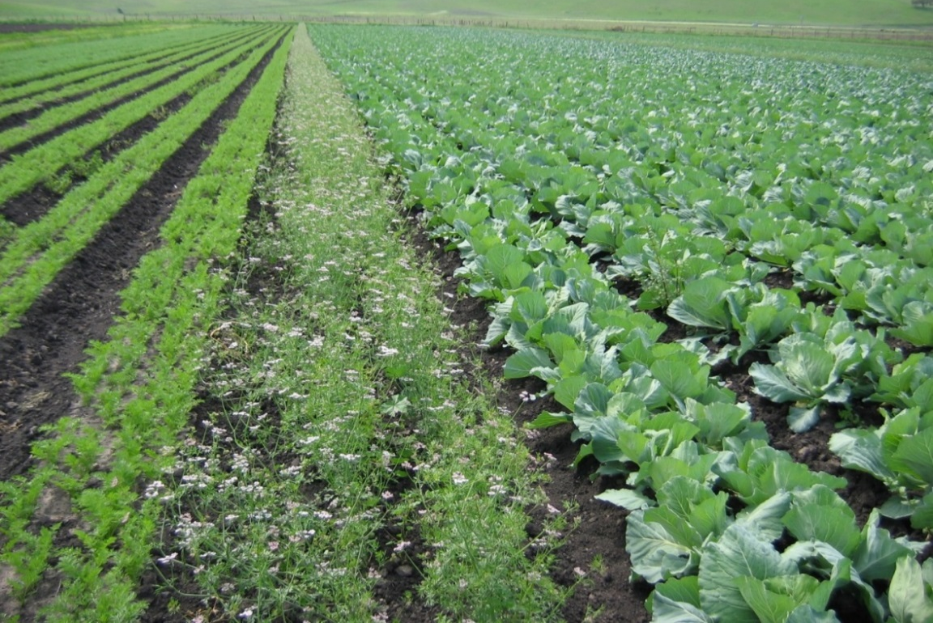
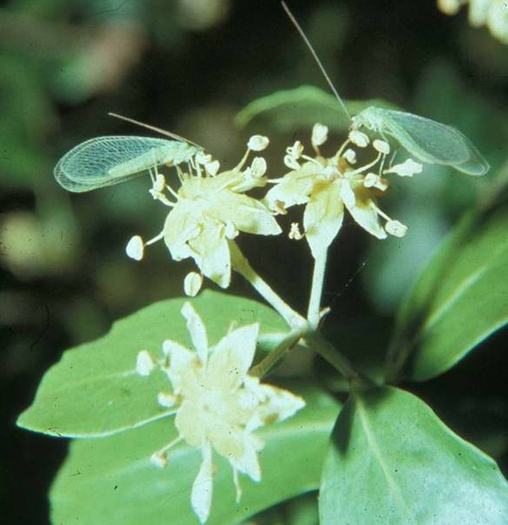
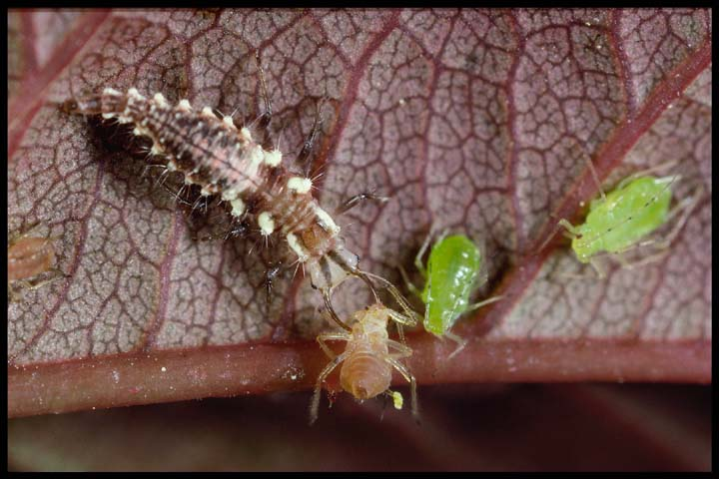
Rachael Long, Farm Advisor
rflong@ucanr.edu or, 530-666-8143
Green lacewings

