Slide 1
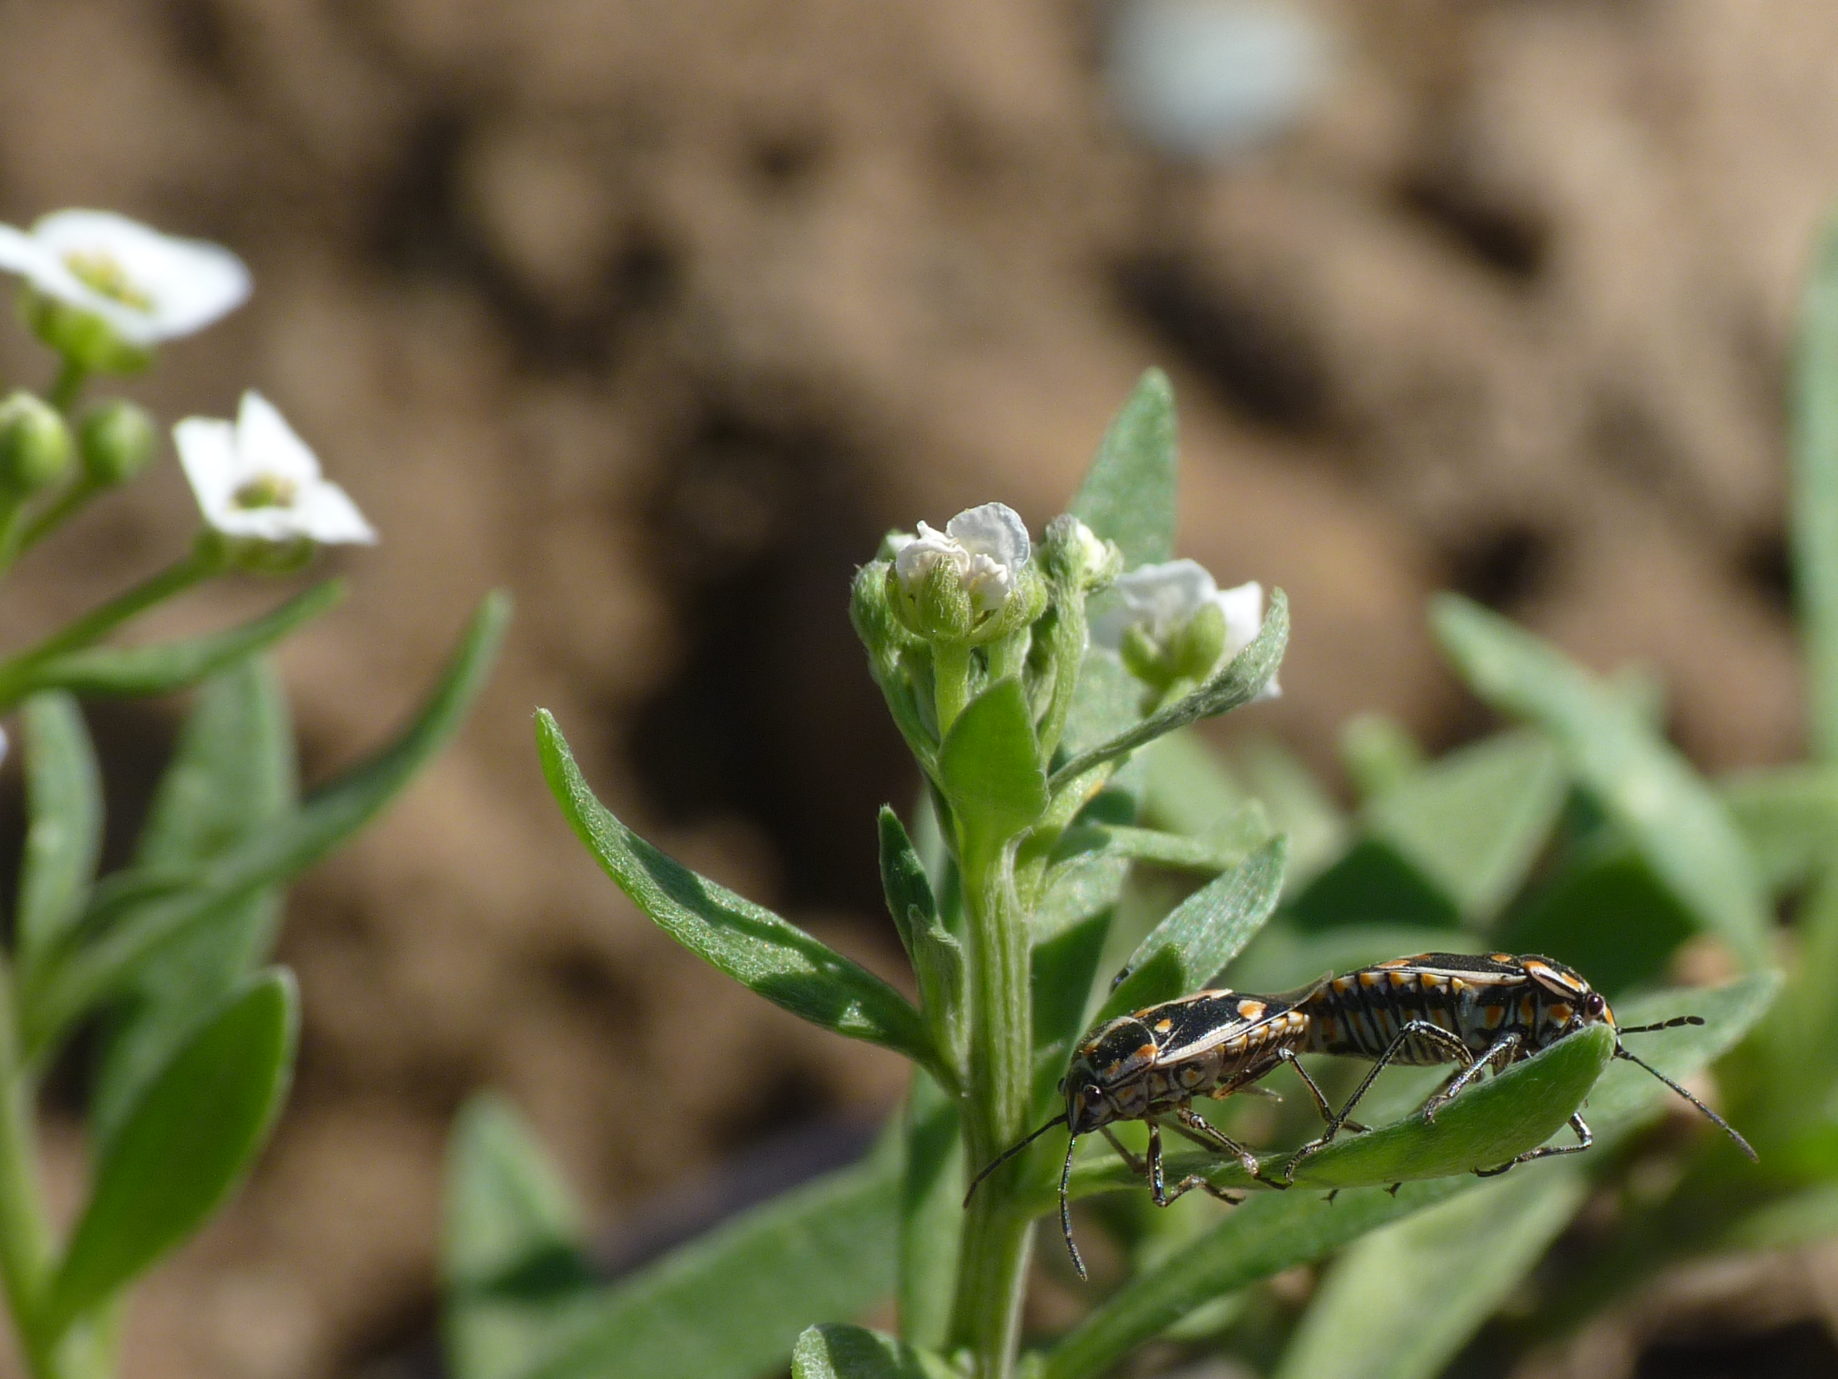
Stink bugs:
Challenging pests in organic systems
Ian Grettenberger, UC Davis

Slide 2
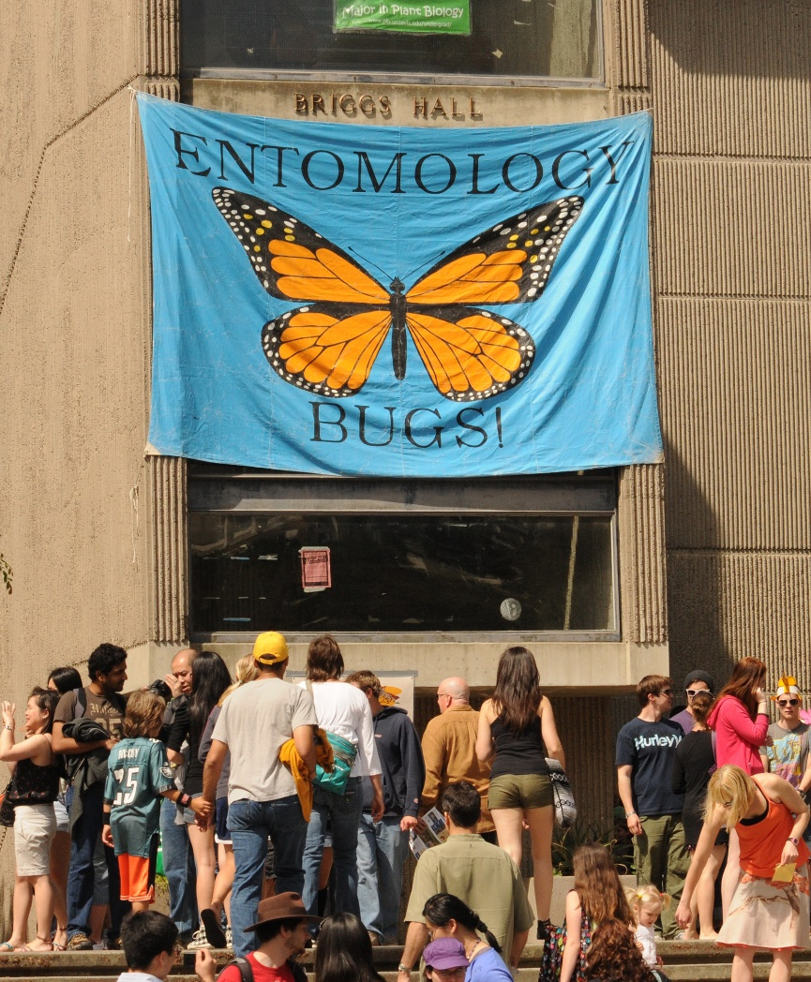



Field and vegetable crop IPM lab
Notes:
Yield and quality vs grading
Overwintering sites
Pheromone baited trap

Slide 3

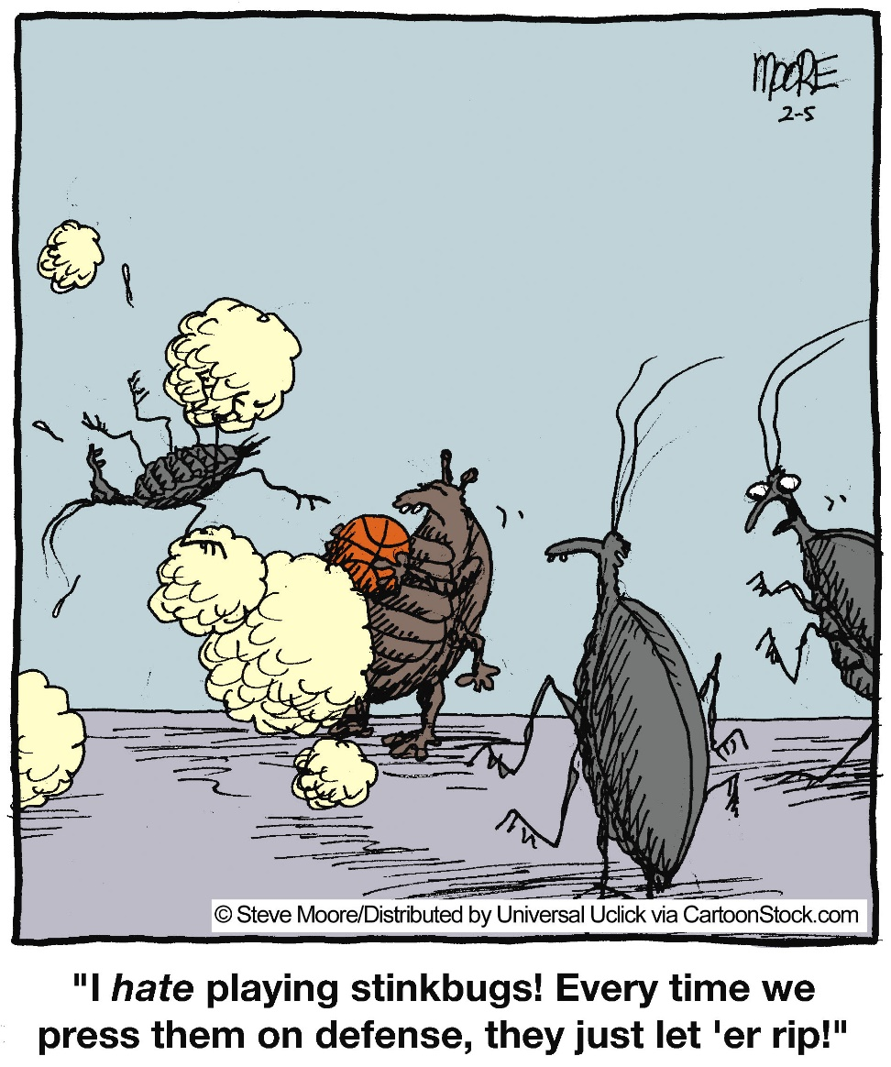

Slide 4
Life cycle

Slide 5
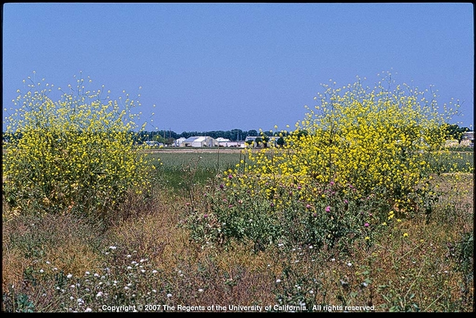
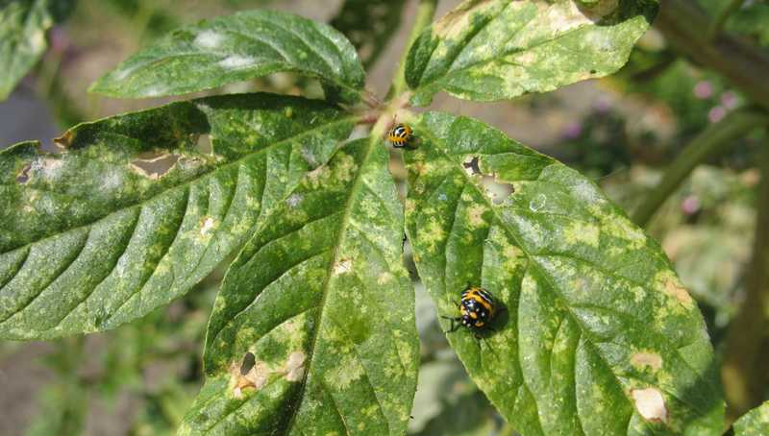
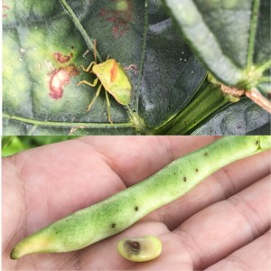
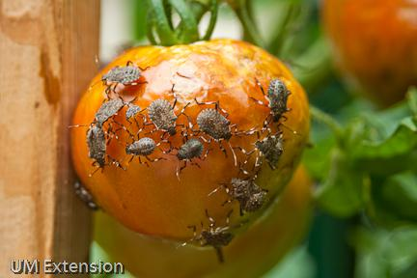
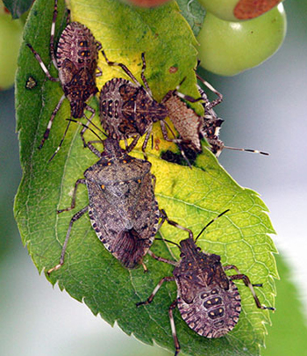
Non-crop hosts, polyphagy

Slide 6
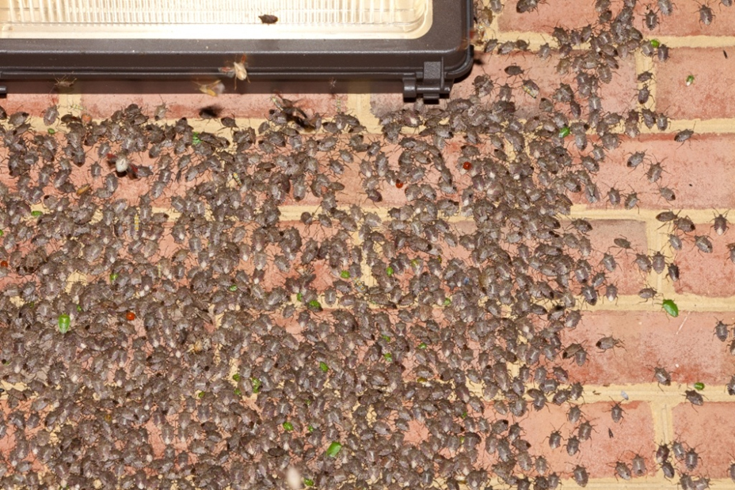
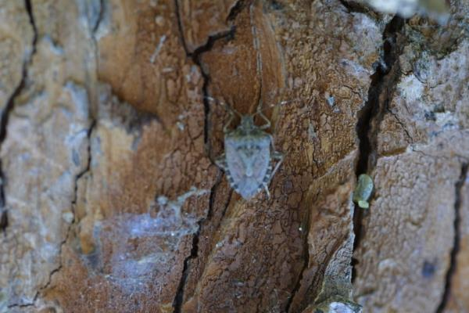
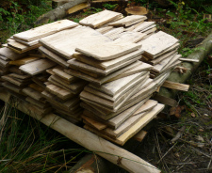
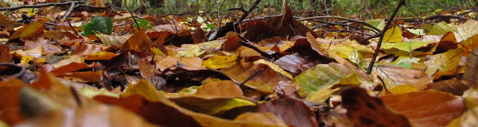
Overwinter behind tree bark, buildings, boards, and leaf litter
Brown marmorated sink bug

Slide 7
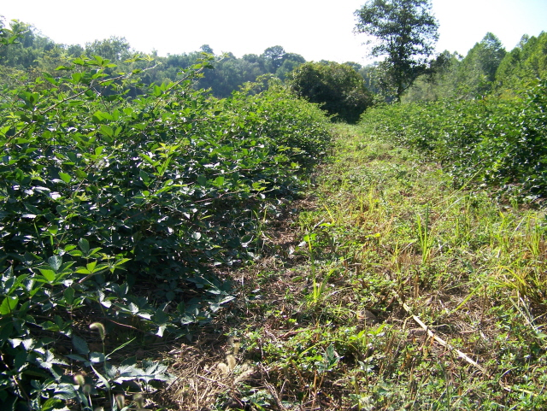
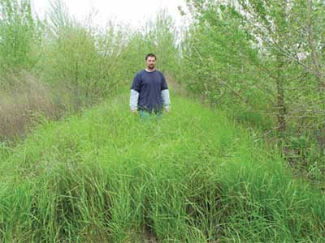
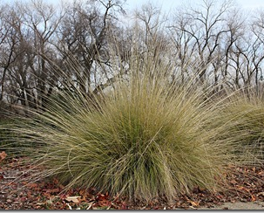
Overwintering sites: Consperse, red shouldered and southern green
Creeping wildrye
Blackberry
Deergrass

Slide 8
Stink Bug Seasonal Movement
Emerging population reproduces on mustard, wild radish and cheeseweed
After harvest, stink bugs
move to blackberry and
under tree bark in riparian
areas to overwinter
First generation
moves into tomatoes

Slide 9
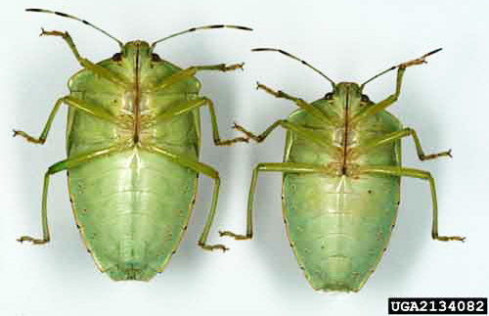
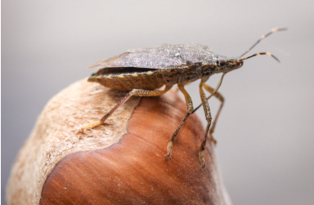
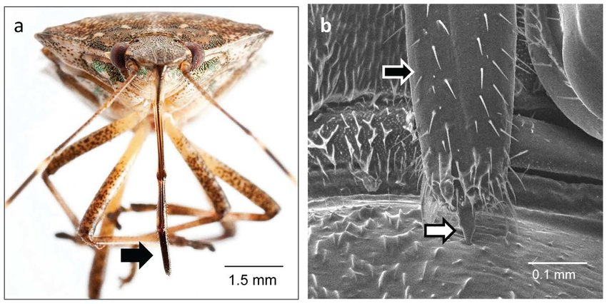
Damage

Slide 10
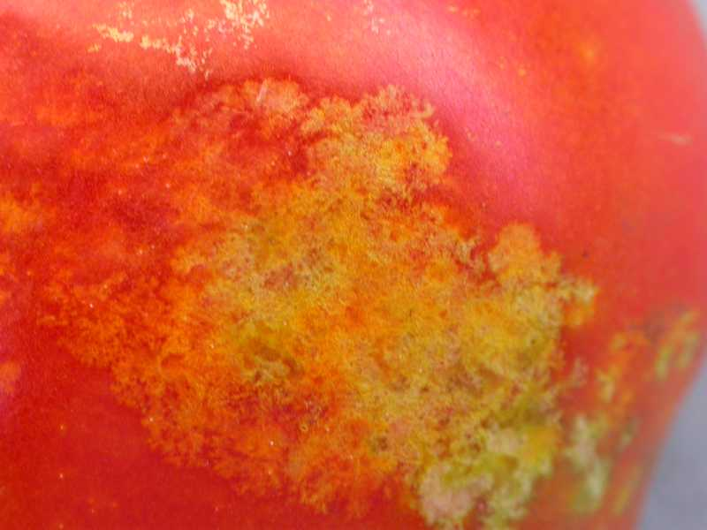
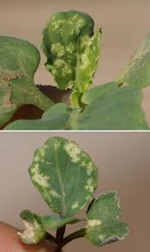
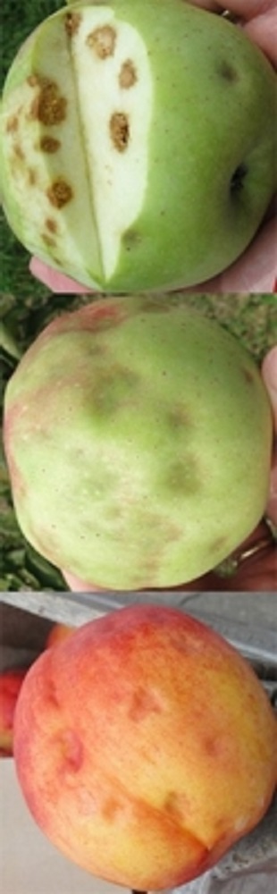
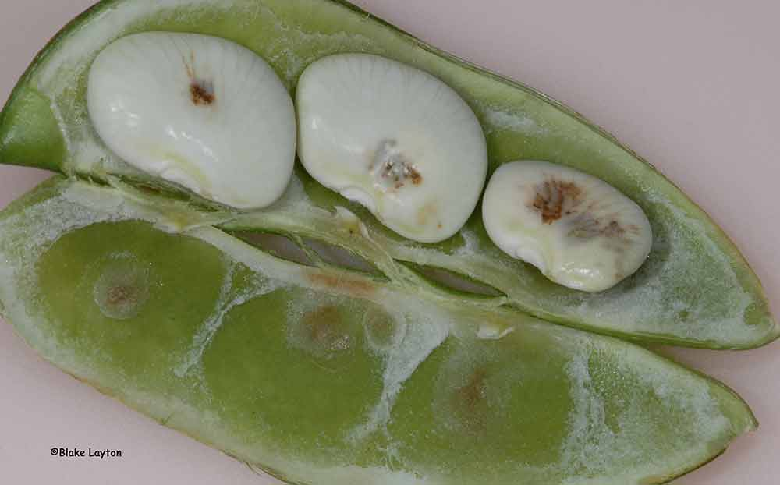
Damage

Slide 11
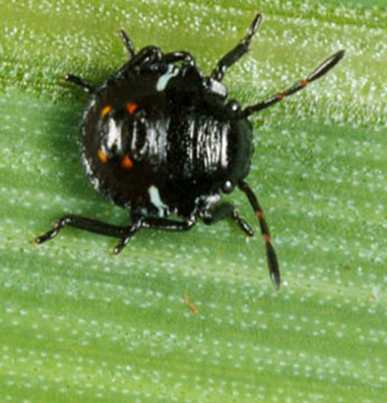
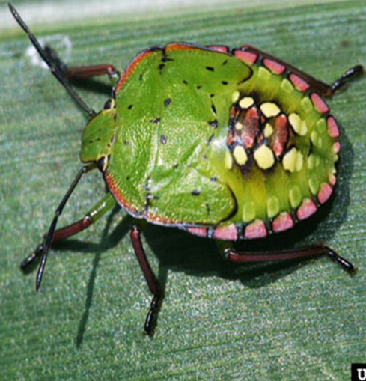
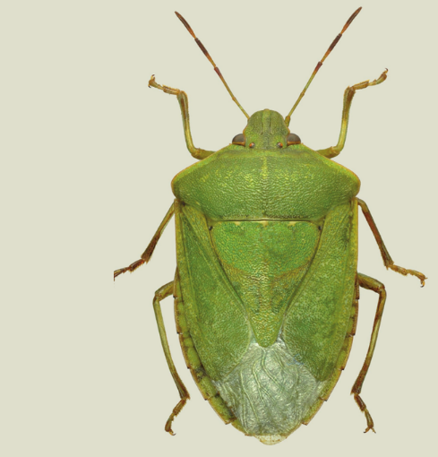
Damage

Slide 12
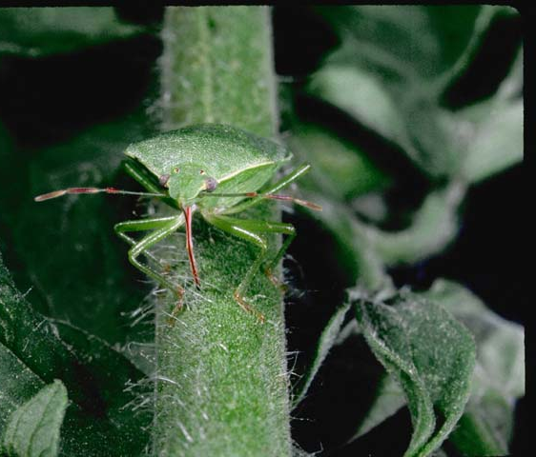
Produce a defensive secretion, also can serve as alarm pheromone
Generally on the larger side as adults
Nymphs range from tiny to as big as adults
Several generations per year
Adults can be long-lived
Populations are variable (outbreaks)
Can be challenging to manage with insecticides, even in conventional systems

Slide 13
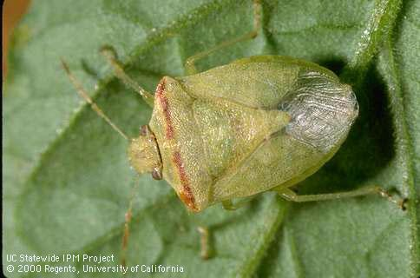
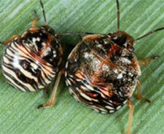
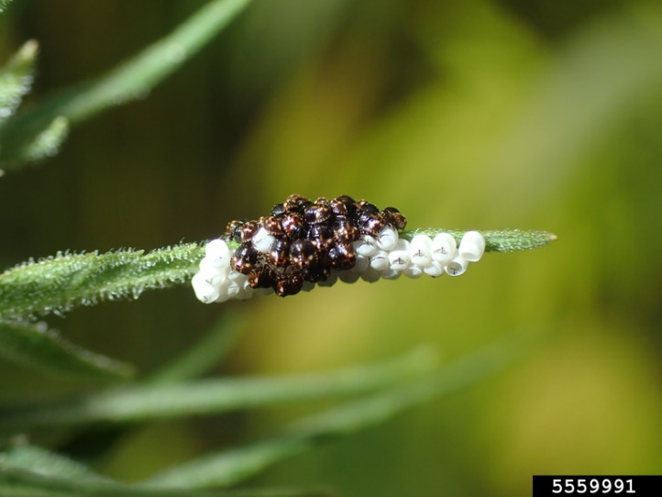
Red shouldered stink bug

Slide 14
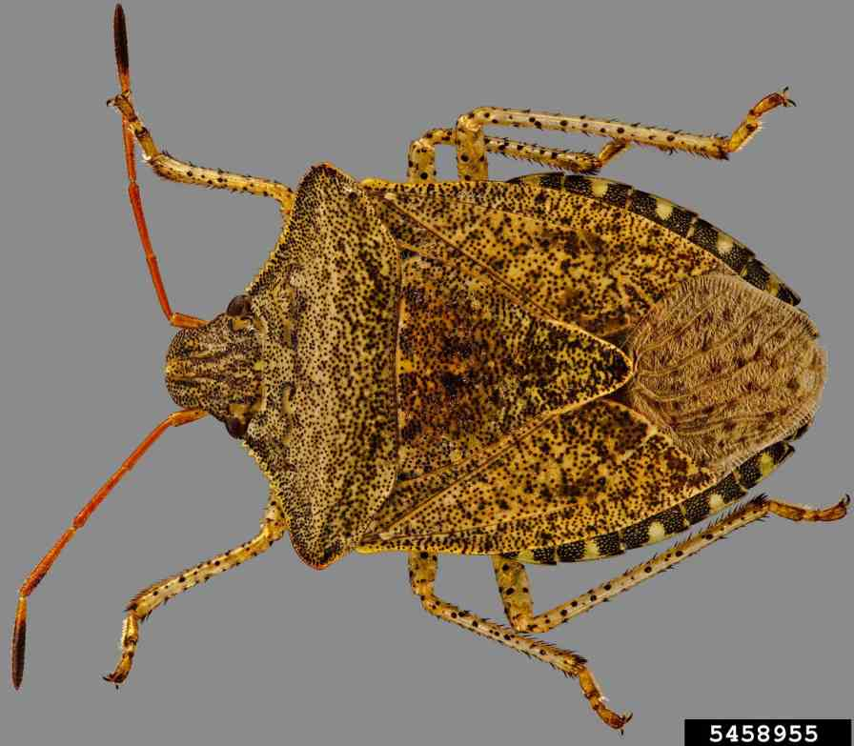
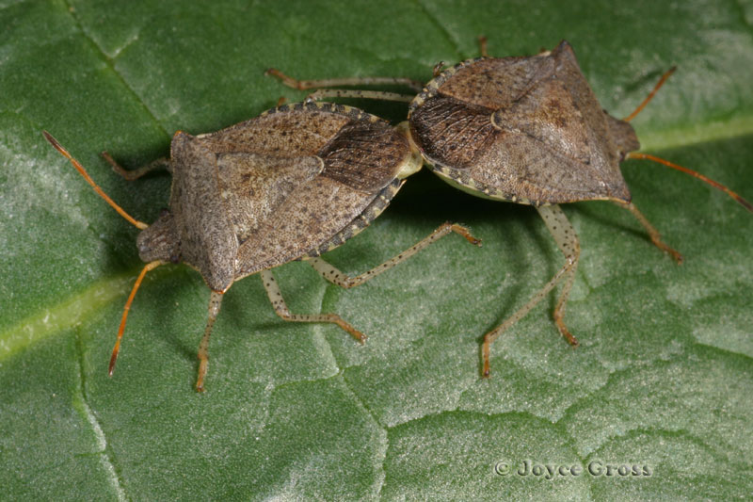
Consperse stink bug

Slide 15
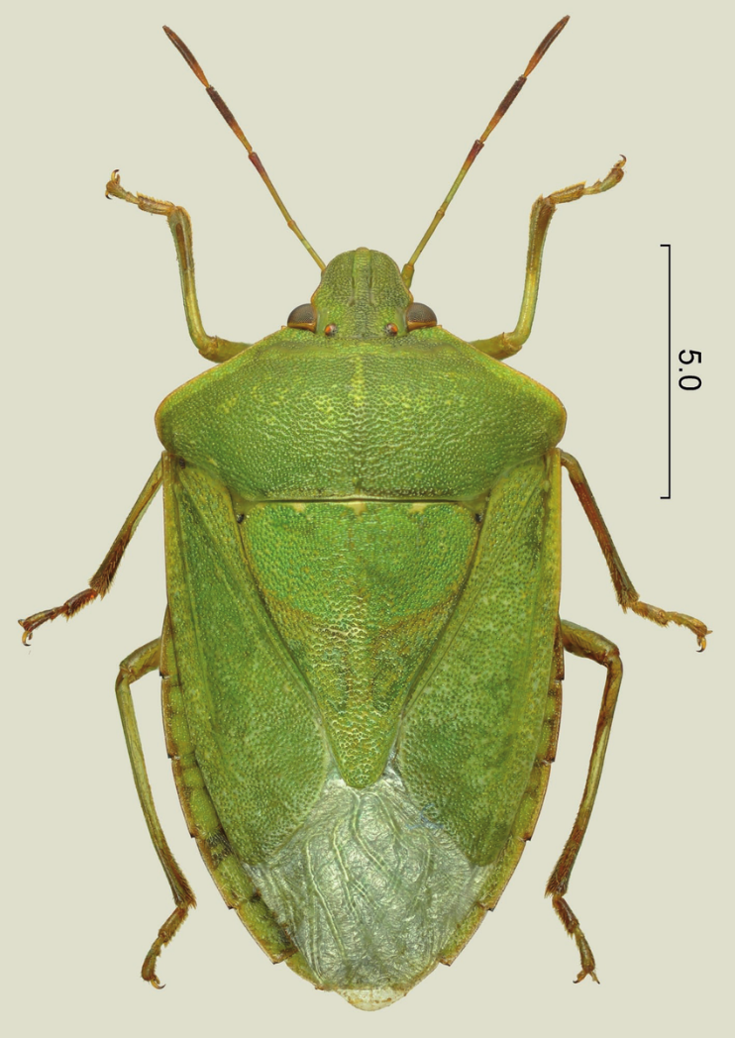
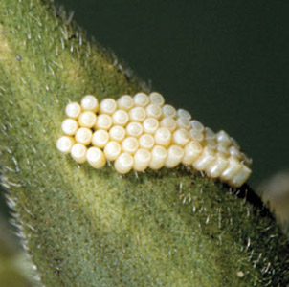
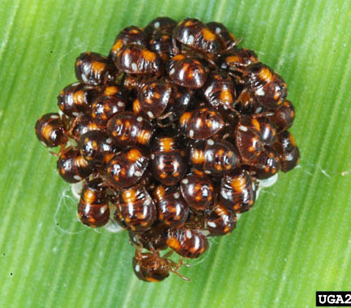
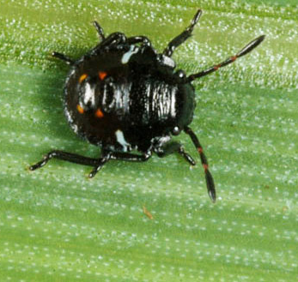
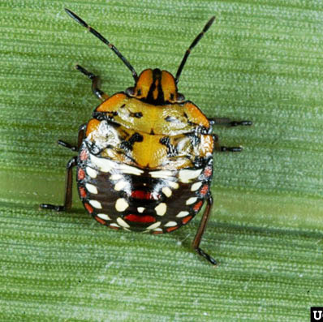
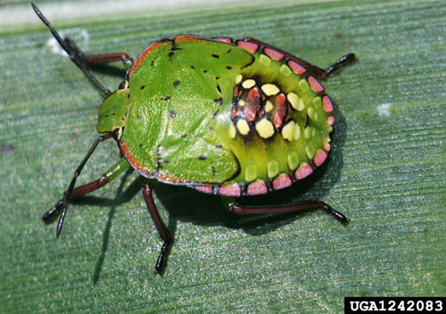
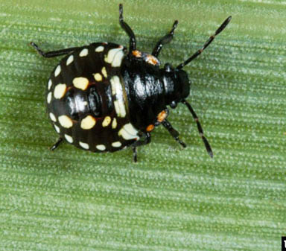
Southern green stink bug

Slide 16
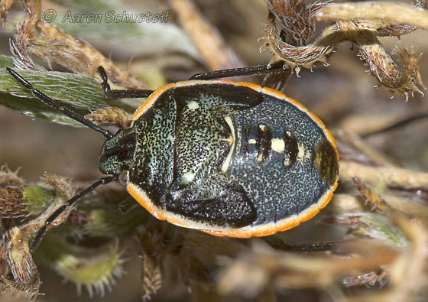
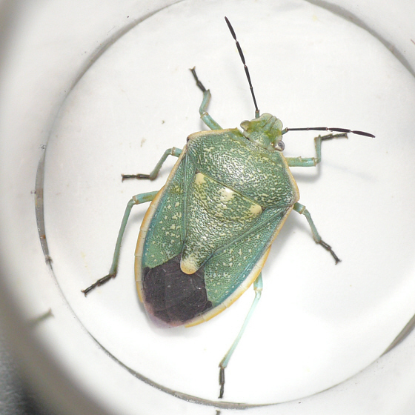
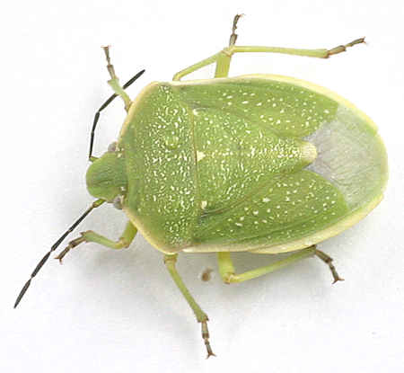
Say’s stink bug

Slide 17
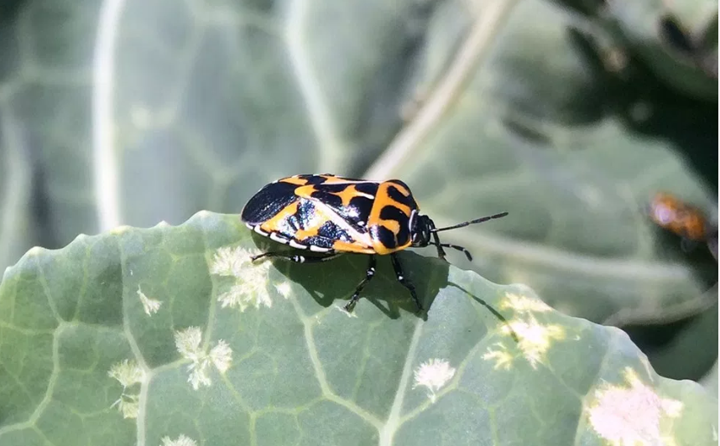
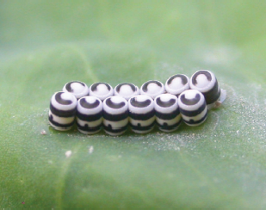
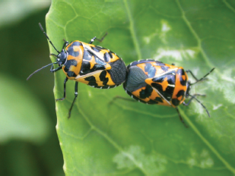
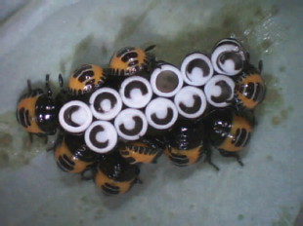
Harlequin bug

Slide 18
Chemical tools?
Stink bugs are difficult to control with organic insecticides
Some organic insecticides, such as pyrethrum, can often be disruptive to naturally occurring biological control.

Slide 19
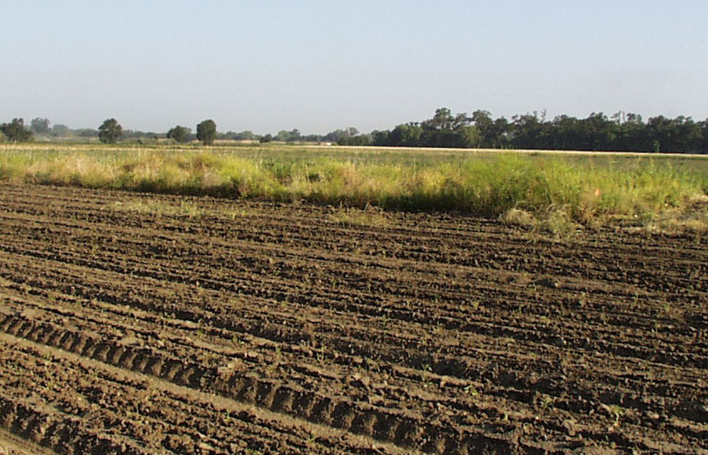
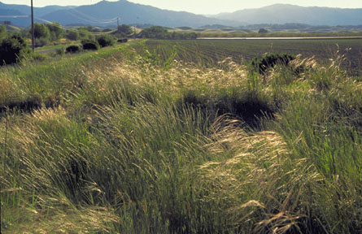
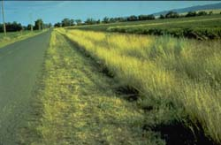
Replacement of vegetation
WEEDS
VS
NATIVE GRASSES

Slide 20
Significantly greater than non-host border (p < 0.05)
Mean of four fields not treated with insecticide for stink bugs

Slide 21
Border weed control
Early spring cultivation of field borders destined to be adjacent to tomato fields
Field-scale or farm-scale elimination of habitat is likely to have the greatest influence

Slide 22
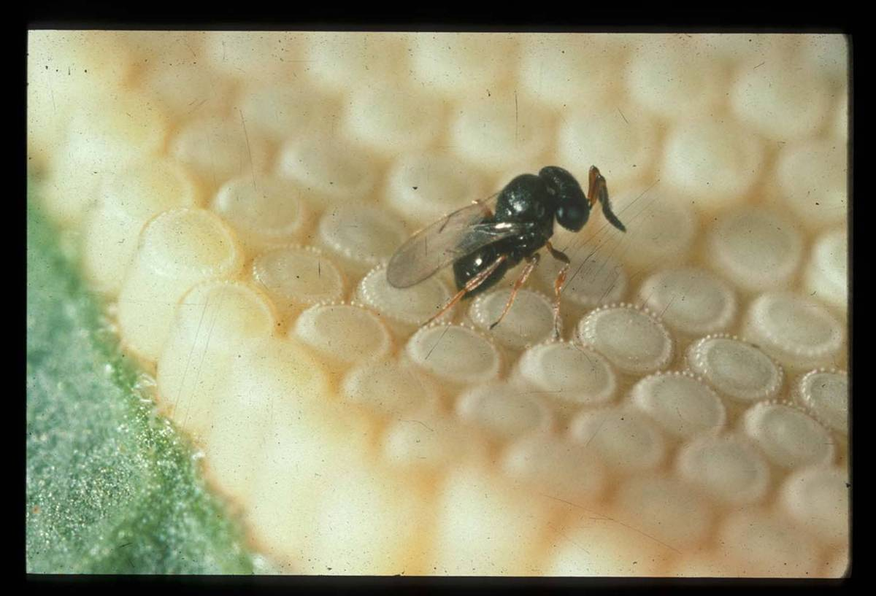
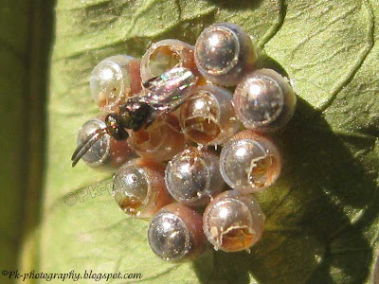
Parasitoid wasps (and other natural enemies) attack stink bug eggs
Egg parasitoid wasps (Scelionid), 15-25% parasitism in tomatoes

Slide 23

Hedgerow of flowering plants enhance natural enemies and biocontrol

Slide 24

Hedgerows had more parasitoid wasps and exported more parasitoid wasps into adjacent crops than weedy edges
Avg numbers of parasitoid wasps
Field edge
Tomato crop

Slide 25



Hedgerows and parasitism of stink bug egg masses

Slide 26
Stink bug parasitism in tomato fields 10% higher with hedgerows
Tomato crop
Field edge

Slide 27
Significantly greater than the control (p < 0.05)

Slide 28

What about stink bugs new to CA?

Slide 29


Slide 30


Slide 31





Slide 32

BMSB in the US

Slide 33


Slide 34


BMSB in California
2017
2018
Notes:
Last year (2017) we showed the map of BMSB infestations in California (next)

Slide 35

Tree in Sacramento CA 2015
Photo: Chuck Ingles
Notes:
Introduced to Eastern US in 1990s. Fee
Found in Sacramento CA 2013
In 2002 was Los Angeles County
Reproducing population found in Sacramento CA in 2013, was detected in Sacramento.

Slide 36



Sentinel Egg Cards for Brown Marmorated Stink Bug
1 cm

Slide 37

Imaging Sentinel Egg Cards

Slide 38
Percent of eggs consumed through predation of sentinel eggs on tree trunks, mean±SEM, Sacramento Region*.
WHAT IS FEEDING ON EGGS?
Year | % damage | N = # sentinel cards
2014 | 5.3±2.1 | 49
2015 | 11.2±2.1 | 218
2016 | 21.7±3.2 | 184
2017 | 26.3±2.4 | 303
*June through October
Notes:
Two possibilities for increase in predation: cueing into host. Or change in egg quality, or both.

Slide 39

Spider Feeding on Eggs
BMSB

Slide 40

Ground Beetle Feeding on BMSB Sentinel Eggs, Sacramento 2015
BMSB
Over 8 hr period, middle of night, 5 minute sequences
Laemostenus complanatus

Slide 41


BMSB
Parasitoid, Ooencyrtus ?

Slide 42




BMSB Earwigs (Dermaptera)
female
male
female
male
European earwig
Ring-legged earwig

Slide 43


Slide 44

Trap crops

Slide 45

Notes:
I now want to switch to my work in vegetable systems with the bagrada bug, and my work developing IPM tactics for this problematic pest and using improved understanding of the pest’s ecology to improve management

Slide 46






Bagrada bugs damage an array of crops
http://ucanr.edu/blogs/blogcore/postdetail.cfm?postnum=4047
http://urbanhomestead.org/journal/2012/07/11/bad-bad-bagrada-bug/
http://www.chowbacca.com/2014/08/bagrada-bugs-bother-bounty-grumpy.html
Notes:
The bagrada bug is an invasive stink bug that damages a wide range of cruciferous crops, and we can see substantial yield loss. Here is bagrada bug damage on a range of cruciferous crops, including cauliflower, broccoli, and arugula.
- For cole crops like broccoli, newly planted crops are most at risk for yield loss and bagrada bugs can cause severe damage. ‘
- Bagrada bugs are also a big issue for salad crops and can cause damage throughout the growing cycle,…cosmetic damage..unmarketable
In the Salinas Valley, bagrada becomes an issue in late summer through fall.

Slide 47




Young plants are most susceptible
JC Palumbo

Slide 48



2008
Notes:
In 2008
*******
bagrada bug made its first appearance in North America and was first detected in LA county

Slide 49





Current
Notes:
Now , we have the pest throughout California, and it has made its way into Texas and Mexico.
Hawaii
Chile – recently showed up, big problem
I am spending time on the spread of the bagrada bug, both to inform you of its recent history here and to show how this influenced development of management tools in the US and the Salinas Valley

Slide 50

Organic management of bagrada
Chemical management
Natural enemies?
Row cover
Weed management
Post-harvest residue destruction
Trap crops
Vacuums
Avoidance
Scouting/risk assessment

Slide 51


Biological control?
Likely minimal control by generalist predators
Specialized natural enemies not yet present
Notes:
http://ucanr.edu/blogs/blogcore/postdetail.cfm?postnum=11669

Slide 52

Notes:
Interesting thing to note about bagrada bug, funny beast as far as stink bug goes when it comes to oviposition
Lays eggs in soil
This affects what we might expect in terms of resident parasitoids attacking their eggs
There are parasitoids in its native range and these are being actively sought out or tested as biological control agents

Slide 53




Slide 54




Notes:
First, out of the 1000s of eggs we put out, we only had .2% of them get parasitized. That is that tiny little bar. These were from 4 different locations, and three different cards.
********************
These three were from one card, and with one in a larger image. These have been identified as an Ooencyrtus, but barcoding will need to be used to get them to species.
- Tom Perring down
**************
On these egg cards, which do represent a optimistic level of predation given how eggs are deployed, we do see a fair amount of predation, more on ground than in the foliage.
Video, LWL

Slide 55
Notes:
First, out of the 1000s of eggs we put out, we only had .2% of them get parasitized. That is that tiny little bar. These were from 4 different locations, and three different cards.
********************
These three were from one card, and with one in a larger image. These have been identified as an Ooencyrtus, but barcoding will need to be used to get them to species.
- Tom Perring down
**************
On these egg cards, which do represent a optimistic level of predation given how eggs are deployed, we do see a fair amount of predation, more on ground than in the foliage.
Video, LWL

Slide 56

Notes:
As you can see from this pepperweed plant, sometimes I found lots of bugs.
This was a great picture to show growers and PCAs to impress upon them why weeds matter

Slide 57



Shortpod mustard sites
Notes:
Here are the survey data.
I am going to separate counts for bugs on shortpod mustard from those on pepperweed. Most sites had only one weed species.
*************
In addition, I am going to separate the data for adults (TOP) and nymphs (BOTTOM)
Here we have date on the x-axis, Number of bugs y-axis
Each color line is a different site.
If we start here in the winter of the first year, we really weren’t finding any insects.
Bagrada bugs start to show up significantly in mid-summer
When populations tail off, that is because plants are senescing and are just too dry to serve as a food source. That is when we are worried about them moving into crops

Slide 58

Bagrada bugs and weeds
A small subset of the total flora are primary hosts
Weed characteristics critical → dry down+movement
Management and scouting → IPM framework
Notes:
Clear the small subset
Weed characteristics, whether it be weed species, phenology, or characteristics of an individual weed
Also clear the it is important to consider weeds for management and scouting, which can help us put weeds into an IPM framework
For instance, mowing or discing weeds when possible at key time points could be very beneficial as can directing scouting efforts to these weeds, both are which are recommendations I have made in extension efforts

Slide 59


Slide 60


Acknowledgements
Grower and PCA cooperators
Funding: CDFA
Slides:
  Rachael Long (UCANR)
  Frank Zalom (UCD)
  Joanna Fisher (UCD)
  Charlie Pickett (CDFA)

Slide 61

Questions?

Slide 63


Organic insecticide work from AZ
Dr. John Palumbo, University of Arizona

Slide 64
Field trials in broccoli
Notes:
Among the products tested, the Veratran D
and EntrustþM-Pede treatments provided the best control of adults
(Table 1) and nymphs (Table 2) relative to the conventional standard
Brigade treatment. In contrast, the X-7476-14 and Tersus treatments
did not provide significant control of B. hilaris adults or nymphs com-
pared to the nontreated check. In most cases, all of the organic spray
treatments significantly reduced the number of fresh feeding signs fol-
lowing each application (Table 3). However, none of the organic
treatments significantly protected plants from B. hilaris feeding com-
pared to Brigade.

Slide 65
Petri dish spray assay #1
Notes:
Brigade, (synthetic pyrethroid) which was included as a conventional standard to serve as a positive check for
the organic treatments, caused 100% adult mortality by 12 h after treatment. None of the organic products provided 100% mortality 3 DAT, but all caused significantly higher mortality than the water-treated check. Among the organic treatments, Entrust caused the highest per- centage adult mortality at 3 DAT, whereas mortality in the Pyganic,
Aza-Direct and Mycotrol-O treatments was significantly lower.

Slide 66
Petri dish spray assay #2

