Slide 1
Fire Weather: Useful Websites and Tools
Presented by Sasha A. Berleman, PhD
Adapted from a presentation by Jeff Stackhouse, UCCE

Slide 2
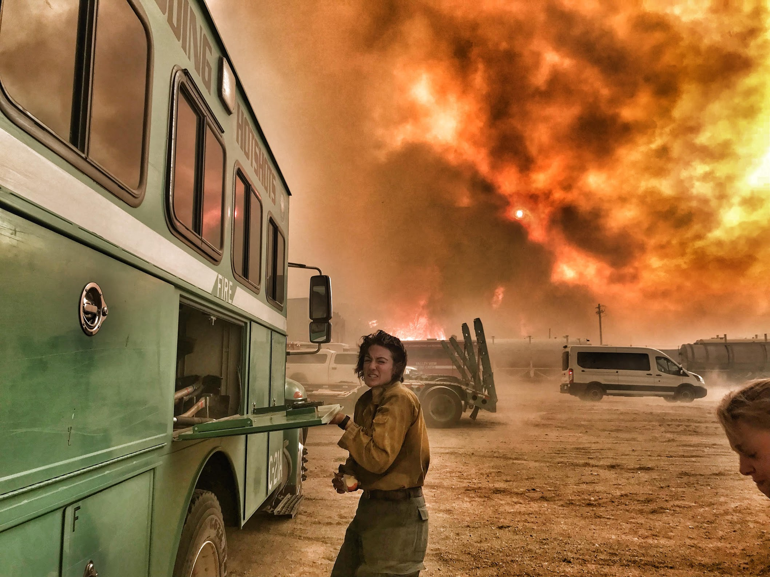
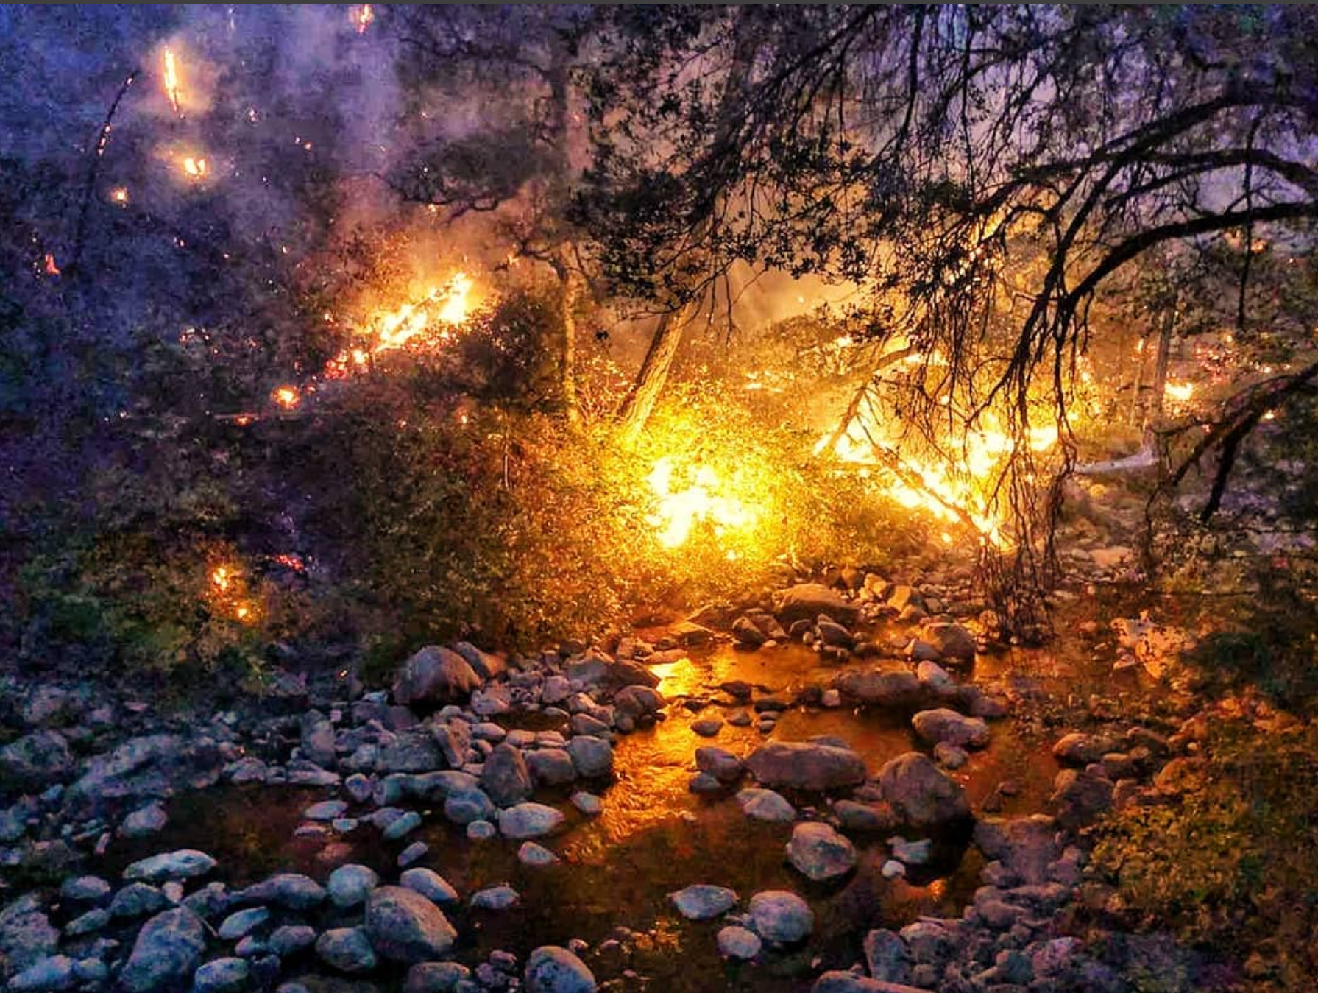
Weather and Fire
Most dynamic factor
Most difficult to predict

Slide 3
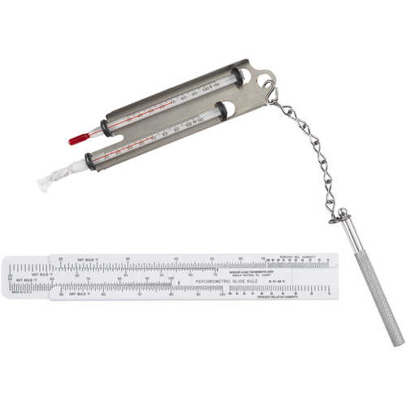
Air Temperature
Referred to as dry bulb in fire

Slide 4
Relative humidity (RH):
Amount of moisture in the air divided by the amount the air could hold when saturated at the same (or “Relative”) air temperature; usually expressed in percent.

Slide 5
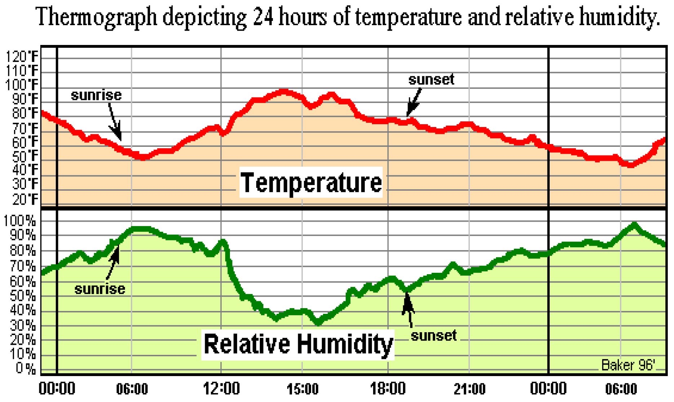
Thermograph
Relationship between temperature and RH

Slide 6
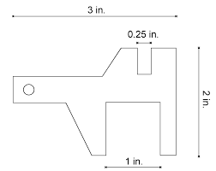

Fuel Moisture
Fine fuels (1hr fuels such as grass) gain and lose moisture quickly
Heavy fuels (100 & 1000 hr fuels such as logs) gain and lose moisture slowly

Slide 7
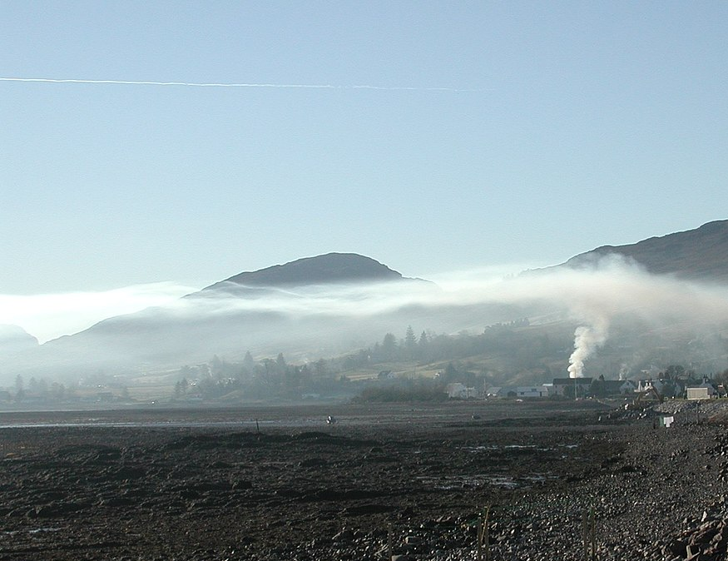
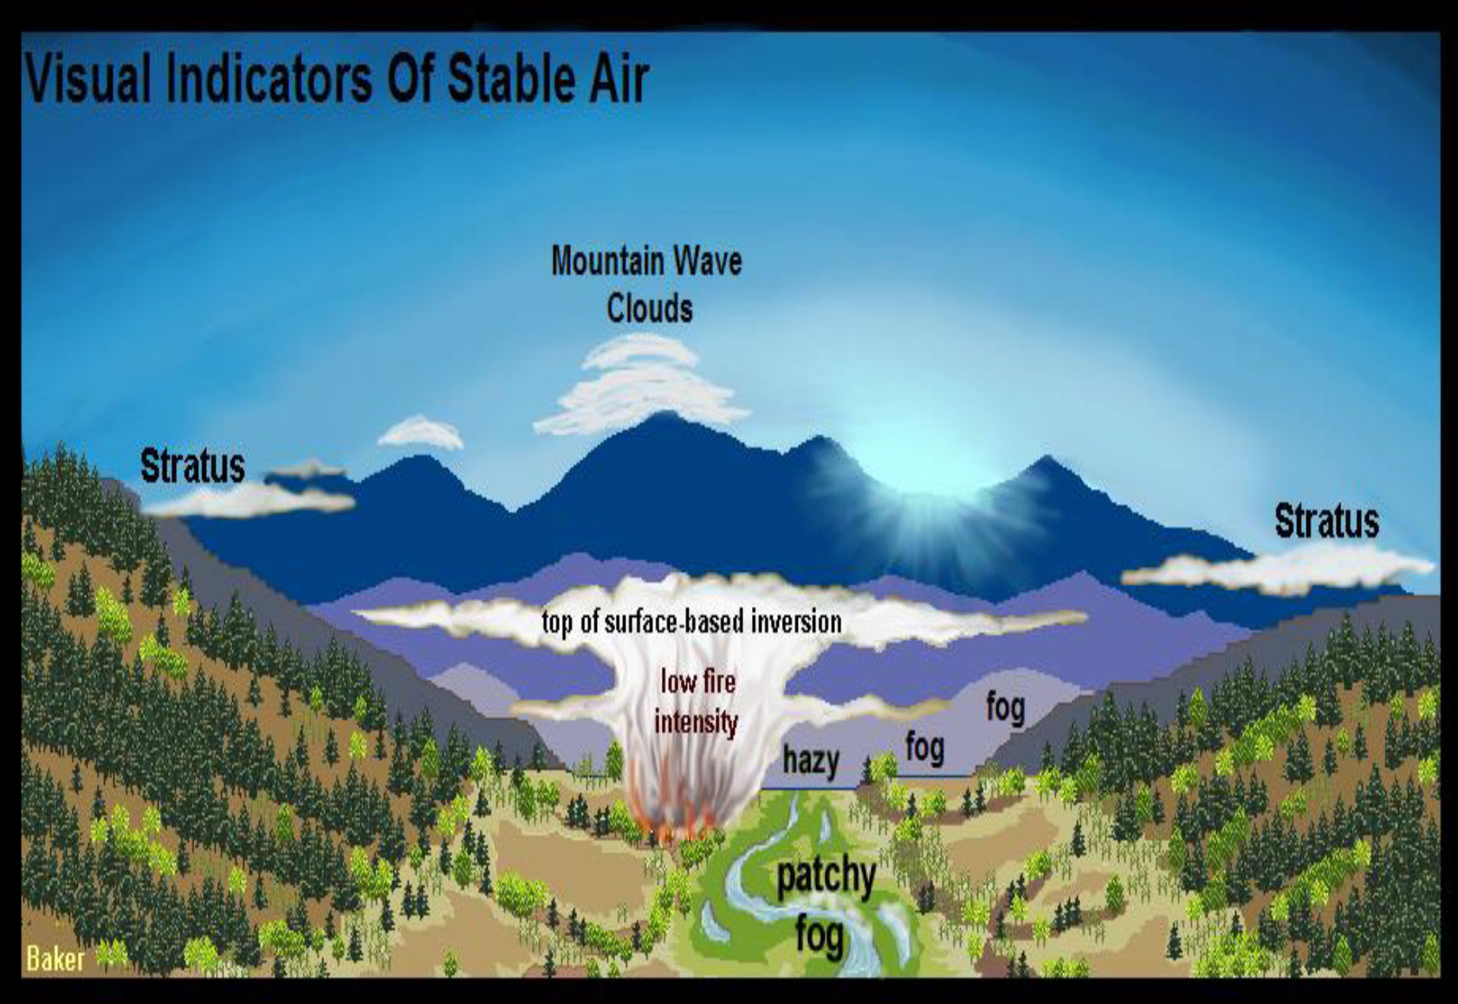
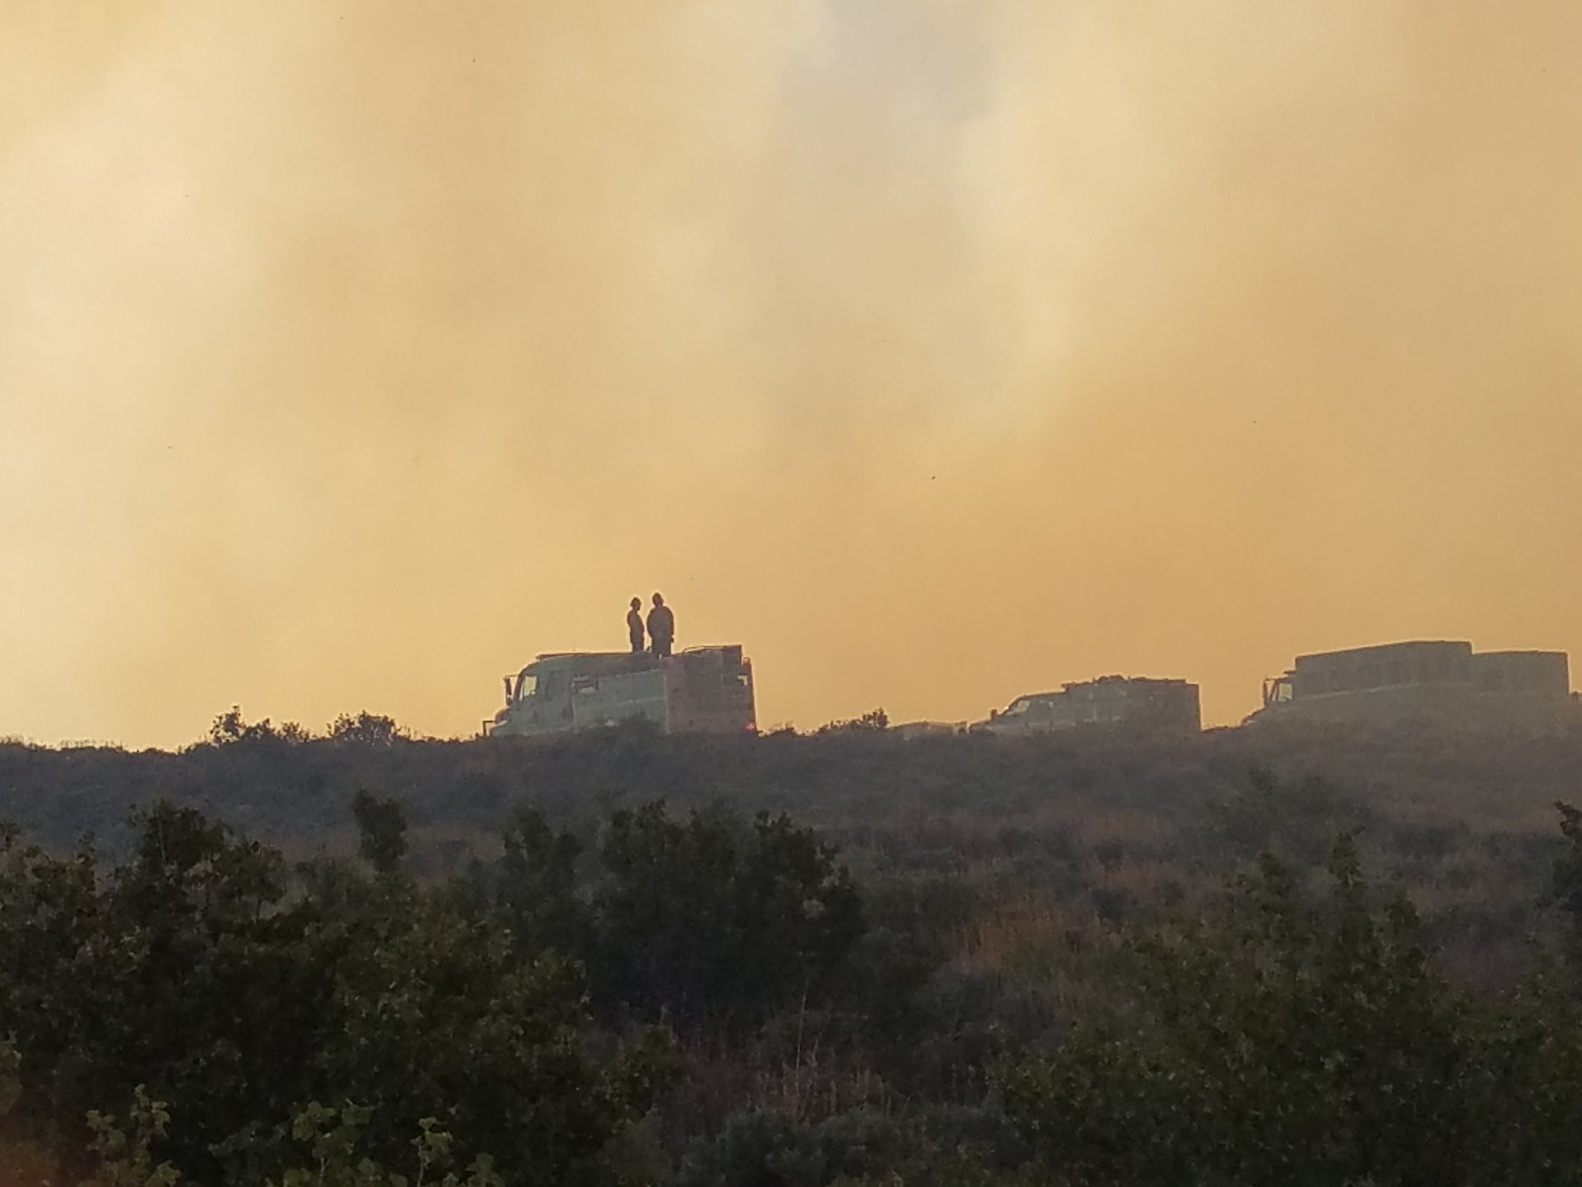
Atmospheric Stability
Stable Atmosphere

Slide 8
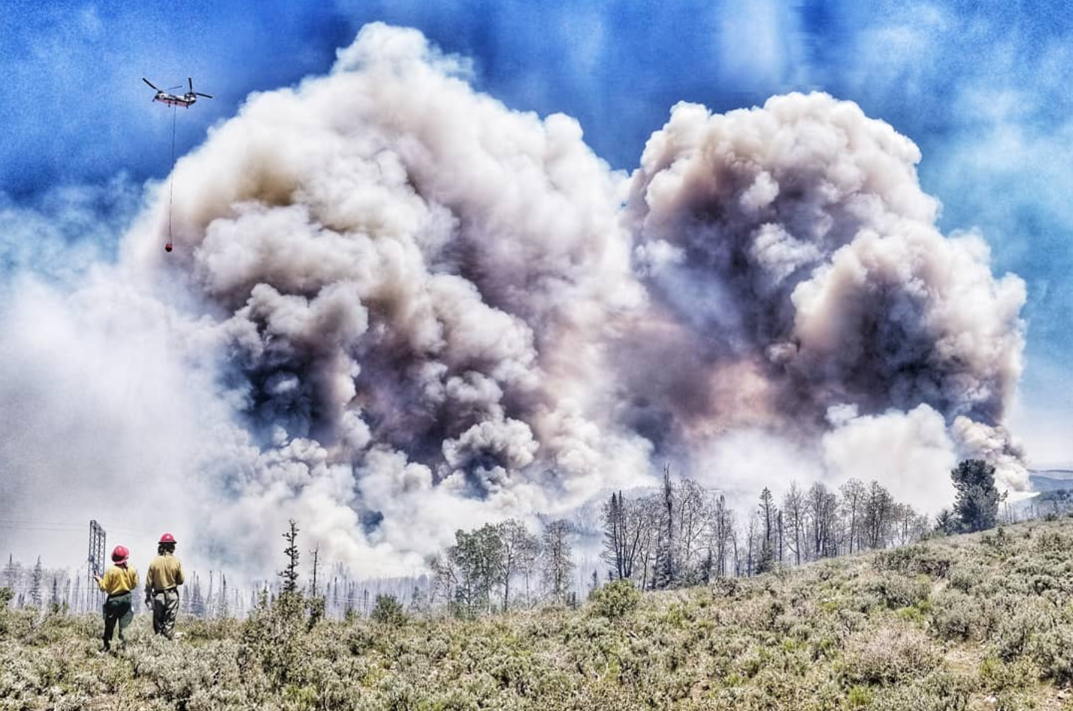
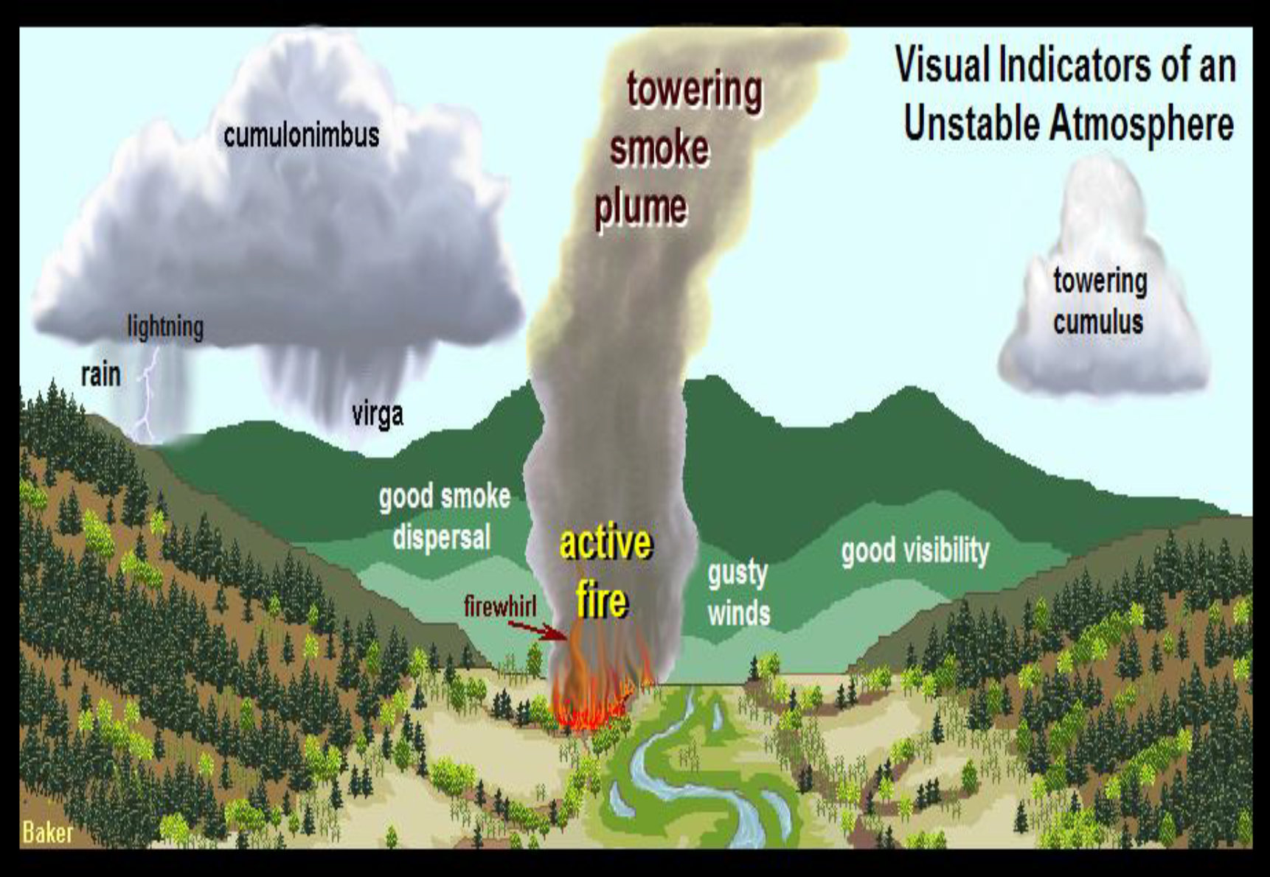
Weather and Fire
Unstable Atmosphere

Slide 9
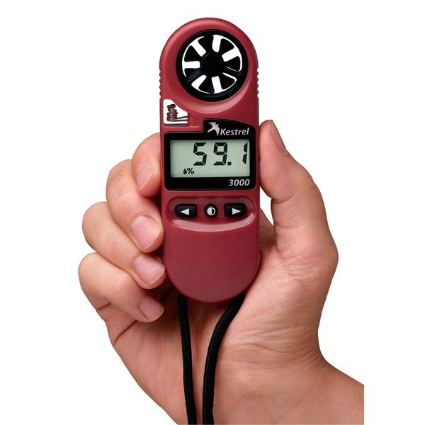
Winds
Impact fire environment by:
Increasing supply of oxygen to fire
Influencing direction of fire spread
Increasing drying of fuels
Blowing embers and firebrands outside of fire area causing potential spot fires
Bending flames to preheat fuels ahead of fire

Slide 10
Preditive Services
Monitor, analyse, and predict weather factors as they relate to fire behavior and resource safety
Utilize and cooperate with your local air district

Slide 11
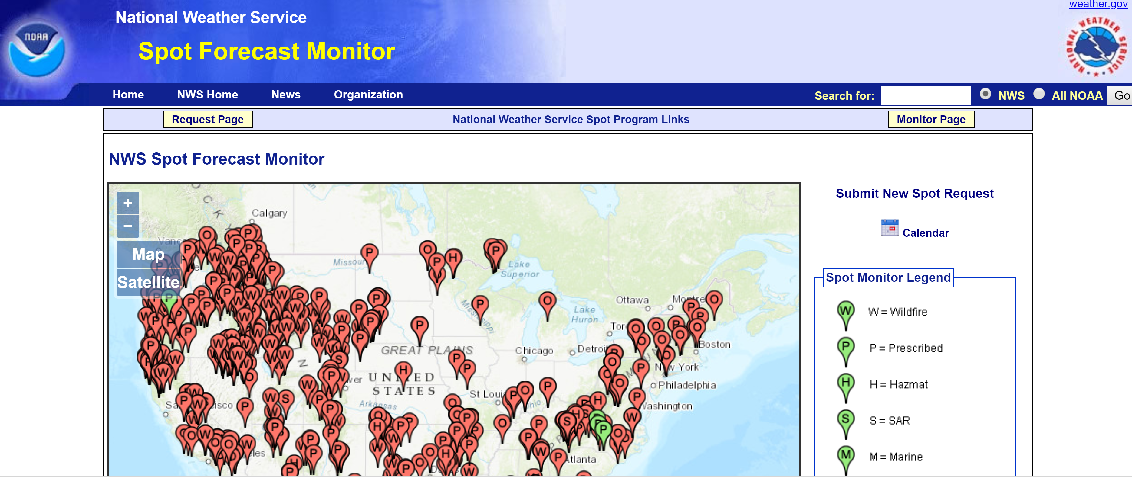
www.weather.gov/spot/monitor/

Slide 12
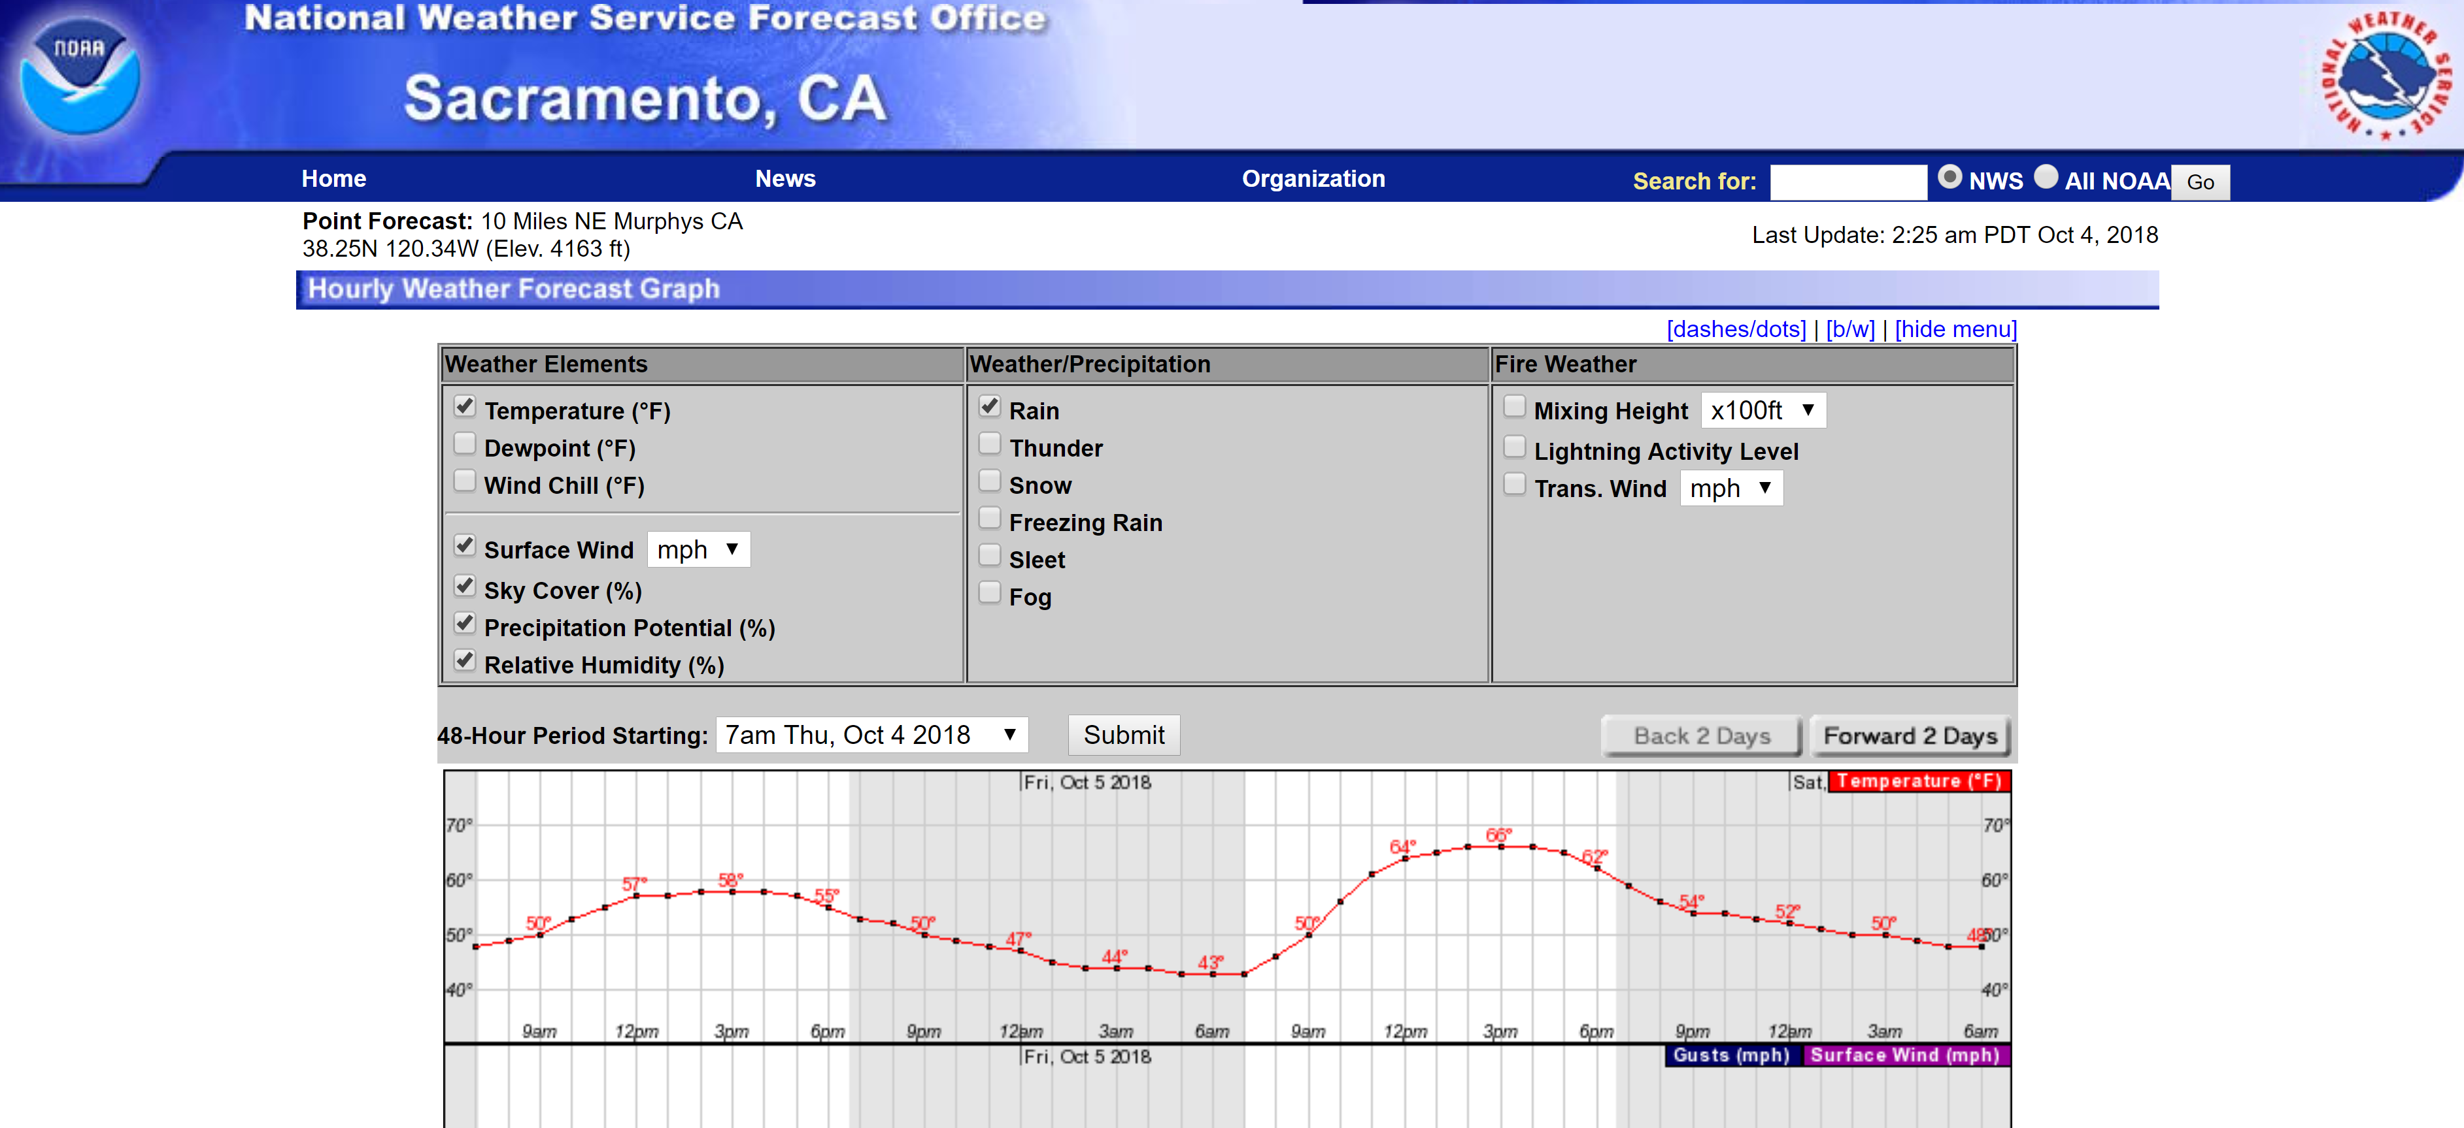
forecast.weather.gov

Slide 13
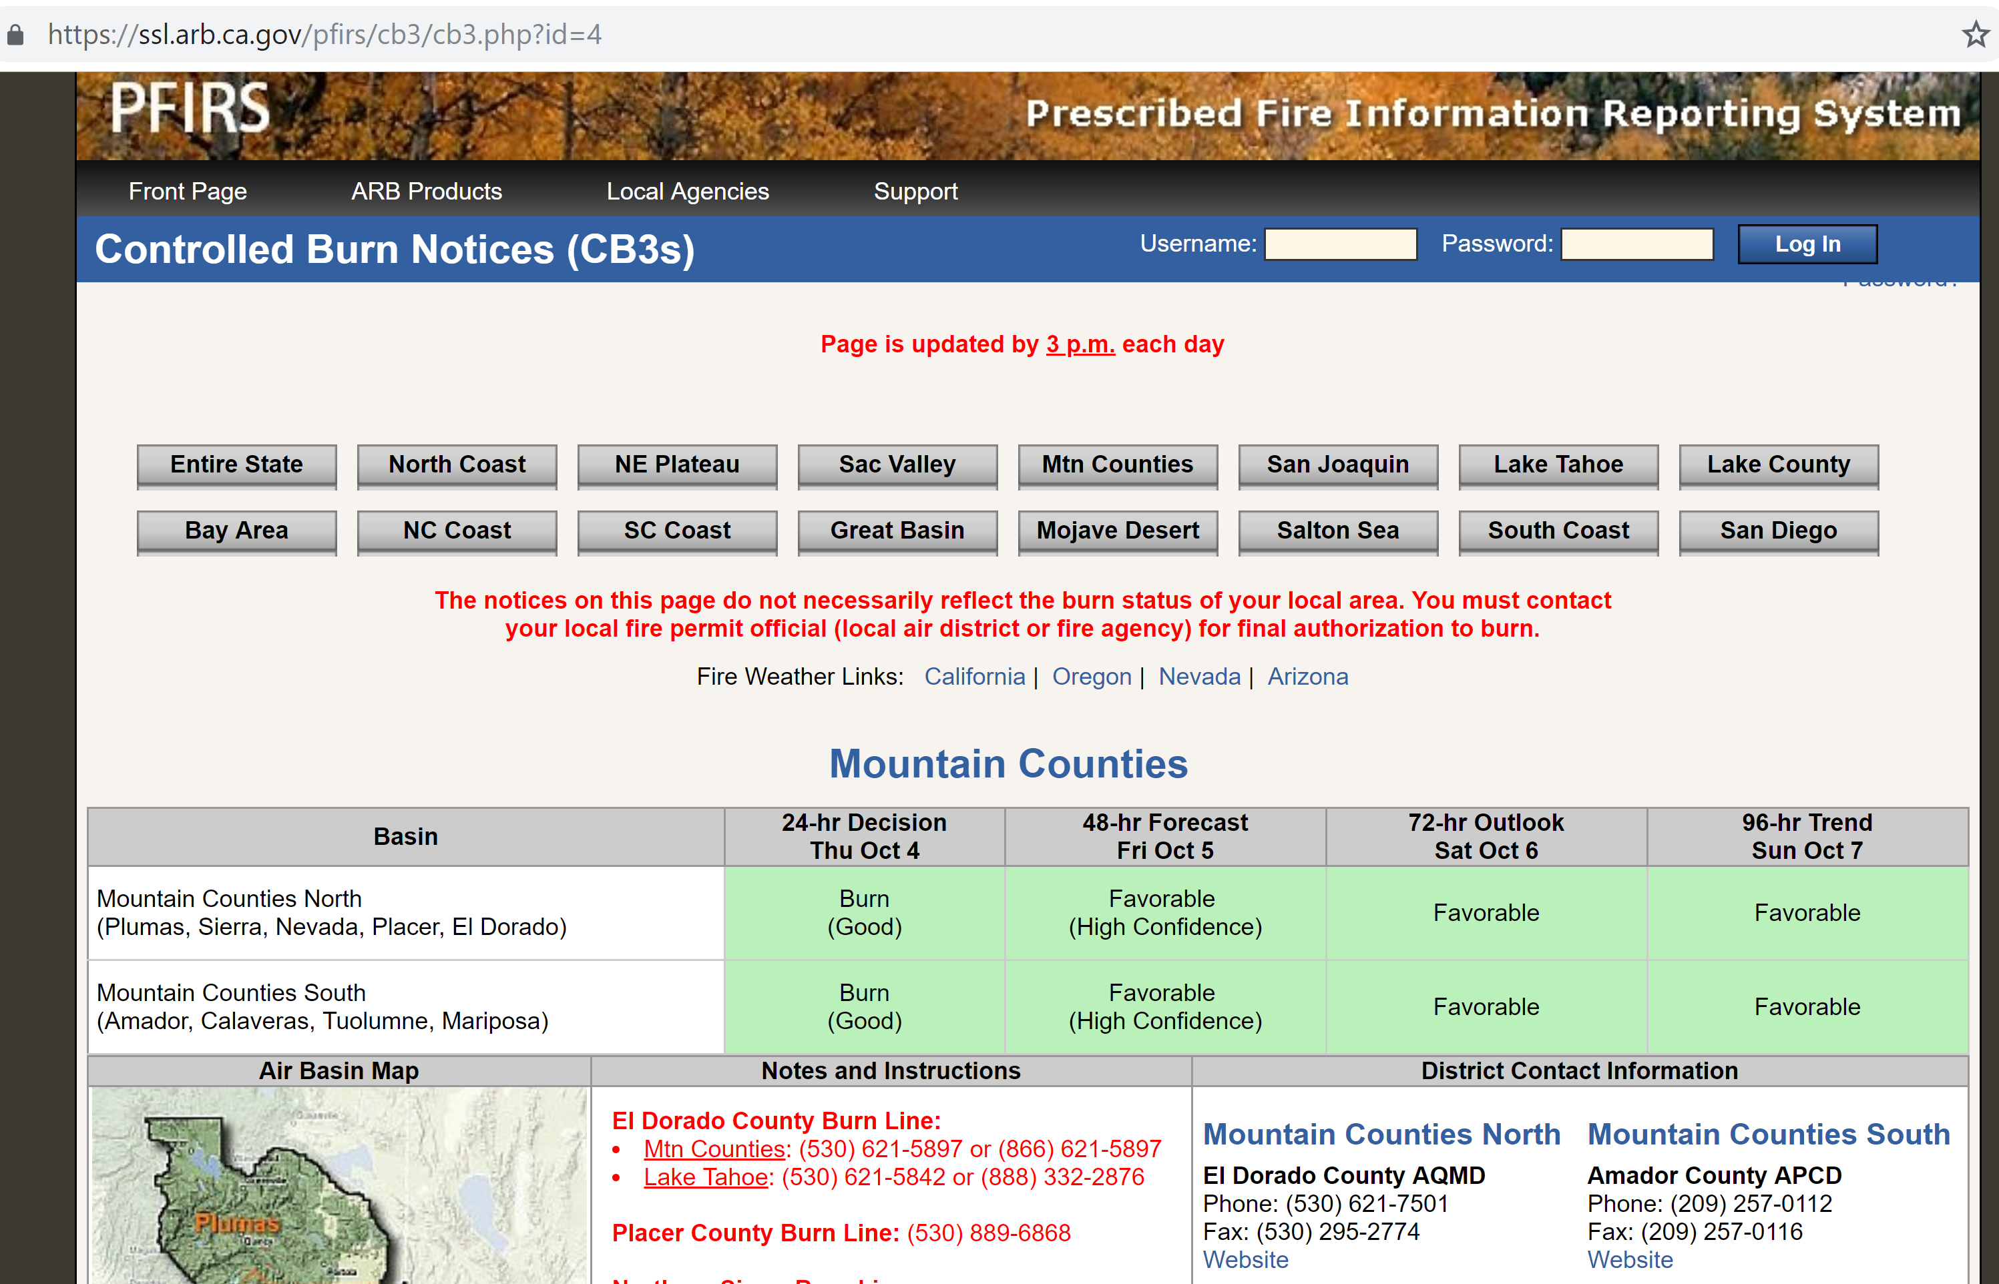
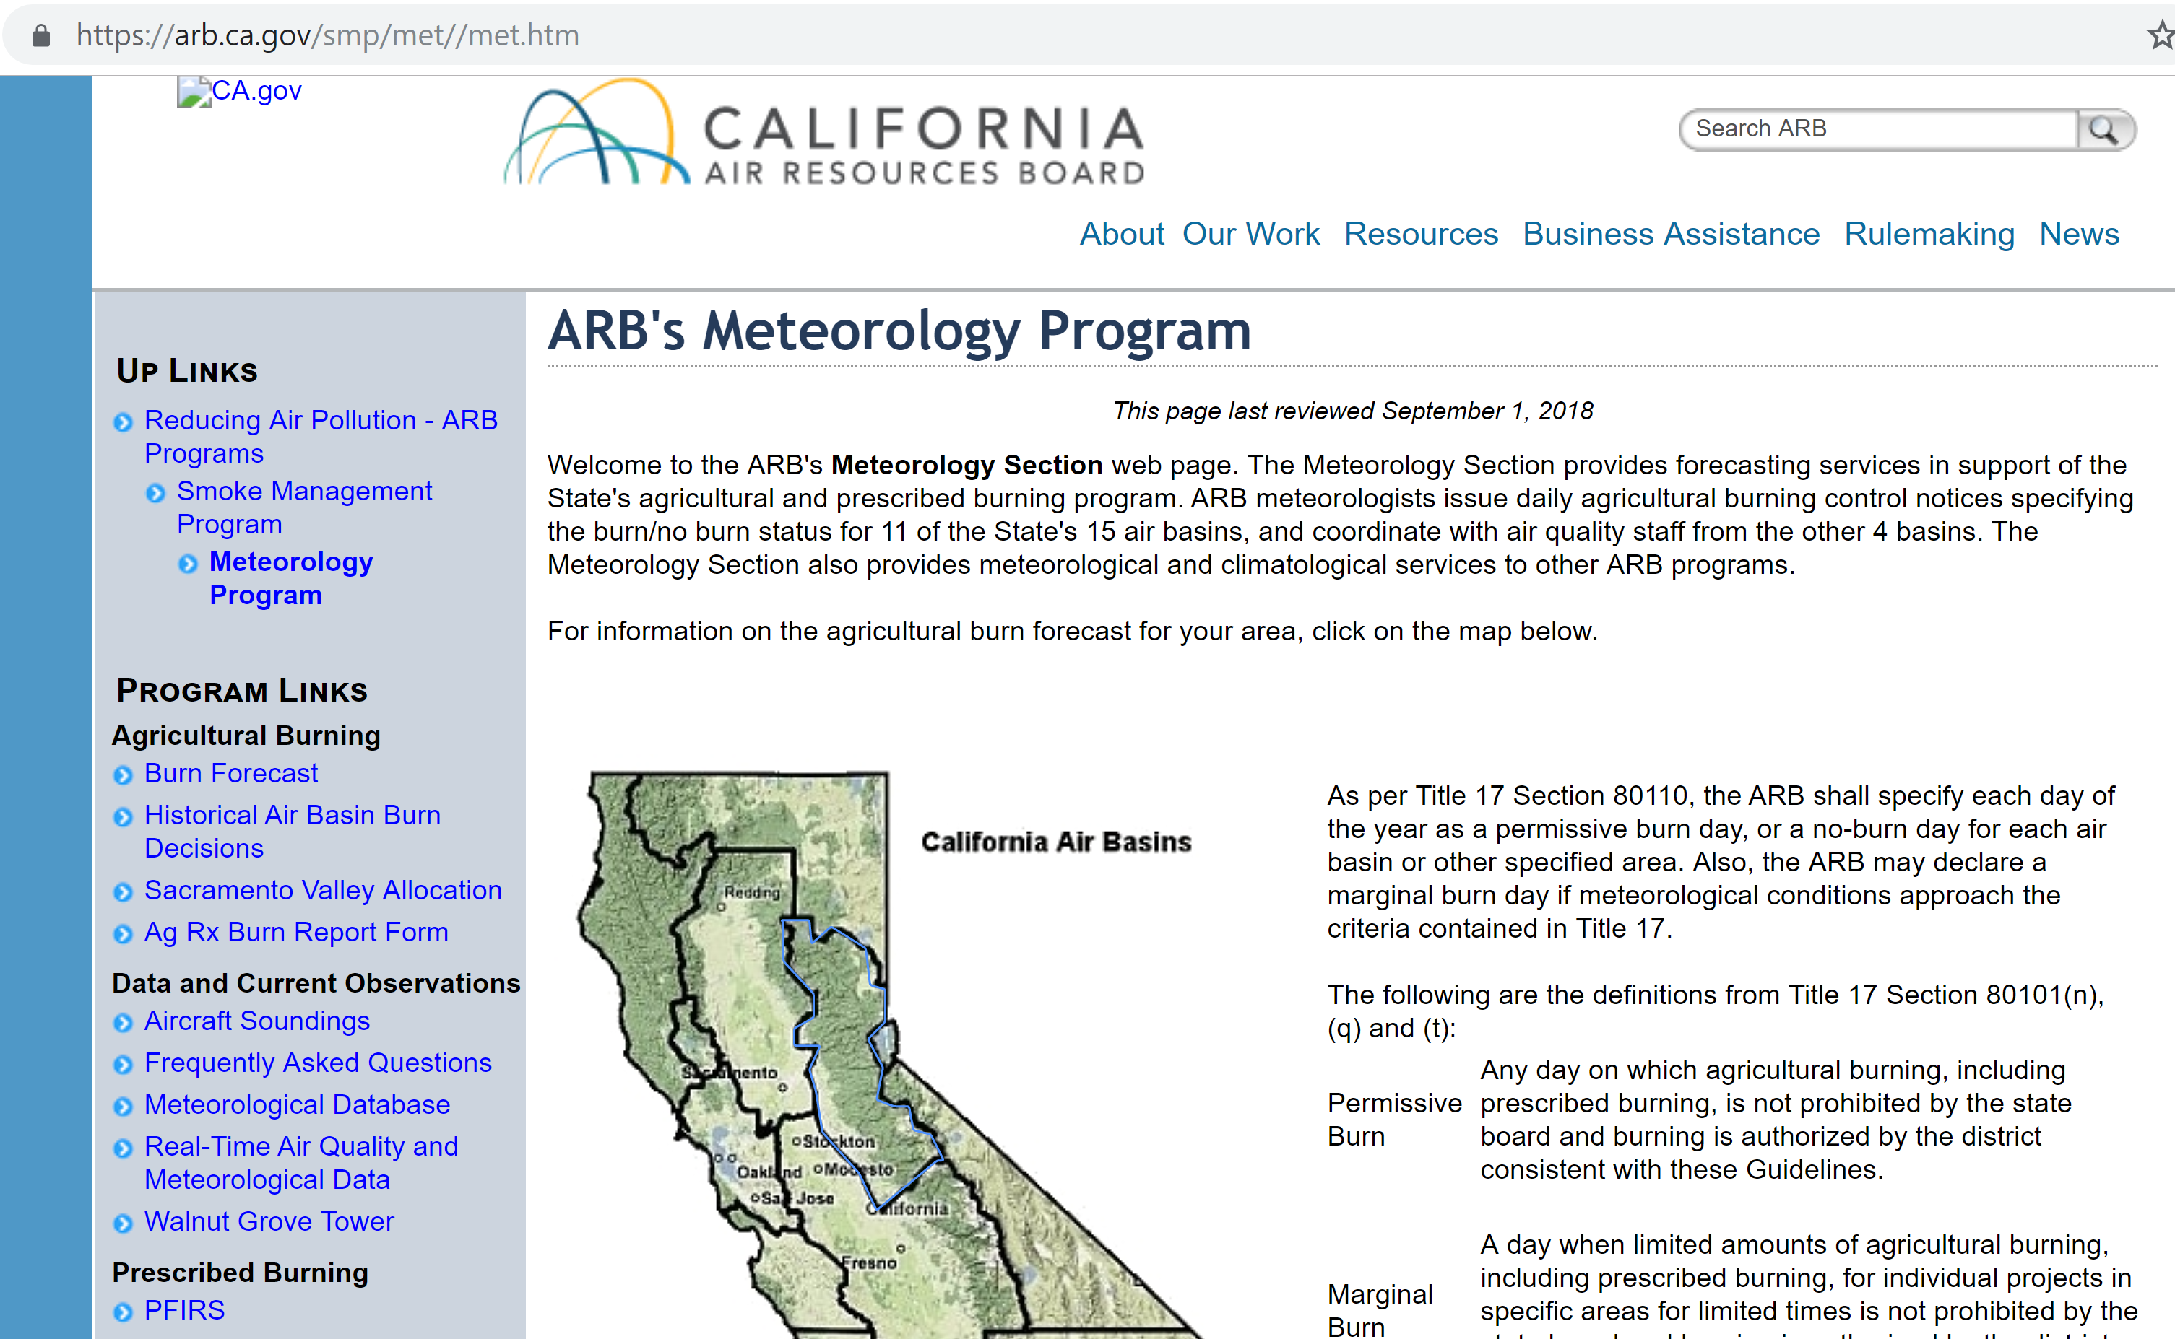
arb.ca.gov

Slide 14
Thank you!

