Slide 1
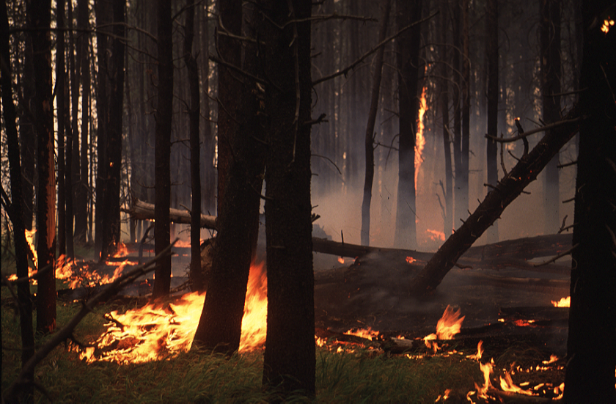
FIRE TERMS & FIRE BEHAVIOR
UCCE Rx Workshop
October 4, 2018
Arnold, CA
Ben Jacobs, Calaveras Big Trees State Park

Slide 2
FIRE BEHAVIOR IS A VERY COMPLEX SUBJECT
THEREFORE, IT’S IMPORTANT TO GET EVERYONE ON THE SAME PAGE WITH TERMS

Slide 3
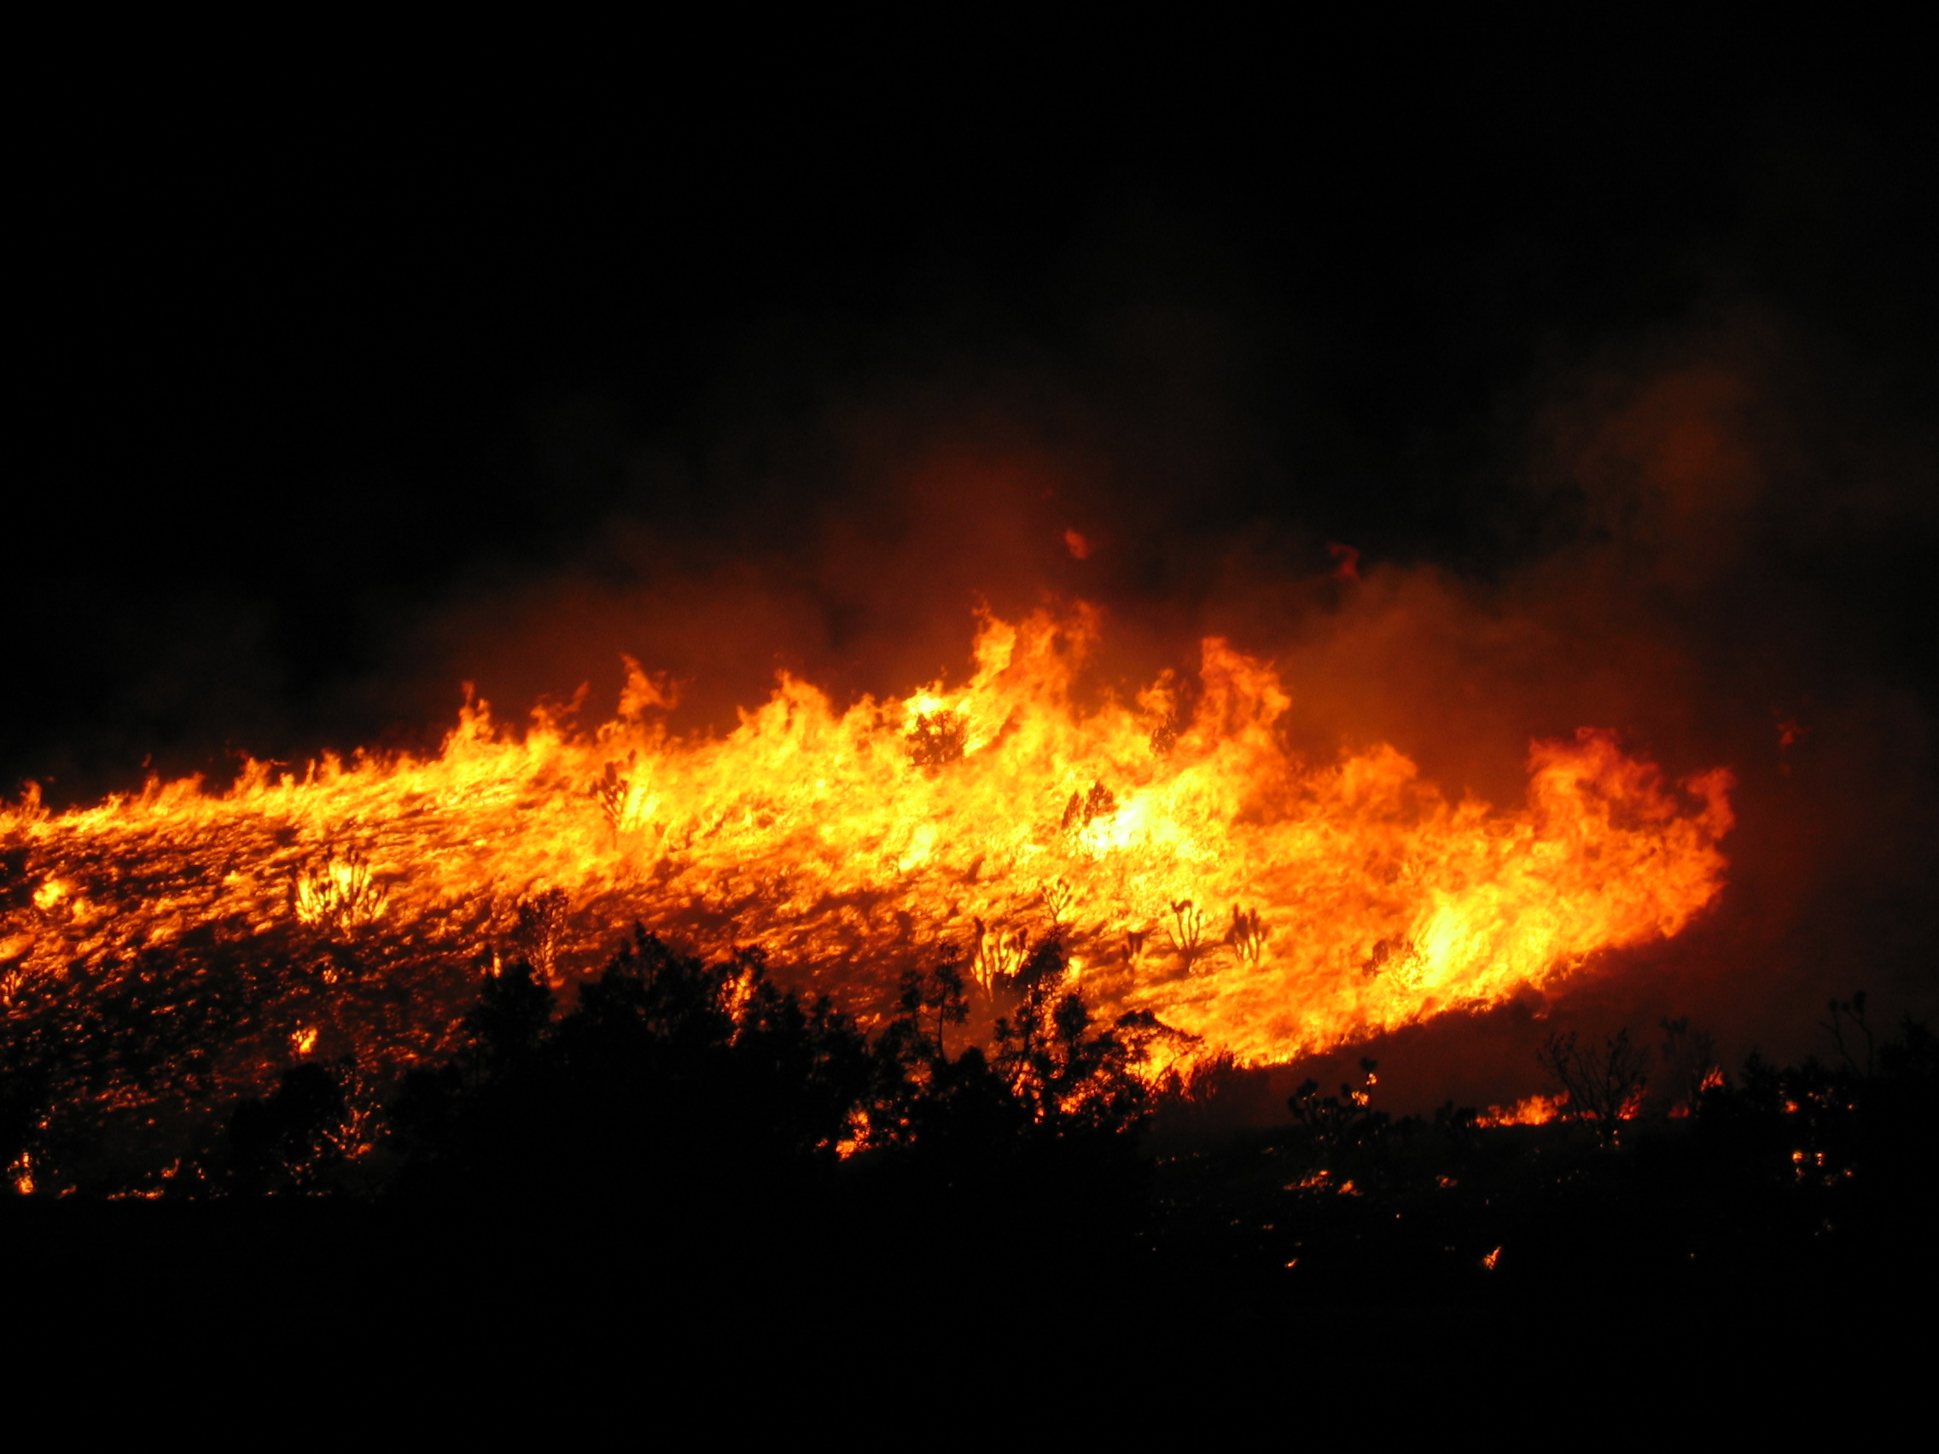
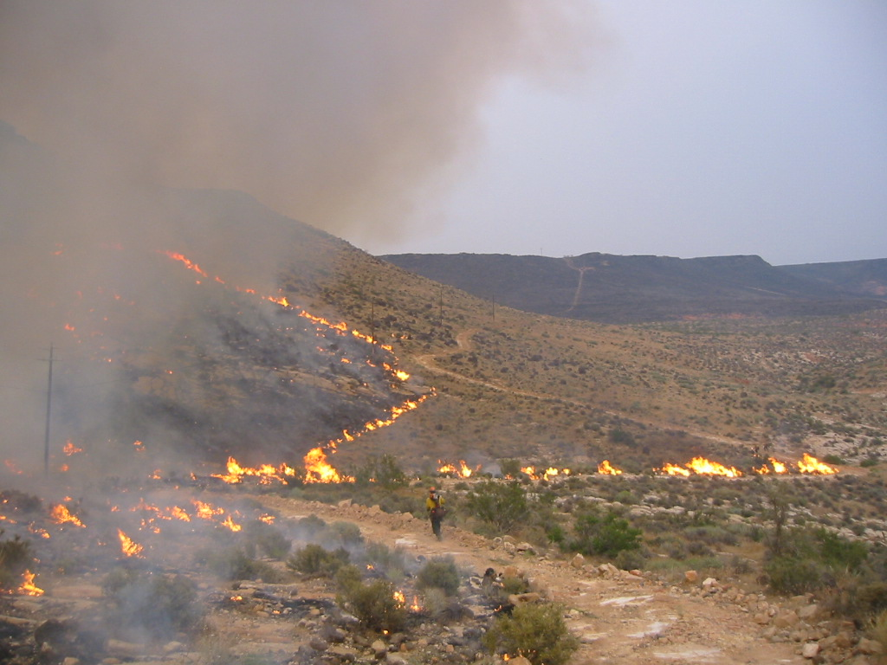
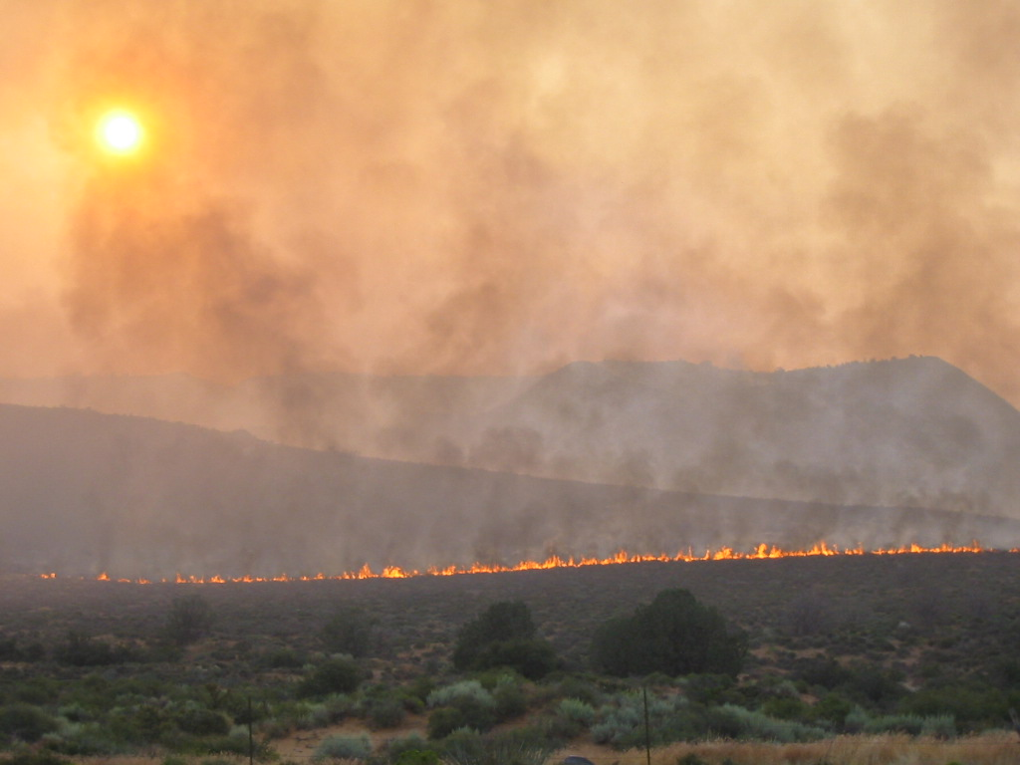
3 TYPES OF FIRE SPREAD
HEAD FIRE
BACKING FIRE
FLANKING FIRE
Notes:
A review of basic fire spreads will be covered in the following slides.

Slide 4
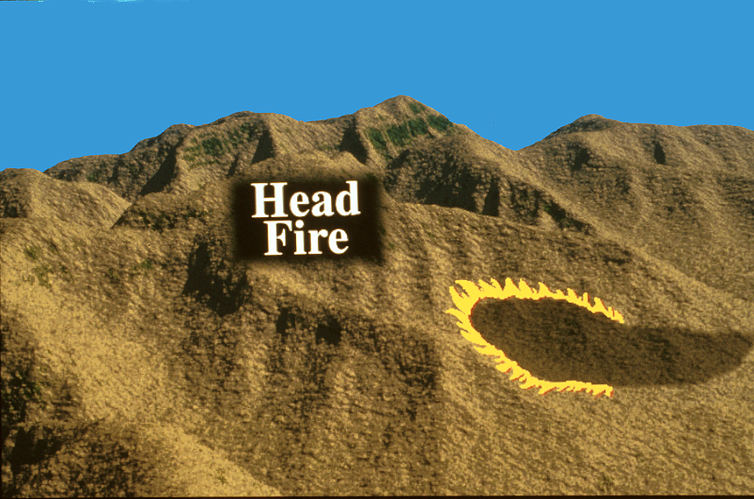
HEAD FIRE
A FIRE FRONT SPREADING WITH THE WIND OR SLOPE
FLAMES ARE BENDING OVER UNBURNED FUELS
PRODUCES HIGH INTENSITY, RATES OF SPREAD, AND CONVECTIVE COLUMN
HIGHER SPOTTING POTENTIAL

Slide 6
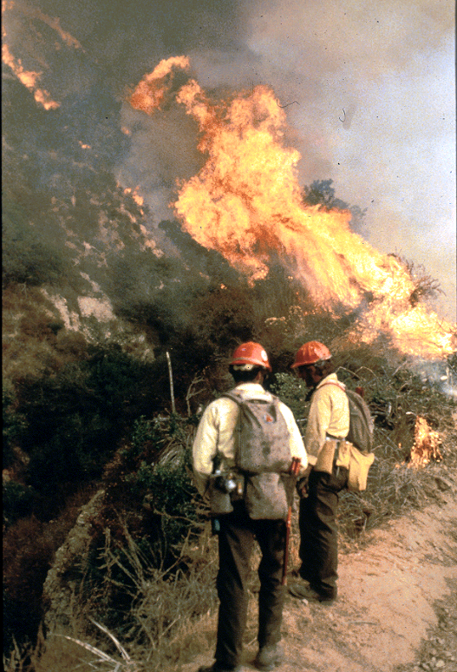

Slide 7
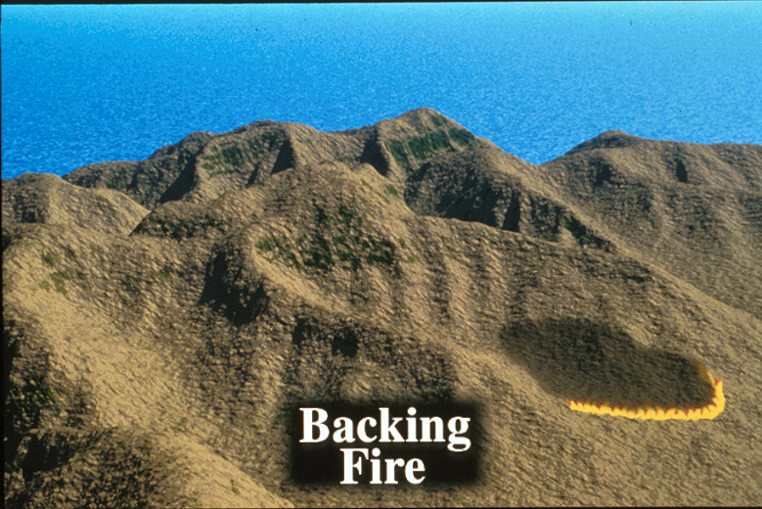
BACKING FIRE
A FIRE FRONT SPREADING AGAINST THE WIND OR SLOPE
FLAMES ARE BENDING OVER BLACKENED FUELS
PRODUCES LOW INTENSITY AND RATES OF SPREAD
LOWER SPOTTING POTENTIAL

Slide 9
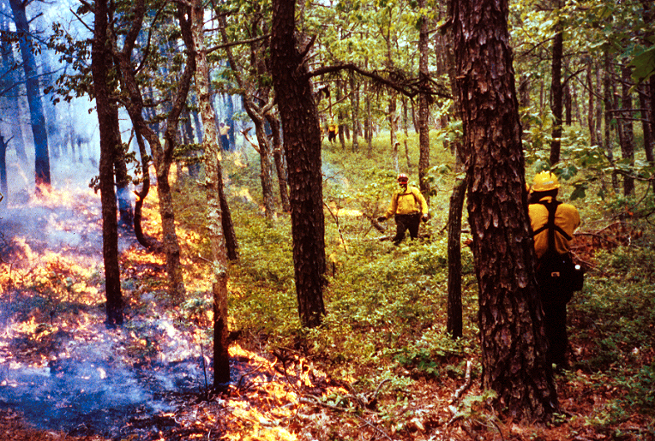

Slide 10
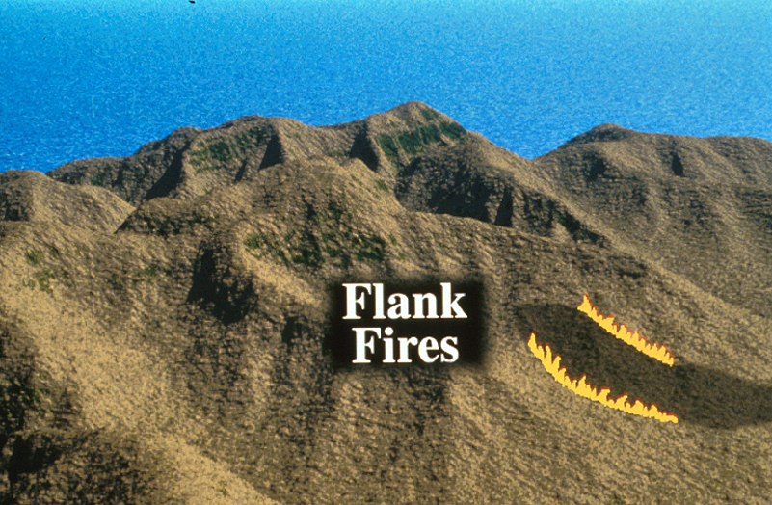
FLANKING FIRE
FIRE SPREADING PERPENDICULAR TO THE WIND OR SLOPE
FLAMES ARE BENDING OVER FLAMES
VERY SUBJECT TO CHANGES BASED ON WIND SHIFTS

Slide 11
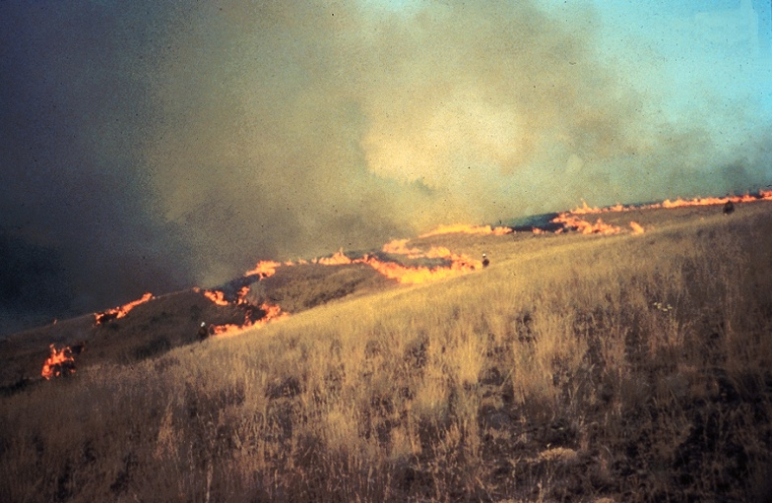

Slide 12
COMMON FIRE BEHAVIOR DESCRIPTORS:
SMOLDERING
CREEPING
BACKING
RUNNING
TORCHING
FLARE UP
CROWNING
BLOW UP
FIREWHIRL
WIND DRIVEN
PLUME DOMINATED
SLOPOVER
SPOTTING

Slide 13
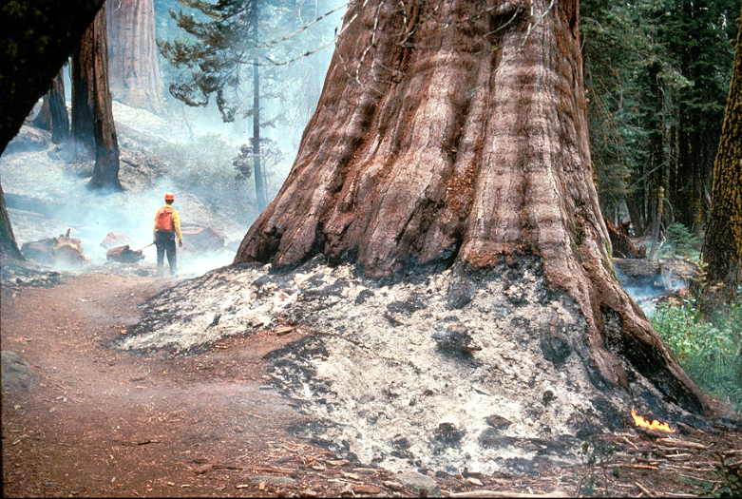
SMOLDERING
BURNING WITHOUT FLAME AND BARELY SPREADING

Slide 14
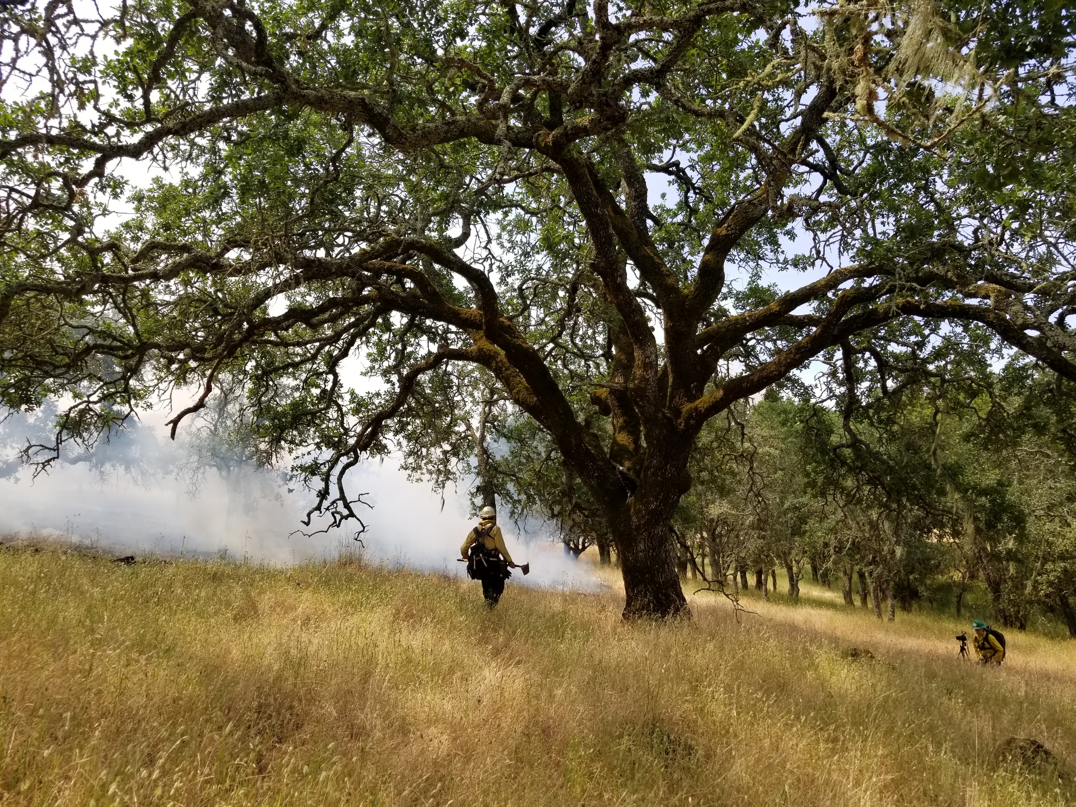
SMOLDERING

Slide 15
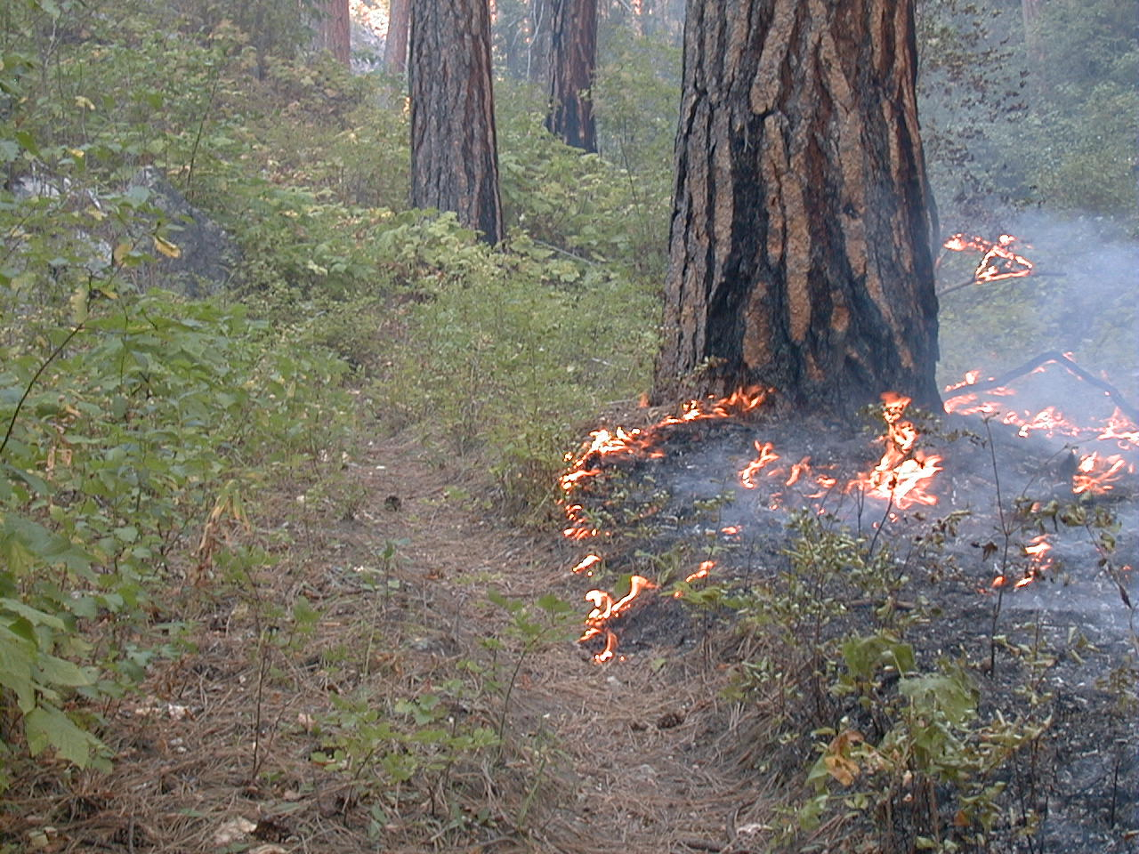
CREEPING
BURNING WITH LOW FLAME AND SPREADING SLOWLY

Slide 16
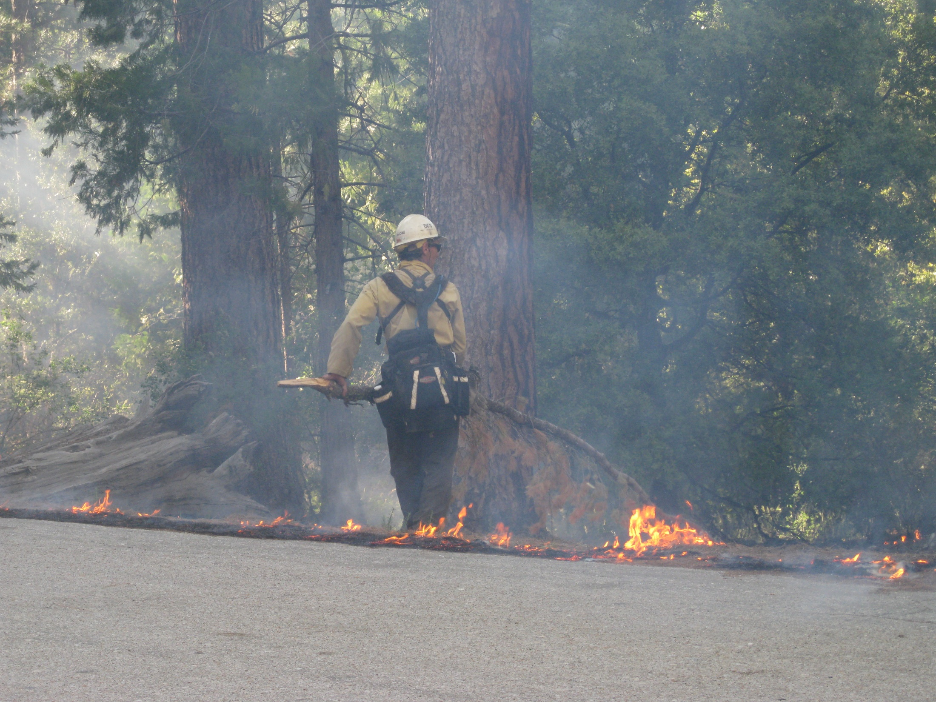
CREEPING

Slide 17
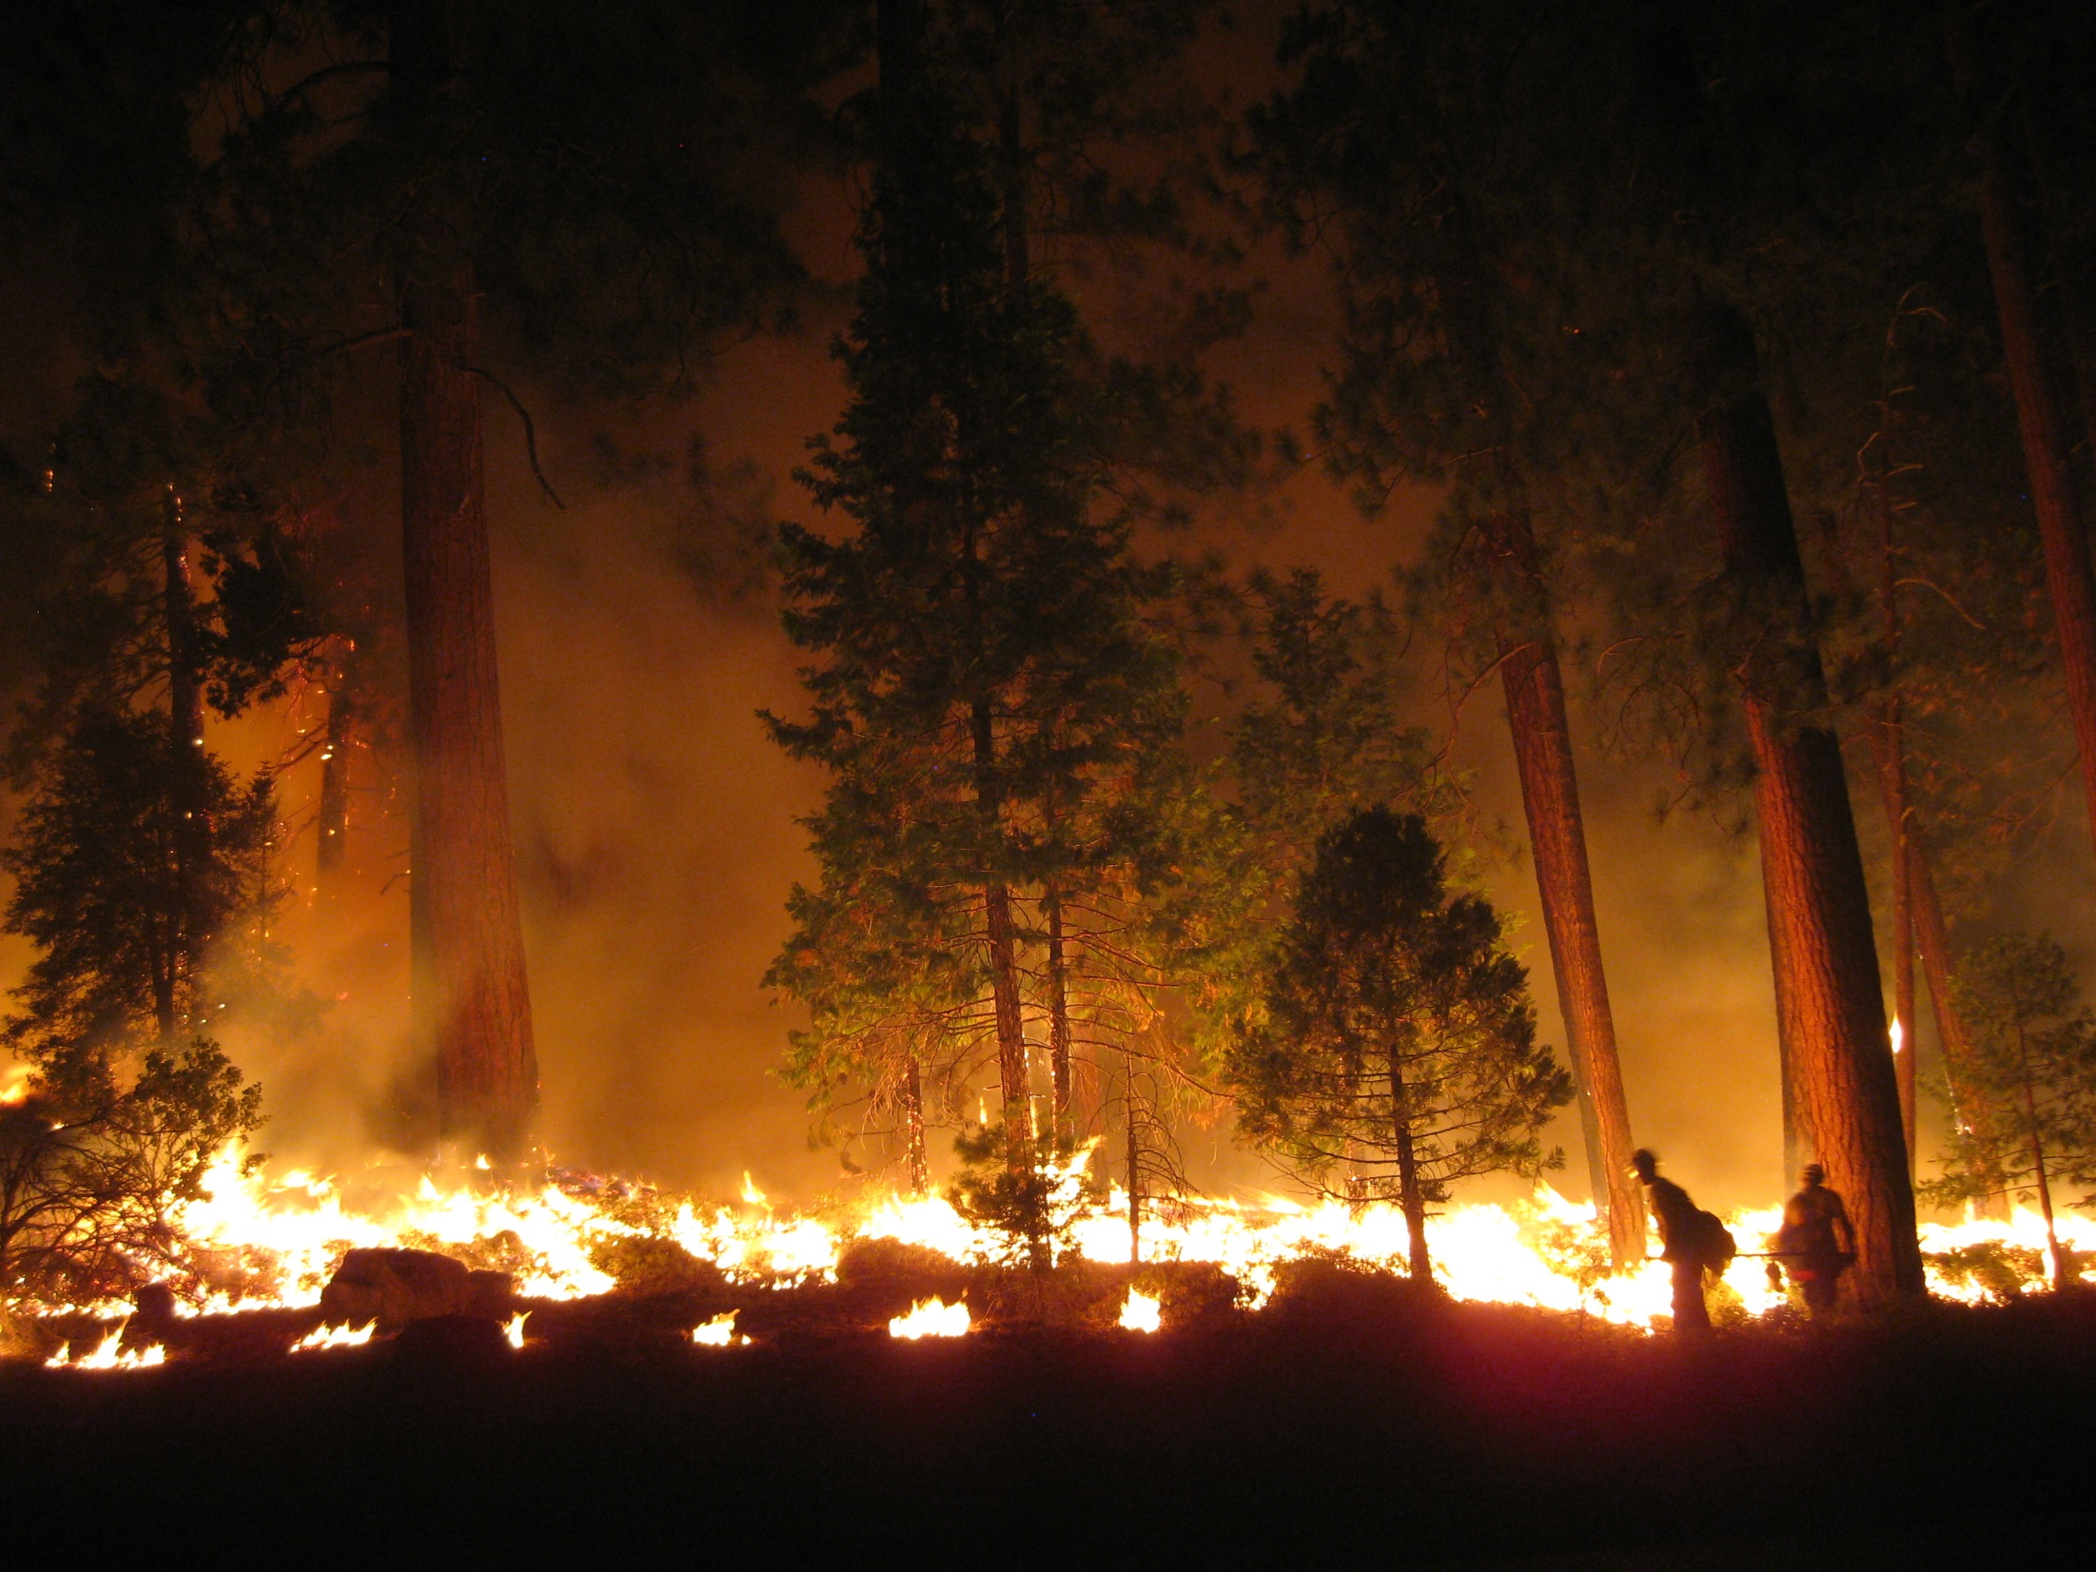
SURFACE FIRE

Slide 18
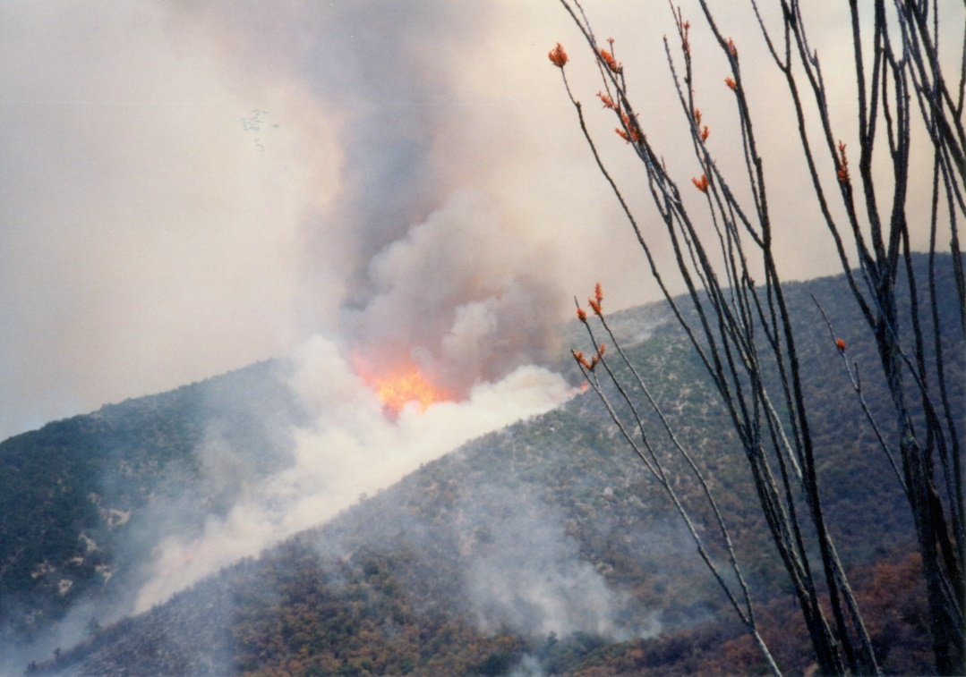
RUNNING
RAPID SPREAD WITH A WELL DEFINED HEAD

Slide 19
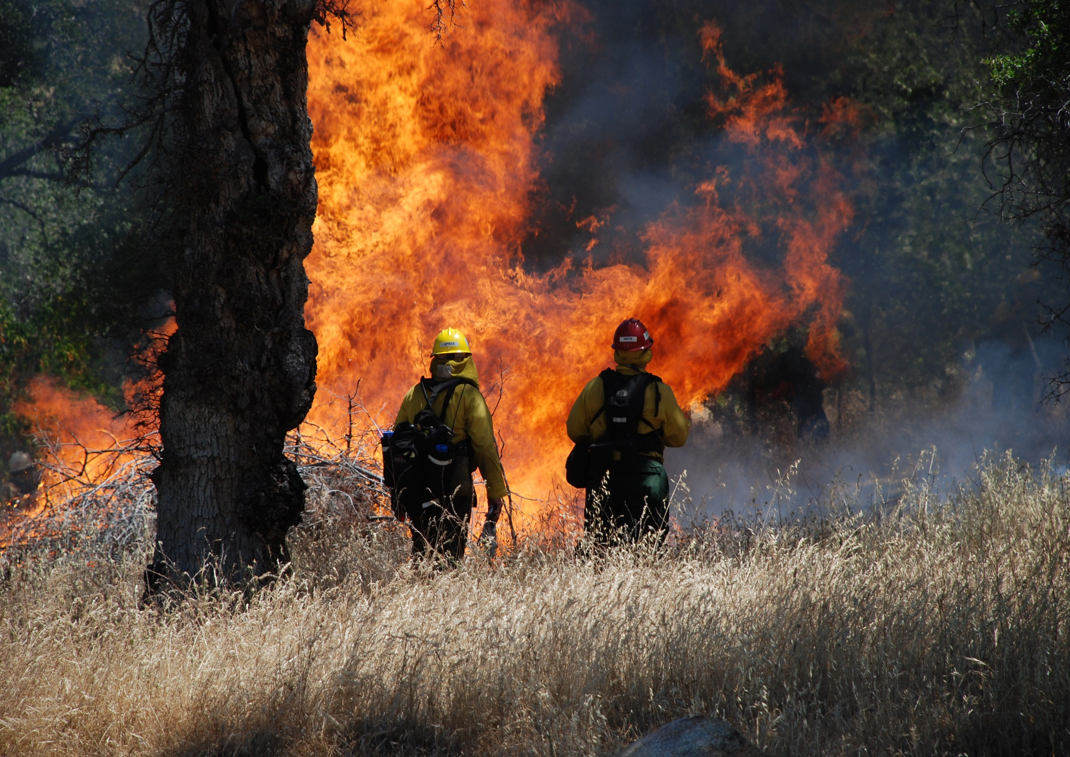
SURFACE FIRE VERTICAL TRANSITION AND TO RUNNING

Slide 20
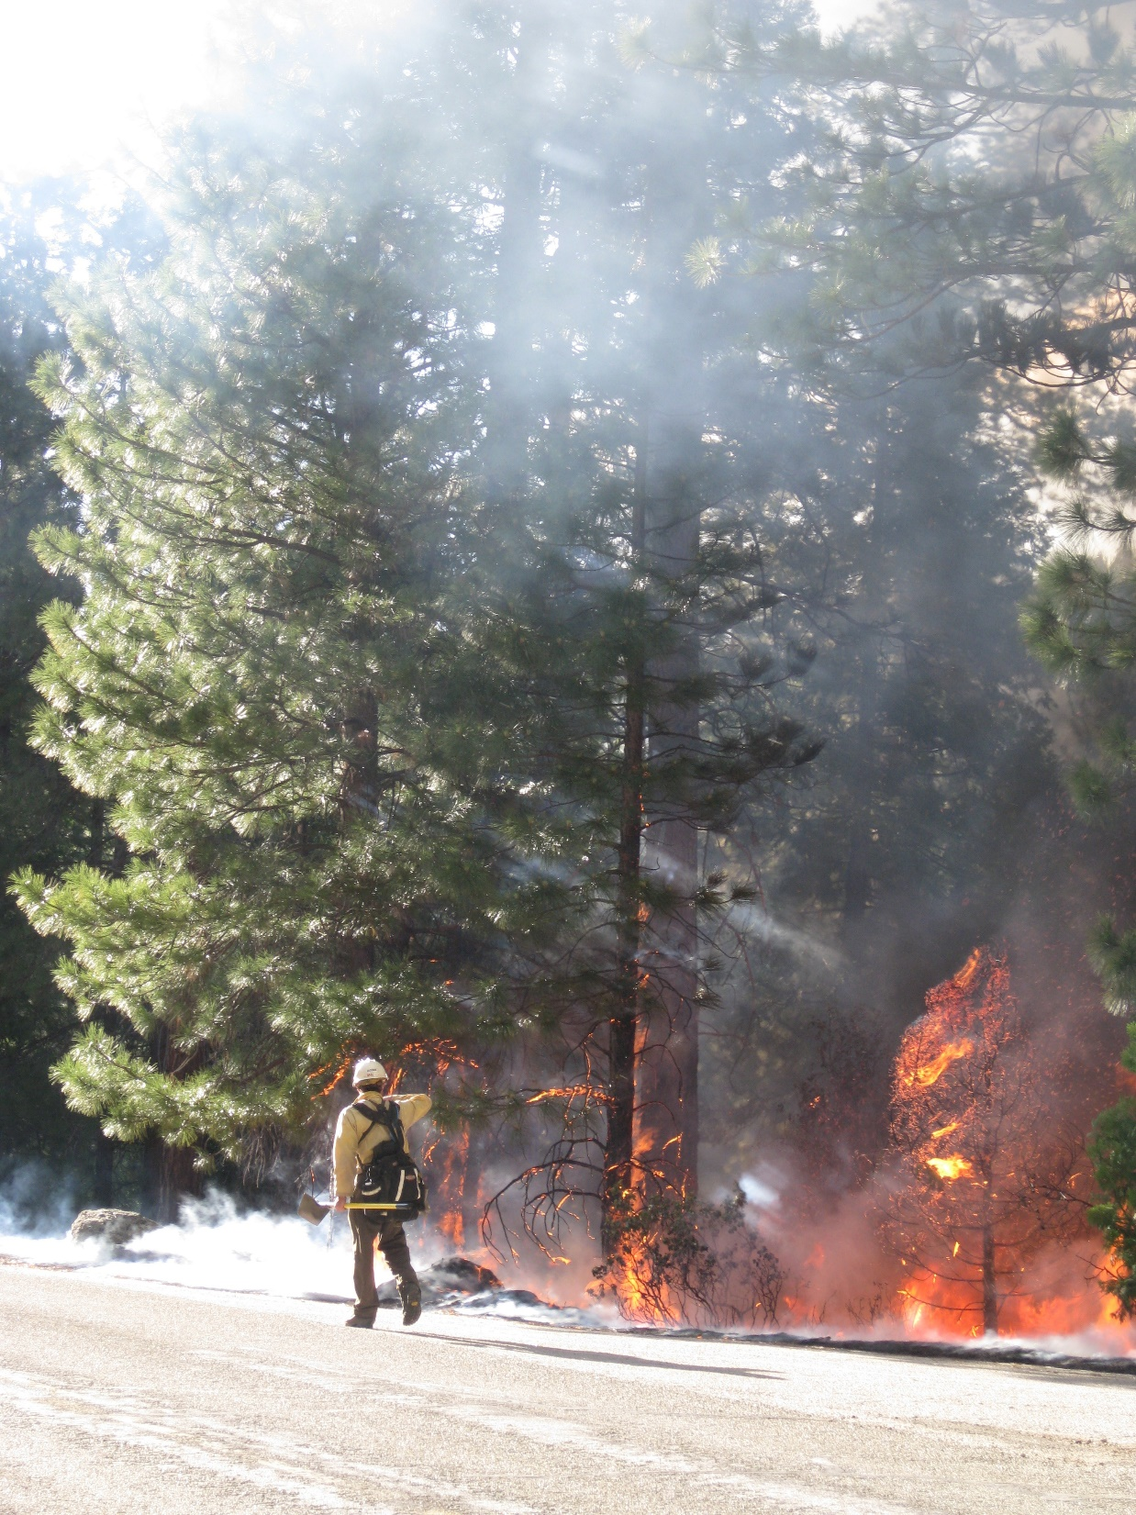
SURFACE FIRE TRANSITION TO SINGLE TREE TORCHING

Slide 21
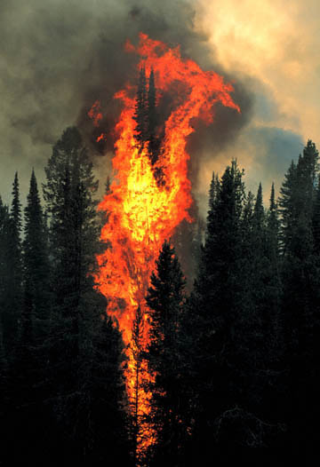
SINGLE TREE TORCHING
LITERALLY ONE TREE BURNING UP
NOTE: TORCHING IS NOT CROWNING

Slide 22
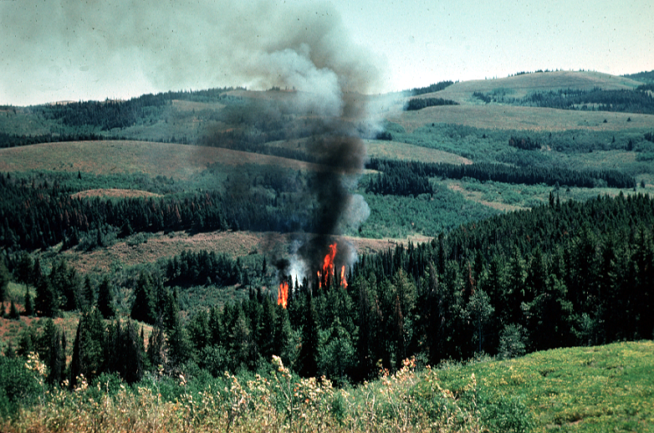
GROUP TREE TORCHING
MORE THAN ONE TREE BURNING UP

Slide 23
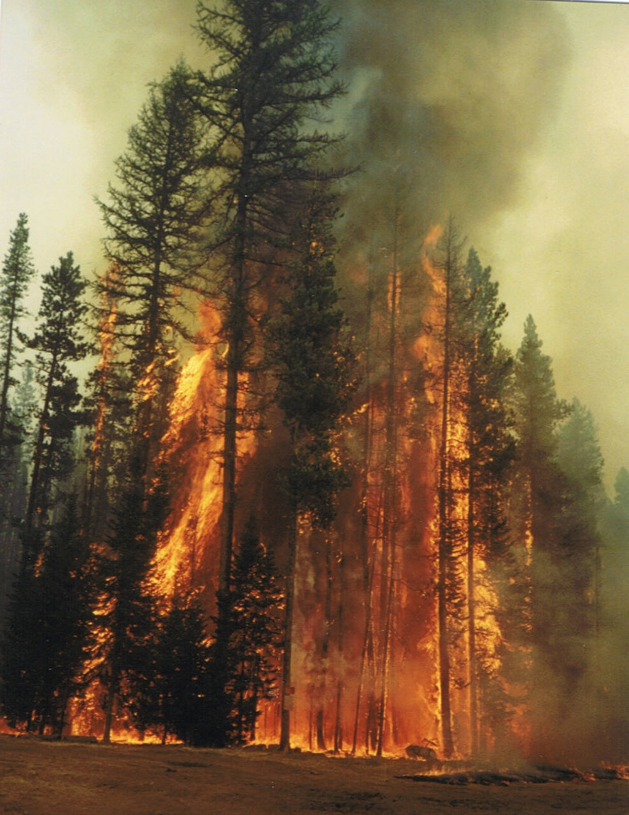
GROUP TREE TORCHING TRANISTION TO A FLARE UP
RAPID BUT SHORT DURATION INCREASE IN SPREAD OR INTENSITY
NOTE: A FLARE UP IS NOT A BLOW UP

Slide 24
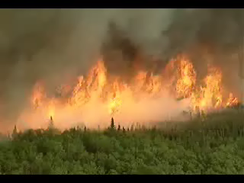
CROWNING
BURNING FROM TREE TO TREE OR SHRUB TO SHRUB MORE OR LESS INDEPENDENTLY OF THE SURFACE FIRE

Slide 25
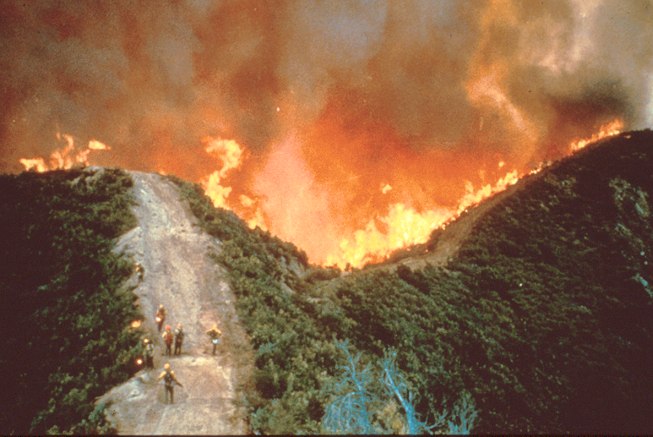
BLOW UP
RAPID AND LONG DURATION INCREASE IN SPREAD AND INTENSITY

Slide 26
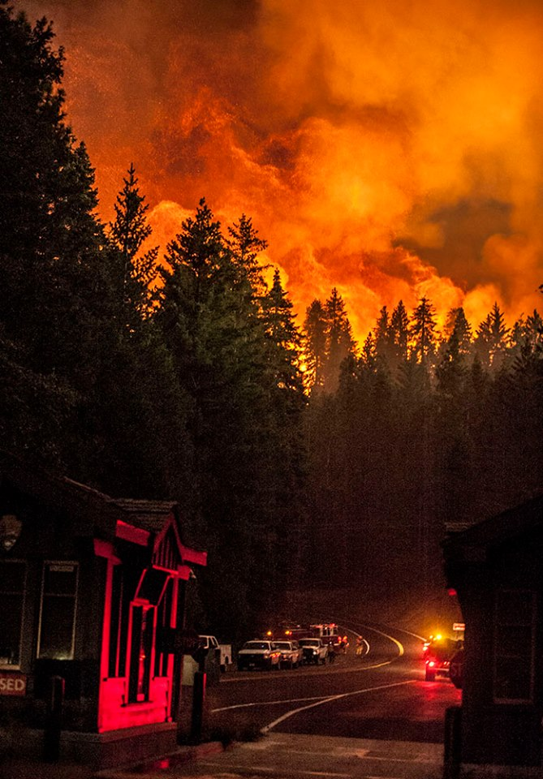
NIGHT TIME CROWN FIRE BLOW UP

Slide 27
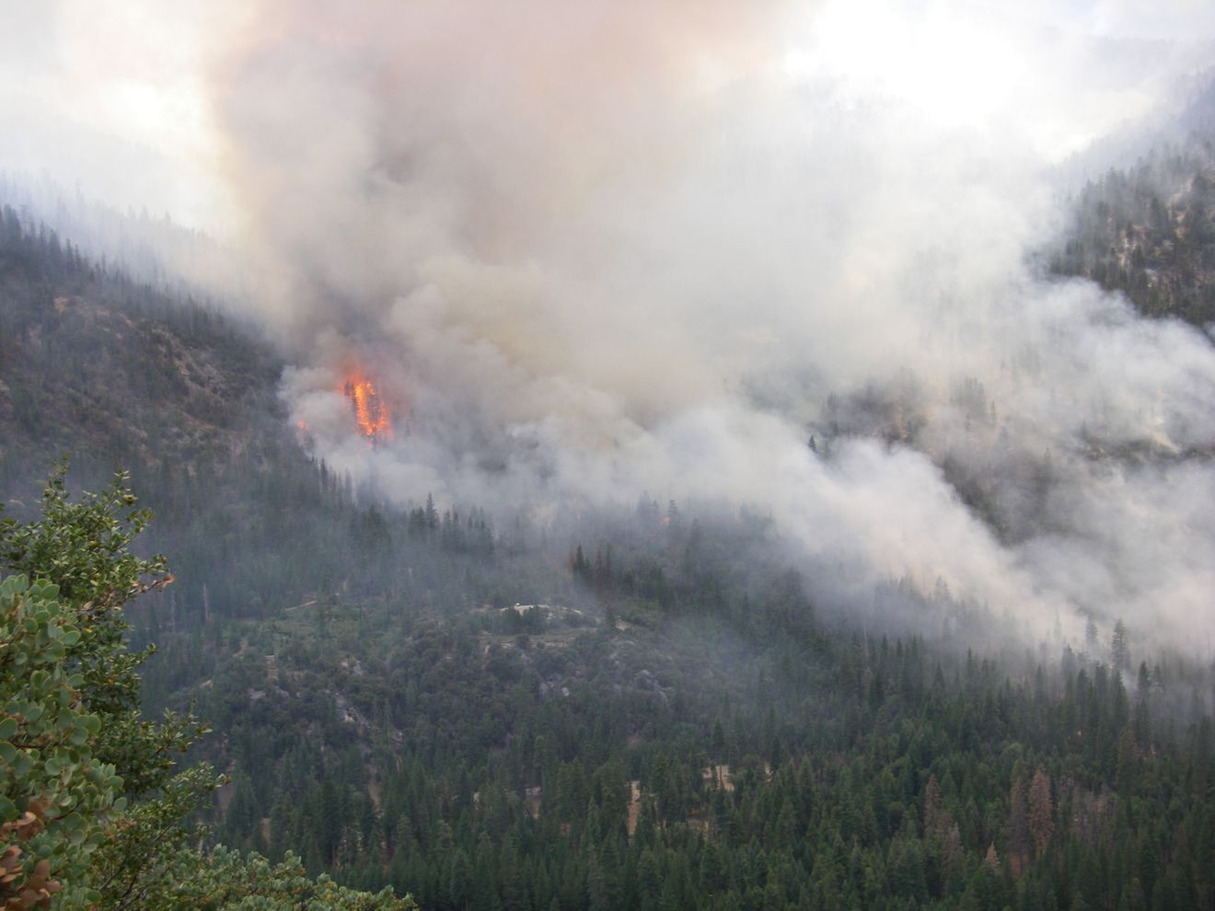
WIND DRIVEN SURFACE RUN TRANSITION INTO A CROWN FIRE

Slide 28
FIREWHIRL
VORTEX OF SPINNING, UNSTABLE, SUPER HEATED AIR CONTAINING FIRE
CAN BE VERY DANGEROUS TO FIREFIGHTERS

Slide 29
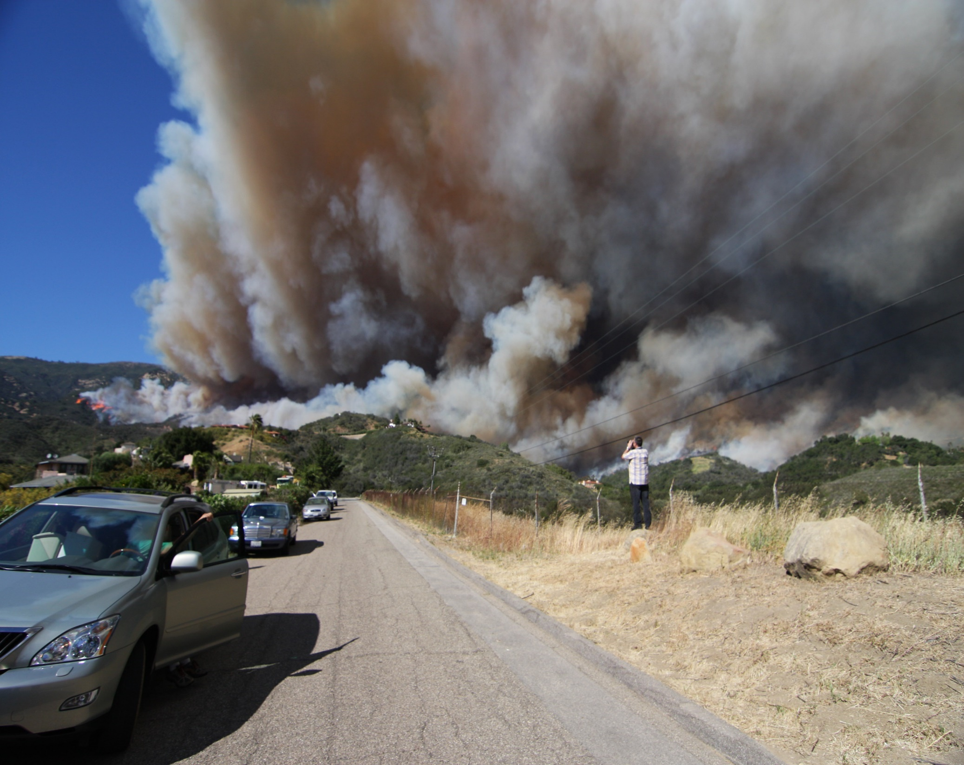
WIND DRIVEN FIRE BLOW UP
WIND IS OVERRIDING THE FIRE, TOPOGRAPHY, AND ALL OTHER FACTORS
WHAT KIND OF WINDS DO YOU HAVE IN YOUR AREA THAT COULD CAUSE THIS?
WIND EVENTS CAN AFFECT AN RX FIRE SEVERAL DAYS AFTER IGNITION IS COMPLETE

Slide 30
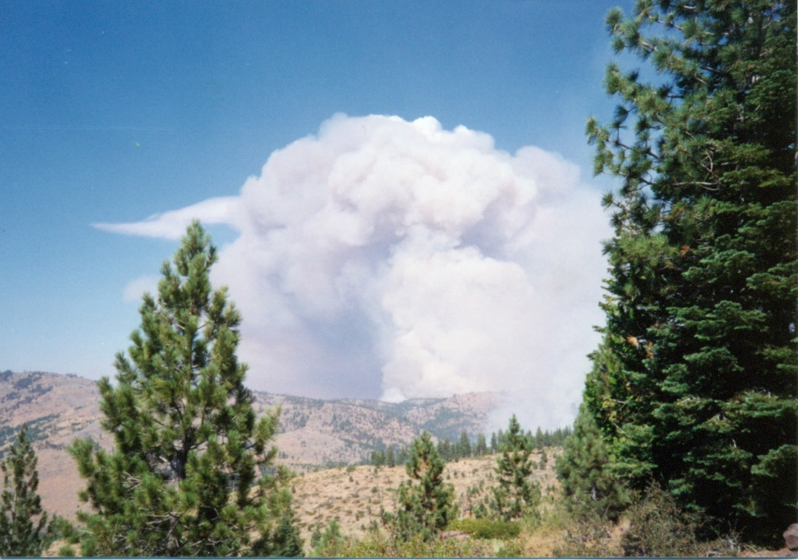
CROWN FIRE TRANSITION TO PLUME DOMINATED BLOW UP
FIRE IS OVERRIDING WIND AND ALL OTHER FACTORS
COLUMN IS ACTING LIKE A PYROCUMULUS AND WILL FORM A CAP
COMPLETELY UNPREDICTABLE AND VERY DANGEROUS WHEN THE COLUMN COLLAPSES

Slide 31
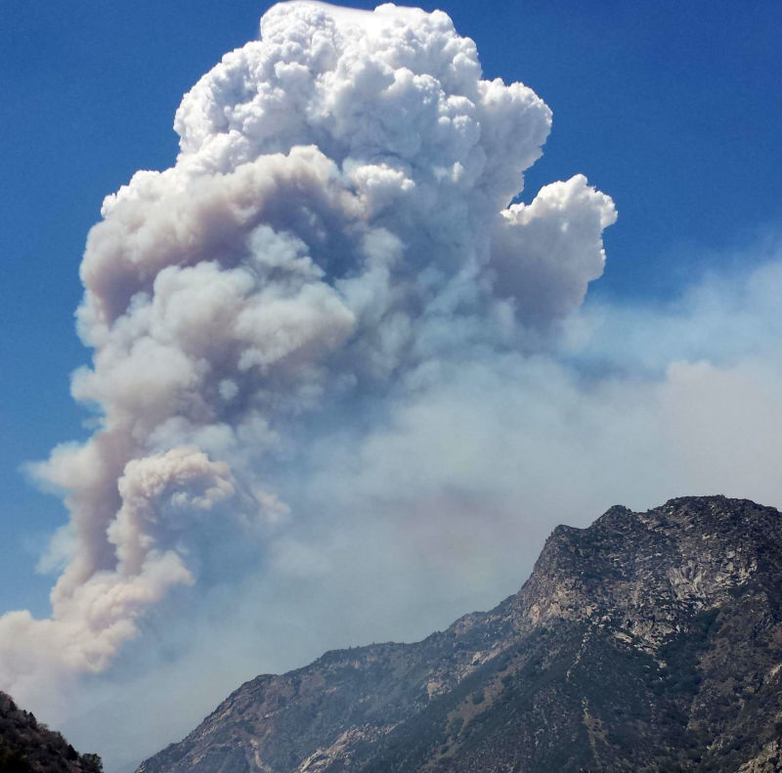
PLUME DOMINATED FIRE

Slide 32
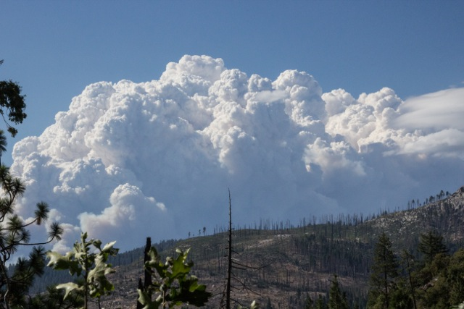
THIS IS WHAT YOU DON’T WANT YOUR RX FIRE TO LOOK LIKE

Slide 33
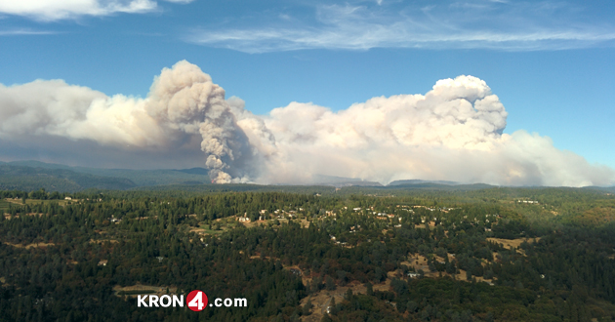

Slide 34
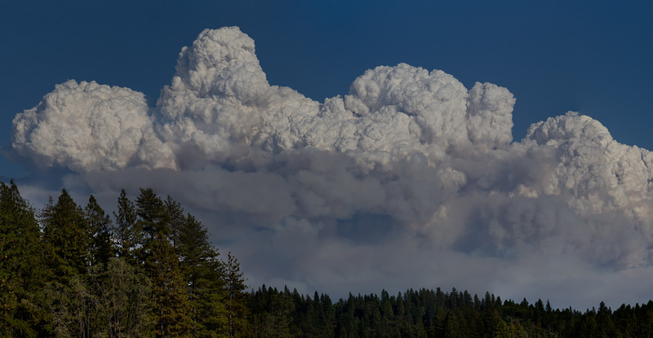

Slide 35
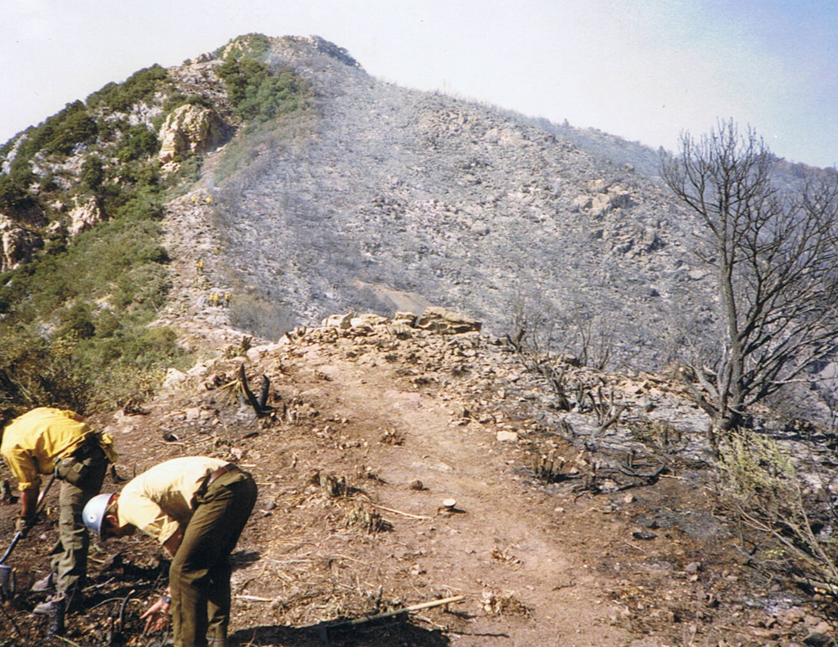
SLOPOVER
FIRE ACROSS THE FIRELINE AND IMMEDIATELY ADJACENT TO THE MAIN FIRE

Slide 36
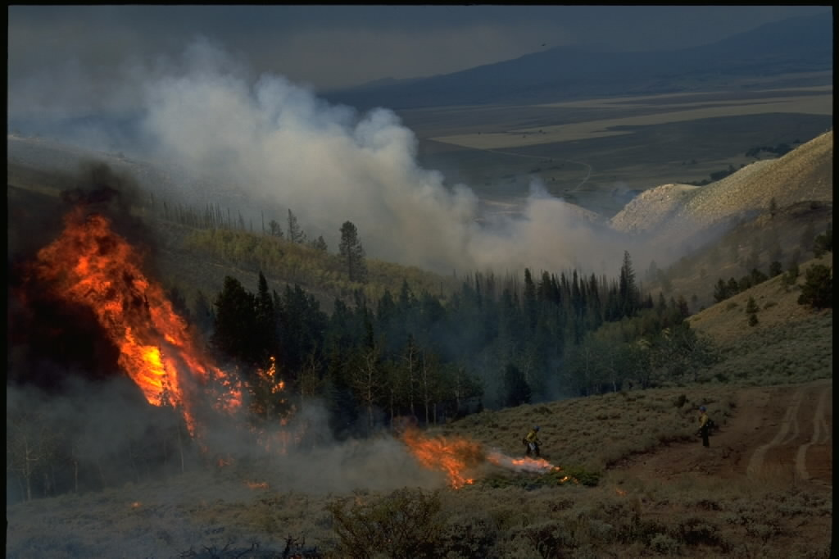
SPOTTING
EMBERS CARRIED BY WIND OR CONVECTION STARTING NEW FIRES AWAY FROM THE MAIN FIRE

Slide 37
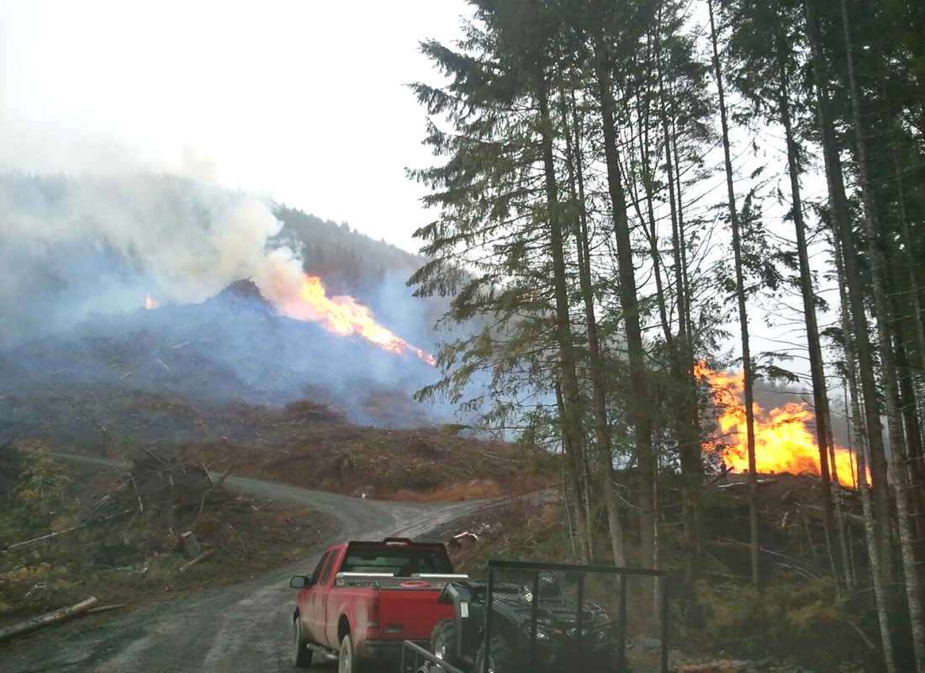
SPOTTING
(AND A NICE LITTLE HEAD FIRE)

Slide 38
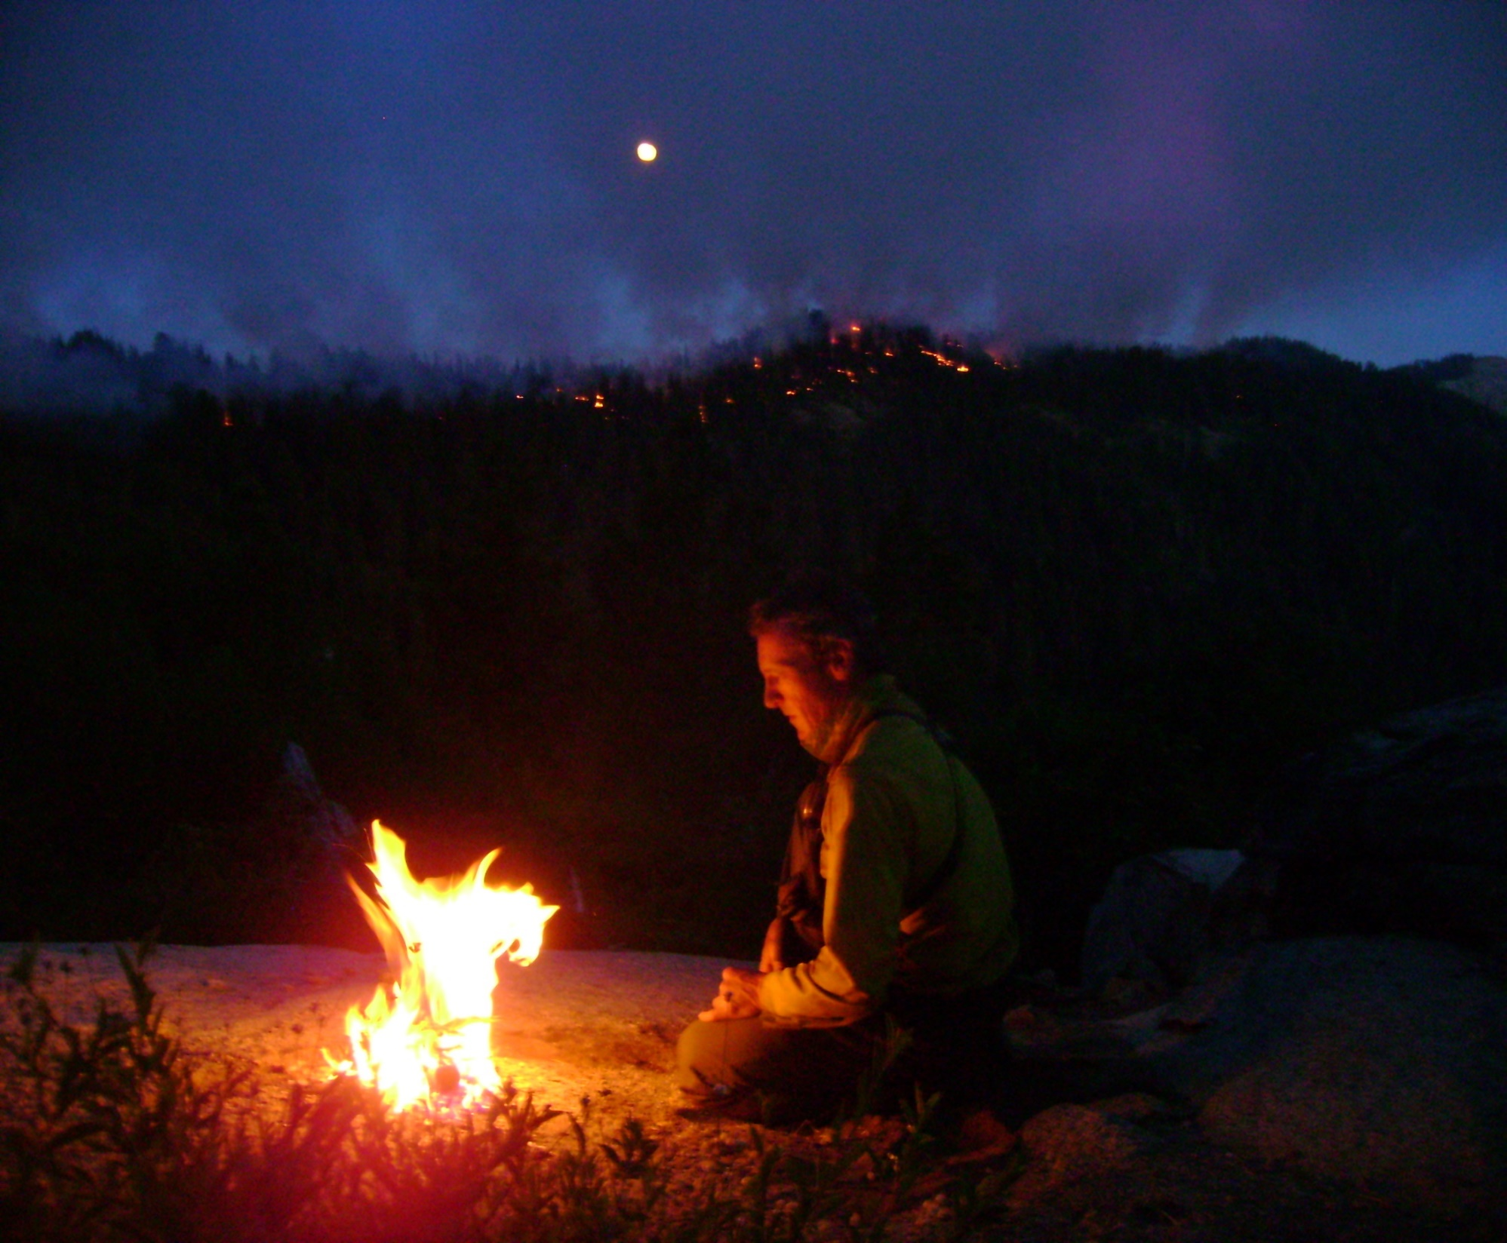
SPOT FIRE?
QUESTIONS?
Ben Jacobs
bjacobs111111@gmail.com
559-679-0047

