Slide 1
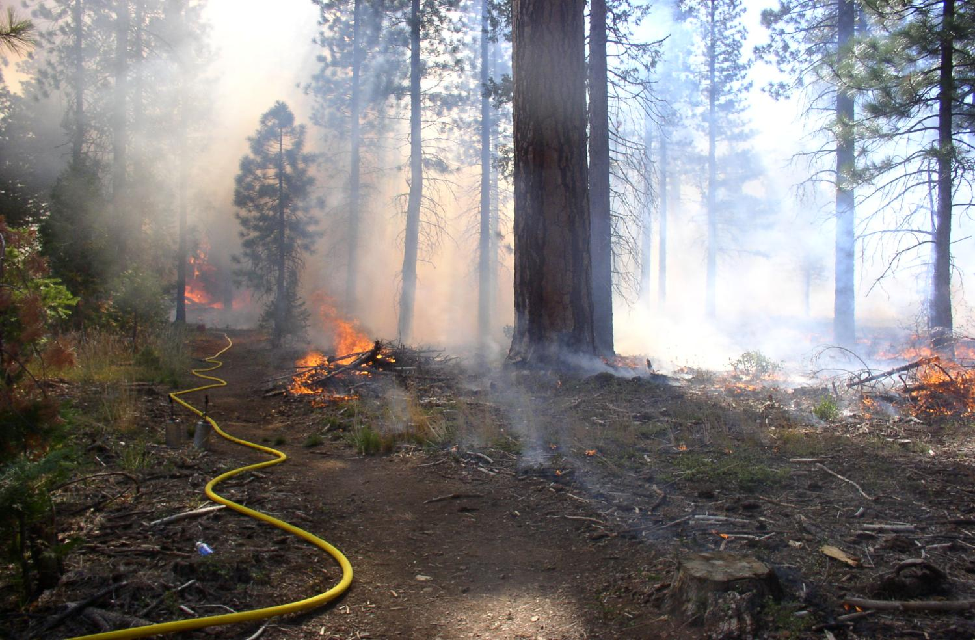
Prescribed fire in the Sierra Nevada
How did we get here? Where are we going?
Susie Kocher, Registered Professional Forester #2874
University of California Cooperative Extension
October 2nd, 2018

Slide 2
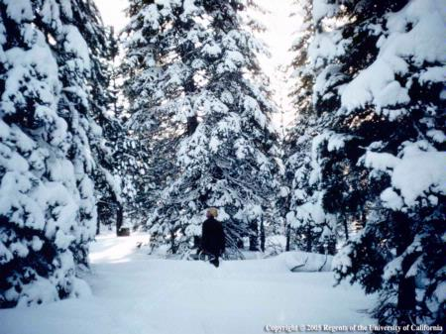
Talk outline
Fire in the Sierra Nevada
  Fire regime as a critical idea
Sierra forest management history
Fire suppression and consequences
Acknowledgement of the role of fire
Where we are now

Slide 3
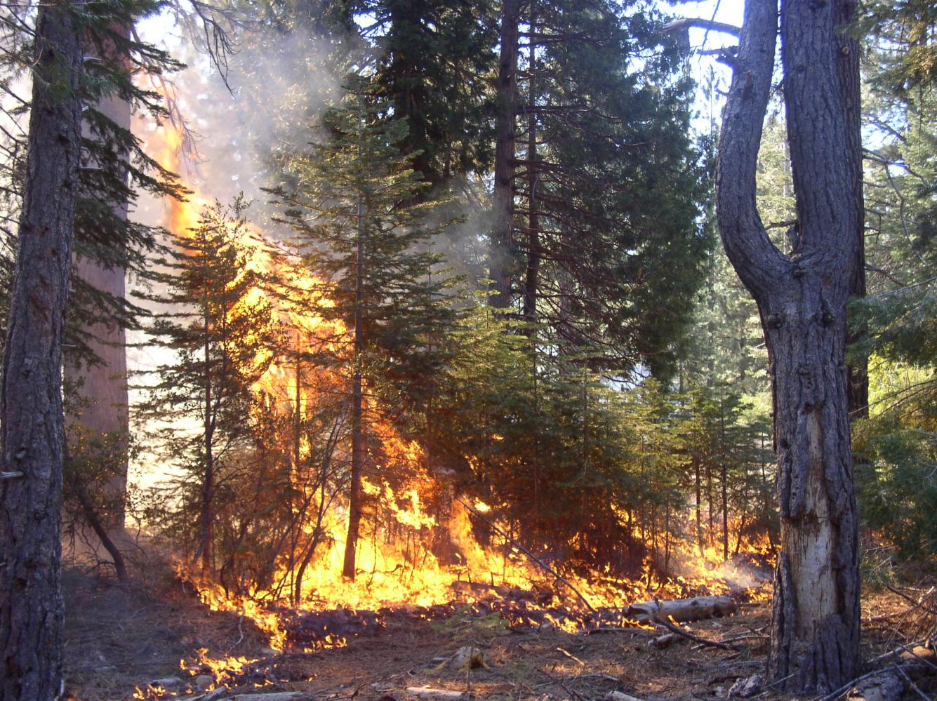
Fire regime – Fires in a given area over long periods of time
Plants evolve adapted to that regime
Major attributes
  Timing – season, return interval
  Size – fires, patches
  Magnitude – intensity, severity (how it affects vegetation)
  Interactions – drought, beetles, invasive species

Slide 4
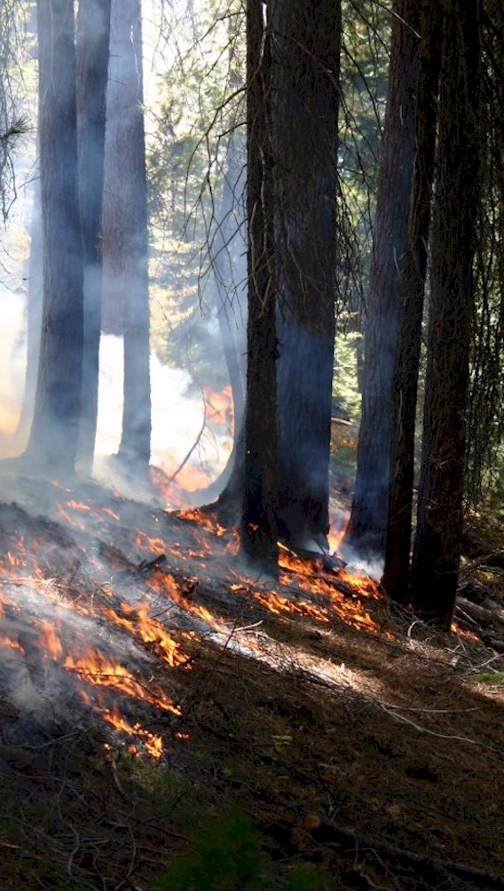
Fire return interval – how do we know?
Sierra forests are adapted to frequent low intensity fire
Ethnographic interviews with native American tribes
Dendrochronology (tree ring) studies - Past fire frequency can be determined from the years between fire scars on a single tree or on several trees in an area

Slide 5
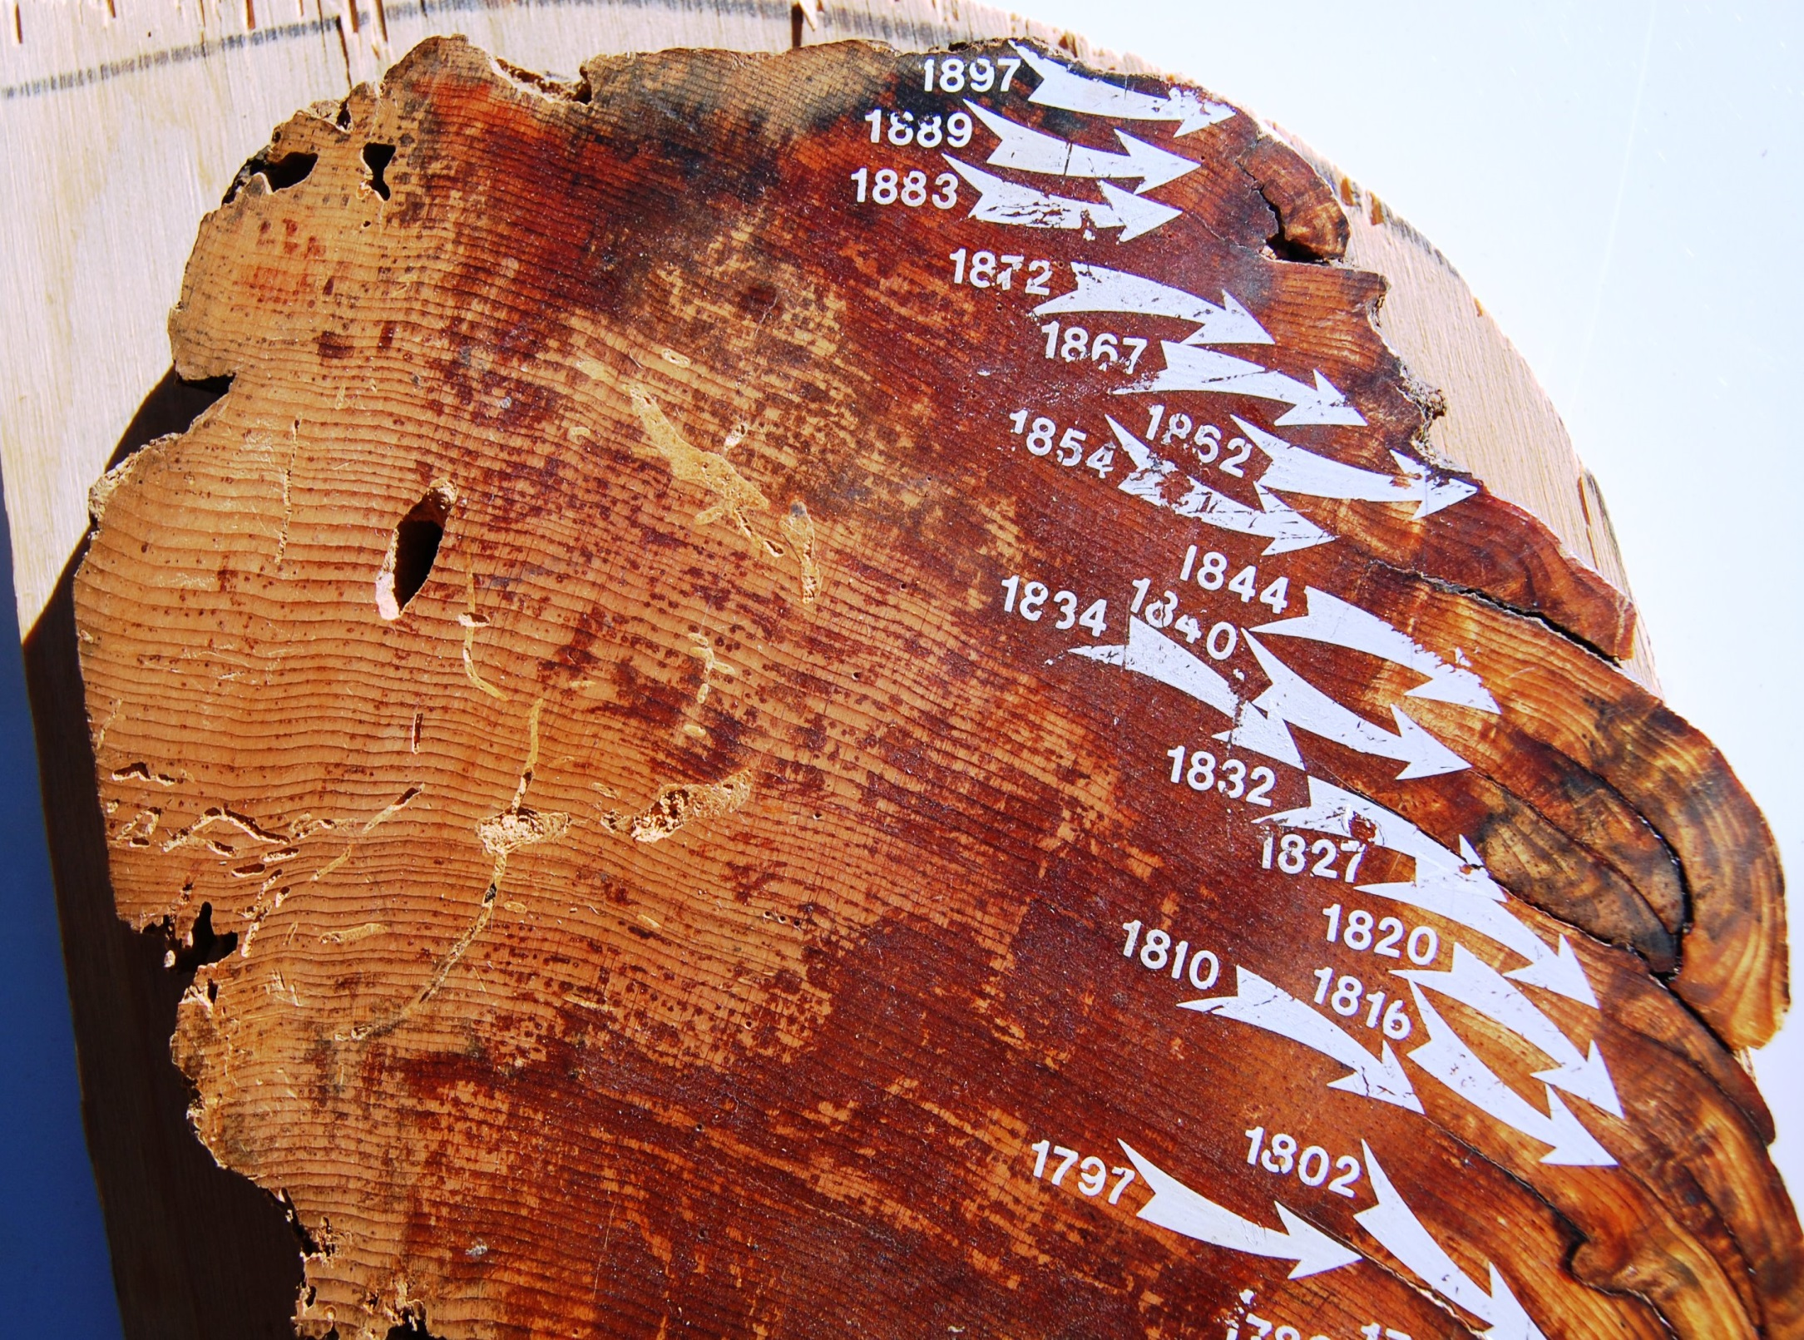

Slide 6
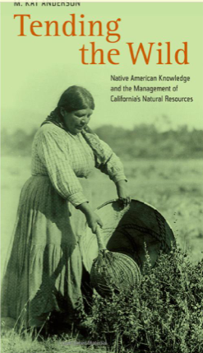
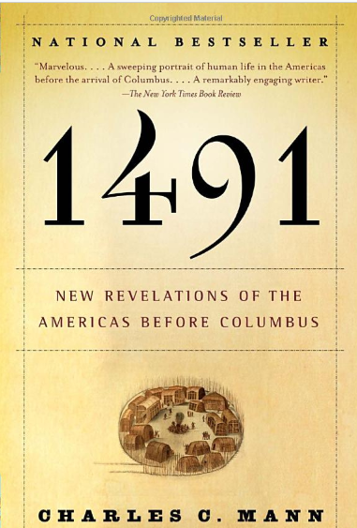
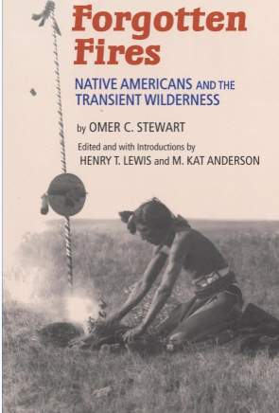
Native burning in California

Slide 7
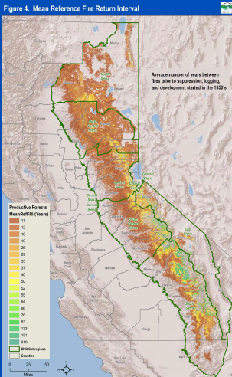
Timing - Fire Return Interval
Time between two successive fire events at a given site or area
Ponderosa 5 – 12 years
Mixed conifer 8 - 20 years
Red fir 15 - 50 years
Sub-alpine 25 - 60 years
4.4 -11.9 million acres/ yr -5% - 12% of California’s lands burned annually before settlement

Slide 8
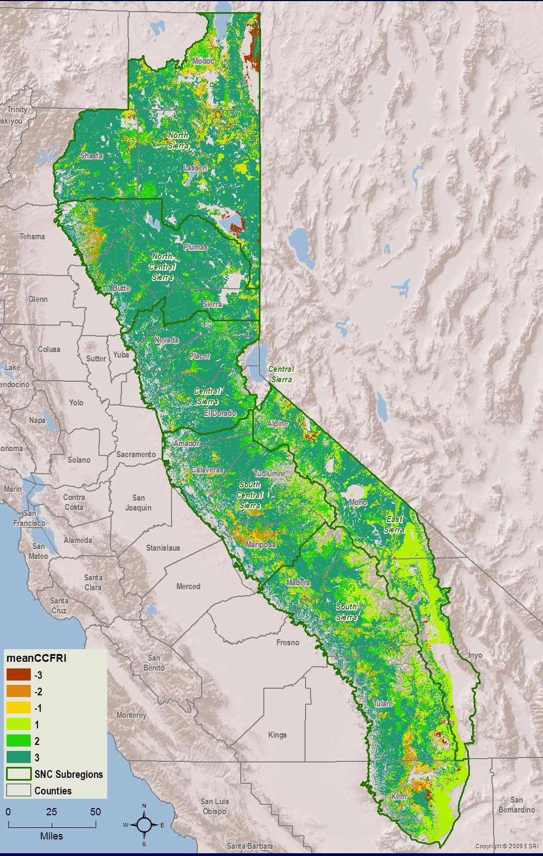
Fire Return Interval Departure
2012
Measure of how many fire return intervals have been missed (or how many extra there have been)
Most of Sierra is 2-3 intervals behind
Southern California has many areas where there have been too frequent of fires

Slide 9
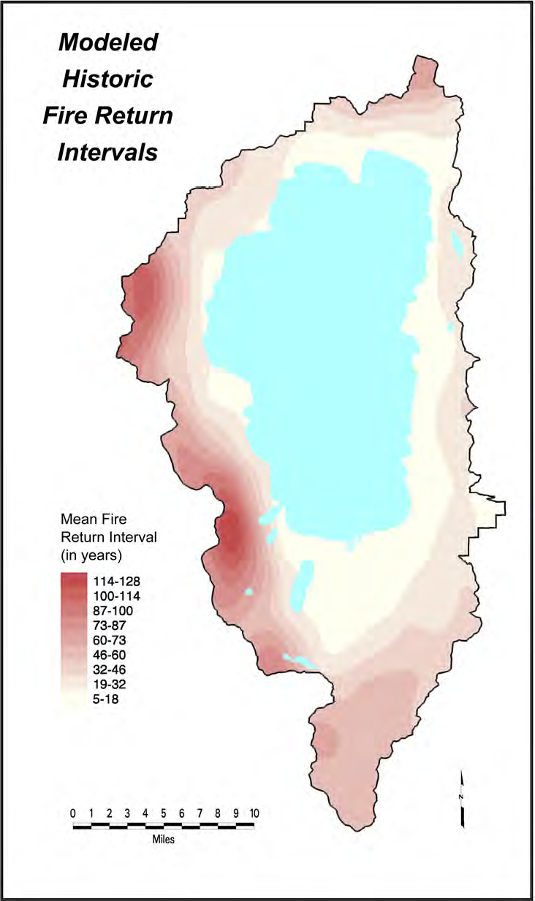
Skies were likely smoky in the summer and fall in California before fire suppression.
‘‘Of the hundreds of persons who visit the Pacific slope in California every summer to see the mountains, few see more than the immediate foreground and a haze of smoke which even the strongest glass is unable to penetrate.’’ -- C.H. Merriam 1898, Chief, US. Biological Survey

Slide 10
Fire regime – severity (conifers)
Low severity (Surface fire) – burns surface fuels, flame lengths under 4 feet, can be controlled with fire breaks and hand tools, few trees killed
Moderate severity (Understory fire) – burn surface and ladder fuels, flame lengths up to 10 feet, some trees killed
High severity (Crown fire) – burns through crowns of trees supported by surface and ladder fuels with unpredictable behavior, most trees killed

Slide 11
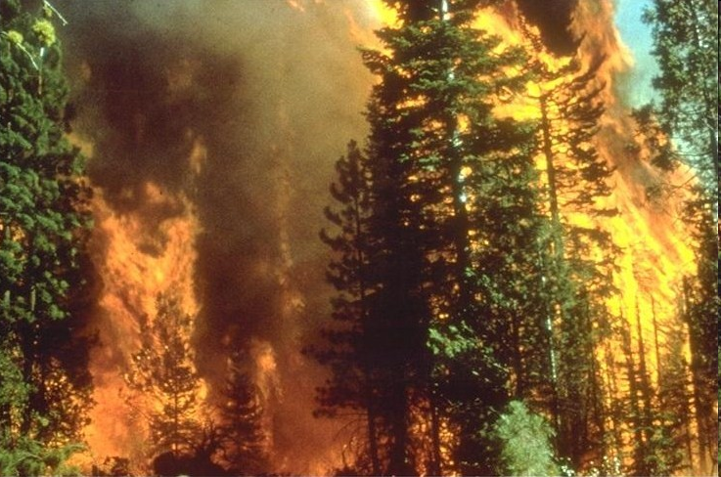
Increase in high severity fires
Forests crowded and unhealthy
Fires now more likely to be high severity meaning most or all trees are killed

Slide 12
Return interval and severity linked
Forest Types | Fire Return Interval | Severity
Ponderosa pine, mixed conifer, Douglas-fir, giant sequoia, oak woodlands | < 35 years | Low/ Mixed
White fir, red fir, mixed conifer moist, redwood | 35-200 years | Mixed/ Low- Moderate
Chaparral, knob-cone pine, cypress, fir-hemlock, PNW Douglas-fir, rocky mountain lodgepole, pinon-juniper | 35-200 years | High/ replacement
  Adapted from Carl Skinner

Slide 13
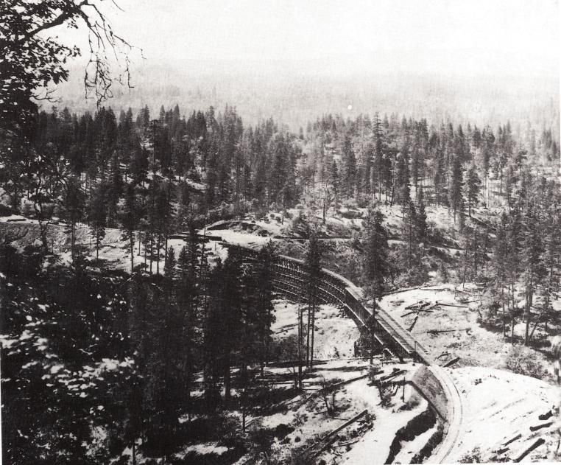
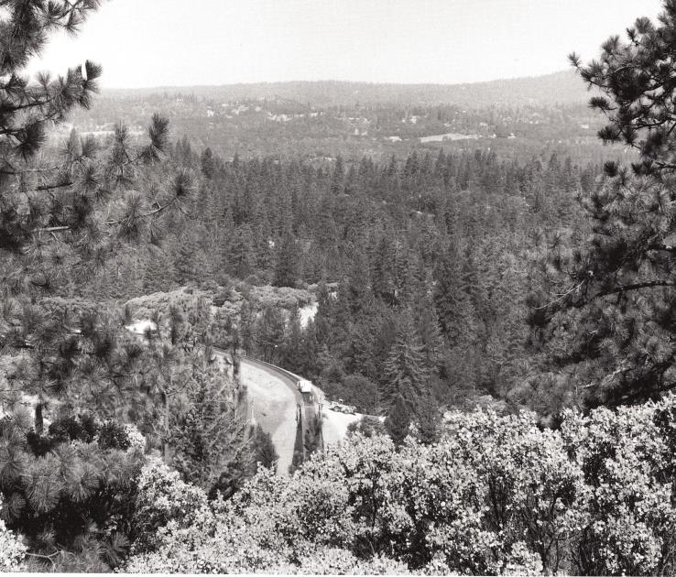
Consequences of Fire Suppression
Long Ravine railroad trestle near Colfax, Placer County. Source: Gruel 2001

Slide 14
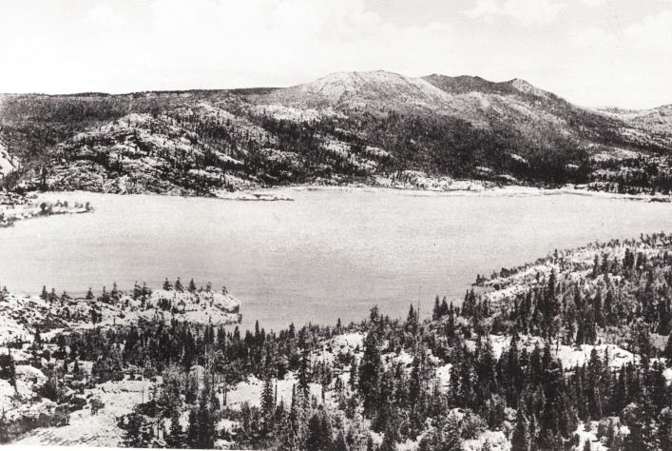
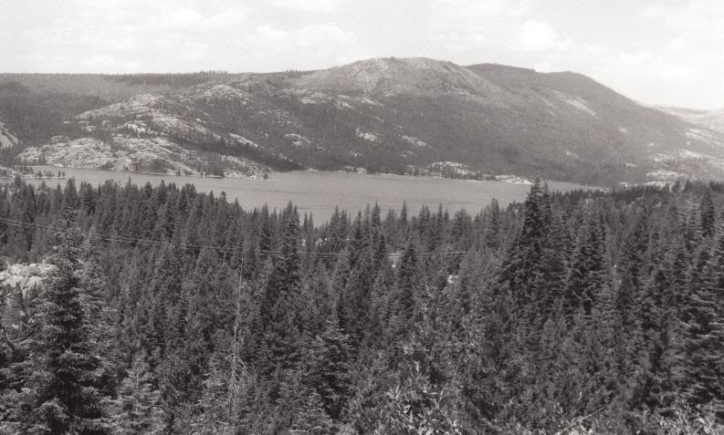
Consequences of Fire Suppression
Spaulding Lake in Nevada County, 1919 and 1993. Source: Gruel 2001

Slide 15
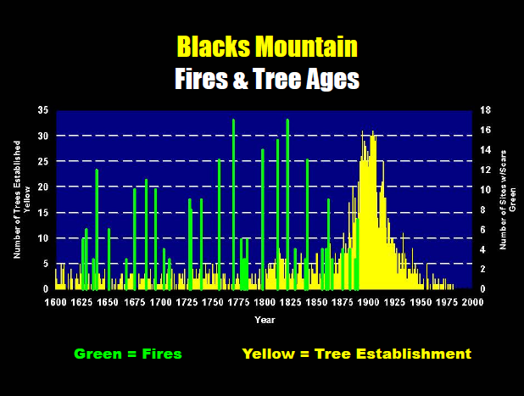

Slide 16
Ecological Consequences
Increased stress due to water competition leaves trees more vulnerable to insect and disease
Displacement and reduction of understory plants due to shade
Conversion of shrub habitats to conifer thickets
Displacement of deciduous vegetation by conifers, especially in riparian areas
Reduction and loss of mountain meadows to conifer encroachment
Reduction and loss of habitat of more open and non-forested habitats
Huge build up in forest fuels

Slide 17
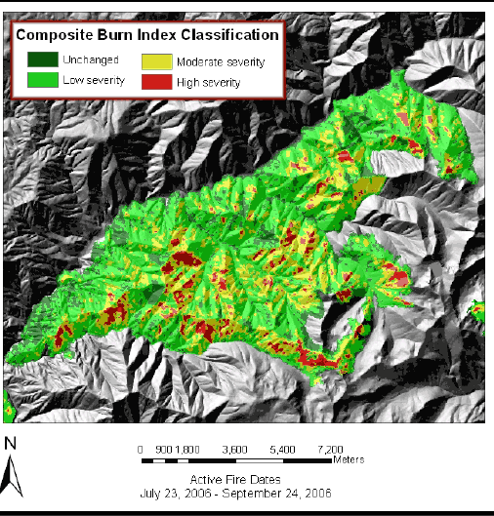
Increase in high severity fires
Fires are now more likely to be of high severity meaning that most or all trees are killed
Still a lot of variety in severity
  Hancock fire 2006

Slide 18
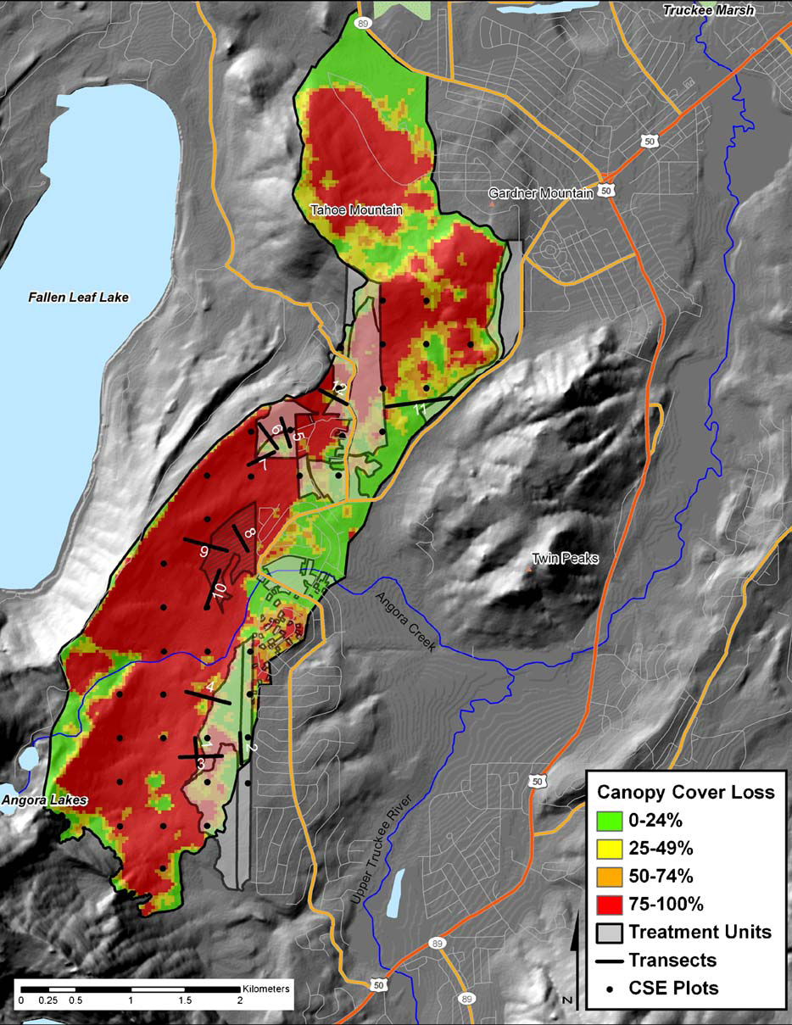
Angora Fire Severity
Source: Safford, et. al. 2009. Effects of fuel treatments on fire severity in an area of wildland-urban interface, Angora Fire, Lake Tahoe Basin, California.

Slide 19
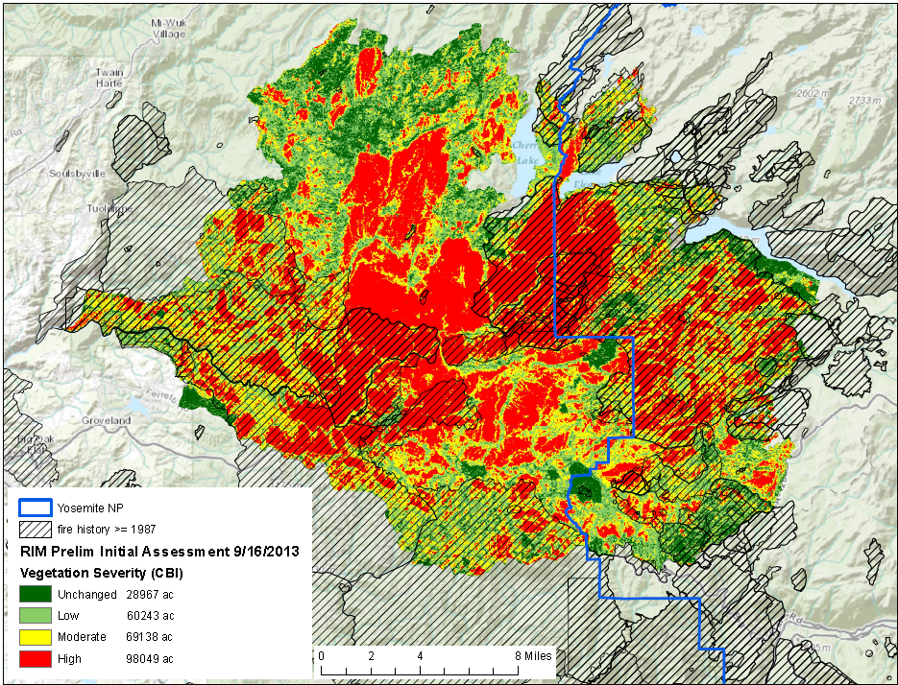
Rim Fire
2013 Rim Fire

Slide 20
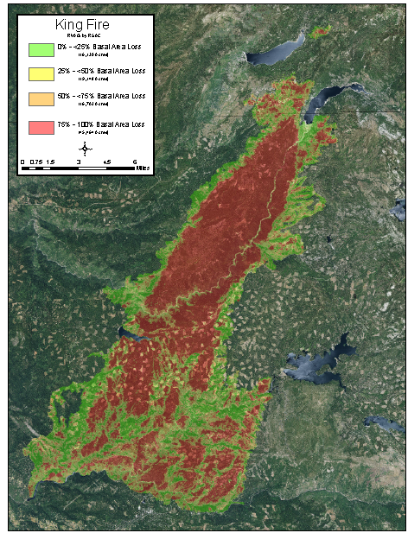
2014 King Fire
35,000 acre high severity patch
No serotinous conifers

Slide 21
Short history on fire suppression
Begins 1905 with formation of the US Forest Service
Big blow up of 1910 burned 5 million acres and killed 79 firefighters - USFS decides to stress fire prevention and control fires as quickly as possible.
Light burning controversy in CA – some continued to burn
  Red River Lumber company near Lake Almanor used fire on 750,000 acres Walker family
1924 USFS researchers concluded light burning was ineffective, impractical, and economically indefensible
1924 California State Board of Forestry adopted the policy of fire exclusion USFS adopted "no burn" policy.

Slide 22
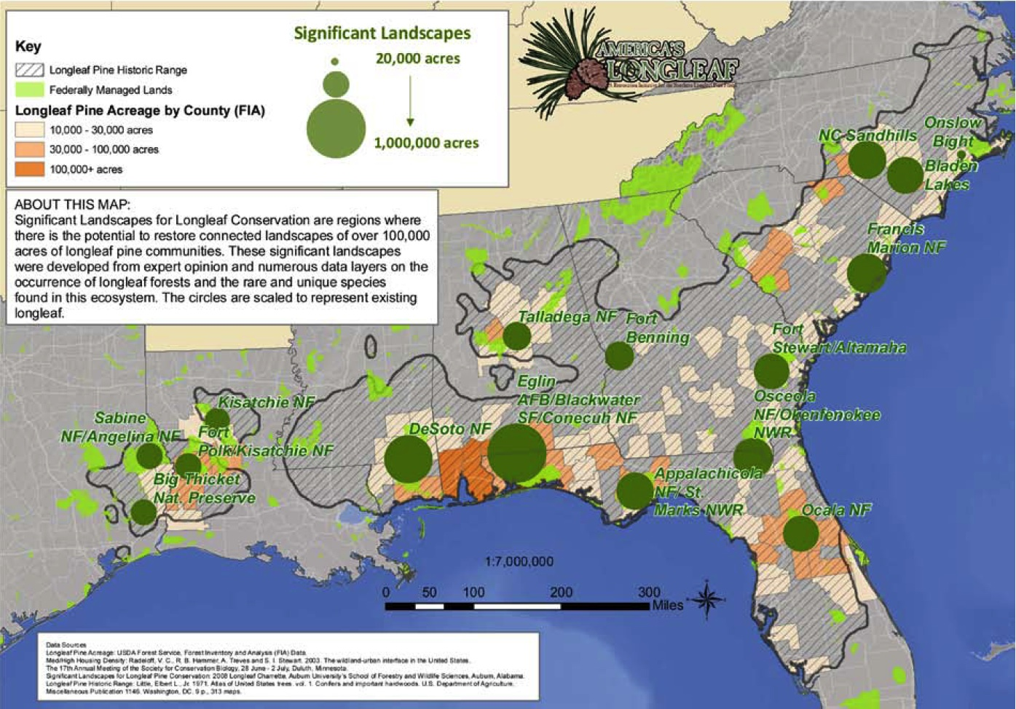
Acknowledging the role of fire
USFS in 1943, an exception to the policy was allowed on National Forest lands in the longleaf pine

Slide 23
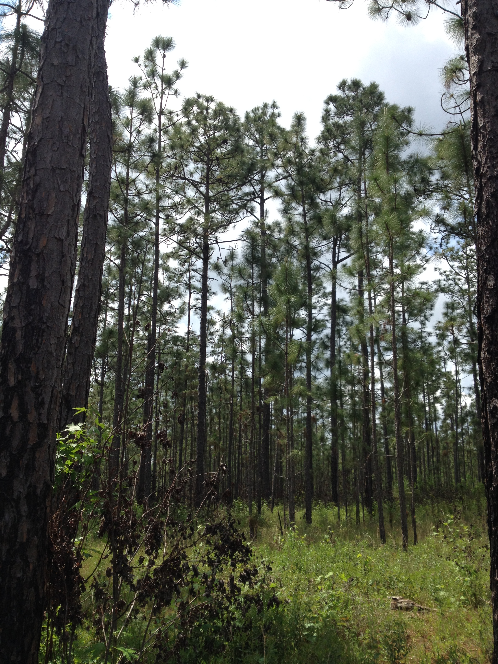
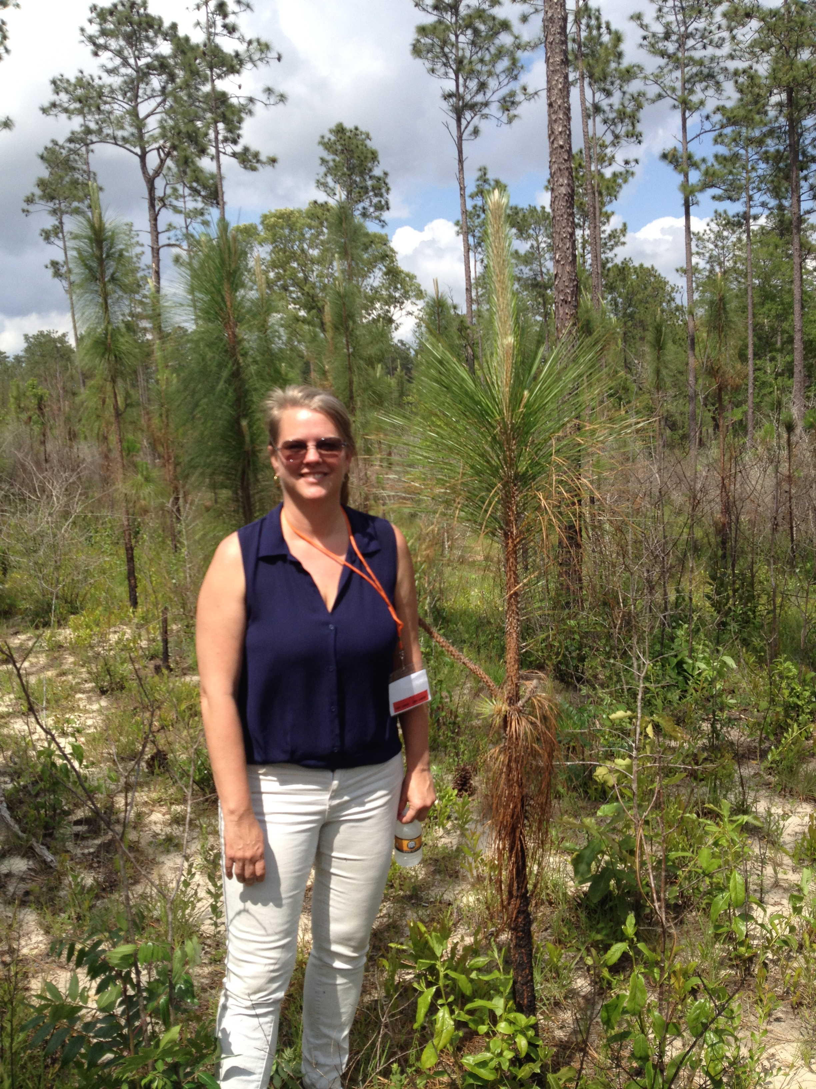
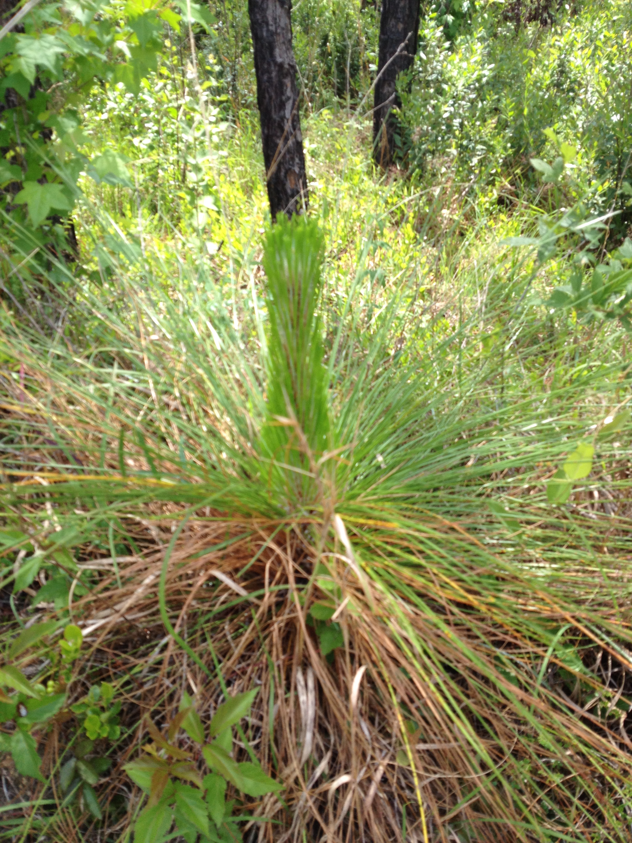
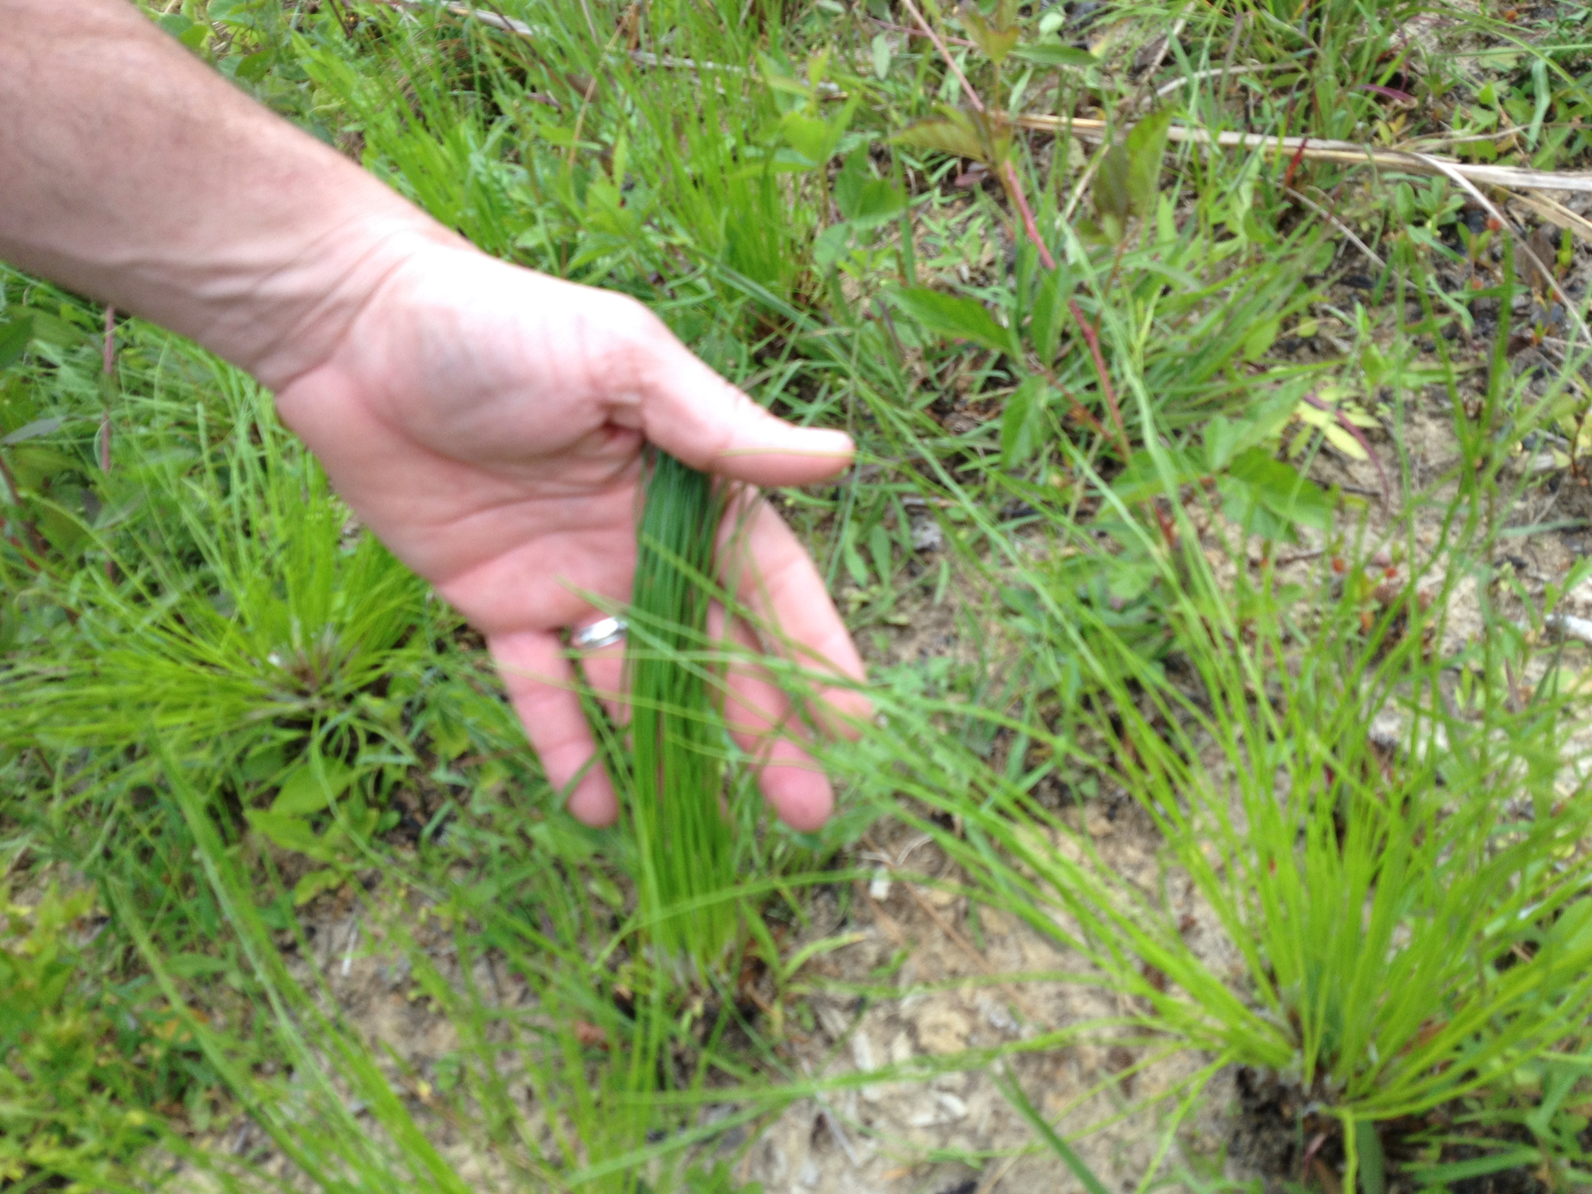

Slide 24
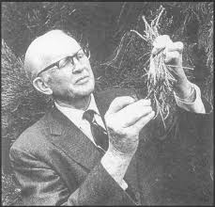
Dr. Harold Biswell
Arrived in California 1947 from Southeast
Professor of forestry UC Berkeley
Experience with Rx fire in long leaf pine
Worked with CA ranchers to develop techniques for Rx fire to kill woody vegetation and promote grasses to increase grazing capacity

Slide 25
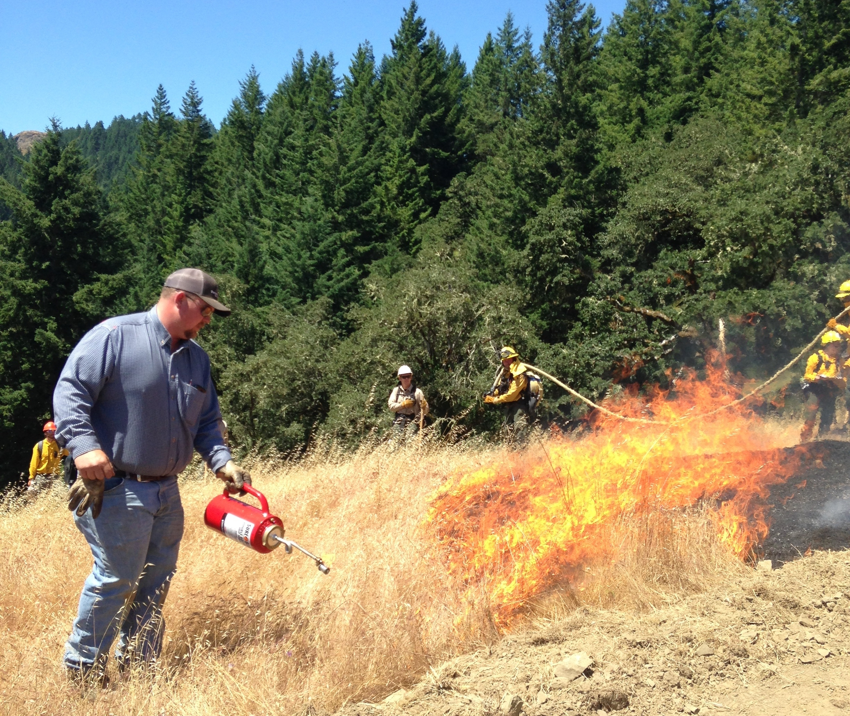
Range improvement burning
1945 first burning permits (CalFire) to conduct Rx fire
Range burning reached peak in 1955 > 200,000 acres burned
Then range Rx declined
  more homes were built on adjacent wildlands and
  ranchers were held liable for escape damage
van Wagtendonk, J. 1995. Dr. Biswell’s Influence on the Development of Prescribed Burning in California. USDA Forest Service Gen. Tech. Rep. PSW-GTR-158.

Slide 26
Rx fire in forests
1951 Biswell started ponderosa pine burning experiments
  to improve timber production by controlling brush in the understory, reducing fire hazards, and thinning
1965, Dr. Biswell started his research on fuel reduction and stand modification in giant sequoia
1970’s national and California park service and USFS adopt burning programs

Slide 28
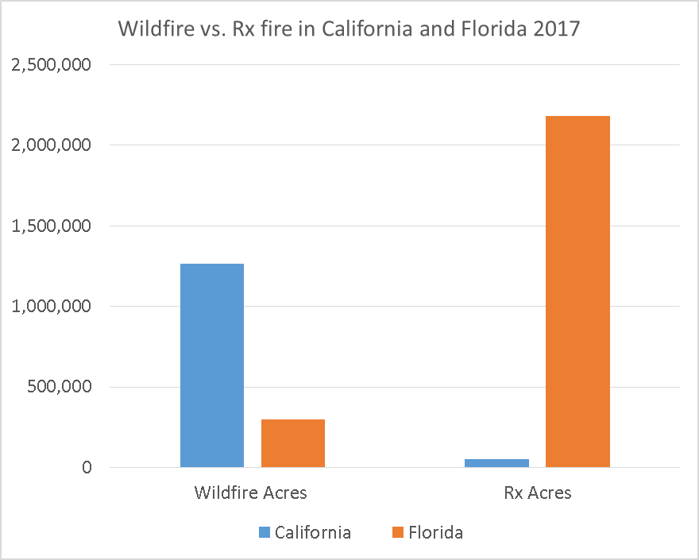

Slide 29
How can we get there from here?
Forest management executive order
Forest management task force
Fire MOU
Prescribed fire councils (Northern Ca/Southern Sierra/ Central California
Prescribed fire Training Exchanges (TREXs)
You?

Slide 30
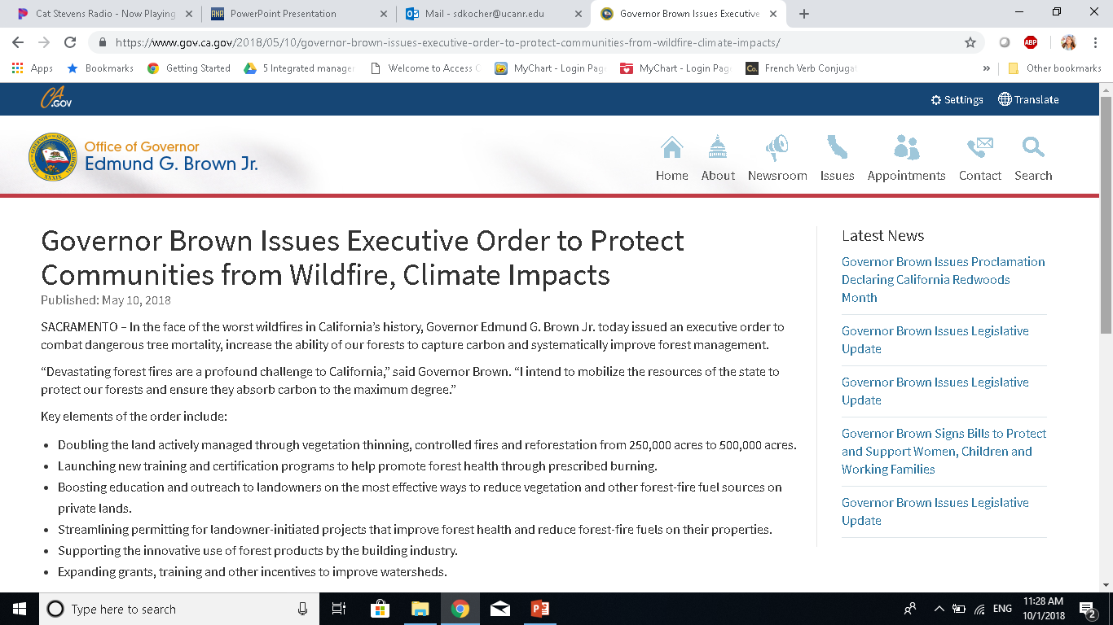
$100 million +$160 million in cap/trade

Slide 31
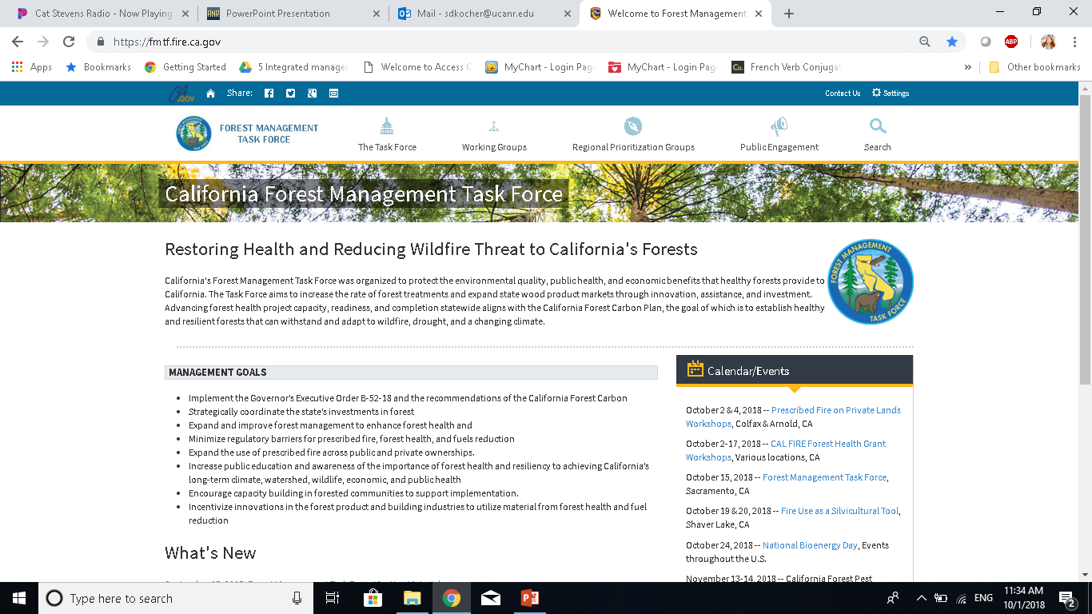
https://fmtf.fire.ca.gov/

