Slide 1
2018 Wood Innovations Grant
Funding Opportunity Overview
Marcus Taylor
USFS Region 5
Larry Swan
USFS Region 5
Roger Swenson
Clean Development International

Slide 2
Background
Substantially expand and accelerate wood energy and wood products markets throughout the United States to support forest management needs on National Forest System and other forest lands.
RFP supports The Agricultural Act of 2014 (Public Law 113-79), Rural Revitalization Technologies (7 U.S.C. 6601), and the nationwide challenge of disposing of hazardous fuels and other wood residues from forestlands to support wood energy and wood products markets.

Slide 3
Wood Innovation Grant Goals
  Reduce hazardous fuels and improve forest health on National Forest System and other forest lands
  Reduce costs of forest management on all land types
  Promote economic and environmental health of communities

Slide 4
History
2017
Awarded over $8.3M
  38 awards (114 proposals):
    12 wood energy
    26 wood products
  Matched by $37M+
2016
Awarded over $8.5M
  41 awards (77 proposals):
    17 wood energy
    24 wood products
  Matched by $18M+

Slide 5
Region 5 History
2017
114 proposals nationally
38 projects funded
7 awards in Region 5
    5 wood energy
    2 wood products
2016
77 proposals nationally
41 projects funded
7 awards in Region 5
    5 wood energy
    2 wood products

Slide 6
2018 Overview
Available Funding: Expect about $7 million. Most awards (excluding match) will not exceed $250,000 (should see around 30 projects funded)
Eligible applicants: For-profits; State, local, and Tribal governments; school districts; communities; not-for-profit organizations; and special purpose districts

Slide 7
2018 Overview
Matching: Applicants must contribute at least 50% of the Forest Service requested funds. For every $2 of Federal funding requested, applicants must provide at least $1 in match. Cash or in-kind match allowed. Federal salary cannot be match.
Award Type: Grants and Cooperative Agreements under this announcement are typically 2 to 3 years.

Slide 8
Category 1: Expansion of Wood Energy Markets & Products
Intent:
  Stimulate, expand, or support wood energy markets that depend on forest residues or forest byproducts generated from all land types.
Example:
  Complete key requirements (engineering designs, cost analyses, and permitting) necessary in the later stages of wood energy project development to secure financing.

Slide 9
Category 2: Expansion of Wood Products Markets
Intent:
  Promote markets that create or expand the demand for non-energy based wood products.
Examples:
  Training or outreach on innovative wood construction
  Developing manufacturing capacity and markets for wood products that support forest restoration

Slide 10
Preferences
General: Preference will be given to projects that utilize existing infrastructure, such as existing manufacturing facilities.
Category 1: Preference given to proposals that bundle or address multiple wood energy projects and make use of wood generated from forest lands with high wildfire risks. Technology must be “commercially proven”.
Grant Category 2: Preference given to projects that support commercial building markets or other markets that use innovative wood products.

Slide 11
Other items to note
Equipment purchases, basic research, and construction will NOT be funded under this funding opportunity.
Previous exception for Computer Numeric Control (CNC) machines for mass timber processing is NOT eligible for the 2018 RFP.
Proposals to establish or continue a SWET/SWUT/SWIT in a state with an existing Team are not eligible.

Slide 12
2018 RFP Timeline
18 October 2017 | Request for proposals announced
22 January 2018 | Proposal submission deadline
15 April 2018 | Approximate date to announce awardees
1 July 2018 | Approximate date of award
RFP: http://www.na.fs.fed.us/werc/wip/2018-rfp.shtm

Slide 13
Evaluation Criteria
 | Points
Alignment with goals/intent of RFP & Category | 20
Program of work & technical approach | 30
Project impact | 40
Qualifications of staff, organization, and partners | 10

Slide 14
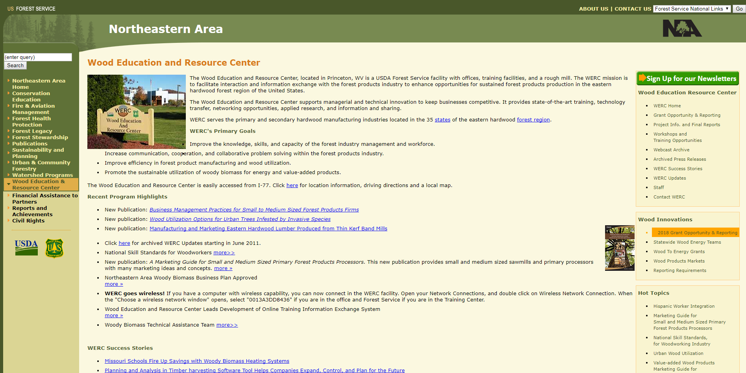
CLICK HERE
Click here ->
http://www.na.fs.fed.us/werc/

Slide 15
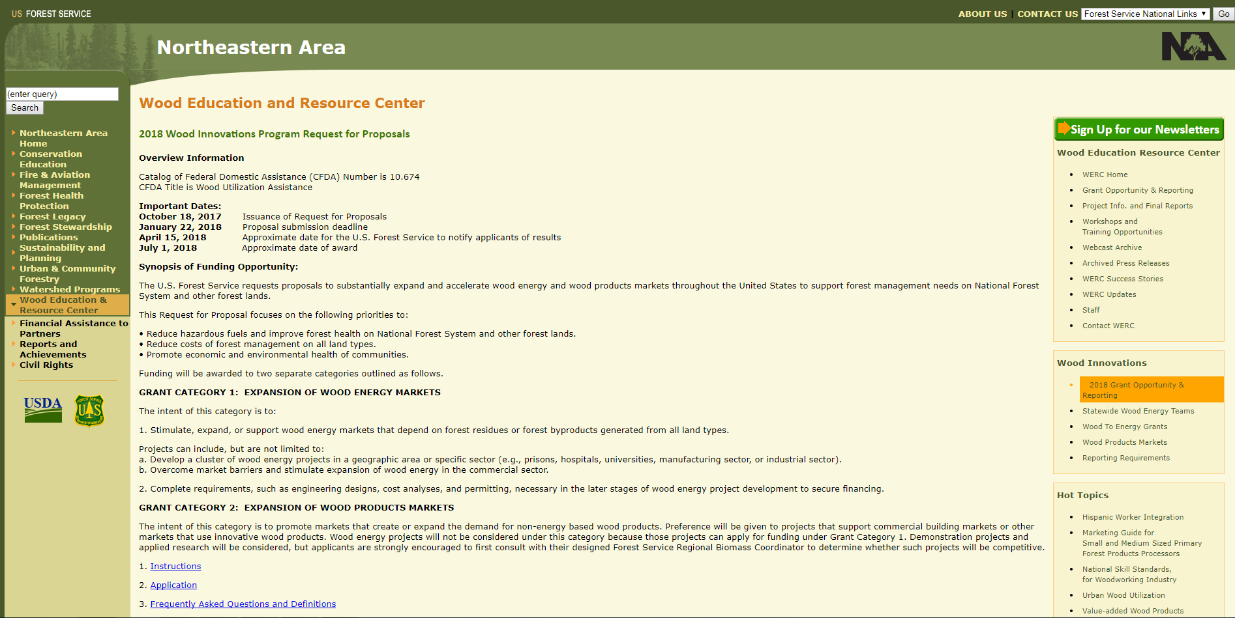
READ THESE

Slide 16
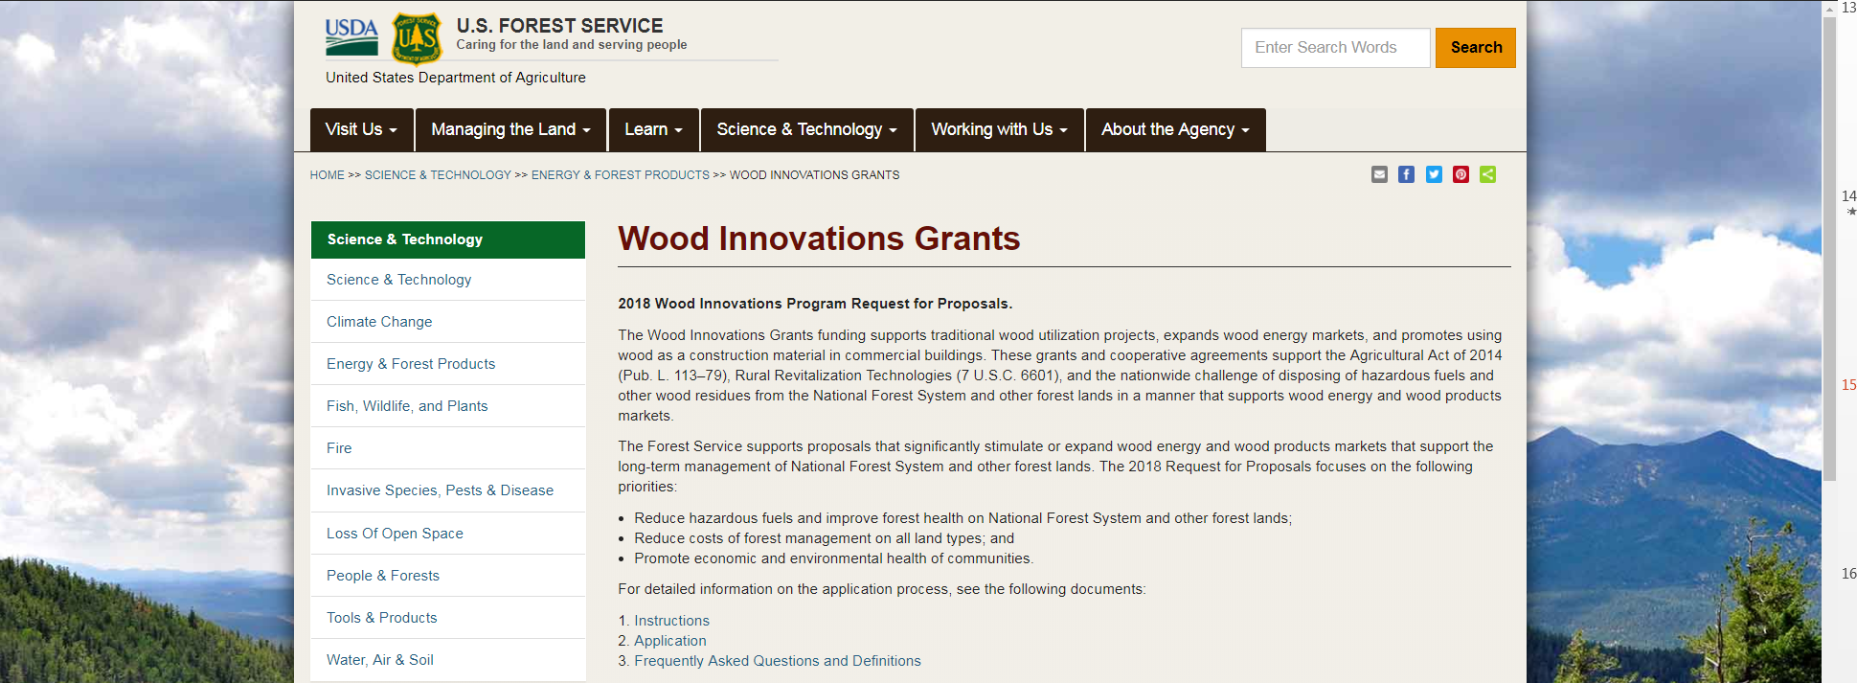
READ THESE
https://www.fs.fed.us/science-technology/energy-forest-products/wood-innovations-grants

Slide 17
Forest Service Regional Coordinators
Receive all application submittals by e-mail (PDF or Word)
Advise interested applicants and answer questions
Manage grants & participate with cooperative agreements
Receive communication about media events or activities generated by the award from awardees

Slide 18
Contact Information
Larry Swan
lswan01@fs.fed.us
707.562.8917
Marcus Taylor
marcustaylor@fs.fed.us
707.562.9122

