Slide 1
Section 6: Leadership Development Report (LDR)

Slide 2
Leadership Development Report
Who?
Intermediate and Senior Members

Slide 3
Leadership Development Report
Job?
Coordinate
  Meeting Times
  Locations
  Material and Supplies
  Expenses with adult partner

Slide 4
Leadership Development Report
Job?
Communicate to Adult Partner
  Group expectations
  Responsibilities
  Expected Outcomes

Slide 5
Leadership Development Report
Job?
Other
  Keep track of hours in Calendar, notebook or journal
  Complete 20 hours
  Complete Part 1 Pre and Post
  Complete Part 2 Pre and Post

Slide 6
Leadership Development Report
Forms: Part 1 (Pre)
Only once for everything
Explain all of you leadership roles
Why they are important to you
Set Leadership goals to be accomplished by the end of the year. Connect them to the 6 C’s
  Confidence
  Competence
  Character
  Caring
  Connection
  Contribution

Slide 7
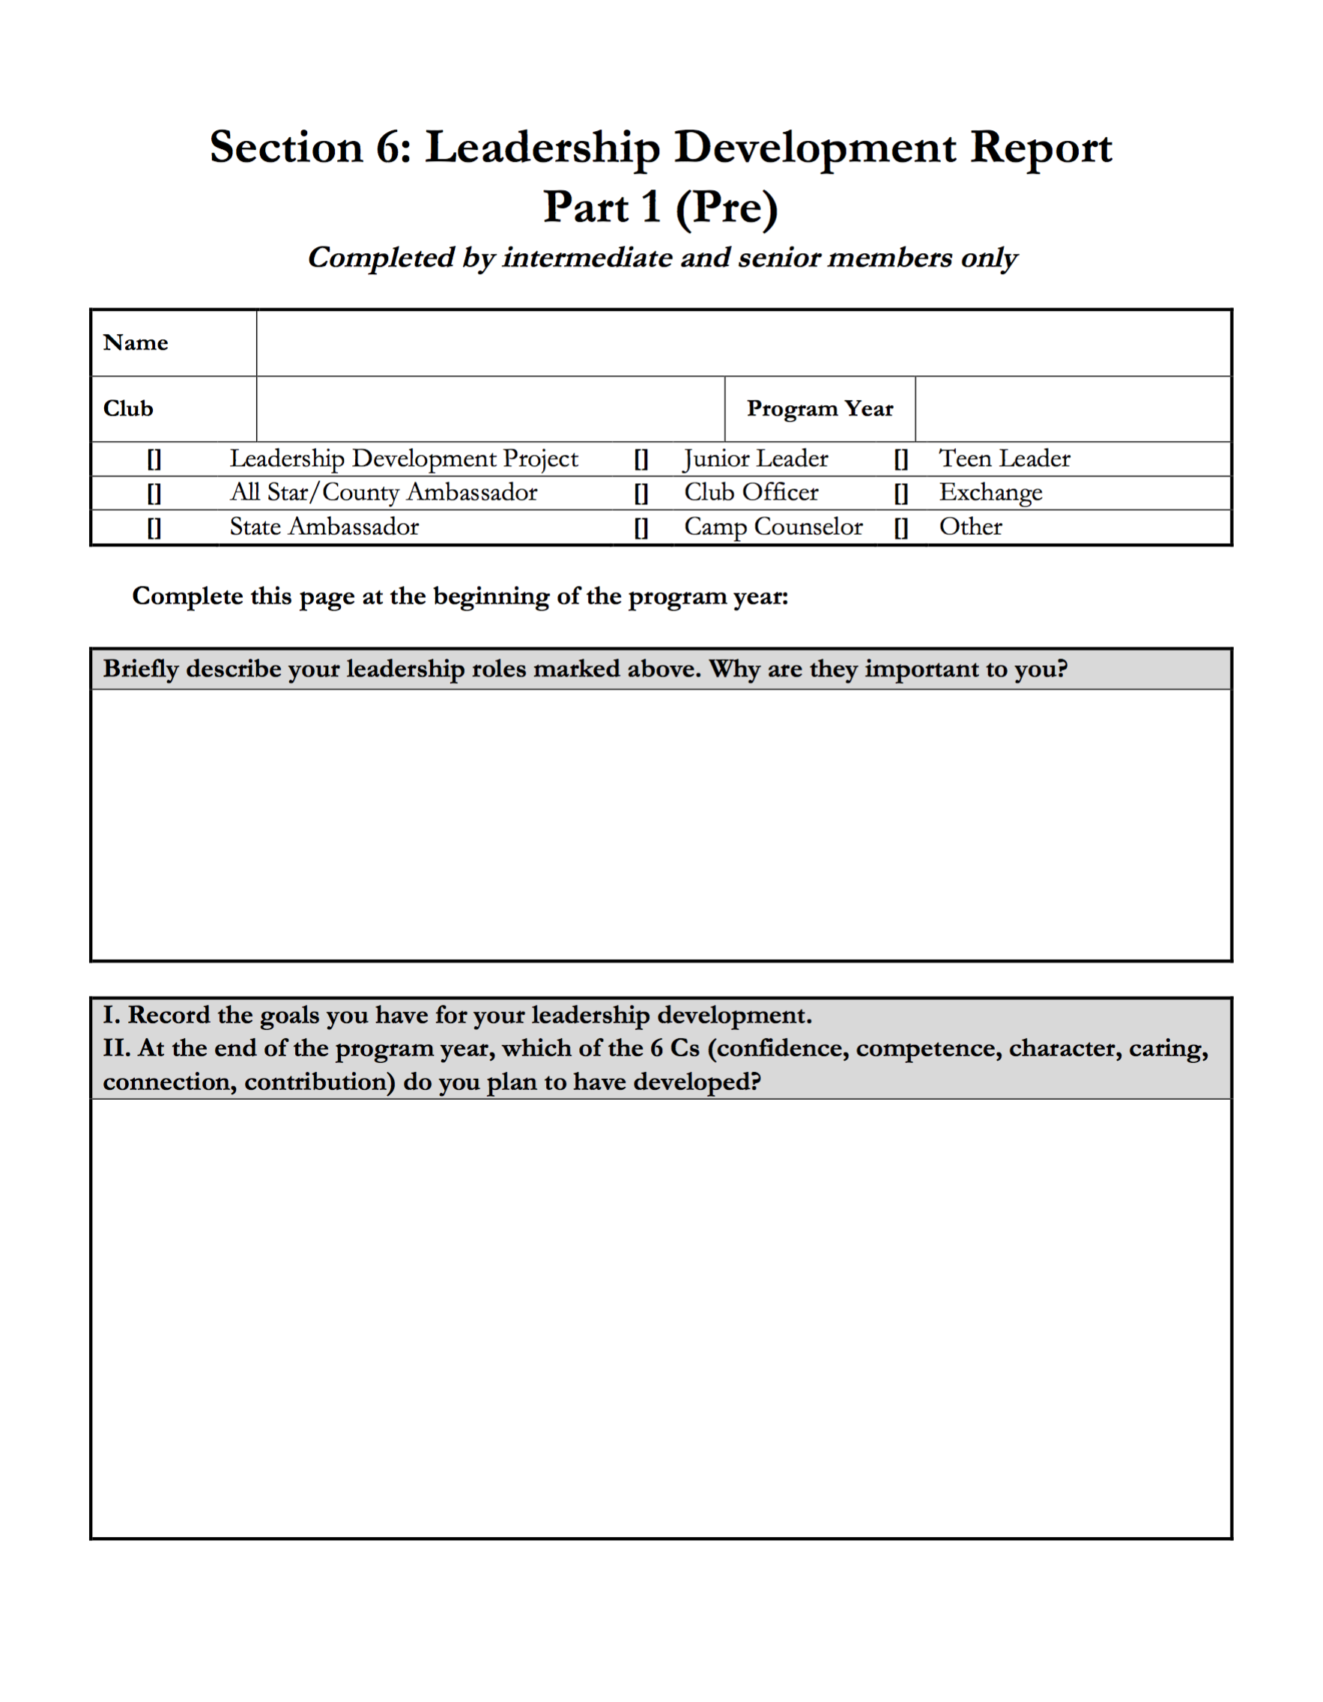
Leadership Development Report
Forms: Part 1 (Pre)

Slide 8
Leadership Development Report
Forms: Part 1 (Pre) - Self Reflection
Confidence
  Positive view of one’s actions in specific areas, including healthy habits, life skills, love of learning, emotional competence, and social skills.
Competence
  An internal sense of overall positive self-worth, persistent resourcefulness and self-efficacy.
Character
  Respect for societal and cultural norms, possession of standards for correct behaviors, a sense of right and wrong (morality), and integrity.

Slide 9
Leadership Development Report
Forms: Part 1 (Pre) - Self Reflection
Caring
  A sense of sympathy and empathy for others.
Connection
  Positive bonds and relationships with people and institutions including faith-based communities.
Contribution
  Giving to self, family and the institutions of a civil society.

Slide 10
Leadership Development Report
Forms: Part 1 (Pre) - Self Reflection

Slide 11
Leadership Development Report
Forms: Part 2 (Pre)
Complete at the beginning of the year
Explain how the goals set in Part 1 (Pre) will be accomplished
Fill out one for each of your Junior/Teen Leader role.
Signed by the Adult Partner

Slide 12
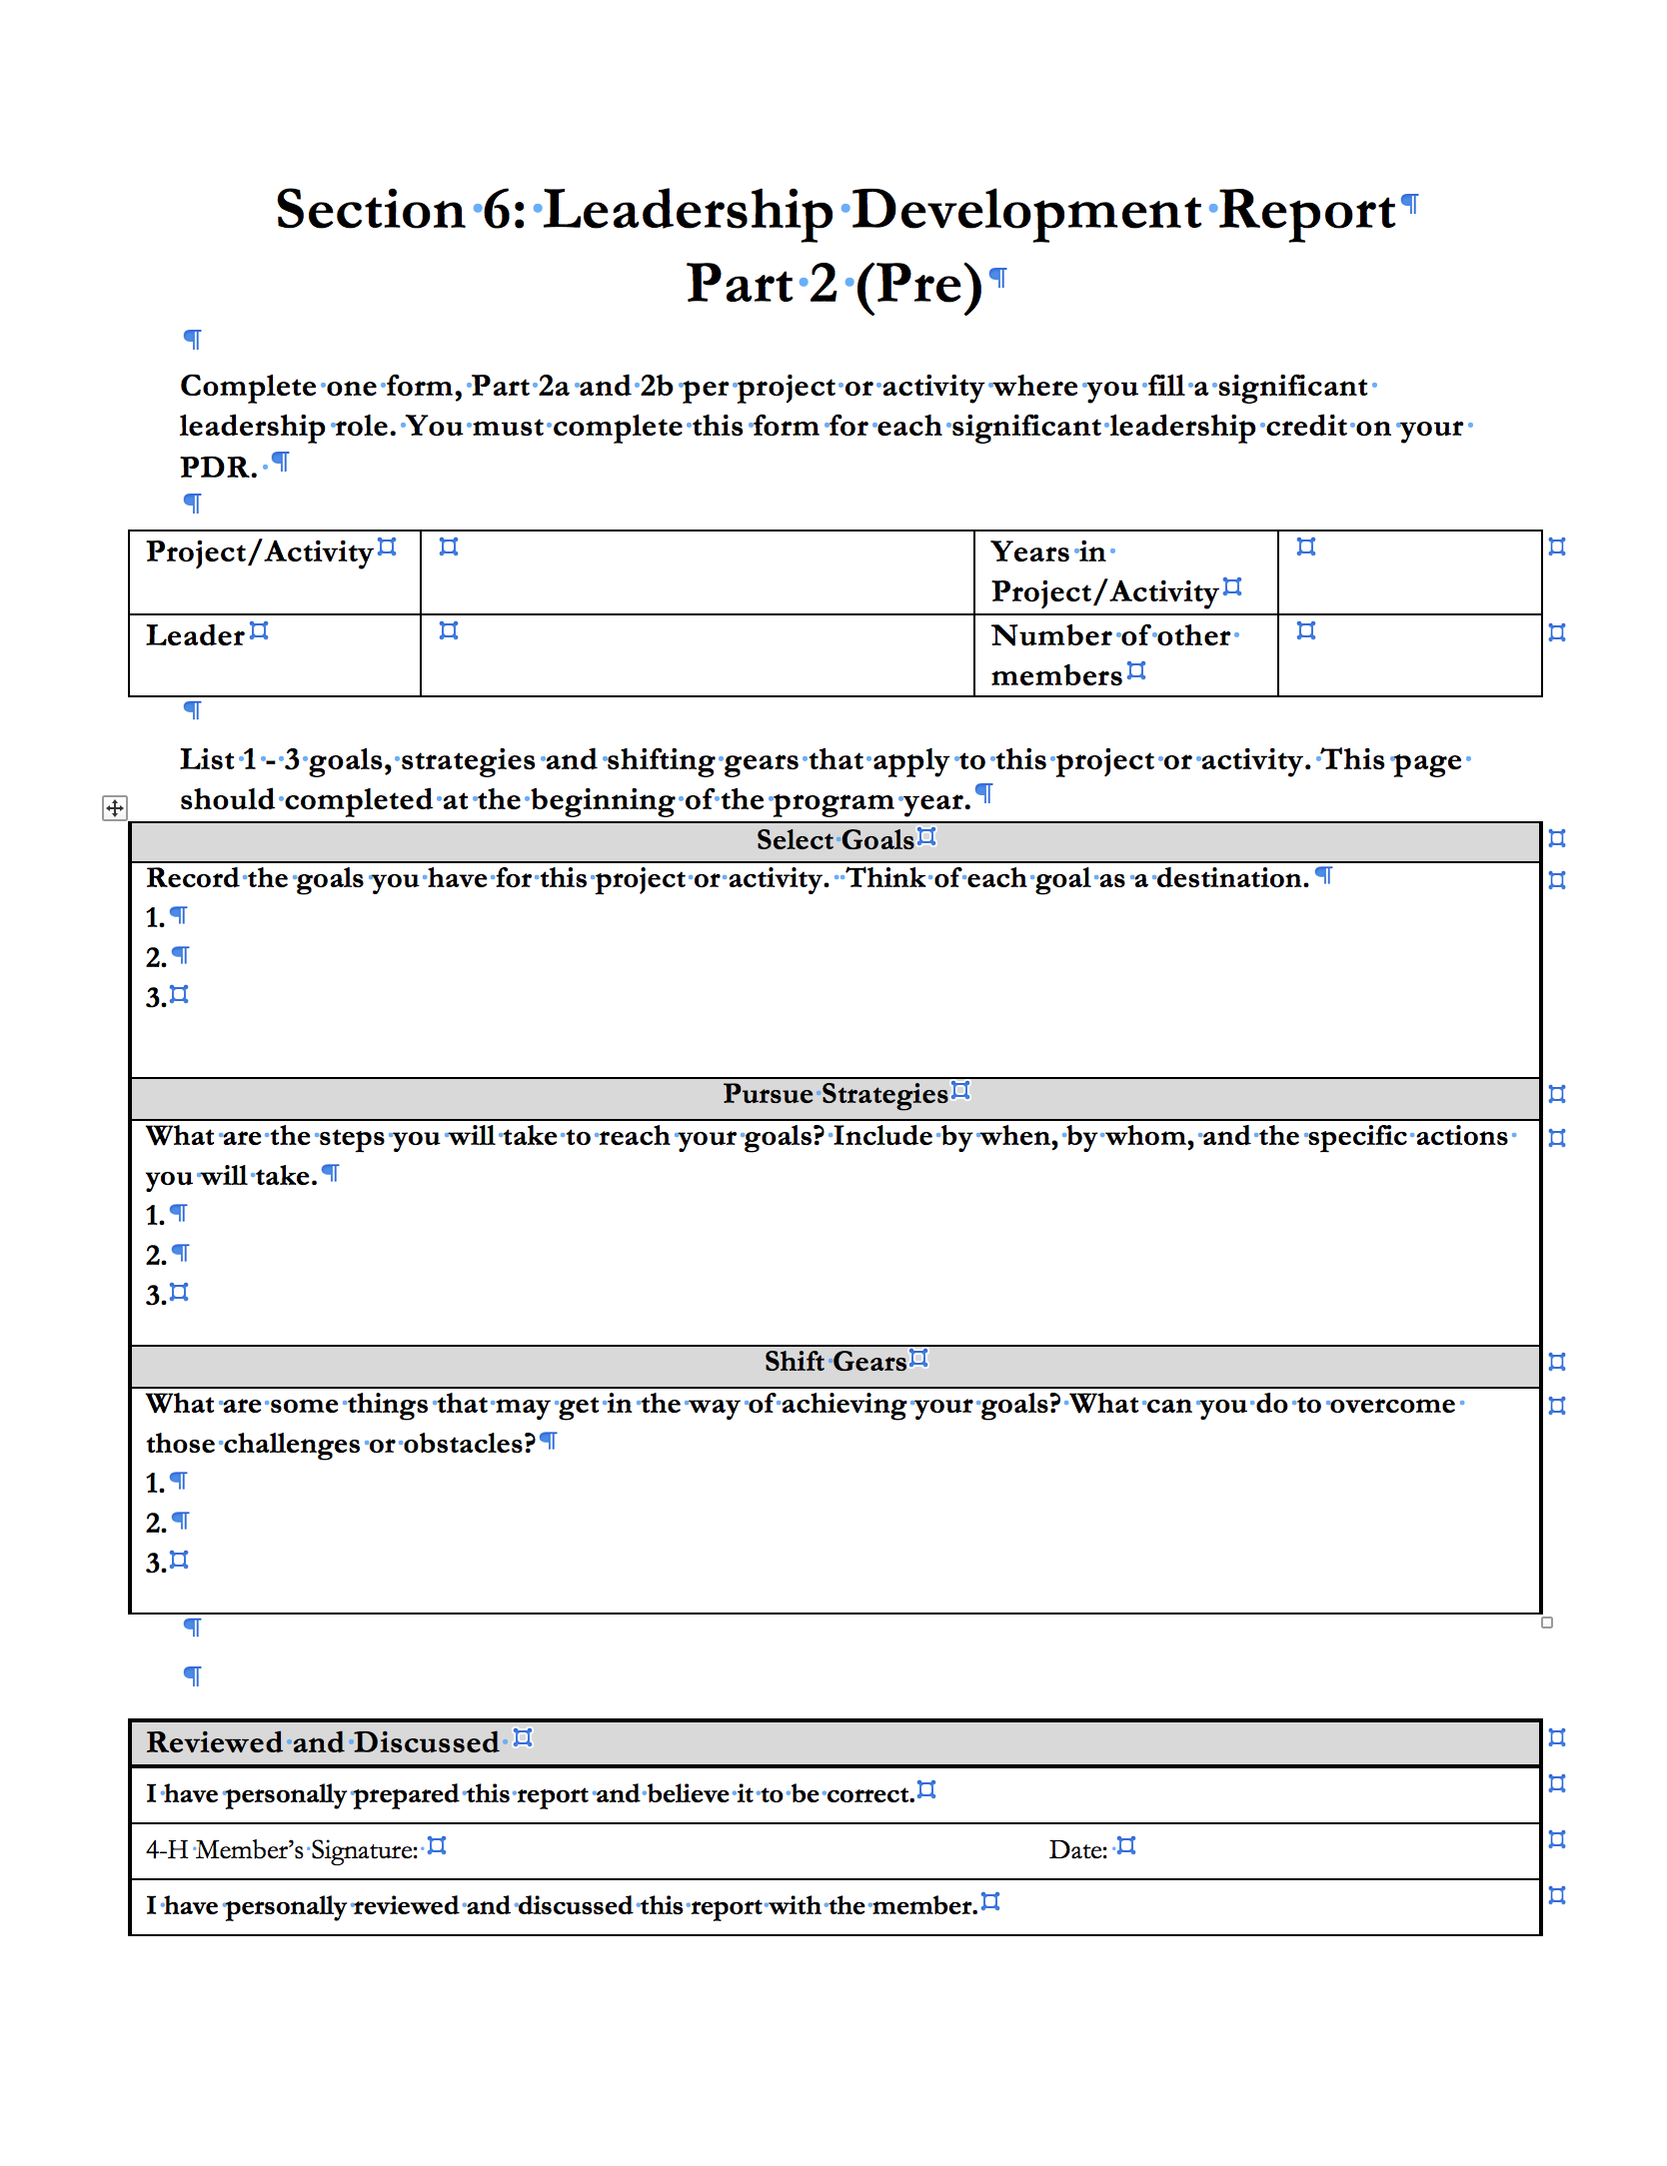
Leadership Development Report
Forms: Part 2 (Pre)

Slide 13
Leadership Development Report
Forms: Part 2 (Pre)
Filling in the form:
  Project/Activity
  Leader
  Years in Project/Activity
  Number of Members
Select Goals
  Where do you want to get to at the end of the project?

Slide 14
Leadership Development Report
Forms: Part 2 (Pre)
Pursue Strategies
  How are you going to accomplish the goals you set?
  When?
  By Whom?
  Specific Actions
Shift Gears
  What could get in the way?
  Overcome challenges or obstacles

Slide 15
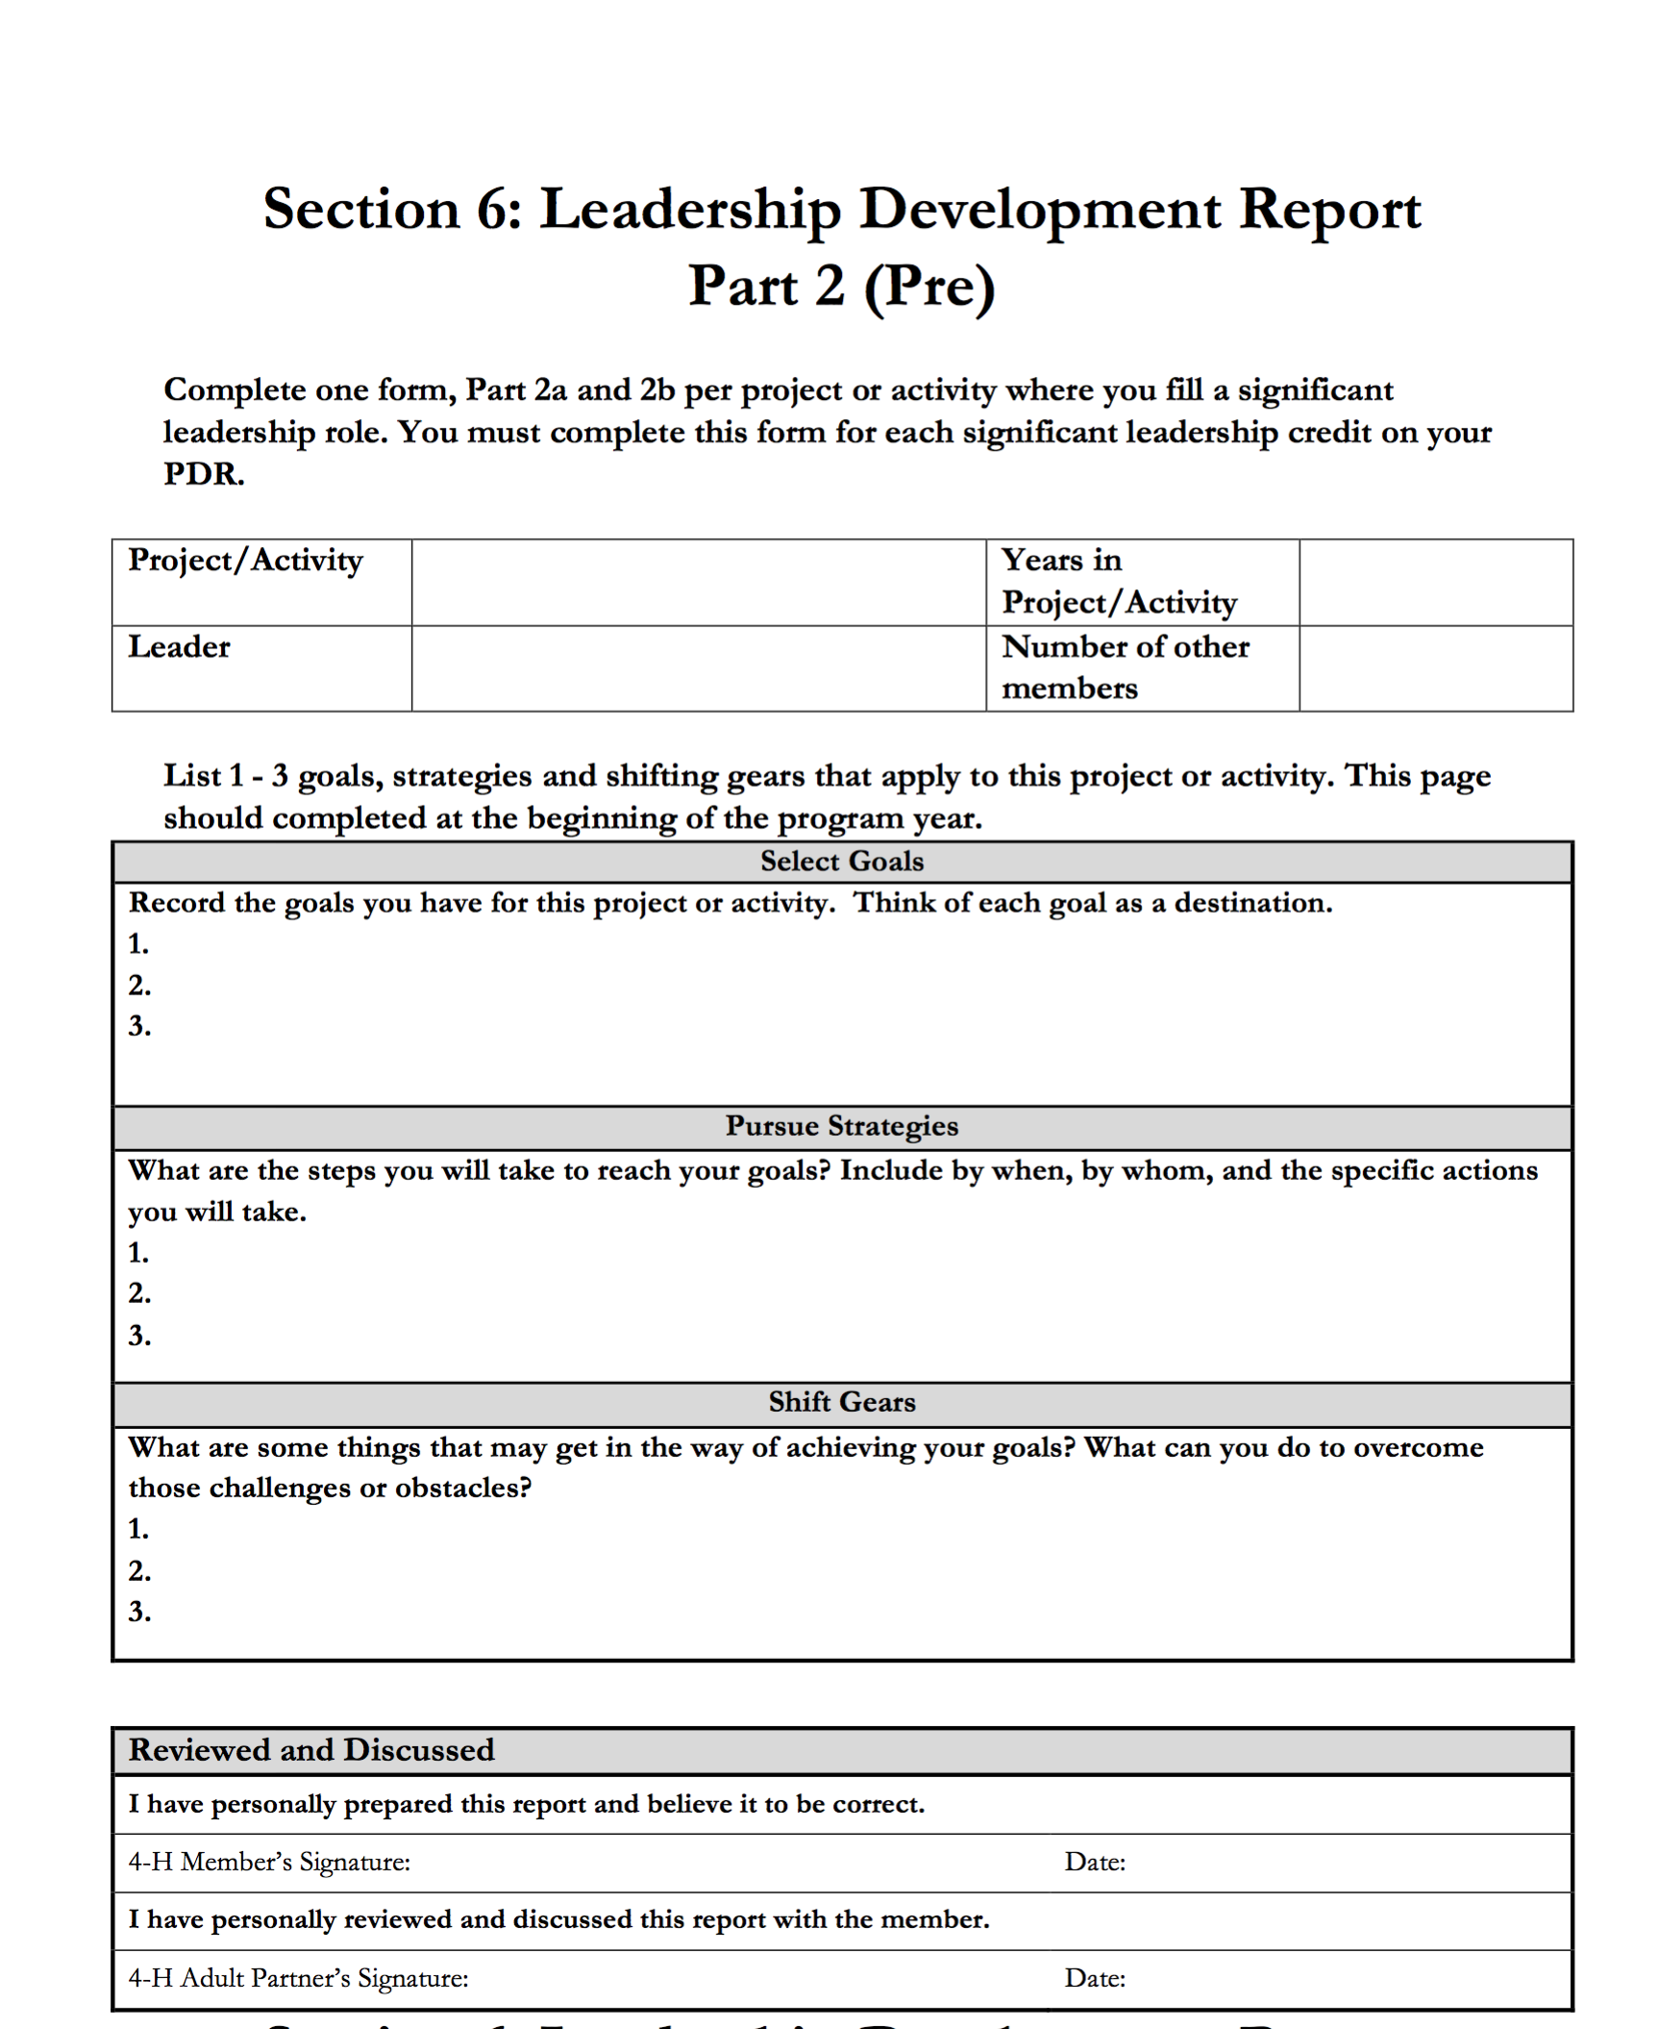
Leadership Development Report
Forms: Part 2 (Pre)

Slide 16
Leadership Development Report
Forms: Part 1 (Post)
Complete at the end of the year
Reflect on how your experiences throughout the year contributed to your development as a leader.
Again discuss and reflect on the 6 C’s
  Which C’s did you develop?
  How did you know that you grew?
  Is there a C that you didn’t plan on working but you developed anyway?
Fill out one.

Slide 17
Leadership Development Report
Forms: Part 2 (Post)
Specific Goals
Discuss if you reached your goals
How you reached your goals
Example of when you shifted gears
Make sure the adult provides feedback and signs the bottom.

Slide 18
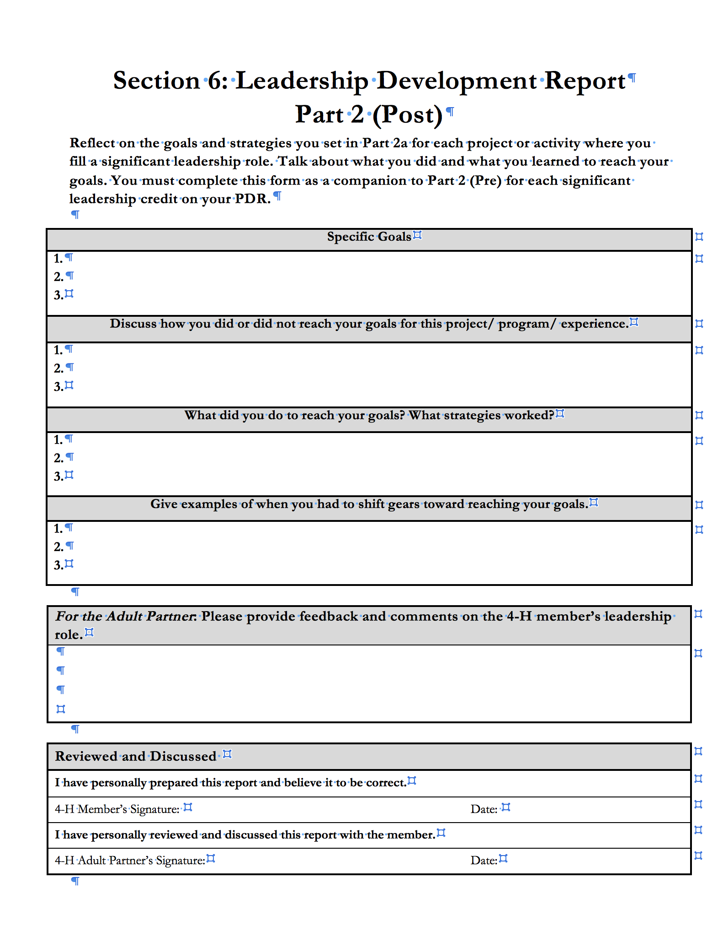
Leadership Development Report
Forms: Part 2 (Pre)

Slide 19
Thanks!
Next: Resume

