Slide 1
Nematode control options for peaches
Andreas Westphal, Department of Nematology, Kearney Agricultural Research and Extension Center, 9240 S. Riverbend Ave, Parlier, CA 93720
Phone: 1-559 646 6555
Email: andreas.westphal@ucr.edu

Slide 2
Outline and Take-home
How to address risk assessments for plant-parasitic nematodes?
What options are out there?
How are options developed?

Slide 3
General strategies
Know the history of the field
Soil/(root ?) sampling
Nematode ID/commercial laboratory
Management strategy

Slide 4
General strategies
Host plant resistance
Chemical control
Cultural management

Slide 5
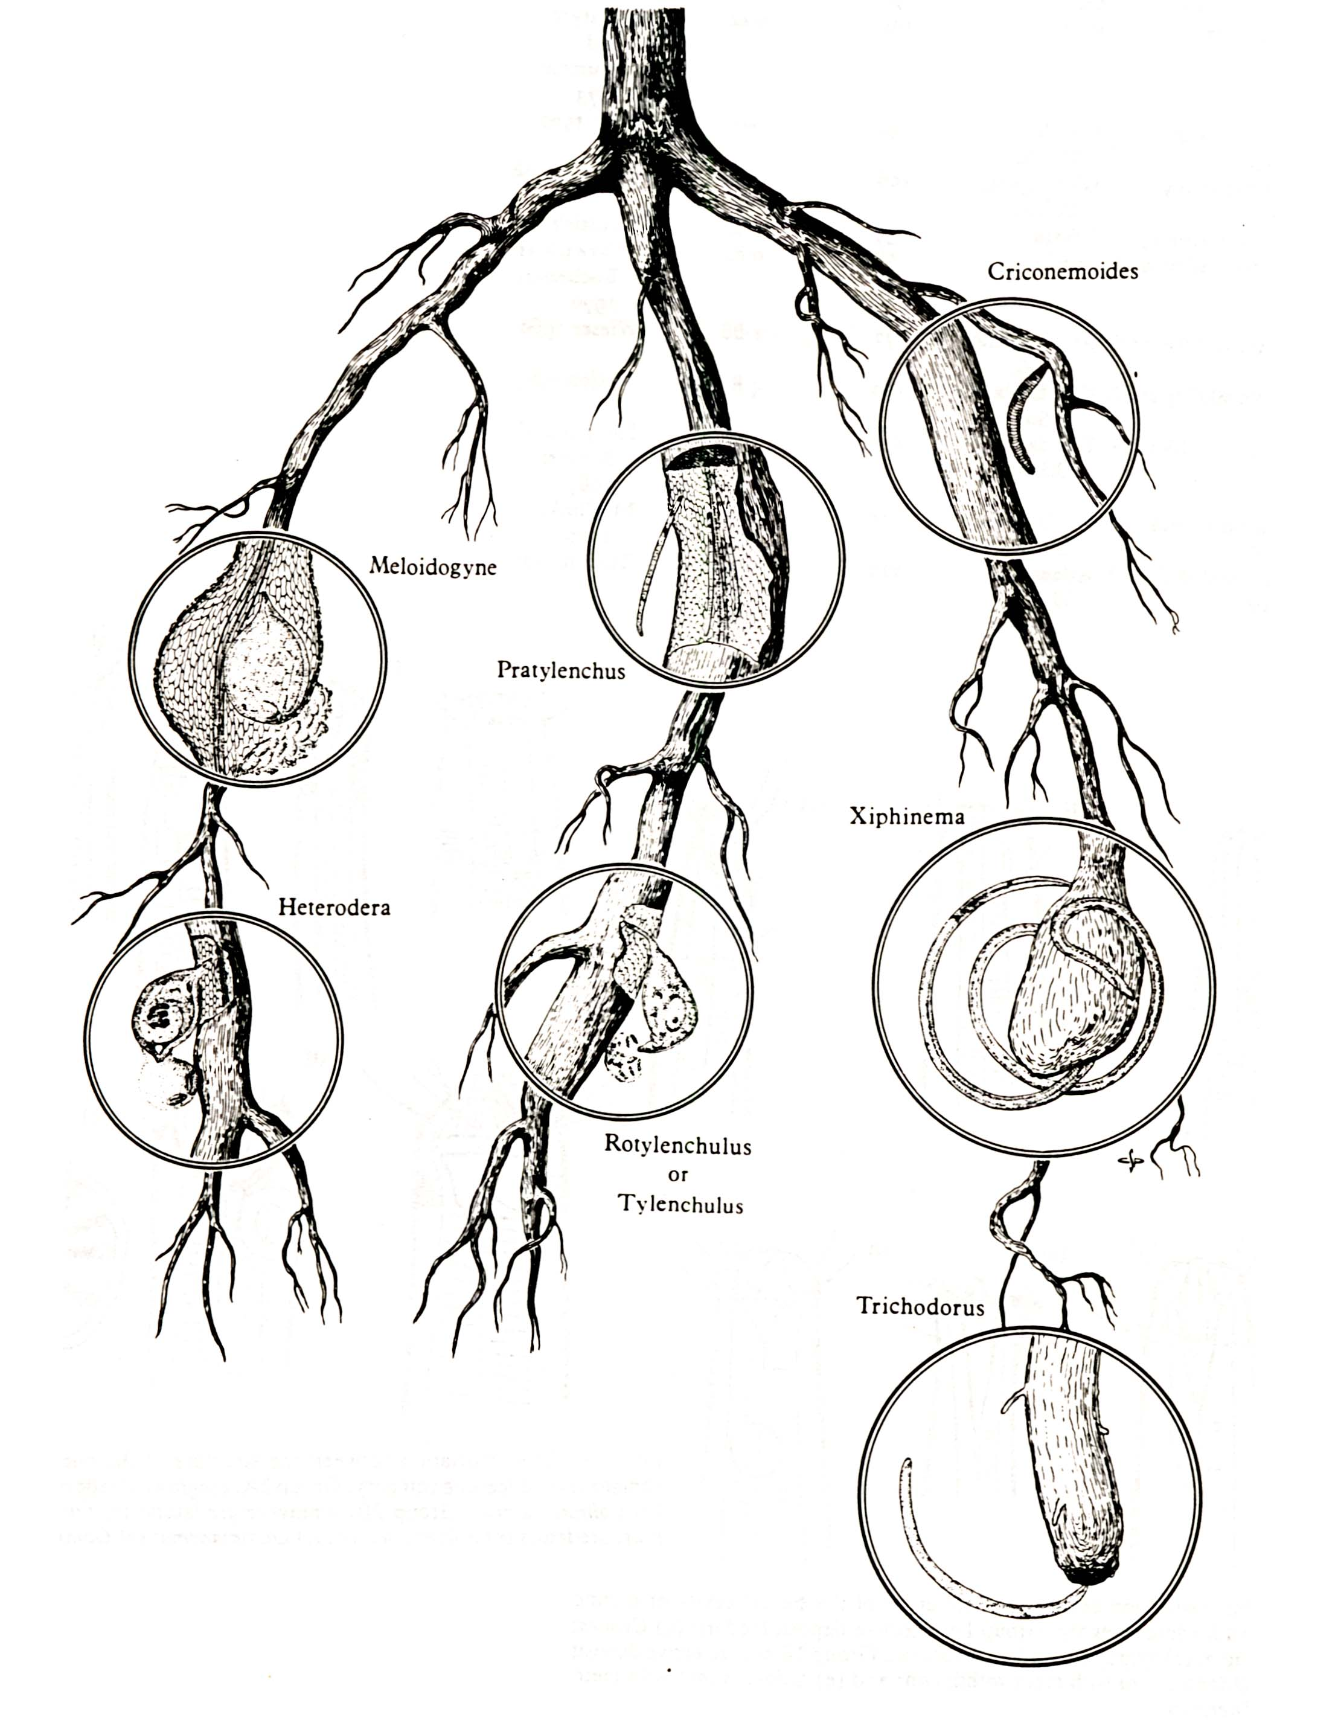
Feeding habits of plant-parasitic nematodes
(Agrios)

Slide 6
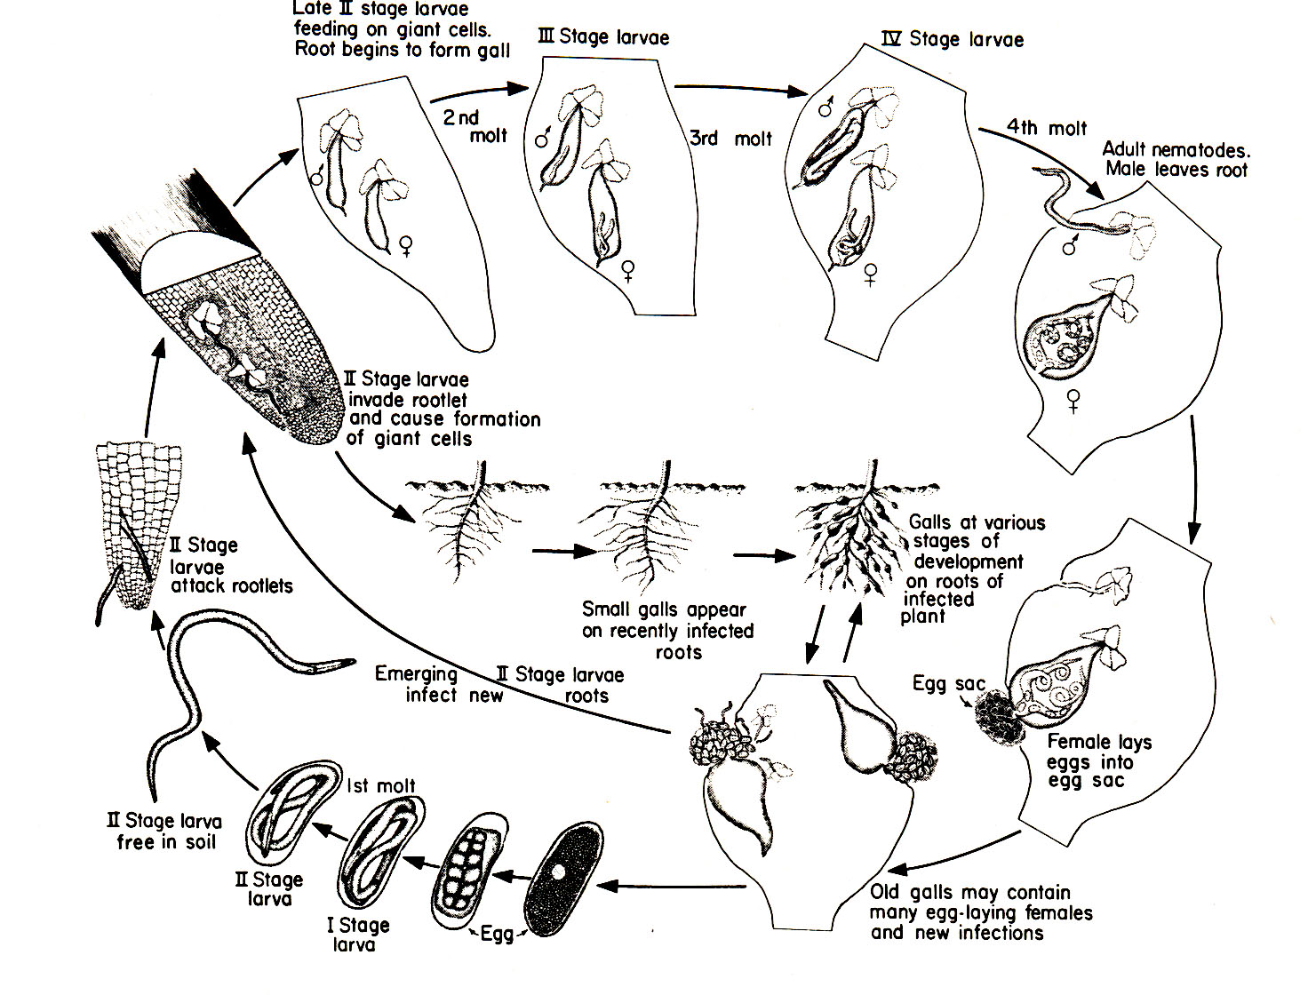
Life cycle of root-knot nematodes
(Agrios)

Slide 7
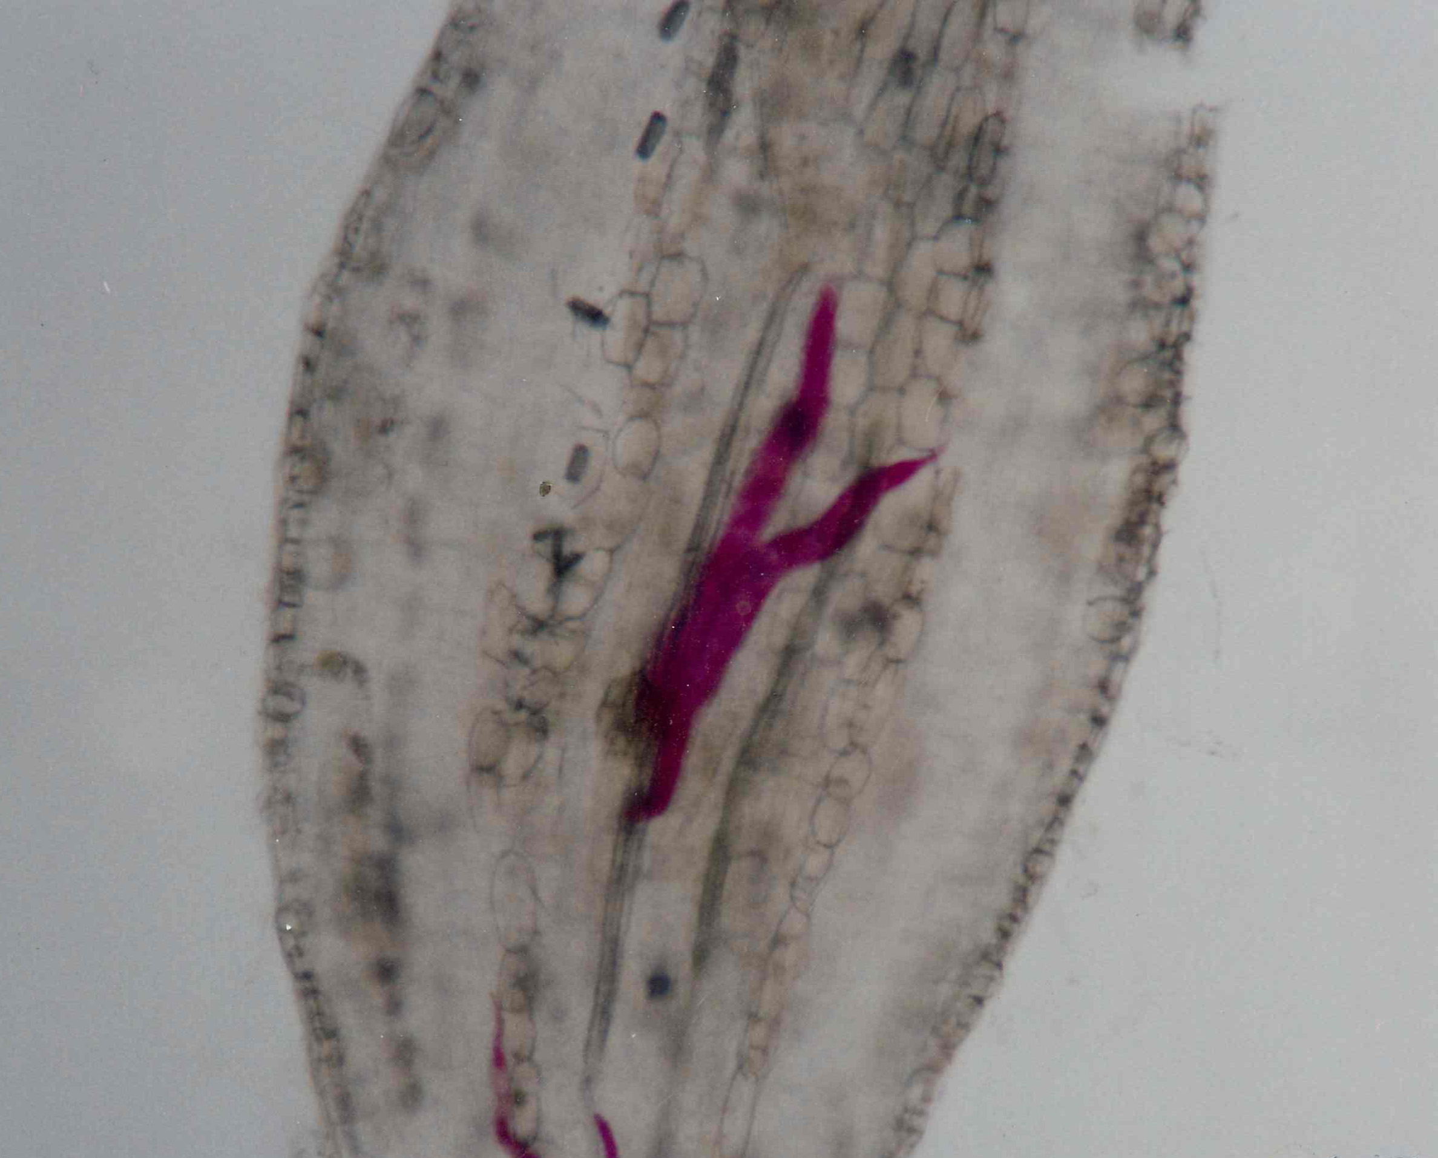
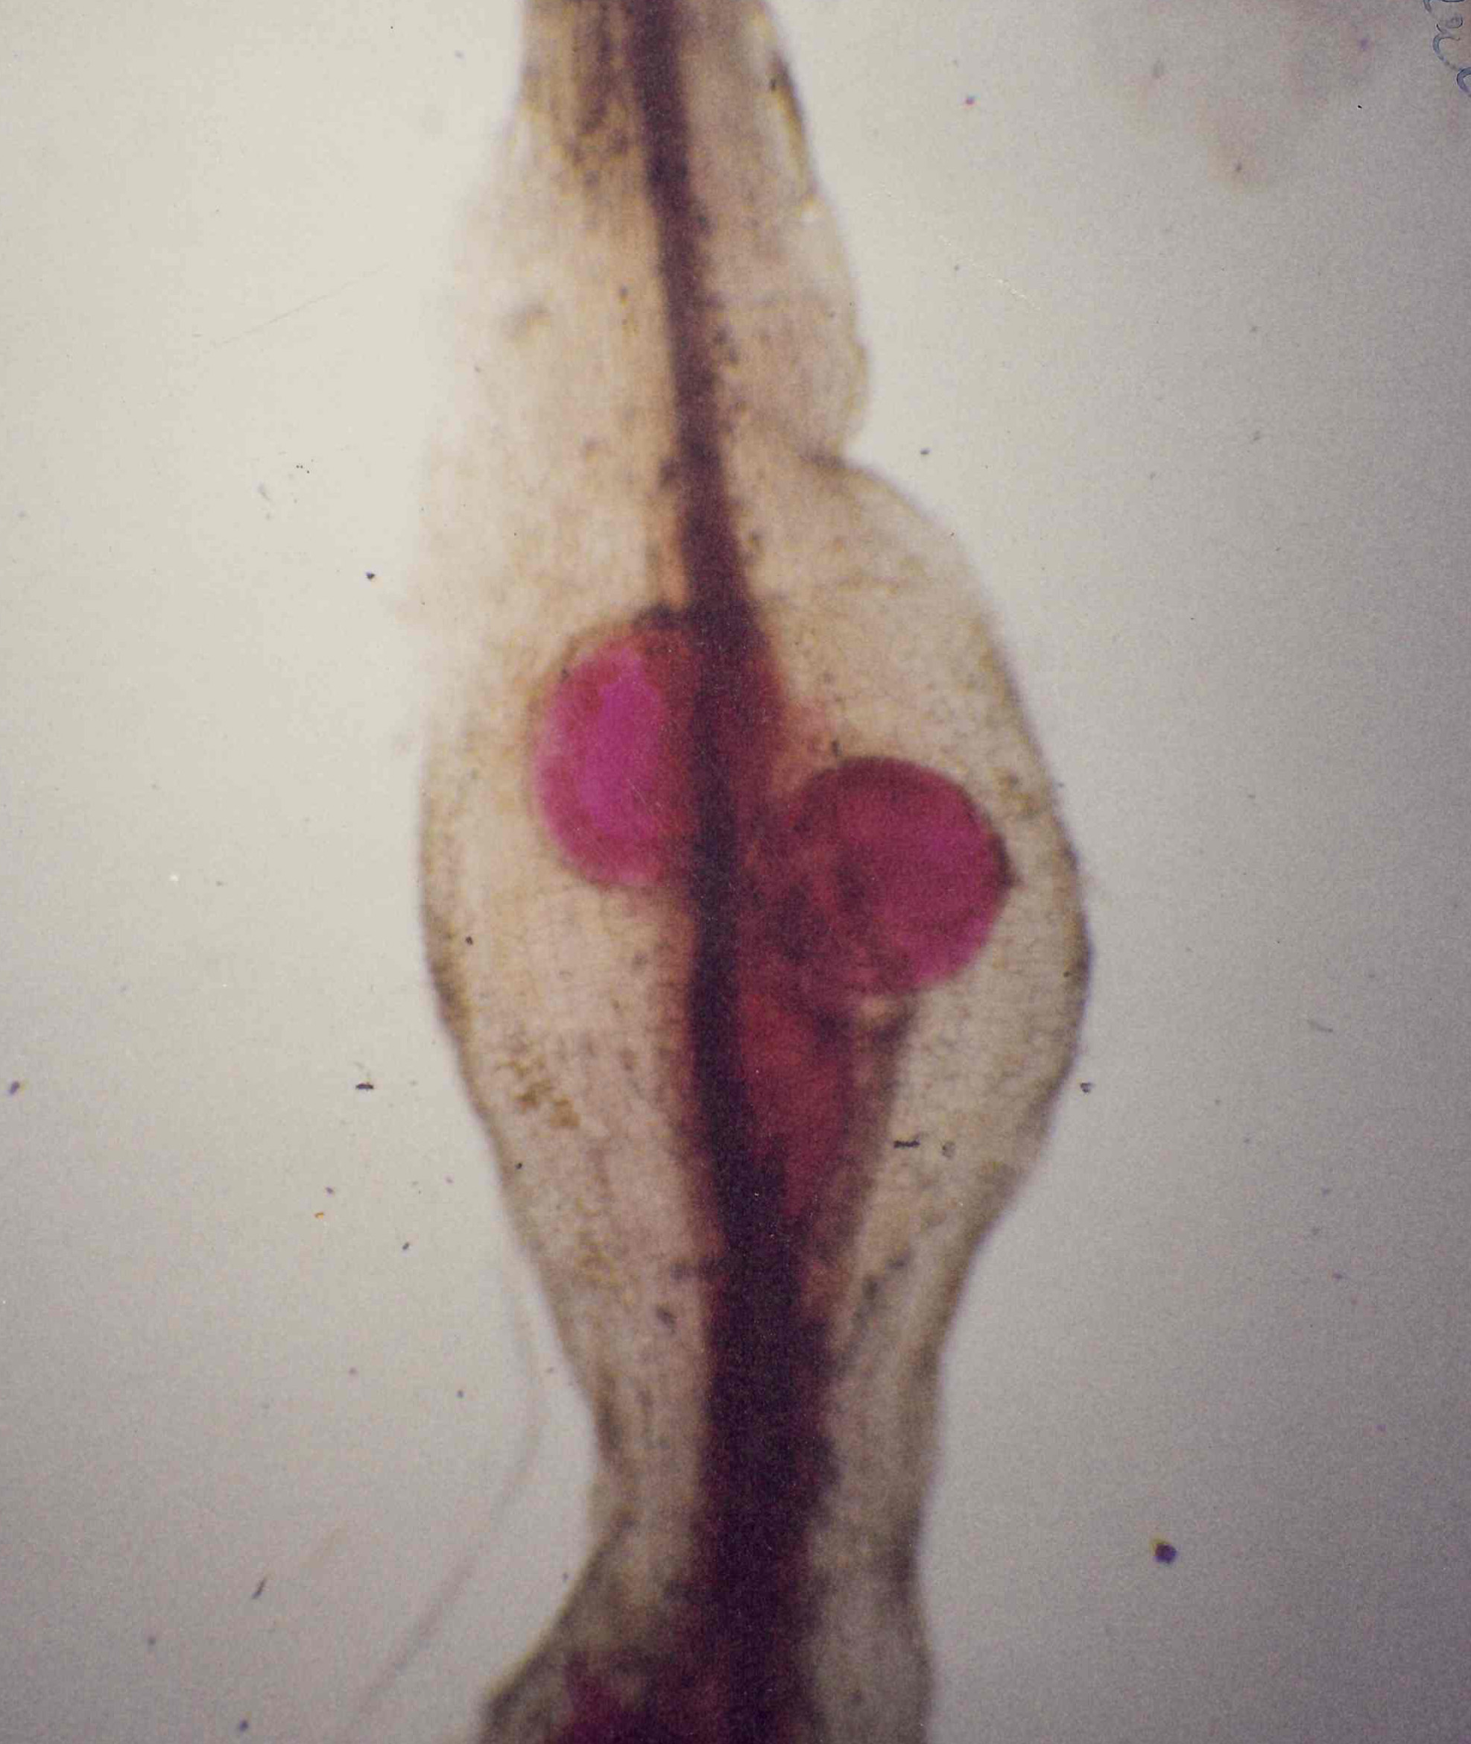
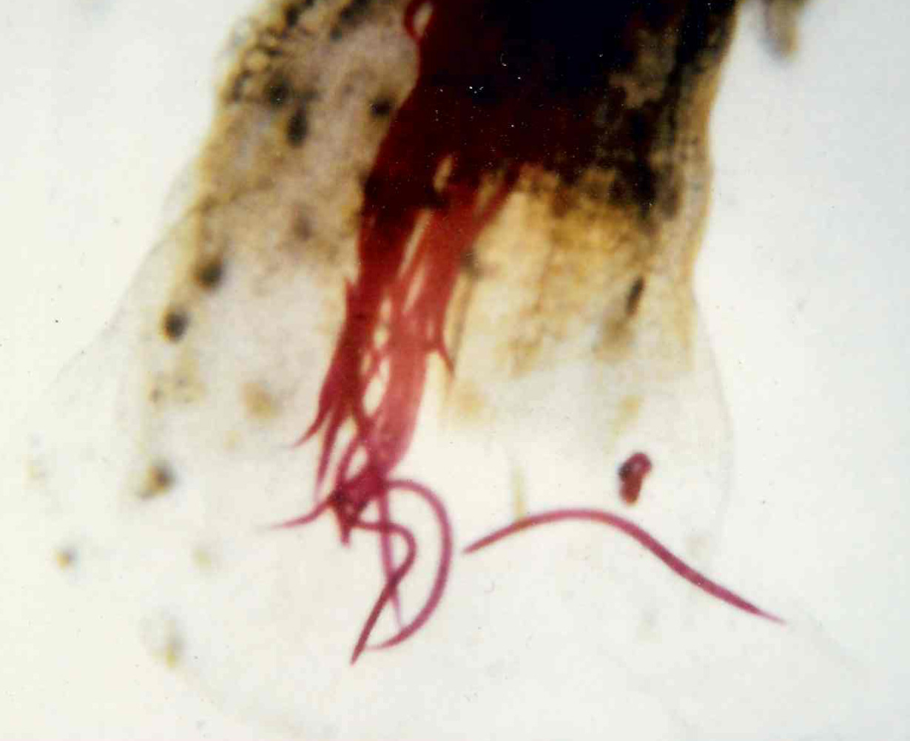
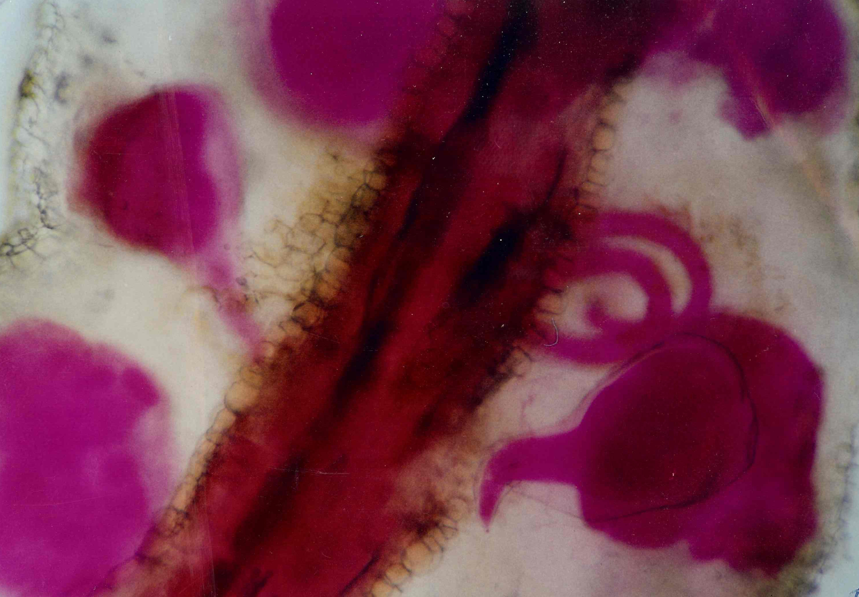
Life cycle of root-knot nematodes
Development
Maturing
Penetration
Reproduction
(Pictures: M. McKenry)

Slide 8
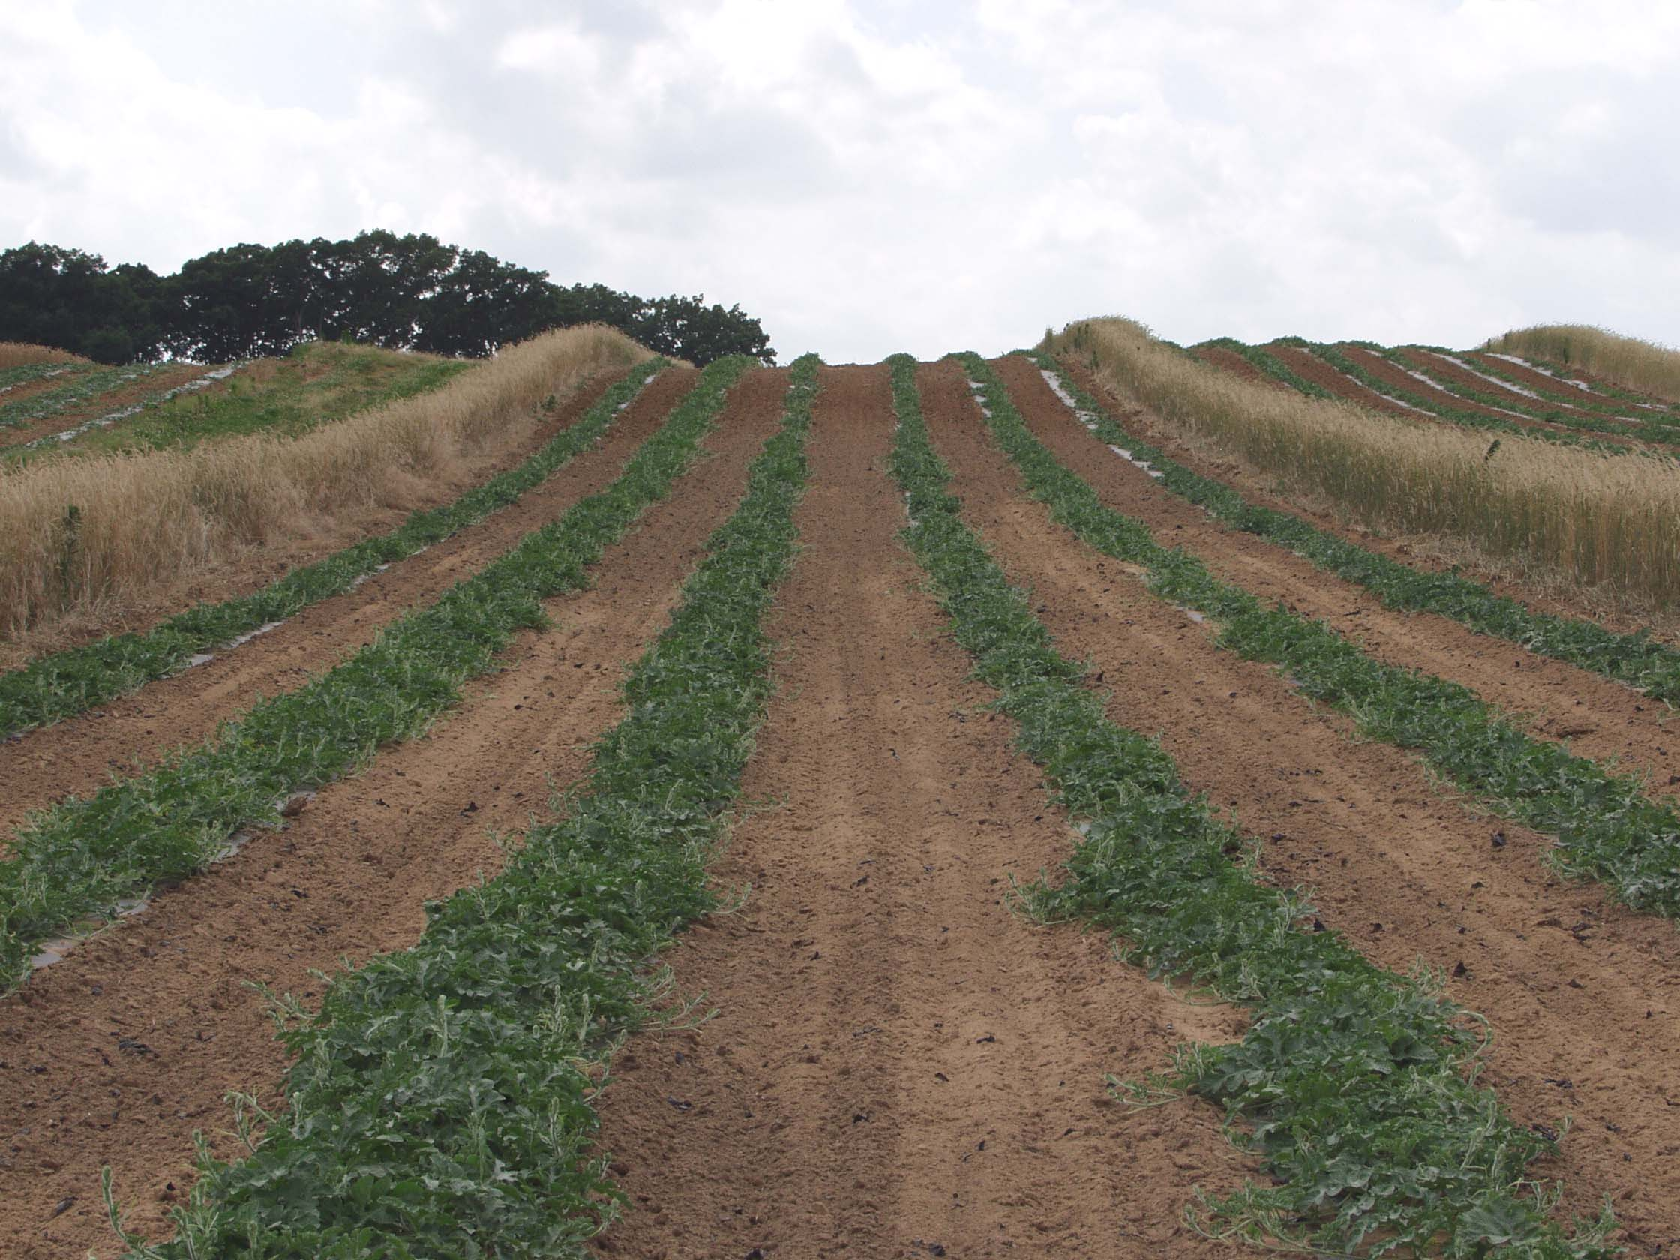
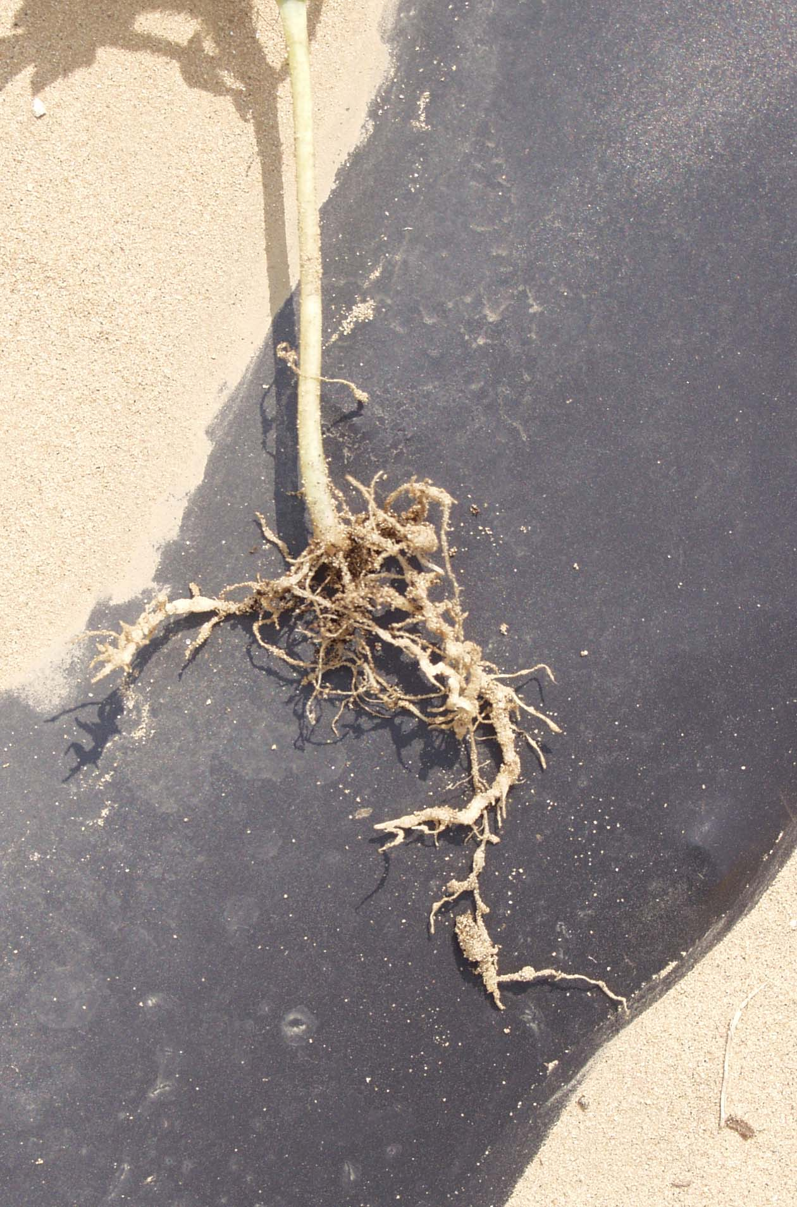
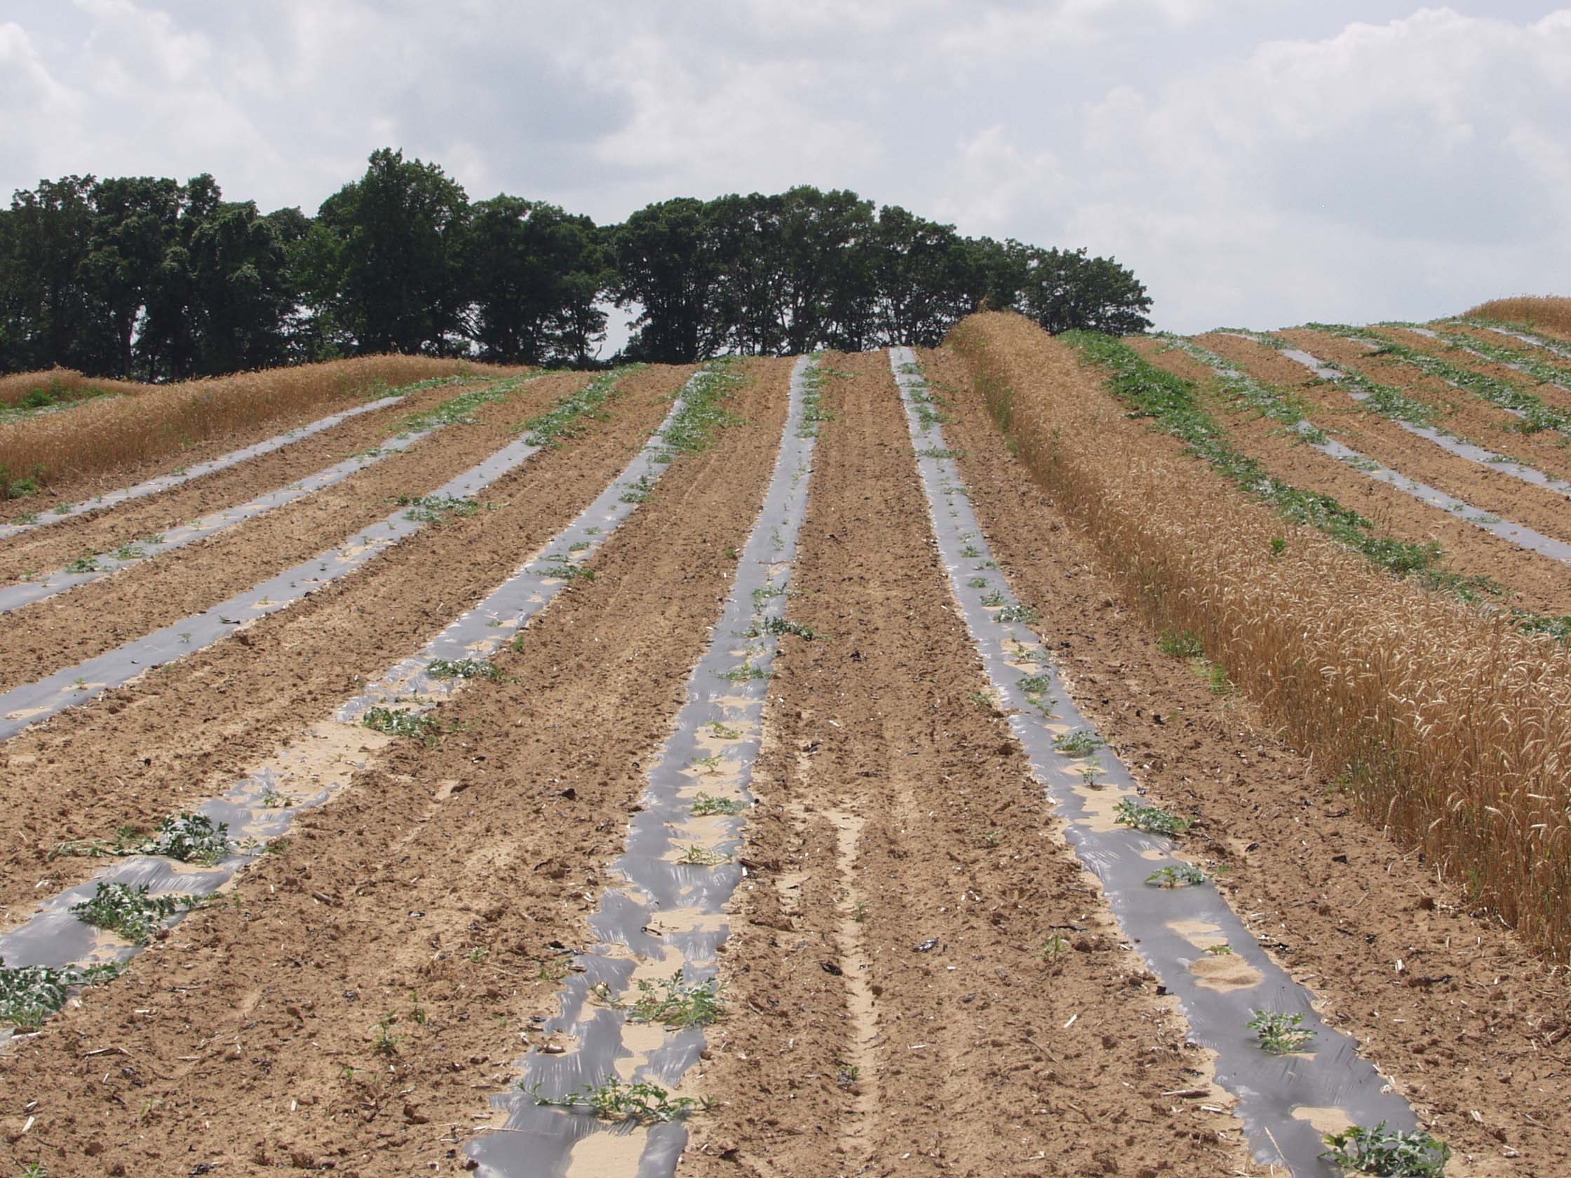
Root Knot Nematode Damage on Watermelon

Slide 9
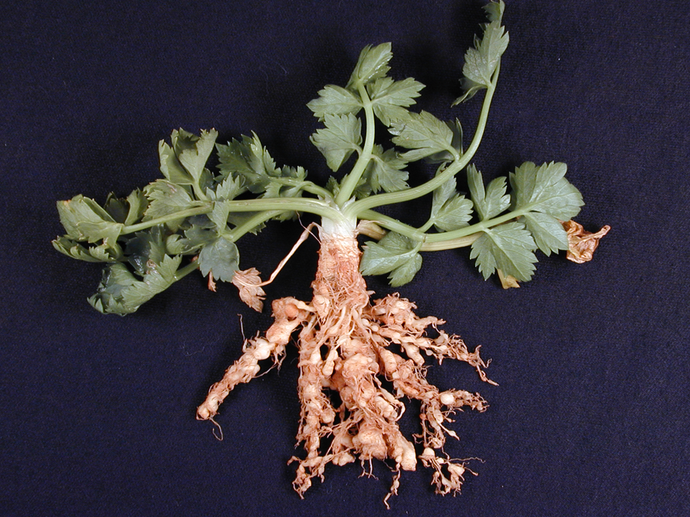
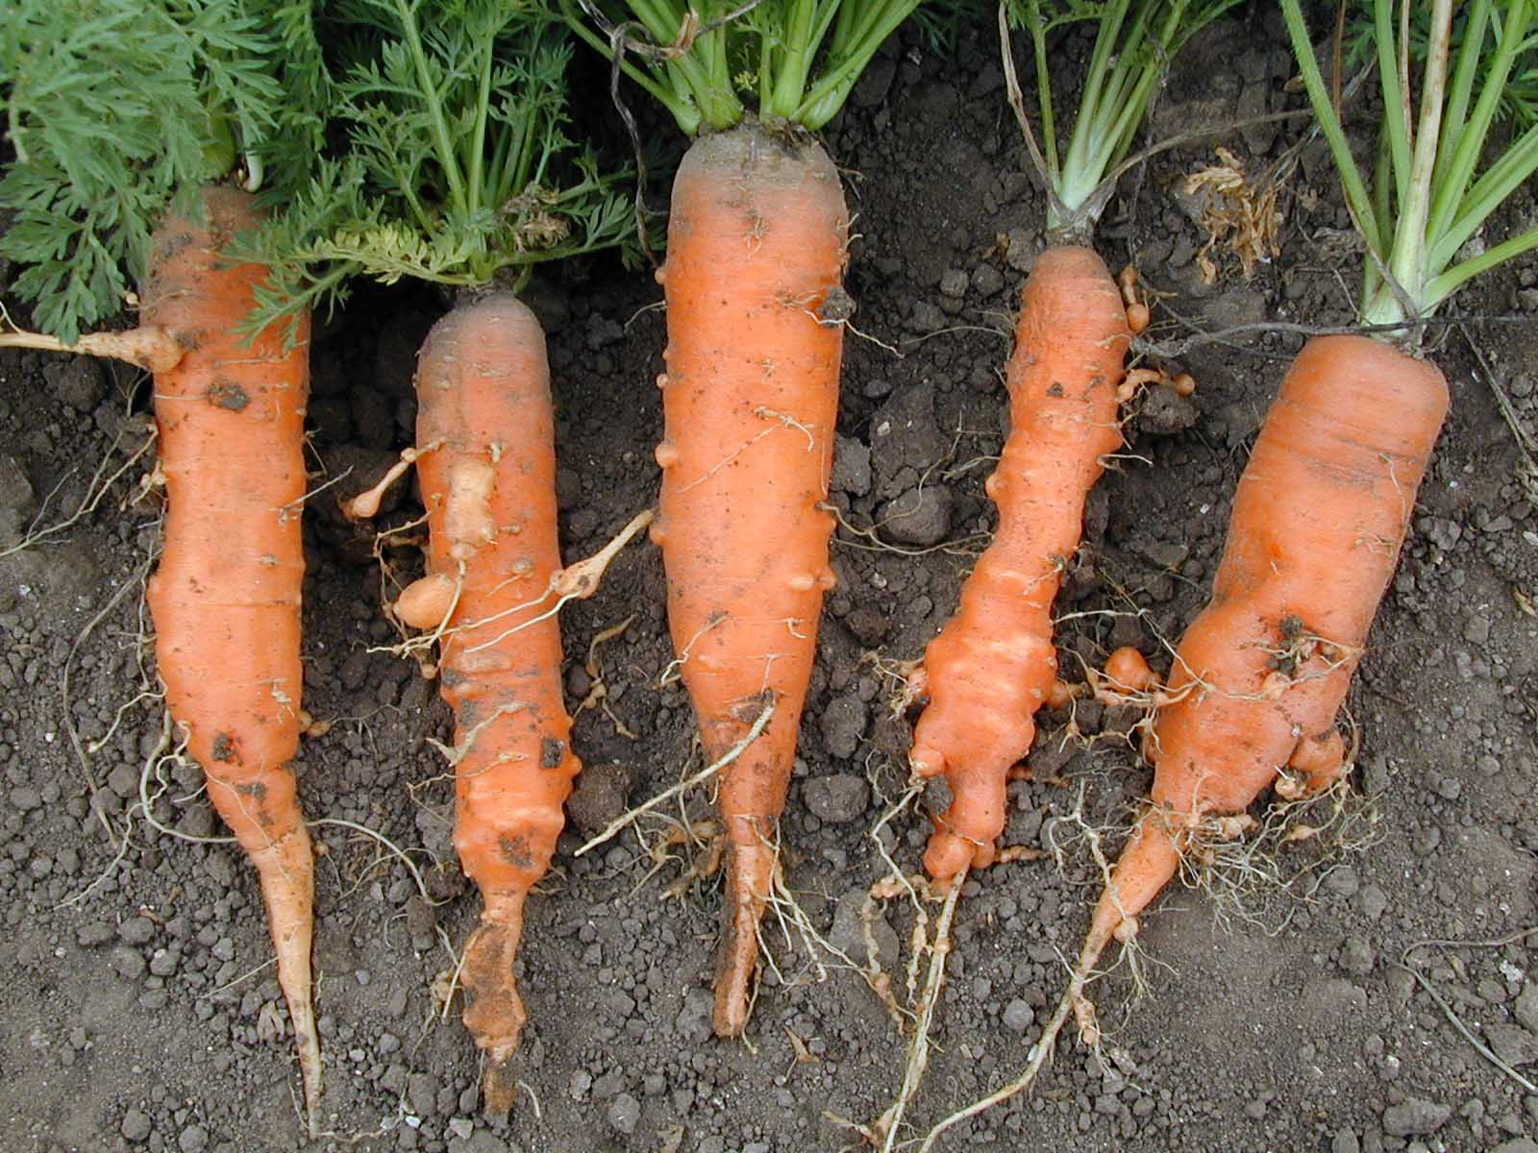
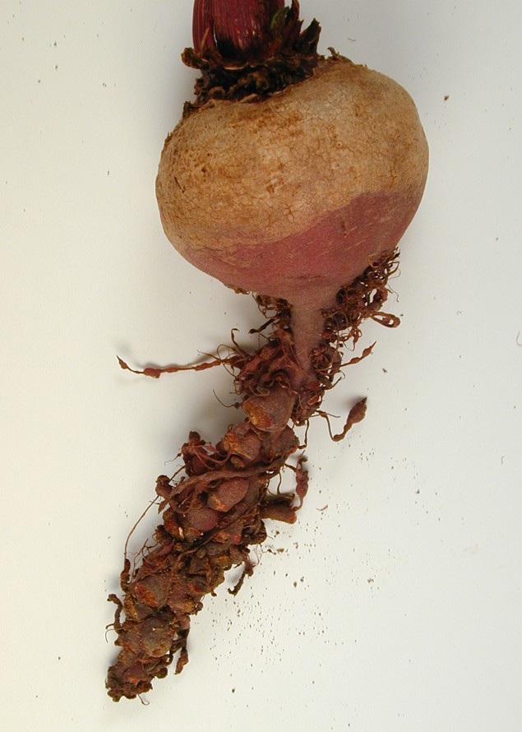
Root Knot Nematode Damage on vegetables

Slide 10
Plant-parasitic nematodes on perennials

Slide 11
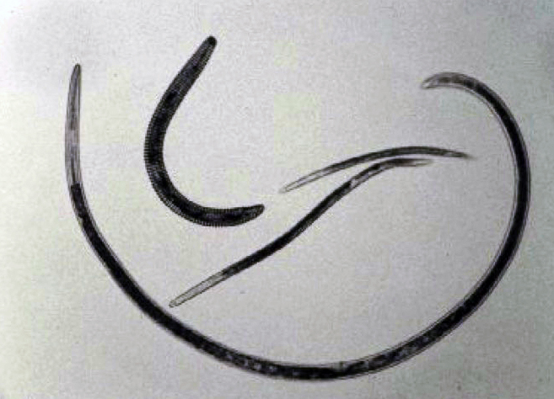
Plant-parasitic nematodes on perennials
(McKenry)

Slide 12
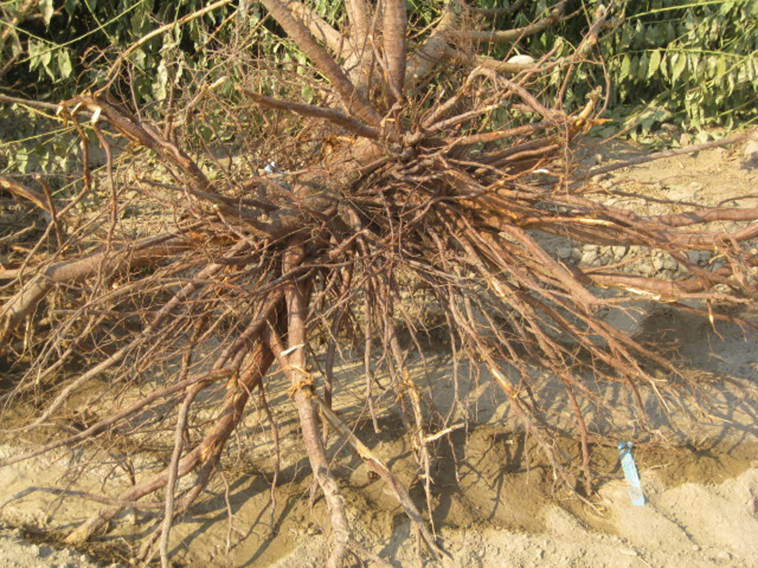
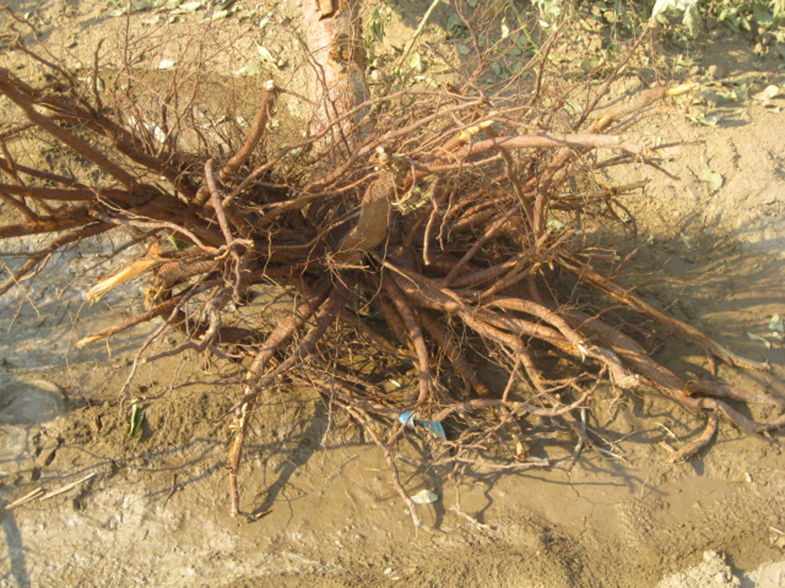
Roots of perennials

Slide 13

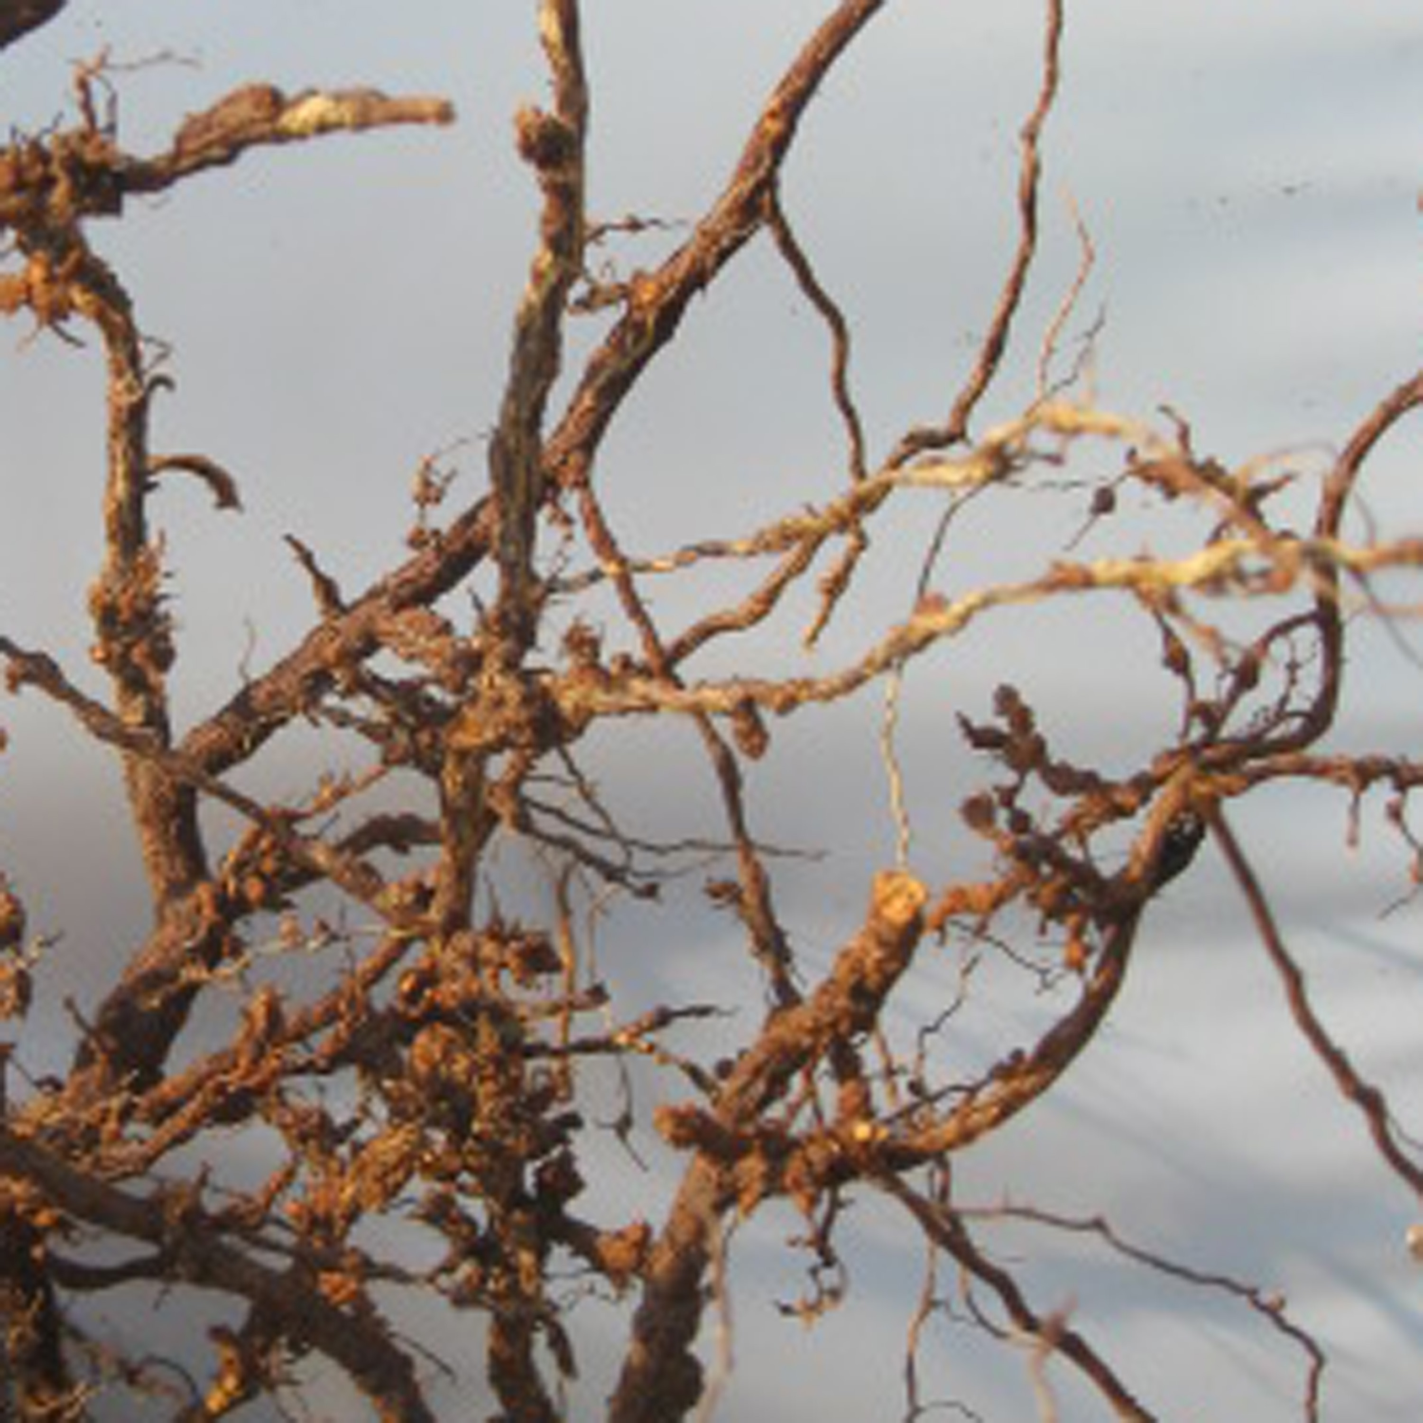
Symptoms in perennials

Slide 14
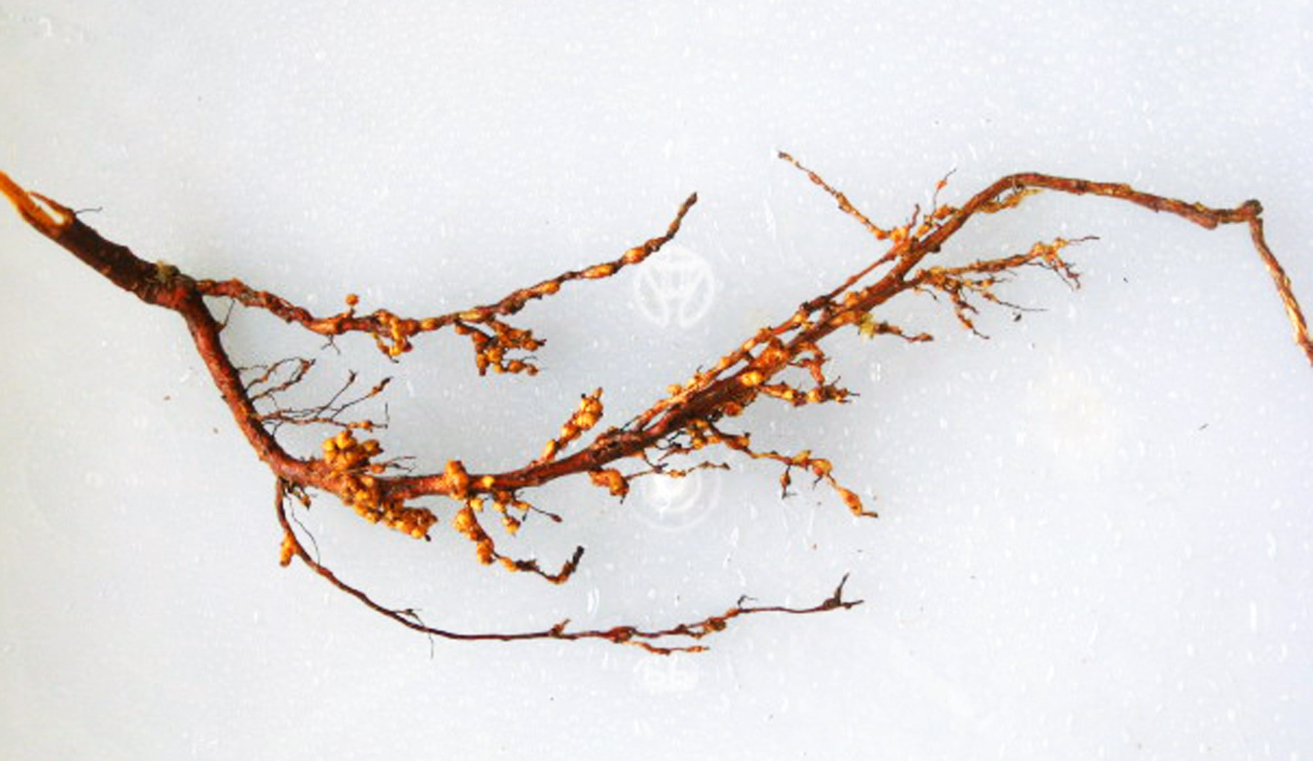
Symptoms in perennials

Slide 15
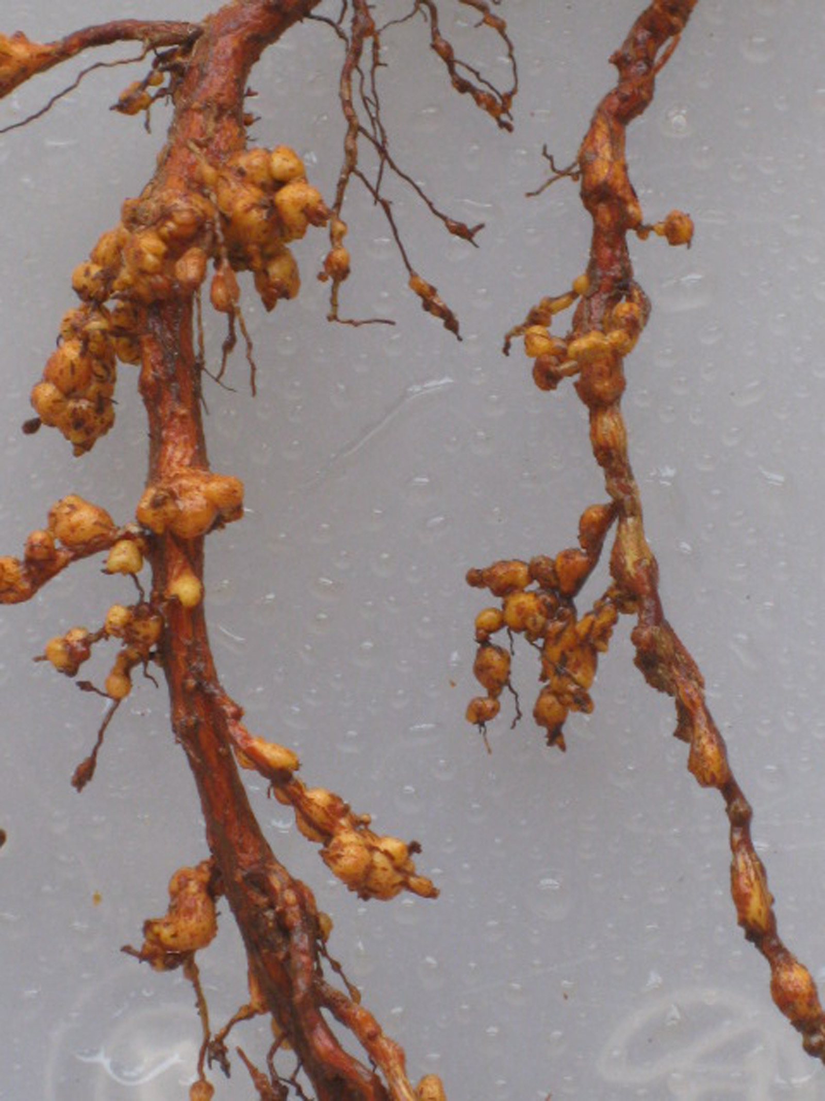
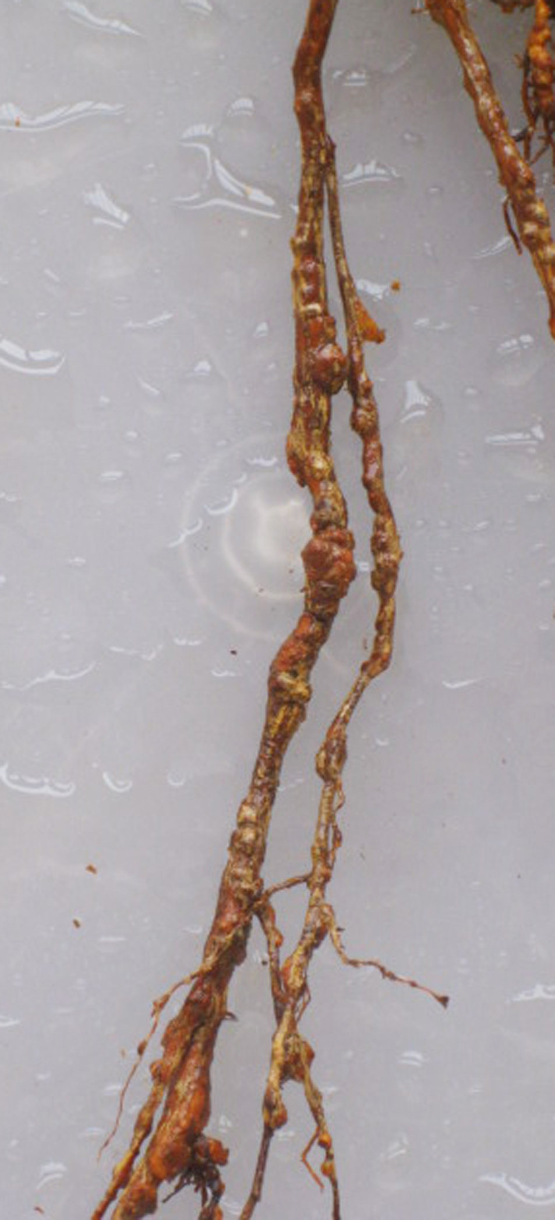
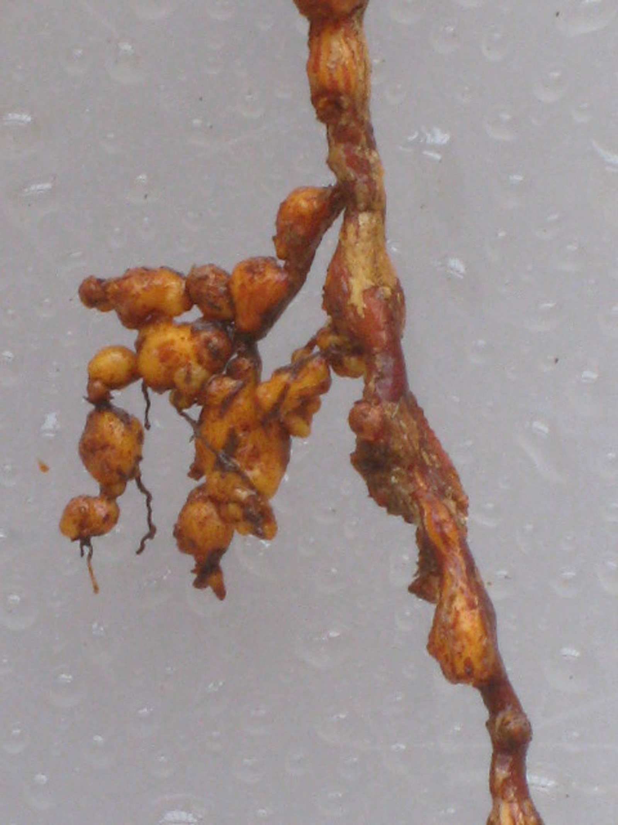
Symptoms in perennials

Slide 16
Breeding concepts

Slide 17
Definitions
Resistance: Reproduction of nematodes
=> population densities?
susceptible ⬄ resistant
Tolerance: Reaction of the plant to nematodes => plant damage?
intolerant ⬄ tolerant

Slide 18
Microplot trial
32 cm
- Cultivars
‘Beretta’ (susceptible)
‘Sanetta’ (resistent)
‘Pauletta’ (tolerant)
- Infestations
control + 5-fold increasing series
Watering
natural precipitation or + additional watering once a week
26 cm

Slide 19
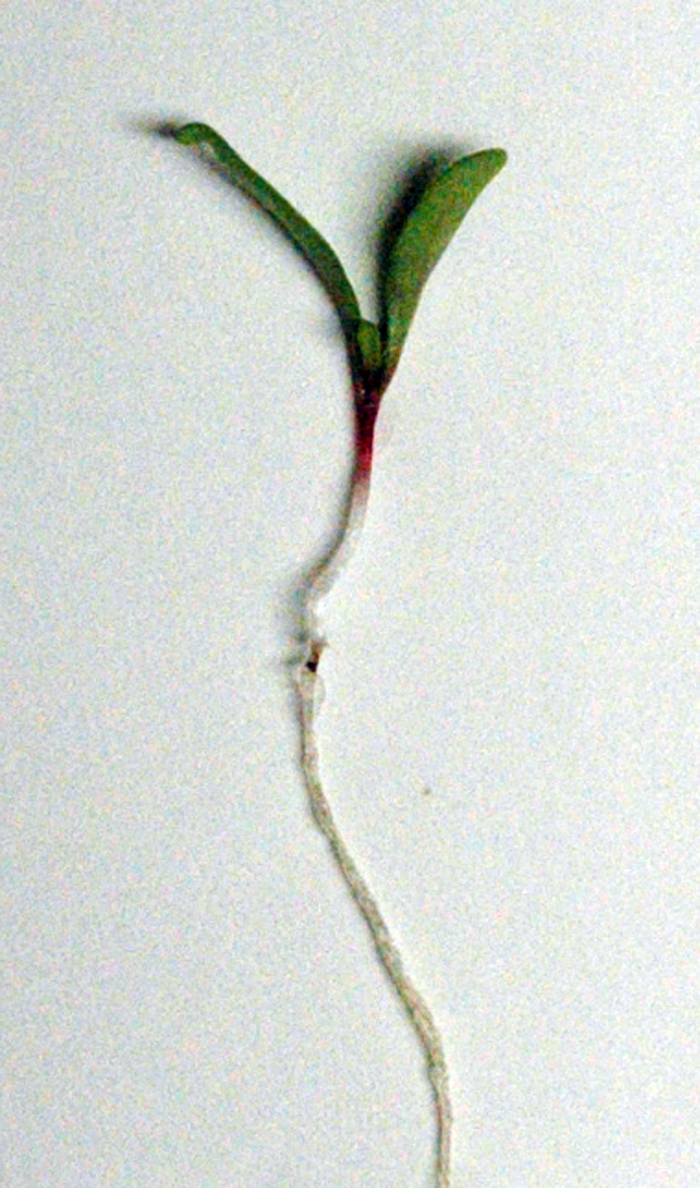
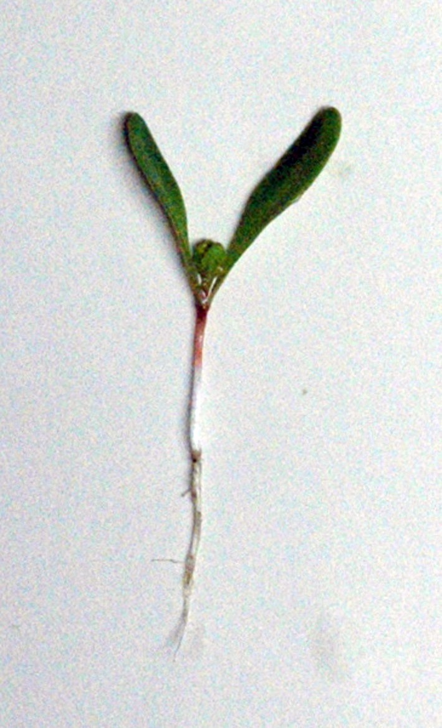
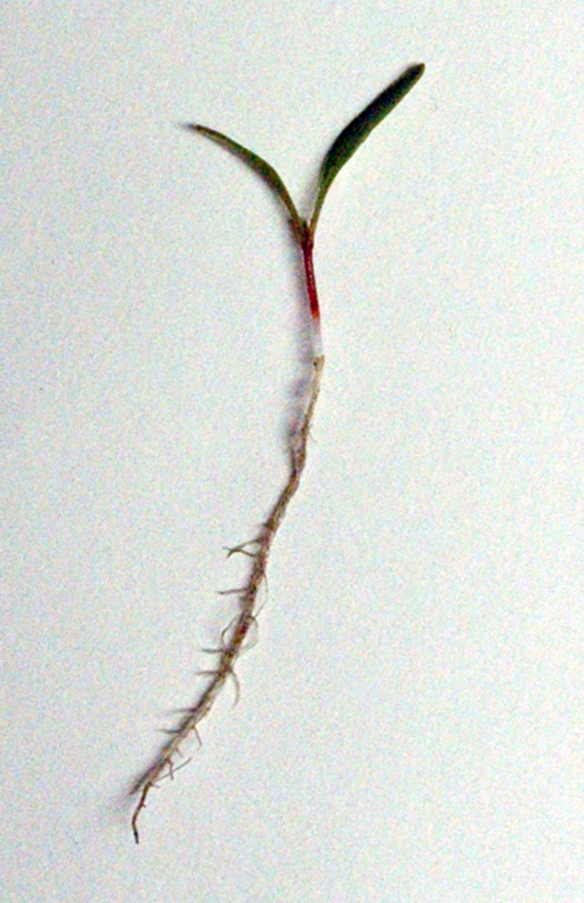
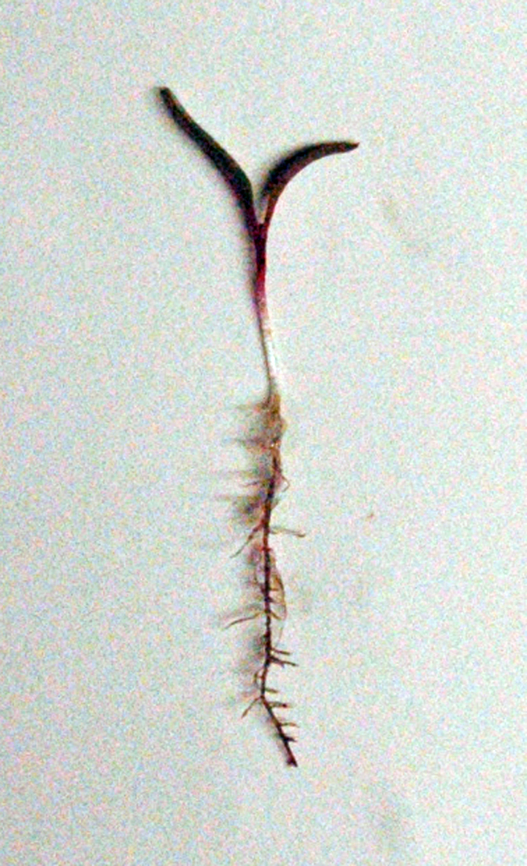
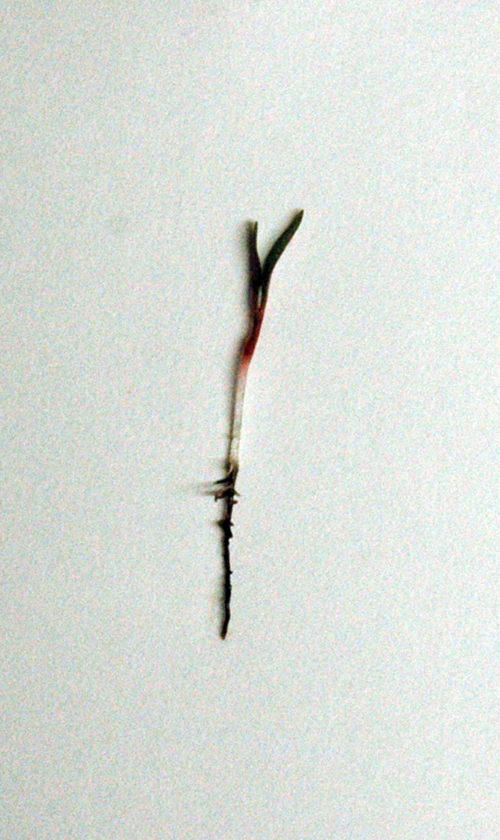

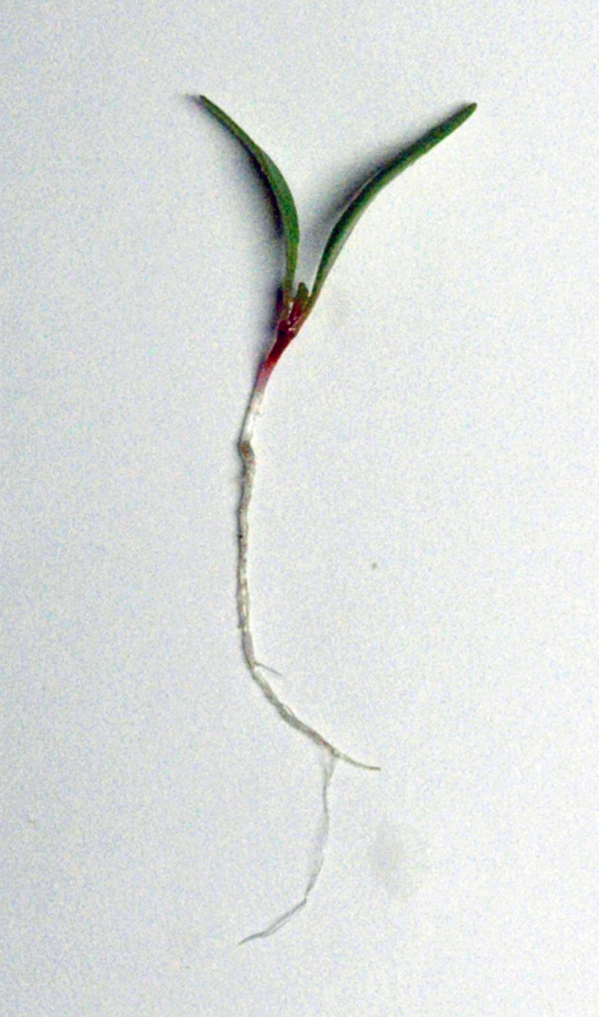
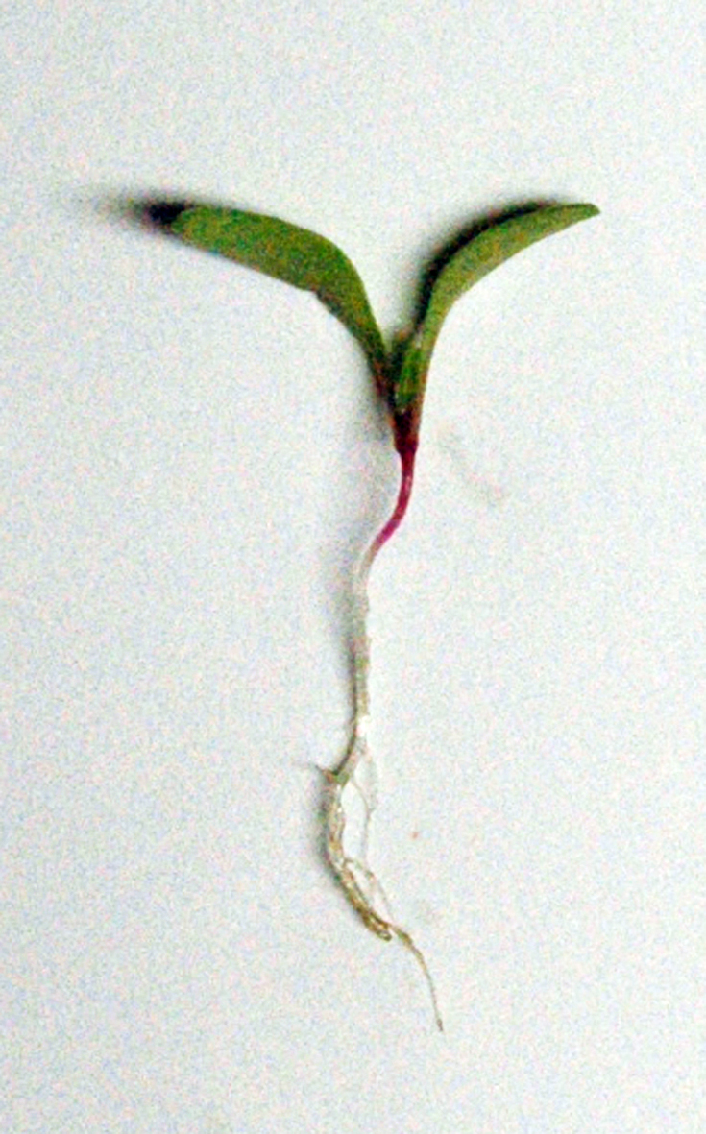
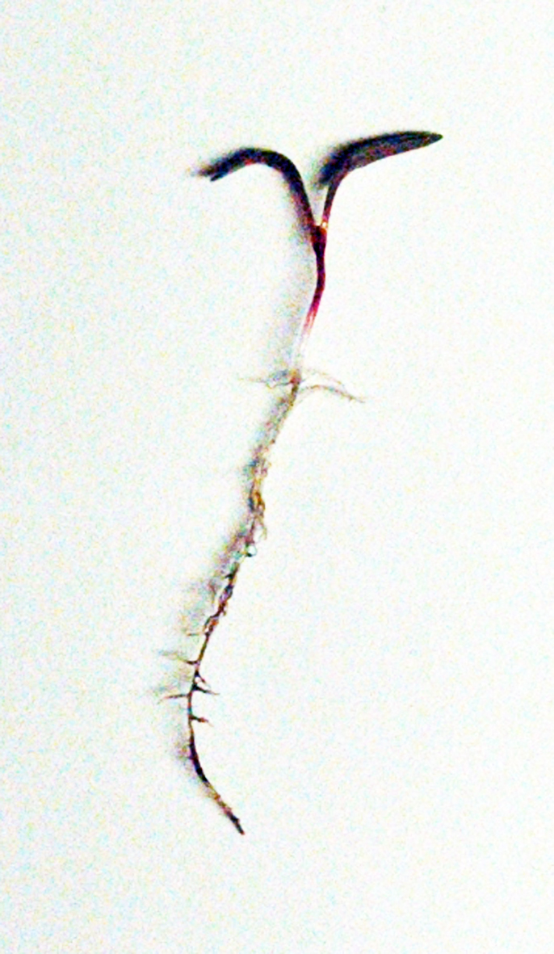
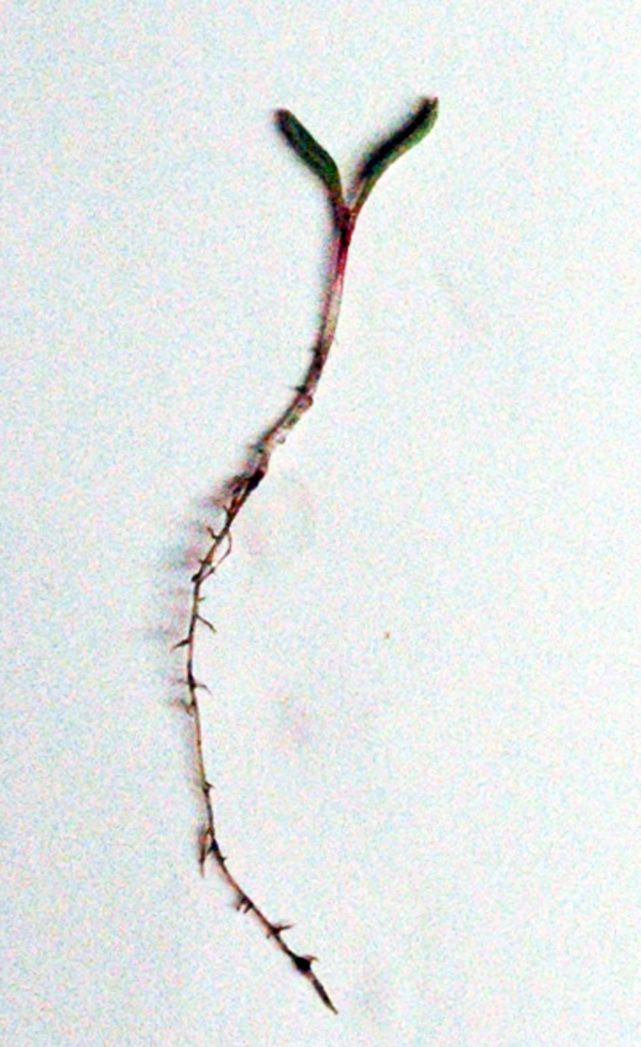
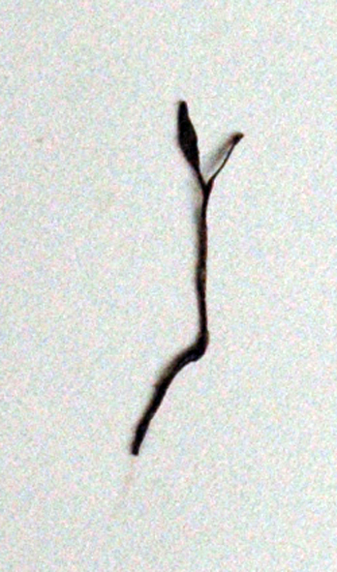

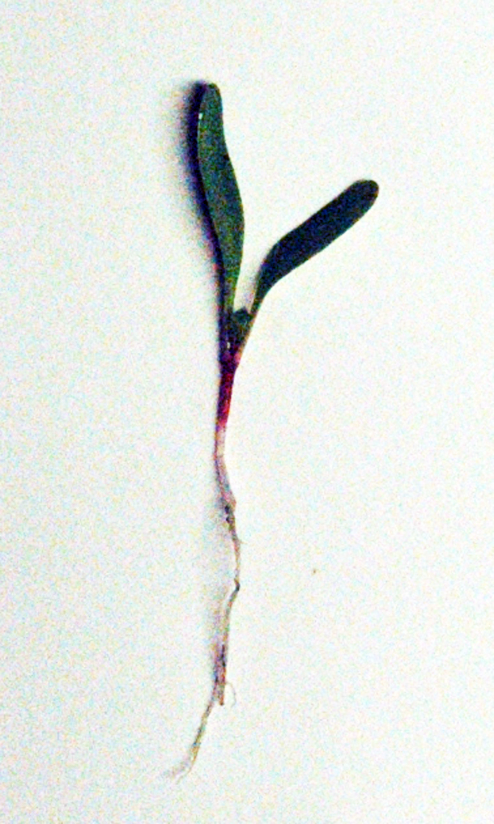
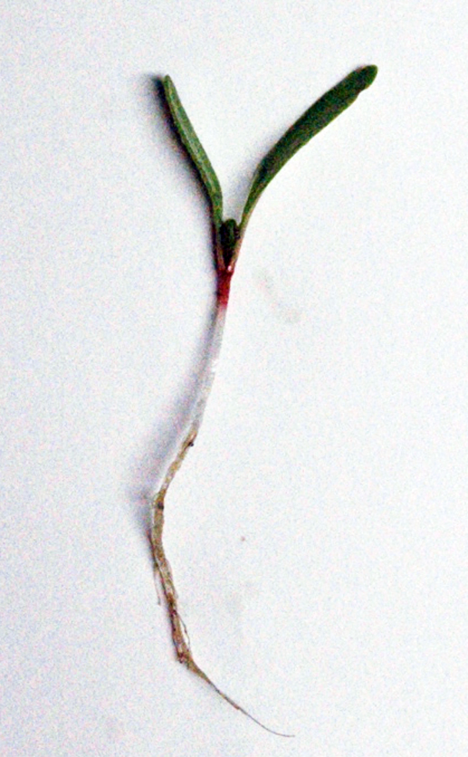
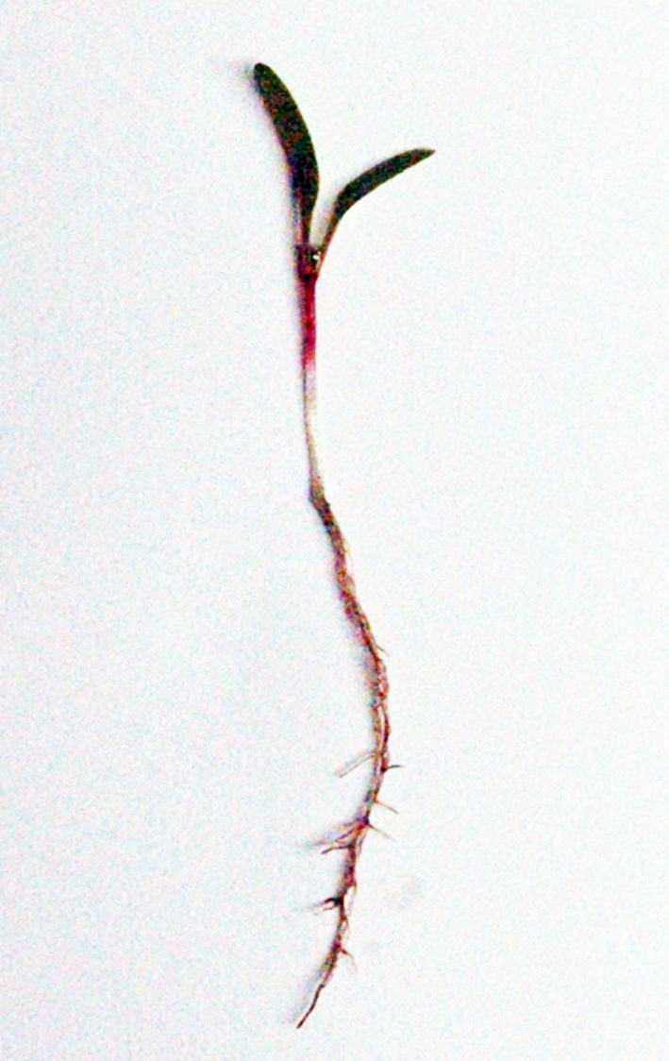
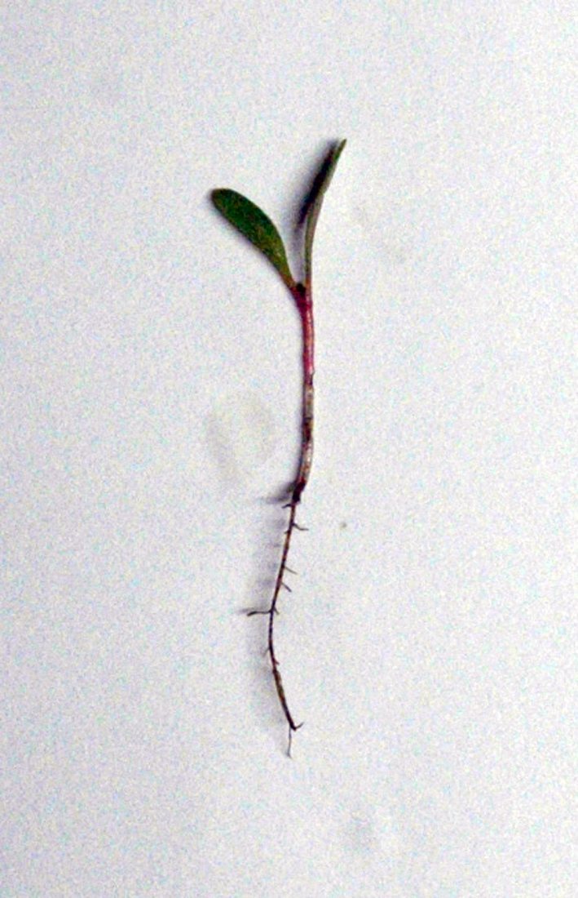
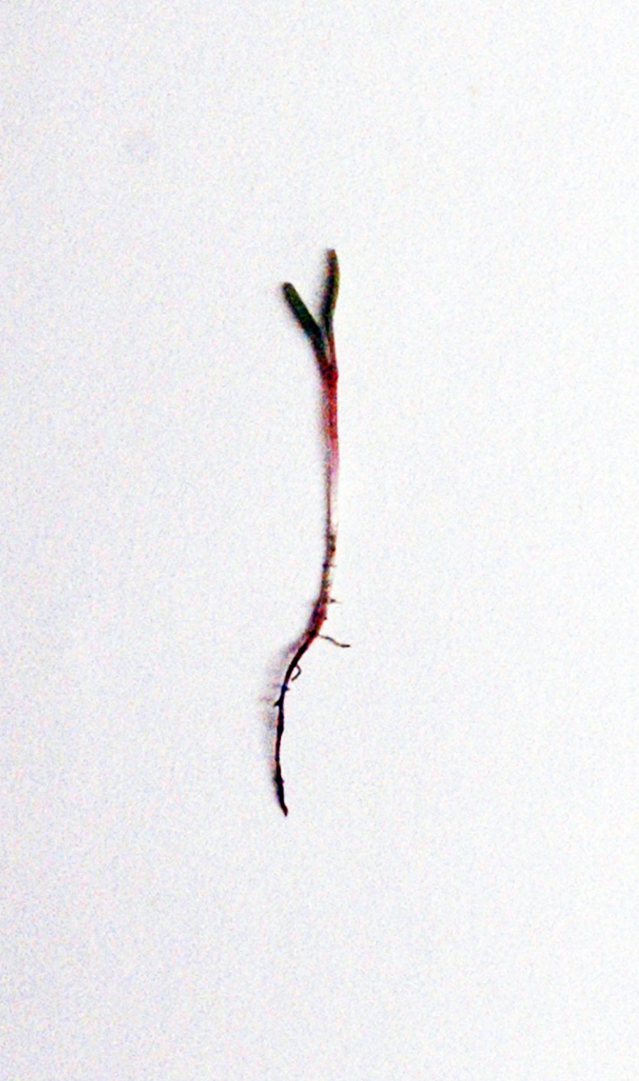
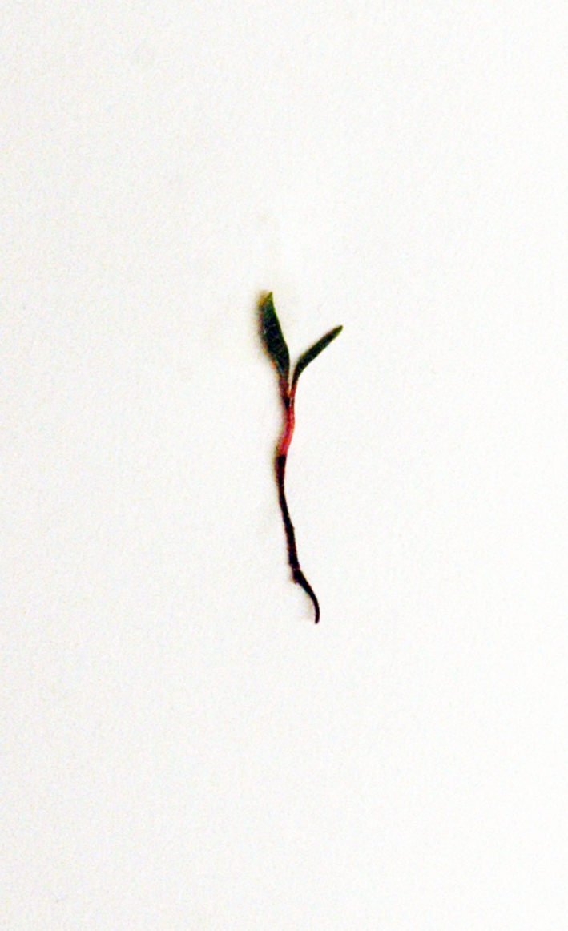
Heterodera schachtii on sugarbeet (eggs/100 g soil)
Control
1.3 × 10²
5.1 × 10²
2.3 × 10³
1.1 × 10⁴
5.1 × 10⁴
Susceptible
Resistant
Tolerant
Notes:
Sämlinge 4 Wochen nach dem Pflanzen

Slide 20
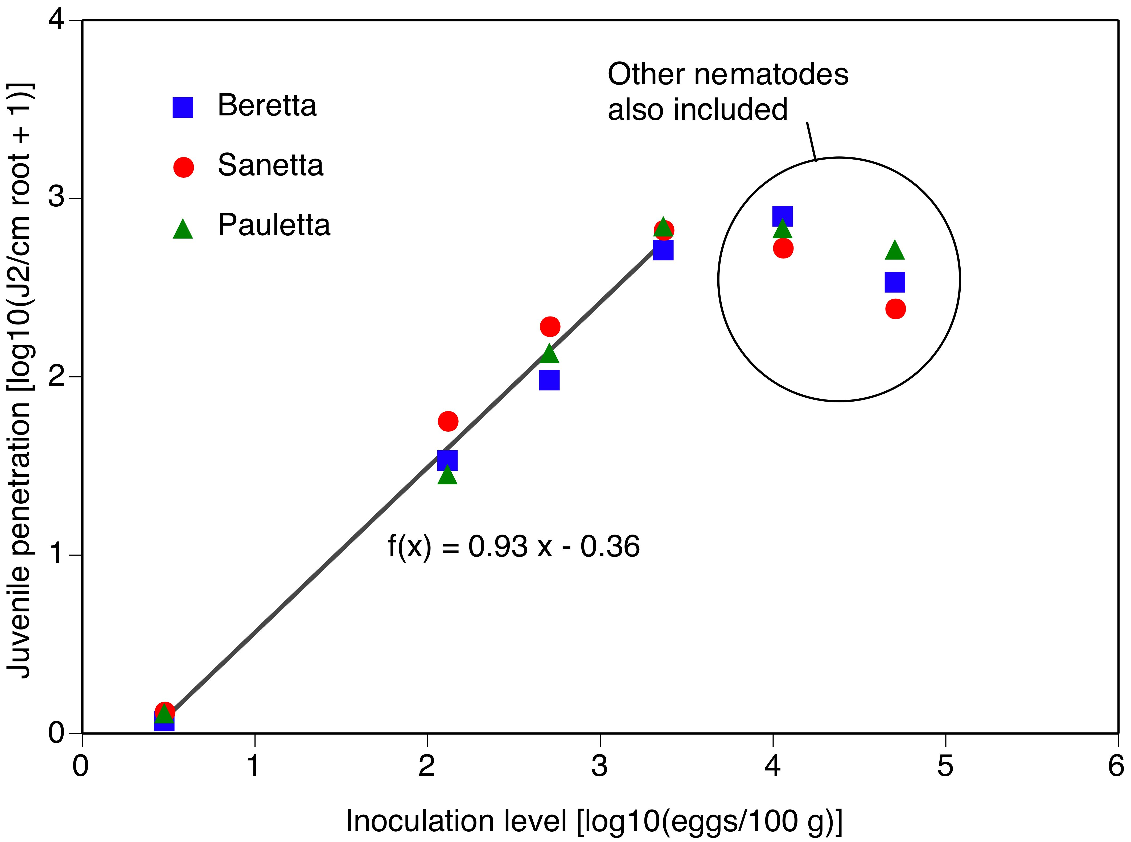
Penetration of roots by Heterodera schachtii in susceptible, resistant or tolerant sugar beet cultivars

Slide 21
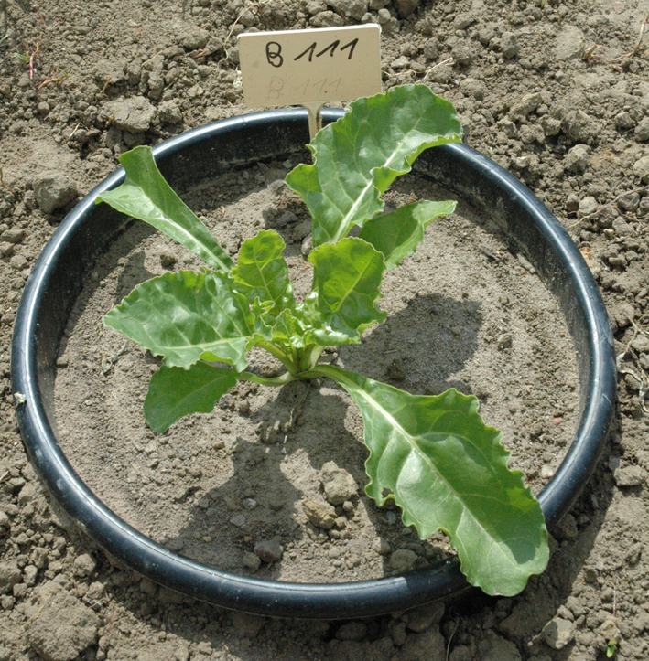
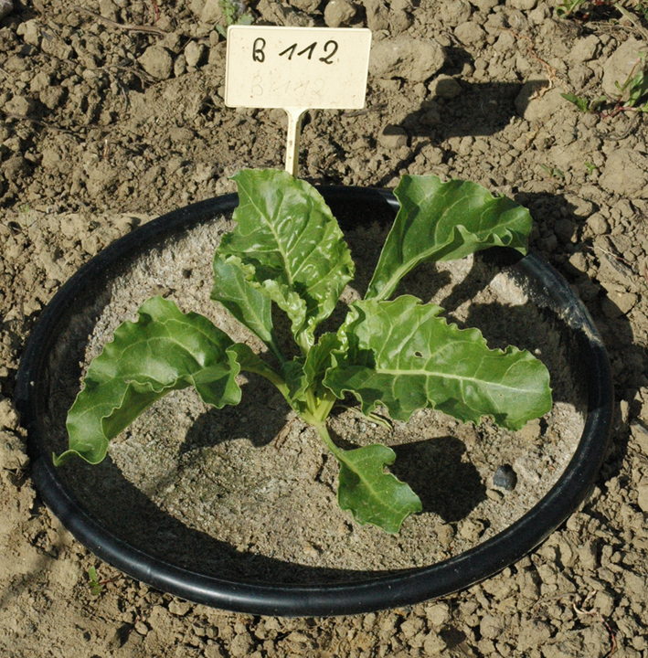
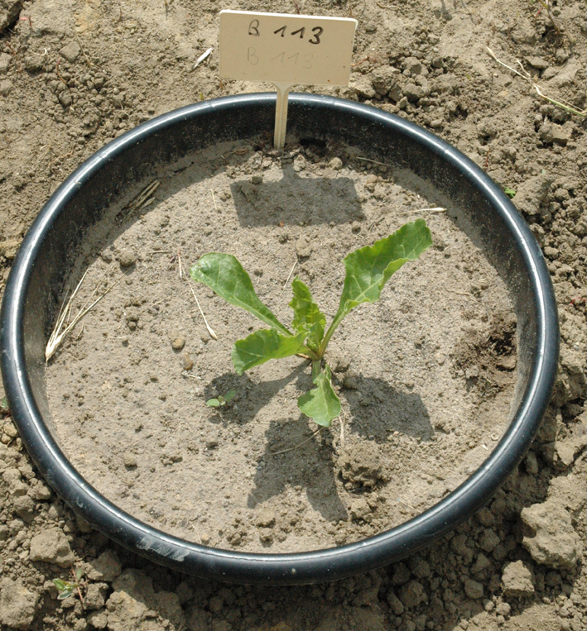
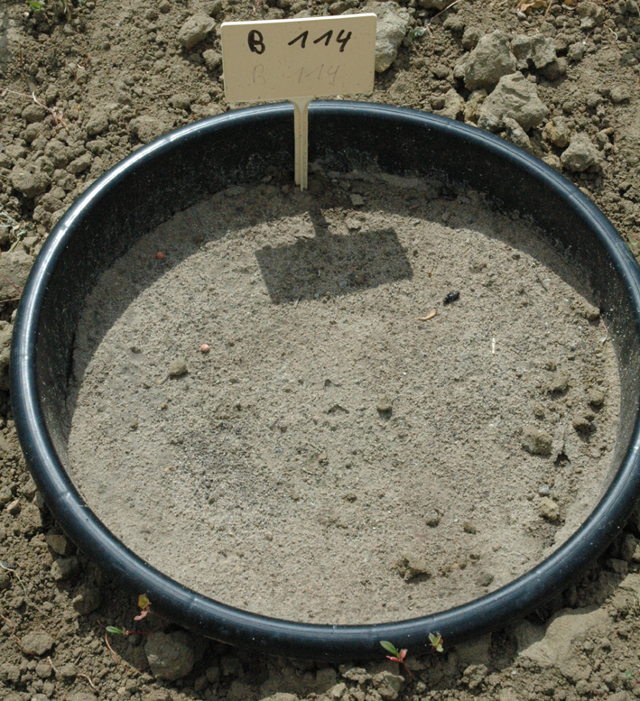
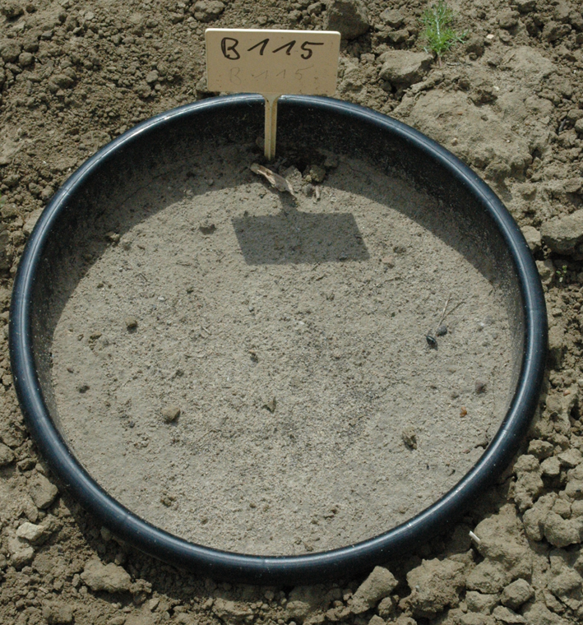
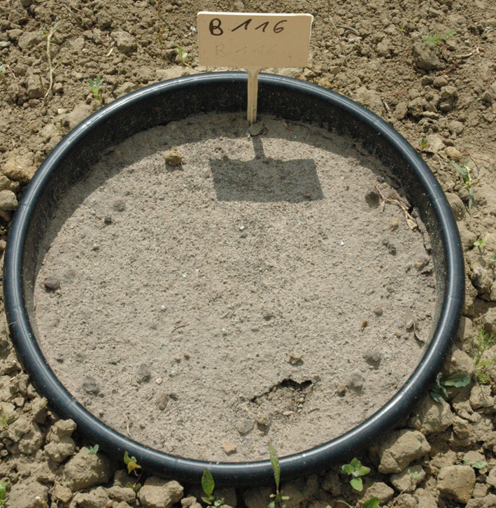
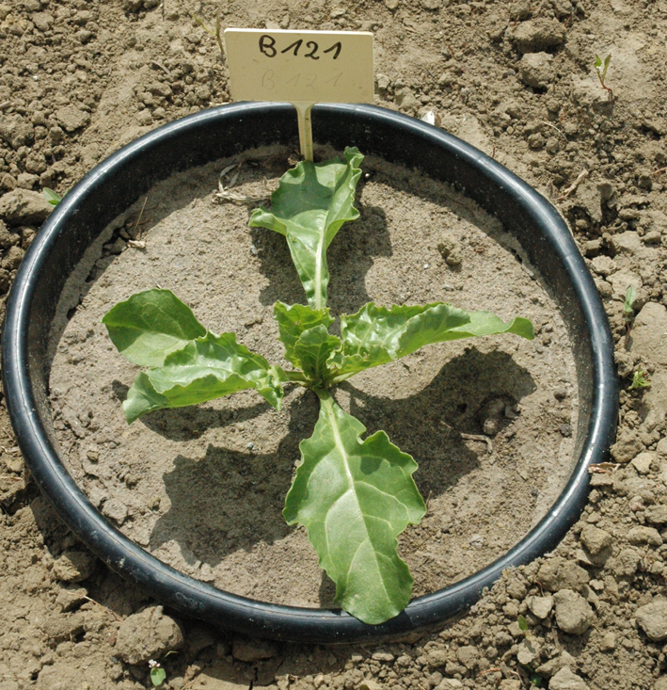
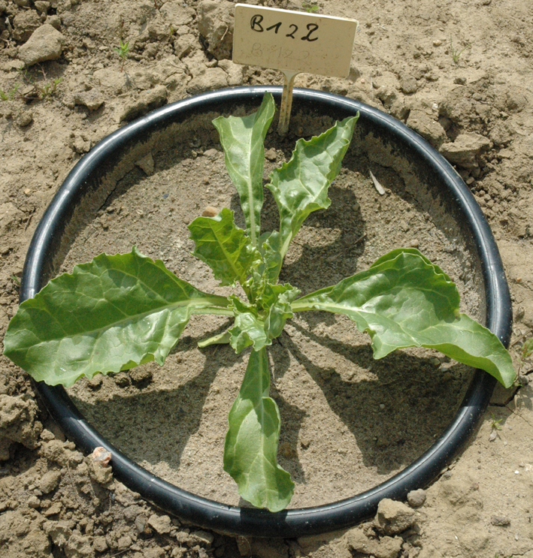
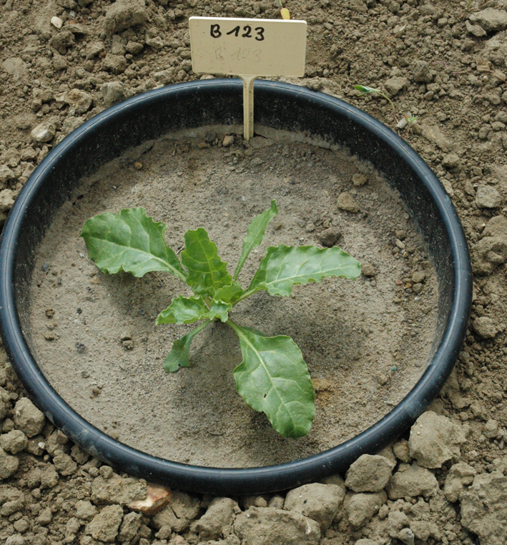
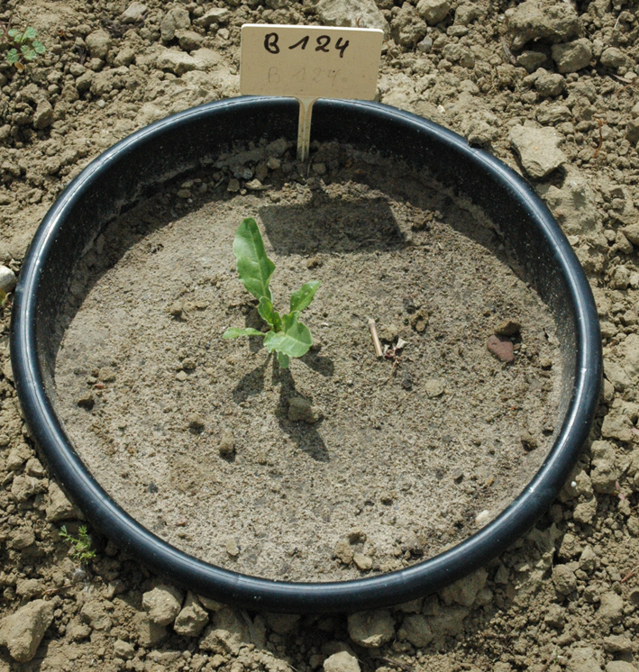
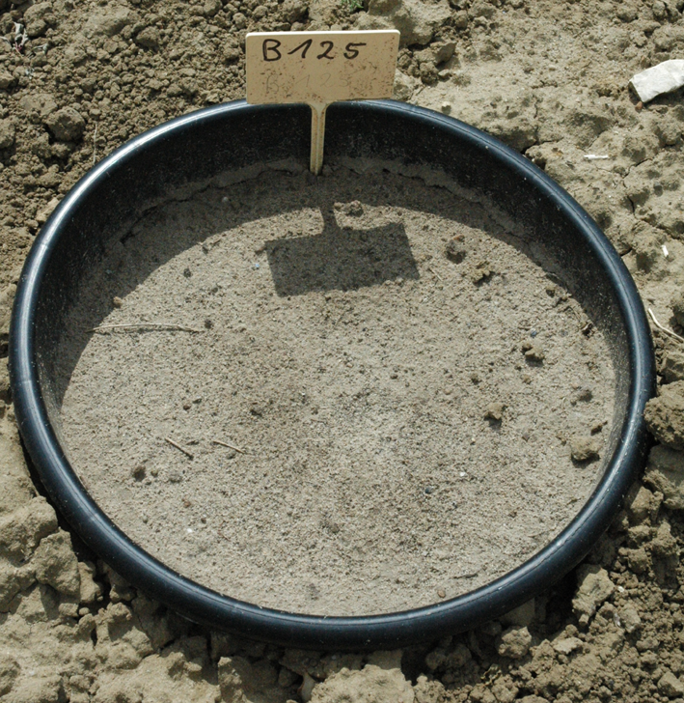
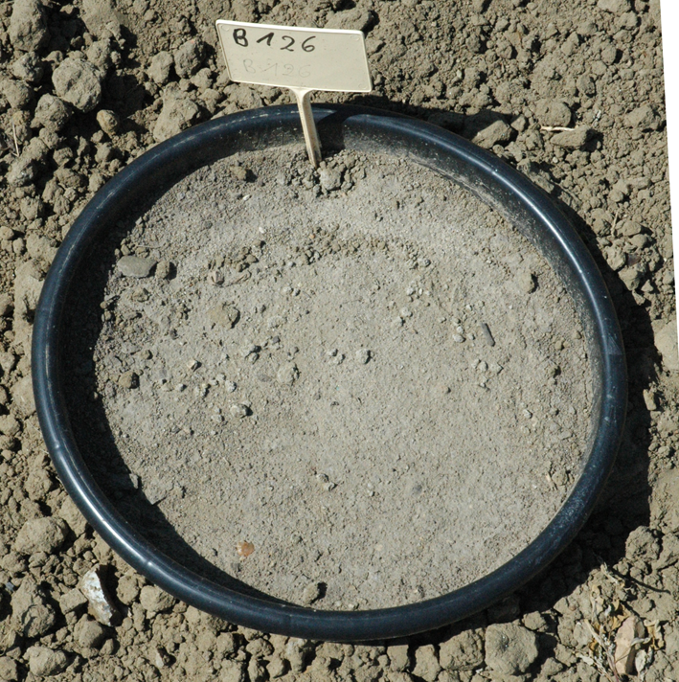
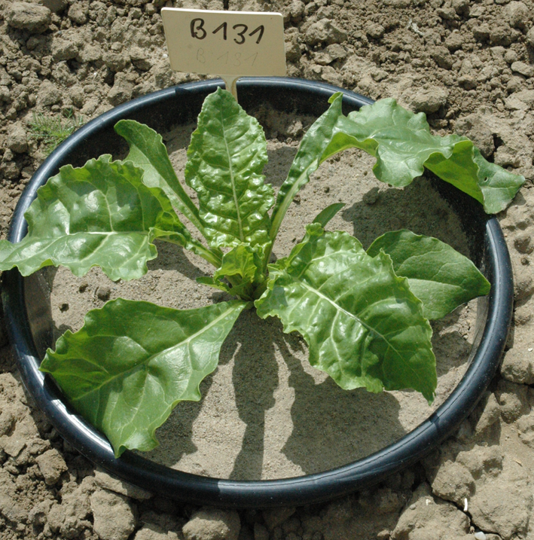





Heterodera schachtii on sugarbeet (eggs/100 g soil)
Control
1.3 × 10²
5.1 × 10²
2.3 × 10³
1.1 × 10⁴
5.1 × 10⁴
Susceptible
Resistant
Tolerant

Slide 22

White sugar yield of a susceptible, resistant and tolerant sugar beet cultivar

Slide 23

Population densities of Heterodera schachtii under a susceptible, resistant or tolerant cultivar in infested soil

Slide 24
Results
Increasing population densities of H. schachtii result in increasing plant damage.
Early root penetration by H. schachtii is similar in the different cultivars.
Population densities approach a “ceiling” in the susceptible and tolerant cultivar.

Slide 25
Chemical nematode suppresison in perennials

Slide 26
Chemical control/suppression
1) Where do we need to treat?
2) What chemicals and at what rates are effective?
3) What impact has soil texture?
4) Field preparation?

Slide 27
Test new chemical management tools
Basic concept:
test delivery capabilities and efficacy
check for possible phytotoxicity
measure yield responses

Slide 28

Chemical control/suppression

Slide 29

Chemical control/suppression

Slide 30
Chemical control/suppression
1) Where do we need to treat?
2) What chemicals and at what rates are effective?
3) What impact has soil texture?
4) Field preparation?

Slide 31
Cultural methods of nematode suppression in perennials

Slide 32
Develop biologically based management strategies
Basic concept:
Improve soil health ⬄ biotic buffering to soil pathogens
Improve organic matter ⬄ water holding capacity!!
Approach
Use cover cropping to improve rooting depth, include nematode antagonistic plants
Use of organic waste products from various sources

Slide 33
Requirements for a effective cover crop
- Nematode resistance!!!
- Fast growth (weed suppression)
Growing when no “nuisance”
Not becoming a weed
“Hardy” withstands water stress, some traffic
Produces copious amounts of biomass

Slide 34


Leguminous cover crops?

Slide 35
Crotalaria juncea
Effects on nematodes
Different species of root-knot nematodes
Some reduction of lesion nematode may be possible – BUT needs exploration!!

Slide 36
Outline and Take-home
How to address risk assessments for plant-parasitic nematodes?
What options are out there?
How are options developed?

Slide 37
Collaborators
Department of Botany and Plant Science, Nematology and Plant Pathology UC Riverside
G. Browne, S. Kaffka, D. Kluepfel, A. Walker, B. Westerdahl, R. Zhang USDA-ARS, UC Davis
Dong Wang, USDA-ARS Parlier
Margaret Ellis, Cal State Fresno
Inga Zasada USDA-ARS Oregon
Julius Kühn-Institut, Germany

Slide 38
Thank you!!
Phone: 1-559 646 6555
Email: andreas.westphal@ucr.edu

Slide 39
Breeding concepts in perennials

Slide 40
Breeding for resistance and tolerance in perennials – Testing protocols
-Create diversity within Walnut genus (SCRI group)
-Prepare seedlings/clones
-Plant offspring in the field
-Inoculate with RL and RKN
-Measure plants and nematodes (three years (!!)
-Make selections & continue testing

Slide 41



Breeding for resistance and tolerance in perennials

Slide 42

Resistance and tolerance in perennials
Plant height
Root-knot nematode
Root lesion nematode

Slide 43



Breeding for resistance and tolerance in perennials

Slide 44
Status of the nematode project
1) Promising material has been identified
2) Further testing before release necessary
3) A long and tedious process from discovery to release

Slide 45
Use of Movento as a post-plant nematicide
(Mike McKenry, UC Riverside)
1) The impact of post- treatment irrigation
2) Yield improvements at three vineyard sites
(Mike McKenry, UC Riverside)

Slide 46
Yield in kg/vine, root-knot nematode on ruby seedless grape in 2009
a
a
b
b
a
b
(Mike McKenry, UC Riverside)

Slide 47
Yield in kg/vine, root-knot nematode on ruby seedless grape in 2010
ef
ef
ef
ef
ef
b-f
abcd
abc
a
bcde
bcde
cdef
ef
abcde
f
(Mike McKenry, UC Riverside)

Slide 48
Population levels of root-knot nematode using normal drip irrigation before and after a May 10 spray of Movento
Differences not significant at P=0.05
(Mike McKenry, UC Riverside)

Slide 49
Population levels of root-knot nematode as impacted by a 9 day wait between spraying and resumption of irrigation
a
a
a
a
b
ab
ab
b
b
ab
b
b
(Mike McKenry, UC Riverside)

Slide 50
2011 Guidelines for getting Nematicidal Value from Movento in a sandy loam soil
Do not irrigate for 9 days after Movento spray
Make single annual treatments, not repeated treatments.
For nematode control with Movento, time treatments for insect control but avoid irrigating the next 9 days.
Do not apply Movento twice in one year until more yield data become available. You only get 5-6 mo of 50% control.
(Mike McKenry, UC Riverside)

