Slide 1

Bioenergy for Heat
The U.S. market, challenges, and opportunities
Joe Seymour, BTEC, June 17, 2014

Slide 2
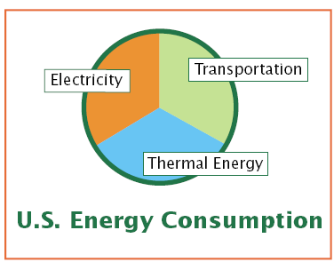
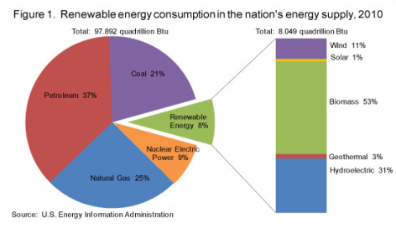
Take Advantage of the (Overlooked) Opportunity
Thermal energy represents the most efficient use of biomass to make energy
Tremendous potential to address major US energy challenges, especially: dependence on foreign fossil energy and rural development
4

Slide 3






About BTEC
The Biomass Thermal Energy Council (BTEC) is the industry trade association dedicated to advancing the use of biomass for heat and other thermal energy applications.
Why was BTEC established?
To advocate for and promote the biomass thermal industry in the national energy policy debate
To reach out to and educate the public and decision makers on the benefits and advantages of using biomass for heat and CHP
To develop biomass energy research and analysis that enables sound investment and policy decisions
3

Slide 4
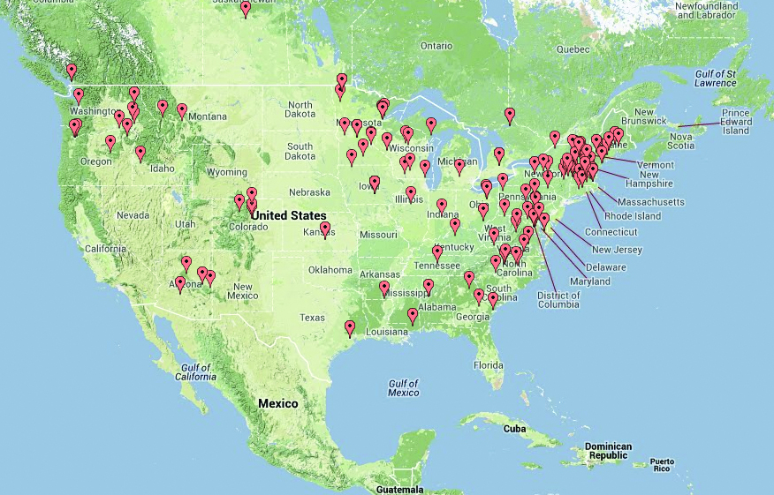

Slide 5
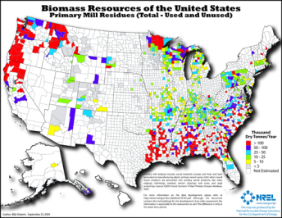
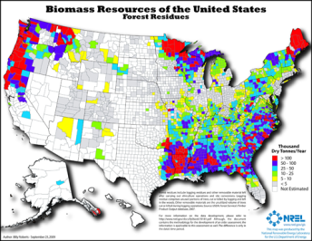
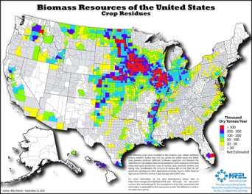
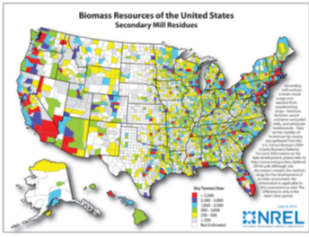
Biomass Feedstocks

Slide 6
Residential Market
Approximately 10 million U.S homes
  2 million homes heat primarily with wood
Estimated 2.8 million homes w/ pellet stoves; central systems gaining traction
Pellet and cordwood appliance shipments up 12% and 15% from 2012, respectively(HPBA ‘14)
Demonstration and bulk storage taking off (OR, VT, NY, ME), significant innovation
Challenges include:
  New emissions limits for new appliances in Feb. ‘15
  High capital costs of central systems and bulk storage
  Volatile sales cycle driven by comparative fuel costs
  Installation expertise

Slide 7
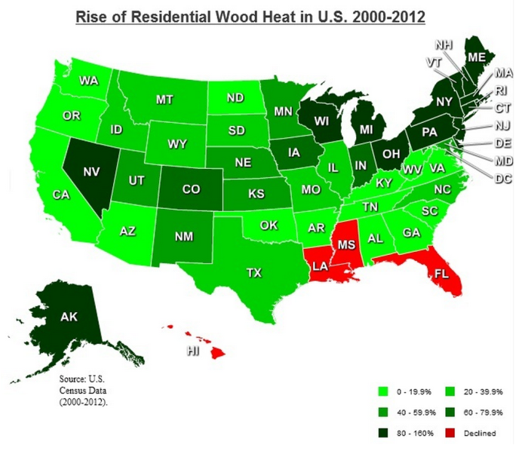
Graph credit: Alliance for Green Heat
Notes:
BTEC's approach to this work, what services you offer, and your interest in engaging and expanding membership in the western U.S.

Slide 8
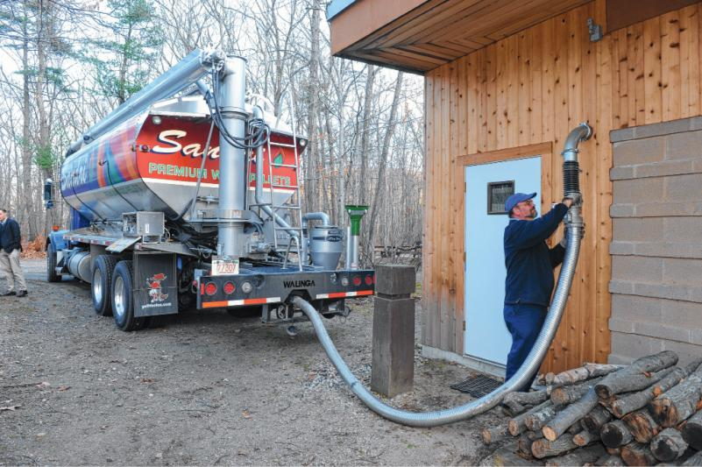
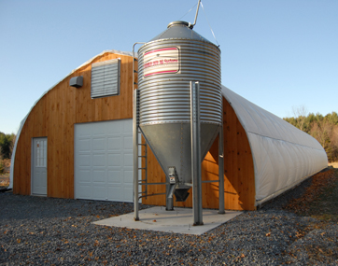
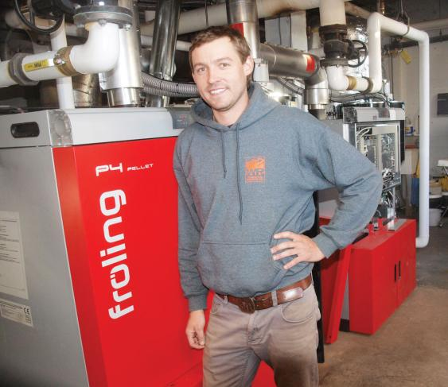

Slide 9
Commercial & Institutional Market
Est. 10,000 industrial and commercial biomass boilers
  Est. 500 biomass CHP/co-gen sites
  Est. 400 institutional (i.e. gov’t, campus) sites
Fuel costs remain primary driver for fuel switching
Challenges include:
  Recently implemented Boiler MACT emissions regulations (tune ups for <10MMBtu)
  High capital costs
  Community support
  Data gathering
  Standards and A/E acceptance

Slide 10
Source:Wood2Energy.org
Notes:
BTEC's approach to this work, what services you offer, and your interest in engaging and expanding membership in the western U.S.

Slide 11
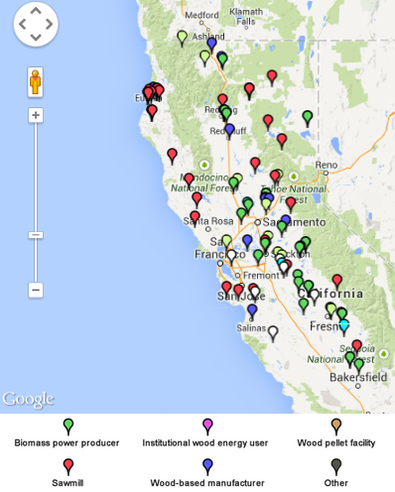
Wood2Energy.Org & Data Collection
Message is only as good as the data
Need industry, private, nonprofit assistance gathering data
Submit data online easily
California’s 103 installations?

Slide 12
Federal Incentives? Yes*
Production Tax Credit*
Residential Energy Tax Credit*
Special USDA Grants (W2E, SWET)
2014 Farm Bill Energy Title Programs

Slide 13
Farm Bill Energy Title
REAP
    Funding just announced with deadlines of July 7th and 31st, new program details in fall 2014
  Producer Payment Program for Advanced Biofuels (Sec. 9005)
    Mandatory funding of $15 million, open now
    However, solid forest biofuels capped at 5%, for now…
  BCAP
    Mandatory funding, revamped BCF payments of $12.5 million for federal lands
  CWEP
    Seeking appropriated funds of $5 million, reimagining program

Slide 14
Proposed Policy Parity
The BTU Act, a.k.a. the “Grand Slam”
  30% tax credit for res/comm/ind biomass thermal systems
  Pending in House, Senate. Potential tax extenders play?
  Eight co-sponsors in each chamber
Renewable Thermal Parity
  Renewable electrons = renewable Btus = renewable kW
  Federal building compliance
EPA’s Biogenic Emissions Rulemaking
  A potential disincentive to biomass utilization
  Impact bioenergy in EPA’s Clean Power Plan

Slide 15
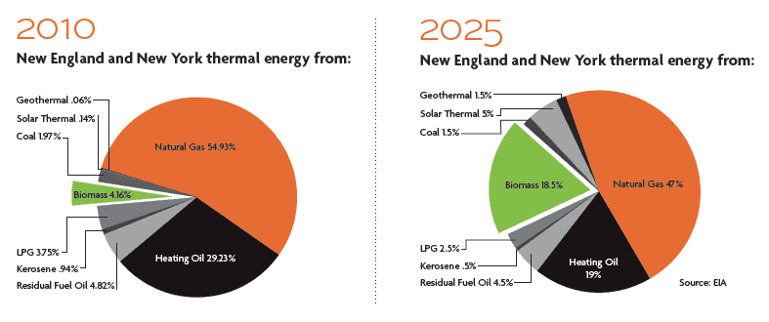
A Bold Northeast Vision for 2025
Supply 19 million green tons of sustainable biomass for thermal energy
Convert 1.38 million households in the seven states to biomass for thermal needs
Reduce 1.14 billion gallons of heating oil annually
Reinvest $4.5 billion in resulting economic wealth in the Northeast economy, and create 140,200 jobs
The market: 9 million homes and businesses off natural gas

Slide 16
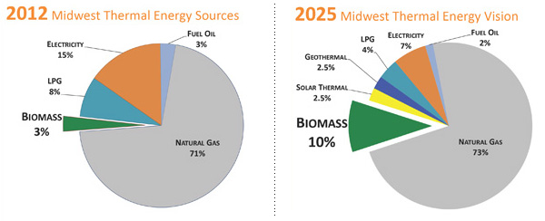
A Bold Midwestern Vision for 2025
Reduce 1.01 billion gallons of propane and 278 million gallons of heating oil
Reinvest $2.2 billion into the Midwest economy
Create 13,170 jobs from the expansion of the thermal biomass industry and up to 210,000 direct, indirect and induced jobs
Supply 17.2 million green tons of sustainable biomass
The market: 12 million homes and businesses are not connected to low-cost natural gas

Slide 17
What’s Your Vision to Heat the West?
Reduce xx billion gallons of propane and xx million gallons of heating oil
Reinvest $xx billion into the Western economy
Create xx,xxx jobs from the expansion of timber, recreation, and thermal energy industry
Supply xx million green tons of sustainable biomass, treating xxx thousand acres
How big is your market? And how will you grow it?

Slide 18
What a Difference a Vision Makes
Vermont – Inclusion in Efficiency Vermont
New York – Launch of “Renewable Heat NY,” thermal PONs
Maine - $5K pellet boiler rebate
New Hampshire –Thermal REC in RPS
Massachusetts – Change out/rebate programs and thermal REC*
Maryland – Commercial scale open, thermal REC study
Wisconsin – Fuel switching grants
Minnesota – SWET leveraging and thermal REC progress
Oregon – SWET Pilot, cluster developments & financing
Washington – Forest Products Financial Asst. Program
California – SWET, SB 1122 bioenergy carve-out
Idaho – SWET
Alaska - SWET

Slide 19
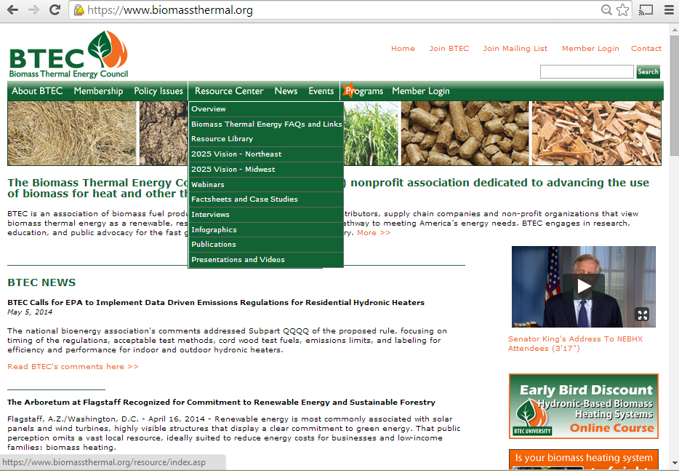

Slide 20
Upcoming Thermal Events
Biomass and the USDA’s REAP Program – What you need to know for 2014 and 2015
  Webinar
  June 24, 2014
Healthier Forests Through Sustainable Energy – A Project Debrief
  Webinar
  June 25, 2014
Hydronic-Based Biomass Heating Systems
  Online educational course
  Sept. 15 – Nov. 21, 2014
  Led by John Siegenthaler, Appropriate Designs
  Second Annual National Bioenergy Day
  October 22, 2014
  Events nationwide for power, heat, pellets

Slide 21

We Are Helping Grow the Biomass Heating and CHP Market
Who BTEC Is
Non-profit advocacy group with 130 members from U.S., Canada, Europe
All sectors represented, from landowners to end users
Why You Should Join
Promote the use of biomass thermal fuels and technology to all industries
Achieve policy parity at the national and state levels
Share best practices and drive innovation and research
Recognition of our company’s leadership and achievements
Join Us!
Membership levels tailored to a company’s size. Ask me about how to join, email info@biomassthermal.org, or visit www.biomassthermal.org

