Slide 1
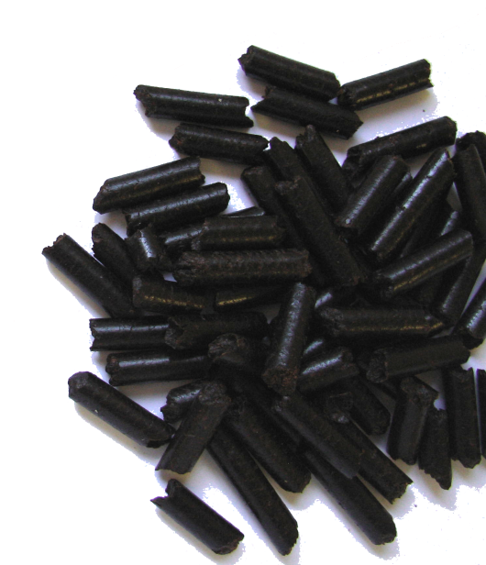
CNFbiofuel™
CNFbiofuel, Inc.
5038 Salida Blvd.
Salida CA 95368, USA
Phone: (209) 545-1663
Fax: (209) 545-3533
info@CNFbiofuel.com
www.CNFbiofuel.com

Slide 2
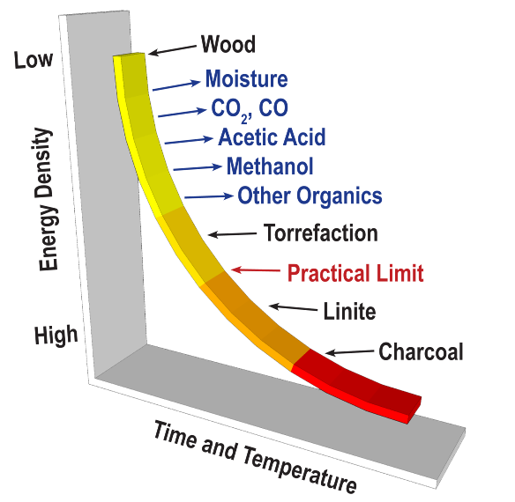
Effects Of Heating
Removes moisture
Removes VOCs
Improves Combustion
Burns Cleaner

Slide 3
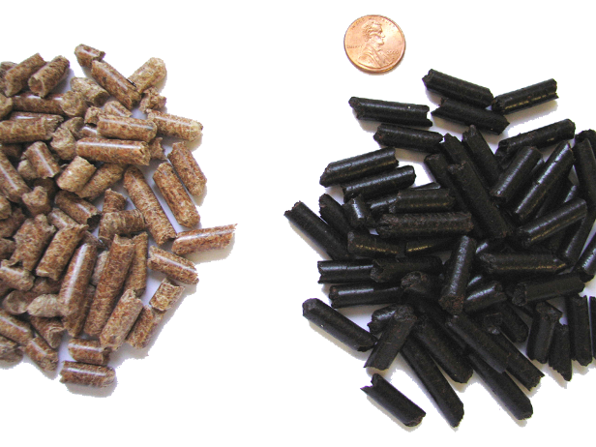
The Solution: Torrefied Wood
Hydrophobic
Friable
Uniform
Used for
  Solid Fuel
  Co-fire
  Gasification
  Fuel Cells

Slide 4
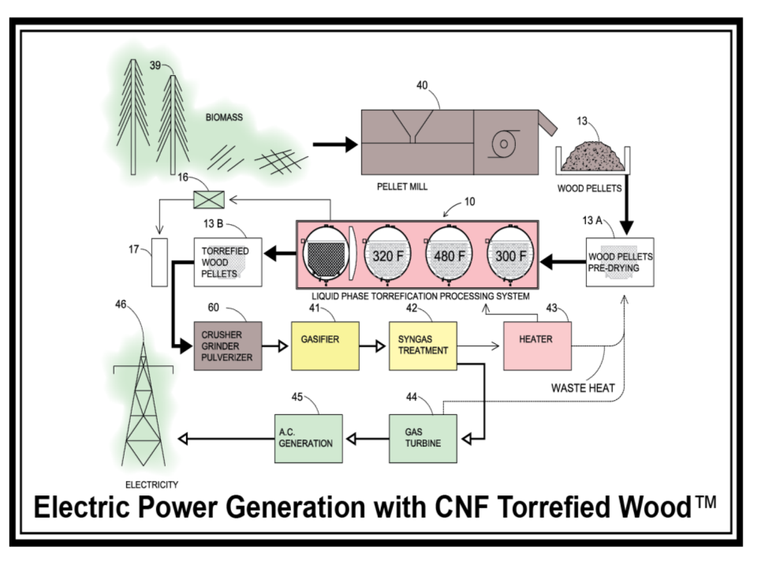

Slide 5
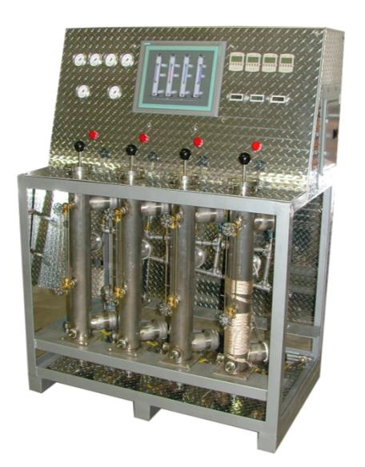
Test Stand

Slide 6
Business Plan
Large Market
Large Demand
Unique System

Slide 7
CNFbiofuel™
CNFbiofuel, Inc.
5038 Salida Blvd.
Salida CA 95368, USA
Phone: (209) 545-1663
Fax: (209) 545-3533
info@CNFbiofuel.com
www.CNFbiofuel.com

