Slide 1

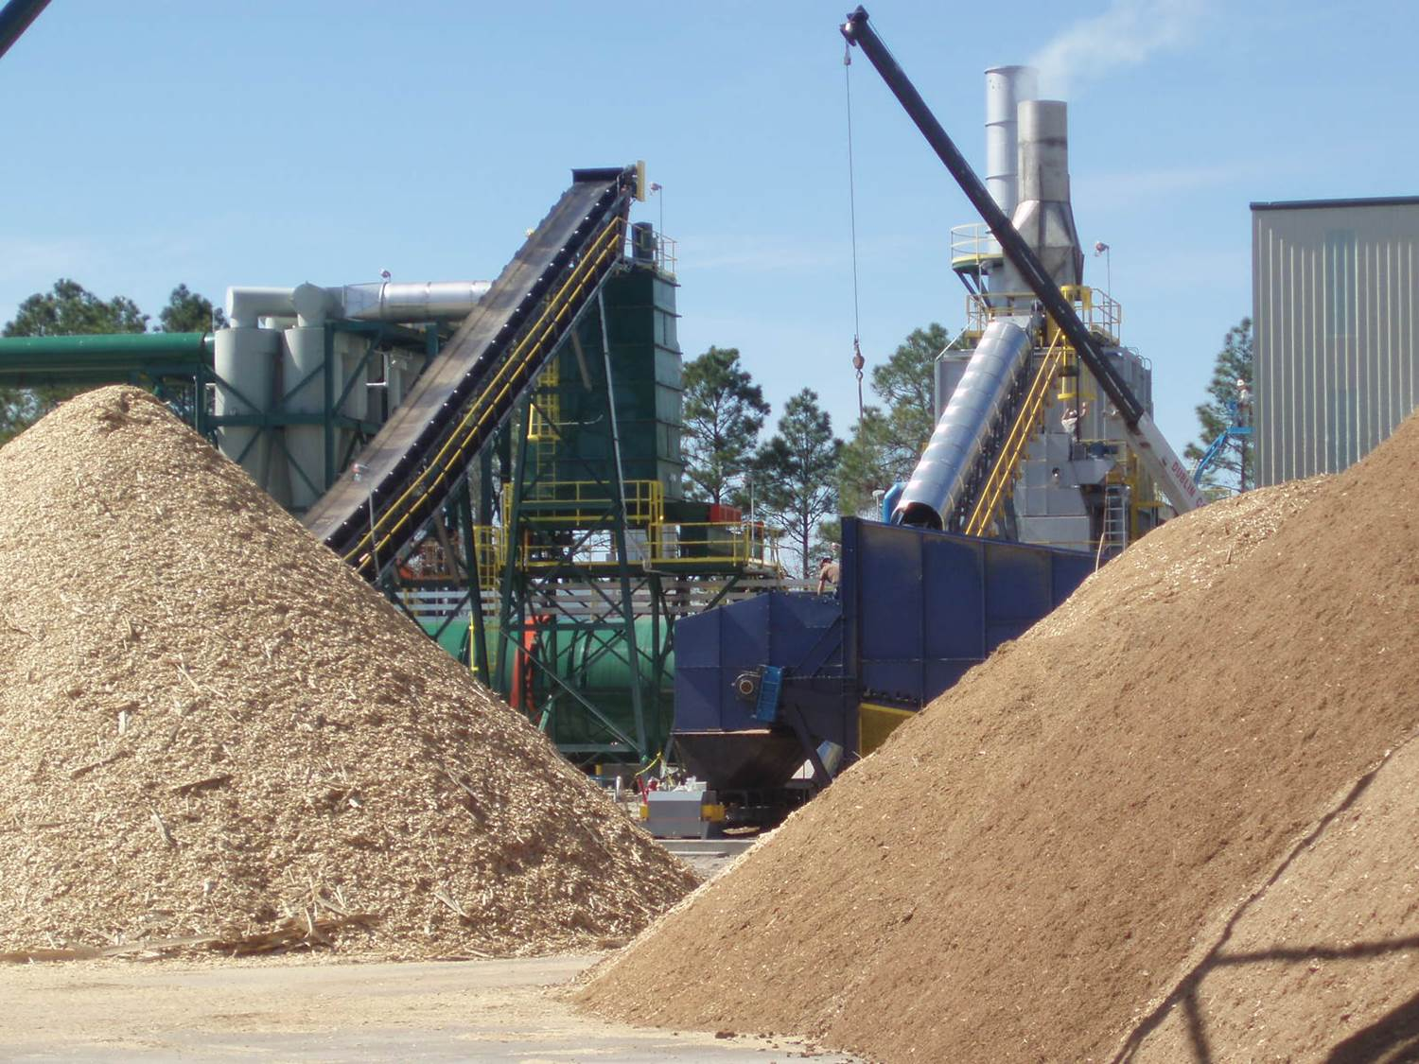

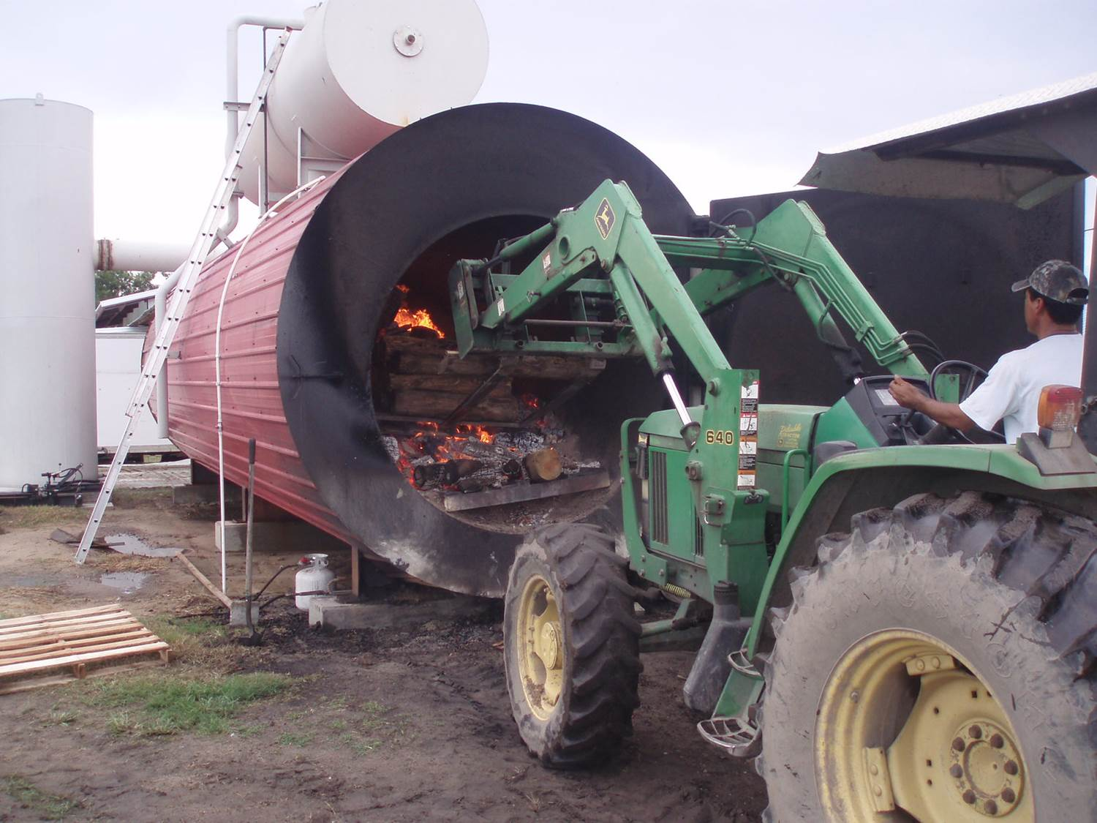
USDA’s Bioenergy Initiative
Case Studies:
Biomass Facility Funding
Biomass Working Group
January 21, 2014

Slide 2
The Federal Government
Family of Departments
Agriculture • Defense • Energy • Interior • Treasury
The Federal Government delivers financial assistance for the development of Biomass facilities through multiple Departments which include but are not limited to:
Department of Agriculture
Department of Defense
Department of Energy
Department of Interior
Department of Treasury

Slide 3
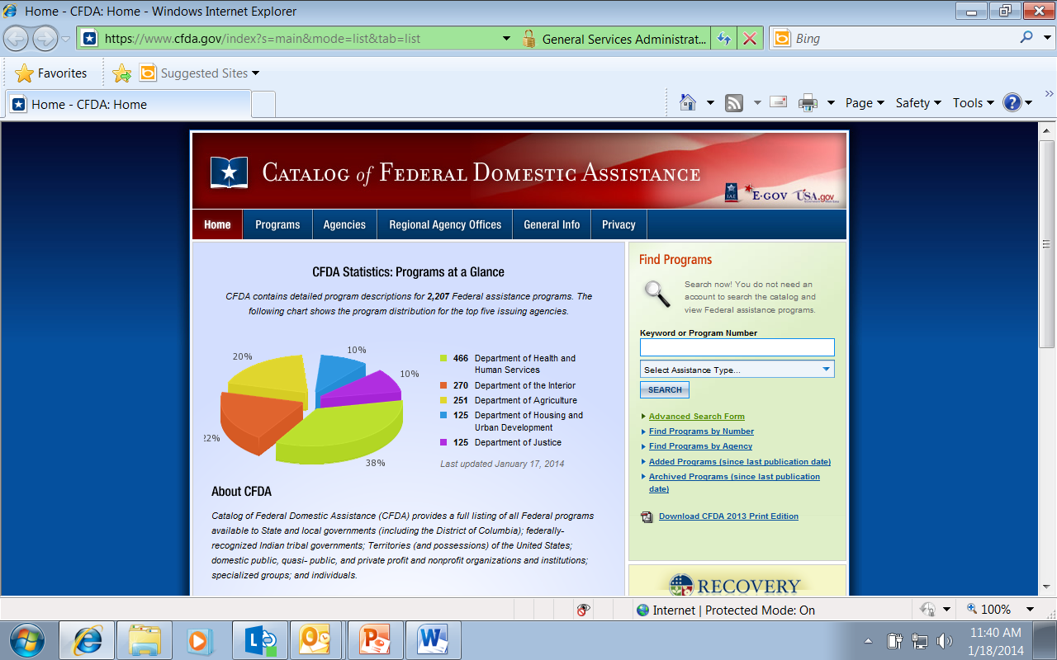
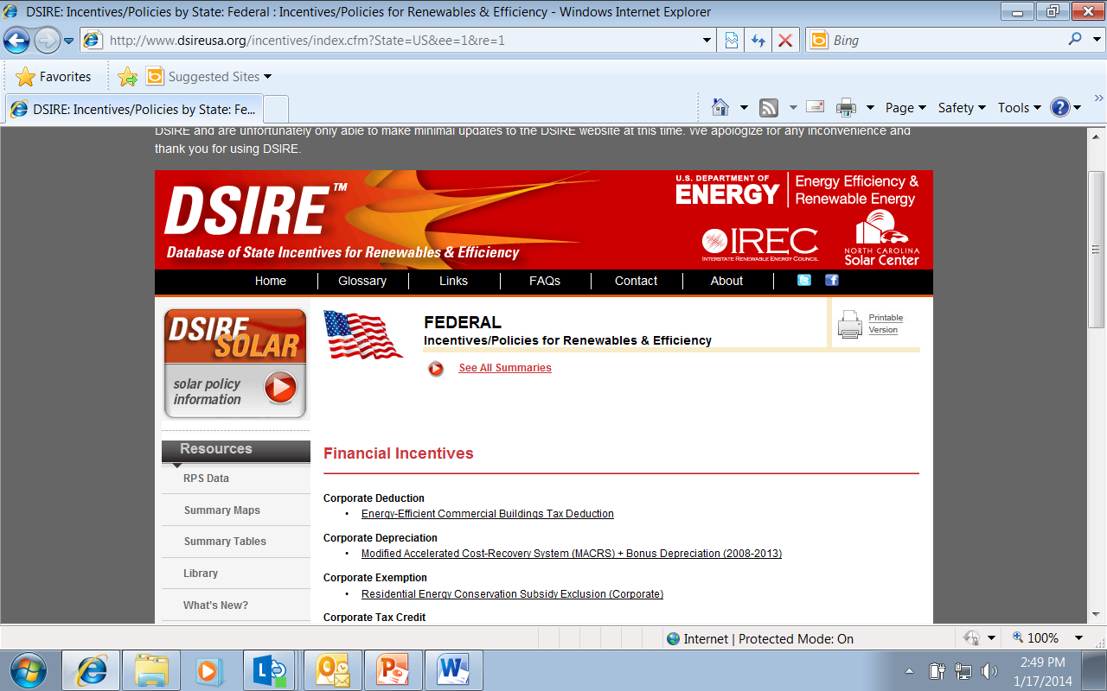
Federal Funding Mechanisms for Biomass Facilities
Federal Financial Assistance Comes In Many Forms
The Federal Government’s Bioenergy initiative delivers financial assistance for the development of Biomass facilities using several funding mechanisms:
Loans
Loan Guarantees
Grants
Payments
Tax Credits

Slide 4
The USDA Family of Agencies
USDA = FS • NRCS • FSA • RBCS
USDA delivers financial assistance for the development of Biomass facilities through multiple Agencies which include but are not limited to:
Forest Service (FS)
Natural Resources Conservation Service (NRCS)
Farm Service Agency (FSA)
Rural Business-Cooperative Service (RBCS)

Slide 5
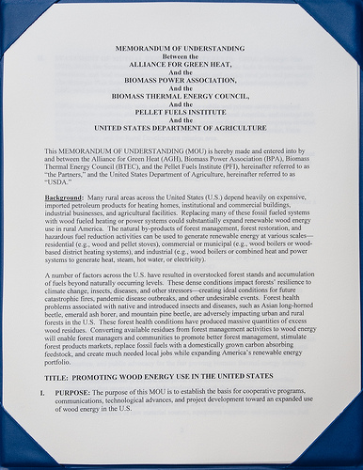
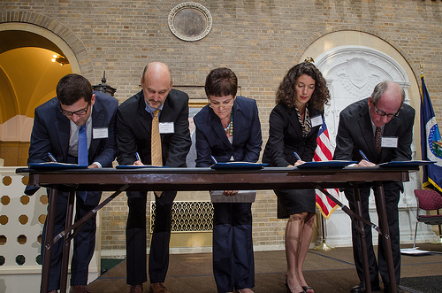
USDA’s Bioenergy MOU
September 11, 2013
USDA Public-Private Partnerships Create Opportunities
USDA supports the development of appropriately scaled Biomass facilities nationwide as a means to address forest fire risk, bolster rural economic development, improve air quality, and meet renewable and energy efficiency goals through partnership agreements like the September 11, 2013 Memorandum of Understanding between USDA and:
Alliance for Green Heat
Biomass Power Association
Biomass Thermal Energy Council
Pellet Fuels Institute

Slide 6
Successful USDA Biomass Partnerships around the Country
USDA Public-Private Partnerships Create Opportunities
• The Eagle Valley project by Evergreen Clean Energy went online in December 2013 in Gypsum, Colorado. It will use woody biomass from 2,500 acres of land ravaged by beetle kill and posing high wildfire risks, to power nearly 8,000 local homes and businesses. A USDA $8.7 million, 10-year Forest Service Stewardship Contract and a $40 million Rural Utilities Service loan guarantee made this possible. [Case Study 5]
• A USDA collaboration in New York with ReEnergy Holdings in the North Country region of New York is helping fund an innovative public/private partnership to invest in energy crops grown on marginal farmland and used as fuel to produce electricity.

Slide 7
Successful USDA Biomass Partnerships around the Country
USDA Public-Private Partnerships Create Opportunities
• The White Mountain Stewardship Project is a partnership between Novo Power LLC in Snowflake, Arizona, and the U.S. Forest Service, created largely as a result of the Rodeo-Chediski fire of 2002. The 10-year contract was established to thin approximately 150,000 acres in the Apache-Sitgreaves National Forest. This program provides approximately 155,000 bone-dry tons of ponderosa pine chips annually to the region, enough to power approximately 20,000 homes and businesses.
• Stoltze Land and Lumber in Columbia Falls, Montana, generates heat for mill operations and sells 2.5 MW of power to Flathead Electric Cooperative. A USDA partnership helped Stoltze replace a 30-year-old wood boiler.

Slide 8
Successful USDA Biomass Partnerships around the Country
USDA Public-Private Partnerships Create Opportunities
• Oregon Biomass One, a 30-MW wood-fired biomass power plant, is located in the Rogue River Valley in southern Oregon that includes federally managed lands such as Siskiyou National Forest, the Umpqua National Forest, the Klamath National Forest and the Medford District of the Bureau of Land Management. This year, an estimated 25 percent of Biomass One’s fuel consumption will consist of material processed and recovered as a byproduct from forest operations. U.S. Forest Service and Bureau of Land Management stewardship projects combined yield around 30,000 tons of woody biomass in the region each year.

Slide 9
USDA Renewable Energy
Special Projects
USDA Renewable Energy Special Projects
USDA Regional Biomass Research Centers
USDA is developing sustainable supply chain strategies and science-based implementation plans designed to accelerate biofuels feedstock production and reduce transaction costs to feedstock producers and biorefineries. Regionalized biofuels feedstock production and conversion systems can minimize transaction costs and create new rural wealth. USDA is coordinating with Department of Energy to enhance work underway through DOE's Regional Feedstock Partnerships and the Bioenergy Research Centers.
Wood-to-Energy Initiative
USDA's interagency team was established to build opportunities for utilizing wood from hazardous-fuels treatment and small-diameter thinning as feedstock for biofuel and bioenergy. The team's aim is to make better and expand the use of this material helping forest health treatments become economically viable, helping to reduce our dependency on foreign oil, creating green jobs, restoring healthy forests and range-lands, reducing fire risks to the land and communities, and improving water quality.

Slide 10
USDA Funding Mechanisms for Biomass Facilities
(Loans)
USDA Provides Loans
USDA’s Bioenergy initiative provides financial assistance for the development of Biomass facilities through the Rural Utility Service to electric utilities to serve customers in rural areas in the form of direct Loans and Loan Guarantees:
Energy Efficiency & Conservation Loan Program [EE&CLP] [Case Study 5]
Renewable Energy Project Financing Program [REPFP]*
  *[Refer to Proposed Rule in Federal Register June 05, 2013]

Slide 11
USDA Funding Mechanisms for Biomass Facilities
(Loan Guarantees)
USDA Provides Loan Guarantees
USDA’s Bioenergy initiative provides financial assistance for the development of Biomass facilities through the Rural Business-Cooperative Service mission areas of Rural Development and the Rural Utility Service in the form of Loan Guarantees:
Business & Industry Loan Guarantee (B&I) [$10 million]
Rural Energy for America Program (REAP) [$25 million]
Biorefinery Assistance Loan Guarantee [$250 million]
Energy Efficiency & Conservation Loan Program [$ unlimited]

Slide 12
USDA Funding Mechanisms for Biomass Facilities
(Grants)
USDA Provides Grants
USDA’s Bioenergy initiative provides financial assistance for the development of Biomass facilities through the Forest Service and the Rural Business-Cooperative Service mission area of Rural Development in the form of grants:
Woody Biomass Utilization Grant [FS]
  Sierra Institute • Calaveras Healthy Impact Product Solutions
Statewide Wood Energy Team Grant [FS]
  The Watershed Research & Training Center
Rural Energy for America Program (REAP) Grant [RBCS]
  Rough and Ready Lumber (Cave Junction, OR)

Slide 13
DOE Funding Mechanisms for Biomass Facilities
(Grants)
DOE’s Office of Indian Energy Provides Grants As Well
DOE’s Strategic Technical Assistance Response Team (START) Program for renewable energy project development and installation provides technical assistance grants to Native American Tribes:
Ho-Chunk Nation (Black River Falls, Wisconsin)
  The Ho-Chunk Nation will receive technical assistance with the development of a one to two megawatt biomass waste-to-energy plant. The plant could potentially use municipal solid waste, agriculture waste or other biomass resources to offset tribal facility energy costs. The Tribe has already approved a land use agreement, completed zoning, and commissioned a feasibility study for the project. The Energy Department will provide assistance with project-related tasks such as analyzing the project plan, reviewing the technology and potential off-take agreements, examining preliminary permitting plans and evaluating financing options.

Slide 14
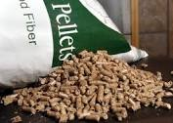
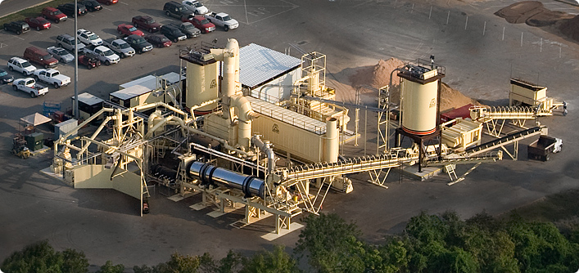
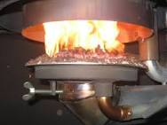
USDA Funding Mechanisms for Biomass Facilities
(Payments)
USDA Provides Payments
USDA’s Bioenergy initiative provides financial assistance for the development of Biomass facilities through the Rural Business-Cooperative Service mission area of Rural Development in the form of payments:
Advanced Biofuel Payment Program
  Mallard Creek, Inc. (Rockland, CA)
  Pacific Pellet, LLC (Salem, OR)
  Ochoco Lumber Company (Prineville, OR)
  Bear Mountain Forest Products, Inc. (Portland, OR)

Slide 15
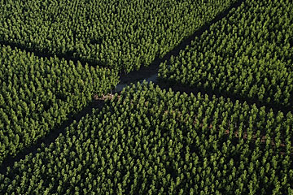
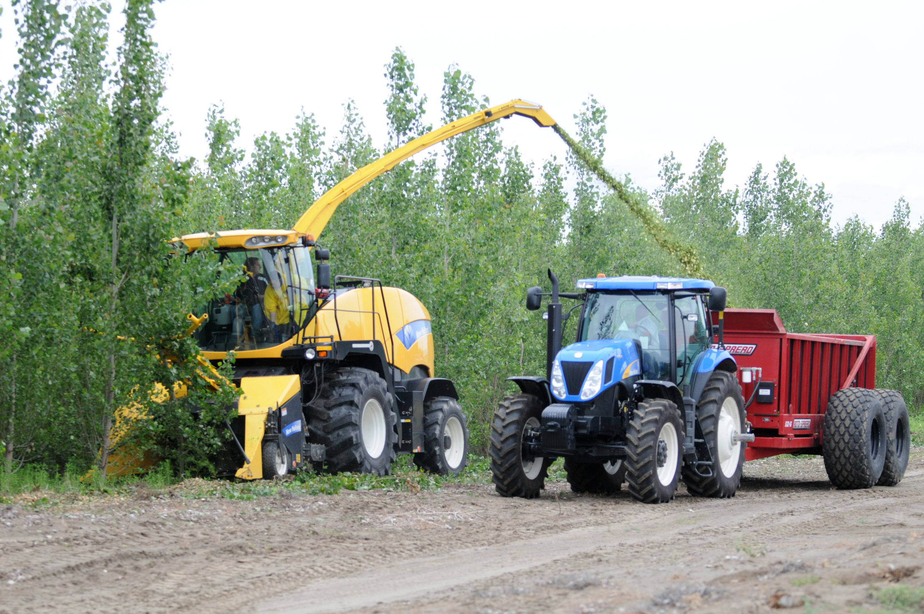
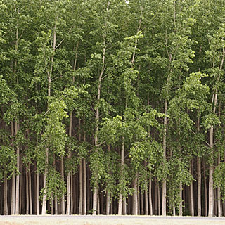
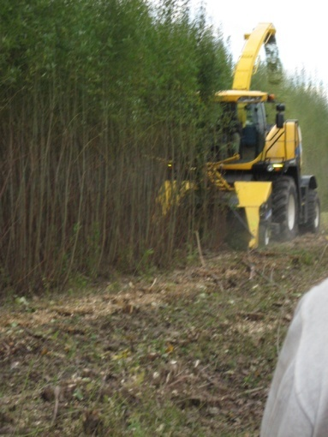
USDA Funding Mechanisms for Biomass Woody Crops
(Payments)
USDA Provides Payments
USDA’s Bioenergy initiative provides financial assistance for the development of Biomass woody crops through the Farm Service Agency (FSA) mission area under the Biomass Crop Assistance Program (BCAP) in the form of payments.
7,000 acres in Oregon will be used for the growth of hybrid poplar trees. This project is part of a series of measures that comprise USDA’s Wood-to-Energy initiative and seeks to build a forest restoration economy by integrating energy feedstock within the larger forest products sector to sustain rural jobs. USDA has allocated funds for contracts that range up to 15 years for producers who volunteer to enroll. Producers who enter into BCAP contracts are eligible for reimbursements of up to 75 percent of the establishment costs of the perennial energy crop and up to five years of annual maintenance payments for herbaceous crops. Reimbursement for woody crops is up to 15 years.

Slide 16
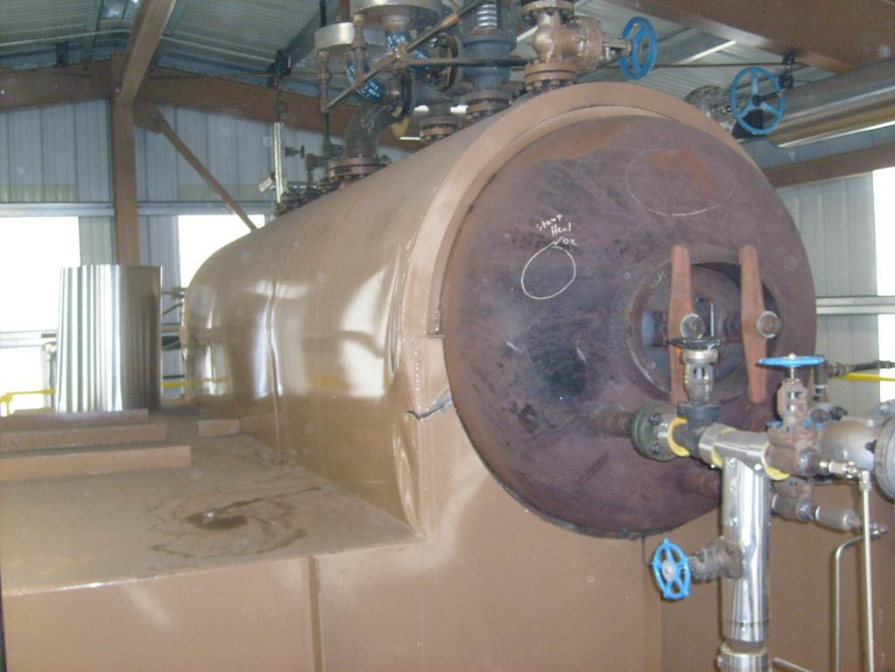
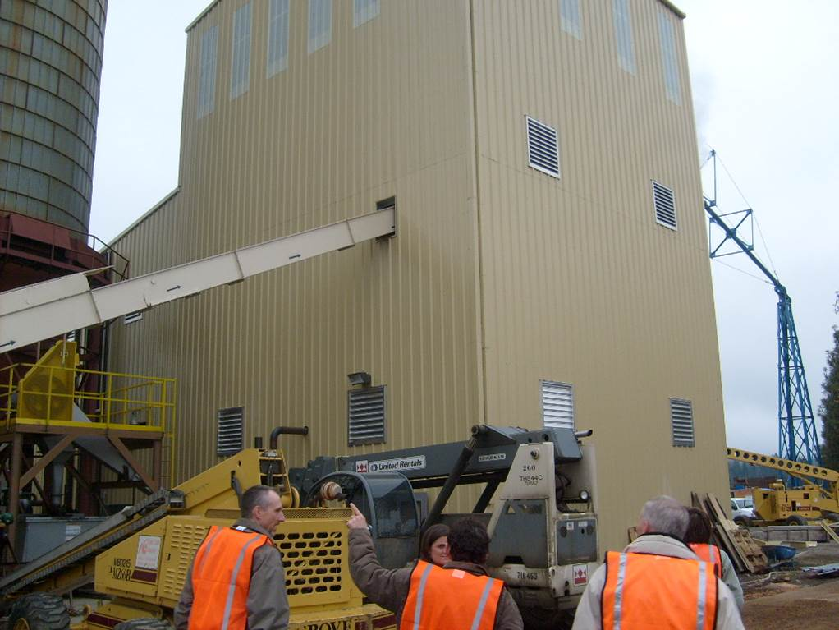
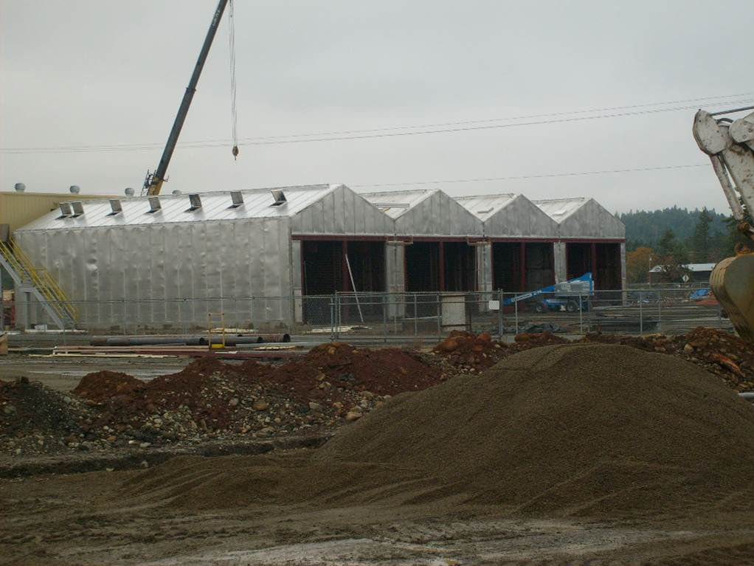
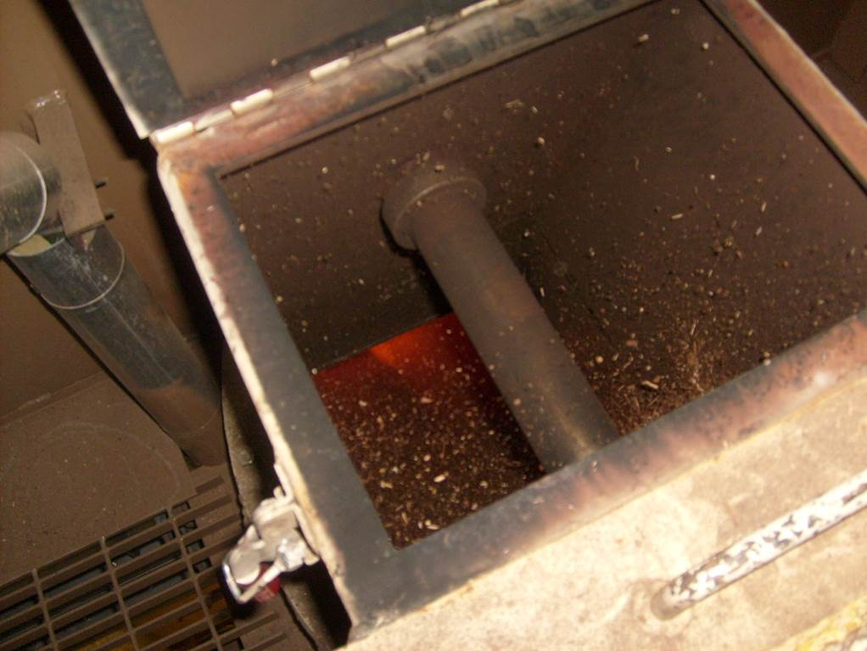
Case Study 1
Loan Guarantee + Grant + Tax Credit
Biomass Facility Funding Case Study 1:
Rough and Ready Lumber (Cave Junction, OR)
Facility: 1.5MW Biomass Project
Location: Cave Junction, OR
Borrower: Rough and Ready Lumber
Lender: Northwest Farm Credit Services
Total Project Costs: $5,743,550
  Finance Structure:
    $2,350,000 Rural Energy for America Program Loan Guarantee
    $ 500,000 Rural Energy for America Program Grant
    $1,350,000 Business Energy Tax Credit (State of Oregon)
    $1,543,550 Borrower Contribution (26.8%)
    $5,743,550 Total Project Costs

Slide 17
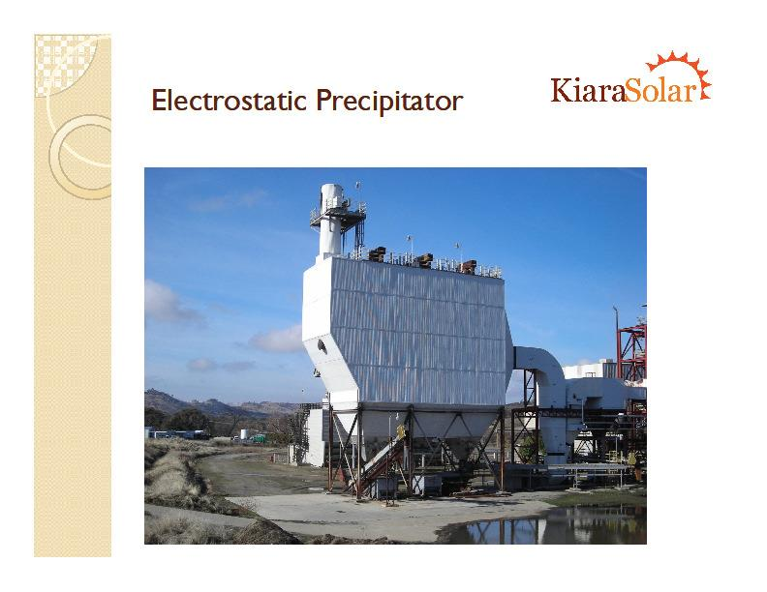
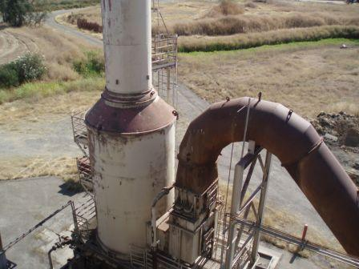
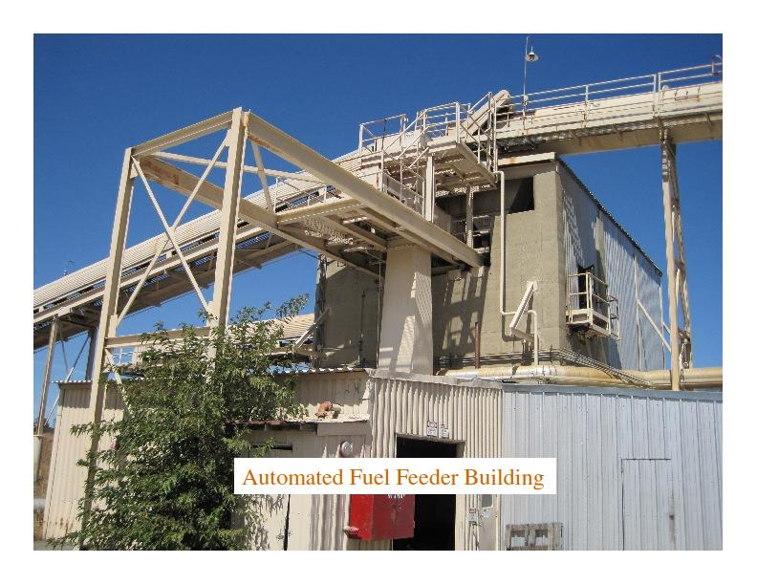
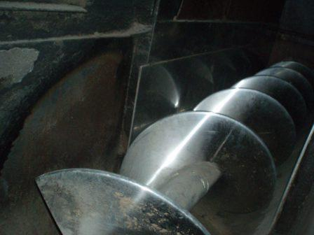
Case Study 2
Loan Guarantee + Grant + Grant
Biomass Facility Funding Case Study 2:
Anderson Plant, LLC (Anderson, CA)
Facility: 6MW Biomass Project (CHP)
Location: Anderson, CA
Borrower: Anderson Plant, LLC
Lender: New Resource Bank
Total Project Costs: $13,500,000
  Finance Structure:
    $ 6,000,000 Business & Industry Loan Guarantee
    $ 3,500,000 1603 Treasury Grant
    $ 250,000 Woody Biomass Utilization Grant
    $ 3,750,000 Borrower Contribution (27.7%)
    $13,500,000 Total Project Costs

Slide 18
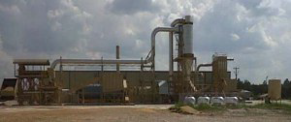
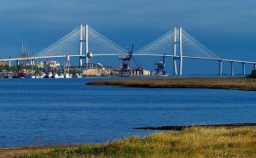

Case Study 3
Loan Guarantee + Loan Guarantee
Biomass Facility Funding Case Study 3:
SEGA Biofuels, LLC (Nahunta, GA)
Facility: Pellets Biomass Project
Location: Nahunta, GA
Borrower: SEGA Biofuels, LLC
Lender: The Heritage Bank
Total Project Costs: $14,273,000
  Finance Structure:
    $ 8,370,610 Rural Energy for America Program Loan Guarantee
    $ 1,304,390 Business & Industry Loan Guarantee
    $ 4,598, 000 Borrower Contribution (32.2%)
    $14,273,000 Total Project Costs

Slide 19
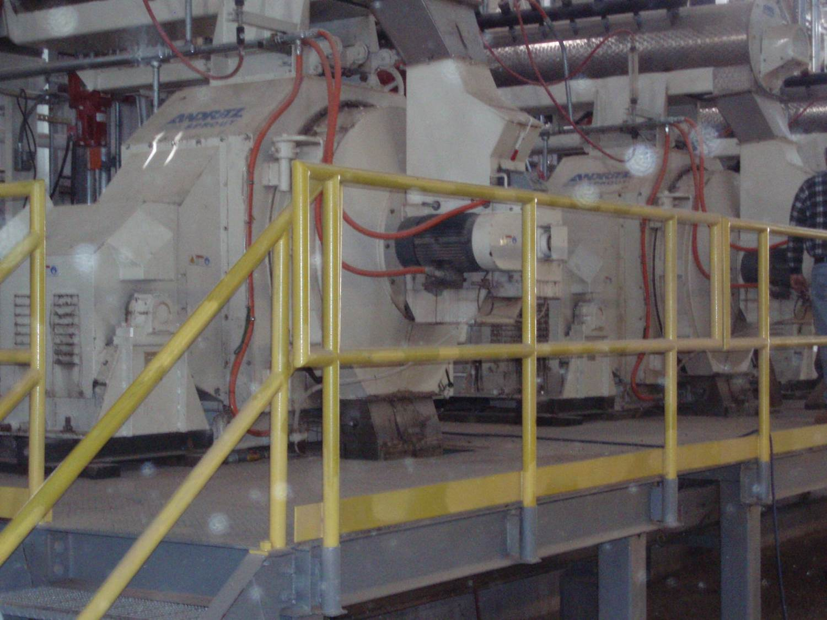
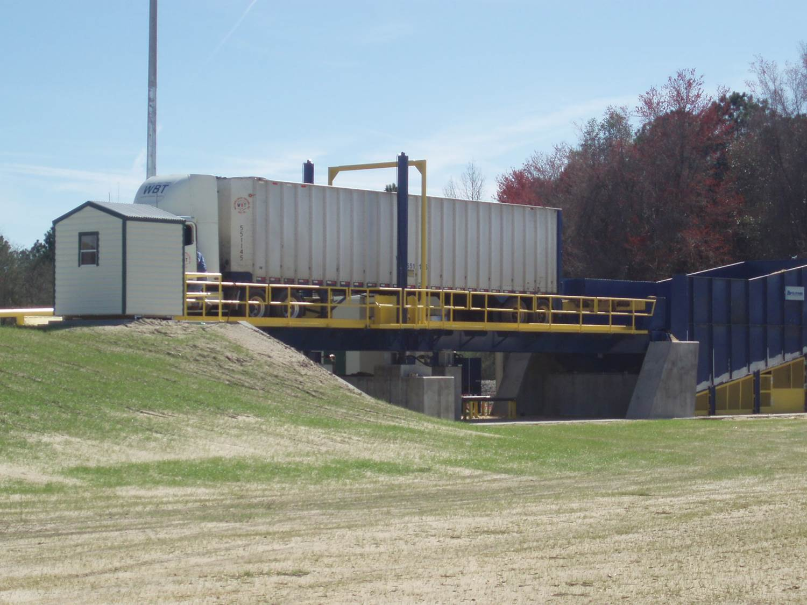
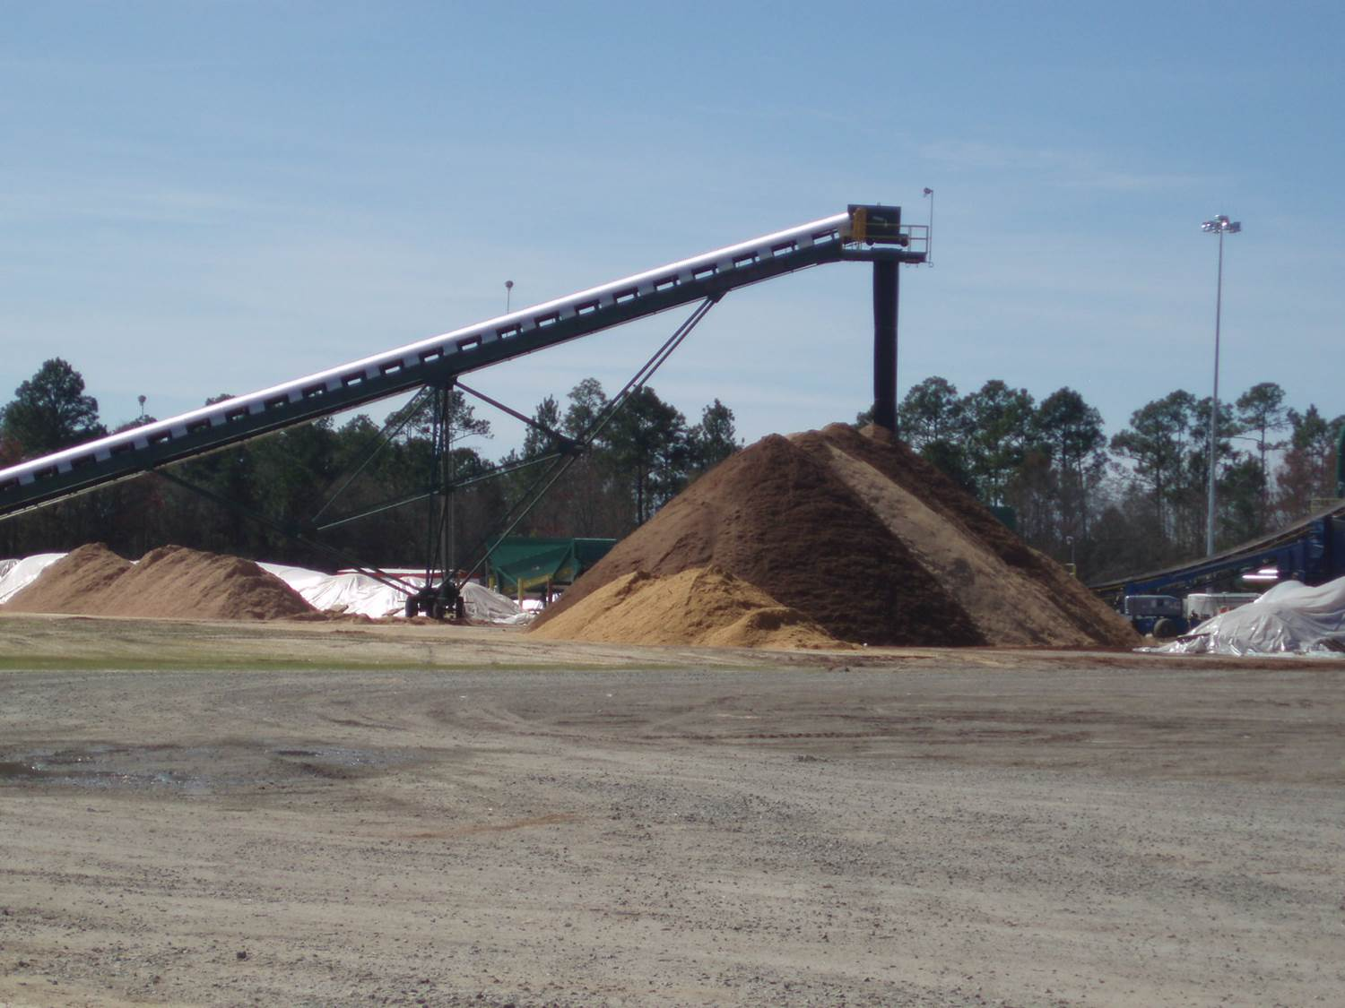
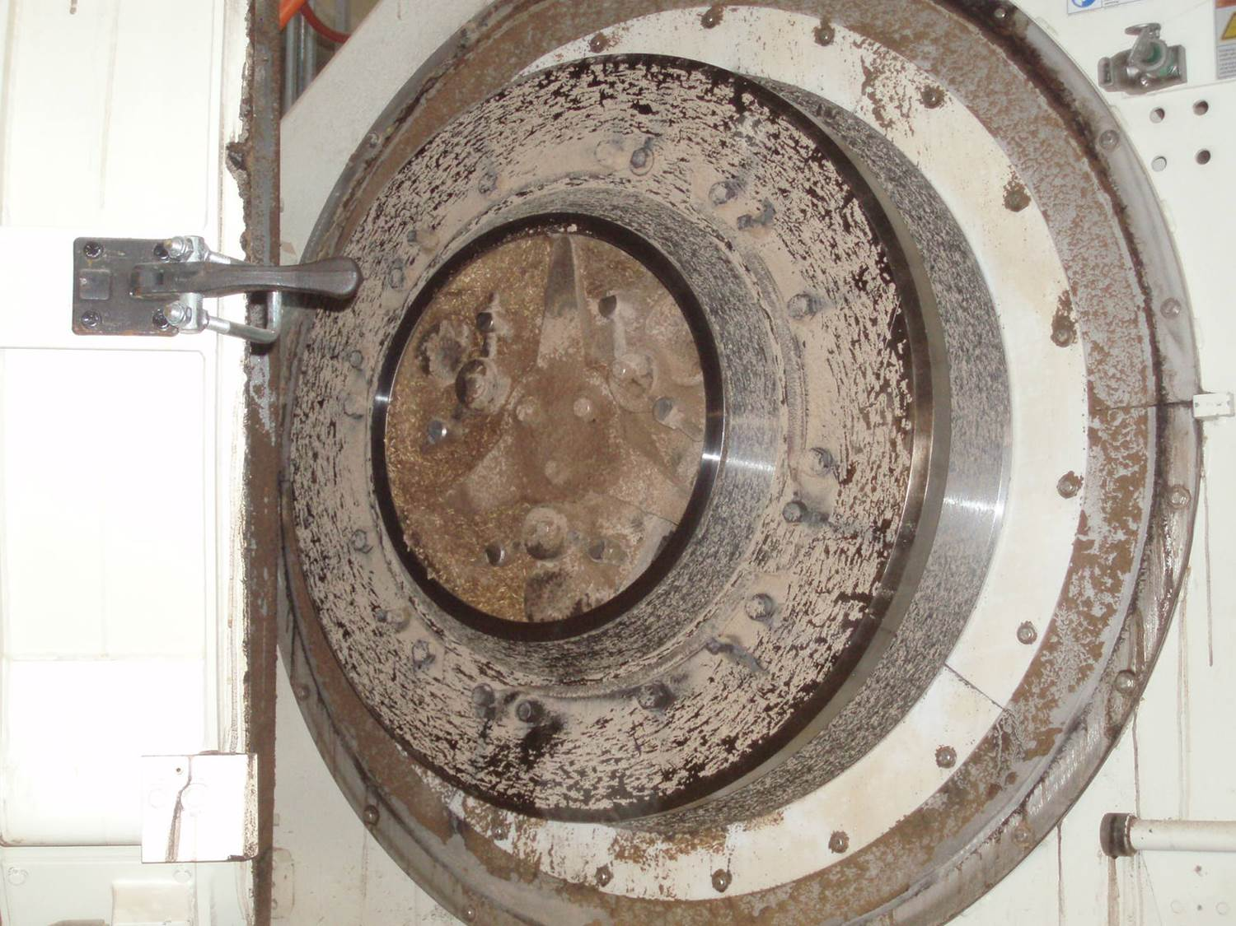
Case Study 4
Triple Loan Guarantees
Biomass Facility Funding Case Study 4:
Appling County Pellets, LLC (Baxley, GA)
Facility: Pellets Biomass Project
Location: Baxley, GA
Borrower: Appling County Pellets, LLC
Lender: AgSouth Farm Credit, ACA
Total Project Costs: $24,500,000
  Finance Structure:
    $10,000,000 Rural Energy for America Program Loan Guarantee
    $ 7,000,000 Business & Industry Loan Guarantee
    $ 1,000,000 Business & Industry Loan Guarantee
    $ 6,500, 000 Borrower Contribution (26.5%)
    $24,500,000 Total Project Costs

Slide 20
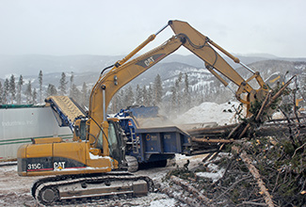
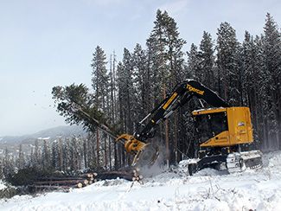
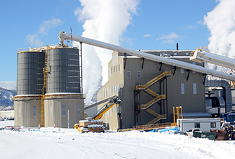
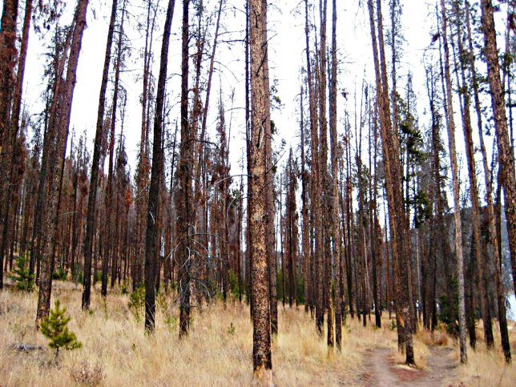
Case Study 5
RUS Loan Guarantee
Biomass Facility Funding Case Study 5:
Eagle Valley Clean Energy, LLC (Gypsum, CO)
Facility: 11.5MW Biomass Project
Location: Gypsum, CO
Borrower: Eagle Valley Clean Energy, LLC
Utility: Holy Cross Electric Association, Inc.
Lender: USDA Rural Utility Service
Total Project Costs: $57,422,000
  Finance Structure:
    $40,000,000 Energy Efficiency & Conservation Loan Program
    $17,422,000 Borrower Contribution (30.3%)
    $57,422,000 Total Project Costs

Slide 21
USDA Rural Utility Service
Loans and Loan Guarantees
Sample Project Finance Structure
Debt -
RUS Loan
Equity Investors
$
$
$
Renewable Project LLC
kWh
Federal
Incentives
Utility
$
Power Purchase
Agreement (PPA)

Slide 22
USDA Rural Utility Service
Loans and Loan Guarantees*
Threshold Eligibility Criteria:
Electricity to serve persons in rural areas where rural is defined as census places where the population is ≤ 20,000
Commercially proven technologies
National Environmental Protection Act (NEPA) review completed prior to the start of construction
Credit support provided in Power Purchase Agreement (PPA) language or corporate guarantee
*Projects need to meet the “3-Rs”: Rural beneficiaries; Renewable generation; and Ready to be financed and built.

Slide 23
USDA Rural Utility Service
Loans and Loan Guarantees
Other Relevant Considerations:
Interest rate: Treasury + 1/8
Term: shorter of PPA term or useful life of asset
Equity: Minimum 25% total project cost
Loan amount: No loan size limit; max = rural ratio* x total eligible project cost
Reserves: 1 year debt service and overhaul and maintenance
Term lending only: RUS does not provide construction loans for renewable projects
* Rural ratio: % of offtaker load that is rural

Slide 24
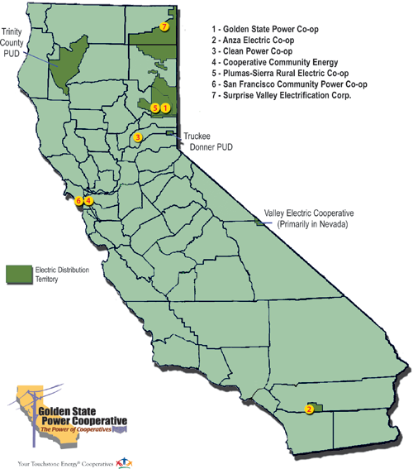
California’s Electric Cooperatives – the funding sweet spot!

Slide 25

Additional Resource Links
How can USDA assist with your Biomass project?
Catalog of Federal Domestic Assistance (CFDA)
Database of State Incentives for Renewables & Efficiency (DSIRE)
USDA Energy Website
USDA Rural Development Energy Programs
USDA Rural Utilities Service Electric Programs
USDA Rural Development Loan Programs
USDA Rural Development Grant Programs
USDA Forest Service Woody Biomass Utilization Grant
USDA Farm Service Agency Biomass Crop Assistance Program
DOE Strategic Technical Assistance Response Team Grant
Golden State Power Corporation – California’s Electric Cooperatives

Slide 26
Presenter Contact Information
Reminder: the NOFA for the REAP is expected any day!
Steven Scott Nicholls
Business & Energy Programs Specialist | State Energy Coordinator
United States Department of Agriculture | Rural Development
430 G Street, Agency 4169 | Davis, CA 95616-4169
Phone: (530)792-5805 | Fax: (530)792-5837
Steven.nicholls@ca.usda.gov | www.rurdev.usda.gov/ca
“Committed to the future of rural communities”

Slide 27
USDA Non-Discrimination Statement
USDA Non-Discrimination Statement

Slide 28
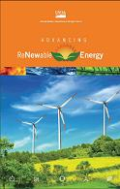
I look forward to collaborating with you on your next Biomass project. Thank you!
Questions
???

