Slide 1
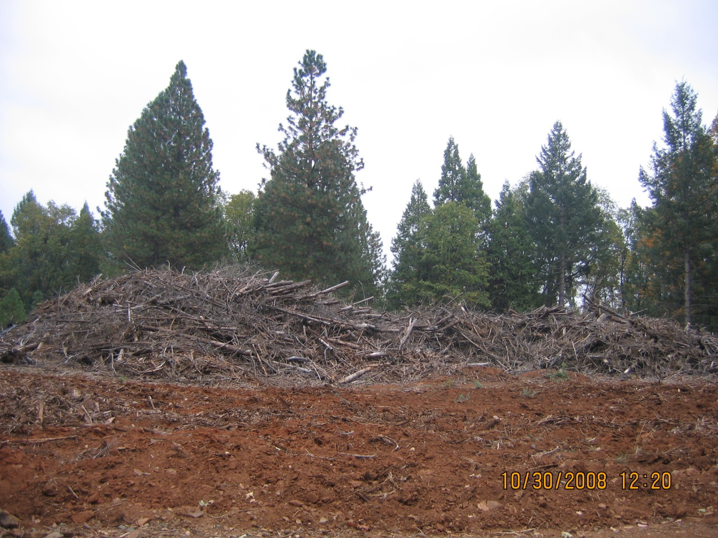
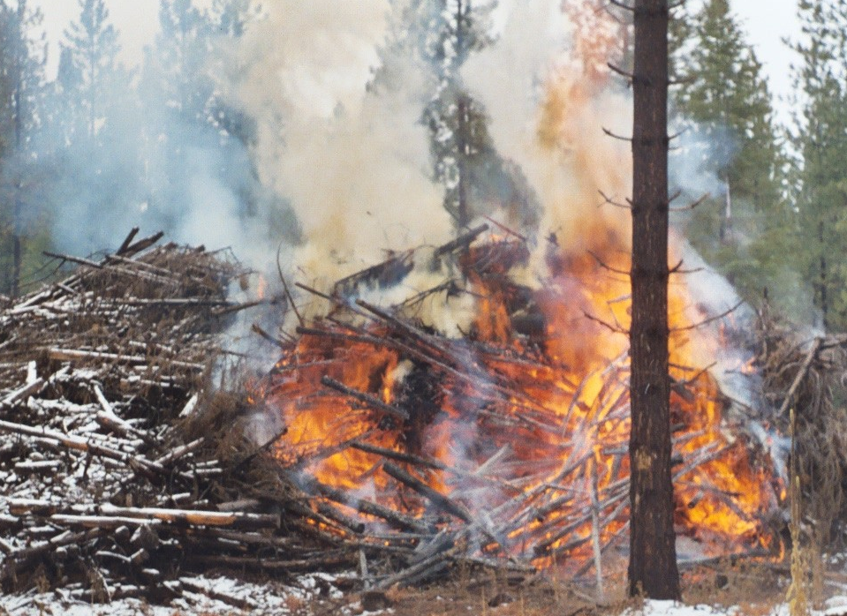
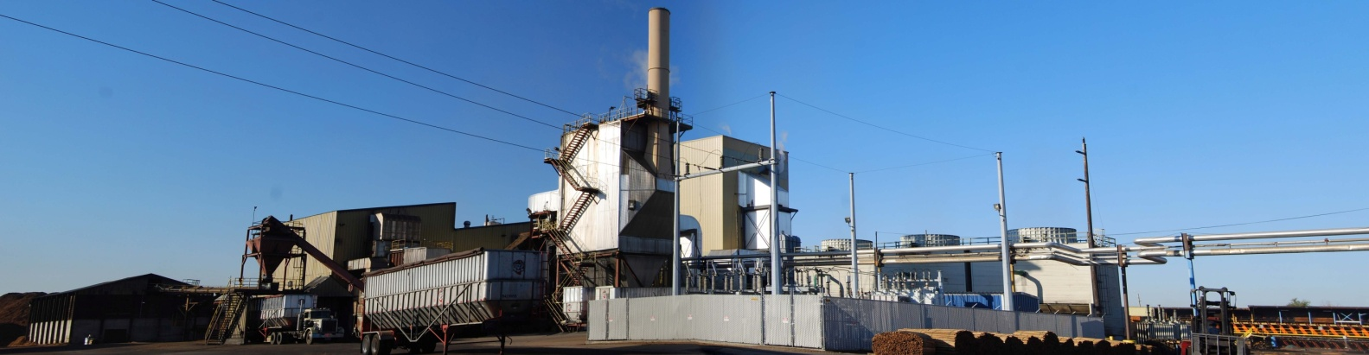
Woody Biomass Waste
Open Pile Burn
CO₂
CH₄
Black carbon
Diesel
Processing and Transport
CO₂
Black carbon
Natural gas, coal
Electricity Generation
CO₂
Bioenergy Generation
CO₂
Black carbon
Biochar

