Slide 1
What’s the Buzz about Pollinators?
Notes:
Created by: created by P. Beltramo in 5/19. Originally built from Attracting Pollinators, Butterflies and Hummingbird modules. Reviewed by K. Marini, date unknown
Updated by : B. Moeller and A. Beinhorn
Audience: Home gardeners
Publicity: Bees? Please! Pollinators like bees, butterflies, hummingbirds and bats are an integral part of our ecosystem and are beneficial in the garden. Learn about the different pollinators and their life cycles, what plants attract these hard workers and how to provide for their habitat. Before you know it, your garden will be fluttering with life.
Update History: for each update to the presentation include date, name of updater, explanation of update. Elaine Applebaum (prior PPt) 2017, and Ann Beinhorn (2018) and Lynne Gold (2020) contributed to the Pollinator slideshow.
(were additional slides added, were web links updated, etc.)

Slide 2
Who Are Master Gardeners?
Master Gardeners of Placer County
Extend research-based, sustainable gardening and composting information
Present accurate, impartial information to home gardeners
Encourage public to make informed gardening decisions

Slide 3
Who Are Master Gardeners?
Where to find us…
Online, in the Media, and Special Publications
Hotline: Call (530) 889-7388 or submit your questions online
Website: pcmg.ucanr.edu
Facebook, Instagram, X, You Tube
Gold Country Media monthly column
Curious Gardener quarterly newsletter on our website
Gardening Guide and Calendar

Slide 4
Who Are Master Gardeners?
Where to find us…
Presentations, Fairs and Festivals, and Special Events
Speakers by Request
Workshops (various venues, check website)
Farmers’ Markets (seasonal: Auburn, Roseville, Lincoln)
Fairs and Festivals Booths (varies)
Garden Faire (April)
Mother’s Day Garden Tour (May)

Slide 5
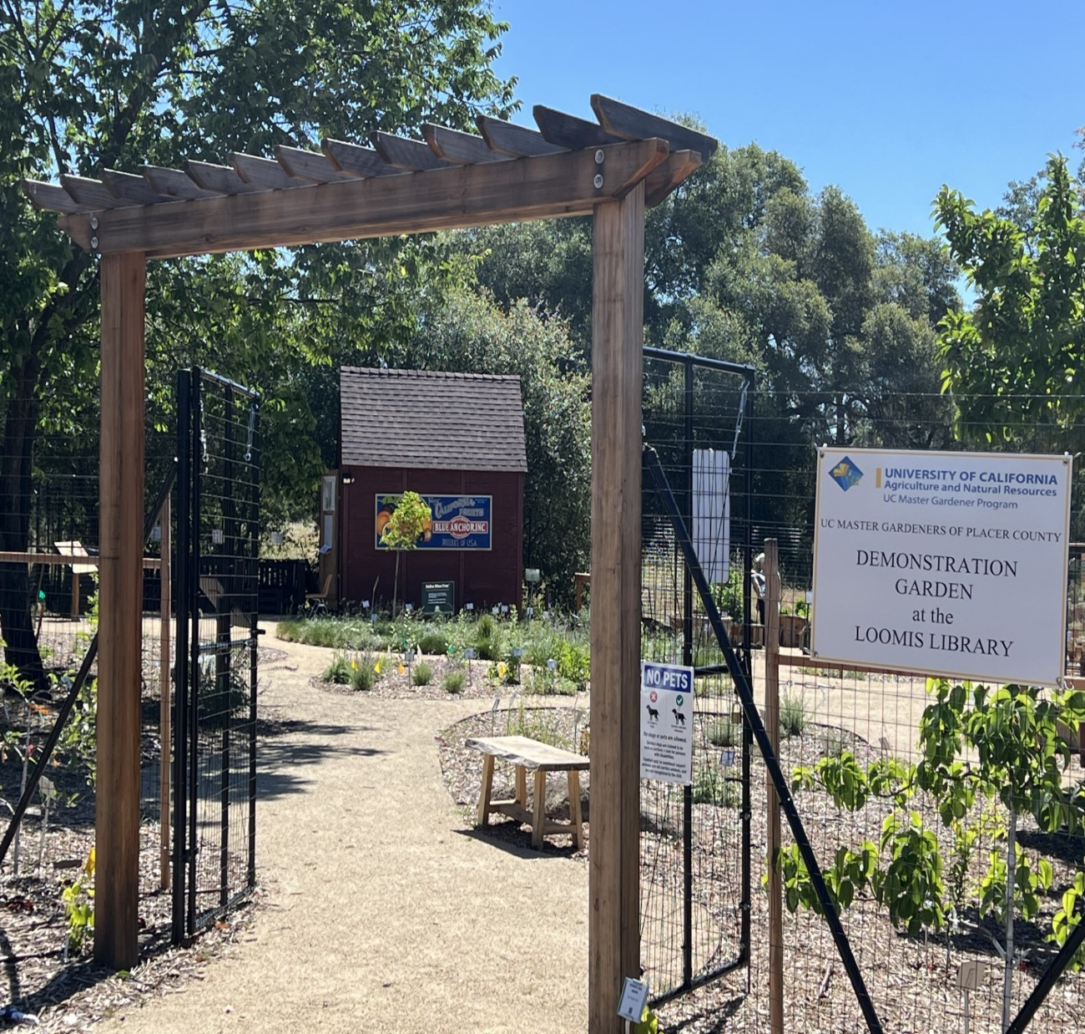
2nd Saturday
Open Garden Dates
July 13
August 10
September 14
October 12
Notes:
Hours 10;00 a.m.-12:00 p.m.
Open House differs from other dates because there will be activities for the whole family and includes kids’ activities, tool sharpening demonstrations, live music, and expert advice focusing on each demonstration bed, fruit tree and vegetable gardening, and irrigation.

Slide 6
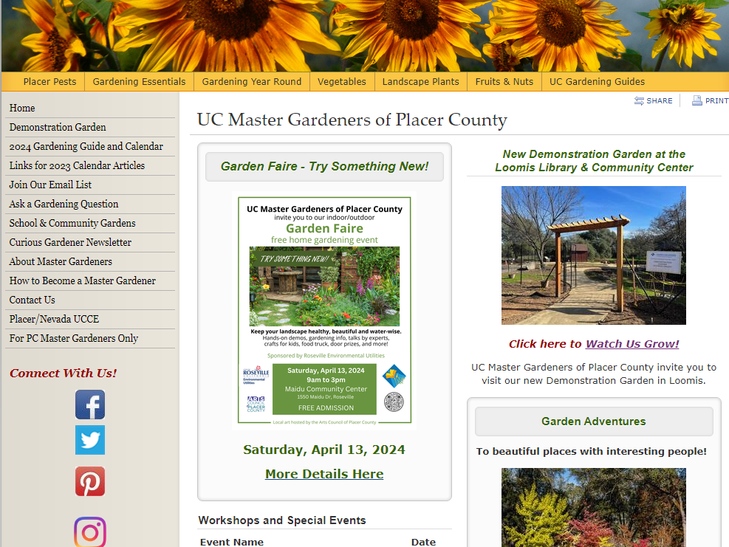
Notes:
Screen shot of our website. Sign up for our quarterly Curious Gardener newsletter. Garden Adventures is a new offering for Placer County Master Gardeners featuring beautiful gardens with interesting people.

Slide 7
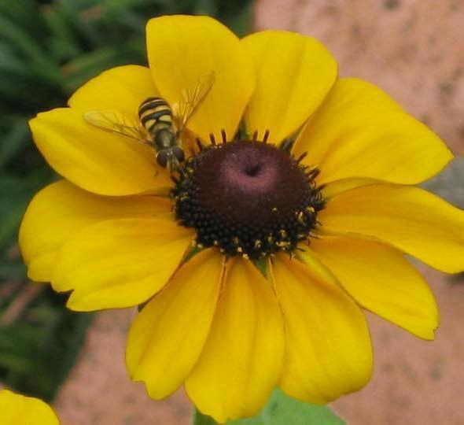
Agenda
Why do we need pollinators?
Who are the pollinators?
Bees
Butterflies
Hummingbirds
Other Beneficials
What is a pollinator habitat?
How can I attract pollinators
PLANTS!
Rudbeckia hirta with syrphid fly Photo: T. Markel

Slide 8
Why Do We Need Pollinators?
Responsible for 1 of every 3
bites of food
A tiny fly is responsible
for all of the world’s chocolate! Chocolate midge
Notes:
Every bite of chocolate we eat starts off as seeds in pods that grow on Theobroma cacao, a tree whose name translates to "cacao, food of the gods." Enter chocolate midges—without the midges, there would be no chocolate! (Seen in US? Yes—National Park in American Samoa)
https://www.nps.gov/articles/chocolate-midge.htm

Slide 9
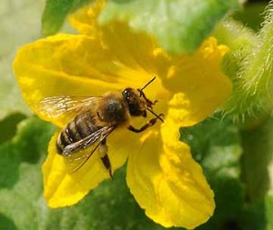

Why Do We Need Pollinators?
Pollinate 75% to 90%
of all flowering plants
180,000 plant species
1,200 crops
Squash bee Kathy Keatley Garvey
Notes:
75% crops, 90% perennials. Kathy Keatley Garvey (photo) is a UCANR Entomologist.

Slide 10
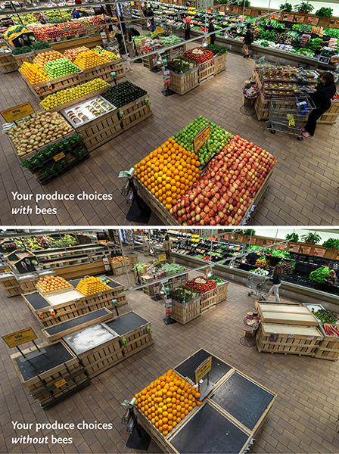
Why Do We Need Pollinators?
Notes:
https://media.wholefoodsmarket.com/news/bees
June 14, 2013 To make a point for the public:
The before-and-after photo (above) is shocking – as are the statistics. Whole Foods Market’s produce team pulled from shelves 237 of 453 products – 52 percent of the normal product mix in the department. Among the removed products were some of the most popular produce items:
Apples, Onions, Avocados, Carrots, Mangos, Lemons, Limes, Honeydew, Cantaloupe, Zucchini, Summer squash, Eggplant, Cucumbers, Celery, Green onions, Cauliflower, Leeks, Bok choy, Kale, Broccoli, Broccoli rabe, Mustard greens

Slide 11
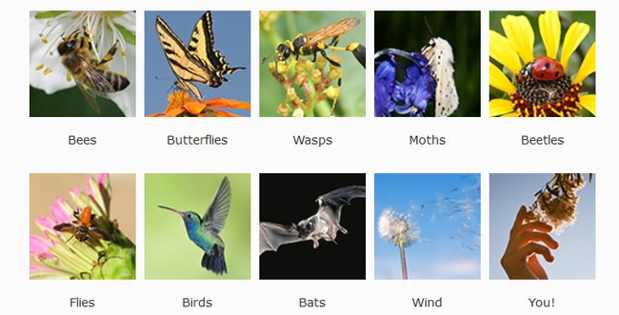
Who Are the Pollinators?
Notes:
POLLINATORS:
bees; butterflies; wasps; moths; beetles; flies; birds; bats; wind; humans
To get animals to help, plants provide:
• food (pollen, nectar) • scents/perfume • oils
• nest materials
Bats do not pollinate here locally but they do in the desert. Wind accounts for 13% of pollination. Think of allergy season and wind driven pollen like that from oak ,pine, olives and grapes.

Slide 12
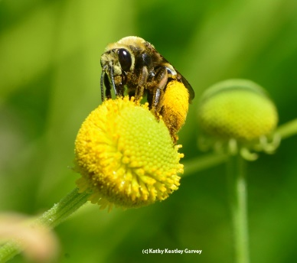
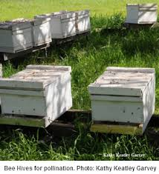
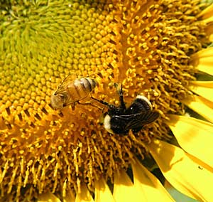
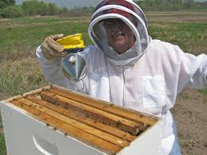
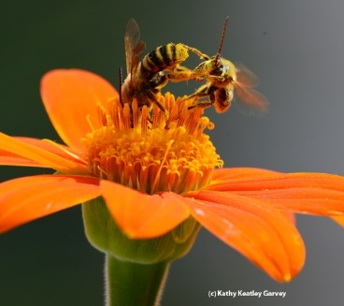
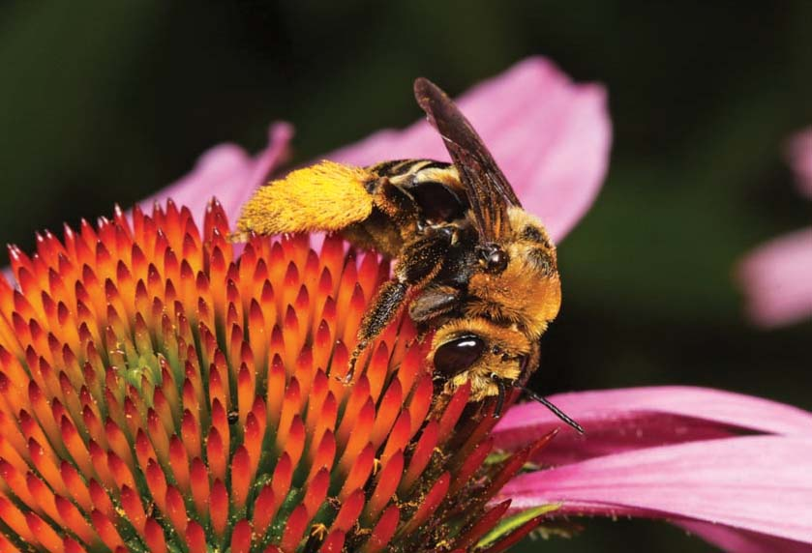
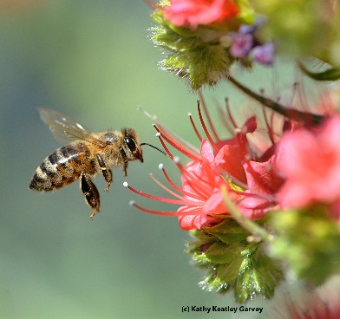
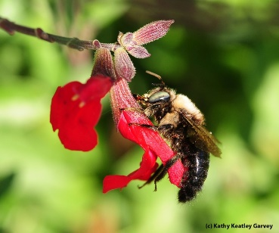
Honeybees and the Other Bees
Notes:
Bee hives; bee keeper; honey bee on Echium wildpretti (Tower of Jewels)
1 Honeybee and bumblebee on sunflower;
2 longhorn bee on Helenium (sneezeweed)- top right
3 female solitary bee on purple coneflower
4 bee fight on Tithonia (Mexican sunflower)
5 bumblebee on Salvia (sage);
Honeybees are not native; they were brought here from Europe. They not only make honey but are also responsible for pollinating crops like almonds, berries, fruits and vegetables.

Slide 13
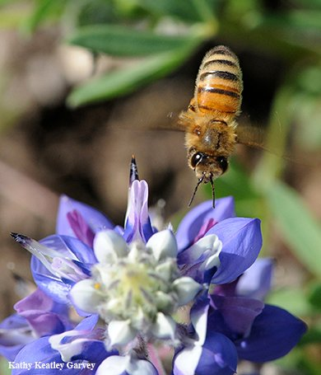
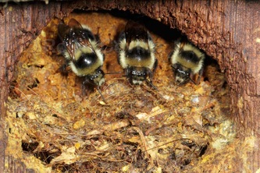
Social Bees
Honey bee
Bumble bee
Honeybees and bumble bees
live together in groups.
They defend their nests
by stinging.
Notes:
Honey bees and bumblebees are “social” bees. They share a home and cooperate with one another. The queen emerges in spring, and starts her colony where she lays eggs. Young bees emerge and look for pollen & nectar which they consume & feed their young with. After several generations, they die out by late autumn. The new queens have mated & will hibernate. Normally they are not aggressive but can sting. Bumblebees can vibrate pollen out of the anthers of the flowers: Buzz noise.

Slide 14
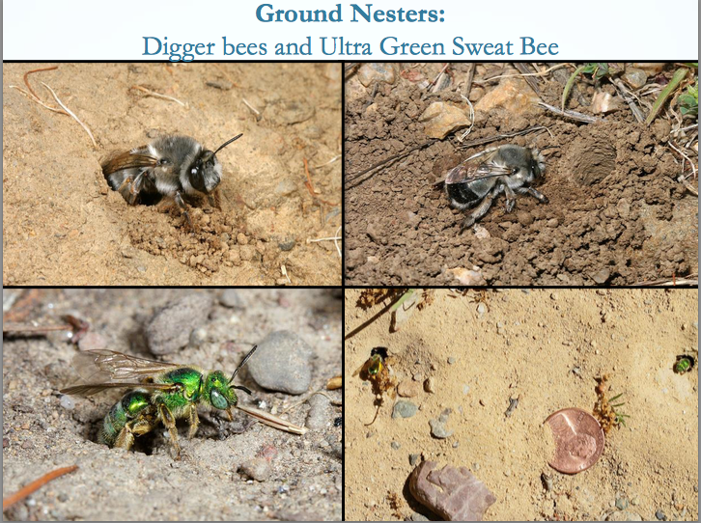
Ground Nesting Bees
Gordon Frankie
Notes:
bee groups ppt http://ucanr.edu/sites/2017MGConference/files/271017.pdf
1600 native bee species in California 75% are solitary Ground nesters. 30% are (pre-existing) cavity dwellers, 10% are social bumblebees, 15% are cuckoo, laying eggs in other bee’s chambers.
Leave some bare soil, not all mulched.
Sweat bees will land on you and drink your sweat for the salt content.

Slide 15
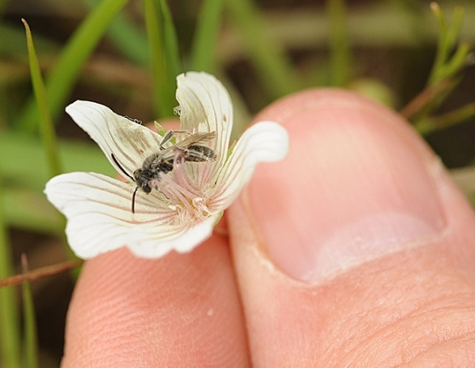
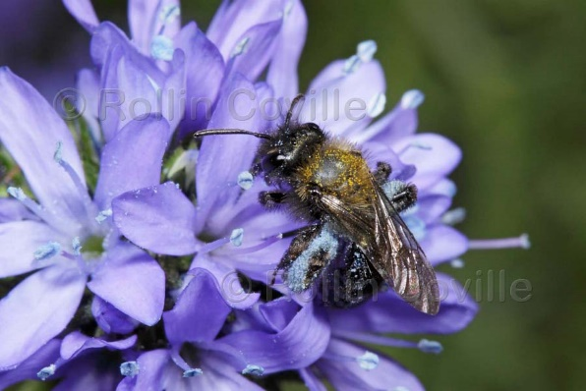
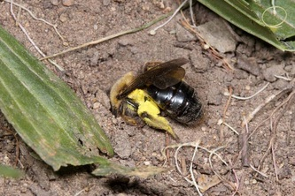
Bees are gentle
“Tickle Bees”
Notes:
Andrenidae Mining Bees. Females excavate tunnels in the ground to lay eggs & raise young. They cannot sting you.
Nest on the play fields. Forage on spring-blooming (male) flowers, plants. Xerxes society video on ground-nesting bees: https://www.youtube.com/watch?v=PB5Nib4O0Zs
(tickle bees: Sabin Elementahttp://www.sabinpta.com/tickle-bee
mining bees in schoolyard. Students observe and protect their friends.
ry, Portland, Oregon )

Slide 16
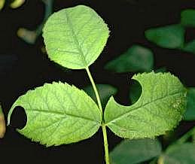
Cavity Nesters
Leafcutter bees
Gordon Frankie
Notes:
Solitary leafcutter bees use leaves (redbud & rose) o build their nest to raise the larvae. Photo: UC IPM https://ipm.ucanr.edu/PMG/GARDEN/PLANTS/INVERT/leafcutbes.html
They use redbud leaves, rose leaves, and petals. About the size of a honeybee. Show up when it’s 70 degrees outside. Pupation takes 3 wks.
Cause scalloped edges, no danger to plants.
It’s possible to create a barrier to prevent further leaf damage, but damage is usually little in home gardens. Pollen-carrying structure on their abdomen. They might nest in hollow stems or dead wood.
Blue orchard bees (Masons) –Photo on right-are also cavity dwellers, and use clay to build a block to the opening of their nest. See the hollow wood set up for the bees to find them.

Slide 17
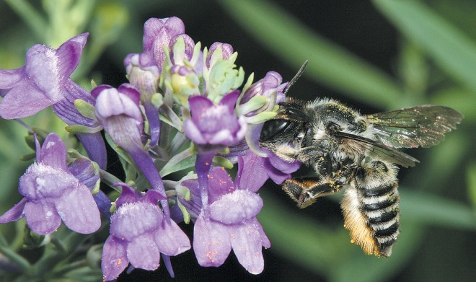
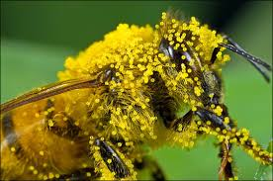
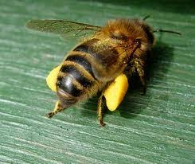
Pollen collection
Notes:
Scopa—hairs on abdomen
Hairy head and body. Flies are not as hairy.
Pollen baskets on hind legs (honeybee females)
light electrostatic charge -= “Used” bloom vs. full store

Slide 18
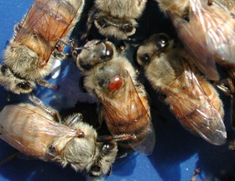
Colony Collapse Disorder
Honey Bee Stressors
Parasites (varroa mite)
Viruses
Bacterial Diseases
Pesticides
Nutrition
Genetics
Queen Quality
Management
https://www.pollinator.org/learning-center/bee-issues
Notes:
Pollinator Partnership: Colony Collapse Disorder is defined as ‘an abnormal phenomenon that occurs when the majority of worker bees in a honey bee colony disappear, leaving behind a queen, plenty of food , and a few nurse bees to care for the remaining immature bees.. There are many factors that have contributed to Colony Collapse Disorder, including parasites, viruses, bacterial diseases, increased use of pesticides on pollinated crops, bee nutrition, genetics and queen quality. For more information, go to Pollinator Partnership Task Force website
CCD https://www.pollinator.org/learning-center/bee-issues: If an insecticide has a sub-lethal affect on honey bees it may result in reduced larval survival, altered foraging behavior or shortened lifespan of adult bees. The extent of the sub-lethal affects is still unknown.
Natural floral diversity has been disrupted by agriculture, so beekeepers have to supplement the honey bees’ diet with other sugar sources.

Slide 19
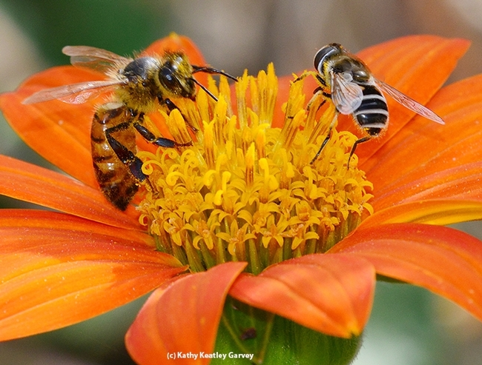
Is it a Bee or a Fly?
Notes:
Photo: UCANR Entomoogist, Kathy Keatley Garvey
Honeybee on left, syrphid fly on right Syrphid fly= hover fly
https://ucanr.edu/blogs/blogcore/postdetail.cfm?postnum=19180 Honeybee has 2 sets of wings, straight antennae, pollen basket if female.
Adult hover flies feed on pollen and nectar. One set of wings, stubby antennae, no pollen basket, but hovers over food source.

Slide 20
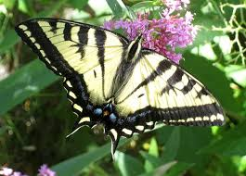
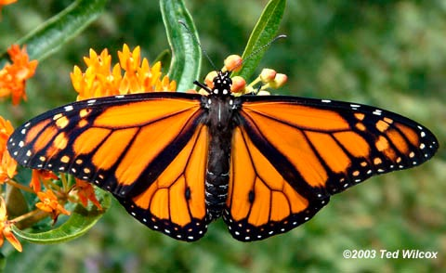

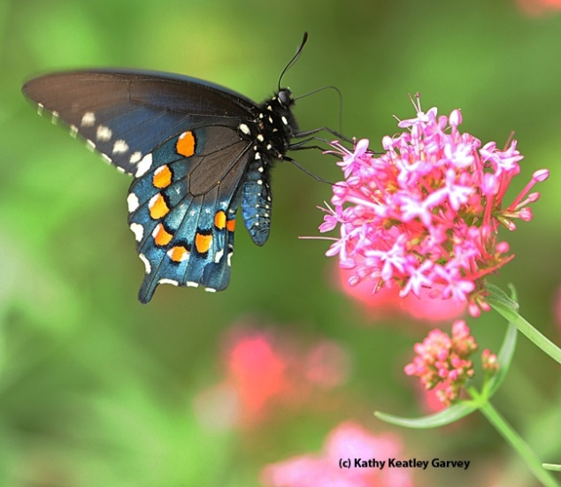
Now, on to Butterflies…
Notes:
Monarch, 2 species of lighter Swallowtail, Pipevine Swallowtail

Slide 21
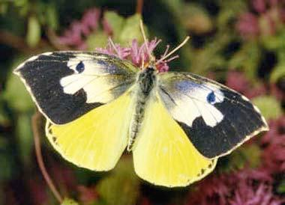
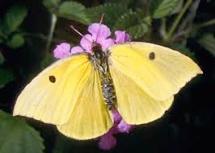
Do You Know This Butterfly?
California State Insect
Male
Female
California Dogface butterfly
Zerene Euridice
Notes:
California Dogface butterflies are not commonly seen, and are important polinators of California native plants

Slide 22
Habitat for Butterflies
Butterflies require:
Mating territory
Larval host plants
Pupation sites
Adult food supply

Slide 23
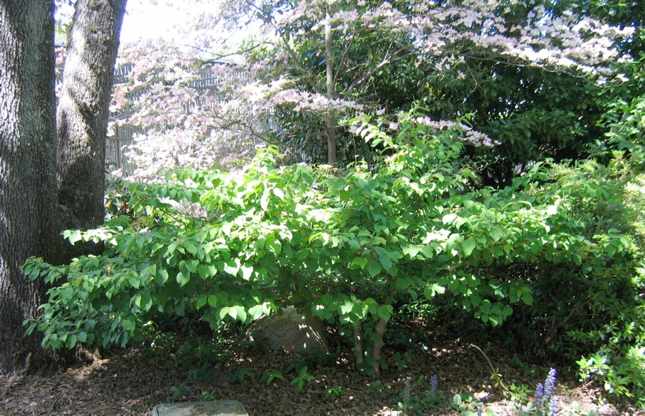
Mating territory
Perching sites to defend territory and
watch for females
Different heights of trees and shrubs
for windbreaks
and shade
Notes:
Photo: Peggy Beltramo

Slide 24
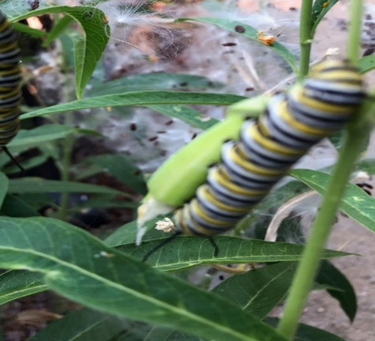
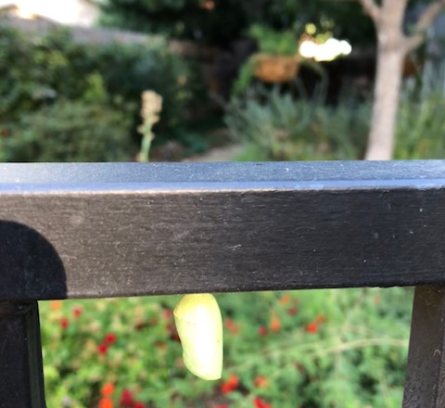
Butterfly Pupation Sites
Caterpillars may travel
50 feet to pupate
Host plants for larvae
A variety of cover for protection/pupation
Notes:
This pupa is from a Monarch butterfly caterpillar who grew on milkweed, and built his chrysalis on a fence beam.
Bottom photo: Lynne Gold

Slide 25
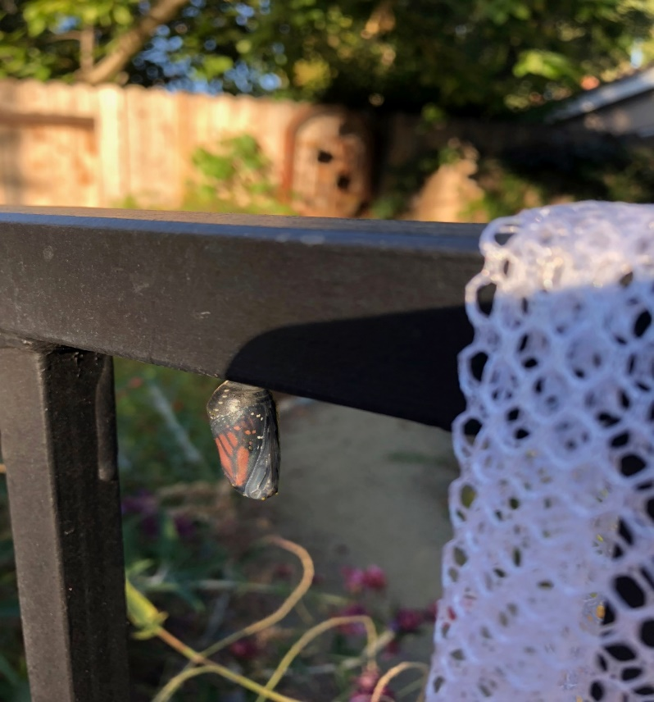
Monarch visible in Chrysalis
Notes:
Photo: Lynne Gold
Butterfly within chrysalis just before exiting.

Slide 26
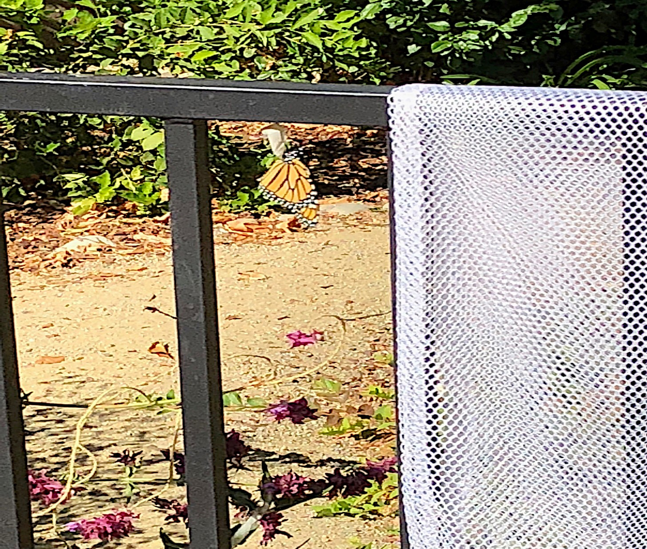
Monarch Eclosing
Notes:
Photo: Lynne Gold
Hatched and will spread wings

Slide 27
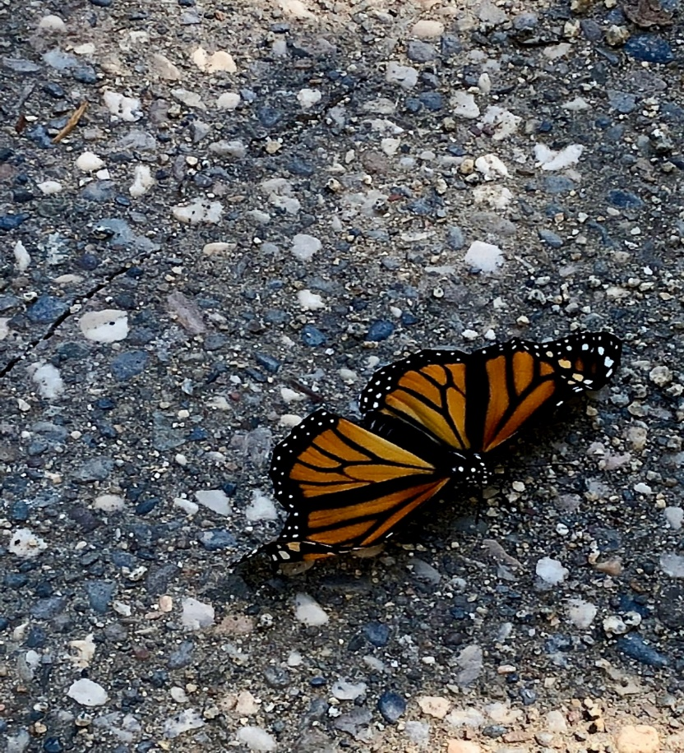
IT’S A GIRL
Notes:
Photo: Lynne Gold
Newly hatched from chrysalis.

Slide 28
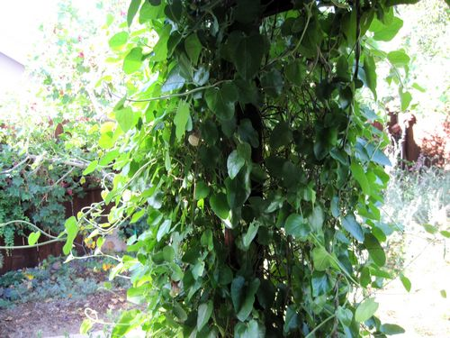
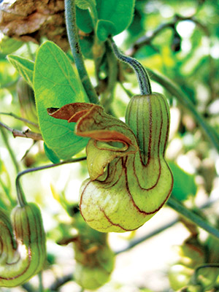

Larval Host Plants
Larval Food = Plant
Adult Food = Nectar
Dutchman’s Pipevine
Aristolochia californica
Pipevine Swallowtail
Caterpillars can be very picky.
Some will only eat one species of plant.
Notes:
The Pipevine Swallowtail (pictured) is a local species who’s only host plant is the Dutchman’s Pipevine (also pictured). If it’s eggs are laid on any other vine or shrub, the hatching caterpillars will not eat and starve to death.
Monarchs will eat multiple species of Milkweed, but no other Genera of plant.
Some butterfly larvae are less picky and will eat multiple plants, but many are specialists and rely on the presence of one particular species in order to survive.

Slide 29
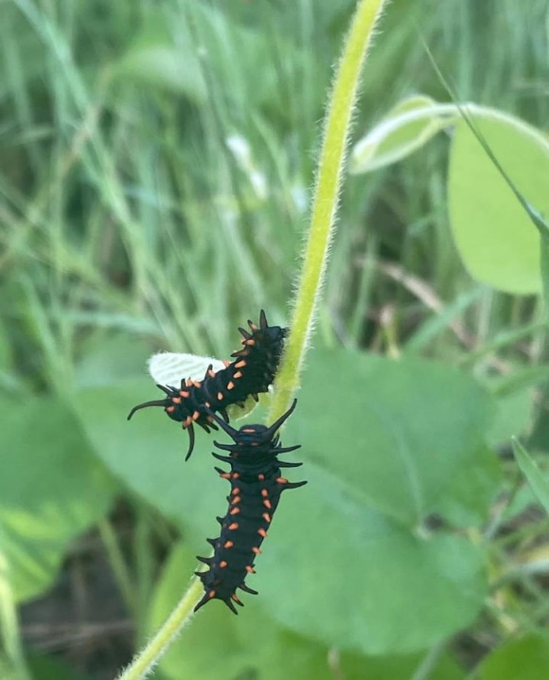
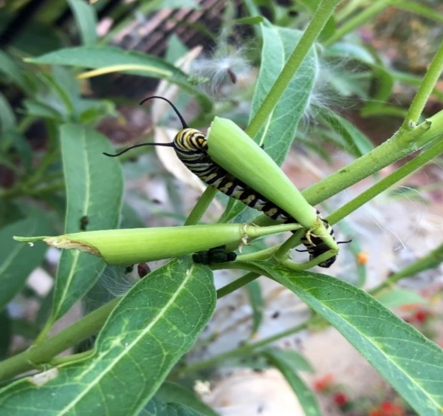
Larval Host Plants where adults lay eggs
Food for caterpillars
Narrow leaf Milkweed Dutchman’s pipe

Slide 30
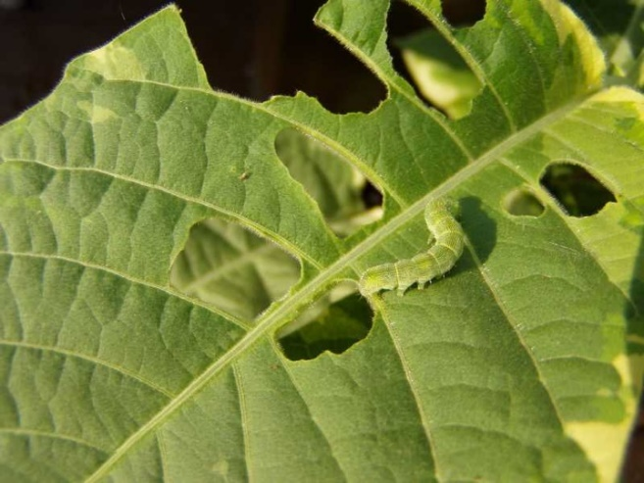
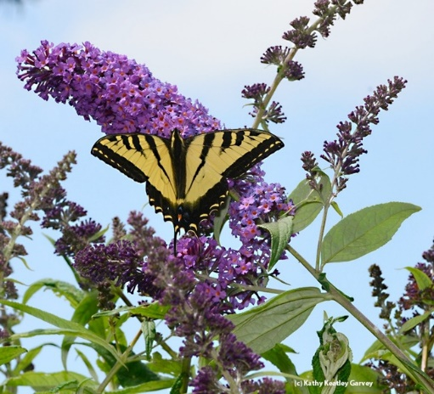
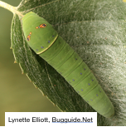
Larval Host Plants
Caterpillars cause damage to host plants
Be willing to put up with holes in leaves
Plant may disappear for the season
Western Tiger Swallowtail

Slide 31
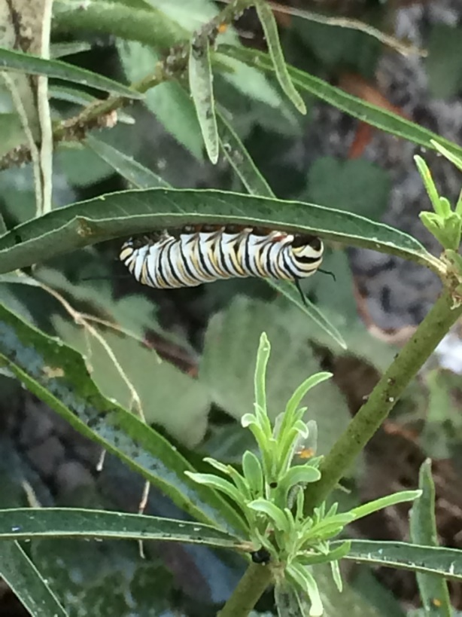
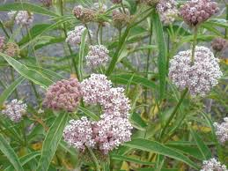
Monarch Larval Host Plants
Narrow leaf milkweed
(aka Mexican whorled) Purple or Heartleaf Milkweed
Asclepias fascicularis Asclepias cordifolia

Slide 32
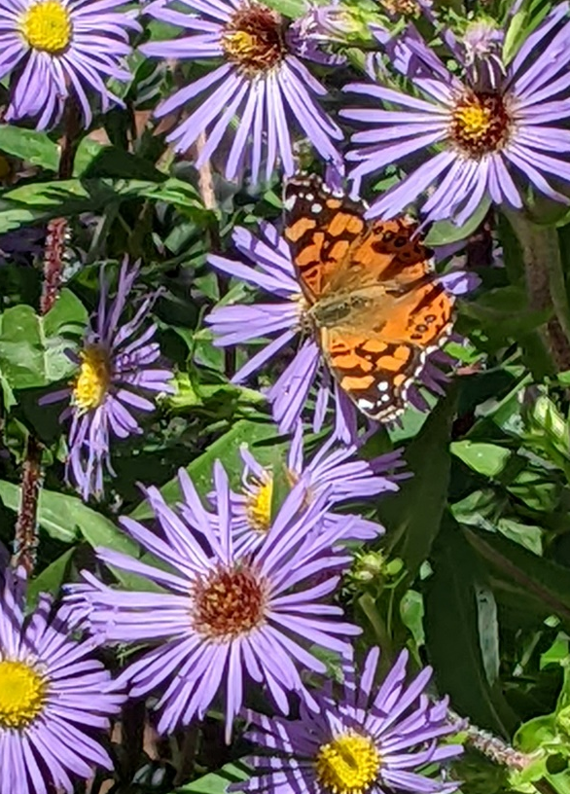
Adult Food Supply
Butterflies land on a flower to drink nectar.
Flat, daisy-type flowers
or
clusters of small flowers
in umbels or spikes
Notes:
land to drink; flat daisy, umbel or spike

Slide 33
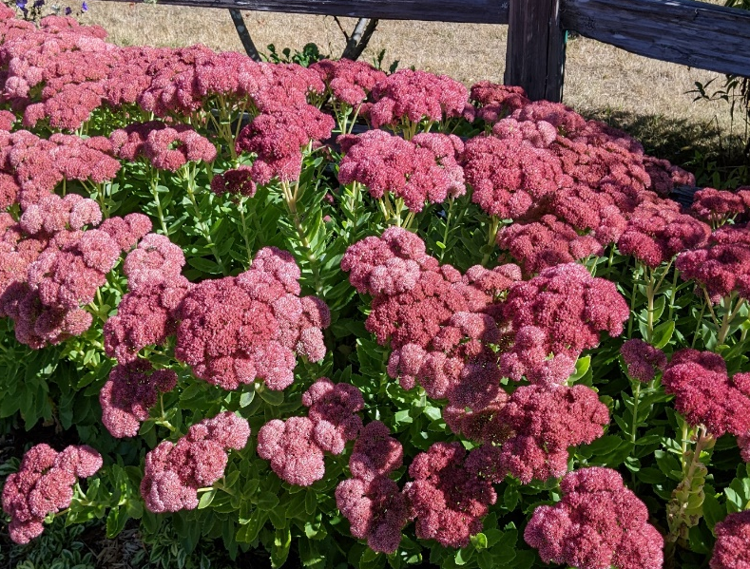
Adult Food Supply
Nectar
Pink, red, purple,
yellow and orange flowers
Large masses of
a single color
At least 3’ x 3’
Notes:
Red buckwheat Photo: Brooke Moeller: Sedum

Slide 34
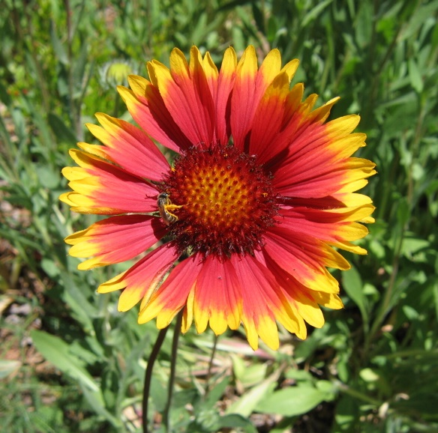
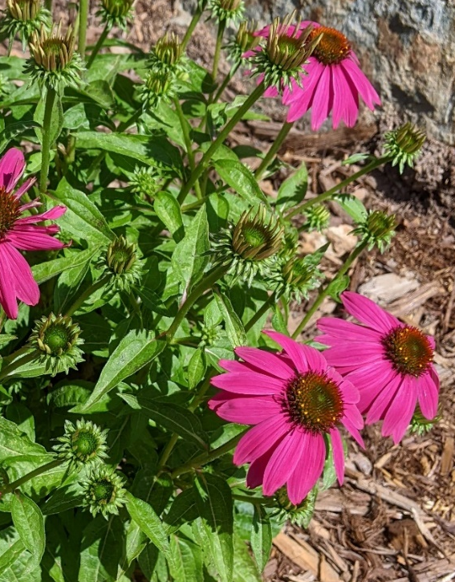

Adult Food Supply
Daisy-type flowers
Blanketflower Coneflower
Gaillardia Echinacea purpurea
Mexican sunflower
Tithonia rotundifolia
Notes:
What we think of as one flower is actually a collection of many. Daisy-type flowers, those in the family Asteraceae, are composite flowers, meaning they have 2 sets of many flowers in each inflorescense: those at the base of each petal (ray flowers) and those in the center (disk flowers). This is the largest plant family, including sunflowers, asters, dandelions, thistles, cosmos, senecio, daisies, many wildflowers and many more.

Slide 35


Adult Food Supply
Flat clusters (umbels) of small flowers
Sulphur Buckwheat
Yarrow
Dill

Slide 36



Adult Food Supply
Spikes of closely spaced small flowers
Goldenrod
Solidago
Lupine
Lupinus
Hummingbird Sage
Salvia spathacea

Slide 37

Additional Food Supply
Not all butterflies eat nectar
Some like
Overripe/rotting fruit
Tree Sap
Manure
Bird Droppings
Notes:
Set out overripe fruit on a plate or on top of a fence post. Be aware that it will also attract ants, wasps and other insects, so put out of the way.

Slide 38


And now, Hummingbirds…
See the pollen?
Notes:
Hummingbirds can get to nectar better than insects if the flower is long and tubular.
Pollen gathers on the beak, head and neck.

Slide 39

Anatomy of a Hummingbird
Selasphorus Rufus
Rufous Hummingbird
Crown
Gorget
Shoulders
Breast
Flight Feathers
Tail Feathers Ron Wolf 2008
Notes:
Color differentiation males vs. females vs. species. Iridescence requires light to spot.

Slide 40
Hummingbird Facts
Hover to feed
Usually tubular flower shape
Flower stamens protrude
Attracted to red and other bright colors
Eat every 10 to 15 minutes
Visit between 1,000 and 2,000 flowers/ day
Notes:
Hummingbirds drink from forked tongues that open up in the flower, trap the nectar, then pump it into their mouths through two grooves. While they frequently visit red flowers, hummingbirds will visit all sizes, colors and shapes of flowers — wherever they can get nectar, but hummingbirds do not survive on nectar alone. For protein, they’ll pick small insects from flowers, from the air, off leaves, or even off spider webs, sometimes along with the spiders themselves.
https://arboretum.ucdavis.edu/blog/hummingbirds-your-garden Eat several times their weight in nectar daily. Slow their heartbeat at night Body temperature drops to as low as 68 degrees; need fewer calories to keep warm In the morning, it takes up to an hour to warm up. Another example of a pollinator. Hummers have been known to cross-pollinate plants, thereby resulting in stronger, hardier plant varieties.
They fly in any direction.
Feeding nectar is possible while hovering or perching, with a long tongue which reaches further into a flower than nectar-feeding insects. They like nectar plants with more than 10% sugar, especially red, orange, and bright pink tubular or trumpet-shaped flowers: Ex- honeysuckle, calif fuchsia, autumn sage

Slide 41


Local Hummingbirds
Calypte anna Female
Anna’s Hummingbird
Male crown & gorget: red
Stays in short range year-round; Male
usually lowlands
Early breeder: December or earlier
Nests 4-25 ft. high
Tom Greer 2004
Notes:
The Anna’s hummer has extended its range due to the wider availability of nectar plants. Anna’s is the first to lay eggs: December. Incubation 14-19 days. First flight in 18-23 days. Adult male has red throat and crown. Adult female develops red spot on center of throat. Iridescent green on back & wings.
Gooseberries blooming in winter ae an important food source.

Slide 42

Local Hummingbirds Selasphorus rufus
Rufous Hummingbird
Male crown & gorget: red-orange
Back: brownish-red, flecked in green
Very defensive of feeding territory
Nests in conifers in spring,
and in deciduous trees in fall
Notes:
Rufous spends the winter in southern U.S. or Mexico. Likes mountain meadows in summer & fall.
Small & aggressive.
Female has green back, while & red spot on throat. Male has orange back. High shrill sound in flight.

Slide 43

Local Hummingbirds Archilochus alexandri
Black-chinned Hummingbird
Male with deep purple throat
White spot behind eye
Female has whitish throat
and speckled green crown
Attracted to tall trees & flowering shrubs
Nests are 4-8 ft. high.
Notes:
Female may have dusky or greenish streaks on gorget. Widespread habitat, arid to river groves. Moves to mountains after breeding, winters in Mexico. Territory covers Texas to British Columbia (Most extensive breeding range) Ticking noises may follow a high-pitched drawn-out note.

Slide 44

Hummingbird Feeders
1 part sugar to 4 parts water
Boil 1 minute
No honey, no red dye
Clean weekly
Refill often in heat
Discard old solution
Notes:
Begin with a clean feeder and add a sugary solution that is one part sugar to four parts water. Using honey or a stronger sugar concentration could be harmful or even fatal. Adding red dye to the solution is discouraged; most hummingbird feeders have red parts that will catch the hummingbird’s eye. Feeders need to be taken down to be cleaned and refilled every 3 days- weekly. Wash the feeder with hot, soapy water, and rinse with hot water. Refill it with a fresh supply of solution, which can be made ahead and stored in the refrigerator. It is important to discard the old solution, as it can ferment into alcohol. If you live in a very hot area, the feeder should be cleaned and solution replaced every 2 to 3 days. In our area, it’s best to have your feeder in full to part shade.
MORE SUGAR RESEARCH https://ucanr.edu/blogs/blogcore/postdetail.cfm?postnum=29560

Slide 45




Plants that Attract Hummingbirds
Notes:
C
Pjoptos: UCANR, Brooke Moeller, Ann Beinhorn. Coneflower, (Astomeria) Peruvian illy, Texas ranger, Calif fuchsia.

Slide 46
Beneficials Defined
Some are Pollinators….
Some are Natural Enemies:
Predators that prey on and devour
their host
Parasites, feeding off other insects
-laying their eggs on or in the host
-Pest becomes a food source for the young
Notes:
A parasitoid is one that spends its immature stages inside the body of the host.

Slide 47

Syrphid Fly 1/8”-1”
Larval stage feeds on insects esp. aphids
Pupa - green to dark brown
Adults feed on aphids, pollen & nectar; they’re also pollinators!
Notes:
Photo UCIPM
Adults 1/8” to 1”, Also known as” hover” or “flower” fly.
Their flying habit is to hover over flowers and then dart quickly away.
They are regularly found where aphids are present in agricultural, landscape, and garden habitats.
Adults are a stingless fly.
Although confused with honeybees because of their black and yellow bands on their abdomen, they are stingless.
Syrphid flies undergo complete metamorphosis with 3 larval instars. They have 12 spines.
Females lay their (whitish to gray) oblong eggs, each measuring (1.32 inch), singly on their sides usually near aphids or within aphid colonies.
Adults must feed on pollen before they can reproduce.
Larvae are legless and maggot shaped and vary in color and patterning but most have a yellow longitudinal stripe on the back.
Larval stage that feeds on aphids and other soft-bodied insects
Larvae move along plant surfaces, lifting their heads to grope for prey, seizing them and sucking them dry and discarding the skins.
A single syrphid larva can consume hundreds of aphids in a month.
Not all syrphid fly larvae are predaceous, some species feed on fungi.
--------------------------
They can be distinguished from caterpillar larvae by their tapered head, lack of legs and their opaque skin, through which internal organs can be seen.
Eggs are 1/25 in.
are brown, green pink or white & vary in length from 1/32 to 1/2 inch
Pupa are oblong, pear-shaped, and green to dark brown in color. Pupation occurs on plants or on the soil surface.

Slide 48

Green Lacewing ½ - 3/4”
Some lacewing species are predators
Others feed on nectar & pollen as adults
Larvae prey on mealybugs, psyllids, thrips, mites, whiteflies, aphids, small caterpillars, leafhoppers, and insect eggs
Notes:
Photo UCIPM
Adults ½ to ¾” long. Green lacewings are generalist predators and are commonly found in agricultural, landscape, and garden habitats.
Adult green lacewings are soft-bodied insects with four membranous wings, golden eyes, and green bodies. Adults often fly at night and are seen when drawn to lights.
Adults feed primarily on nectar, pollen and aphid honeydew, with the larvae the active predators.
Some species of green lacewing adults are predaceous, others feed strictly on honeydew, nectar, and pollen.
Females lay their tiny, oblong eggs on silken stalks attached to plant tissues. Depending on the species, eggs are laid singly or in clusters, each on an individual stalk. Eggs are green when laid, then darken before hatching.
Larvae look like tiny alligators.
Larvae are flattened, tapered at the tail, measure 1/8 to 4/5”long, have distinct legs, and possess prominent mandibles with which they attack their prey.
Larvae prey upon a wide variety of small insects.
Green lacewings are commercially available and are among the most commonly released predators.
---------------------------------------------------------------------------------------
Lacewings undergo complete metamorphosis with eggs hatching about 4 days after being laid, and larvae develop through three instars.
Pupation occurs in loosely woven, spherical, silken cocoons attached to plants or under loose bark.

Slide 49


What is a Habitat?
Notes:
Habitat is the place where a plant or animal lives. There are 4 components.

Slide 50
What is a Habitat?
Food
Water
Shelter
Space

Slide 51
Provide a Healthy Habitat
Food
Adult food
Food for young

Slide 52


Provide a Healthy Habitat
Water
Shallow, or with landing spots
Not clean water

Slide 53

Provide a Healthy Habitat
Shelter
Perching sites to defend territory and watch for females
Layers of trees and shrubs for windbreaks and shade

Slide 54

Provide a Healthy Habitat
Space
Leave a portion of yard or property
“wild”

Slide 55

Provide a Healthy Habitat
Plants that are Native or adapted to our climate
healthier
tolerate pest
damage better
Manzanita Arctostaphylos

Slide 56

Avoid Pesticides
Neonicotinoids are used by growers
Kill all species in the food chain
Bacillus thuringiensis (BT) -a bacterium
absorbed into plant tissues & pollen
lasts for 2 years
kills insects not on the label (all caterpillars)
Notes:
Neonicotinoids are systemically-applied synthetic neurotoxic insecticides which stay in the soil for years, affecting plants & their flowers, etc., and can stay in the water sources..
Ex: Imidacloprid. Could be harmful to us (esp. children)
BT: Affects desirable caterpillars as well as pests.

Slide 57


Results of Pesticide Use
Before spraying: population of good and bad insects.
Later in the season or next year: original pests & secondary pests flourish.

Slide 58

How Can I Attract Pollinators?
A wide variety
of plants
A long bloom season
Large masses of a
single color/plant

Slide 59

Use Diverse Flowers and Shapes
Notes:
Including a variety of plants with different flower sizes, shapes and colors, as well as plant heights, will support the greatest number and diversity of pollinators.
Flowers often have contrasting color marks – lines, patterns or freckles – that serve as guides to where the bee should go in the flower. These are called nectar guides.
Let me describe a few flower shapes. I will be labeling the plants with common names but later you may check the resource list that accompanies this presentation on our PCMG website for a listing of the botanical names which will help when purchasing plants. You may also view this talk again via our YouTube channel.

Slide 60


Plants! Plants! Plants!
ANNUALS ARE IMPORTANT!
+60 species
Lacy Tansy
Phacelia tanacetifolia
California poppy Tidy Tips
Eschscholzia Californica Lavia platyglossa
Notes:
Lacy Tansy Phacelia tanacetifolia,
California poppy Eschscholzia californica Photos by Kathuy Keasey Garvey
Common tidytips Layia platyglossa

Slide 61

Plants! Plants! Plants!
Hedgerows provide shelter and food.
Notes:
Hedgerows can benefit pollinators in cropland, as well as large properties with space for large plantings.

Slide 62


Plants! Plants! Plants!
Spring Bloom
Summer Bloom
Fall Bloom
© 2013 John Doyen
Las Pilitas Nursery
Las Pilitas Nursery
Lupine
Lupinus albifrons
Penstemon
Penstemon palmeri
California Aster
Symphiotrichum Chilense
California Natives
Winter Bloom
Photo credit:CountryMouse13
Coyote Bush
Baccharus pilularis ‘Pigeon Point’

Slide 63




Plants that Attract Natural Enemies
Notes:
Milkweed with Monarch caterpillar, Coneflower, Sunflower (Photos by UCANR) Yarrow, California Lilac
Tropical milkweed has been shown to be an acceptable plant for our area despite some controversy: https://ucanr.edu/blogs/blogcore/postdetail.cfm?postnum=55375

Slide 64





Plants that Attract Beneficials
Notes:
Mexican Bush sage, Bottlebrush, Foxglove, Cherry red sage, Pineapple sage,
Photos : Lynne Gold & Ann Beinhorn

Slide 65
Plants! Plants! Plants!
Plant for year-round bloom
Plant in the sun.

Slide 66


YOU CAN
create a garden attractive to humans
and
provide a habitat to attract beneficials
Notes:
Photos from PCMG Elaine Applebaum.
See UCANR Pub #8498 for comprehensive list of Plants to Attract Pollinators.
Have perennial plants in your yard that can provide habitat for Beneficials especially over the winter.

Slide 67
Notes:
calscape.org find out which CA native plants grow in your zip code.
Can demonstrate and/or use phones to play with zip code. Gardeners are excited to discover lists of native plants and Advanced Search lets you select for pollinators, season of bloom, color of bloom, etc.

Slide 68





Book Resources
Notes:
Attracting Native Pollinators. 2011 by The Xerces Society and Dr. Marla Spivak Bringing Nature Home by Doug Tallamy
The Bee Friendly Garden. 2016 by Kate Frey and Gretchen LeBuhn California Bees and Blooms. 2014 by Gordon Frankie, et al.
The California Wildlife Habitat Garden. Aug 8, 2012 by Nancy Bauer
California Native Plants for the Garden. Dec 1, 2005 by Carol Bornstein and David Fross

Slide 69
Thank You!
Any Questions?
Master Gardener Hotline: (530) 889-7388
Master Gardener Website: pcmg.ucanr.edu

