Slide 1

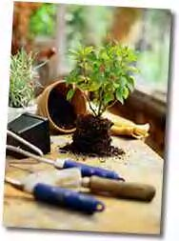
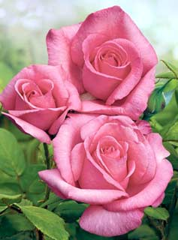
SALVIAS
MORE FAMILIARLY KNOWN AS SAGE
Notes:
Created: 03-2024
Created by: Lynne Gold
Audience: Garden club or other small venue.
Publicity: Learn about the many varieties of Salvias (sages) that can be grown in the gardens of our region, how they are different, and what they have in common. Included is the basic cultural care and pest management of these plants.
Update History: May 2024, approved by Bruno J.L. Pitton, acting advisor.

Slide 2
Who Are Master Gardeners?
Master Gardeners of Placer County
  Extend research-based, sustainable gardening and composting information
  Present accurate, impartial information to home gardeners
  Encourage public to make informed gardening decisions

Slide 3
Who Are Master Gardeners?
Where to find us…
Online, in the Media, and Special Publications
  Hotline: Call (530) 889-7388 or submit your questions online
  Website: pcmg.ucanr.edu
  Facebook, Instagram, X, You Tube
  Gold Country Media monthly column
  Curious Gardener quarterly newsletter on our website
  Gardening Guide and Calendar

Slide 4
Who Are Master Gardeners?
Where to find us…
Presentations, Fairs and Festivals, and Special Events
  Speakers by Request
  Workshops (various venues, check website)
  Farmers’ Markets (seasonal: Auburn, Roseville, Lincoln)
  Fairs and Festivals Booths (varies)
  Garden Faire (April)
  Mother’s Day Garden Tour (May)

Slide 5
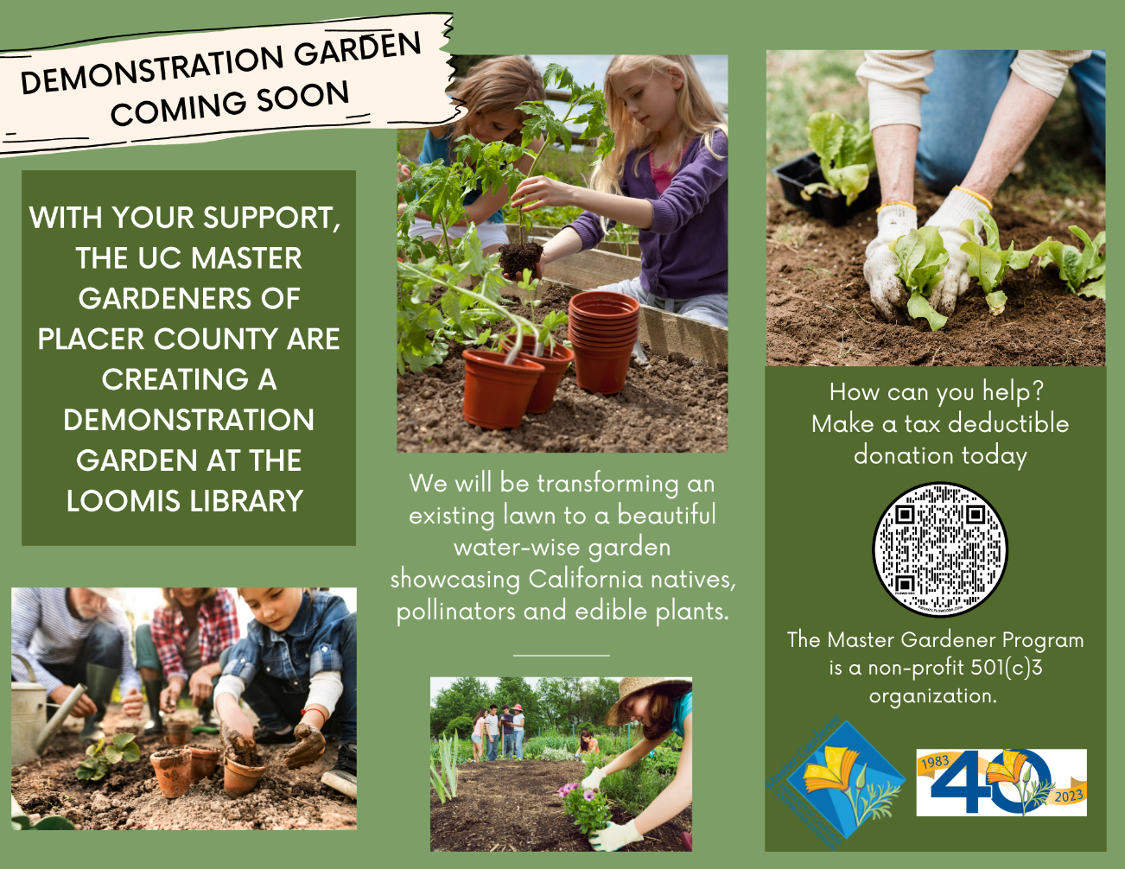
?

Slide 6
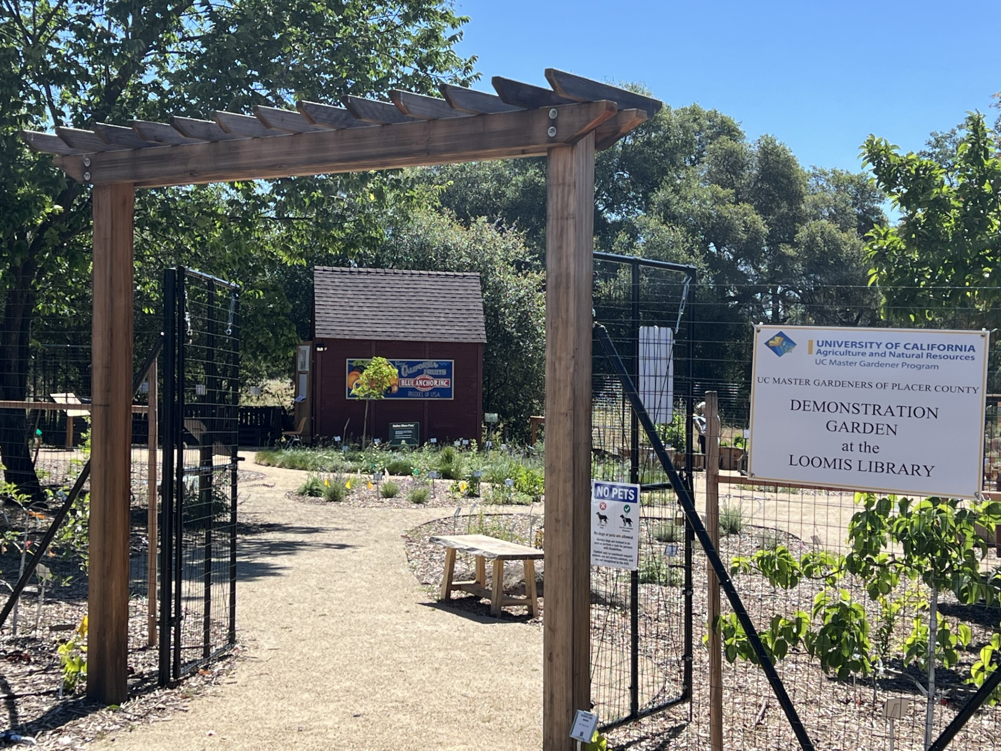
2nd Saturday
Open Garden Dates
May 11
June 8
July 13
August 10
September 14
October 12
Master Gardeners on site between
11:30 am – 1:30 pm
6050 Library Dr., Loomis

Slide 7
AGENDA
Why Salvias
Types of Salvias
History of Salvias
Growing Salvias
Notes:
Gardening has always been my passion. Today I’m going to talk about salvias also known as sage. I love all things gardening but salvias are my favorite. There are so many varieties to choose from and I will go over some of them with you. I will show you the photos that I have taken of salvias in my garden and we will talk a little about each one and how they are different. If you have any questions during the talk feel free to ask. I hope you all have a garden and if not I hope after this talk you will be convinced to create one.

Slide 8
WHY SALVIA (sage)?
Long-blooming, some with aromatic flowers
Attracts bees, butterflies, and others
Leaves have a pungent odor which detracts deer and rabbits
Heat and drought tolerant
Flowers come in a range of colors, including purple, blue, red, pink, and white

Slide 9
TYPES OF SALVIAS
Interestingly, salvias are a member of the mint family
Their tubular blossoms attract hummingbirds among other pollinators
A review of the Sunset Western Garden Book will represent various Salvias; several from my garden are displayed here.

Slide 10
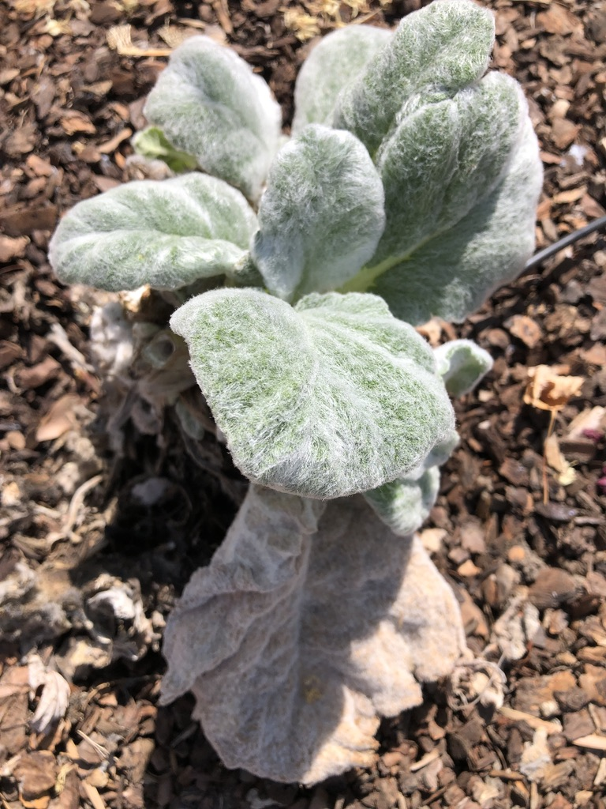
SALVIA ARGENTEA ‘ARTEMIS’ silver sage, artemis sage
Notes:
I didn’t realize this was a sage the first time I spotted it and much to my surprise. It shows how Salvias can be so varied.

Slide 11
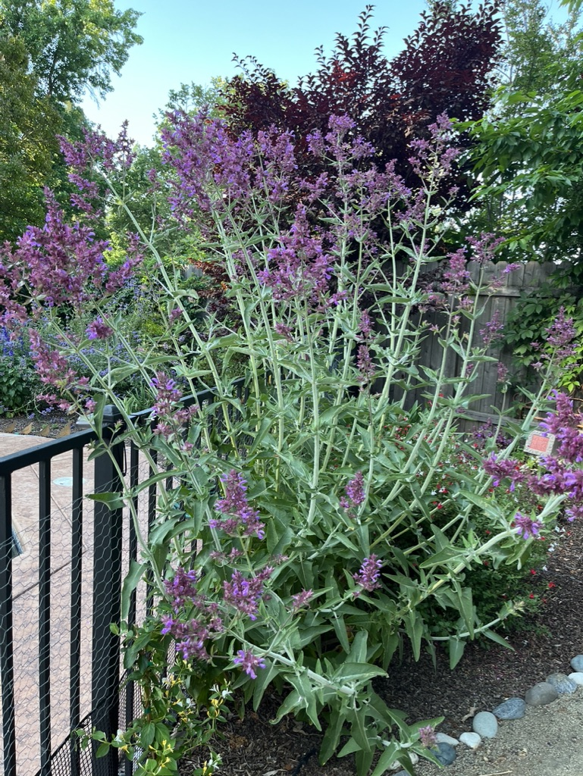
SALVIA CANARIENSIS
Canary Island sage
Notes:
Although not a California native, is a gorgeous plant and easy to grow in the north California garden. It has the distinctive arrows shaped leaves of sages, and it is best to use gloves when pruning because they underside of the leaves have hairs that can be scratchy to the skin.

Slide 12
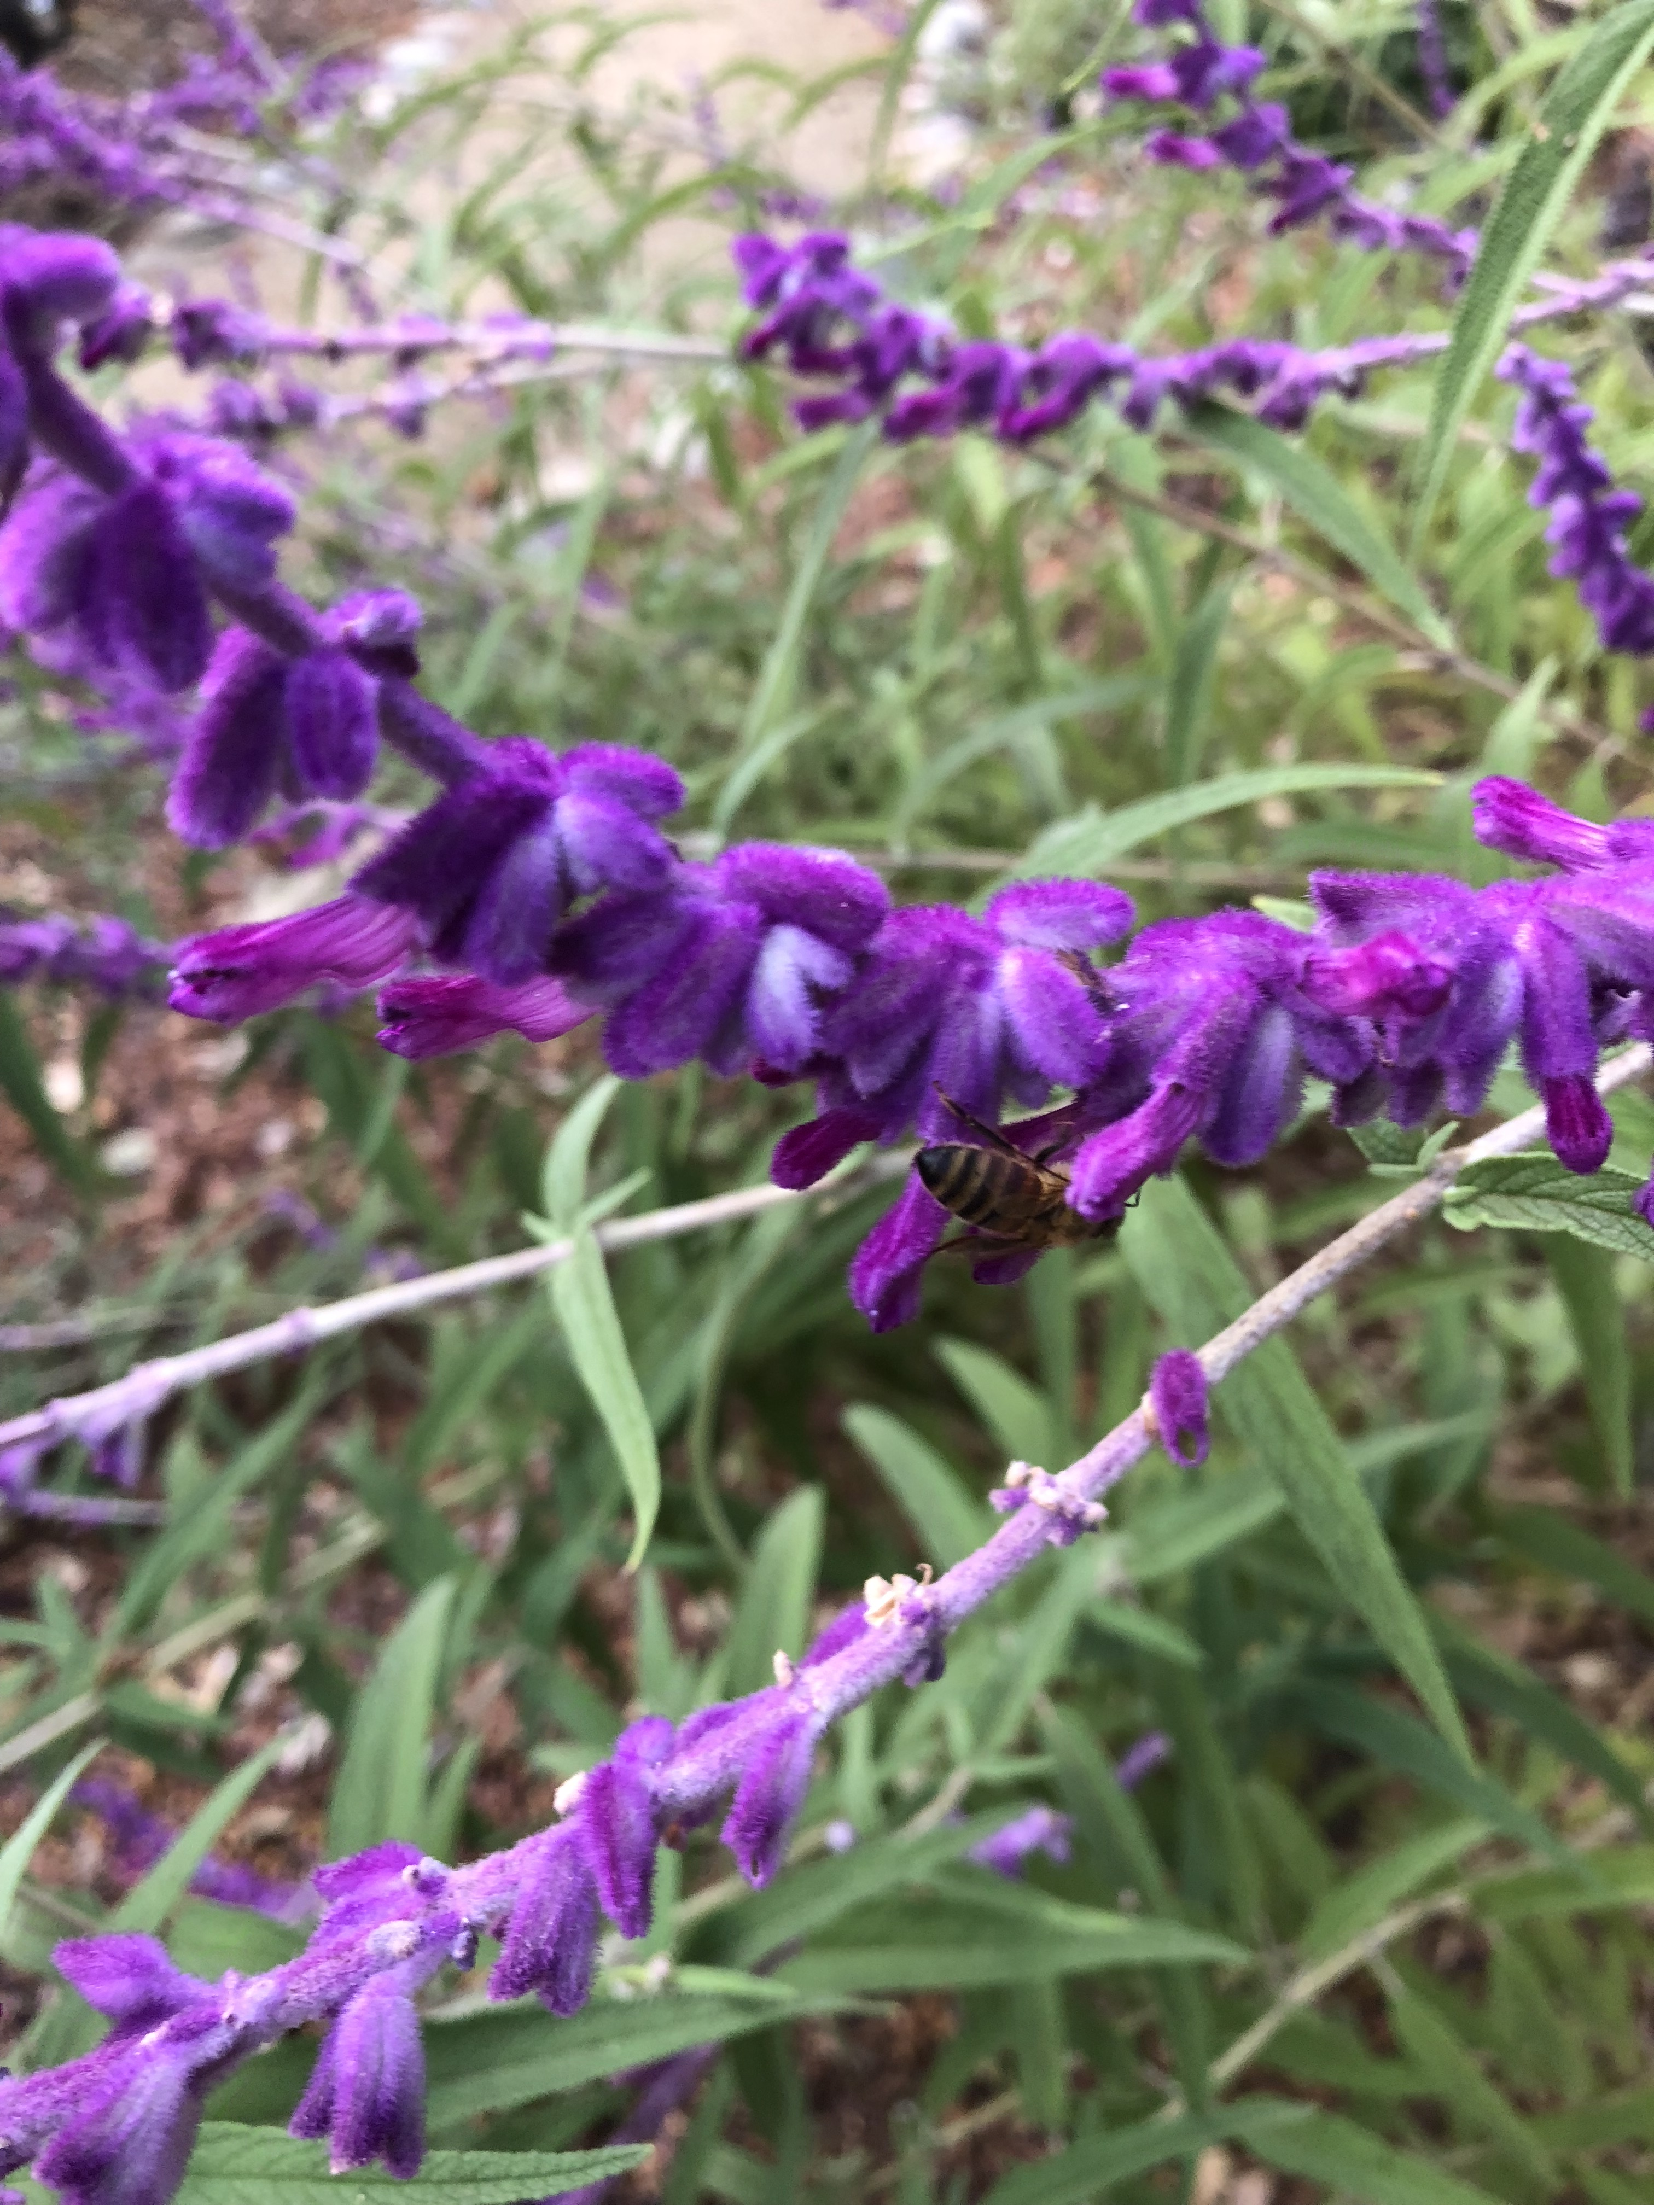
SALVIA LEUCANTHA
Mexican bush sage
Notes:
This is one of my favorite sages. It just seems to never stop growing and like all stages it is visited by all kinds of pollinators, especially hummingbirds. Cut old stems to the ground; this Salvia doesn’t stop blooming. You can grow it from pieces of old clumps with roots attached. It is so forgiving.

Slide 13
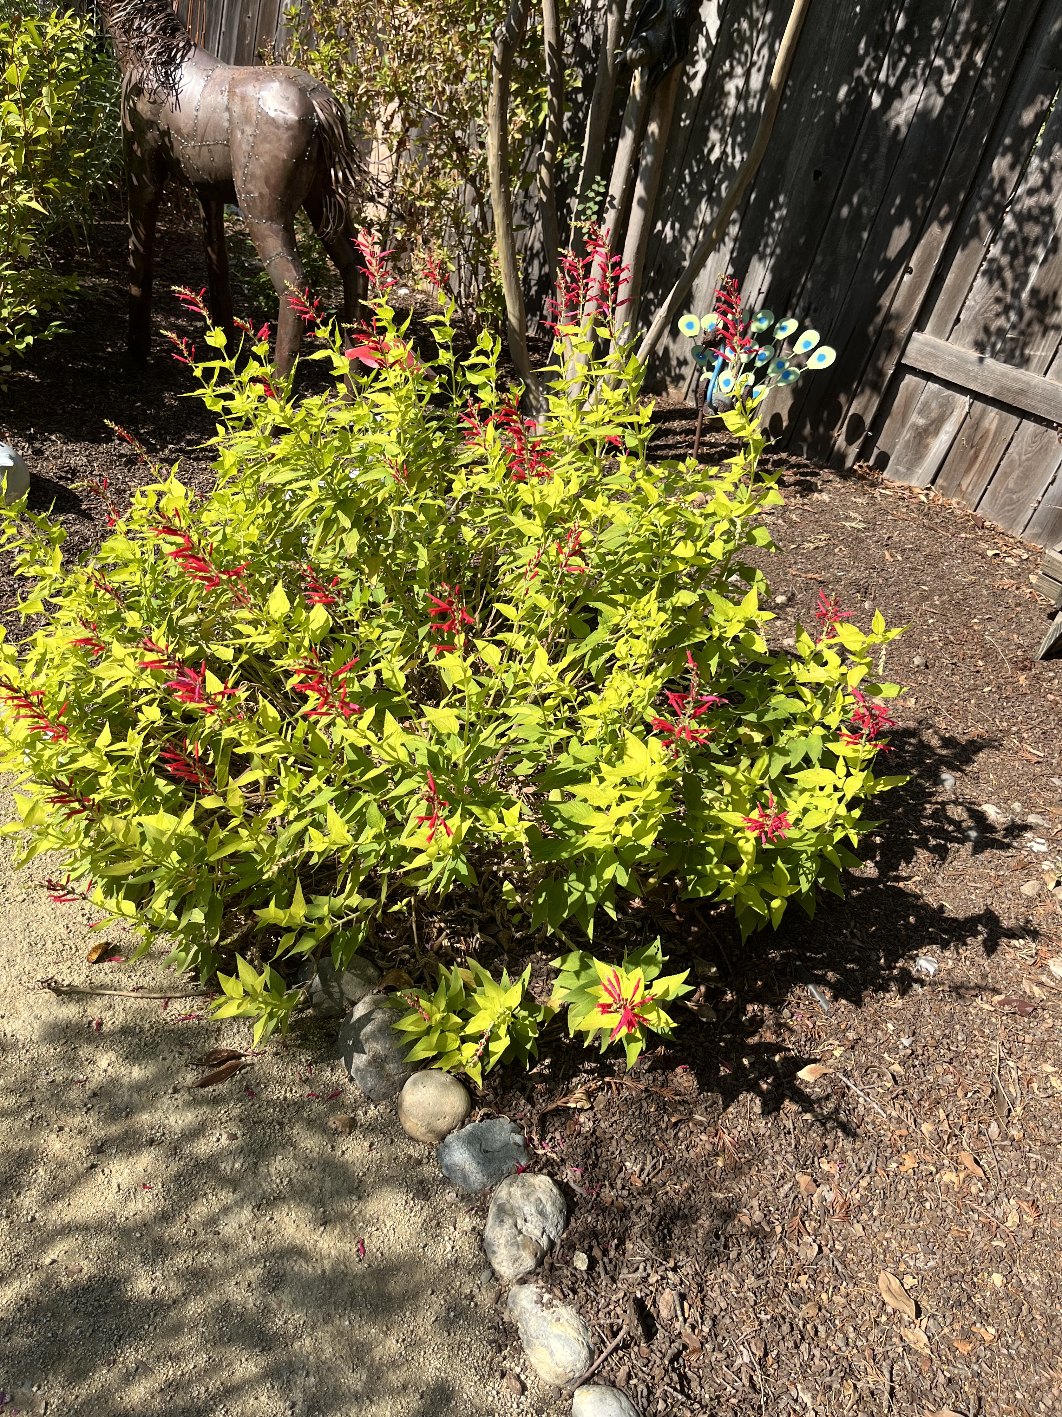
SALVIA ELEGANS
Pineapple sage
Notes:
The leaves of this unique Sylvia actually smell like pineapple. The one pictured above is called golden delicious. I often use the leaves on top of my roast pork roast in the oven. It has a wonderful fragrance in the garden.

Slide 14
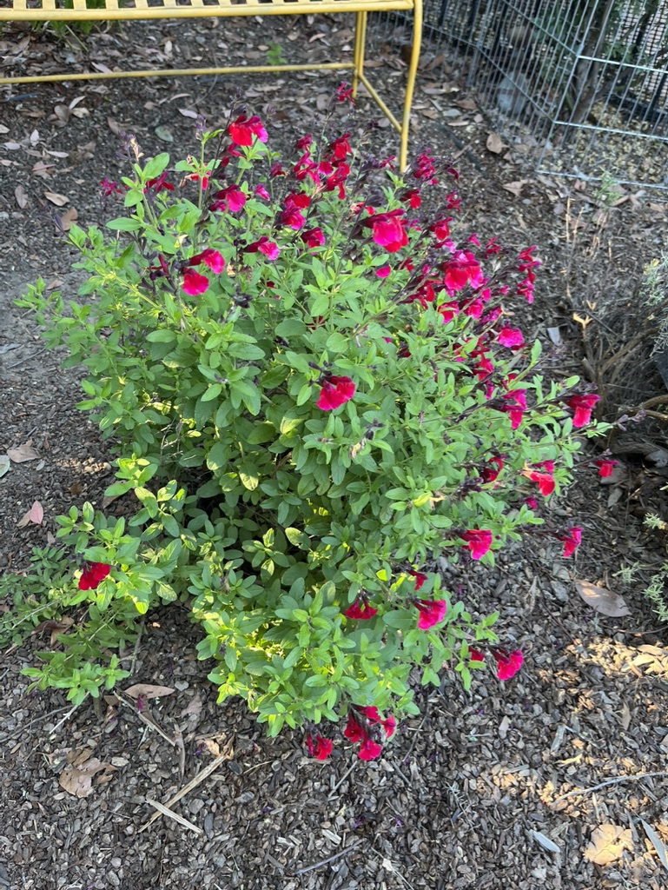
SALVIA ‘MIRAGE’ cherry red sage
Notes:
‘Mirage’ is a type of Salvia greggii. Growing to only about 18" tall, this low growing salvia makes an excellent container plant. Like other salvias, is drought tolerant once established and blooms throughout the Spring, Summer, and Fall months. Deer and rabbit resistant. Perennial zones 7-9.

Slide 15
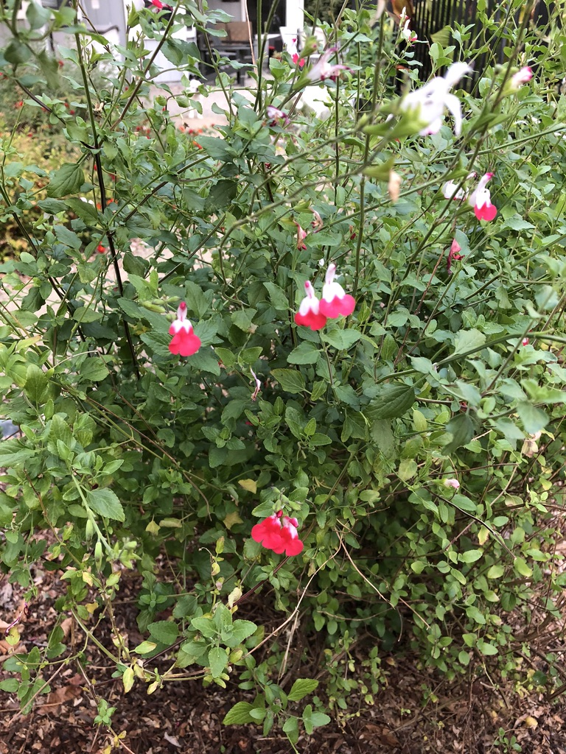
SALVIA ‘HOT LIPS’
Notes:
This Salvia is one of the most popular. It has lipstick, red flowers, and some spring and summer turning white at the end of the growing season. and pollinators. Growing to only about 18" tall, this low growing salvia makes an excellent container plant. Like other salvias, is drought tolerant once established and blooms throughout spring and summer. It is a recipient of the prestigious Award of Garden Merit from the Royal Horticultural Society.

Slide 16
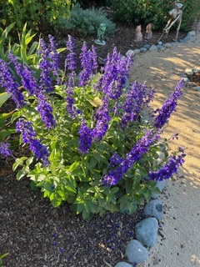
SALVIA ‘MYSTIC SPIRES’

Slide 17
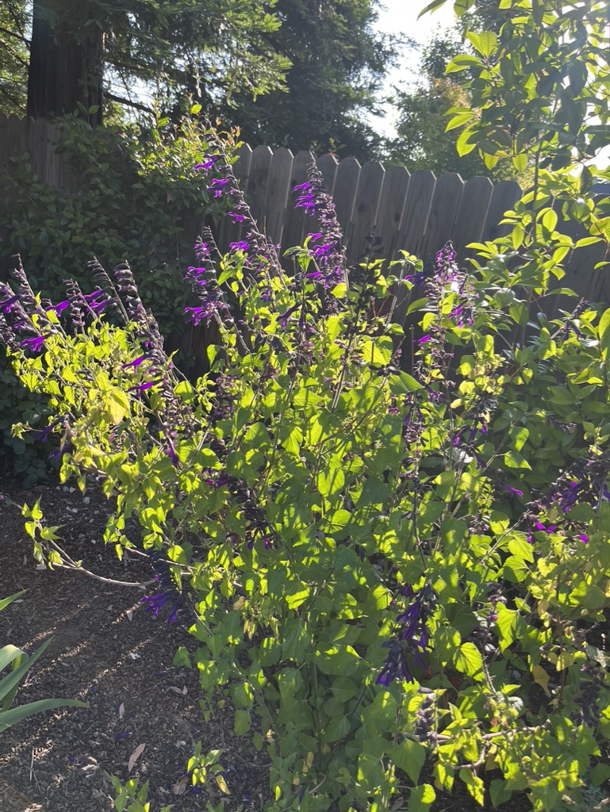
SALVIA ‘AMISTAD’
Notes:
This Sylvia is a hummingbird magnet. Amistad is more compact and has a fuller habit then other guaranitica types. Spring to frost.

Slide 18
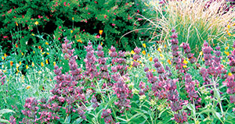
Arboretum All-Star Favorites:
Perennials
Salvia spathacea
hummingbird sage
Easy to grow
CA native plant
Pleasant, fruity fragrance
Excellent drought-tolerant groundcover for sun or shade
Attracts hummingbirds
Full sun to part shade
Notes:
Photo: UCD Arboretum All-Stars https://arboretum.ucdavis.edu/allstars_browse.aspx?i

Slide 19
HISTORY OF SALVIAS
The term Sage is used for the culinary variety and is native to the Mediterranean region
Salvia is the term used for ornamentals and originated in Oaxaca, Mexico.
Notes:
Although sage is used as the term for the culinary variety, some have has attractive flowers as well some

Slide 20
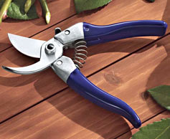
Tools
Clean sharp tools
Alcohol
Sanitizing spray
Pruning file
BY-PASS PRUNERS
Notes:
Clean tools after each use.

Slide 21
GROWING SALVIAS:
SOIL PREFERENCE
Salvias do best in well-drained soil,
& 6-8 hours of sun
Amend clay soil with compost before planting. A 2” layer of mulch around the plant will retain moisture and control weeds
Use WUCOLS classification for determining water needs.
Notes:
Salvias need 6 to 8 hours of sunlight per day, although some will do well in part shade, but flowering will be reduced.

Slide 22
GROWING SALVIAS:
Irrigation
Pruning, Deadheading
Don’t fertilize, just add compost
Pest Management. Check for aphids and fungus.
Notes:
Salvias need 6 to 8 hours of sunlight per day, although some will do well in part shade, but flowering will be reduced.

Slide 23
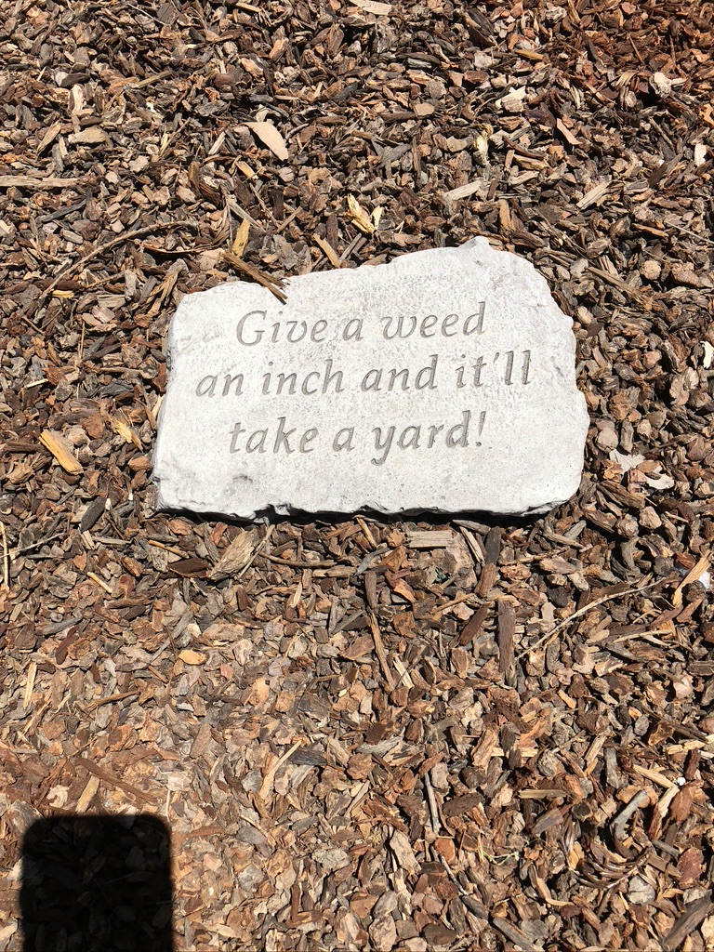
Controlling weeds is a must for any garden
Notes:
This is a sign on the ground in my garden to remind me all the time not let the weeds take hold.

Slide 24
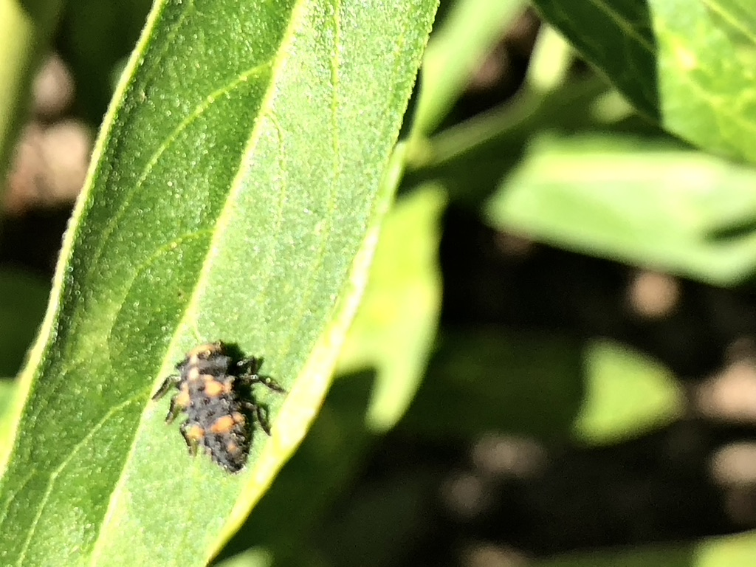
Friend - Lady beetle larva
Notes:
This is what a ladybug Largo looks like, so please don’t kill it. It’s a good guy. It’s just looks like an alligator.

Slide 25
RESOURCES
A Book of Salvias (Sages for every garden) Betsy Clebsch
Clemson University Home and Garden Information center Factsheet #114
https://hgic.clemson.edu/factsheet/salvia/
Invertebrate Conservation
https://xerces.org/blog/day-without-invertebrates
UC Davis Arboretum All-Star Database
https://arboretum.ucdavis.edu/allstars_browse.aspx?i
UC Davis Arboretum Blog Taylor Lewis
https://arboretum.ucdavis.edu/news/chasing-your-pozo-blues-aw
BOOK: Sunset Western Garden Book. Kathleen Norris Brenzel, Editor,
Sunset Publishing Company.

Slide 26
Thank You!
Any Questions?
Master Gardener Hotline: (530) 889-7388
Master Gardener Website: pcmg.ucanr.edu
Evaluations, please!

