Slide 1
GARDEN GREETER ORIENTATION
MGPC’s Demo Garden
April 2024
Notes:
Created: March 2024; updated April 2024
Created by: Diane Arnold, Marianne Calhoun, Placer County Master Gardener(s)
Audience: Description of intended audience
Publicity: Text that could be published on calendar, Facebook, newsletter to attract an audience
Update History: for each update to the presentation include date, name of updater, explanation of update
(were additional slides added, were web links updated, etc.)

Slide 2
AGENDA
Welcome
Development of Our Garden
Our Volunteer Program
Engaging Visitors
Volunteer Responsibilities
Intro to Garden Areas
Garden Exercise

Slide 3
I. WELCOME
Today is an overview:
    History of the garden
    Volunteer program and responsibilities
    Tips for engaging visitors
    Where to find garden info
2024 Schedule
Education Committee

Slide 4
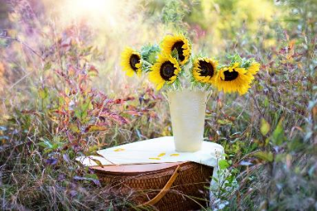
2024 Schedule
Open Garden following MG presentations:
  May 11
  June 8
  August 10
Spring Open Garden:
  June 1
Books for Kids:
  June 15
MG Docent Training
  June 23
MG Tour Guide Training
  August 24
Notes:
https://pixabay.com/photos/sunflowers-vase-bouquet-flowers-1719119/

Slide 5
Education Committee
Committee Co-Chairs:
  Becky Dirk, Beth Lantz & Sherry Murphy
Website Coordinators:
    Peggy Beltramo, Sherry Murphy & Barbara Villareal
  Publicity Coordinator:
    Becky Dirk
  Garden Information Coordinator:
    Beth Lantz

Slide 6
Education Committee - continued
  Volunteer Coordinators:
    Neal Clapper & Susan Gedney
  Group Tour Coordinator:
    Brooke Moeller
Education Trainers for Adult Tours:
  Diane Arnold & Marianne Calhoun
Education Trainer for Youth Tours:
    Lynda Alvarez

Slide 7
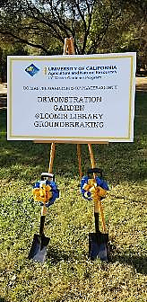
II. DEVELOPMENT OF DEMO GARDEN
Purpose
Historical Timeline
Design Goals
Funding

Slide 8
Purpose
MGs focus on visitor’s education and create enthusiasm for “Gardening for Today”:
  Water-wise, environmentally-focused, and inspirational
Our garden is a living classroom supporting education and workshops for the Placer County Community that emphasize:
  Sustainable gardening
  Integrated pest management
  Backyard food production

Slide 9
Historical Timeline
2021
2022
  January
  Loomis Library and Community Center (LL) proposed demo garden to MGPC.
  March
  Communication begins to create MOU between Regents of the University of California (UC), LL, UCCE MG Program, and Town of Loomis.
  November
  LL Board approves resolution in support of demo garden.
  February
  MG Board approves Ad Hoc Design Committee’s Design Program.
  March
  MG Board approves Demo Garden Plan Package.
  July
  UC, LL, and Town of Loomis approves Memo of Understanding (MOU) for educational purposes!!!

Slide 10
Historical Timeline - continued
2023
2024
  January
  Steering Committee of MG, LL, and Town of Loomis meet for first time.
  March
  MG Board approves Cal Wild Landscape Design's proposal.
  September
  Public ground breaking occurs.
  Site Wise Construction begins work.
  November
  MGs begin installation of irrigation, garden beds, plant plants, mulch, etc.
  March
  Public ribbon-cutting ceremony for nine garden areas, including compost!
September (goal)
  Group tours begin

Slide 11

Design Goals
Aesthetics:
  Attractiveness
  Scalability for home gardeners
Accessibility and Safety:
  Compliance to American for Disabilities Act (ADA), CA Building Code, Fire and Life Safety, other codes
  Communication aids
  Open views for safety; and fire-wise
Hardscape:
  Paths with easy circulation, drainage and maintenance
  Gardens with access to utilities
Notes:
https://www.istockphoto.com/search

Slide 12
Design Goals - continued
Historic Context:
  Preserve existing natural features/memorials
  Consideration of historical references: property, library, town, county
Signage:
  Easy to comprehend
  Donors and sponsors thanked at entrance, exit or other
  QR codes consideration for learning and tracking visitors
Sustainability:
  Installation, maintenance and usage for resource-efficiency and water-wise
Visitor Comfort:
  Gathering areas (shelter, moveable seating, drinking water)
  Access to restrooms

Slide 13
Funding
July 1, 2023 – March 1, 2024:
Garden completed with the generosity of dozens of individuals and numerous community organizations and businesses. MGPC donated 1,800 volunteer hours.
Multi-tiered program recognizing contributors:
Individual tiles on the Sponsor Wall, near the straw bale garden bed
Contribution levels include: Oak at $10,000; Willow at $5,000; Manzanita at $2,500; Ceanothus at $1,000; and Sunflower at $500
Significant donors include:
Placer County Water Association (cash and rebates), rock retaining wall by Parsons Retaining Wall, shed by Western Roofing Group, native plants by Xerces Society, interpretive signage by the Nevada County Master Gardeners, and mulch/compost from Loomis Recycling
Buy-A-Brick campaign:
Initiated by Friends of the Loomis Library for engraved bricks to be installed around our entry water fountain. 80% of the proceeds are generously donated to MGPC. Donations are still appreciated!

Slide 14

III. OUR VOLUNTEER PROGRAM
  Volunteer Characteristics
  Three Levels of Volunteering

Slide 15
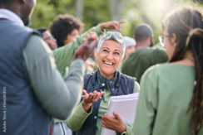
Volunteer Characteristics
  Warm and friendly
  Enthusiastic and authentic
  Knowledgeable and confident
  Minimal lecture + maximum interaction
  Strives for interpersonal rapport with visitors
  Helps visitors apply information learned to own gardens
Notes:
https://www.istockphoto.com/search

Slide 16
Volunteer Characteristics - continued
  Open-minded to learn from visitors
  Doesn’t impose judgments or put a visitor on the “spot”
  Flexible in adapting content to meet visitors’ needs
  Awareness and sensitivity to visitor’s age groups, learning styles, cultural backgrounds, and special needs

Slide 17

Three Levels of Volunteering
Garden Greeter:
  Treats everyone as a personal guest
  Introduces visitors to garden
  Actively listens to visitors
  Keeps visitors and garden safe
  References Pocket Summaries
  Two-hour shifts following MG presentations and Open Garden days
Notes:
https://www.istockphoto.com/search

Slide 18
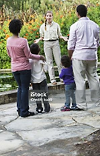
Three Levels of Volunteering - continued
Trained Docent:
  Same expectations as a Garden Greeter
  Training includes:
    Building confidence
    Asking questions using Inquiry and Discussion methods (best for adults) for each garden area
Notes:
https://www.istockphoto.com/search

Slide 19
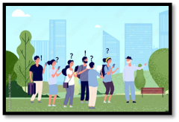
What is a Docent?
  Latin word “docere” – to teach
  Traditional definition – an unpaid lecturer
  Newer definition “…a guide for a visitor’s journey of discovery helping them to blend what they already know with what they learn on the tour.”
Notes:
Quote from: Workshop Leader’s Copy of “How Do I Become a Great Docent?” https://repository.library.csuci.edu/bitstream/handle/10139/4162/Docent_Training_Workshop_050711$.pdf?sequence=1
Picture: https://www.istockphoto.com/search

Slide 20

Three Levels of Volunteering - continued
Tour Guide:
  Same expectations as a Trained Docent
  Training includes:
    Introducing yourself with a prop
    Planning tour logistics
    Focusing on learning outcomes
    Sharing garden rules
    Practicing in small groups
  Additional training for leading youth groups using Guided Discovery methods
Notes:
https://www.istockphoto.com/search

Slide 21

Now That You Know…
With a show of hands:
  How many have interest in the Trained Docent training?
    Sunday June 23rd, 1-3 pm at Loomis Library
  How many have interest in the Tour Guide training?
    Saturday August 24th, 1-3 at Loomis Library
  Please sign-up on VMS
    Not necessarily a commitment but an indicator to help us with planning

Slide 22

IV. ENGAGING VISITORS
Effectively engaging visitors uses
good communication skills & taps into
the power of balancing of words, vocals, and
nonverbal communication elements.
Positive results
Communication elements
Notes:
https://www.istockphoto.com/search

Slide 23
Positive Results
  Immediately engages visitor
  Connects you to visitor
  Visitor better able to apply information to their gardens
  Increases retention of information received
  Creates interest
  Sets the tone for the time together

Slide 24


Communication Elements
Use interactive learning vs. lecturing:
  All lecture = visitor in a passive role = passive listener = less information retained
And then… Furthermore…Also…
Help me!

Slide 25

Communication Elements - continued
Maximize interactive learning with visitors
by balancing words, vocals and nonverbals.
This will increase visitors willingness to remember
and understand your message!
Nonverbals
(55%)
Vocals
(38%)
Words
(7%)

Slide 26
Tips for Meaningful Engagement
Words (7%):
  Actual words we speak
  Tips
    Choose appropriate vocabulary:
    Adults vs. children
    Mixed group, vary words to keep interest
  Must speak the same “language”:
    Avoid using slang and jargon
    Keep it simple silly (KISS)
  Use positive words
  Ask questions

Slide 27

Tips for Meaningful Engagement - continued
1. Words - continued
Questions Help Create Interactive Learning
Ask questions to draw visitor into the experience:
  Use thought-provoking questions to set the tone for the time together
  Use open-ended vs. closed-ended questions
  Allow time for visitor to respond
  Know the answers to your questions ahead of time!
Notes:
https://www.istockphoto.com/search

Slide 28
Tips for Meaningful Engagement - continued
Questions Help Create Interactive Learning- continued
When you are asked questions:
  Repeat or paraphrase question for all visitors to hear;
  Keep answer simple
  If don’t know answer, offer to find out
  If question not related to topic, redirect visitor

Slide 29


Tips for Meaningful Engagement - continued
2. Vocals (38%). How we say the words:
  Volume
  Pitch/Inflection
  Rate of Speech
  Speak at 120-150 words/minute
      Can listen at 400-500 words/minute
Articulation/Pronunciation
Tips
  Speak loudly and clearly:
    Competing with outside noise
  Vary tone of voice for emphasis
  Use to express emotions and enthusiasm
Notes:
https://www.istockphoto.com/search

Slide 30


Tips for Meaningful Engagement - continued
3. Nonverbal (55%):
Personal appearance
  Clothing, height, weight, age, ethnicity, etc.
Facial expressions
  Eye contact, smiling, frowning, etc.
Physical expressions (movement)
  Posture, gestures, walking, etc.
Physical environment
  Temperature, room, tables, etc.
Space (proxemics)
Notes:
https://www.istockphoto.com/search

Slide 31
Tips for Meaningful Engagement - continued
3. Nonverbal/Body Language – continued
  Tips
  Establish rapport:
    Smile
    Make eye contact
    Use relaxed and open posture
    Share a personal story or anecdote related to topic
  Use gestures as appropriate
  Listen attentively:
    Eye contact
    Nodding/shaking your head
    Leaning forward or backward

Slide 32

V. VOLUNTEER RESPONSIBILITIES
Arrive 15 minutes early
Wear MG apron and name tag
Collect ring of Pocket Summaries from garden shed
Familiarize yourself with the garden conditions
Welcome and thank visitors for coming
Explain bathrooms are located in the library
Notes:
https://www.istockphoto.com/search

Slide 33
Volunteer Responsibilities - continued
Direct visitors to MG website for more information
Garden Administrator
  Will determine procedures for:
  tracking visitors
  addressing safety issues
  reporting any maintenance issues
Volunteer Coordinator
  Will collect comments & questions after each volunteer day
  Will share with Garden Administrator & Education Co-Chairs

Slide 34
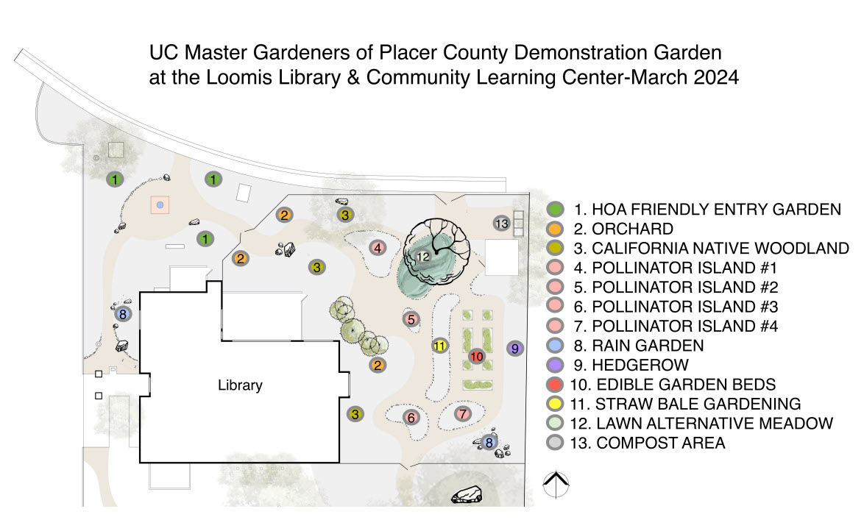
VI. INTRO TO GARDEN AREAS
Total Size: 1/3 of an Acre

Slide 35
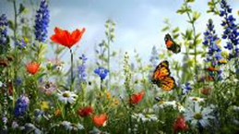
Intro to Garden Areas - continued
We aim to update information quarterly:
Pocket Summaries
Same information posted/found:
  in each garden area
  on MG Demo Garden webpage
  in this Orientation PPT
Topics include:
  What’s blooming/fruiting
  Benefits
  Fun facts
Notes:
https://www.istockphoto.com/search

Slide 36
Intro to Garden Areas – continued
Plant Labels:
Approximately 200 plants
10% edible & 90% ornamental
Lists common name and scientific name
QR codes lead to research based information
HOA APPROVED DROUGHT TOLERANT
Festuca idahoensis
Muhlenbergia rigens
Achillea millefolium
Epilobium ‘Everett’s Choices’
Erigeron x ‘Wayne Roderick’
Iris douglasiana
Monardella villosa ‘Russian River’
Penstemon heterophyllus ‘Blue Spring’
Salvia clevlandii ‘Poza Blue’
Arbutus undeo
Arctostaphylos densiflorus ‘Howard McMinn’
Arctostaphylos uva-ursi
Ceanothus thyrsiflours ‘Skylark’
Ceanothus ‘Yankee Point’
Heteromeles arbutifolia
Rhamnus californica ‘Eve’s Case’
Cercis occidentalis

Slide 37
1. HOA Friendly Entry Garden
The HOA (Homeowners’ Association) Friendly beds are planted with cultivars and straight species of California native plants. These are plants that thrive in our Mediterranean climate, support local biodiversity, and differing bloom times, textures and heights.
To be included in the garden, plants should meet these requirements:
Readily available to the home gardener, free from pesticide and supportive of local ecology
Attractive year-round and provide seasonal interest
Low to very low water and maintenance requirements
Mostly evergreen, and deer resistant
As in residential yards, utility equipment is an unfortunate focal point. Therefore, every effort has been made to choose plants that will screen or hide these obstacles.
Straight species of Deer grass, Toyon, and Western redbud
Concha was selected to screen the HVAC system
Since Loomis Library doesn’t have gutters to steer runoff, rain garden plants of Carex and Juncus have been planted along the front of the building. These plants also do well in summer when there is no rainfall.
Groundcovers in the entry garden include California fuchsia, Coyote brush, Manzanita, and Yarrow.

Slide 38
2. Orchard
Seven fruit trees are part of our Demo Garden, including Pome (Apples and Asian pear), Stone (Plum, Cherry and Pluot) and Citrus ( Satsuma mandarin orange and Meyer lemon). There is also a Strawberry guava and four Blueberry bushes.
All fruit trees should be under 7 feet tall in order to be maintained without ladders
Asian pear is espaliered
Apple trees are espaliered, one is a “6 in 1” multi-graft
Compact stella cherry and Meyer lemon are grown in large pots, illustrating that small spaces can have fruit trees
Satsuma mandarin orange is grown in a raised bed with other edibles
The fruit flowers provide pollen and nectar for the bees and butterflies during the spring season. No chemical pest or disease controls are utilized
Trunks are painted white to prevent sunburn which causes cracks that allow further/deeper burning and access for critters to burrow in. The paint is a 50/50 mixture of interior latex paint and water
The areas around most fruit trees have a thick mulch for soil health and weed control.

Slide 39
3. California Native Woodland
Foothill Woodlands habitat is the natural habitat for much of this part of Placer County. Native plants, well adapted to our region, support local birds and butterflies plus give our gardens a “sense of place”.
Common trees include Blue oak, Interior live oak, and Valley oak.
Understory plants include Buckbrush, Coffeeberry, Manzanita, and Redbud.
Wildflowers include Brodiaea, Iris, Larkspur, Lupine, Mariposa lily, Miner’s lettuce, Shooting star, and Yarrow
Specific plants to look for throughout our Demo Garden:
Blue elderberry: multi-branched shrub with creamy-white flowers in the Spring and purple berries in the Summer. Favorite of birds and pollinators plus sole host for threatened Valley Elderberry Longhorn Beetle
Deergrass: Large ornamental grass is low maintenance with low water use
Hummingbird sage: grows well in shade/part shade under trees and large shrubs. It’s drought tolerant and can survive without summer irrigation once established; some supplemental water will keep the foliage green
Redbud: showy shrub with magenta-pink flowers in the Spring, round lily-pad shaped leaves in Summer, and yellow Fall foliage; low maintenance and low water use
Seasonal pairing: purple blooms of Coyote mint and yellow flowers of Sulphur buckwheat occur together naturally in the Sierra Foothills which are a striking color combination and irresistible pollinator magnet

Slide 40
4. Pollinator Island #1
This bed features plants that are attractive to bees, butterflies and hummingbirds.
All of these flying creatures are considered to be pollinators, meaning they transfer pollen from one flower to another as they either sip nectar or actively or inadvertently pick up pollen as they go.
Common Yarrow has clusters of disc-shaped flowers (called umbels) which provide nectar and pollen for bees, butterflies and ladybugs. In fact, ladybugs use this native Yarrow frequently as a “nursery”, where they lay their eggs and then the larvae hatch out. These are great plants to intersperse in your flower beds as well as veggie gardens, as the ladybug larvae are voracious eaters of aphids.
There are two varieties of Pincushion in this bed, both attracting butterflies and bees to this garden.
Black pincushion
Florists pink pincushion
Do you see a shallow terra cotta saucer in this bed? This is called a “puddling station” and is filled with a damp mixture of sand, compost and a few larger stones. Butterflies will use this station to gather moisture and to extract minerals needed for reproduction. The larger stones are for perching. In the wild, you can observe butterflies sipping near a sandy moist pond or river edges.

Slide 41
5. Pollinator Island #2
This bed features plants that are attractive to bees, butterflies and hummingbirds. All of these flying creatures are considered to be pollinators, meaning they transfer pollen from one flower to another as they either sip nectar or actively or inadvertently pick up pollen as they go.
Chick lupine is a favorite pollinator plant for many species of native bees, including Mason bees, gentle solitary bees which are excellent early season pollinators during fruit tree bloom time. This annual plant is also a possible larval host for many species of butterflies and moths.
Purple needlegrass has been our state grass since 2004. Its deep roots make it good for erosion control. Birds will eat the seeds and a few butterflies use the plant as a larval host plant. (The female butterfly will lay eggs on them and the resulting caterpillars eat the plant as “baby food”.)
Tower of jewels is a biennial plant that blooms in its second year. (The first year grows a large rosette of silver leaves.) It is a super plant for hummingbirds and bees. The plant can reach up to 8’ high, is deer resistant and is drought tolerant. It has blue pollen! Be sure to check the bees that visit for this pollen.

Slide 42
6. Pollinator Island #3
This bed features plants that are attractive to bees, butterflies and hummingbirds. All of these flying creatures are considered to be pollinators, meaning they transfer pollen from one flower to another as they either sip nectar or actively or inadvertently pick up pollen as they go.
In this bed are several species of native Milkweeds that are the larval host plants that are used exclusively by Monarch butterflies for laying their eggs. This bed features two of Placer County’s Milkweed species:
Narrowleaf milkweed
Showy milkweed
These plants go dormant in late fall (completely dying to the ground) and return again in spring. Their flowers are very attractive to bees.
Bee balm is a terrific pollinator plant, especially attractive to bumble bees. You may notice quite a crowd nectaring at the same time.
Coyote mint is an excellent plant choice of a native groundcover for nectaring butterflies.

Slide 43
7. Pollinator Island #4
This bed features plants that are attractive to bees, butterflies and hummingbirds. All of these flying creatures are considered to be pollinators, meaning they transfer pollen from one flower to another as they either sip nectar or actively or inadvertently pick up pollen as they go.
Desert globemallow is attractive to bees and butterflies for its pollen and nectar, as well as being a larval host plant for butterflies and moths. Many cavity nesting bees seek out its hollow or pithy stems in which to lay their eggs and where their larvae can form.
Support native bees by growing pithy-stemmed plants like Desert globemallow and by leaving 8-12” cut lengths of attached spent stems to allow bees to use them!
This bed features the third Placer County Native milkweed, Woollypod milkweed, an important larval host plant for Monarch butterflies.
Hummingbirds and butterflies love Hummingbird mint, Tall verbena, and Wild bergamot.
Bees of all kinds are especially attracted to Rock purslane, which is a succulent.

Slide 44
8. Rain Gardens
A rain garden collects rainwater, holds it for a limited amount of time, and filters it before slowly releasing the water into the ground. It collects rainwater from surfaces such as roofs, pavements, driveways, patios, parking lots, or waterlogged yards, allowing the water to slowly seep back into the ground, preventing runoff from reaching local waterways. A rain garden is not a water garden since rain gardens are mostly dry and drain within 12-48 hours.
Benefits
Protects the environment by reducing runoff pollution
Reduces runoff by being placed in a location enabling the garden to collect water
Provide food and shelter for wildlife and pollinators, such as butterflies
Controls soil erosion
Reduces mosquito breeding problems when standing water is eliminated/reduced
How to Design a Rain Garden
Determine if soil is suitable - does not have heavy clay soils
Location - fed by one or two downspouts, 10 feet from buildings, not over utilities, near a septic tank or well
Depth - typically 4 to 8 inches and not to exceed 8 inches
Shape - crescent, oval, teardrop or kidney are more appealing than a rectangle
Plant Selection - Native plants that tolerate variable moisture
Enhancements - rock, stonework, fences or other ornaments

Slide 45
9. Hedgerows
Hedgerows are dense vegetation (perennial grasses, shrubs, and trees) planted along the edges of fields.
An ancient feature of agricultural landscapes throughout the world, hedgerows are increasingly recognized for their significant ecological benefits. These benefits include:
Increases biodiversity with habitat for wildlife including birds, insects and mammals
Serves as field boundaries and creates natural windbreaks
Improves ecosystem function and resiliency
Protects and improves both water runoff and groundwater quality
Provides supplemental food such as fruits, nuts, and herbs
Supports natural enemies of common crop pests and crop pollinators
Hedgerows planted primarily with California natives support higher populations of common and rare birds.
Our hedgerows use plants found in the Sierra Foothills: Coffeeberry, Redbud, and Sentinel manzanita

Slide 46
10. Edible Garden Beds
These beds have seasonal (Cool and Warm Season) vegetables and berries planted in the ground plus in five raised beds (including one accessible bed).
Culinary Herbs and Edible Flowers are planted in Raised Beds, Terra Cotta Pots (demonstrating container planting for smaller home/apartment growing possibilities) and in Orchard area Ground Cover.
4’ x 4’ Beds are demonstrating Hügelkultur (German word meaning ‘mound culture’) growing plants in decomposing organic materials, providing natural long-term fertilizer as well as reducing water and irrigation needs.
In ground Bed planting of Native American style of the ‘Three Sisters’ (Corn, Beans and Squash) which provide each other support while growing, soil Nitrogen, and water retention.
All edible plant flowers provide pollen and nectar for the bees, butterflies, and moths.
No chemical pest controls are used. Plants have been purchased from nurseries that do not use herbicides or pesticides.

Slide 47
11. Straw Bale Gardening
This illustrates how to create a beautiful garden with straw bales.
Benefits
Cheapest raised bed
No soil or weeding required
Less water consumption
Extends the growing season
Plenty of room to plant- top, sides, and end of bales
Creates super compost at end of growing season
How to construct a Straw Bale Garden
  To deter Gophers place hardware cloth on the bottom of the bale
  Place string bale cords on the side and ensure no herbicide has been used
  Pretreat 2 weeks before with high nitrogen fertilizer. Bacterial composition turns into a warm , fertile planting ground
  End of 2 weeks apply balanced fertilizer (10-10-10)
Use a trowel to dig holes in the bale
Add a handful of sterile plant mix, seeds/plants and a dose of water

Slide 48
12. Lawn Alternative Meadow
Native Mow Free grass from Delta bluegrass is versatile and adaptable to different mow heights. This slow growing, shade tolerant, fine-textured grass can be mowed at 4-6 inches or left unmowed as a beautiful garden meadow.
Because native grasses are adapted to survive in almost any soil condition, they require little to no inputs such as fertilizer or pesticides plus use significantly less water. Landscaping with native grasses can be a wise environmental decision, especially when combined with California native trees, shrubs, and wildflowers. Benefits to homeowners and our environment including providing food and shelter to beneficial insects, butterflies, ladybugs, and wildlife.
SHADE TREE
With limited space to feature one shade tree, we chose the Chinese pistache. This drought and heat-tolerant tree, reaching 25-35’ tall, has a wide spreading canopy with a deep vivid red Fall color. A great deal of pruning is not required to keep the tree strong and attractive. As this tree can be somewhat invasive in wetlands, we planted the easily found male cultivar called ‘Keith Davey’.
(A close second was the Chitalpa tree, a cross between our native Desert willow and non-native Catalpa. It’s a deciduous small tree with attractive orchid-like flowers. This tree does well in low to moderate water and full sun.)

Slide 49
13. Compost Area
Benefits of Composting
Easy, low cost, and a compost pile can fit any yard
Aids the environment and improves soil structure by increasing water holding capacity, supplies
nutrients to plants, feeds micro-organisms, and reduces the need for expensive chemical fertilizers
Different types of composting bins: 3 Bin System; Geobin; RUEC Garbage Can; Tumbler
Particular system depends on
Labor and Cost - How much time and money can you invest?
Rate of Results - Faster results require close supervision
Organic Material Availability - This makes a big difference!
What layers go into the pile?
Nitrogen or “greens” - vegetable or fruit scraps, grass clippings, coffee grounds, manures and alfalfa hay
Carbon or “browns” - dry leaves, straw, sawdust, wood chips, corn stalks, and cardboard/paper
What does not go into the pile?
Diseased/infected plants, weeds that have gone to seed, or plants with severe insect attack
Cat/dog manures, meat, dairy, or fish
BBQ or wood ashes

Slide 50
Garden Exercise
This exercise will deepen your familiarization with our
13 garden areas plus introduce you to Pocket Summaries.
Please take 45–60 minutes to:
Choose a Garden Greeter Buddy
Visit each area & review corresponding Pocket Summary
Suggest 6-8 minutes at #1 Entry Garden
Suggest 6-8 minutes for four Pollinator areas
Suggest 4-5 minutes at the other eight garden areas
Return Pocket Summaries to Diane or Marianne
The garden gates will be closed at 3pm today

Slide 51
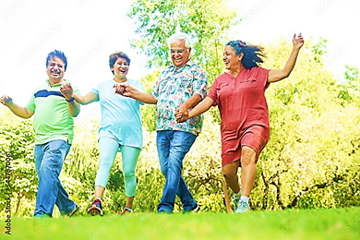
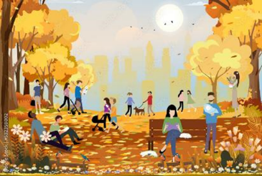
WRAP-UP
Thank you for listening to this orientation!
Please take your belongings with you.
Let’s go outside!
Notes:
https://www.istockphoto.com/search

