Slide 1
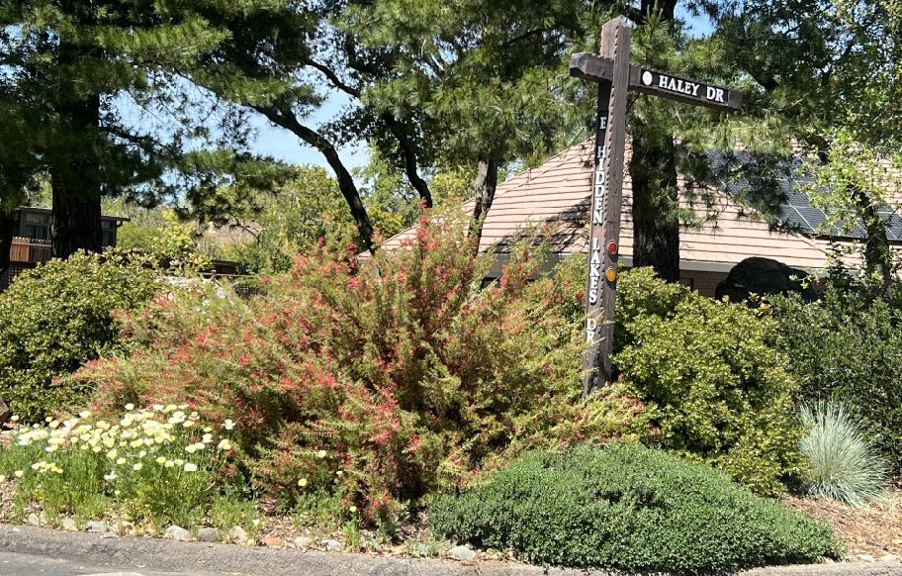
Water-wise Plants
for Year-round Color
Notes:
Created October 2023; approved December 2023; title modified June 2024
Created by: Marianne L. Calhoun & Louise Crosby,, UC Master Gardeners of Placer County
Audience: Hands-on gardeners transforming their garden to water-wise
Publicity: Do you desire a water-wise garden that positively impacts both humans and pollinators? Learn how to select low-water plants, to place in low water zones, and to irrigate with low water. We'll bring cuttings and focus on 16 desirable plants that together provide year-round color.
(Marianne + Louise)
Met as MG trainees five years ago + carpooled from our homes near Folsom Lake
L is a licensed Architect & M studied Landscape Design + Horticulture
for MG’s new demo garden, both on committee to create the Design Concept + Program
(Marianne)
after being raised on the East Coast, moved to the West Coast over 30 years ago;
documented the transformation of our property to a water-wise garden over six years;
now I’m passionate about sharing approaches, lessons learned, wonderful plants & resources with all of you!
(Louise)
-Born in Southern California and lived in central and northern California
-Architect working for the State-also interested in landscape design
-Experimented with native and Mediterranean plants in my own garden
* All photos are credited to Marianne Calhoun

Slide 2
Who Are Master Gardeners?
Master Gardeners of Placer County
Extend research-based, sustainable gardening + composting info
Present accurate, impartial information to home gardeners
Encourage public to make informed gardening decisions
Notes:
(Louise)
Marianne and I are Placer County Master Gardeners.
You may not know that volunteers like us are organized by county and we operate under the UC system.
We initially go through their excellent training program and have a required amount of annual Continuing Ed and Volunteer hours.
Did you Know?
This UC Davis program trains it’s volunteers and requires annual hours of service and Continuing Education be completed
There are 150 Placer County Master Gardeners to help the public with Gardening Information

Slide 3
Who Are Master Gardeners?
Online, in the Media, and Special Publications
Hotline: Call (530) 889-7388 or submit your questions online
Website: pcmg.ucanr.edu
Facebook, Instagram, X, YouTube
Gold Country Media monthly column
Curious Gardener quarterly newsletter on our website
Gardening Guide and Calendar
Workshops, Fairs and Festivals, and Special Events
Speakers by Request
Workshops (various venues, check website)
Farmers’ Markets (seasonal: Auburn, Lincoln, Roseville)
Fairs and Festivals Booths (varies)
Garden Faire (April)
Mother’s Day Garden Tour (May)
Notes:
(Louise)
You can find many excellent resources through our Placer County Master Gardener website.
Find Us:
Website-Sign up for our newsletter
Social media for events
information booth at Farmer’s Markets

Slide 4

RAISE
YOUR HAND
IF YOU:
Desire plants for yourself + beneficial wildlife?
Know the Sunset zone in which you live?
Research which plants thrive with low water?
Place plants in high, moderate + low water zones?
Notes:
(Marianne)
As you’ve learned a bit about ourselves & breadth of MG program
We’d like to learn about yourselves…
- These questions touched on topics that will be covered in our presentation

Slide 5
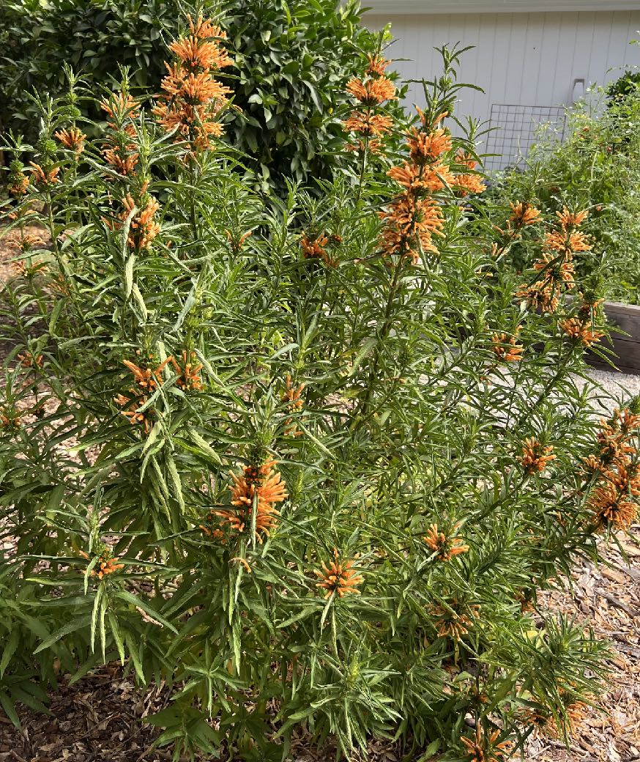
Colorful Low Water Plants
AGENDA
I. Making an Impact
II. Selecting Low Water Plants
III. Gardening with Low Water
Notes:
(Marianne)
Photo: Lion’s Tail, Leonotis
Discuss color + other design elements
Focus on 16 plants
Tips for success

Slide 6
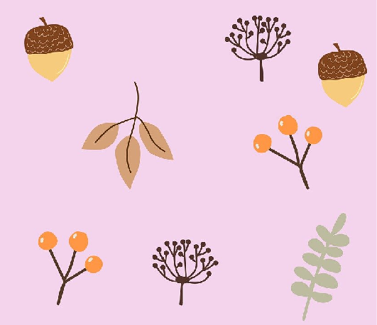

I. Making an Impact
PLAN FOR FOUR SEASONS
Humans desire year-round beauty and interest
Birds + pollinators need year-round food and habitat
Use masses of colorful long-blooming flowers
Contrast variety of textures, plant + flower shapes
Notes:
(Louise)
We want to show you a handful of water conserving plants that successfully provide landscape color and interest while providing food and shelter for wildlife over all four seasons.
Planting Design Basics
https://ucanr.edu/blogs/dirt/index.cfm?tagname=planning garden

Slide 7
COMMON NAME | WINTER | SPRING | SUMMER | FALL | ALL STAR
Western redbud | magenta flowers |  | seed pods | fall foliage | *
Manzanita | white flowers | white flowers |  |  | *
California lilac | blue flowers | blue flowers |  |  | *
Monkeyflower |  | apricot flowers | apricot flowers
Verbena |  | lilac purple flowers | lilac purple flowers | lilac purple flowers
Toyon | red berries |  | white flowers | orange berries | *
Coyote bush |  |  |  | white flowers
EXAMPLE:
HOA
FRIENDLY
ENTRY
GARDEN,
LOOMIS
LIBRARY
Notes:
(Louise)
We have a new Placer County Master Gardeners Demonstration Garden at the Loomis Library
Currently there are year round displays of colorful water conserving and home owner association friendly plants in the areas in front of the entry gate. Plants are located in masses for visual impact and pollinator attraction, while being contrasted with other massed plants. Repetition of plants throughout is use to create a harmonious design.
This chart shows just a small selection of plants used in this area (7 out of 18.) You can see which season an impact is made in terms of flowers or berries for each selection.
Please note that in our demo garden entrance, we are showcasing primarily ornamental plants from California.
For additional variety of low water plants, you may also consider plants from parts of the world with the same Mediterranean climate as ours.
https://arboretum.ucdavis.edu/arboretum-all-stars

Slide 8
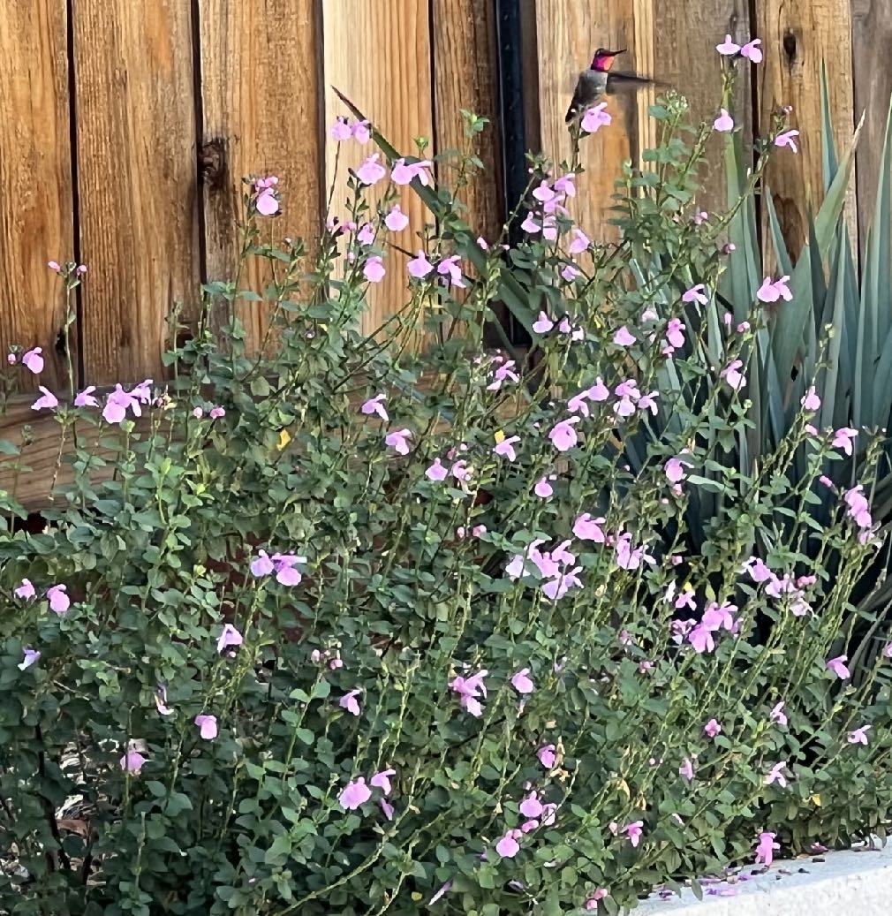
USE OF WARM COLORS
Evoke energy and excitement
Place as focal points in garden
Attract hummingbirds + butterflies
Consider plants vs. hummingbird feeders near windows
Notes:
(Marianne)
Photo: Mountain sage, Salvia
The Use of Color in your Garden
https://extension.psu.edu/the-use-of-color-theory-in-your-landscape
Which Flower Colors Best Attracts Pollinators & Birds?
https://extension.illinois.edu/sites/default/files/what_are_the_best_flower_colors_to_attract_pollinators-1.pdf
Meet the Pollinators
https://marinmg.ucanr.edu/PLANTS/POLLINATOR_HABITATS/Meet_the_Pollinators/
Landscaping Colors that Attract Birds to Your Yard
https://www.thespruce.com/colors-that-attract-birds-386400

Slide 9
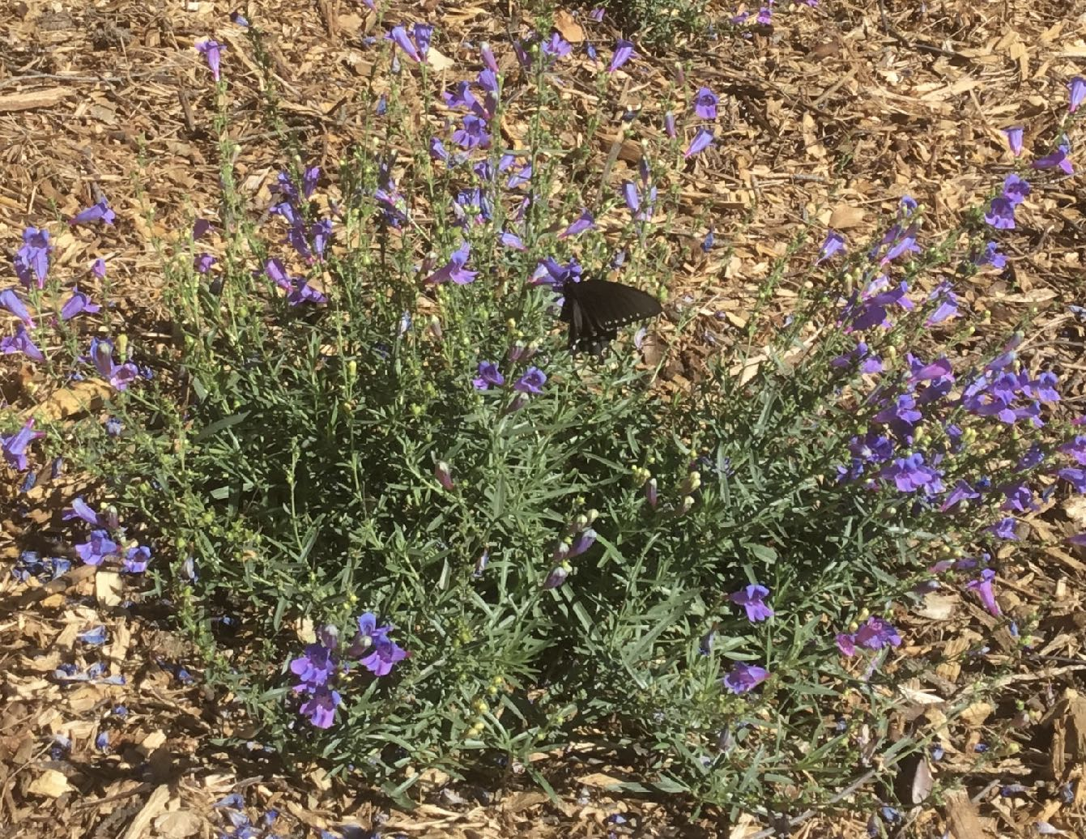
USE OF COOL COLORS
Elicit calm, quiet + coolness (welcome during hot summers)
Attract butterflies and bees
Place away from house to expand sense of space (+ keep bees afar)
Notes:
(Marianne)
Photo: Foothill Penstemon, Penstemon

Slide 10
YEAR-ROUND
Impact humans + beneficial wildlife
Contrast shapes + textures
Contrast deciduous + evergreens
Research flower colors + shapes
3’x3’ masses
Flowering shrubs: 3 or 5
Herbaceous plants: 3, 5 or 7
REPETITION
Notes:
(Marianne)
Two design elements to consider
Learned from Plant Composition class at Portland Community College
Note: odd numbers are preferable design approach
Any questions about making an impact with plants?

Slide 11
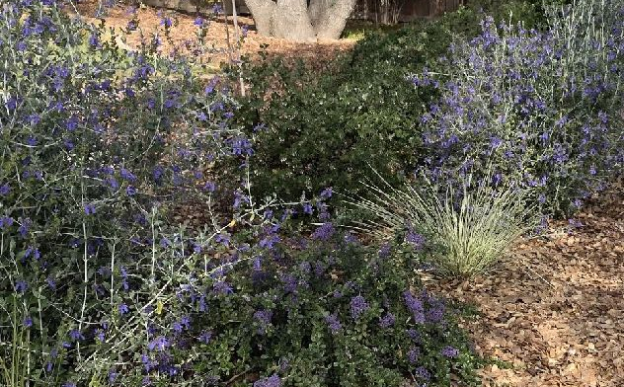
II.
Selecting
Low Water Plants
“Low water” vs. “drought tolerant” (plants thriving versus surviving)
Determine Sunset zone & soil
Seek plants that thrive in hot summers
Focus on flowering evergreen shrubs
Research water need of each plant
Select long-blooming plants (Handout)
Notes:
(Louise)
Drought-tolerant plants survive but not necessarily thrive when the water is restricted.
Low-water plants are already adapted to and live normally on less water.
https://ucanr.edu/blogs/blogcore/postdetail.cfm?postnum=25612
“Low water” versus “drought tolerant”
Determine Sunset zone & soil
Seek plants that thrive in hot summers
Research water need of each plant
Limited shaping and deadheading needs
Select long blooming plants
See Handout for 16 examples
Generally, the more water used, the more maintenance required such as mowing of lawns.
Low Water (objective in California via WUCOLS)
versus Drought tolerant (subjective)
(Confirm before you purchase)
To determine your soil:
https://ucanr.edu/sites/ucmgnapa/files/254561.pdf

Slide 12
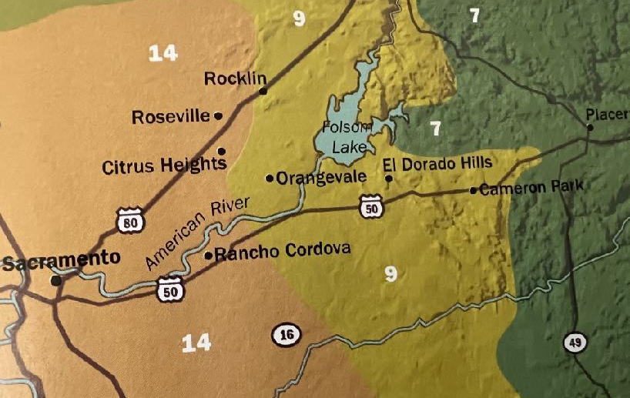
SUNSET
ZONES
#7 Foothills:
Hot Summer, Mild Winter
#9 Central Valley:
Hot Dry Summer
#14 Valley Floor:
Ocean Influence, Cold Winter
Notes:
(Louise)
For our Mediterranean climate zone, consider California natives and other plants from similar zones around the world such as Australia and the Mediterranean Basin.
The New Sunset Western Garden Book, 2012:
“cold, heat, humidity, wind, proximity to the Pacific Ocean, snow cover, and length of the growing season.”
Zone 7: Gray pine belt with hot summers and mild winters Foothills-higher elevations and east of Folsom Lake
Zone 9: Central Valley with hot dry summers and occasional tule fog in winter-surrounding the Folsom Lake area
Zone 14: Some ocean influence in cold-winter valley floor-Parts of Rocklin and Roseville
It is always helpful to visit nurseries that are within your same Sunset zone to obtain information on water, soil, sun requirements etc. You are more likely to find expert advice and plants suited to your area there. Even the plant labels may be more applicable.

Slide 13
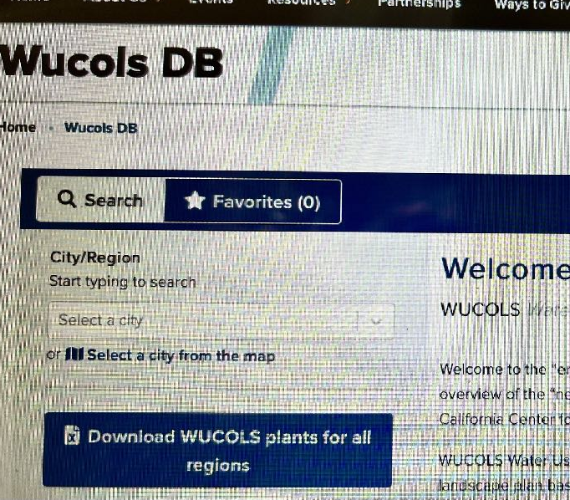
RESEARCH
WATER NEED
Water Use Classification
of Landscape Species
3,500 plants currently;
5,000 by end of 2024
Notes:
(Louise)
I’m wondering how many of you are aware of the Wucols data base on the UC Davis website?
this handy resource can help you select and zone low water plants even before your trip to the nursery.
It has data currently for 3500 plant groups and aims to provide water use data for as many as 5000!
You may consider this as a simple additional step to researching your plant selections.
(Louise)
I’m wondering how many of you are aware of the Wucols data base on the UC Davis website?
this handy resource can help you select and zone low water plants even before your trip to the nursery.
It has data currently for 3500 plant groups and aims to provide water use data for as many as 5000!
You may consider this as a simple additional step to researching your plant selections.
I’ve personally used this resource and was surprised at how simple it was to generate a list of plants to put together in my area. For Granite Bay, I used to closest and similar available location which was Loomis.
Water Use Classification of Landscape Species
https://ccuh.ucdavis.edu/wucols-db
enter your city;
enter Common or Scientific plant name

Slide 14
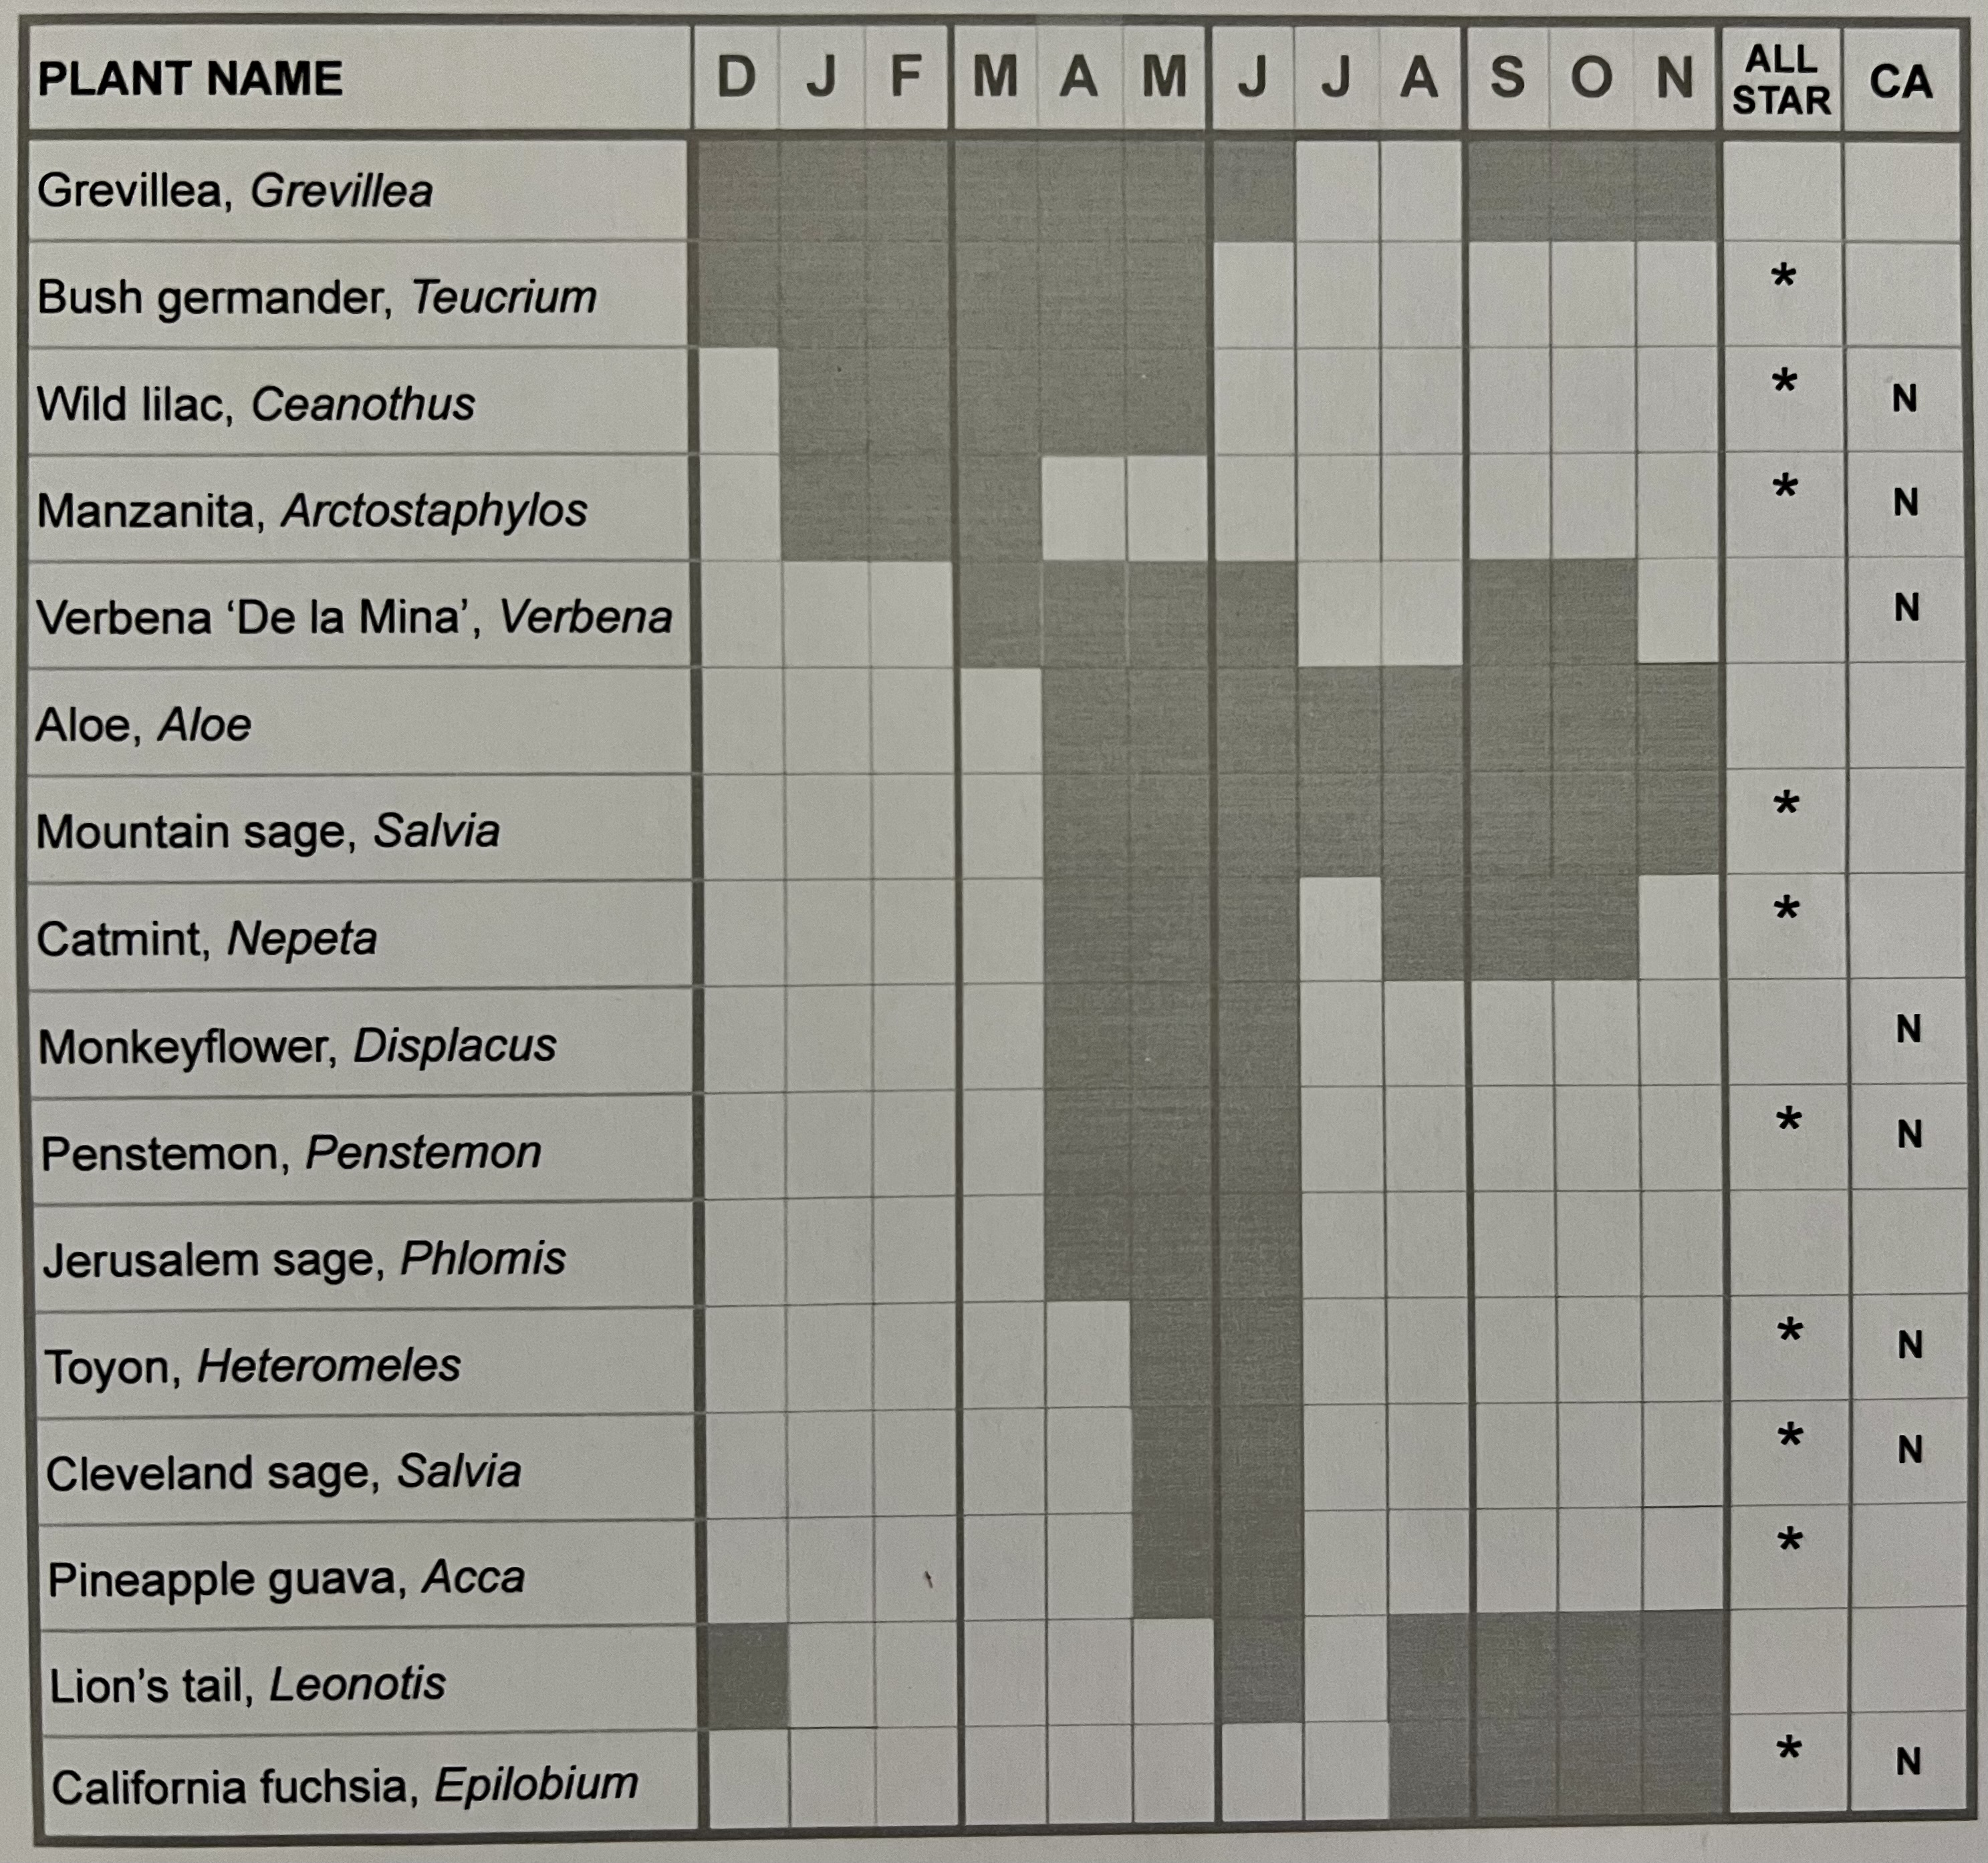
EXAMPLES ON HANDOUT
16 low water plants per WUCOLS in Granite Bay, CA
10 are Arboretum All Stars
8 natives in MG Demo Garden
8 bloom for 5 months
Notes:
(Marianne)
Examples from monitoring plants on my property for several years
This year, many plants are blooming/ending earlier than last & not blooming mid-summer
Plants may perform differently at your home

Slide 15
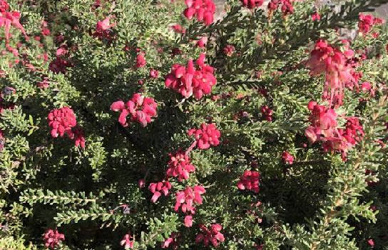
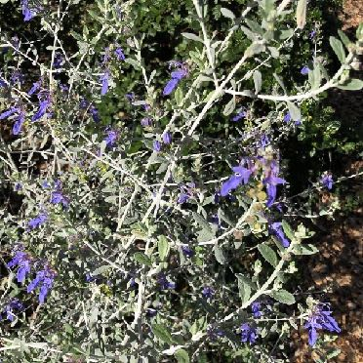
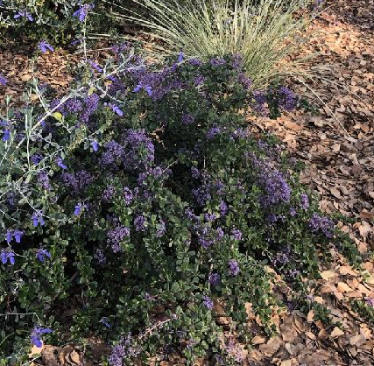
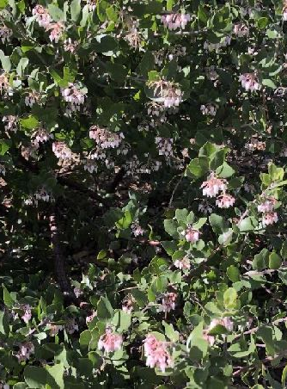
WINTER:
Grevillea
September-June
Bush germander *
December-May
Manzanita * N
January-March
Wild lilac* N
January-May
All Star; N = California Native
Notes:
(Marianne)
- Flowering shrubs are best for color and interest in the winter & are important for beneficial wildlife
2 are warm colors & two are cool colors; all play nice together in hedgerows
2 native plants are represented in our Demo Garden; many different varieties available
https://calscape.org/loc-California/Ceanothus-(all)?newsearch=1&srchcr=sc655655d22e269
https://calscape.org/loc-California/Manzanita-(all)?newsearch=1&srchcr=sc6556560d5b5d4
https://arboretum.ucdavis.edu/plant/bush-germander
https://arboretum.ucdavis.edu/plant/valley-violet-maritime-ceanothus
https://arboretum.ucdavis.edu/plant/vine-hill-manzanita

Slide 16
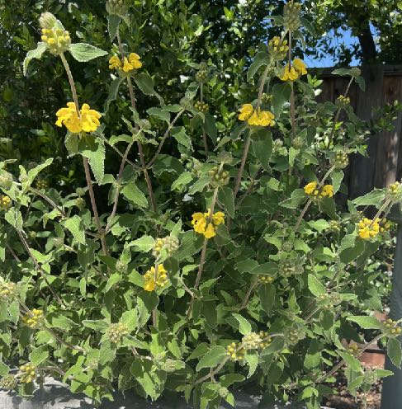
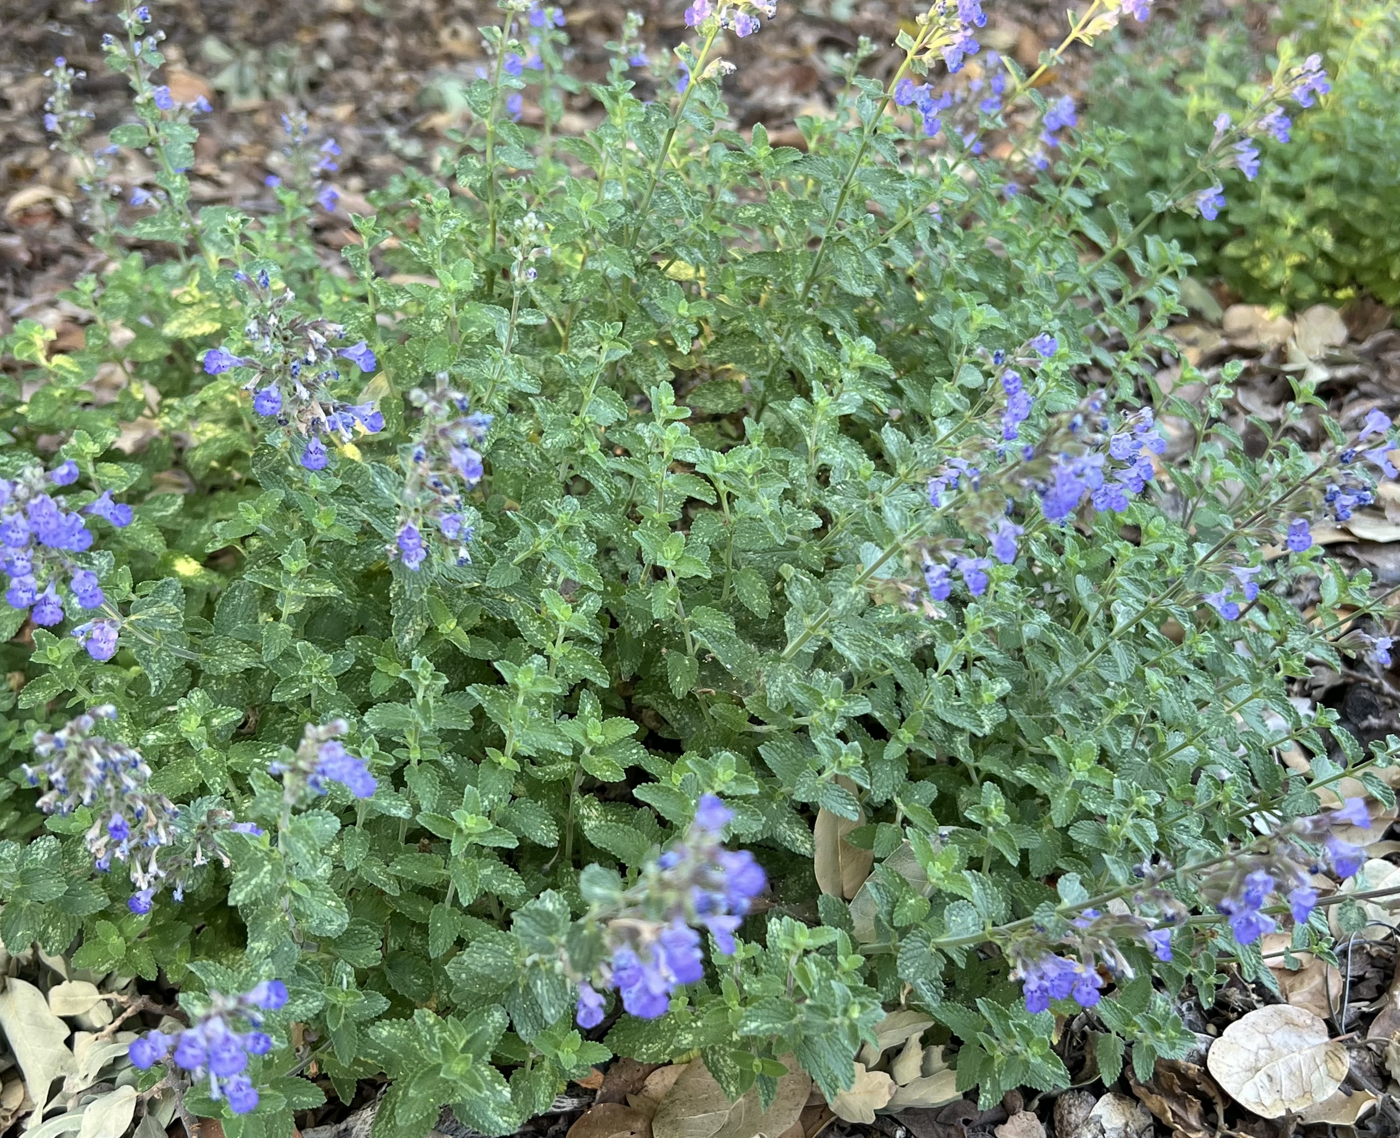
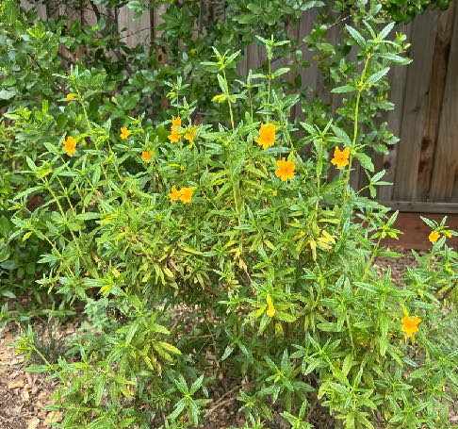
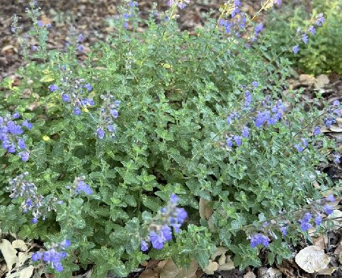
SPRING:
Jerusalem sage
April-May
Monkeyflower N
April-June
Penstemon * N
April-June
Catmint *
April-October
All Star; N = California Native
Notes:
(Marianne)
Again, mix of colors and shapes
2 native plants are found in our Demo Garden
Catmint, All-star, continues through October
Jerusalem sage is what I use around our pool in full sun
https://calscape.org/Diplacus-aurantiacus-(Bush-Monkey-Flower)?srchcr=sc662be8b8b8ca0
https://calscape.org/loc-California/Penstemon-(all)?newsearch=1&srchcr=sc6556568e4a3d1
https://arboretum.ucdavis.edu/plant/Santa-Margarita-foothill-penstemon
https://arboretum.ucdavis.edu/plant/hybrid-catmint

Slide 17
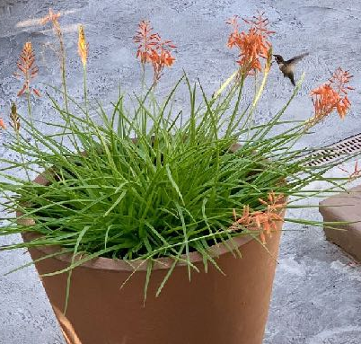
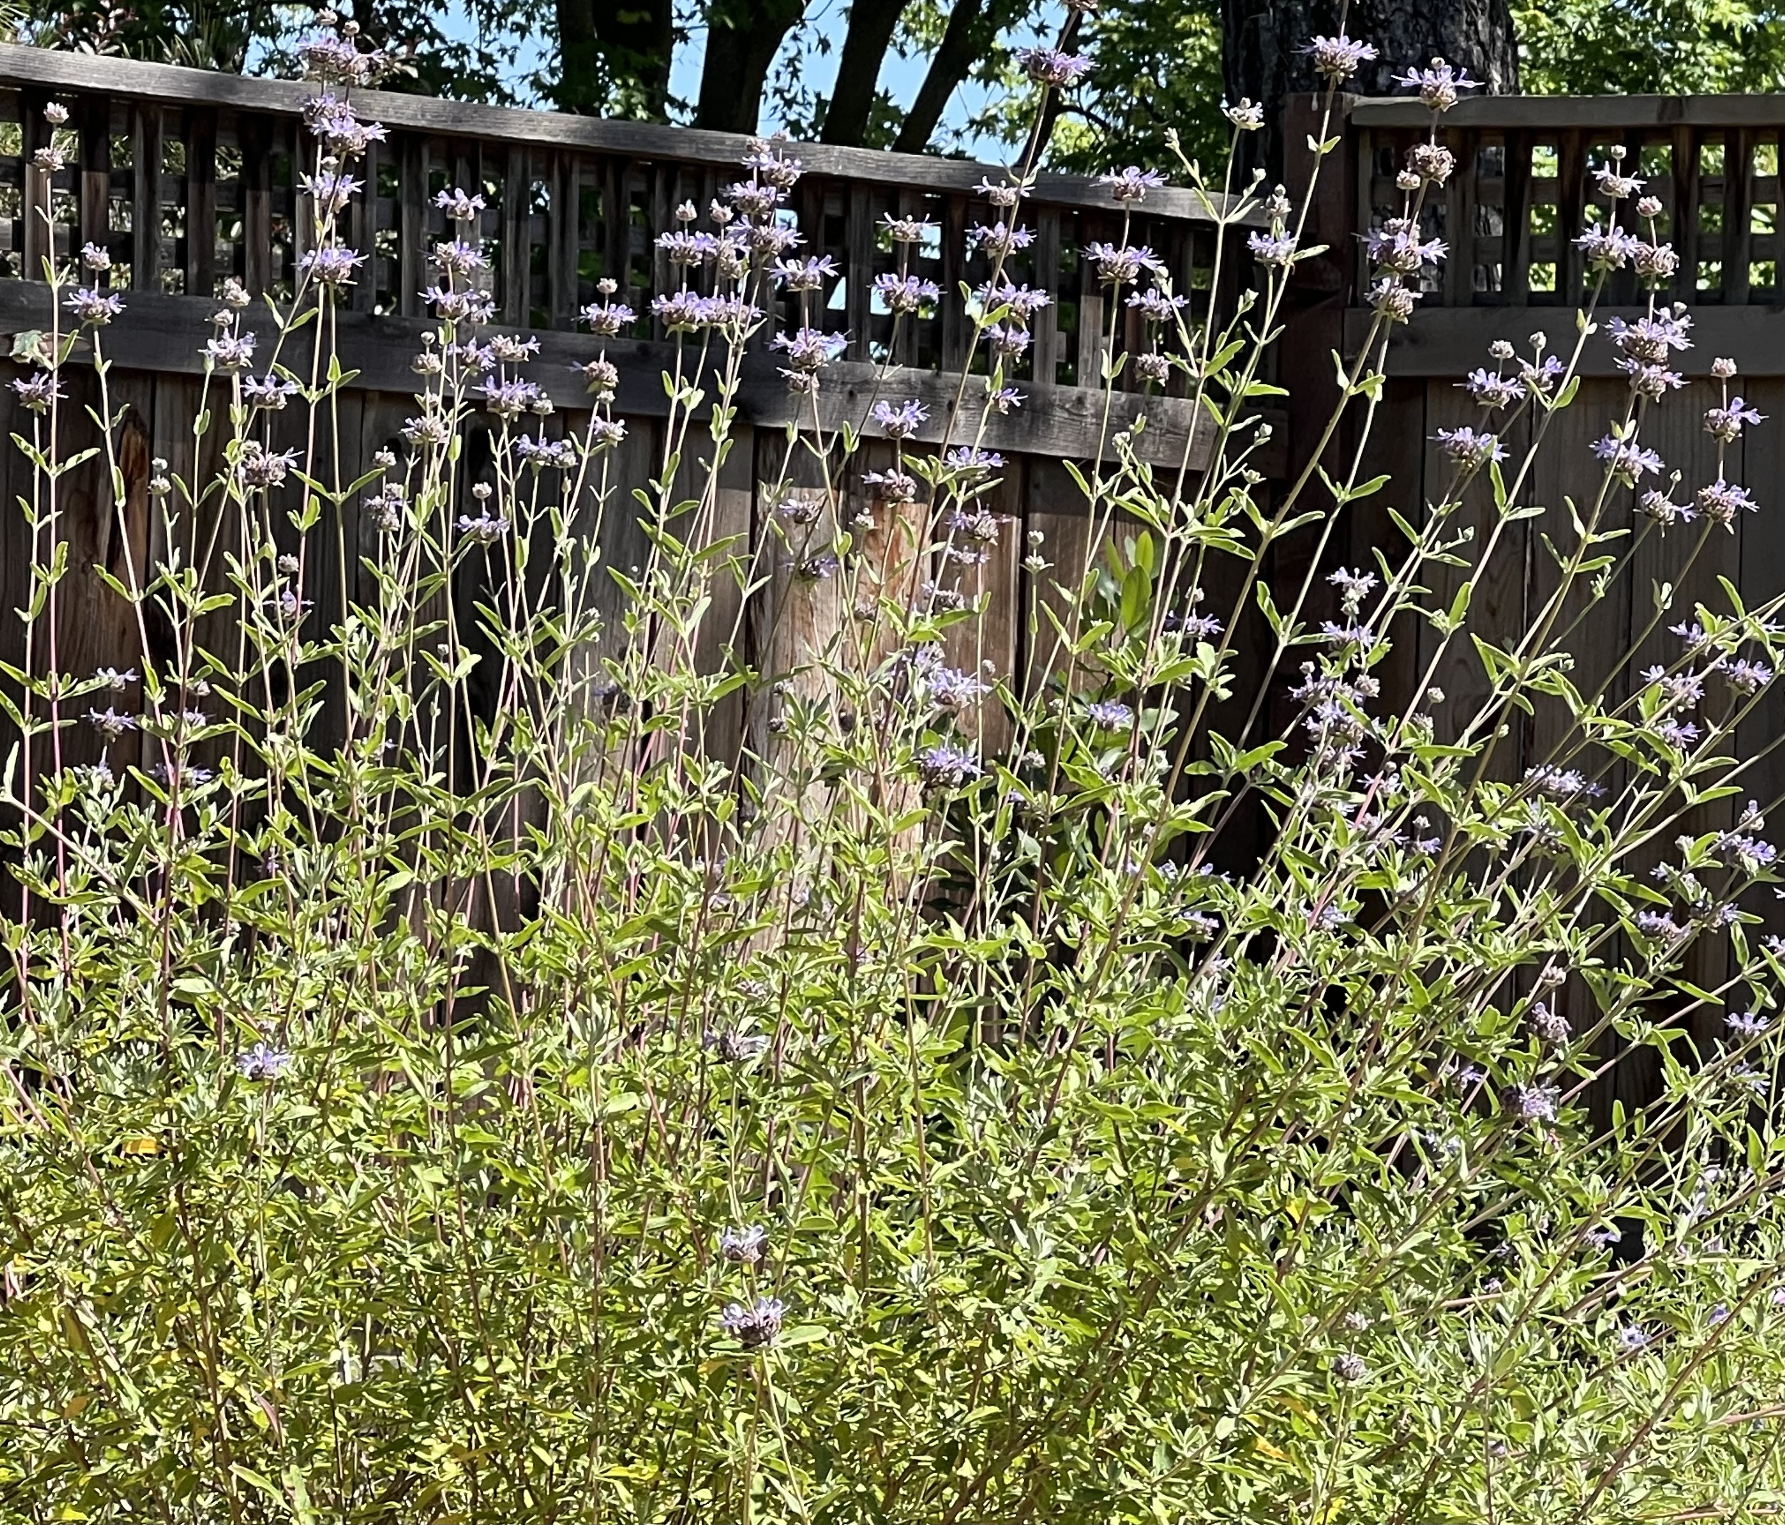
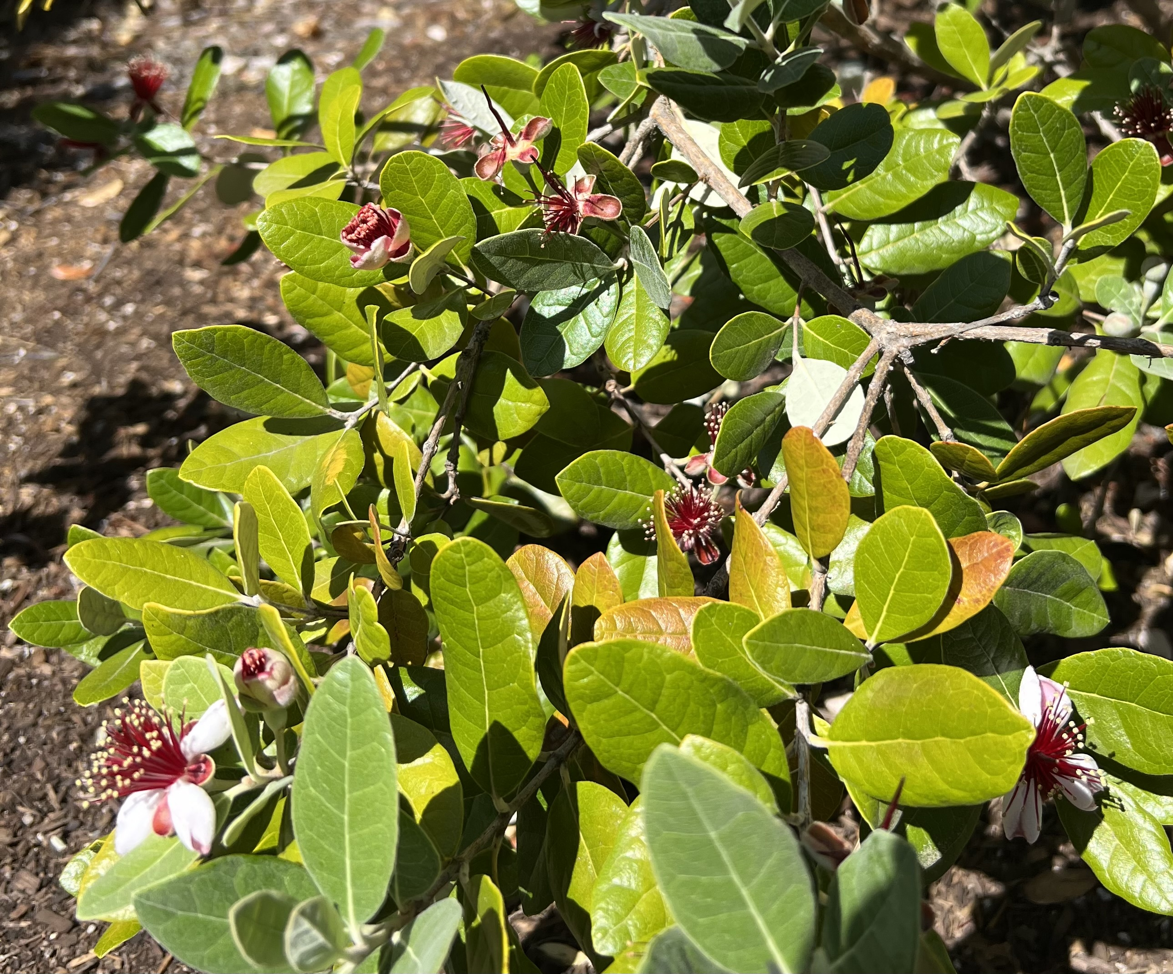
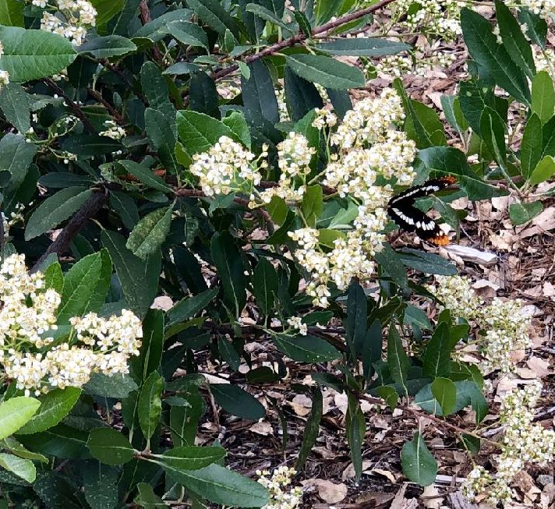
SUMMER:
Aloe
April-November
Cleveland sage * N
May-August
Pineapple guava *
May-June
Toyon * N
May-June
All Star; N California Native
Notes:
(Louise)
Consider using Aloe in containers-works well even with full and afternoon sun and only watered once a week
Cleveland Sage with pleasant fragrance
Pineapple guava with edible fruit and showy flowers
Toyon with white flowers in Summer and red berries in Winter a large shrub or can be pruned into a tree
https://calscape.org/Heteromeles-arbutifolia-(Toyon)?srchcr=sc655656e7b6e0e
https://arboretum.ucdavis.edu/plant/toyon
https://arboretum.ucdavis.edu/plant/pineapple-guava

Slide 18
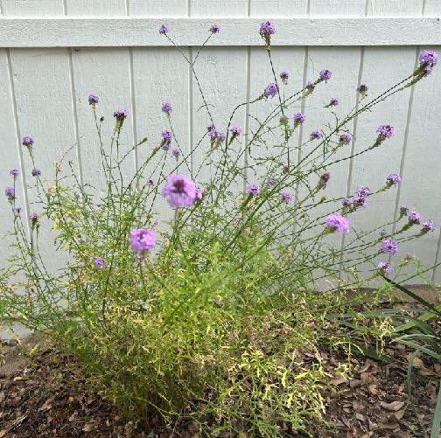
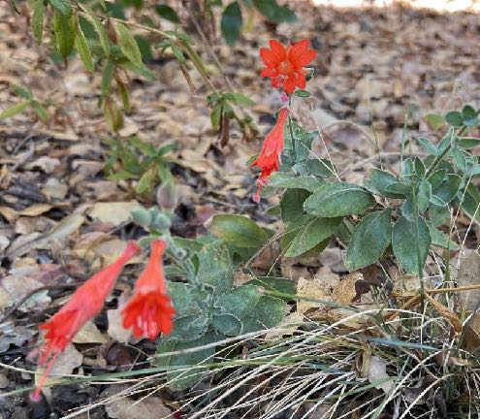
FALL:
Mountain sage *
April-November
Verbena ‘De la Mina’ N
March-June +
September-October
Lion’s tail
June-November
California fuchsia * N
August-November
All Star; N = California Native
Notes:
(Louise)
Autumn sage Salvia greggii and Salvia x jamensis prune to maintain compact form
Verbena lilacina de la Mina deadhead for further bloom
Lion’s tail plant Leonotis leonurus, not Leonotis nepetifolia deadhead after flowering
California fuschia cut down when flowers are spent
https://arboretum.ucdavis.edu/plant/autumn-sage
https://arboretum.ucdavis.edu/plant/California-fuchsia
https://calscape.org/Epilobium-canum-(California-Fuchsia)?srchcr=sc655657197ed19
https://calscape.org/Verbena-lilacina-'De-La-Mina'-(De-La-Mina-Verbena)?srchcr=sc662bedbd177e4

Slide 19
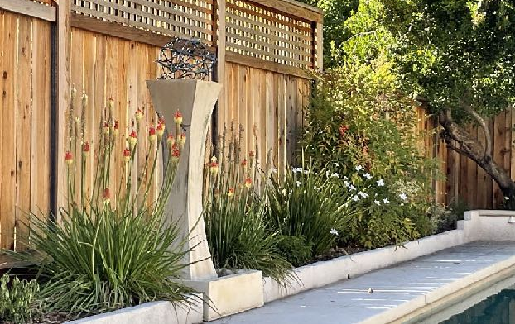
III. Gardening
with Low Water
Plant in Fall for roots to establish
Place together in irrigation zones for thoughtful watering
Research optimum watering times
Slow growth = minimal maintenance
Notes:
(Marianne)
After “low water” plants have been researched, selected, purchased…
Tips for successful gardening
Fall planting allows roots to grow for 4-6 months (aka CA natives)
Next two slides will focus on zones + watering
Benefit of LW plants + LW is slow growth (contrast to HW lawn)

Slide 20

WANT
TO BE
WATER-WISE
and
FIRE-WISE ?
High
Moderate
Water
Low Water Zone(s) =
largest proportion of property
Notes:
(Marianne)
- How many of you know the term Hydrozone?
Place plants sharing same water + exposure needs together in a zone
Looking from front door: ideally your high water zones are smallest proportion
Best for roses, containers, veggie garden, lawn
Triangle adapted from Green Gardener Training Program for professionals, Fall 2015
https://ucanr.edu/sites/GreenGardener/Becoming_a_GREEN_GARDENER/
“A small green house in flat design” from openclipart.org by TVLuke

Slide 21
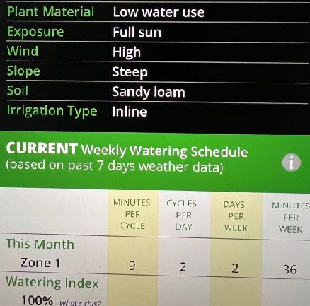
RESEARCH
MINUTES
PER WEEK
Greater Sacramento area
July (peak) becomes baseline
Input in smart controller
Relax on vacation!
Notes:
(Marianne)
Free Regional Irrigation Scheduler
BeyondTheDrought.com
First enter where you live, then your gardening situation (LOW WATER USE PLANTS+)
Example was created in April
Click on Historical info: July is the baseline when entering info in smart controller
Set up free account and save inputs for each irrigation zone

Slide 22
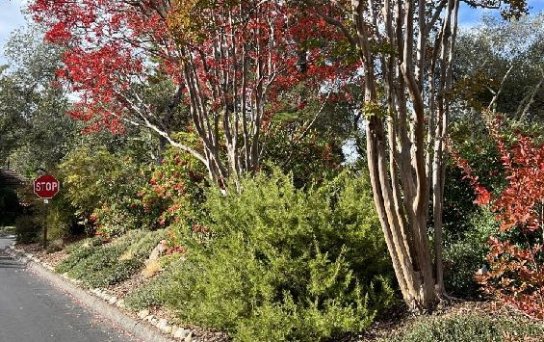
SUMMARY
You can positively impact
both humans + pollinators by:
researching before purchasing plants,
selecting low water plants,
placing together in low water zones,
plus irrigating with low amounts of water !!
Notes:
(Louise)
Any questions about gardening with low water?

Slide 23
RESOURCES
UC Davis Arboretum and Public Garden (for All-star plants)
https://arboretum.ucdavis.edu/sustainable-gardening-toolkit
California Center for Urban Horticulture (for W.U.C.O.L.S.)
https://ccuh.ucdavis.edu
California Native Plant Society (for plants from California)
https://www.calscape.org
Beyond the Drought (for Regional Irrigation Scheduler)
beyondthedrought.com
Notes:
(Louise)
Here are four websites we would like to highlight for you.
They are all user friendly and have been around for some time so have been continuously improved.
UC Davis Arboretum is a great site in general and specifically to find the UC Davis Allstar Plants-100 recommended plants for our area.
CA Center for Urban Horticulture is where you can search for plants of various water use levels for your location.
CA Native Plant Society provides a wealth of information about plants from California and you can search for plants native to your location.
Beyond the Drought will help you determine a watering schedule depending upon your area and a few variables.

Slide 24
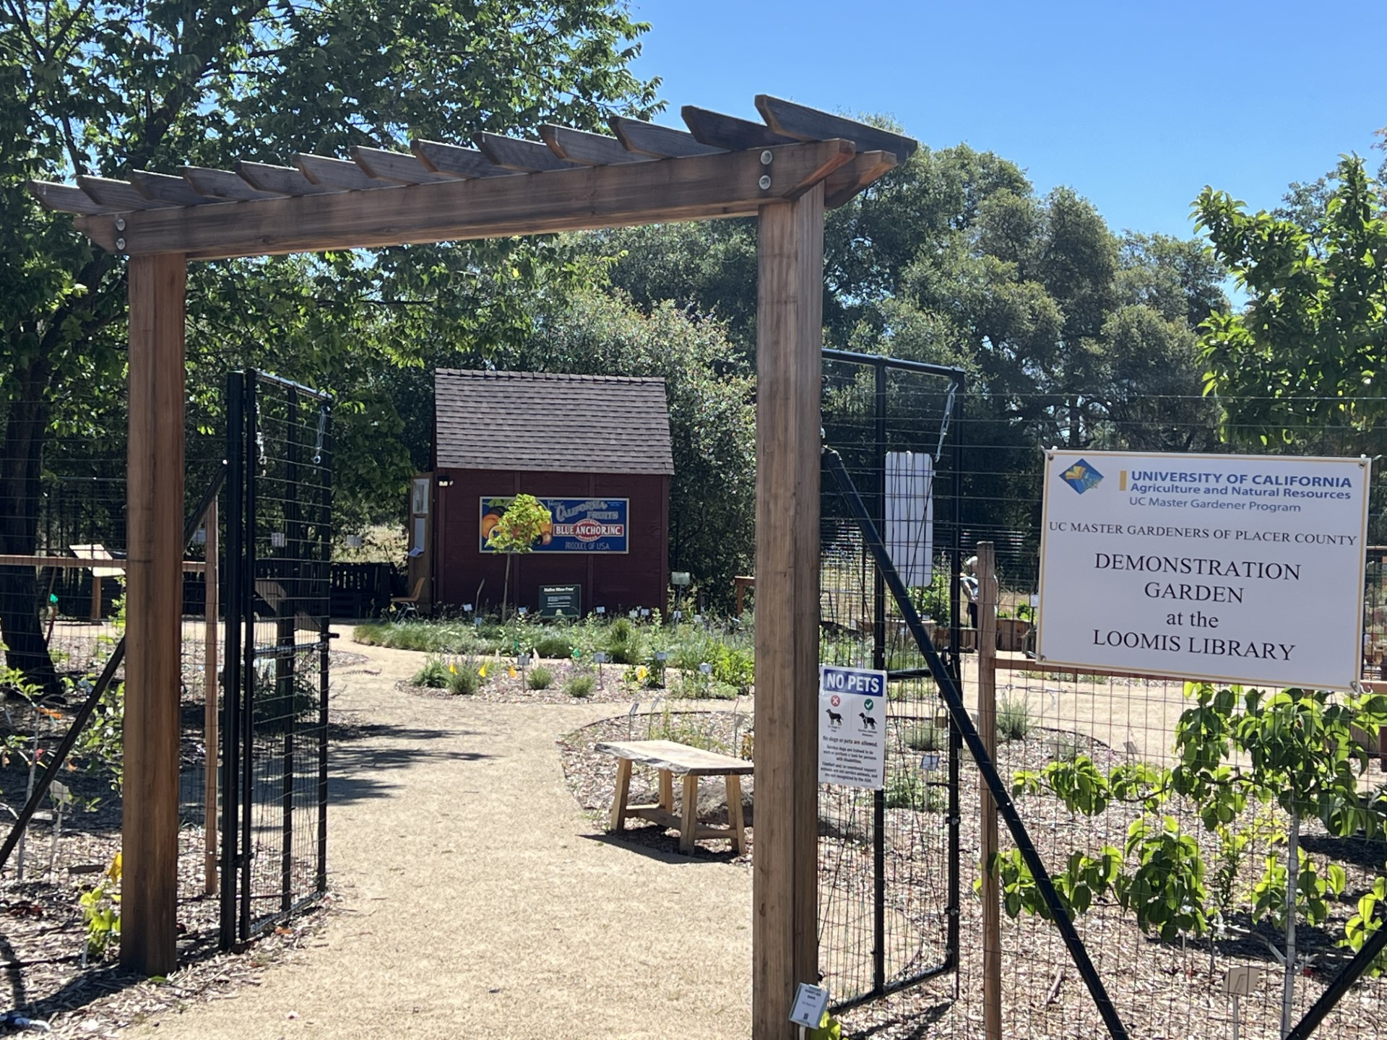
Open Garden
2nd Saturdays
Master Gardeners on site
10 am – noon
6050 Library Drive, Loomis
Notes:
(Louise)

Slide 25
Thank You!
Master Gardener Hotline: (530) 889-7388
Master Gardener Website: pcmg.ucanr.edu
Any Questions?
Notes:
Hope you’re all successful and have fun in gardening with low water plants!

