Slide 1

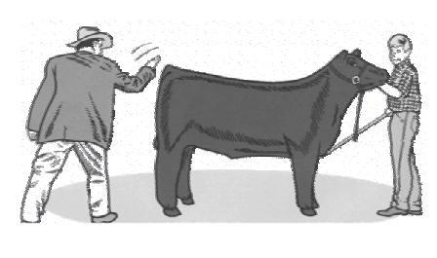
Dixon Ridge 4-H
Showmanship Question Study Guide

Slide 2
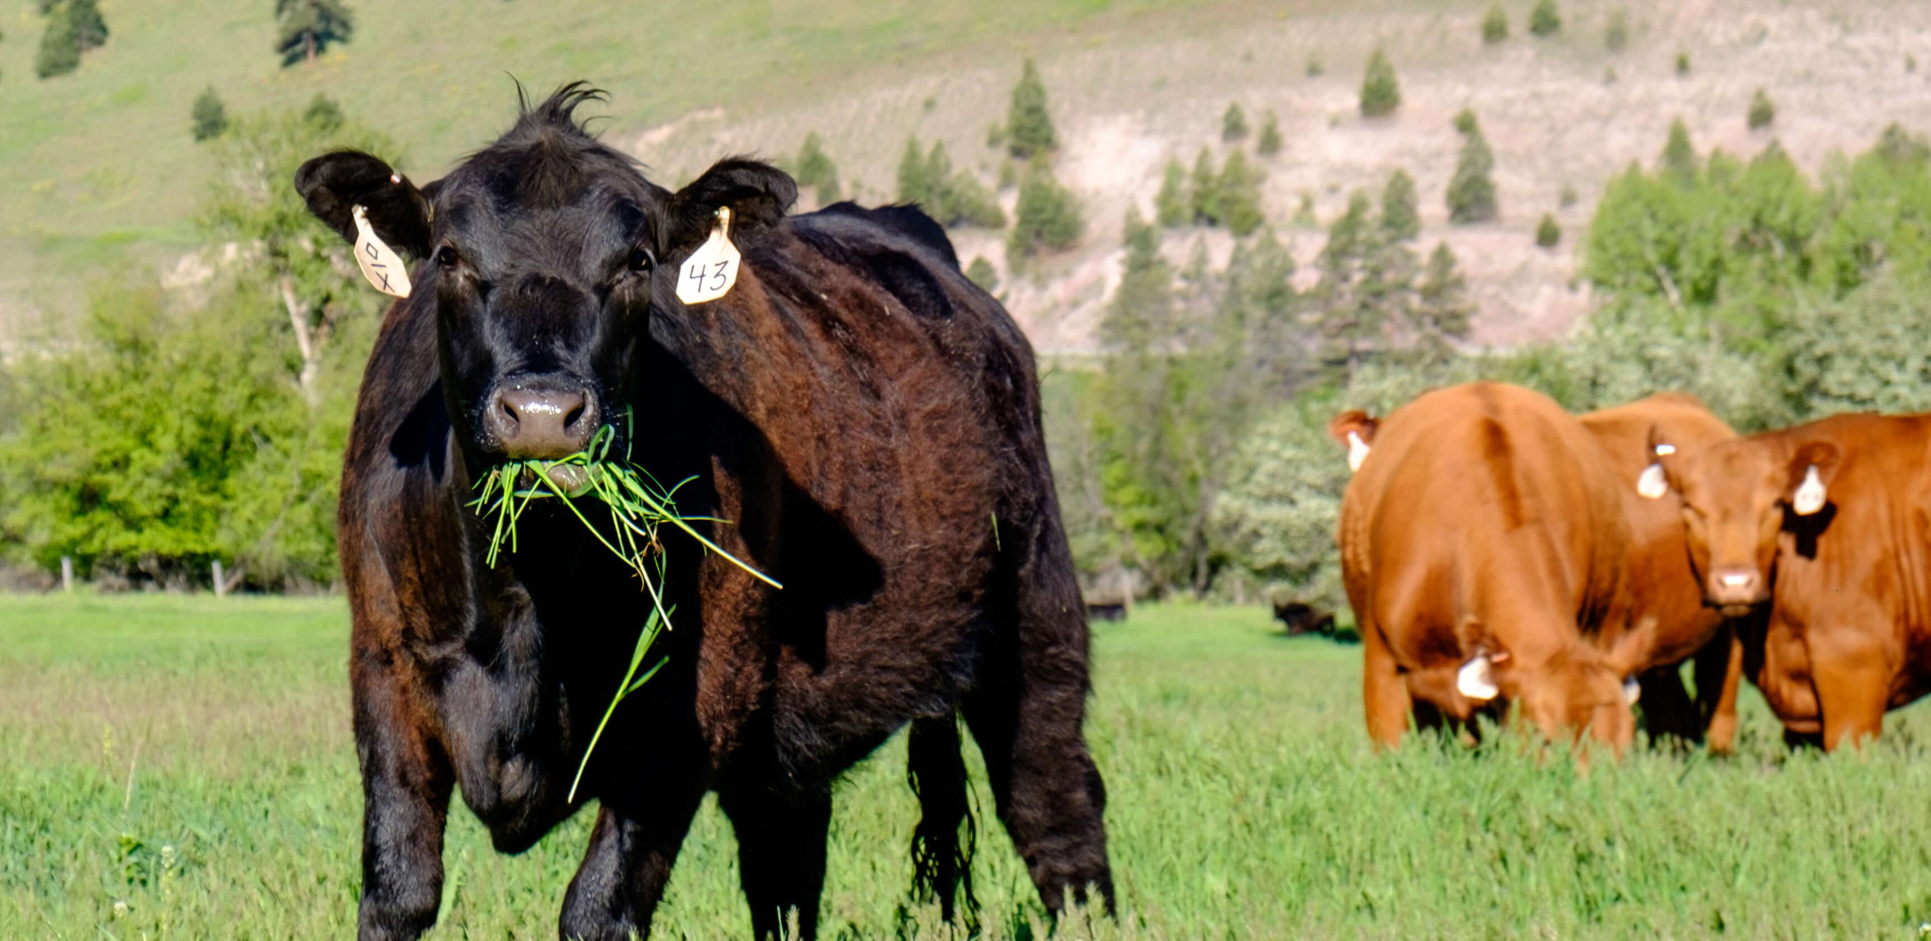
Care & Nutrition
Most important nutrient for all cattle?
  Water
Average daily water intake for cattle
  1-2 gallons per 100 pounds of body weight
Feed conversion ratio for market steers?
  6 pounds of feed = 1 pound of weight gain, or “6 to 1”
Daily feed intake
  2% of their body weight, around 15-25 pounds a day depending on size of animal
Average daily weight gain for market steers?
  2-4 pounds per day depending on frame size
Average protein percent in show cattle feeds?
  12-16% (check your feed tags for your exact amount)
Two most common forage products in beef cattle rations
  Grass Hay (rye, oat, 3-way, etc.) and alfalfa
Three examples of feed ingredients that add protein
  Cottonseed, barley, soybeans, distiller/brewer grains
Purpose of corn as a feed ingredient?
  “energy rich” feed, meaning adds fat
What cautions do you need to take when feeding a high protein diet?
  Make sure you feed enough roughage (forage feed) to help prevent frothy bloat, a deadly condition caused by high protein diets from grain, fresh green spring grasses and clover, and high protein alfalfa. Access to fresh, clean water is also important to help prevent bloat

Slide 3
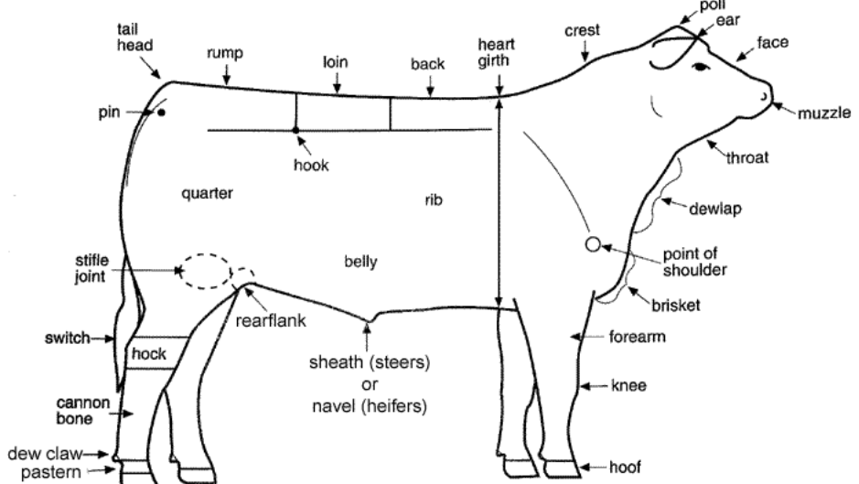
Anatomy & Common Diseases or Afflictions
Normal temperature of a cow?
  101-102
Gestation period?
  283 days, or just over 9 months
How many stomachs do cattle have?
  1, with 4 compartments
Name the compartments in a cow’s stomach
  Rumen, Reticulum, Omasum, Abomasum
Which is the largest compartment?
  Rumen
Judges often refer to the stifle when evaluating muscle on a finished steer. Where is the stifle?
  Joint at the top part of the back leg near the rear flank. Joint isn’t visible like a hip bone or hock, but the general area is used to evaluate average amount of muscle on an animal
What typically causes scratching, rubbing, or loss of hair?
  Lice, mites, or mange
Disorder caused by gas retention in the Rumen?
  Bloat
Contagious skin disease in cattle?
  Ring worm and warts
Reproductive diseases that cause abortion
  leptospirosis, brucellosis, vibriosis
What causes white muscle disease (calf disease)
  Lack of selenium and/or vitamin E
Two common calf diseases that cause death
  Pneumonia and scours
Medical name for “pink eye”
  Conjunctivitis
Name for infection in udder most commonly caused by bacteria introduced through the teat after milking or nursing?
  Mastitis

Slide 4
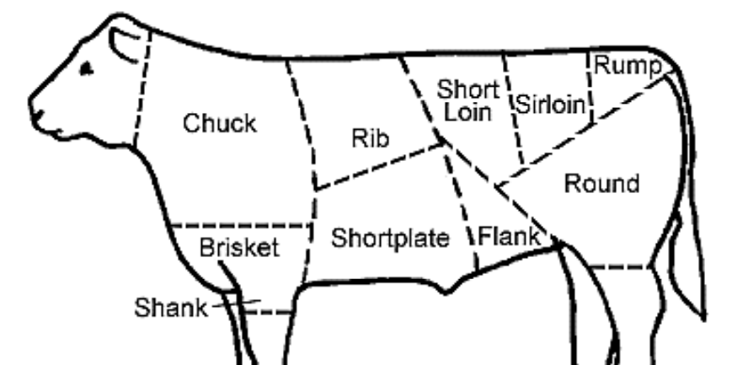
Cuts of Meat and Product Terminology
Average ideal live weight range for finished steers?
  1200-1350 pounds
Average dressing percentage (live weight vs carcass weight)
  60-65%
Most expensive cuts of meat
  Loin, rib, round, rump
Grades of meat quality
  Prime, choice, select, standard, utility
What determines the grade of meat quality?
  The total amount of intramuscular fat streaks inside the rib eye
Why is marbling important to a cut of meat?
  Flavor and influences juiciness
Where is the back fat measured on a steer?
  Over the 12th rib (opposite the rib eye area)
The ideal back fat on a market steer?
  .4 inches
What is a hanger steak? (aka a butcher steak)
  Comes from the lower belly of a steer near diaphragm. Since the muscle itself doesn’t move very much, it’s a tender cut of meat
Three common types of steaks
  Rib eye, New York, T-bone, round, sirloin, skirt
Three common types of roasts
  Prime rib, brisket, sirloin roast, tri-tip, chuck
Three byproducts
  Leather, fertilizer, gelatin products (like medicine capsules), glue, pet foods, instrument strings, and so much more

Slide 5
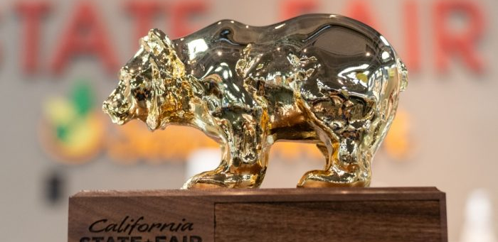
Misc. Questions and Terminology
Top 5 states in cattle production for 2022-2023?
  Texas, Oklahoma, Missouri, Nebraska, & South Dakota
Name 5 beef breeds
  Angus, Hereford, Shorthorn, Charolais, Simmental, Chianina, Maine-Anjou, Limousin, Scottish Highland, Texas Longhorn
What is the most common breed cross that creates a “black baldy” variety?
  Black Angus and Hereford
What does “polled” mean in relation to cattle?
  Naturally without horns, a genetic trait
Name for an intact male
  Bull
Name for a female who has given birth
  Cow
Name for a female who has not yet given birth
  Heifer
Name for a castrated male
  Steer
What is a freemartin?
  When there is a set of twins and one is male and the other is female, the female will be born sterile because there are too many male hormones present during gestation that the female organs don’t properly form. The name for that female twin is a freemartin.
What is the name for the food that the cow regurgitates from their rumen to re-chew it into finer pieces so it can be moved farther down the digestion chain for nutrient absorption
  Cud
“What would you change about your calf” or “What do you like about your calf” are often asked and are specific to the animal. Be prepared for that question.

