Slide 1
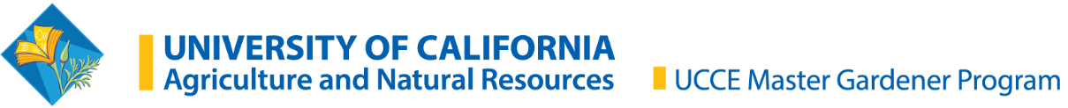
Small Fruit Trees
Getting Started in Winter
Presented by Kathy Wiersch
Placer County Master Gardener
1/18/2024
Notes:
Created: January 2024
Created by: Kathleen Wiersch of Placer County Master Gardener(s) who created this originally
Audience: Placer County gardeners
Publicity: Have you ever wondered what kinds of fruit trees would be best in your garden? This class is for you if you are interested in learning the five most important steps that ensure flourishing fruit trees:
- Selecting the right varieties
-Understand the importance of chill requirements
-Attracting pollinators for your fruit trees
-Learn successful bareroot planting techniques
-How to increase the variety of your fruit trees
Update History: for each update to the presentation include date, name of updater, explanation of update
(were additional slides added, were web links updated, etc.)

Slide 2
Who Are Master Gardeners?
Master Gardeners of Placer County
  Extend research-based, sustainable gardening and composting information
  Present accurate, impartial information to home gardeners
  Encourage public to make informed gardening decisions

Slide 3
Who Are Master Gardeners?
Where to find us…
Online, in the Media, and Special Publications
  Hotline: Call (530) 889-7388 or submit your questions online
  Website: pcmg.ucanr.edu
  Facebook, Instagram, X, YouTube
  Gold Country Media monthly column
  Curious Gardener quarterly newsletter on our website
  Gardening Guide and Calendar

Slide 4
Who Are Master Gardeners?
Where to find us…
Workshops, Fairs and Festivals, and Special Events
  Speakers by Request
  Workshops (various venues, check website)
  Farmers’ Markets (seasonal: Auburn, Lincoln, Roseville)
  Fairs and Festivals Booths (varies)
  Garden Faire (April 13)
  Mother’s Day Garden Tour (May 12)

Slide 5
Table of Contents
Selecting Varieties
Understanding Requirements
  Chill, pollinizers, harvest
Why and how of Bareroots
Brief Intro to Pruning Systems
Grafting & CRFG
Notes:
There are thousands of varieties. Choose ones you like to eat but also investigate it’s chill and pollinizer requirements. More on both of those in following slides. https://anrcatalog.ucanr.edu/pdf/8396.pdf. More on tree selection here: Tree Selection - The California Backyard Orchard (ucanr.edu)

Slide 6
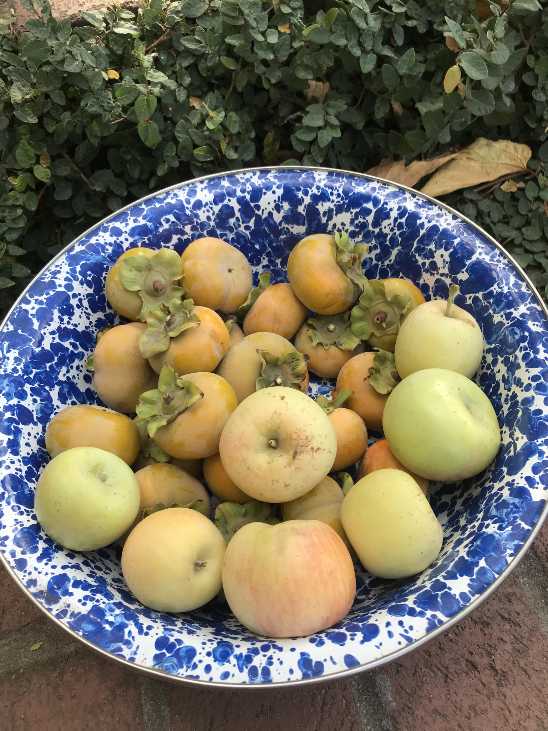
“I Want Them All” - how to narrow the search
Choose fruit you will eat!
What do you have and when does it get ripe?
Does your favorite variety need a lot of chill? Does it need a pollinizer?
Should I consider disease resistance?
A place to start: Fruit and Nut Varieties for Low Elevation Sierra Foothills https://anrcatalog.ucanr.edu/pdf/8396.pdf
Notes:
There are thousands of varieties. Choose ones you like to eat but also investigate it’s chill and pollinizer requirements. More on both of those in following slides. https://anrcatalog.ucanr.edu/pdf/8396.pdf. More on tree selection here: Tree Selection - The California Backyard Orchard (ucanr.edu)

Slide 7
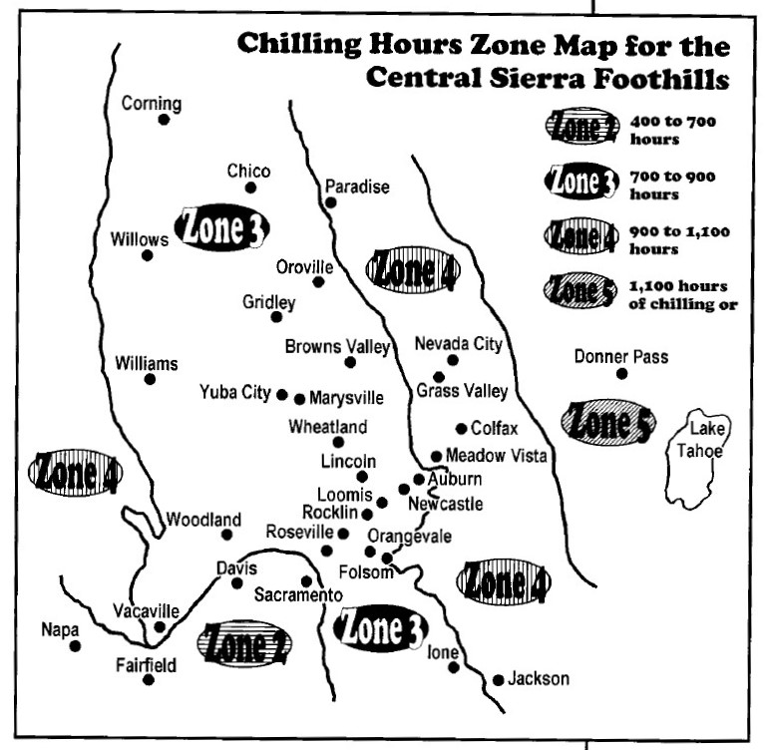
Chill Out, Dude
Short answer: 700-900 chill hours below 1200’
Nerdy deep dive into Chill Hours: https://fruitsandnuts.ucdavis.edu/chill-calculator
A Guide to Home Orcharding for the Sierra Nevada Foothills, UCCE Placer/Nevada Publication #31-701 (can be purchased at Fowler’s)
Notes:
We in Placer County are lucky in that we get enough chill hours to ensure that deciduous fruit trees will “break dormancy” aka, sufficient cold temperature breaks down the growth inhibitors within the tree. This is called vernalization, “chilling,” or “winter chill.” Southern California may only receive 100–400 hours. Tree Selection - The California Backyard Orchard (ucanr.edu)

Slide 8
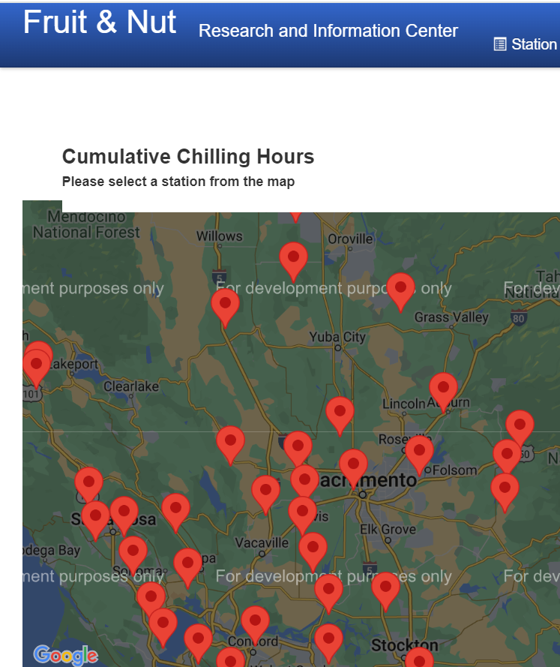
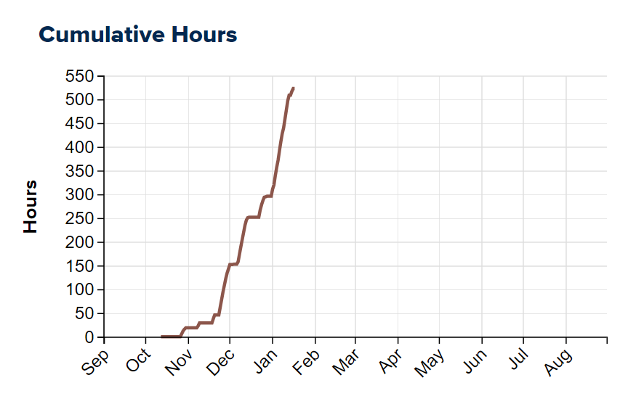
CIMIS Weather Stations
Chill hours are calculated for California Irrigation Management Information System (CIMIS) weather stations
Auburn is #195
Notes:
The cumulative hours chart above is from 1/18. Map is here: https://ucanr.edu/chillcalc/?controller=station&action=index&DISPLAY=map

Slide 9
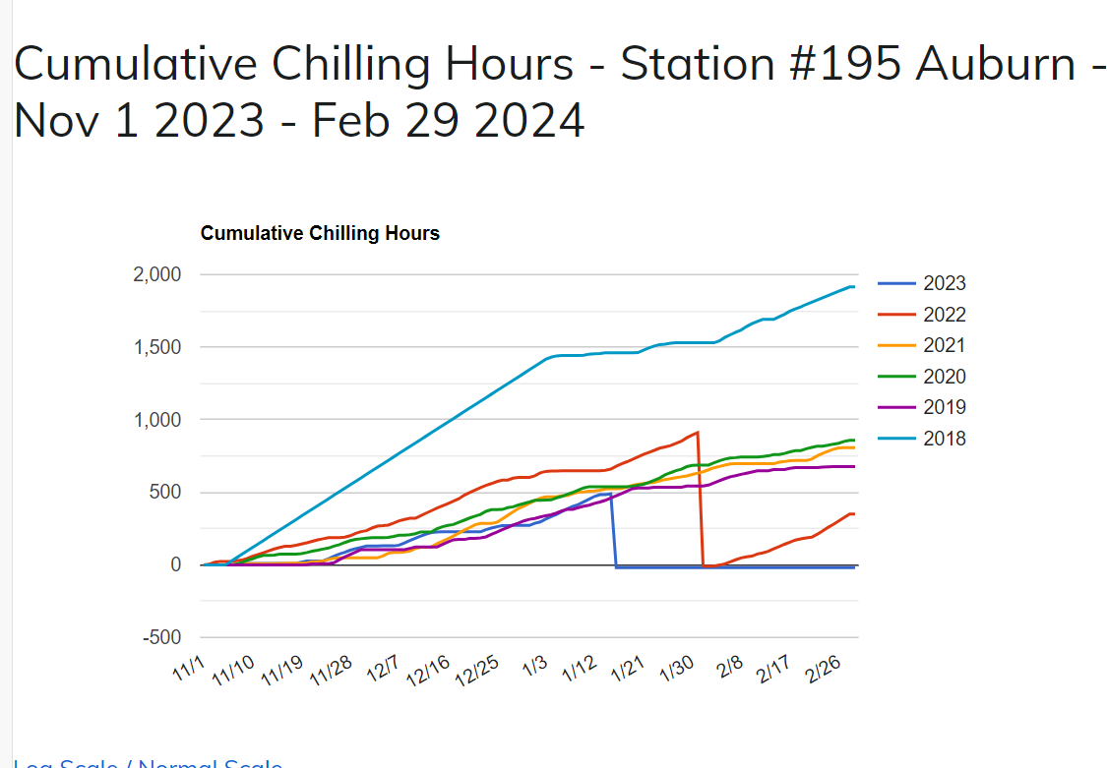
How Chill are we?
Snapshot is from 1/15
490 for Auburn
493 in Fair Oaks
511 in Diamond Springs
64 in Santa Barbara
1481 in Alturas
Look up and compare stations here: https://ucanr.edu/chillcalc/
Notes:
This data was calculated on 1/16/24 for Auburn (Ophir). It compares to the last 5 years. 2023 had a lot of chill. 2019 had the least. 2022 - data errors. Placer has no other stations. Nevada County has no station.

Slide 10
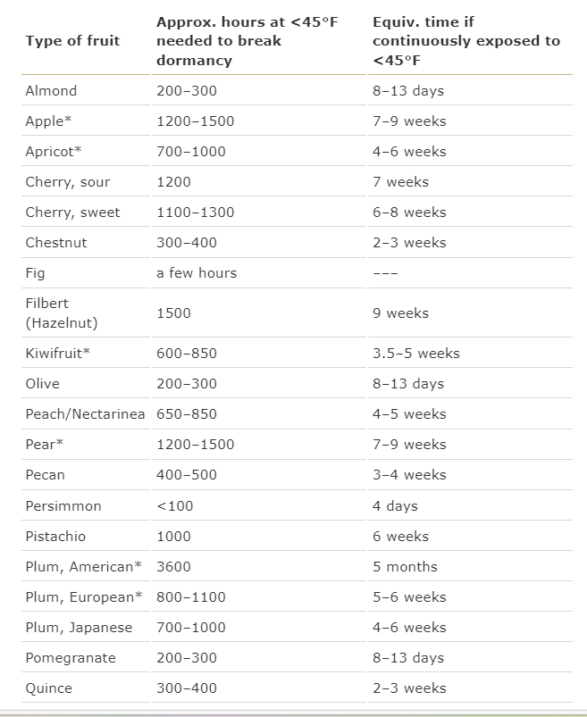
What can’t I grow?
Good News! Only some varieties require more chill than we get (and these are usually only found mail order not locally).
“Low Chill” varieties might bloom early
Notes:
Tree Selection - The California Backyard Orchard (ucanr.edu). Hazelnuts are one of the few fruits or nuts that have no variety that works for most of placer. Also see: Varieties (ucanr.edu) According to Home - Fruit Report (ucanr.edu), low chill varieties bloom earlier that higher chill varieties and this put them at risk for early spring weather

Slide 11
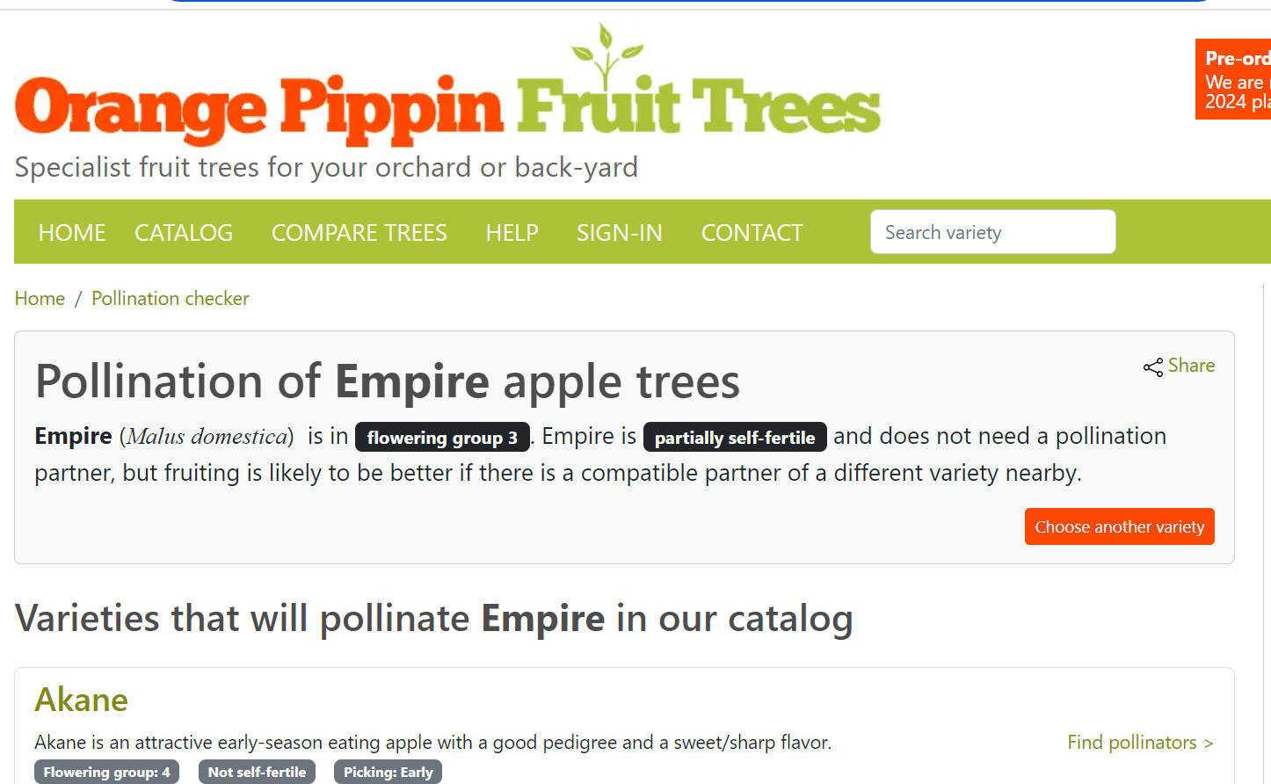
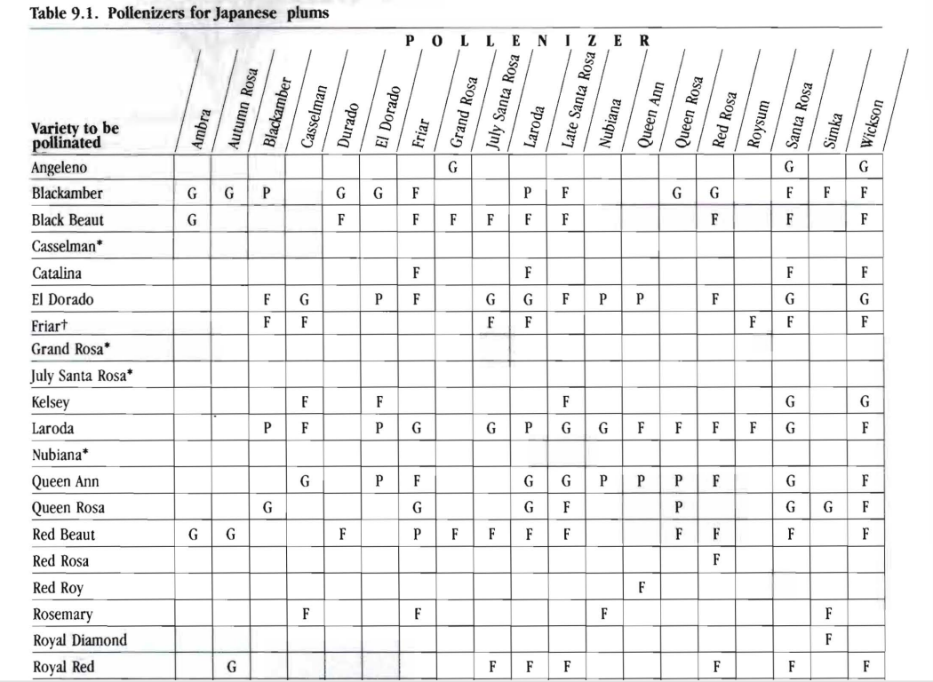
Pollinizers
Before you buy, research pollinizers (pollination partner)
Pollinizer needs to be within 100 feet
Most “self-fertile” stone and pome fruits do better with a pollinizer
Japanese Plum Pollination 132874.pdf (ucanr.edu) page 50
Notes:
Pollinizers are the same fruit but a variety that blooms at the same time that “donates” pollen. The closer, the better. UCANR explains pollination but does not have a comprehensive/updated list of pollinizers and suggests “Numerous popular publications such as Sunset books, commercial nursery literature, University and other publications are good references on pollination requirements.” Pollination - The California Backyard Orchard (ucanr.edu). While “Pollinizer” is the preferred term, many resources will call this second variety a “Pollinator.” Orange Pippen lists pollinzers for 700+ apple varieties.

Slide 12
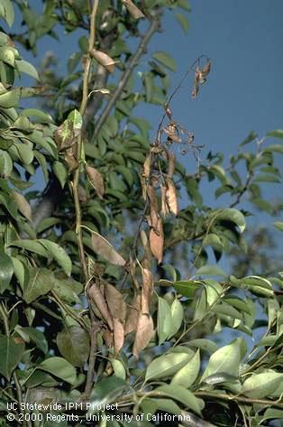
Disease Considerations for Fruit Varieties
Plant breeders are developing “modern” fruit varieties that are more tolerant of certain diseases like varieties of Apples and Pears for fireblight.
Research whether your favorite variety is susceptible, e.g. Fuji, Gala, Golden Delicious, Granny Smith, Gravenstein, Jonathan, Mutsu, Pink Lady, and Yellow Newtown apples are all susceptible to fireblight.
Notes:
This pest note describes some fireblight “tolerant” varieties of Asian Pears along with the list of susceptible varieties: Fire Blight Management Guidelines--UC IPM (ucanr.edu). Later blooming varieties are generally more susceptible. WSU also did a study and ranked varieties: https://treefruit.wsu.edu/article/fire-blight-susceptibility-of-apple-cultivars/. Newer “disease-resistant” varieties not always available locally: https://ucanr.edu/sites/SoCo/files/27141.pdf

Slide 13
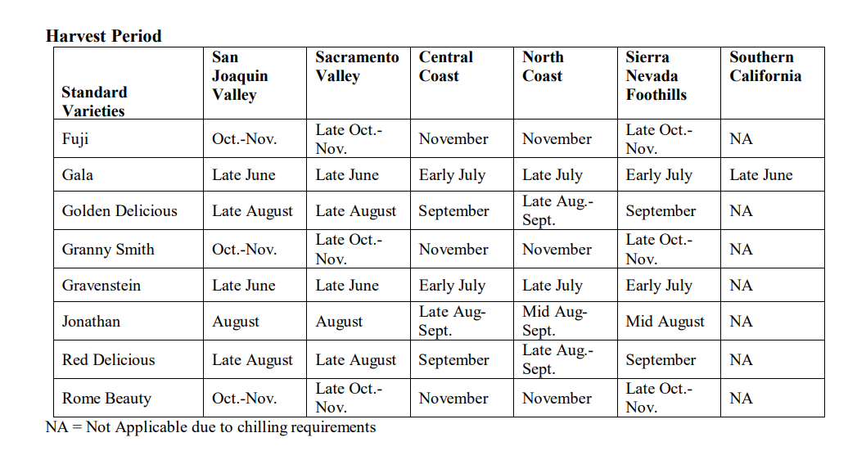
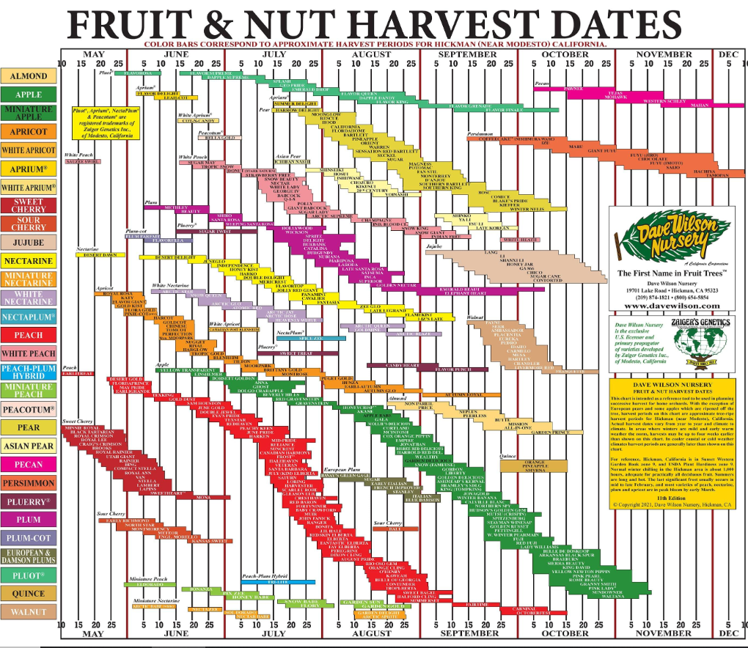
Spreading Harvest
Ask about harvest times locally to augment “California” resources like Dave Wilson (based on Fresno)
Pay attention at Farmer’s Market (early season? Mid season? Late Season?
https://homeorchard.ucanr.edu/plant_apple.pdf
https://www.davewilson.com/img/content/harvestdates-bareroot-hg-2021.jpg

Slide 14
Start with Small, Start in Winter
Why?
How?
More fruit variety
Longer harvest
Easier harvest
Easier disease and pest management
They looks so adorable
Buy bareroot from a nursery preferably
  As soon as they are available
  Actual bareroot if possible
  (not in bags, not in pots)
  But why?
(https://anrcatalog.ucanr.edu/pdf/8057.pdf). https://ucanr.edu/blogs/blogcore/postdetail.cfm?postnum=55885

Slide 15
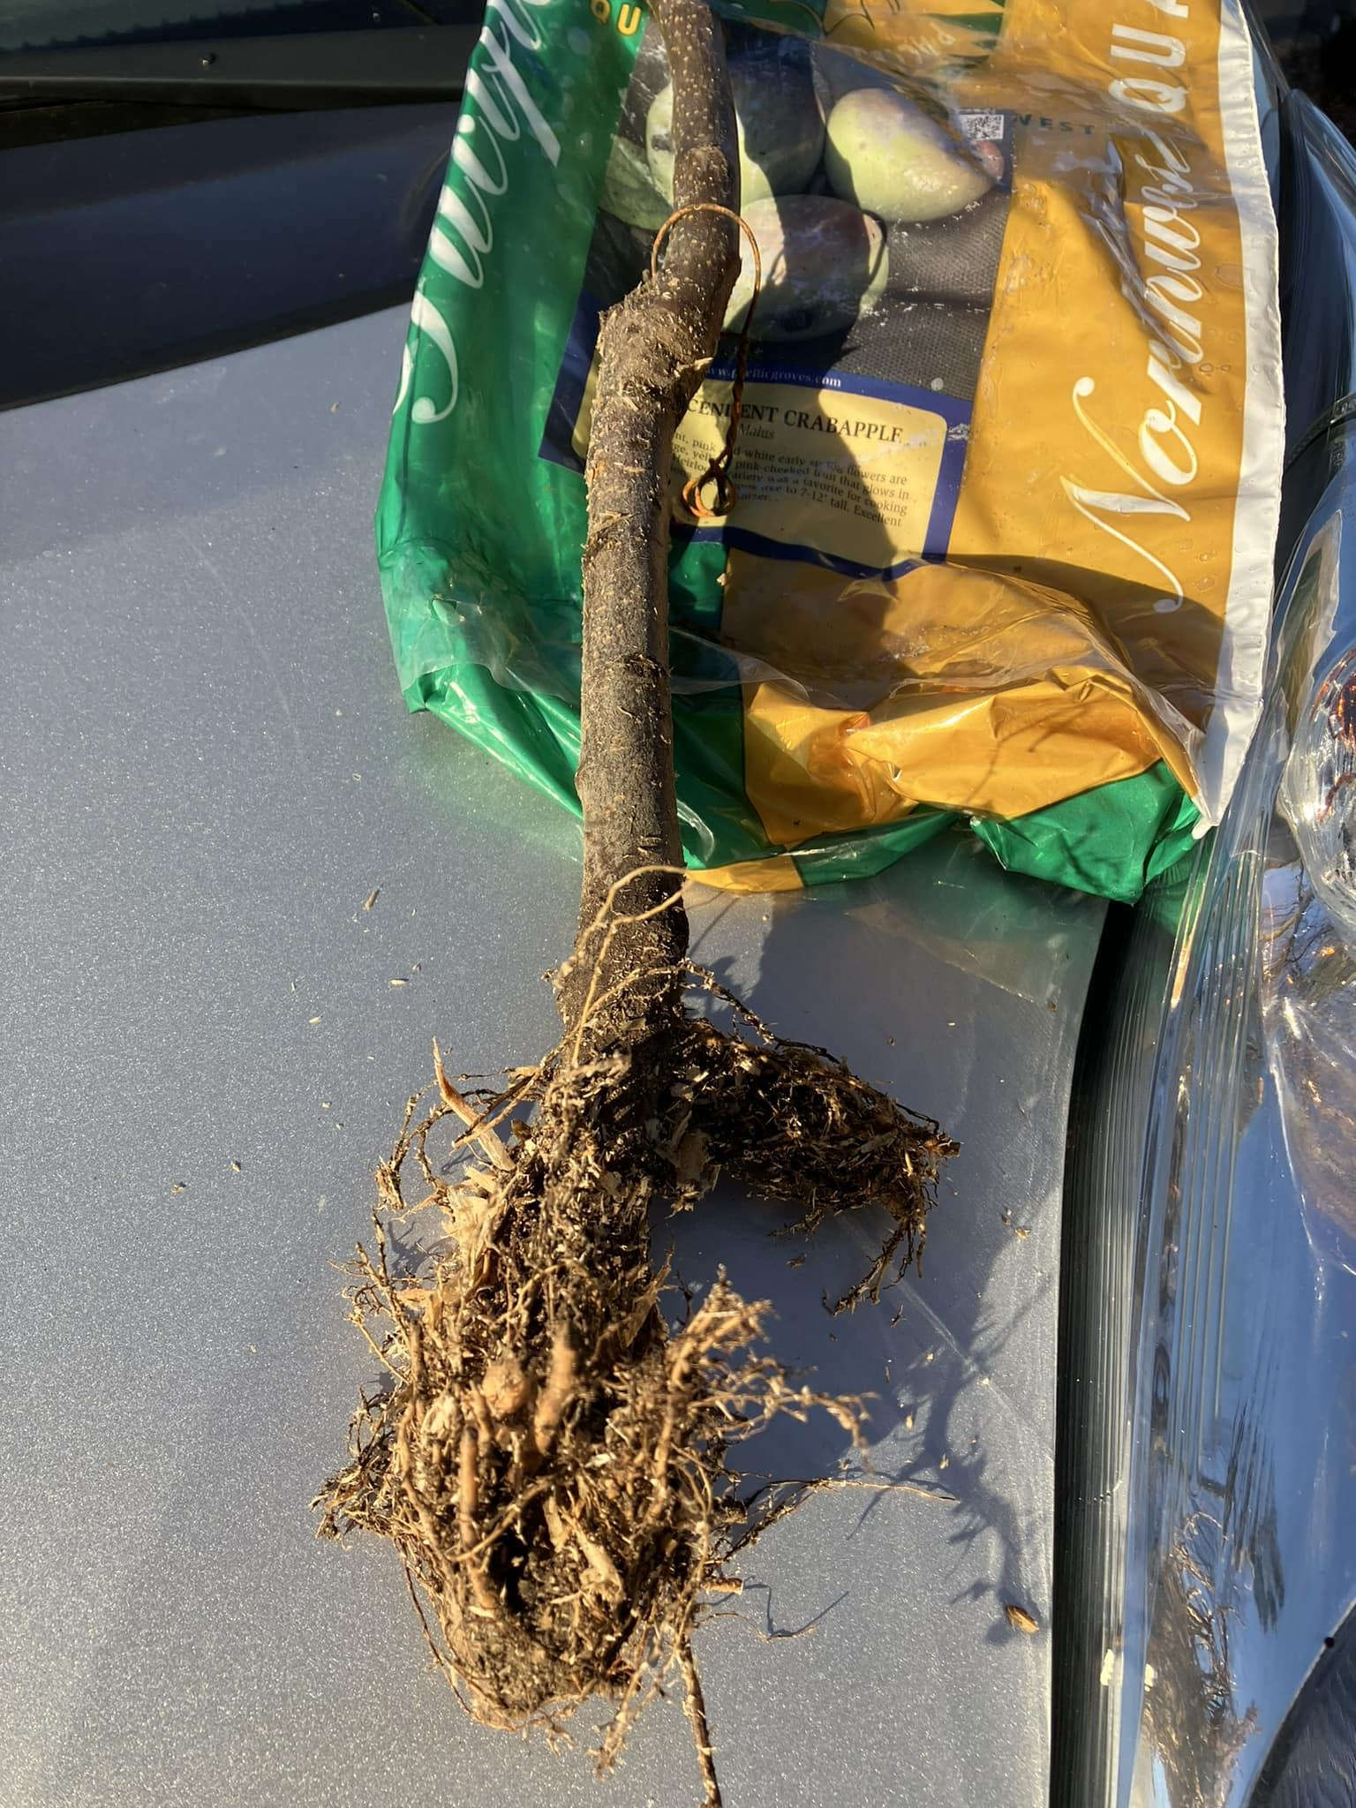
The Advantages of Bareroot
Bareroots
vs
More roots intact
Establish best in your soil
Nurseries that are managing water,caring for roots
Special orders via mail
Roots have been cut to fit containers
Roots cut for bags and watering hard to manage by retailers
(and you “can’t*” see roots when you buy it!)
Notes:
The picture is of a bagged “bare-root” tree with a very small root ball. Planting Bare-Root Fruit Trees: Planting Bare-Root Fruit Trees - The Real Dirt Blog - ANR Blogs (ucanr.edu)

Slide 16
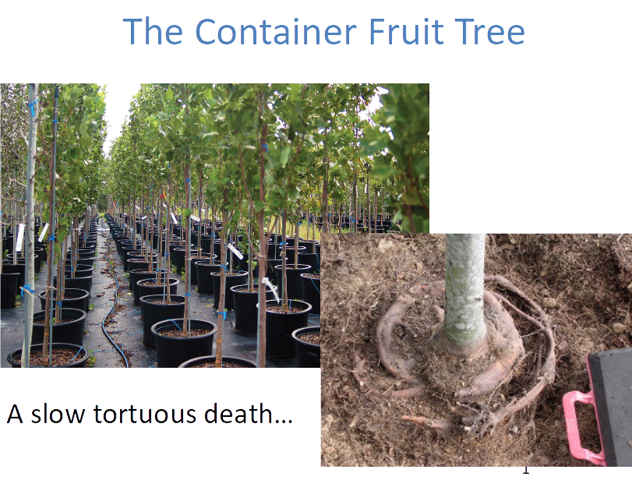
The risks of container fruit trees
From Kevin Marini’s “The Backyard Orchard: Top 10” https://ucanr.edu/sites/ucmgplacer/files/378739.pptx

Slide 17
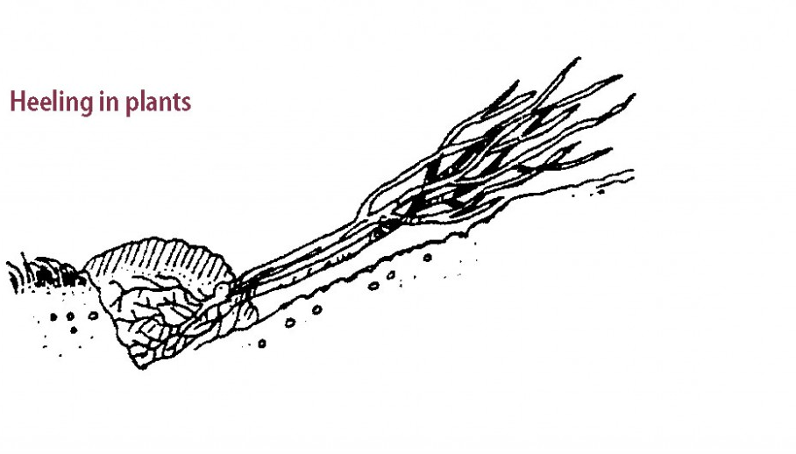
Ok I bought a bareroot, now what?
Admire your previously dug hole, OK fine, dig an appropriately sized hole
If you can’t plant immediately, heal in bareroots
Hole size is a “whole” thing - please see: https://homeorchard.ucanr.edu/The_Big_Picture/Preparation_&_Planting/#planting

Slide 18
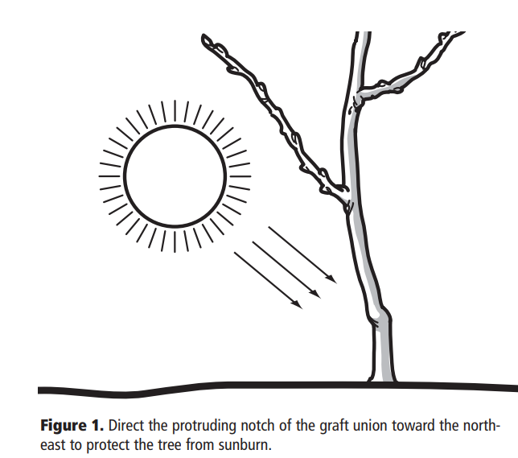
Planting your new bareroot - the short version
Dig hole twice as wide but no deeper than roots
Firm an inner hill for roots
Orient graft union towards NE
Notes:
Digging the hole no deeper than the roots helps prevent the tree from settling and reduces crown rot. 8048.ps (ucanr.edu) page 1.

Slide 19
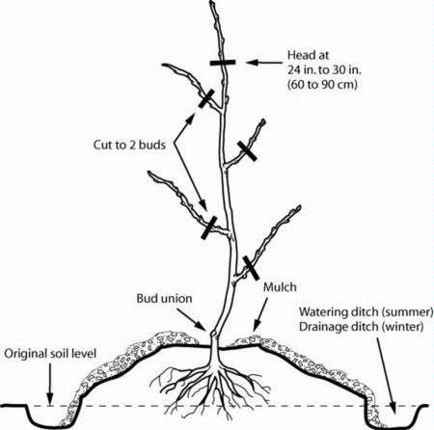
Pruning Bareroot - off to the knee!
Head tree at “20 to 24” inches or roughly “knee” for those tall enough
Shorten or remove lateral branches
https://homeorchard.ucanr.edu/The_Big_Picture/Preparation_&_Planting/#planting
Diagram from Master Gardener Handbook, page 502, second edition
Notes:
Better to plant too high than too low. The soil should slope downward to prevent water from accumulating near the trunk. 8048.ps (ucanr.edu) page
An important goal of backyard orchard culture is to maintain relatively small trees to facilitate pruning, thinning, pest management and harvesting: source 8048.ps (ucanr.edu)

Slide 20

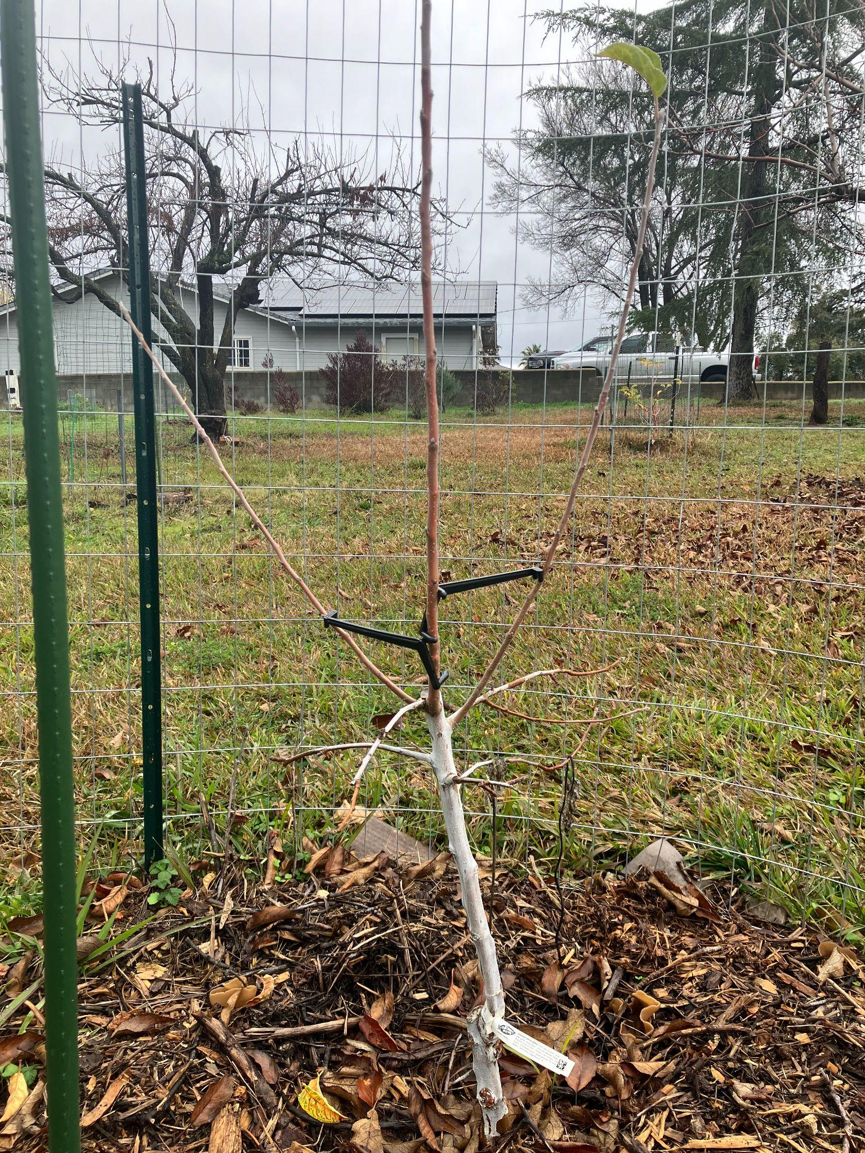
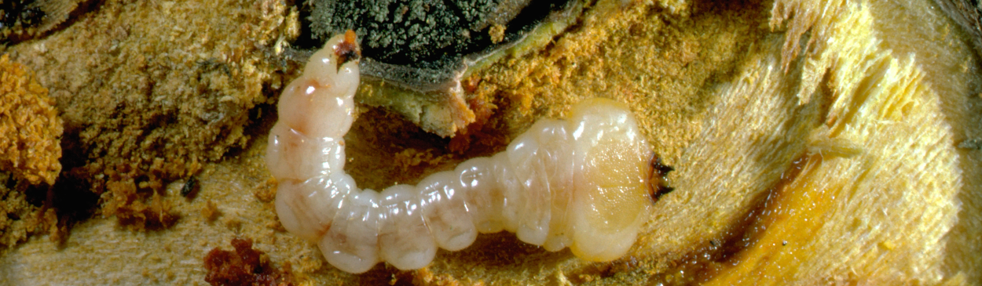
I see a gray tree and I want to paint it white….
Paint newly planted trees with 50/50 white on warmish day for sunburn
Sunburned trees more susceptible to borers
Granny Smith Apple, one year after planting and pruning
Pacific Flathead Borer
Notes:
Painting new fruit trees with 50/50 water/latex paint when you plant them will reduce damage from sunburn and insect damage especially flat head borers. Apply two inches below mulch/soil if possible. Also tree trunks may need to be re-painted in the second summer. Sources: 8048.ps (ucanr.edu) and Managing Pests in Gardens: Environmental Factors: Whitewashing Trunks—UC IPM (ucanr.edu) https://homeorchard.ucanr.edu/The_Big_Picture/Preparation_&_Planting/#planting

Slide 21
Second Winter for Apple
Pome fruit tend to central or modified central leader (all the growth above white in one year! p.s. I didn’t prune in summer)
To prune or not to prune?
(choosing between vase and central leader)
More on Modified Central Leader: https://sacmg.ucanr.edu/Fruit_and_nuts/Training_fruit_trees/Central_Leader_and_Modified_CL/ and
https://ipm.ucanr.edu/PMG/GARDEN/FRUIT/CULTURAL/appletraining.html
?
Granny Smith Apple, one year after planting and initial pruning
Notes:
Pruning systems is a whole topic unto itself. This picture is just to show the result of the heading cut made at planting one year prior. This is a decision point for deciding which system to employ. UCANR recommends pruning young trees in summer to begin developing trees with the desired rather than waiting until the next dormant season. Source: 8048.ps (ucanr.edu) page 4

Slide 22
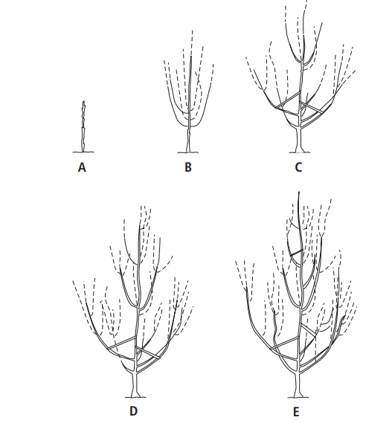
Pruning Systems Intro (Apples with Central Leader)
Pruning, Spreading and Training over 3 year period
Notes:
The UC has extensive information on pruning advice for different kinds of deciduous fruit trees: Pruning & Training - The California Backyard Orchard (ucanr.edu) Apples and other pome fruit often tend towards a central leader system which results in a christmas tree like shape. For young central leader trees, the goal is to create 3-4 tiers of lateral branches with the bottom ones being the longest. Also: Fruit Trees: Training and Pruning Deciduous Trees (ucanr.edu)

Slide 23
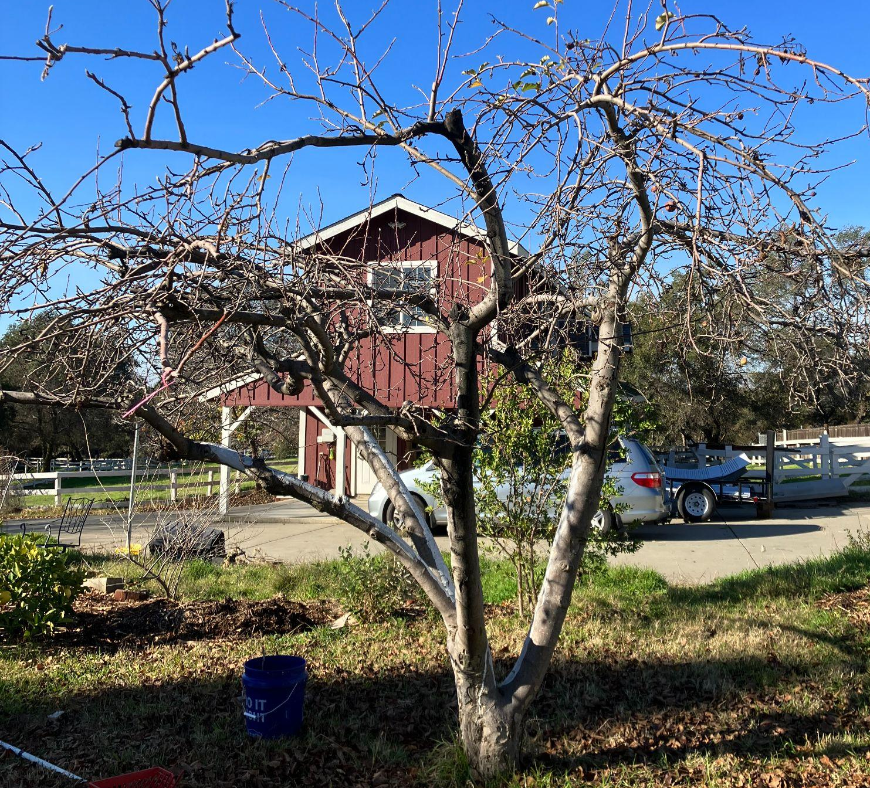
Mature Apple (pruned as vase)

Slide 24
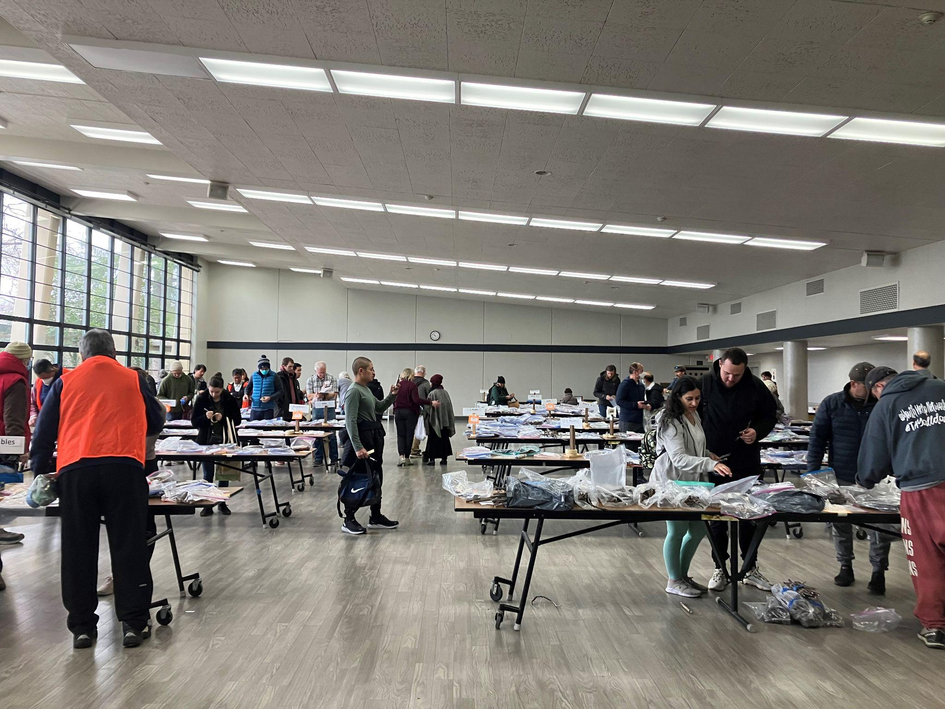
Fruit Tree Grafting
Increase the number of varieties in your existing space!
California Rare Fruit Growers has a Sacramento Chapter and they have a Scion Exchange on Feb 4th at La Sierra Community Center,
5325 Engle Road, Carmichael, CA 95608.
The Sacramento Chapter of the California Rare Fruit Growers (sacramentocrfg.org)
Notes:
1000 of varieties. Also some “rootables” like pomegranates and figs. Green Acres podcast: Green Acres Garden Podcast: CRFG Scion Exchange on Apple Podcasts

Slide 25
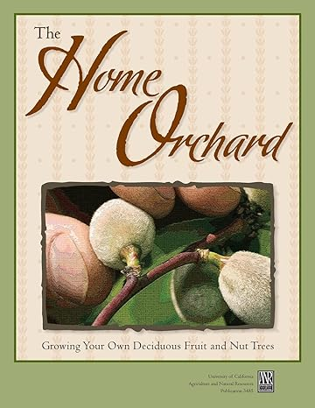
Resources
The California Backyard Orchard https://homeorchard.ucanr.edu/
Home Orchard: Growing Your Own Deciduous Fruit and Nut Trees: https://anrcatalog.ucanr.edu/Details.aspx?itemNo=3485 (2009)
Small Yard Ideas: https://sacmg.ucanr.edu/FOHC_Orchard_tour/
Fruit Trees for the Lower Foothills: https://anrcatalog.ucanr.edu/pdf/8396.pdf
Apples and Pears: Calendar of Operations for Home Gardeners: https://homeorchard.ucanr.edu/7258.pdf
Harvest Times for Selected Fruit Cultivars in the Sacramento Valley Foothills https://homeorchard.ucanr.edu/harvest-foothills.pdf
Growing Temperate Tree Fruit and Nut Crops in the Home Garden and Landscape https://homeorchard.ucanr.edu/plant_apple.pdf
Why Fruit Trees Fail to Bear: Why Fruit Trees Fail to Bear OSA 31-S68.pub (ucanr.edu)
California Stone Fruit Varieties - Fruit Report (ucanr.edu) https://sonomamg.ucanr.edu/Food_Gardening/Additional_KG_Articles/Planting_Bare-root_Fruit_Trees

Slide 26
Thank You!
Any Questions?
Master Gardener Hotline: (530) 889-7388
Master Gardener Website: pcmg.ucanr.edu
Evaluations, please!

