Slide 1
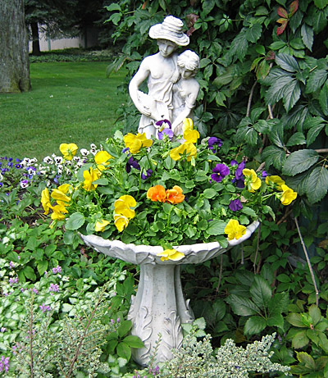
Container Gardening
Notes:
Created by: Joan Basque of Placer County Master Gardener(s) who created this originally, unknown date.
Audience: Home gardener
Publicity: Container gardening is a great solution if you don’t have a suitable garden space. This workshop will cover choosing the right container, plant selection tips, transplanting and more. Learn how to be successful growing ornamental plants, as well as fruit and vegetables.
Update History:
Updated 2020 by Brooke Moeller with new template/approved by Kevin Marini.
Updated March 2024 by Brooke Moeller with new template and new photos.
Container Gardening
Take a examples of containers .. a good variety ; different materials & sizes, refer to each during the Get it Right ‘containers’ portion of the presentation
Take at least one potted arrangement .. something unusual is always good for conversation .. ask members of the audience for examples of non-traditional items they have used as containers
Set out several books on containers, select several examples … the larger the photos the better

Slide 2
Who Are Master Gardeners?
Master Gardeners of Placer County
  Extend research-based, sustainable gardening and composting information
  Present accurate, impartial information to home gardeners
  Encourage public to make informed gardening decisions

Slide 3
Who Are Master Gardeners?
Where to find us…
Online, in the Media, and Special Publications
  Hotline: Call (530) 889-7388 or submit your questions online
  Website: pcmg.ucanr.edu
  Facebook, Twitter, Instagram
  Gold Country Media monthly column
  Curious Gardener quarterly newsletter on our website
  Calendar and Gardening Guide

Slide 4
Who Are Master Gardeners?
Where to find us…
Workshops, Fairs and Festivals, and Special Events
  Speakers by Request
  Workshops (various venues, check website)
  Farmers’ Markets (seasonal: Auburn, Roseville, Lincoln)
  Fairs and Festivals Booths (varies)
  Garden Faire (April 13, 2024)
  Mother’s Day Garden Tour (May )

Slide 5
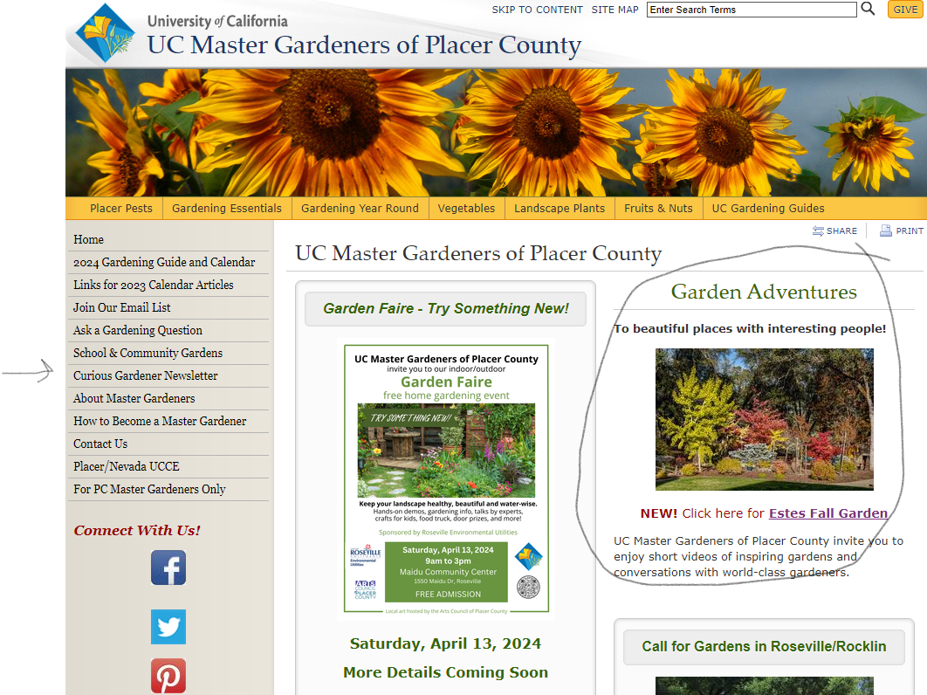
Notes:
Over on the left is where youcan sign up for the Curious Gardener Newsletter
And Garden Adventures is a new offering by Placer County Master Gardeners
Our website will also tell you all the upcoming events and our video library of past presentations.

Slide 6
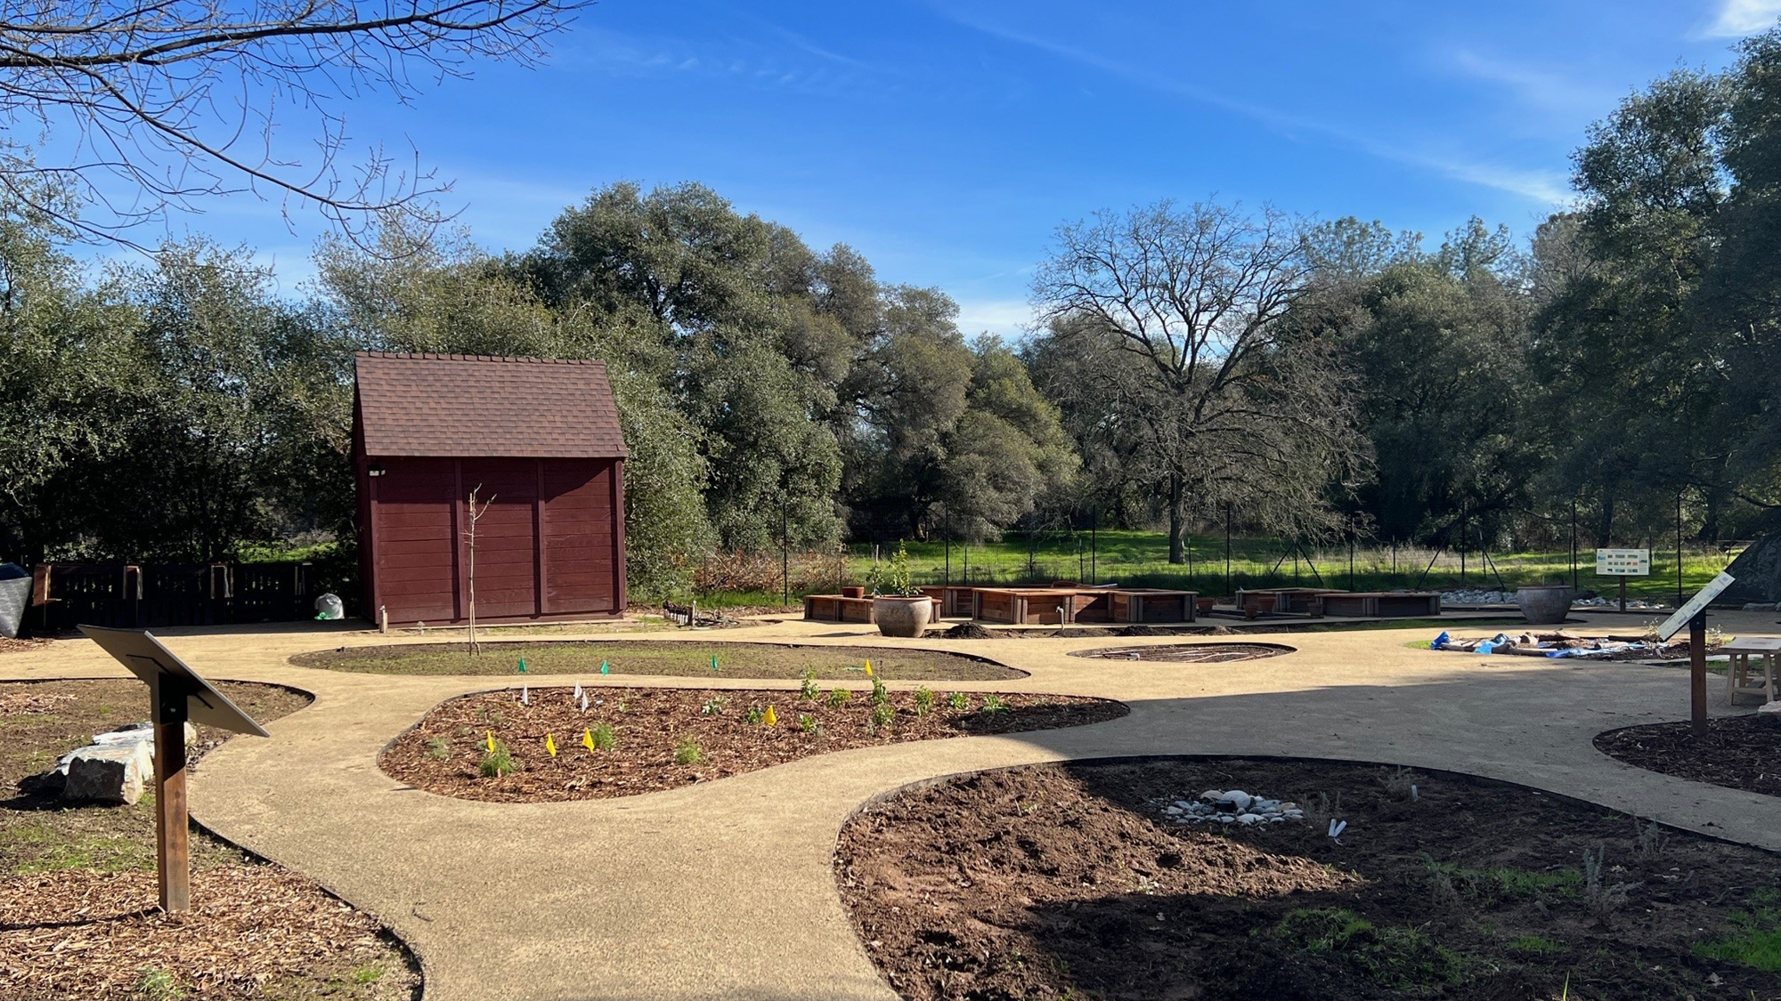
Ribbon Cutting Ceremony
March 27, 2024
Notes:
Our demonstration garden has been an act of love and many hours of hard work for our Master Gardeners. Our ribbon cutting ceremony will be on March 27.

Slide 7
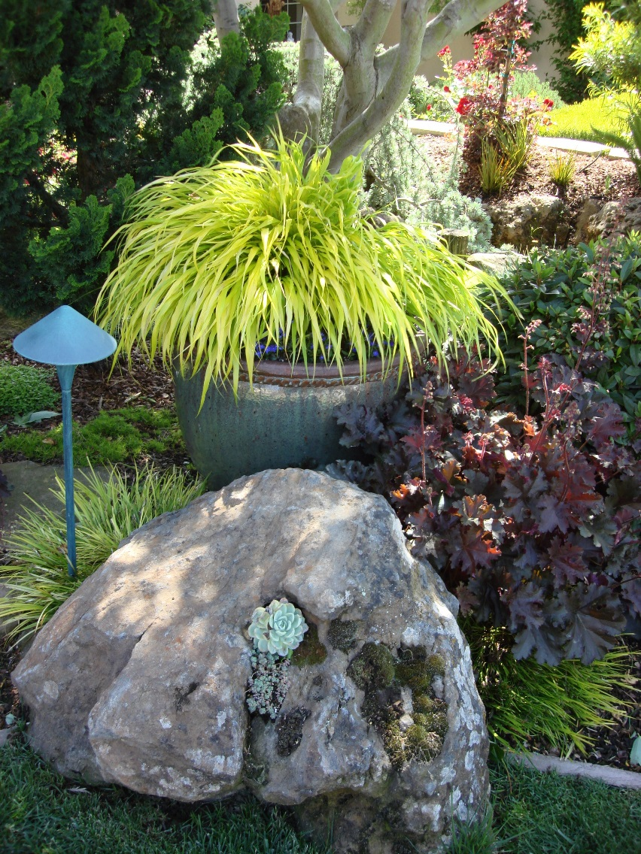
Container Gardening
Agenda:
History
Advantages of Container Gardening
Get it Right
  Containers
  Planting Medium
  Plants
  Planting - Repotting
Notes:
Review Agenda .. Encourage questions ..
Ask about specific areas of interest .. If not covered in the presentation material address where appropriate during the presentation or at the end.

Slide 8
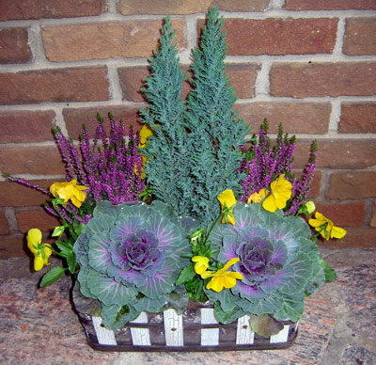
Agenda Continued
Vegetables, Fruits &Herbs
Care & Troubleshooting
Photo Gallery
Summary & Tips

Slide 9
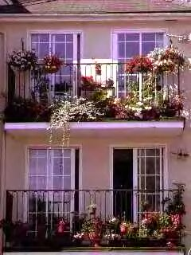
History
Container gardening defined
  “not open to the garden soil below”
Ancient Rome, Egypt, Orient
Grand Gardens of Great Britain & France
50% bedding plants go into containers
  Shrinking “open soil”
Notes:
What is “Container Gardening”?
Container Gardening can be defined as “not open to the garden soil below… a raised bed on open ground is a ‘bed’, a raised bed on paving is a container . Container Gardening has a long history, remnants of Container Gardens are found at excavations of ancient Rome, Egypt and the Orient. Many of the grand old gardens of Great Britain and France showcased spectacular container plantings of trees, shrubs, flowers and herbs.
Fifty years ago the majority of bedding plants sold to the household gardener landscaped open soil. Today greater than 50% of all bedding plants can be found in containers of all sizes and varieties. The growing interest in Container Gardening seen in recent years can be in part attributed to shrinking “open soil”. The numerous balconies of large apartment complexes, paved patios for outdoor entertaining, and the “greening” of commercial properties contribute to the demand for container gardens

Slide 10
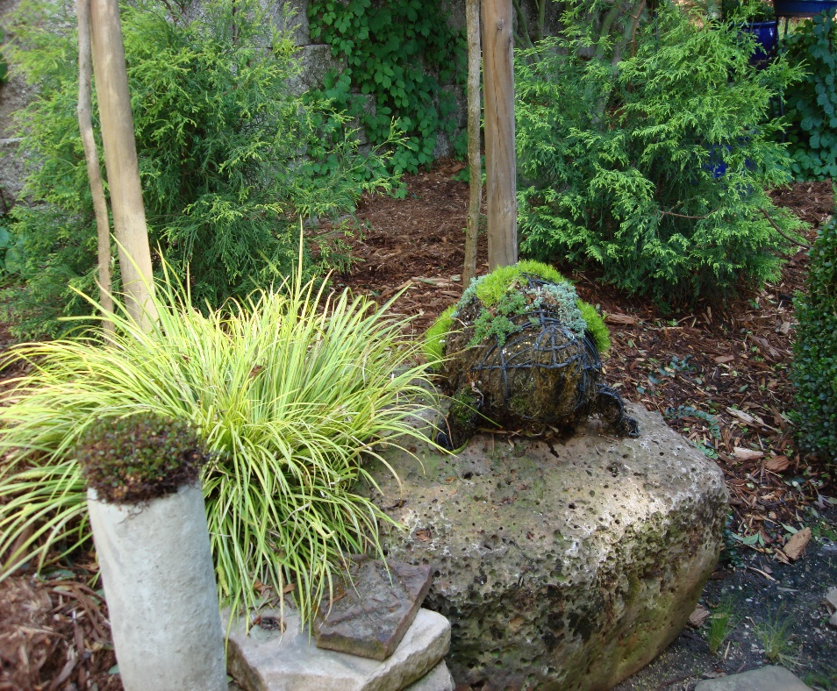
Advantages of Container Gardening
Ground is not needed
Display element
Tailor soil to specific plant needs
Incorporate tender plants
Enhance flat and boring areas
Block or camouflage eyesores
Notes:
Ground is not needed…containers are suitable for roof tops, balconies, paved area, porches, walls and they enhance a traditional ‘in ground’ garden.
Display element…of container gardening adds extra dimension – containers make great focal points. Small and fragrant plants can be positioned closer to the eye and nose. Trailing plants cascading from a hanging container or raised container can really show off – something that is lost in the open garden.
You can Tailor soil to meet the specific needs of a plant. You are not limited by your heavy clay open soil and therefore can raise plants not suited to your soil.
Tender plants not suited to your climate zone can be raised in containers and moved to protected areas when the weather changes.
Add color and dimension to flat and boring areas. Walls, paved patios, windows, fences, terraces and court yards can be enhanced by containers
Containers can block or camouflage eyesores such as utility boxes and manhole covers.

Slide 11
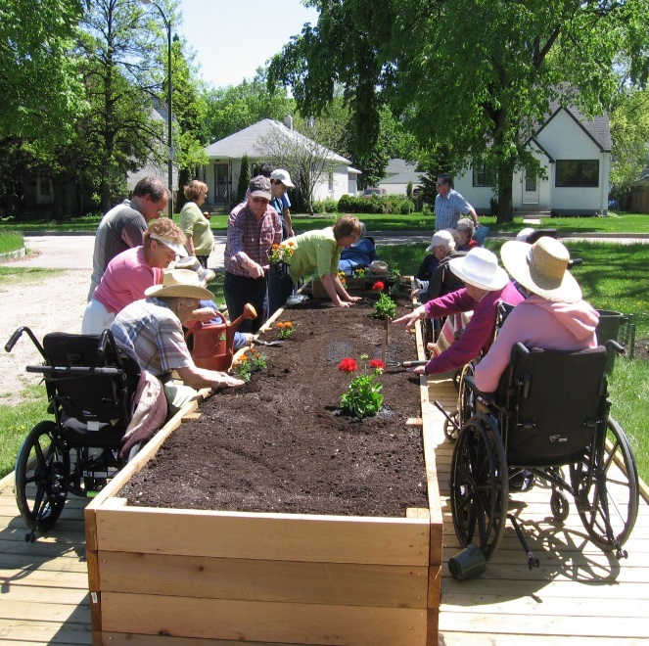
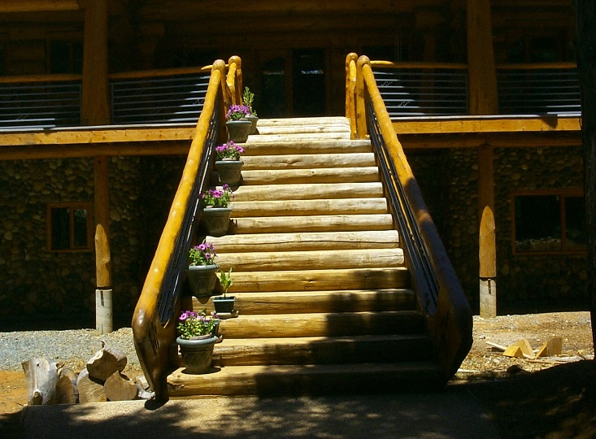
Advantages of Container Gardening cont.
Accessible for physically challenged
Rotate displays
Plants to go …
Photo courtesy of
The Arc at Gray’s Harbor
Notes:
The use of tall containers & hanging containers makes gardening accessible to physically challenged persons. Positioning the plantings with access in mind eliminates the need to stoop for planting, deadheading, and other maintenance tasks.
Rotation of displays can be made easy with the use of containers … once the plant (s) are past their prime they can be moved out of a focal point and a new display moved in.
Container plants can be taken with you when you move

Slide 12
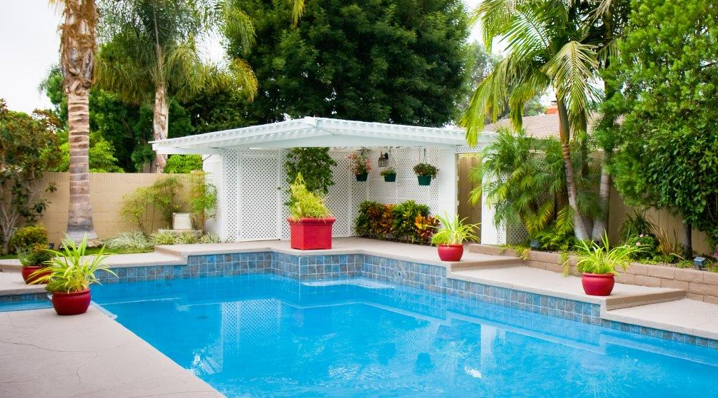
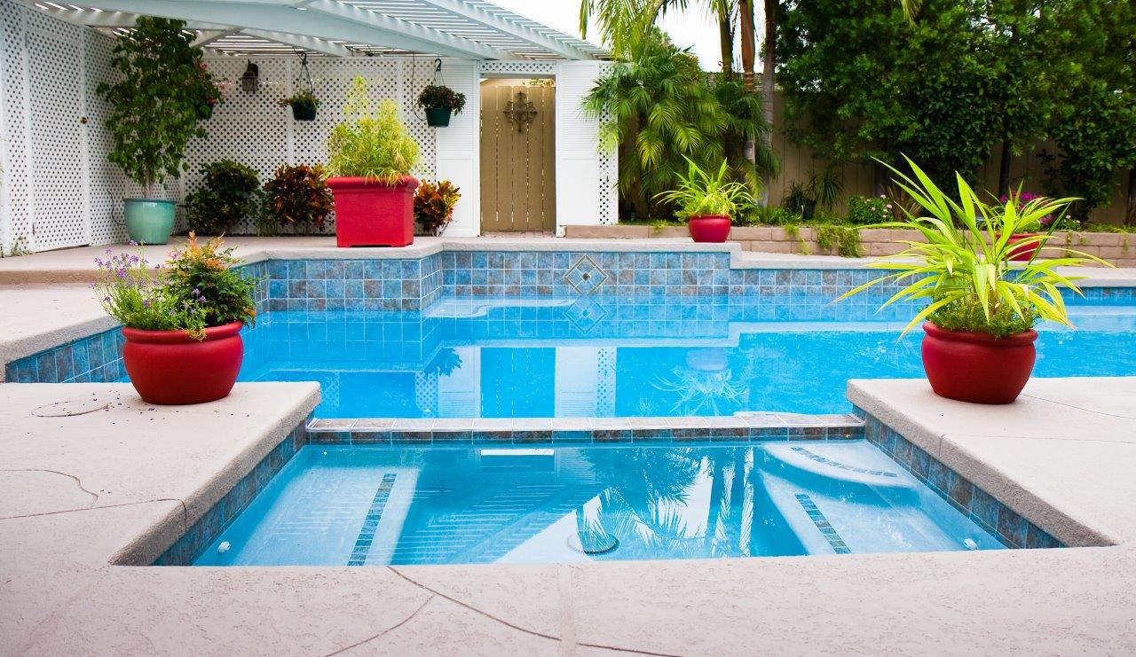
Adding a Focal Point and Color
Photos courtesy of Steve Moeller

Slide 13
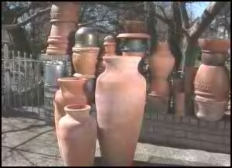
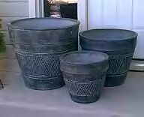
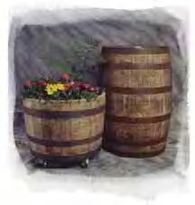
Get it Right .. Containers
Size…Large & deep
Water and nutrient retention
Notes:
Getting off on the Right Foot
Many problems associated with Container Gardening can be avoided before you begin to plant.
Right Container: large and deep enough to insure adequate soil mass necessary for water retention and nutrition.
The container selection is as important as the plant selection. Almost any receptacle can become a garden container … use your imagination.

Slide 14
Containers… cont
Clay / Terracotta
Plastic
Wood
Metal
Fiber
Stone
Tufa
Concrete
Fiberglass
Glazed earthenware
Straw bales
“The Unexpected”
  Have fun, use your imagination
Notes:
Clay / Terracotta dries out easily and is heavy but keeps roots cool. Soak in water before using.
Plastic ~ lightweight; durable; inexpensive and available in a wide variety of colors and shapes. The more expensive ones have better durability & insulation than the cheap ones.
Wood ~ keeps roots moist longer moderately heavy
Metal ~ Mainly white coated metal wire for hanging baskets used with coca liners, by itself its heavy and roots get too hot
Fiber ~ usually made from recycled paper, not very attractive (use trailing plants) .. cheap, light & bio-degradable. Last only 2-3 years
Stone ~ heavy & expensive. Do not plant acid loving plants in limestone.
Tufa ~ form of magnesium limestone – porous & holds more than it’s own weight in water – plants roots will grow into it. Drill holes in it & insert plants ; keep rock moist in hot weather
Concrete ~ least expensive of the “stone” containers. Thick walls provide good insulation… generally not very attractive
Fiberglass~ many patterns & styles. Can be made to look like wood, stone etc. Brittle, chips easily , - poor insulation:
Glazed Earthenware ~ heavy but holds moisture better
The “Unexpected” ~ where the fun begins Old shoes; old coffee pots; discarded sink; worn out heel barrel … there is no end to the possibilities, each with their own unique characteristics.

Slide 15
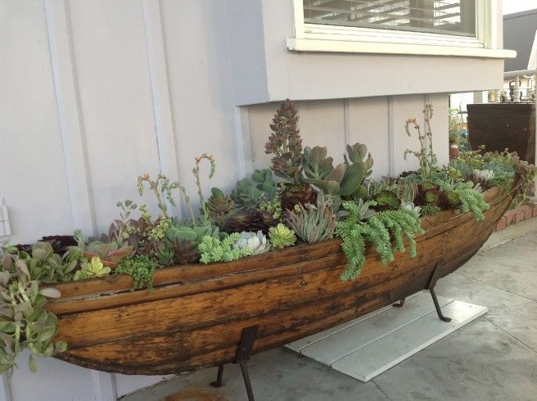
The “Unexpected”
Notes:
Repurpose….Reuse… Pick a theme to express your interests & hobbies.

Slide 16
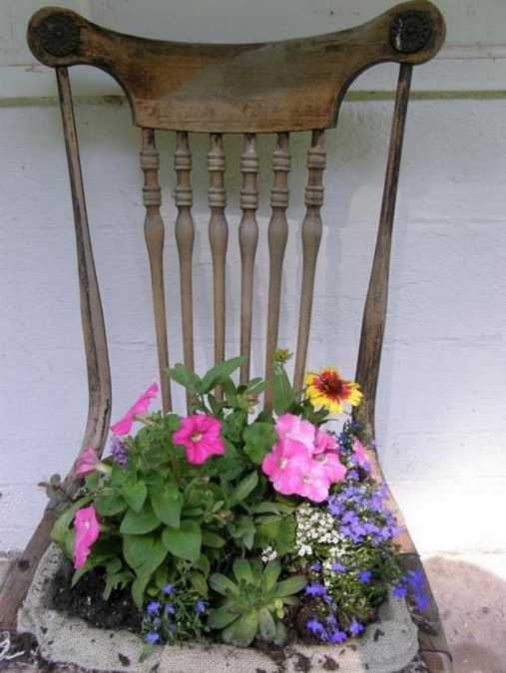
Notes:
A chair planter. Using some mesh screening, planting mix. Add moss for mulch to help retain moisture.

Slide 17
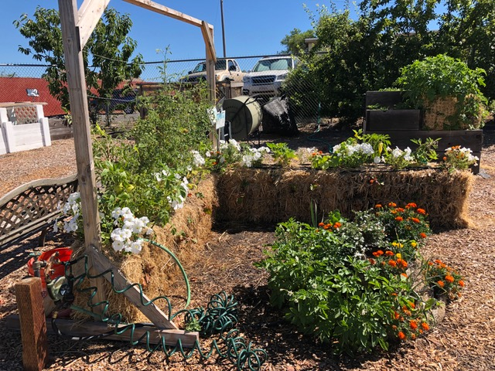
Straw Bales
Unexpected
Easy once it is ‘ready’
Breaks down into great mulch
https://youtu.be/vxbXr4BLMas
Notes:
Need to use rice straw bales and eliminates weeds!

Slide 18
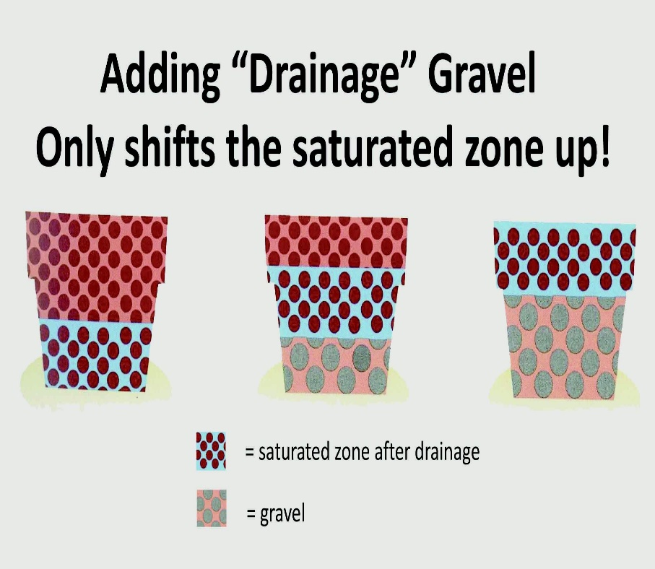
Drainage
Plants need a few drainage holes
Don’t add gravel to the bottom of the pot.
Saucer vs No Saucer
Notes:
After watering there is a saturated zone at the bottom of the pot. Adding gravel shifts the level up, leaving less unsaturated soil for the plant to grow in. Studies show that gravel or pot shards interfere with drainage and cause the potting soil to stay over-saturated with water.
No saucer is better if you don’t need it. Irrigation water with fertilizer will leave soluble salts in the soil. If you don’t leech the salts out by adding enough irrigation water so some water drips from the bottom of the pot, the salts will build up in the soil and could cause problems for your plants. You can use ‘pot feet’ between the pot and saucer.

Slide 19
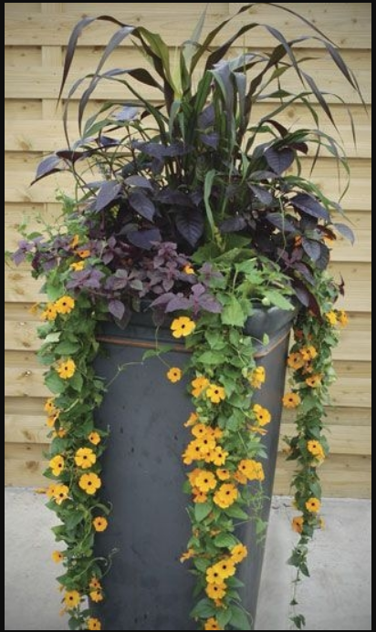
Big Pots and Drainage
Does your plant need a lot of root room to grow?
For annuals or shallow rooted plants, use the pot in a pot method
OK to use peanuts/filler if not blocking drainage
  then add planting pot on top of the peanuts
  Make sure your peanuts are not compostable (dissolve in water)
Notes:
Are you planting a tree? If yes, just add soil. Yes, it will be heavy, so plant it in place.
Choose a container that will support your plants but shallower than the deep planter. Easy to remove and refill with potting soil and new plants.
Don’t put peanuts in the bottom and then add soil. Roots will grow into the peanuts and dry out.
OK to put heavy things in the bottom to help ‘anchor’ it, then peanuts, then the potted container on top, and top off with mulch or moss.

Slide 20
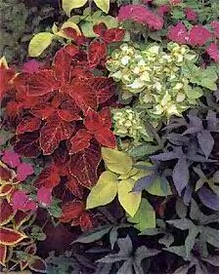
Get it Right...Planting Medium
No garden dirt...roots require air & water
Sterile, pre-mixed quality potting soil
  Bark, sphagnum peat moss, vermiculite or perlite are desirable
  Leach any potting soil before planting
  Fertilize with soluble fertilizer within 2 weeks after plants are growing
  Re-use old potting soil?
Notes:
Ordinary soil taken from the garden is not suitable. Whatever is wrong with the soil will be even more so when used in a container
Pre-mixed sterile potting soil is easy to buy at your local nursery. Most brands come with fertilizer already added.
Vermiculite and perlite improve drainage
Leaching the potting mix before planting reduces soluble salts to acceptable levels
You can add used potting soil to your compost pile or mix in about one-third the volume of new potting soil and add fertilizer

Slide 21
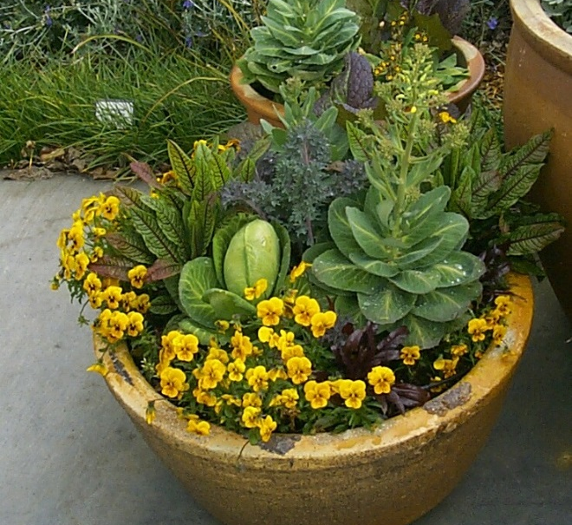
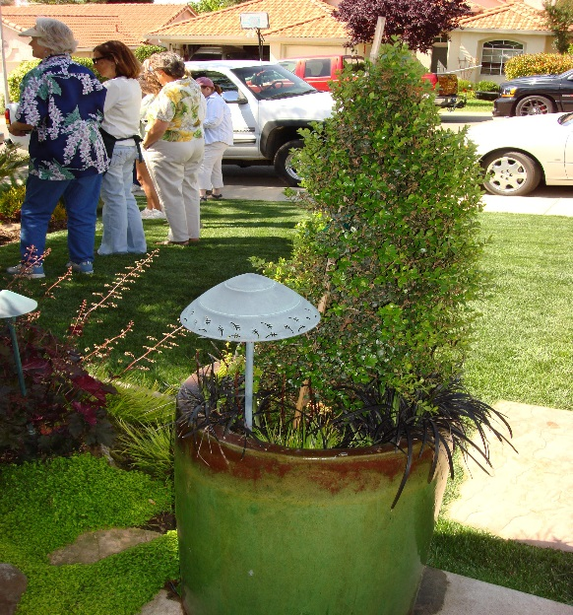
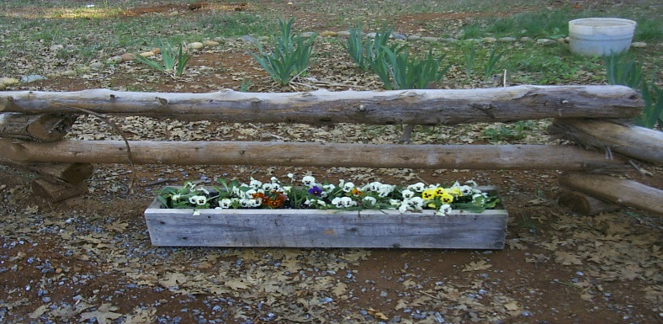
Get it Right…Plant Selection
Select suitable high-quality plants
Location .. Location ..Location
Notes:
Suitable Plants: Select quality plants for your container displays. Carefully inspect your selections .. Roots (yes, look at them, gently remove the plant & inspect the roots), look for insects & deficiencies (leaf color).
.
Location … location … location…. For optimal permanent display select plants suitable to your zone. If you intend to move plants indoors you can get away with less tender plantings.
Design your container display so plants with like requirements … sun / shade / Ph / nutrient / water are together.
Think about finished size of the plants

Slide 22
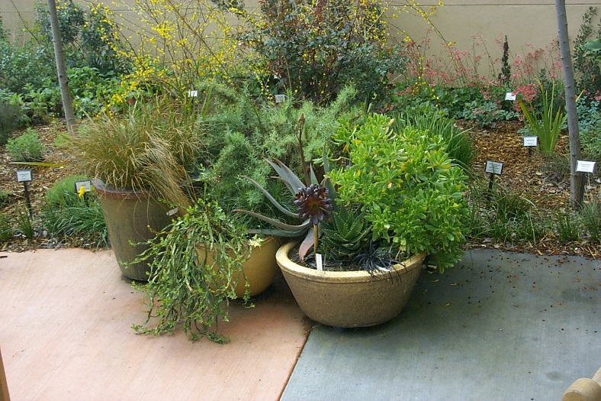
Planting
Plan your design
Medium should be moist
Provide for adequate drainage
Start with the largest plant & dig a
hole large enough for the root ball
Remove the plant from the pot set
in the hole - the top of the root ball
should be just at or just below the surface
Leaving about 1” space in the top of the container, firm in by replacing some of the medium taken out from the hole & press down with your fingers
Continue planting – finishing off with the edging plants
Water gently
Notes:
The time invested in designing your container planting is time well invested.
Consider color, height, soil PH requirements, sun or shade, water needs, everything you look for to have successful open soil plantings.
Design your container display so plants with like requirements are together
Before you begin :Water plants thoroughly and allow to drain
The growing medium in the container should be moist
Provide for drainage .. Drainage holes and add drainage material - broken clay pots, stones or coarse gravel, or polystyrene chunks in the bottom of the pot, and a mulch of gravel on the top. Plants should never sit in water
Leave about 1” of space at the top for even water penetration.

Slide 23
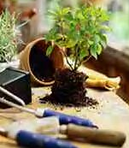
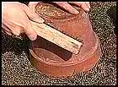
Repotting
Remove plant; clean pot
Loosen roots from medium
Trim roots <25%
Put plant back into same pot
Notes:
As the plant grows increase the pot size by 2-3 “ in diameter until the plant has reached the desired size.
Re-Potting~
Re-potting is necessary when the plant is pot bound and it/ or the container had attained maximum size. During dormant season remove the plant ~ tease away the growing medium form the root ball. Trim away some of the root tips but do not decrease the root ball by more than 25%. Put the plant back into the same pot ~ scrub the pot clean first.
Clean and scrub pots with a firm-bristled brush and rinse with a strong spray of water from a hose. Thorough cleaning reduces the spread of pests and plant diseases.

Slide 24
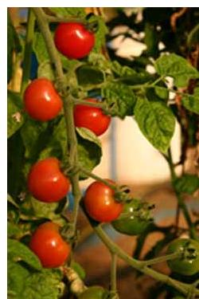
Vegetables
Many vegetables do well in containers
Same principles apply:
  Proper plant selection
    Dwarf or Bush varieties
  Suitable container
  Good planting media
  Location, location, location
Notes:
You don't need a plot of land to grow fresh vegetables. Many vegetables lend themselves well to container gardening.
Plan your selection: With some thought to selecting bush or dwarf varieties, almost any vegetable can be adapted to growing in a pot. Vegetables that take up little space, such as carrots, radishes and lettuce, or crops that bear fruits over a long period of time, such as tomatoes and peppers, are perfect for container vegetable gardens.
What you can grow in a container vegetable garden is limited only by the size of the container and your imagination.
A Summer Salad container? Plant a tomato, a cucumber and some parsley or chives all in a large (24-30") container. They grow well together and have the same water and sun requirements. By late summer they might not be very pretty, but they'll keep producing into the fall.
Size: The size of the container is important. For larger vegetables like tomatoes and eggplants, use a five gallon container for each plant. two gallon containers can be used however you need to give the plants considerably more attention.

Slide 25
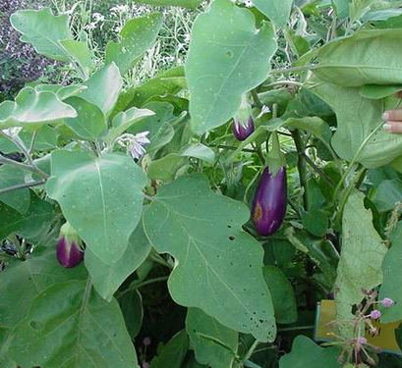
Vegetables: try these..cont
Eggplant
- Bambino, Slim Jim, Florida Market, Black Beauty, Long Tom

Slide 26
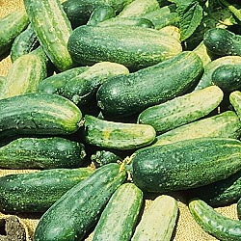
Vegetables: try these
Cucumbers
- Salad bush hybrid, Spacemaster, Bush Pickle
Bush pickle: sets a huge supply of crisp 4-5” fruits. Bushy vines grown just 2-3 ft long. 45 days.

Slide 27
Vegetables: try these …cont
Green beans
  Kentucky Wonder, Blue Lake, French Dwarf
Green Onions
  Bettsville bunching, Crystal Wax, Evergreen bunching
Lettuce
  Buttercrunch, Salad Bowl, Bibb, Romaine
Peppers
  Frigitello, Cubanelle, Sweet Banana, Apple (Hot) Red Cherry, Jalapeno, Robustini

Slide 28
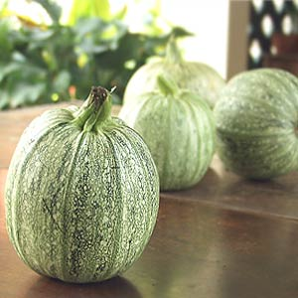
Vegetables: try these ...cont
Radishes
  Cherry Belle, Scarlet Globe, (White) Icicle
Squash
  Ronde de Nice, Gold Rush
Ronde de Nice.. Pick at 1”-2” diameter.

Slide 29
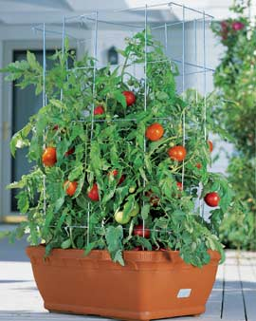
Vegetables: try these…cont
Tomatoes
Patio, Pixie, Saladette
Toy Boy, Spring Giant
Tumbling Tom, Small Fry
Notes:
Tiny tim: 70 days. Lycopersicon esculentum. (F1) Plant produces large yields of 2" red tomatoes. Excellent for small gardens or containers. Great for school projects. Kids love them. Disease Resistant: F. Determinate.
Red Robin: Red robin 55 days. Lycopersicon esculentum. Plant produces good yields of 1 ¼" extra sweet red cherry tomatoes. This small plant is perfect for pots and containers. Suitable for growing indoors all year. Determinate. Plant is only 12" tall

Slide 30
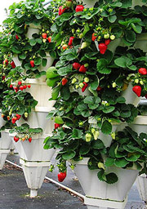
Fruits & Berries
Try …Apples, Plums, Cherries, Apricots, Citrus, Nectarines, Peaches
And … Strawberries, Blueberries, Gooseberries, Grapes
Notable Exceptions:
Blackberries and certain hybrid berries are difficult to grow in pots because they can’t seem to ‘contain’ themselves due to vigorous growth
Notes:
Not all fruit trees will grow well in containers for long periods of time. If you want to grow a fruit tree in a container for just a couple of years, then you can grow just about any fruit tree. For long term container life select dwarf trees.

Slide 31
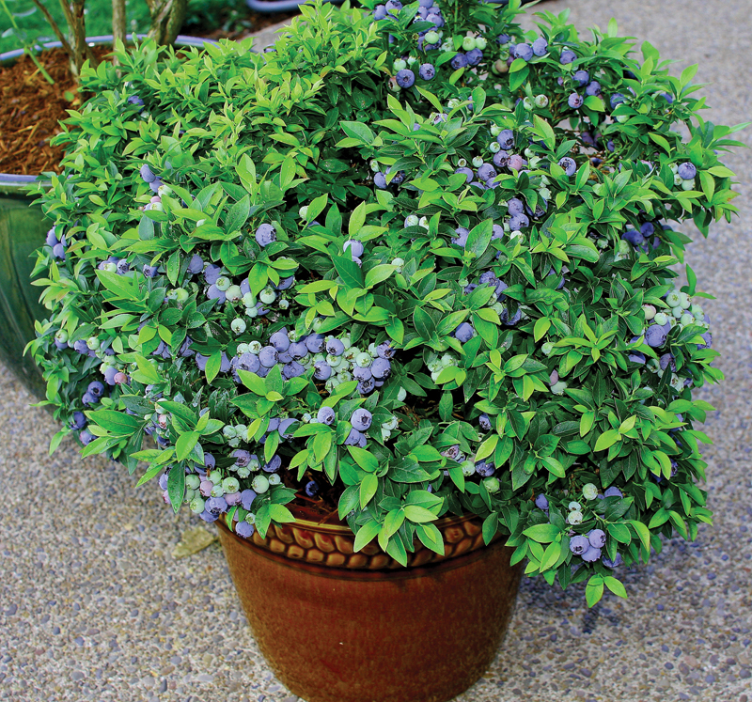
More on Blueberries…
  Look for low growing bushes
  Need acidic soil Ph5
  Remove all flower buds or blossoms that appear the first year
  Drainage is key … do not allow to sit in water
  Never let a berry pot go dry
Notes:
Look for low-growing (3 to 4 feet) blueberry bushes for northern climates and taller bushes (6 to 8 feet) for warmer climates. Snow will cover the lower plants, insulate them and keep them from freezing.
Blueberries need acid soil (Ph 5). Try a mixture that includes leaf mold for acid, perlite for drainage, peat moss, time-released fertilizer (try the three-month type) and coffee grinds. Combine ingredients well, then add to pot or hole for the blueberry bush. Fill in with regular soil.
If blueberries have yellow leaves and don’t seem to thrive, try adding wooden match sticks with sulfur tips to the potted plants (about 20 per pot). Simply insert them all the way into the soil. Nails added in this way will add iron to the soil.
Once a month, treat the plant to a solution of one cup apple-cider vinegar added to five gallons of water. Straight vinegar will kill the plant, so be sure it is diluted. Diluted vinegar also acts as an herbicide.
Drainage is important for blueberry bushes. Don’t set a saucer under the plant because it will hold excess water and kill the plant. Set the pot directly on the ground or deck.
Need more than one shrub for pollination.

Slide 32
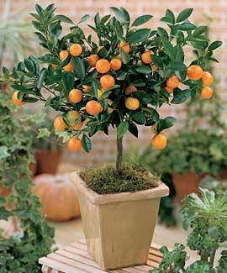
Citrus
Some of the most popular dwarf citrus trees to grow in containers are:
Meyer lemon: Imported from China in 1908, it is believed to be a cross between a lemon and a mandarin. The fruit has a very sweet flavor and is less acidic than a true lemon.
Calamondin: Prized for its attractive shape and foliage, it produces fragrant flowers nearly year-round. It is grown primarily for aesthetics and less for actual, edible fruit.
Dwarf Kaffir lime tree: The rind of the fruit and the unique double-lobed, aromatic leaves are often used in cooking.

Slide 33
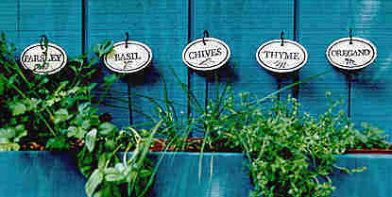
Herbs
Basil
Easy to grow from seed. Likes heat and sun. Usually only lasts a season (clip flowers to extend life). Small-leaved varieties like ‘Spicy Globe' good in pots.
Chives
Easy to grow from seed. Likes heat and sun. May last for years. Clip individual leaves at the base, rather than cutting several at the top.
Parsley
Needs bright light. Usually lasts only one season. New leaves grow from the center, so clip outer stalks first.

Slide 34
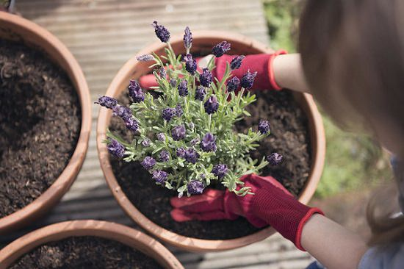
Herbs…cont
Rosemary
Needs bright light, not hot sun. Will live many years with good care.
Scented geraniums
Likes sun. Scented leaves, some with pale, delicate flowers.
Sweet marjoram
Easy to grow from seed. Likes sun. May last several seasons (clip flowers to extend life). Leaves have refreshing, heady scent.
Lavender
Will live several years with good care. Species like Lavandula augustfolia is good for containers.

Slide 35
Theme Herb Combinations
An Italian chef’s selection
·Sweet basil
·Italian parsley
·Oregano
·Marjoram
·Thyme
A perfume pot
·Lavender
·Rose scented geranium
·Lemon balm
·Lemon thyme
·Pineapple sage
A salad bowl
·Garlic chives
·Rocket
·Salad burnet
·Parsley
·Celery
A French chef’s selection
·Tarragon
·Chervil
·Parsley
·Chives
·Sage
Notes:
Plant mint alone … it will take over the entire container

Slide 36
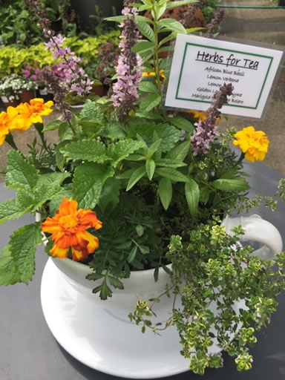
Tea Time
Lavender
Marigolds
Mint
Verbena
Photo courtesy of Thrillers, Fillers and Spillers

Slide 37
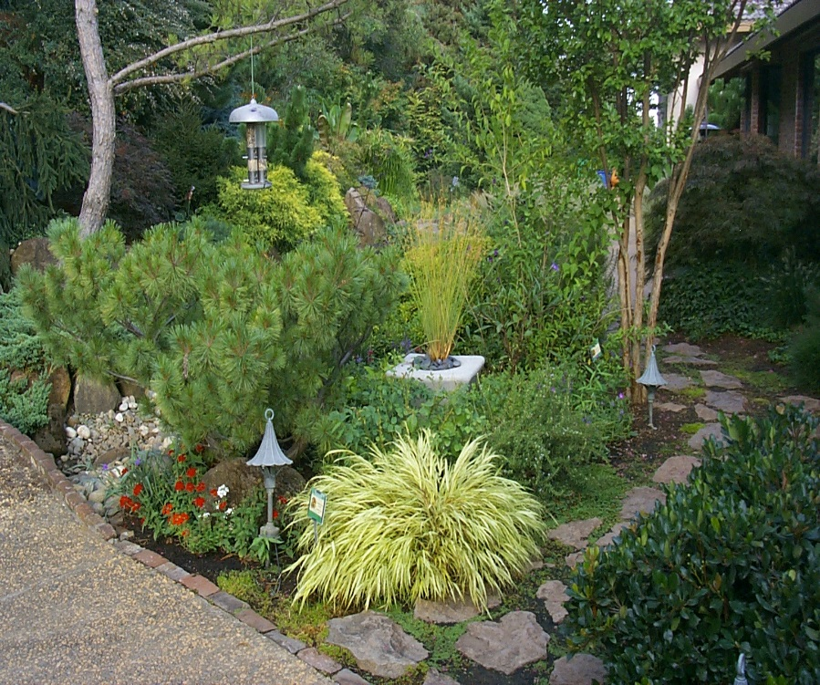
Care & Troubleshooting
POOR feeding & watering = stress
  Consider a drip system
Winterizing
Maintenance
  Inspect plants regularly
  Remove dead blooms
  Trim dead branches
  Use Chemicals sparingly
  Turn on a weekly basis if against a wall or fence

Slide 38
Container Gardening Troubleshooting- most problems are cultural
Symptom | Possible Cause(s) | Action
Few or No Flowers | Too much shade | Move to sunnier location
 | Too much nitrogen | Add postash
 | Dryness at the roots delaying flowering & flower & bud drop | Change watering schedule
 | Frost damage (improper or no hardening off) | Wait until frost is past or provide frost protection
 | Poor pruning – too much; too little; too late | Research pruning needs & follow them
Leaf Wilt, Leaf Drop, Yellowing | Insufficient watering during summer months | Water thoroughly during summer months.. sprinkle the leaves at the first sign of wilt

Slide 39
Troubleshooting…Cont
Symptom(s) | Possible Cause(s) | Action
Limp-soft leaves – stem & root rot | Waterlogged | Check drainage holes for blockage. Add more drainage holes or slits if using a growing bag
 | Growing medium too heavy | Replant with lighter growing medium
Brown / dead evergreens | Cold induced drought ~ bright sunny weather after a cold spell | Spray leaves of newly planted specimens – provide protection from frost & east winds
Brown patches on leaves | Sun scorch is likely the problem (in the absence of any pests or disease) caused by overhead watering. The droplets of water act as lenses & burn the leaves. | Minimize the suns’ effect on water droplets .. water early in the day or in the evening

Slide 40
Troubleshooting…cont
Symptom | Possible Cause(s) | Action
Twisted leaves & twisted leaf stalks | Exposure to lawn weed killer | Minimize the suns’ effect on water droplets..water early in the day or evening.
 | Over watering | Reduce watering &/or check drainage
 | Lack of sunlight | Move plant to a sunnier location
Lanky plants | Lack of sunlight | Move plant to a sunnier location
 | Under nourished | Feed regularly per pkg instructions
 | Crowded | Thin out

Slide 41
Troubleshooting
Symptom | Possible Cause(s) | Action
Plant Death: Summer | Container too small; Dark container absorbing too much heat. Container poorly insulated. Exposure to sun all day.
Plant Death: winter | Frozen plant medium causes root damage. Container too small &/or poorly insulated
Pot bound | Roots growing through drainage holes | Release root ball from soil; trim roots and pot in same or larger pot
 | Plant dries out quickly | Release root ball from soil; trim roots, pot in same or larger pot.

Slide 42
Troubleshooting…cont
Symptom | Possible Cause(s) | Action
Stunted growth, small pale leaves, weak stems | Nutrition deficiencies (Nitrogen shortage) | Apply a balanced fertilizer
Leaves wit brown brittle edges. Small flowers, Low disease resistance | Nutrition deficiencies (Potash shortage) | Use a lime-free compost
Lime haters affected: Yellow between veins. Oldest leaves worst | Nutrition deficiencies (Manganese shortage) | Use a lime-free compost
Gnats flying around | Overwatering, Too much organic material (mulch) | Improve drainage; allow top of soil to dry between watering; Bacillus thuringiensis (BT)

Slide 43
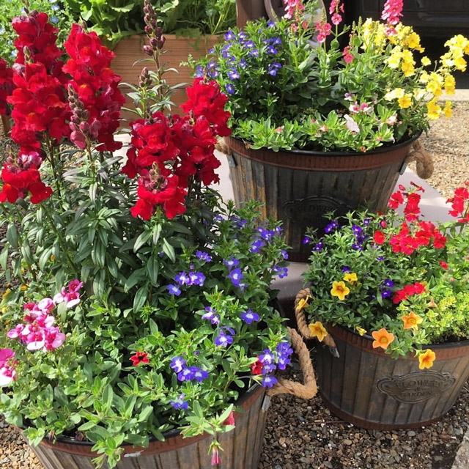
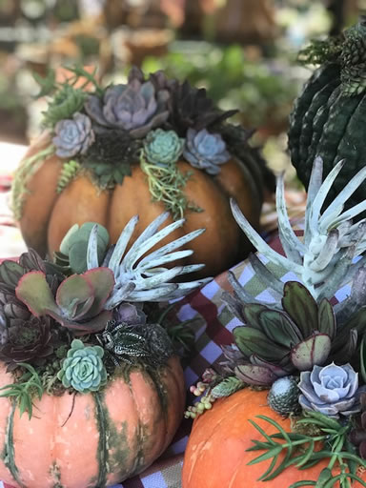
Photo Gallery
Photo Credit: thrillersfillersand spillers.com

Slide 44
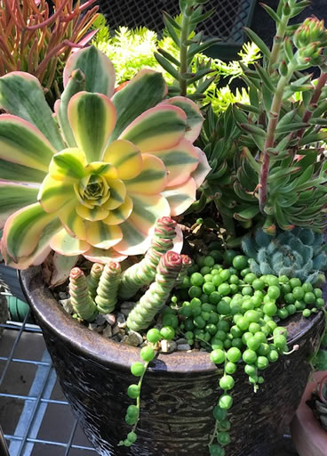
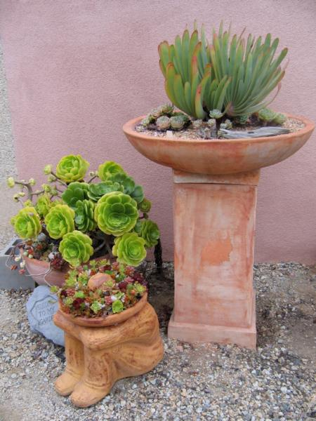
Photo Credit: www.thrillersfillersandspillers.com
Photo credit: Master Gardeners of Placer County

Slide 45
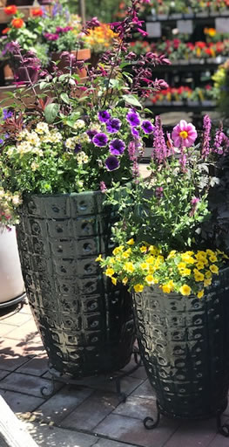
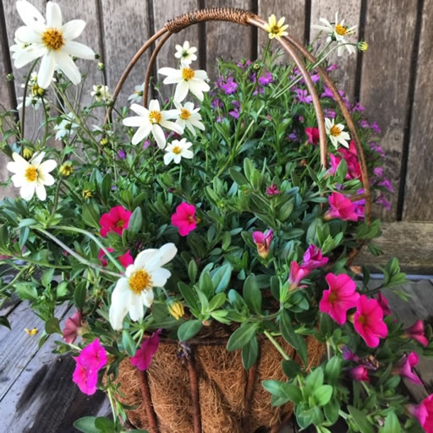
Photo Credit: www.thrillersfillersandspillers.com

Slide 46
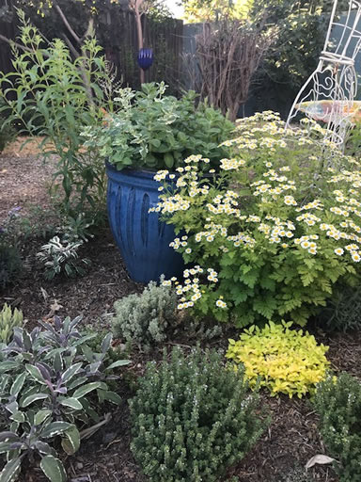
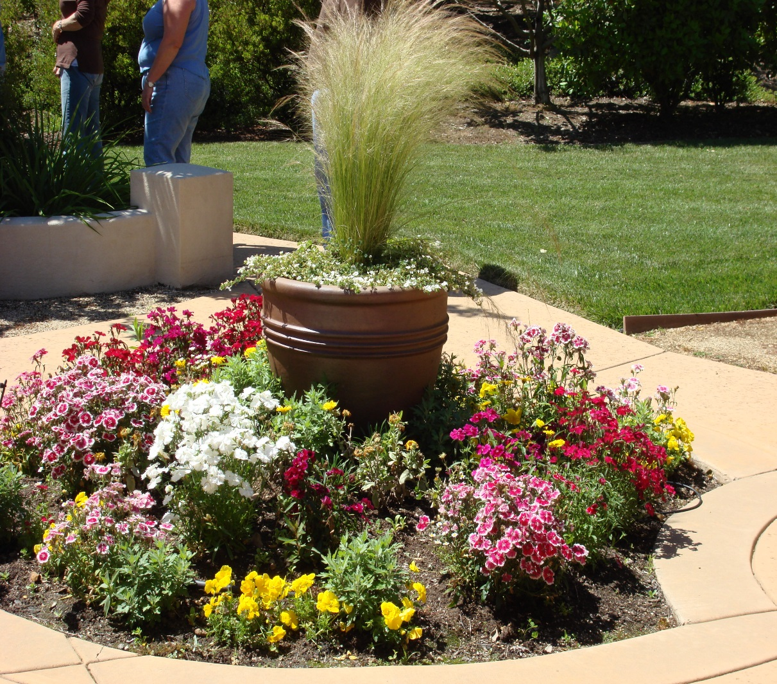
Photo Credit:
Master Gardeners of Placer County
Photo Credit: thrillersfillersandspillers.com

Slide 47
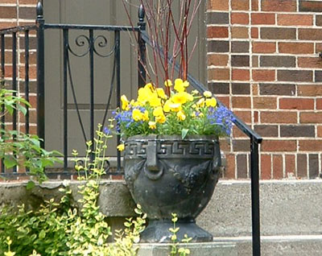
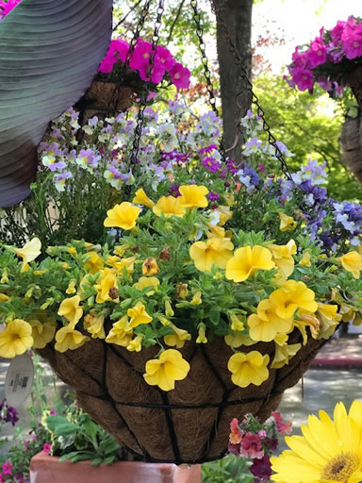
Photo Credit: thrillersspillersandfillers.com

Slide 48
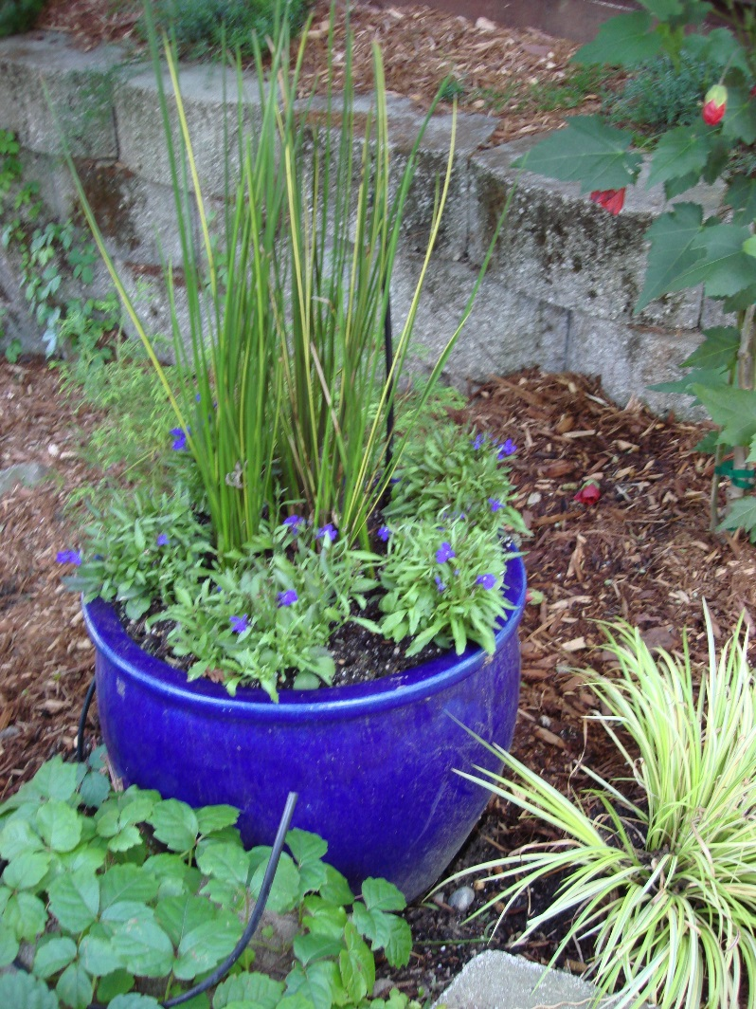
Summary & Tips
Design elements
Container .. Almost anything goes
Plant selection .. Few limitations
Regular watering, feeding and maintenance = Success
  Winterize & guard against frost
Notes:
Design Elements: Color; height; grouping (groups of containers have a visual impact); specimen plants vs mixed plants; location .. right plant, right place
Container .. Almost anything goes: If an object can hold soil you can adapt it to container gardening. Just make sure it is large enough to hold a volume of soil suitable for your selected plant(s) and has a drainage hole or holes
Plant selection .. Few limitations: Coupled with a suitable container you can plant trees , shrubs, climbers, perennials, ferns ,bulbs, annuals and perennials. .Experiment
Regular watering, feeding and maintenance = Success: Water until it drains out, feed according to package directions (consider slow release products) inspect plants regularly, use chemicals sparingly
Winterize & guard against frost: Roots in containers are more exposed to temperature extremes then plants in open soil. Extreme cold can freeze roots, consider insulated containers. Move smaller containers into protected areas. Cover large container plants with fleece or other protective covering.

Slide 49
References
UCCE: Tip Sheet – Getting Started With Container Gardening
https://ucanr.edu/sites/Nutrition_BEST/files/191401.pdf
UCCE Tip Sheet- Helpful Hints for Successful Container Gardening http://pcmg.ucanr.org/files/171549.pdf
UCCE Tip Sheet - Container Gardening http://cestanislaus.ucanr.edu/files/111733.pdf
California Master Gardener Handbook – 2nd edition

Slide 50
Thank You!
Any Questions?
Master Gardener Hotline: (530) 889-7388
Master Gardener Website: pcmg.ucanr.edu

