Slide 1

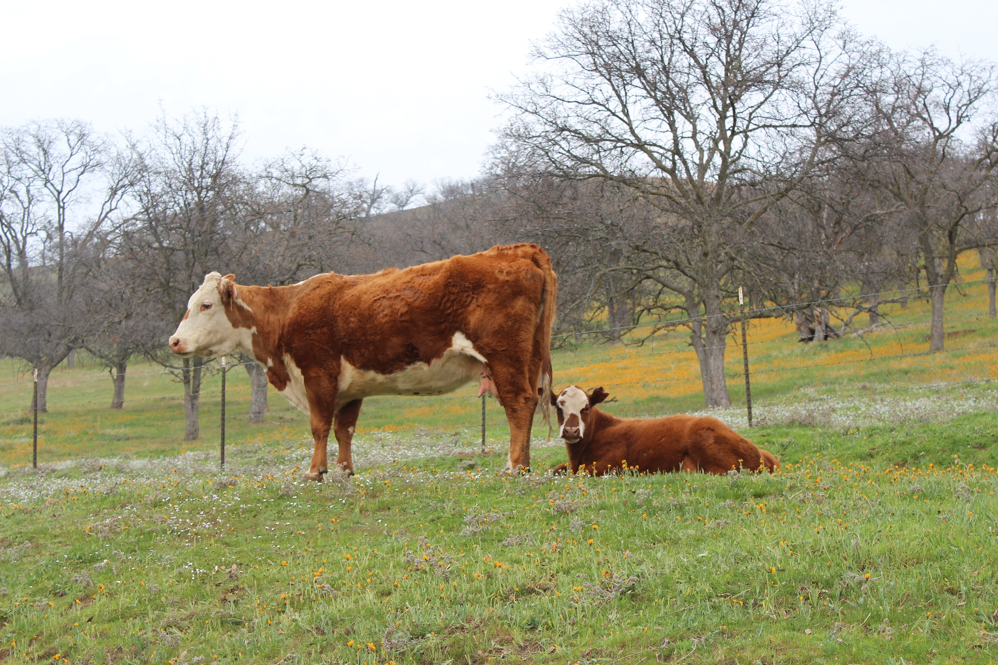
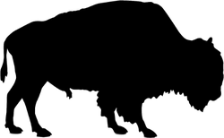
HOW MANY ANIMALS CAN YOUR LAND SUPPORT?
First things first;
Before knowing how many animals (cows, horses, sheep, goats, etc) your land can support, we must first determine how much feed (grass and forbs) is available for the animals to graze.
If you place too many animals on a piece of land - it is likely to be overgrazed very quickly, which can lead to degradation of the land, as well as you having to buy supplemental feed (the most expensive thing on a ranch!)
Notes:
Before we can determine how many cows we can have, we need to first know the basics.

Slide 2
DETERMINING CARRYING CAPACITY:
Carrying Capacity - the number of grazing animals a given area or pasture is able to support without depleting rangeland vegetation or soil resources.
Determining the carrying capacity (how many animals your land can support) is all about BASIC math.
Here are the basic equations you need:
Pounds/year = (pounds of forage/acre/yr – RDM) * # of acres * HE
Pounds/year/animal needed = Average weight * 0.03 * 365 days/year
Residual Dry Matter (RDM) - the amount of old plant material left on the ground at the beginning of a new growing season. The beginning of the new growing season is defined as the first rain event in the fall. Sometimes September 1st is used as an objective, consistent time to measure RDM. in California, RDM indicates the previous season's use and can be used to describe the health or condition of annual rangelands.
Notes:
Harvest Efficient Note: Imagine when you go hiking in the mountains. How easy is it to cover a lot of the ground when you start off in a meadow? You can cover a lot of the area pretty easily. As you start to climb, you can probably still cover a lot of ground at the gentle slopes, but as the trail gets steep, how easy is it to cover the whole hillside, vs just staying close to the trail? You have to use more energy to cover the steeper slope.

Slide 3
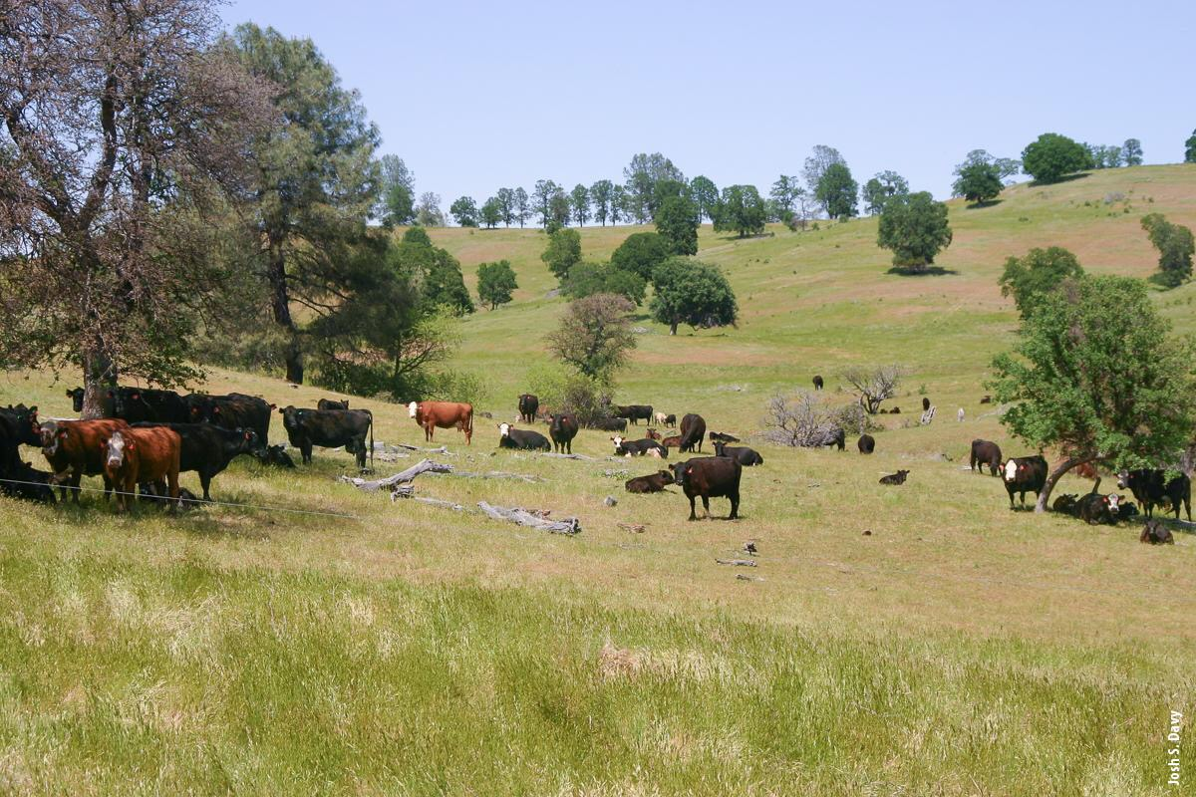
DETERMINING CARRYING CAPACITY:
Harvest Efficiency (HE) - intake by livestock. A standard measure based on slope of terrain. The steeper the ground, the more difficult it will be for the animal to graze it; thus providing a lower Harvest Efficiency.
Harvest Efficiency and RDM
Site Description & Slope | Harvest Efficiency | RDM (pounds/ acre)
Dry Annual Range, 0-10% | 0.50 | 300
Dry Annual Range, 10-20% | 0.40 | 400
Dry Annual Range, 20-40% | 0.20 | 500
Dry Annual Range, >40% | 0.10 | 600
Notes:
Harvest Efficient Note: Imagine when you go hiking in the mountains. How easy is it to cover a lot of the ground when you start off in a meadow? You can cover a lot of the area pretty easily. As you start to climb, you can probably still cover a lot of ground at the gentle slopes, but as the trail gets steep, how easy is it to cover the whole hillside, vs just staying close to the trail? You have to use more energy to cover the steeper slope.

Slide 4

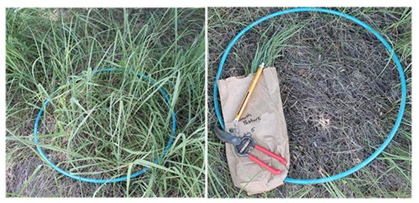

DETERMINING CARRYING CAPACITY: FORAGE PRODUCTION
When determining the average forage productivity of a given area there are typically 3 options:
Web Soil Survey
Local Cooperative Extension Office (dependent on office - not all of them have range managers on staff)
Forage clipping (field method)
  Clipping should be conducted at the peak production period (right after the annual grasses have developed their seeds, before the landscape starts to turn brown). Roughly the middle of May for most of the Central Valley in California.
  Once clippings have been collected, they must be dried to remove moisture and obtain an accurate weight.
Notes:
Holechek, Jerry, et al. Range Management. 6th ed., Prentice Hall, 2010.

Slide 5
DETERMINING CARRYING CAPACITY: FORAGE PRODUCTION
Animal Unit Month (AUM) - the amount of forage required by one animal unit for one month.
The Natural Resources Conservation Service (NRCS) uses 30 pounds of air-dry forage per day as the standard forage demand for a 1,000- pound cow (one animal unit AU).
Average Animal Weights at Maturity and Animal Units (AU)
Animal | Weight (lbs) | Animal Unit (AU)
Cattle (cows) | 1,000 | 1*
Cattle (bulls) | 1350 | 1.35
Horses | 1,250 | 1.25
Sheep | 200 | 0.20
Goats | 150 | 0.15
Notes:
* these weights are outdated. The average weight of a mature cow is 1,300 pounds. Therefore, 1 cow would actually be 1.3 AUs. Try with the old data first with your class for a clear understanding of how to perform the calculations. Then make the adjustments to the actual weights if you feel your class is up for the challenge.

Slide 6
DETERMINING CARRYING CAPACITY: EXAMPLE #1
You have 10 acres of a flat pasture (0-10% slope) that produces 3,300 lbs of forage/acre a year.
How many horses can your pasture support?
Use the tables below to determine the Harvest Efficiency (HE), Residual Dry Matter (RDM) and average weight of a horse.
Harvest Efficiency and RDM
Site Description & Slope | Harvest Efficiency | RDM (pounds/ acre)
Dry Annual Range, 0-10% | 0.50 | 300
Dry Annual Range, 10-20% | 0.40 | 400
Dry Annual Range, 20-40% | 0.20 | 500
Dry Annual Range, >40% | 0.10 | 600
Average Animal Weights at Maturity and Animal Units (AU)
Animal | Weight (lbs) | Animal Unit (AU)
Cattle (cows) | 1,000 | 1
Cattle (bulls) | 1350 | 1.35
Horses | 1,250 | 1.25
Sheep | 200 | 0.20
Goats | 150 | 0.15

Slide 7
DETERMINING CARRYING CAPACITY: EXAMPLE #1
Step 1 - How many pounds of forage per year is efficiently produced on your 10 acres? (remember, each acre produces 3,300 pounds/year)
Pounds/year = (pounds of forage/acre/yr – RDM) * # of acres * HE
Pounds/year = (3,300 lbs/acre/year – 300 lbs)* 10 acres * 0.50
= 15,000 pounds/year
Harvest Efficiency and RDM
Site Description & Slope | Harvest Efficiency | RDM (pounds/ acre)
Dry Annual Range, 0-10% | 0.50 | 300
Dry Annual Range, 10-20% | 0.40 | 400
Dry Annual Range, 20-40% | 0.20 | 500
Dry Annual Range, >40% | 0.10 | 600
Average Animal Weights at Maturity and Animal Units (AU)
Animal | Weight (lbs) | Animal Unit (AU)
Cattle (cows) | 1,000 | 1
Cattle (bulls) | 1350 | 1.35
Horses | 1,250 | 1.25
Sheep | 200 | 0.20
Goats | 150 | 0.15

Slide 8
DETERMINING CARRYING CAPACITY: EXAMPLE #1
Step 2 - How many pounds of forage per year is needed by one horse?
Pounds/year/animal needed = Average weight * 0.03 * 365 days/year
Pounds/year/animal needed = 1,250 * 0.03 * 365 days/year
= 13,687.5 pounds of forage/year/horse
Livestock will eat between 2-4% of their body weight (on a dry matter basis) per day. Using an average of 3% gives us a good estimate.
Harvest Efficiency and RDM
Site Description & Slope | Harvest Efficiency | RDM (pounds/ acre)
Dry Annual Range, 0-10% | 0.50 | 300
Dry Annual Range, 10-20% | 0.40 | 400
Dry Annual Range, 20-40% | 0.20 | 500
Dry Annual Range, >40% | 0.10 | 600
Average Animal Weights at Maturity and Animal Units (AU)
Animal | Weight (lbs) | Animal Unit (AU)
Cattle (cows) | 1,000 | 1
Cattle (bulls) | 1350 | 1.35
Horses | 1,250 | 1.25
Sheep | 200 | 0.20
Goats | 150 | 0.15

Slide 9
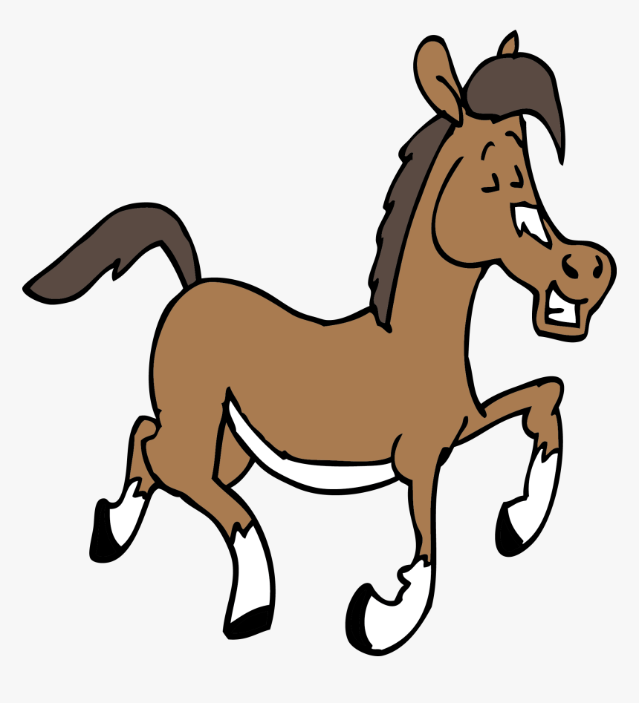

DETERMINING CARRYING CAPACITY: EXAMPLE #1
Step 3 - How many horses can you have on your 10 acres without having to buy hay?
Your 10 acres has the ability to produce 15,000 pounds of feed/year
One horse requires 13,687.5 pounds of feed/year
15,000 pounds of feed/year / 13,687.5 pounds of feed/year/horse = 1.09 Horses
1 Horse
Notes:
Remind your students that you cannot have partial animals, so in this case we alway round down.

Slide 10
DETERMINING CARRYING CAPACITY: EXAMPLE #2
You have 75 acres of rangeland (10-20% slope) that produces 5,290 lbs of forage/acre a year.
How many cows can your rangeland support?
Use the tables below to determine the Harvest Efficiency (HE), Residual Dry Matter (RDM) and average weight of a cow.
Harvest Efficiency and RDM
Site Description & Slope | Harvest Efficiency | RDM (pounds/ acre)
Dry Annual Range, 0-10% | 0.50 | 300
Dry Annual Range, 10-20% | 0.40 | 400
Dry Annual Range, 20-40% | 0.20 | 500
Dry Annual Range, >40% | 0.10 | 600
Average Animal Weights at Maturity and Animal Units (AU)
Animal | Weight (lbs) | Animal Unit (AU)
Cattle (cows) | 1,000 | 1
Cattle (bulls) | 1350 | 1.35
Horses | 1,250 | 1.25
Sheep | 200 | 0.20
Goats | 150 | 0.15

Slide 11
DETERMINING CARRYING CAPACITY: EXAMPLE #2
Step 1 - How many pounds of forage per year is efficiently produced on your 75 acres? (remember, each acre produces 5,290 pounds/year)
Pounds/year = (pounds of forage/acre/yr – RDM) * # of acres * HE
Pounds/year = (5,290 lbs/acre/year – 400 lbs)* 75 acres * 0.40
= 146,700 pounds/year
Harvest Efficiency and RDM
Site Description & Slope | Harvest Efficiency | RDM (pounds/ acre)
Dry Annual Range, 0-10% | 0.50 | 300
Dry Annual Range, 10-20% | 0.40 | 400
Dry Annual Range, 20-40% | 0.20 | 500
Dry Annual Range, >40% | 0.10 | 600
Average Animal Weights at Maturity and Animal Units (AU)
Animal | Weight (lbs) | Animal Unit (AU)
Cattle (cows) | 1,000 | 1
Cattle (bulls) | 1350 | 1.35
Horses | 1,250 | 1.25
Sheep | 200 | 0.20
Goats | 150 | 0.15

Slide 12
DETERMINING CARRYING CAPACITY: EXAMPLE #2
Step 2 - How many pounds of forage per year is needed by one cow?
Pounds/year/animal needed = Average weight * 0.03 * 365 days/year
Pounds/year/animal needed = 1,000 * 0.03 * 365 days/year
= 10,950 pounds of forage/year/cow
Remember to use 3% for body weight consumption
Harvest Efficiency and RDM
Site Description & Slope | Harvest Efficiency | RDM (pounds/ acre)
Dry Annual Range, 0-10% | 0.50 | 300
Dry Annual Range, 10-20% | 0.40 | 400
Dry Annual Range, 20-40% | 0.20 | 500
Dry Annual Range, >40% | 0.10 | 600
Average Animal Weights at Maturity and Animal Units (AU)
Animal | Weight (lbs) | Animal Unit (AU)
Cattle (cows) | 1,000 | 1
Cattle (bulls) | 1350 | 1.35
Horses | 1,250 | 1.25
Sheep | 200 | 0.20
Goats | 150 | 0.15

Slide 13
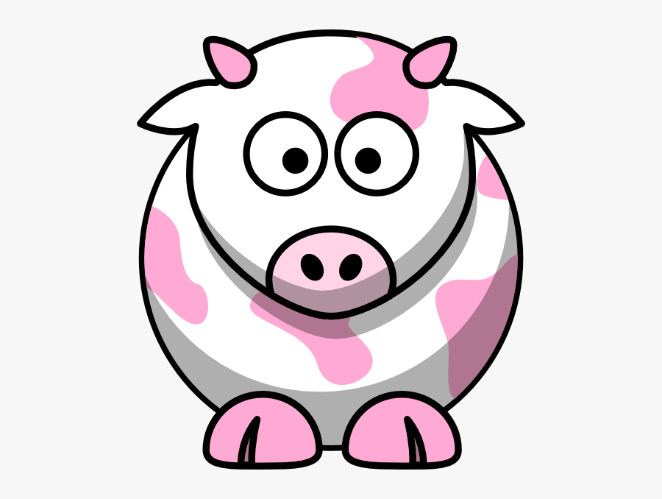
DETERMINING CARRYING CAPACITY: EXAMPLE #2
Step 3 - How many cows can you have on your 10 acres without having to buy hay?
Your 10 acres has the ability to produce 146,700 pounds of feed/year
One cow requires 10,950 pounds of feed/year
146,700 pounds of feed/year /10,950 pounds of feed/year/cow = 13.39 Cows
13 Cows

