Slide 1
UC ANR AggieEnterprise
UC ANR Survey Process

Slide 2
UC ANR Survey Tool
UCANR Survey will be updated to reflect changes needed for Aggie Enterprise and usage of the Common Chart of Accounts (CCOA)
UC ANR Survey will replace the KFS Chart, Account, Subaccount for a dropdown for new CCOA values that can be used
After Aggie Enterprise go-live, new CCOA dropdown values will need to be added in coordination with BOC so please plan for additional lead time

Slide 3
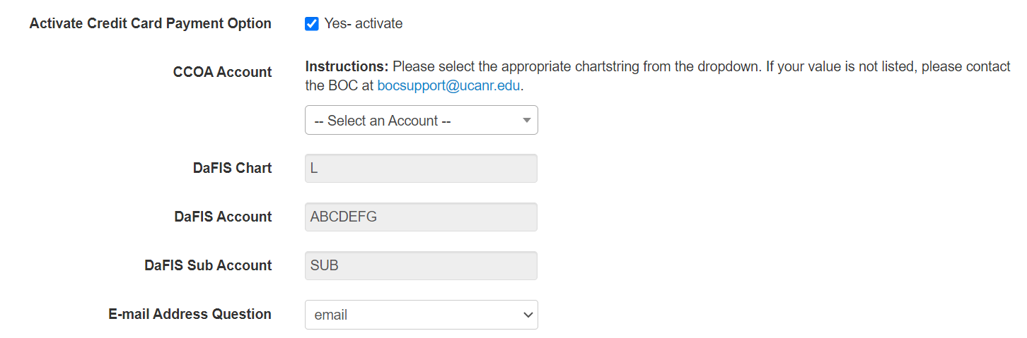
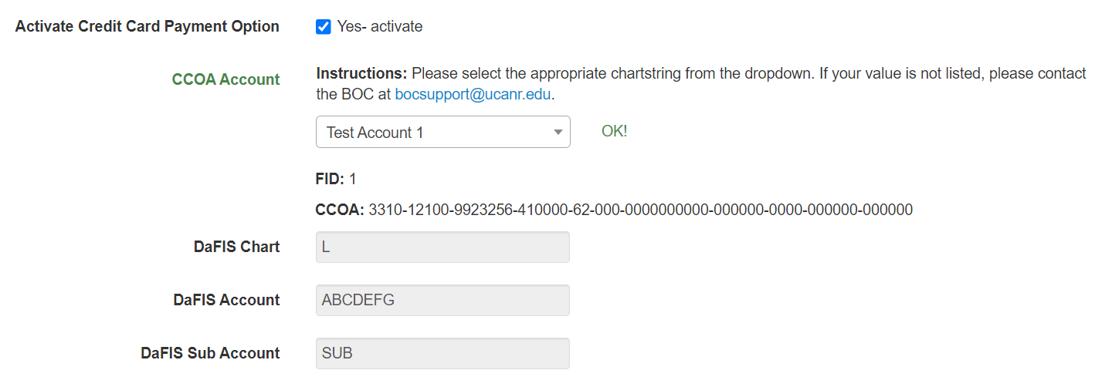
UC ANR Survey Changes Preview
When adding Credit Card Payment, CCOA Account dropdown with description and display of full Chart of Account
Existing surveys that get mapped to CCOA will display prior values

Slide 4
UC ANR Survey Tool Cutover Impacts
UCANR Survey will no longer support Entity 3110 (Formerly Chart 3) after Aggie Enterprise go-live
Mapping to new Chart of Accounts will only include active surveys after Wednesday (12/20/23)
  Active includes payment activity existing 7/1/22 and forward
New surveys won’t be mapped but can be submitted
Surveys can be submitted throughout cutover and go-live

Slide 5
UC ANR Survey with Credit Card Process With New Chart of Account String
Requester create the UC ANR Survey with Credit Card Payment Option
Requester review CCOA Account options on Credit Card Information screen
Requester confirms CCOA value not listed in CCOA Account dropdown
Requester emails bocsupport@ucanr.edu incl:
Date Survey Is Needed
Full CCOA String
CCOA Description (Not Specific to Survey)
BOC reviews requests for completeness
BOC submits request to UC Davis to create new FID
UC Davis creates and provides BOC the new FID
BOC works with UCANR IT to add new FID and CCOA value to UCANR Survey
BOC notifies requester UC ANR Survey is updated to be submitted
Please note the longer processing time if new Chart of Account is needed to ensure proper accounts are used.

