Slide 1
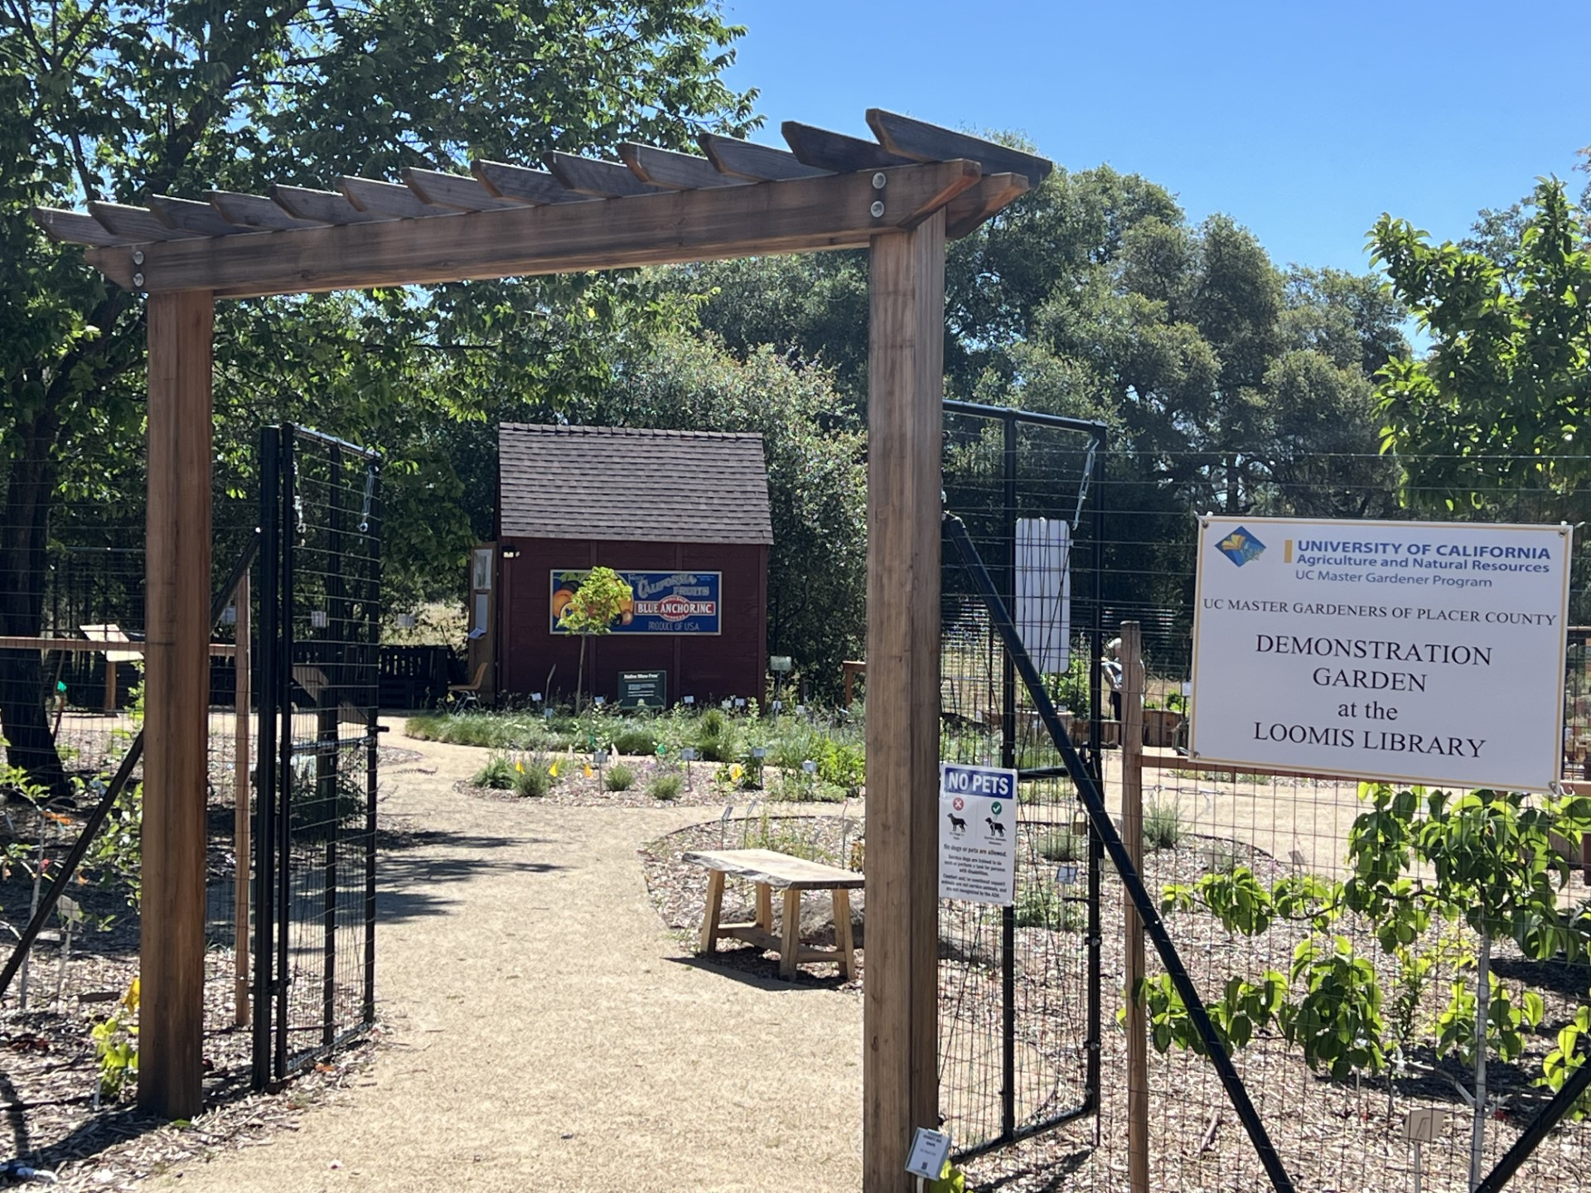
2nd Saturday
Open Garden Dates
May 11
June 8
July 13
August 10
September 14
October 12
Master Gardeners on site between
11:30 am – 1:30 pm
6050 Library Dr., Loomis

