Slide 1
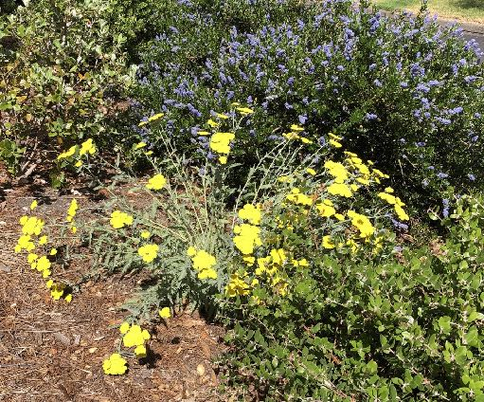
Improving Your Water Efficiency
Notes:
Created August 2022; approved September 2022; converted December 2023
Created by: Marianne L. Calhoun, UC Master Gardener of Placer County
Audience: Hands-on gardeners
Publicity: Hands-on gardeners will learn some low and no-cost ways to improve their water efficiency. They’ll also learn tips for upgrading their irrigation system and/or downsizing their lawn (both of which may be eligible for rebates.)
Bit about myself:
after being raised on the East Coast, moved to the West Coast over 30 years ago;
upon retiring, studied landscape design + horticulture; then joined MG in 2019;
documented the transformation of our property to a water-wise garden over six years;
now I’m passionate about sharing approaches, lessons learned, wonderful plants & resources with all of you!
* All photos are credited to Marianne Calhoun

Slide 2
Who Are Master Gardeners?
Master Gardeners of Placer County
Extend research-based, sustainable gardening and composting information
Present accurate, impartial information to home gardeners
Encourage public to make informed gardening decisions
Notes:
May not know we are trained volunteers & organized by county
We have 150 MG in Placer County to help you make informed gardening decisions!

Slide 3
Who Are Master Gardeners?
Where to find us…
Online, in the Media, and Special Publications
Hotline: Call (530) 889-7388 or submit your questions online
Website: pcmg.ucanr.edu
Facebook, Instagram, X, YouTube
Gold Country Media monthly column
Curious Gardener quarterly newsletter on our website
Gardening Guide and Calendar
Notes:
Sign up online for our free quarterly newsletter - Curious Gardener;
long articles are posted separately so they can be found by topic

Slide 4
Who Are Master Gardeners?
Where to find us…
Workshops, Fairs and Festivals, and Special Events
Speakers by Request
Workshops (various venues, check website)
Farmers’ Markets (seasonal: Auburn, Lincoln, Roseville)
Fairs and Festivals Booths (varies)
Garden Faire (April)
Mother’s Day Garden Tour (May)
Notes:
we are now at three farmers markets; great place to ask gardening questions in person

Slide 5
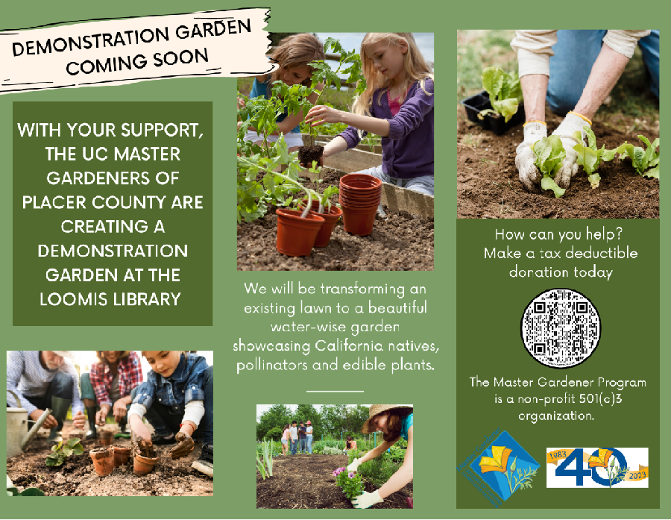
OUR
DEMO
GARDEN
Planted
January ’24

Slide 6
RAISE YOUR HAND IF YOU:
Know outdoor irrigation uses 60-75% potable water?
Had free irrigation audit from your water district?
Place plants in high, moderate + low water zones?
Upgraded to smart irrigation controller?
Downsized some lawn areas?
Notes:
I’m curious to learn about you!

Slide 7
FOUR APPROACHES
TO IMPROVING
YOUR
WATER EFFICIENCY
1. Enhance Your Soil
2. No Cost Ways
3. Wise Investments
4. Downsize Front Lawn

Slide 8
1. Enhance Your Soil
to improve water retention
for plants to thrive
slow the flow of water
increase water retention
SOIL IS KEY
Notes:
Planting Design Basics
https://ucanr.edu/blogs/dirt/index.cfm?tagname=planning garden

Slide 9
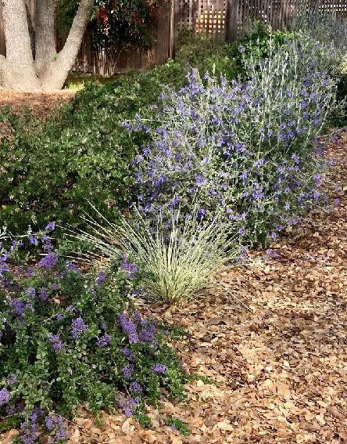
ALLOW TO DECOMPOSE
fallen leaves
grass clippings
plant trimmings
build healthy soil
Oak leaves, blown off driveway
Notes:
Autumn sage
The Use of Color in your Garden
https://extension.psu.edu/the-use-of-color-theory-in-your-landscape
Which Flower Colors Best Attracts Pollinators & Birds?
https://extension.illinois.edu/sites/default/files/what_are_the_best_flower_colors_to_attract_pollinators-1.pdf
Meet the Pollinators
https://marinmg.ucanr.edu/PLANTS/POLLINATOR_HABITATS/Meet_the_Pollinators/
Landscaping Colors that Attract Birds to Your Yard
https://www.thespruce.com/colors-that-attract-birds-386400

Slide 10
undecomposed organic matter
cools ground
suppresses weeds
builds healthy soil
shades irrigation lines
MULCH

Slide 11
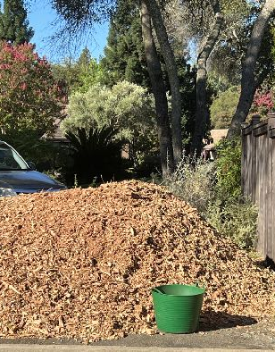
MAINTAIN TWO INCHES
place directly on soil
protect drip irrigation
replace rocks under trees
coarse mulch more fire resistant than shredded "gorilla" mulch
Arborist mulch from Blue Oak
Notes:
Penstomen

Slide 12
opposite of mulch
decomposed organic matter
COMPOST
after aerating lawn
after harvesting veggies
under edible trees/shrubs
ADD 1-2x YEAR
Notes:
Lawn: use compost vs fertilizers
Veggies: need to replace nutrients after harvesting
Citrus trees and edible plants: appreciate good compost 1-2x year

Slide 13
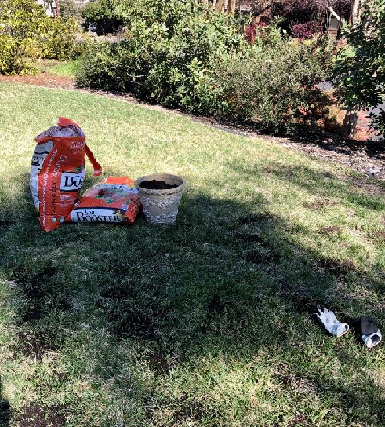
ADDED BENEFITS
slows flow of water
increases water retention
Top dress lawn after aerating
Notes:
Any questions about enhancing your soil?

Slide 14
2. No Cost Ways
to improve water efficiency
discover rebates
learn water pressure
finetune controller settings
upgrade irrigation system
consider "hydrozones"
FREE CONSULTATION
WITH WATER DISTRICT
Notes:
Check out services and rebates at your water district
Hydrozone is a technical term for Irrigation Zone;
group plants with similar sun + watering needs in same zone

Slide 15
IRRIGATION TERMINOLOGY: INLINE DRIP
Emitter Spacing
12" for perennials
18" for shrubs
24” for trees
measured by Gallons Per Hour:
0.9 GPH for sandy loam soil
0.6 GPH for clay soil
measured by Pounds per Square Inch
Flow of Water
Water Pressure
Notes:
EXAMPLE: Rainbird inline drip has info on label + stamped on dripline

Slide 16
MAXIMUM LATERAL LENGTH
Examples:
12" emitter spacing + 0.9 GPH + 60 PSI = 290 feet max
18” emitter spacing + 0.9 GPH + 60 PSI = 455 feet max
Notes:
Examples are from one manufacturer; look online for usage chart!

Slide 17
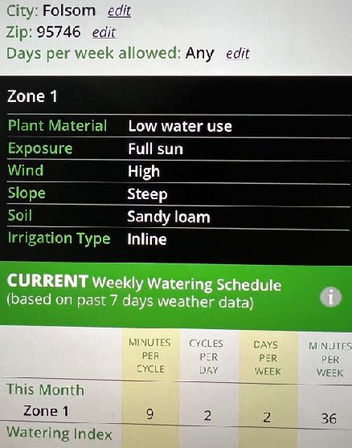
FREE
REGIONAL
IRRIGATION
SCHEDULER
Beyond the Drought
Notes:
BeyondTheDrought.com
Enter your city and zip
Enter plants, exposure, wind, slope, soil, irrigation type
Click on Historical Info to learn Minutes per Week in hottest month of July, etc

Slide 18
PROGRAM YOUR SMART CONTROLLER
Example for a
low water zone
50 minutes per week in July
Maximum watering cycle = 18 minutes
Soak time in sandy loam = 30 minutes
Water early = begin 6am
Notes:
Controller is key to managing your irrigation system!
Using Hunter’s Hydrawise smart controller:
50 minutes in July…reduces to 20 minutes by mid-October
RECOMMENDED SOAK TIMES: 30 minutes for sandy loam; 60 for clay soil

Slide 19
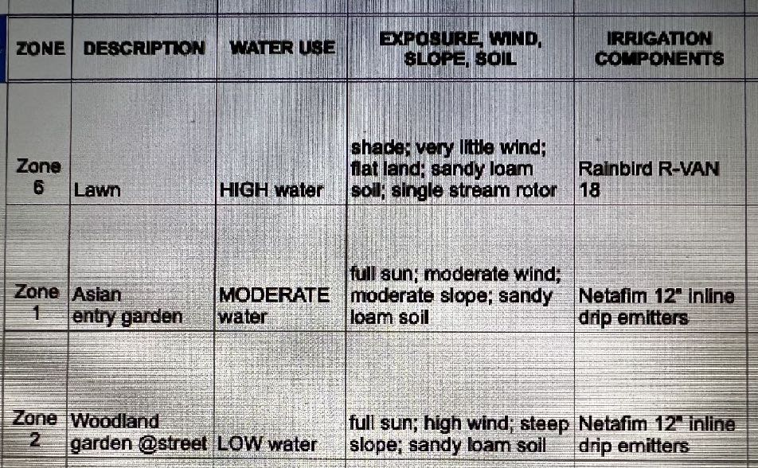
EXPERIMENT
+ MONITOR
Screenshot
of spreadsheet
Tracking 11
irrigation zones
Notes:
Experiment & Monitor:
Shorten watering times & see how plants respond
Lengthen number of days between watering & promote plants’ deeper roots
I’ve learned:
- lawn and edible shrubs/ trees: water 2x week, with less water than recommended
CA/mediterranean plants: water 1x week, with bit more water than recommended
Any questions about no cost ways?

Slide 20
3. Wise Investments to upgrade irrigation system
smart controller, consider WiFi
online app, consider more weather stations
flow meter
non-lawn: inline drip irrigation
lawn: low-flow sprinkler heads
lawn: 6" pop-up nozzles
FROM
PROFESSIONAL
IRRIGATION
STORES
Notes:
Smart controller adjusts irrigation daily based on weather + ET ($100-300 depends on number of irrigation zones)
free app included (paid option to access 5 personal weather stations versus airport)
Flow meter placed before irrigation valves to monitor usage ($120-160)
Non-lawn: inline drip versus overhead irrigation ($35-65 for 100’)
Lawn: low-flow sprinkler heads with matched precipitation ($7-10 each)
Lawn: 6" pop-up nozzles versus 4" pop-ups for 2-3" grass ($25 for 10)

Slide 21
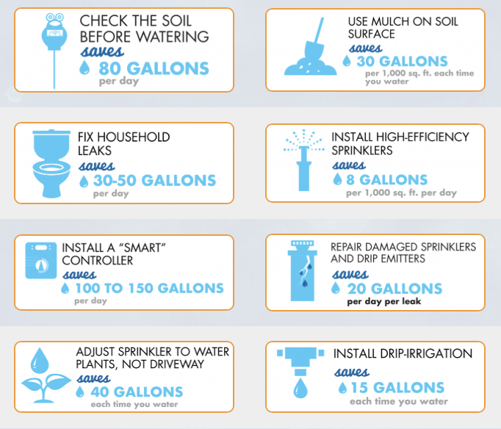
TOP WAY
TO SAVE
WATER:
Smart
Controller
Be Water Smart
Notes:
Be Water Smart
https://bewatersmart.info/top-ways-to-save/

Slide 22
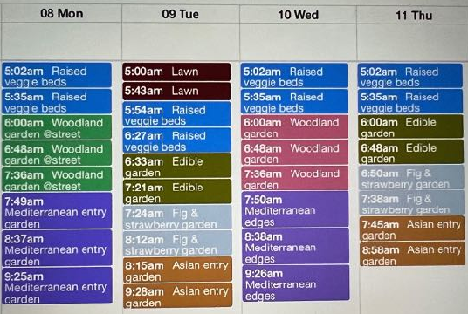
CONSIDER
ONLINE APP
Screenshot:
Hunter’s
Hydrawise
in August
Notes:
Named Zones have individual colors & spaced in blocks throughout the week
water everyday between 5-10am for most efficiency
Any questions about investments?

Slide 23
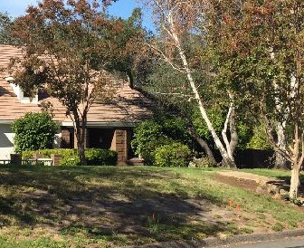
4. Downsize Front Lawn
to lower water usage
Notes:
Lawns are thirsty high-water plants
Outdoor irrigation uses 60-75% of your potable water
Consider downsizing - not eliminating- your lawn
Smaller lawn requires less water, fertilizer, money and time

Slide 24
On slopes
Shady areas
Competing with roots
Well trodden paths
Small odd shapes
EXAMINE YOUR
THIRSTY LAWN:
IS GRASS
THRIVING?

Slide 25
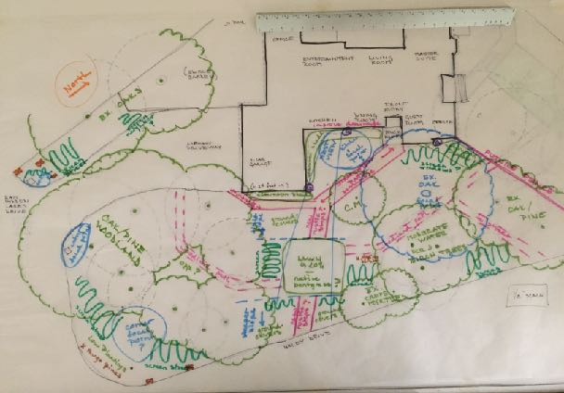
SKETCH YOUR
WISH LIST
Smaller lawn?
Screen busy street?
Multiple paths?
Notes:
Visual aid to understanding your wish list
print screenshot from Zillow or Google Earth
Create a drawing that shows the relationship of your house to the street + various elements
Play with color markers or pencils!

Slide 26
ENVISION
SMALLER LAWN
Best Lawn
Best Shape
Flat plane
Full sun
Drought tolerant grass
Square
Series of squares
Sprinklers in 4 corners
Notes:
Learned from Irrigation Design class at American River College
Squares are also easier to mow; mine now takes 10 minutes!
https://homeguides.sfgate.com/typical-lawn-sprinkler-layout-37358.html
"The drought needs not be a death sentence for lawns"
https://ucanr.edu/?blogpost=18306&blogasset=2578

Slide 27
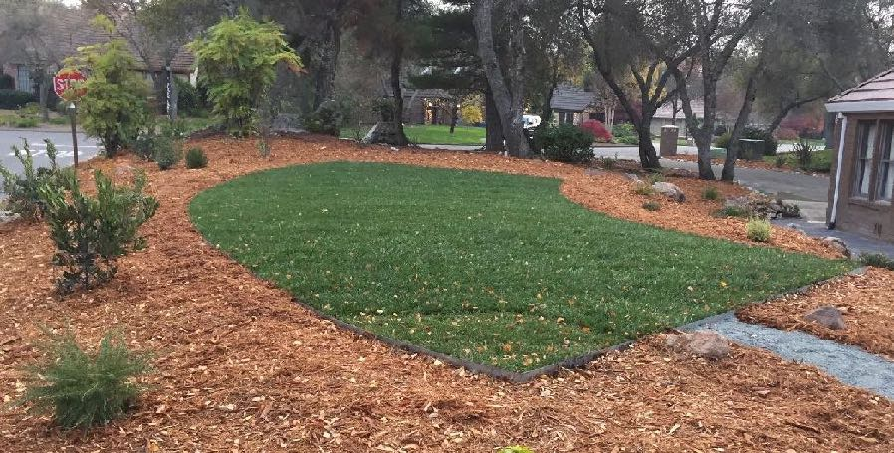
DOWNSIZED LAWN
550 vs. 3,300 SF
flat plane + full sun +
drought tolerant grass
Notes:
Did not follow what I learned in Irrigation Design class;
Curves are aesthetically pleasing, yet…
Example has highly drought tolerant sod from Delta Bluegrass
https://www.deltabluegrass.com/sod-products/residential-commercial-sod/

Slide 28
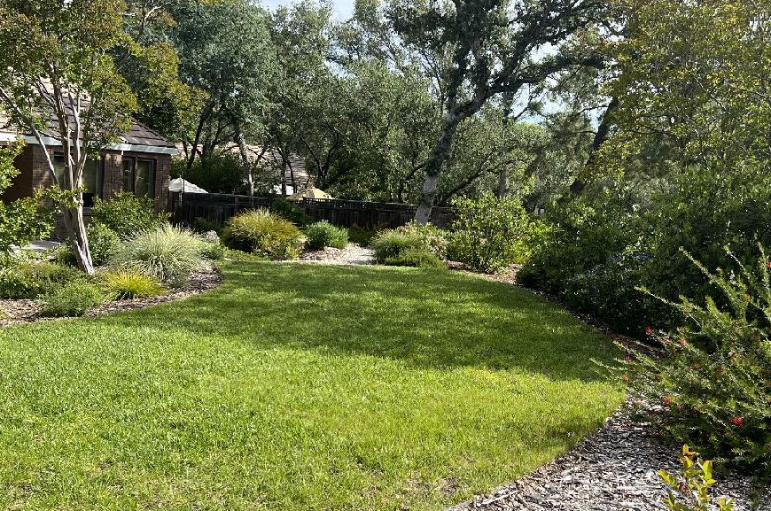
WISHFUL
THINKING
5 years later
Lawn was
series of squares
+ surrounded
by perennials
Notes:
One side with small plants are very happy, yet other side is encroaching…

Slide 29
LESSONS LEARNED
Sprinklers
along Curves
Large Shrubs
surrounding Lawn
not efficient watering pattern
constantly need to adjust
consider series of squares
create shade on lawn
grow wider than anticipated
need to be constantly trimmed
consider perennials or sub-shrubs
Notes:
Reality vs. Looking nice on paper!

Slide 30
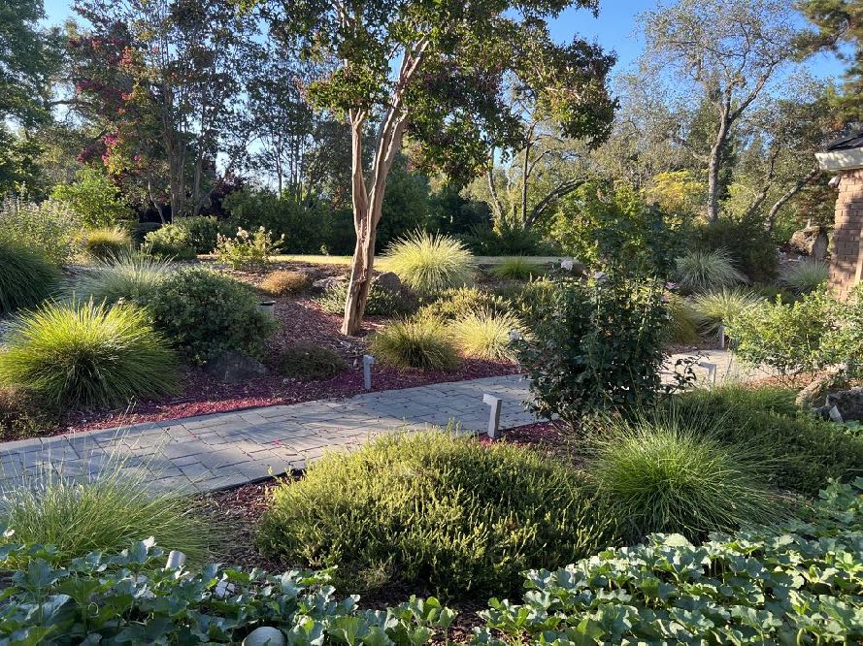
WATER-WISE
GARDEN
after 5 years
lawn watered 2x week
slope watered 1x week
foreground watered 2x week
Notes:
August:
Lawn = .7”
Slope = .4”
Foreground = .6”
Any questions about downsizing front lawn?

Slide 31
SUMMARY
Four Approaches:
Enhance your soil to improve water retention
No cost ways to improve water efficiency
Wise investments to upgrade irrigation system
Downsize Front Lawn to lower water usage
Notes:
Try these approaches to improve the water efficiency of your landscape!
Enjoy sharing water-efficient approaches + results!
Any questions??

Slide 32
RESOURCES
Be Water Smart https://bewatersmart.info
Beyond the Drought beyondthedrought.com
ReScape https://www.rescapeca.org/eight-principles
Save our Water https://saveourwater.com
MORE RESOURCES
California Center for Urban Horticulture https://ccuh.ucdavis.edu
Notes:
- BTD and BWS are for Sacramento region
- Rescape is for Northern California
- Save our Water is for state of California:
Model Water Efficient Landscape Ordinance applies to rehabbing 2,500sf+ landscapes
- CCUH is from UC Davis:
includes WUCOLS plant database (details plants and need for high, moderate or low water)

Slide 33
MASTER
GARDENER
PRESENTATION
Examples
Composting
Removing lawn
Designing water-wise gardens
California native plants
Pollinator-friendly gardening
Growing edibles: fruit trees, veggies
Integrated Pest Management
Notes:
What Do You Wish to Learn?
We welcome new ideas!
Please note on Evaluation Form your top preferences

Slide 34
Thank You!
Any Questions?
Master Gardener Hotline: (530) 889-7388
Master Gardener Website: pcmg.ucanr.edu
Evaluations, please!
Notes:
Really appreciate this opportunity to share what I’ve learned
Hope you all experiment with improving your water efficiency!
Note this recorded presentation will be posted on website

