Slide 1
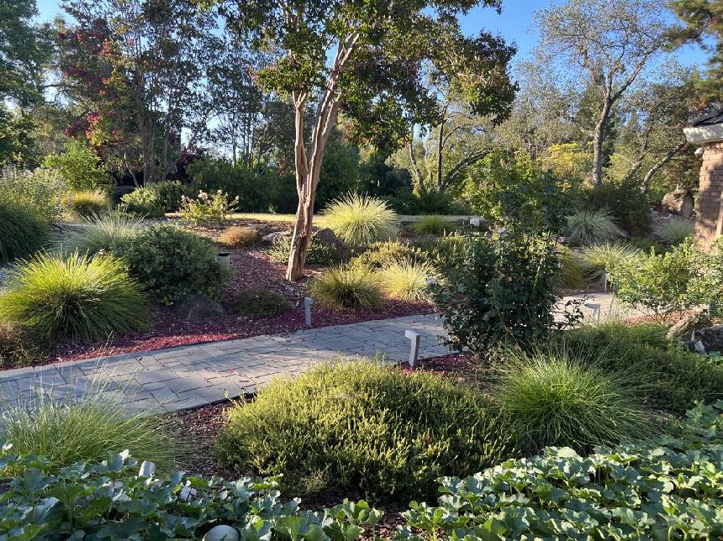
Designing
Water-wise
Gardens
Notes:
Created November 2022; approved April 2023; Converted December 2023
Created by: Marianne L. Calhoun, UC Master Gardener of Placer County
Audience: Hands-on gardeners
Publicity: Have you wondered how to create a water-wise garden? Hands-on gardeners will learn six steps for transforming their landscape plus plants to consider, inspiring visuals, and online resources.
Bit about myself:
after being raised on the East Coast, moved to the West Coast over 30 years ago;
upon retiring, studied landscape design + horticulture; then joined MG in 2019;
documented the transformation of our property to a water-wise garden over six years;
now I’m passionate about sharing approaches, lessons learned, wonderful plants & resources with all of you!
* All photos are credited to Marianne Calhoun

Slide 2
Who Are Master Gardeners?
Master Gardeners of Placer County
  Extend research-based, sustainable gardening and composting information
  Present accurate, impartial information to home gardeners
  Encourage public to make informed gardening decisions
Notes:
May not know we are trained volunteers & organized by county
We have 150 MG in Placer County to help you make informed gardening decisions!

Slide 3
Who Are Master Gardeners?
Where to find us…
Online, in the Media, and Special Publications
  Hotline: Call (530) 889-7388 or submit your questions online
  Website: pcmg.ucanr.edu
  Facebook, Instagram, X, YouTube
  Gold Country Media monthly column
  Curious Gardener quarterly newsletter on our website
  Gardening Guide and Calendar
Notes:
Sign up online for our free quarterly newsletter - Curious Gardener;
long articles are posted separately so they can be found by topic

Slide 4
Who Are Master Gardeners?
Where to find us…
Workshops, Fairs and Festivals, and Special Events
  Speakers by Request
  Workshops (various venues, check website)
  Farmers’ Markets (seasonal: Auburn, Lincoln, Roseville)
  Fairs and Festivals Booths (varies)
  Garden Faire (April)
  Mother’s Day Garden Tour (May)
Notes:
we are now at three farmers markets; great place to ask gardening questions in person

Slide 5
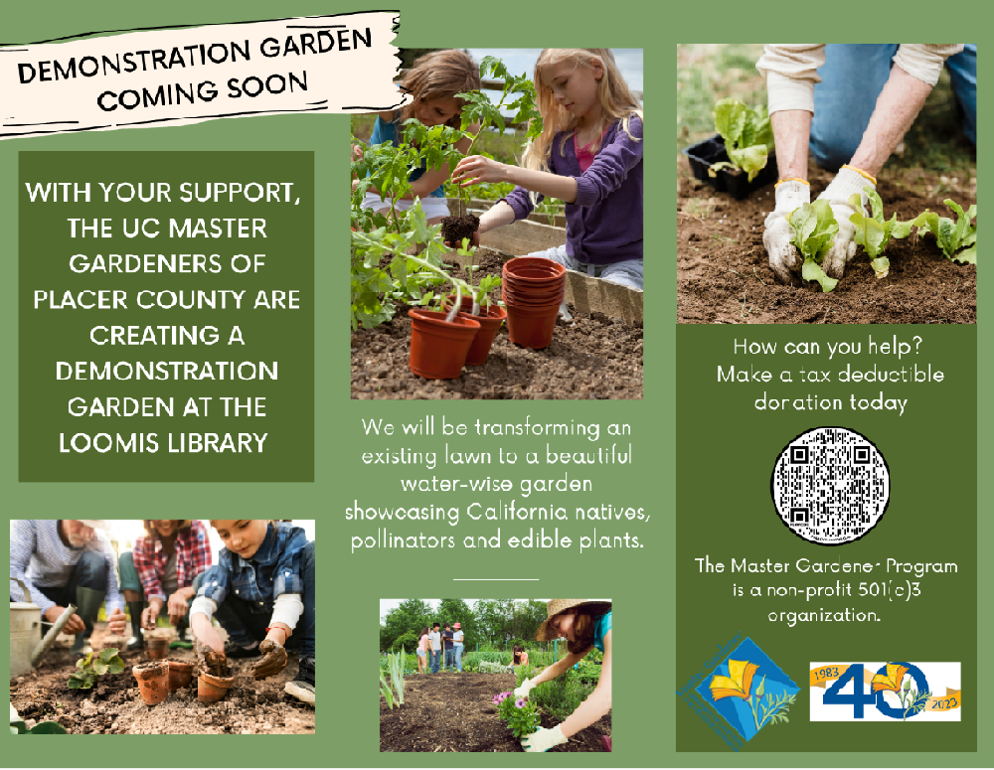
NEW
DEMO
GARDEN
Planted
December ’23
Notes:
Visit our new MG demo garden @Loomis Library!

Slide 6
RAISE YOUR HAND IF YOU HAVE:
  Learned which of your trees thrive with low water?
  Created a scaled plan of your property?
  Kept information about your plants?
  Downsized your thirsty lawn?
  Moved plants to high, moderate + low water zones?

Slide 7
High
Moderate
Water
APPROACH
TO
WATER-WISE
GARDENS
Low Water Zones
Notes:
IRRIGATION ZONE = ZONE = HYDROZONE
Plants share same water + exposure needs
Graphic adapted from Green Gardener Training Program for professionals, Fall 2015
https://ucanr.edu/sites/GreenGardener/Becoming_a_GREEN_GARDENER/

Slide 8
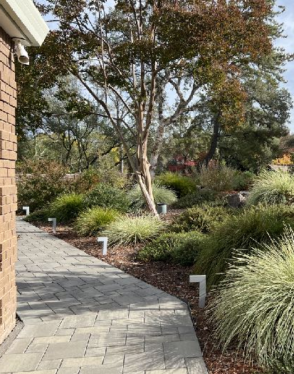
SIX STEPS
1. Assess Your Landscape
2. Research Your Trees
3. Prepare a Base Plan
4. Downsize Your Thirsty Lawn
5. Design Irrigation Zones
6. Select Water-wise Plants

Slide 9
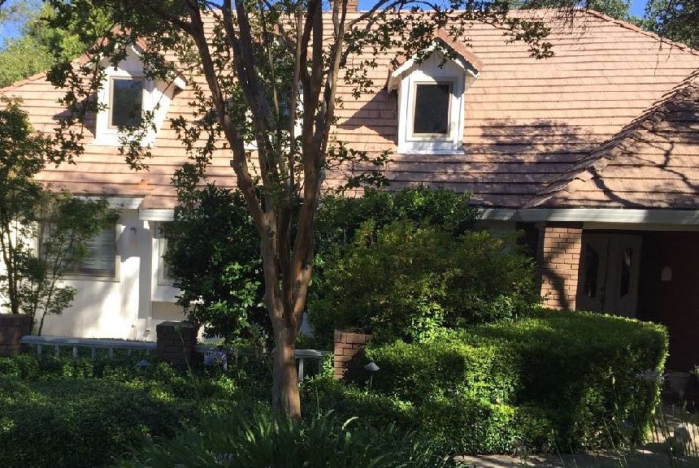
Step 1. Assess Your Landscape
  Views
  Wish to screen?
  Wish to enhance?
  Ratio
  Public:private:semi-private?
  Trees + Shrubs
  Blocking windows?
  Overhanging roof?
Notes:
Photo of our house purchased from original owners after 35 years
At your own property:
1. Look from the street towards house
2. Look outwards from your windows + doors

Slide 10
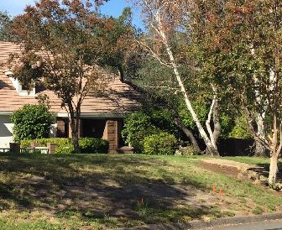
    GRASS THRIVING?
  On slopes
  Shady areas
  Competing with roots
  Well trodden paths
  Small odd shapes
Notes:
Any questions about assessing your landscape??

Slide 11
Step 2.
Research
Your Trees
  Names: common + Latin
  Exposure: full sun, sun-shade, shade
  Water: high, moderate, low
  Sizes: height + width
  Origin: Asia, California, Mediterranean…
Notes:
You’ll be designing around existing trees
Origin will inform you about the environment in which the plant thrives

Slide 12
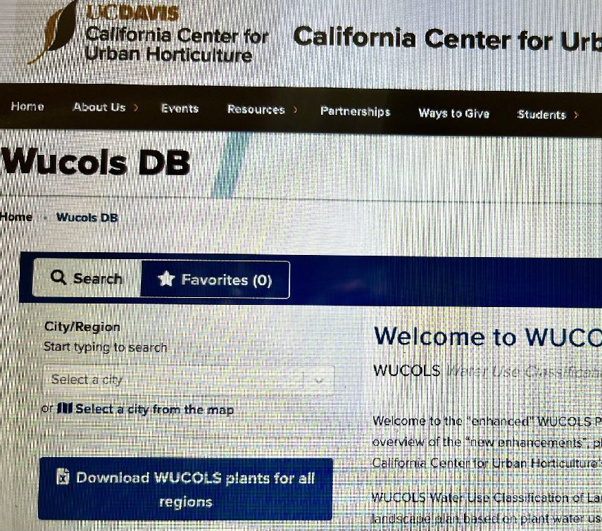
RESEARCH
EACH TREE’S
WATER NEED
Water Use Classification
of Landscape Species
Notes:
WUCOLS https://ccuh.ucdavis.edu/wucols-db
free website detailing plants in California is housed at UC Davis
1. enter your city. 2. Enter Common or scientific plant name
"Using WUCOLS IV Plant Database to Hydrozone Effectively"
https://ucanr.edu/blogs/blogcore/postdetail.cfm?postnum=27809

Slide 13
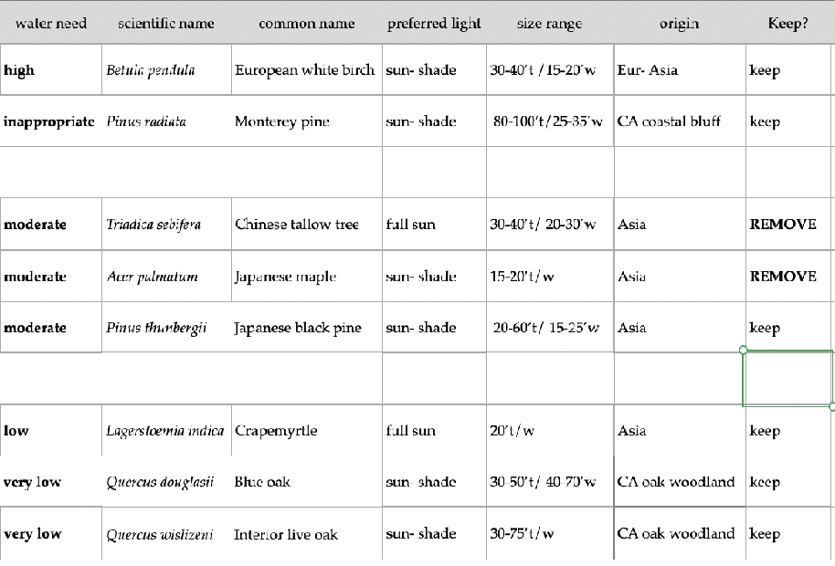
EXAMPLE: COLLECTING
TREE INFO
Sorted by water need
Notes:
Example how I collected info after purchasing home (inspired by plant identification classes, Portland Community College)
Maples were facing south in full sun & not happy
Any questions about researching & organizing info on existing trees??

Slide 14
  Evergreen or deciduous
  Texture + shape
  Seasonal interest
  Attracts birds, butterflies, bees
  Prefers clay or sandy loam soil
CONSIDER
ADDITIONAL
INFO

Slide 15
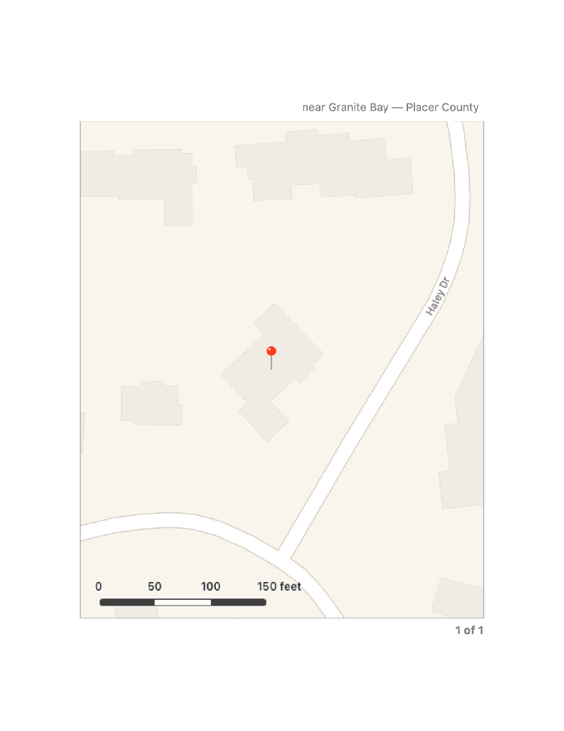
Step 3.
Prepare a Base Plan
1. ‘Plat’ from real estate records
2. Mapping app on computer
Take screenshot
Include scale
Print on largest size paper
Notes:
Plat is terminology for record of the property
2. Google Maps shows house in relationship to street
* Don’t need to be landscape designer or buy landscape design app *

Slide 16
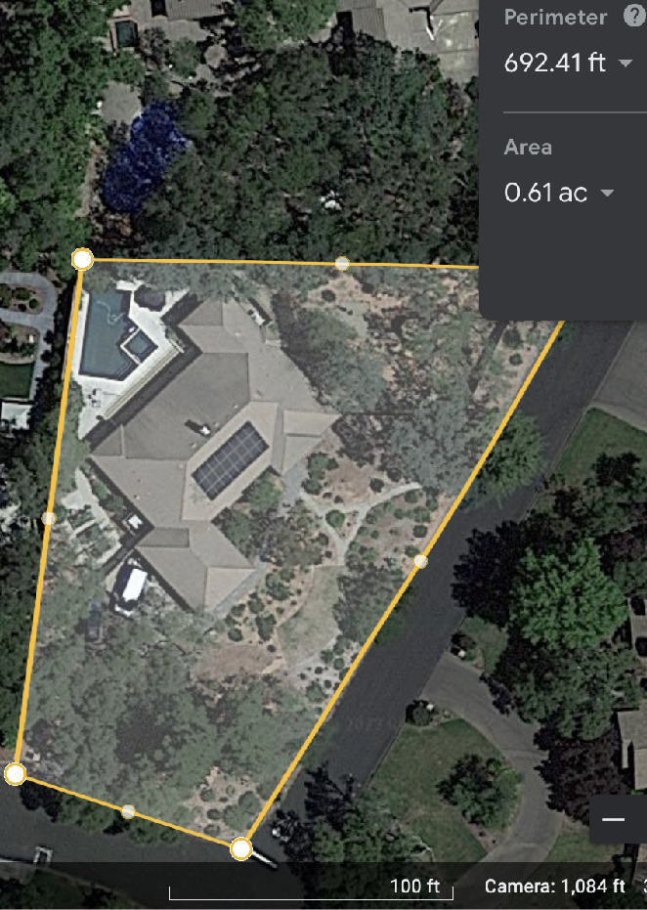
EXAMPLE:
FROM
GOOGLE EARTH
Notes:
Google Earth Pro version has more features such as historical imagery
This example was taken after our lawn was downsized

Slide 17
  Property lines
  Arrow pointing north
  5’ increments to scale
  Hardscape: driveway, paths, pool
  Softscape: trees + large shrubs
ADD
PERMANENT
FEATURES
Notes:
Hint: iPhones have a compass app which will indicate North

Slide 18
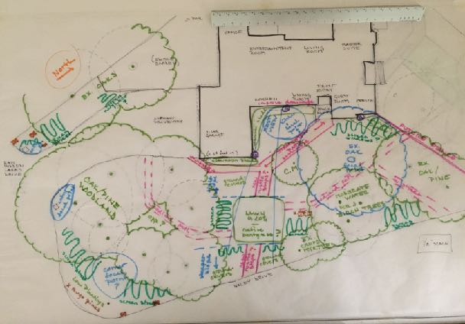
SKETCH
YOUR WISH LIST
  Smaller lawn?
  Screen busy street?
  Multiple paths?
Notes:
This is the fun part! Use colored pencils or markers on tracing paper over the Base Map
Consider what you might want to change
Example: squiggles = privacy; pink was for potential paths; lawn was a smaller central area
Any questions about preparing a Base Map??

Slide 19
Step 4.
Downsize Your Thirsty Lawn
  Flat plane
  Full sun
  Drought tolerant grass
Best Lawn
Best Shape
  Square
  Series of squares
  Sprinklers in corners
Notes:
Learned from Irrigation Design class at American River College
Squares are also easier to mow; mine now takes 10 minutes!
https://homeguides.sfgate.com/typical-lawn-sprinkler-layout-37358.html
"The drought needs not be a death sentence for lawns"
https://ucanr.edu/?blogpost=18306&blogasset=2578

Slide 20
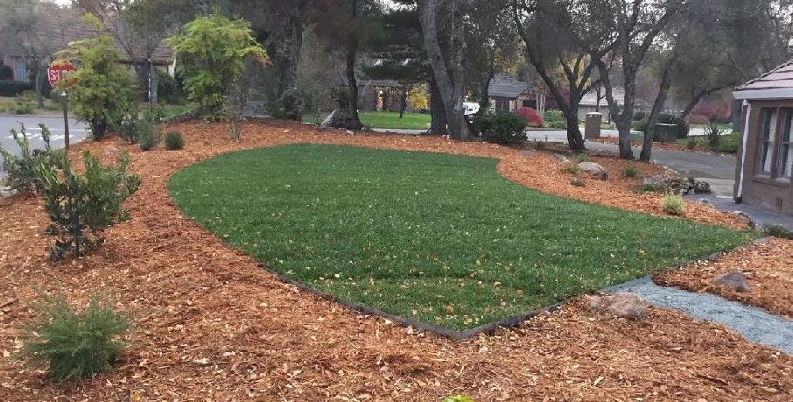
DOWNSIZED LAWN
550 vs. 3,300 SF
flat plane + full sun +
drought tolerant grass
Notes:
Example has highly drought tolerant sod from Delta Bluegrass
https://www.deltabluegrass.com/sod-products/residential-commercial-sod/

Slide 21
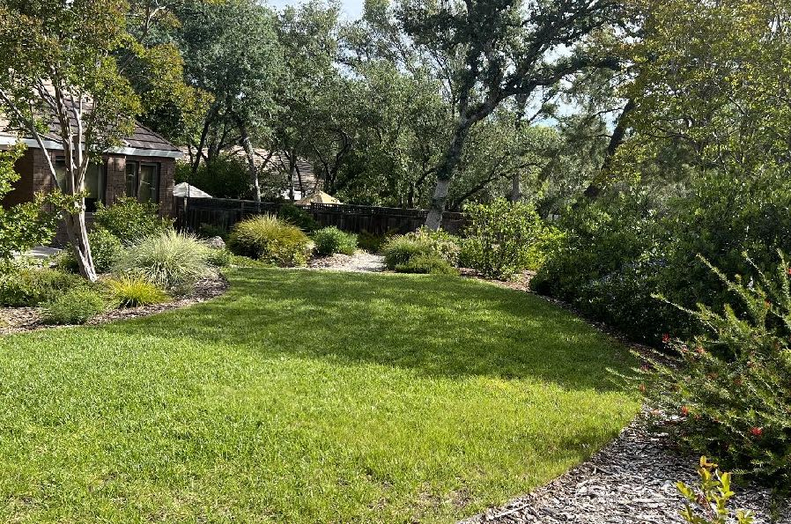
WISHFUL
THINKING
five years later
Lawn was
series of squares
+ surrounded
by perennials
Notes:
One side with small plants are very happy, yet other side is encroaching…

Slide 22
LESSONS LEARNED
Sprinklers
along Curves
Large Shrubs
surrounding Lawn
  not efficient watering pattern
  constantly need to adjust
  consider series of squares
  create shade on lawn
  grow wider than anticipated
  need to be constantly trimmed
  consider perennials or sub-shrubs
Notes:
Any questions about downsizing your thirsty lawn from design point of view??

Slide 23
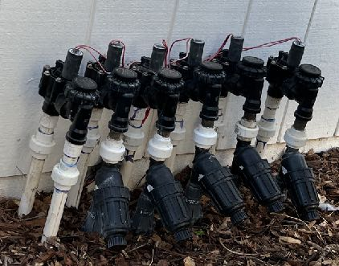
Step 5. Design Irrigation Zones
IRRIGATION ZONE =
ZONE = HYDRAZONE
  Plants share water + exposure needs
  Lawn may be one hydrozone
  Group existing trees as appropriate
Notes:
Photo shows 1 valve for overhead spray on lawn & 5 valves for inline drip zones in garden beds
Example of zone names: Mediterranean Front Slope, Asian Entry Garden, Edible Garden, Native Woodland G
“Solutions for Drought Gardeners: Hydrozones"
https://ucanr.edu/blogs/blogcore/postdetail.cfm?postnum=17992

Slide 24
  Most important defensible space
  Hardscape + well irrigated small plants
  Illustrate "less is more”
  Lawn, islands of plants, permeable paths
  Well-spaced large shrubs + shade trees
LEARN FROM APPROACH TO FIRESCAPING
0-5’ Zone
5-30’ Zone
30-100’ Zone
Notes:
Firescaping is landscaping to prevent fires
https://firesafemarin.org/create-a-fire-smart-yard/firescaping/

Slide 25
BLEND FIRESCAPING + WATER-WISE
  Small areas close to house
  Flowers, raised beds, lawn
  Aids in defensible space
  Larger areas away from house
  Well-spaced trees + large shrubs
  Separated by permeable hardscape
  Moderate + High
  Water Zones
  Low Water Zones
Notes:
Permeable means water penetrates your hardscape, such as gravel
"Fire-wise Water-Wise Landscaping"
https://www.pcwa.net/smart-water-use/fire-wise-landscaping

Slide 26
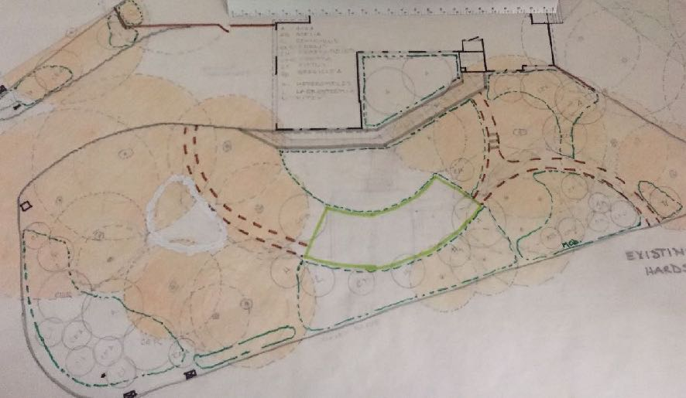
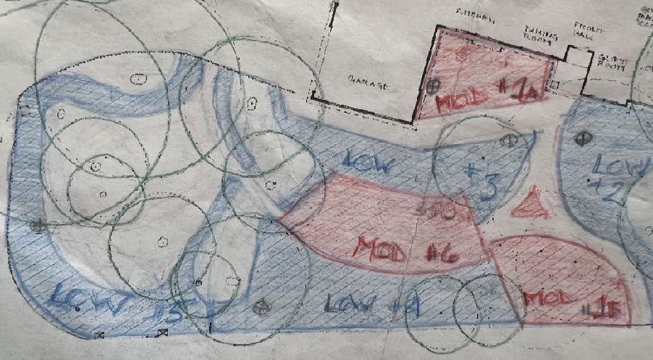
DESIGN ZONES
Around
existing trees
Low water zones:
Crape myrtle
+ Oak trees
Notes:
1st. Approximated areas of tree canopies
2nd Determined sunniest/flat area for lawn
3rd. Added several permeable paths
4th. Designed multiple zones around existing trees
Any questions about designing multiple irrigation zones??

Slide 27
Step 6. Select Water-wise Plants
  that thrive in hot summers
  Placer Nature Center, Auburn
  San Juan Water District W.E.L. Garden, Granite Bay
  Fair Oaks Horticultural Center, Sacramento (MG)
  Visit Public
  "Water Efficient
  Landscape"
  Gardens
Notes:
MGs have Sherwood DG outside Placerville & DG at Nevada Irrigation District
And new garden in Loomis!

Slide 28
  Deciduous trees for shade in SW/W
  Variety of flowering shrubs for privacy
  Colorful perennials along pathways
  Succulents in containers
ENVISION
NEW
PLANTINGS
Notes:
Lots of things to contemplate as you envision new plantings

Slide 29
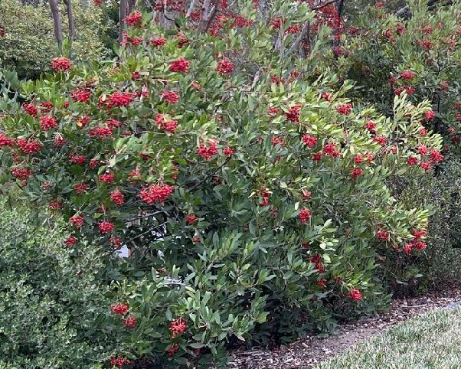
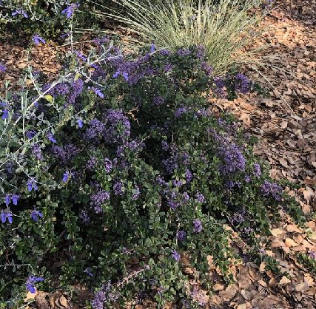
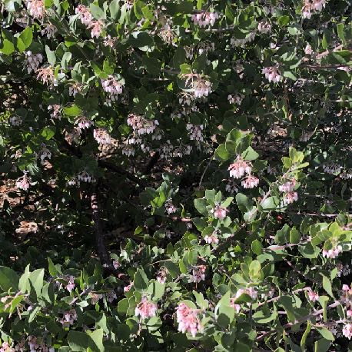
CONSIDER
LOW WATER PLANTS FROM CALIFORNIA
Toyon
Ceanothus
Manzanita
www.calscape.org
Notes:
I begin by considering native plants from California, ideally from Placer County
(Adapted to our environment, attract native birds and beneficial insects, require very little maintenance)
I first select evergreen shrubs; later perennials
- Heteromeles arbutifolia/ Toyon (All-Star)
- Ceanothus maritimus ‘Valley Violet’/ Wild lilac (All-Star)
- Arctostaphylos densiflora 'Howard McMinn'/ Vine Hill Manzanita (All-star)

Slide 30
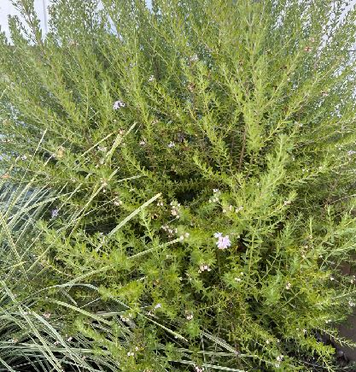
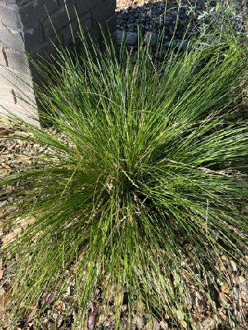
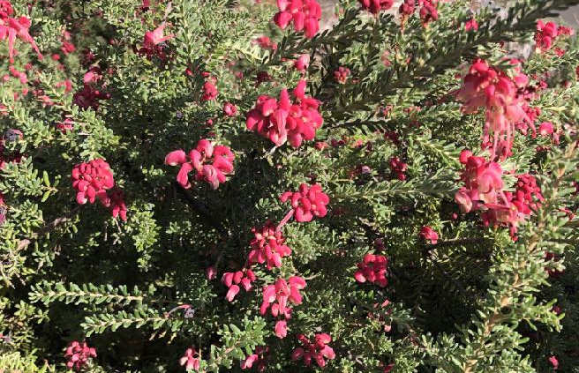
CONSIDER
LW PLANTS
FROM AUSTRALIA
Coast rosemary
Lomandra
Grevillea
Notes:
I next look at evergreen shrubs from Australia, which thrive is the same conditions as our native plants.
Again these three plants come in many sizes and colors:
Westringia fruticosa ‘Morning Light’/ Coast rosemary
- Lomandra longifolia 'Roma’/ Platinum beauty lomandra (UC Davis Blue Ribbon)
- Grevillea lanigera ‘Coastal Gem’/ Wooly grevillea

Slide 31
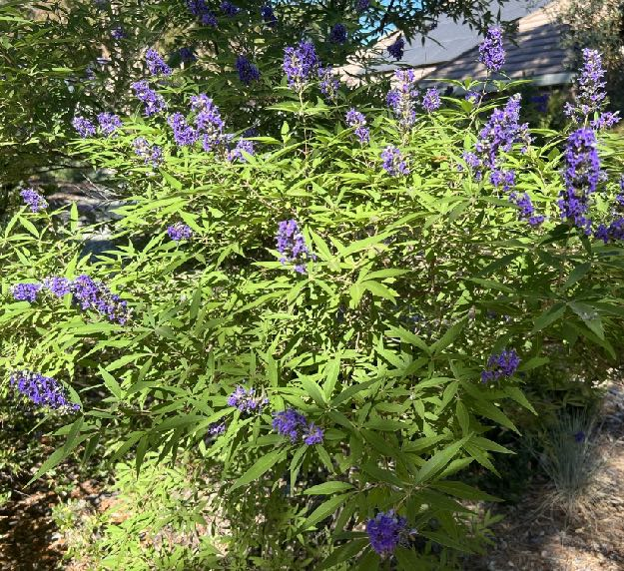
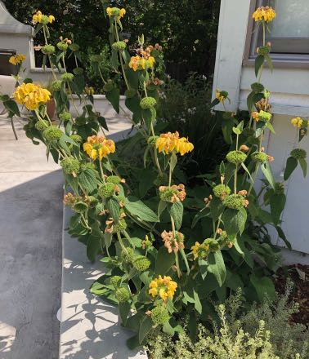
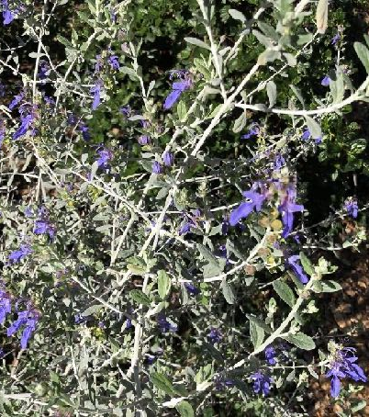
CONSIDER
LOW WATER
MEDITERRANEAN
PLANTS
Chaste tree
Jerusalem sage
Bush germander
Notes:
Lastly, I consider shrubs from Mediterranean climates; also come in many sizes and colors:
Vitex agnus-castus / Chaste Tree (UC Davis Blue Ribbon)
Phlomis fruticosa 'Edward Bowles' / Jerusalem sage
- Teucrium fruiticans 'Azureum’/ Bush germander (All-Star)

Slide 32
Year-round interest
NARROW OPTIONS
  75-80% evergreen
  Variety plant + foliage shapes
  Large, medium + small textures
  Small trees: 1 or 3
  Flowering shrubs: 3 or 5
  Herbaceous plants: 3, 5, 7, 9
Repeat
for unity
Notes:
Learned from Plant Composition class at Portland Community College
Note: odd numbers are preferable design approach

Slide 33
EXAMPLE AFTER FIVE YEARS
Small Lawn
watered 2x week
Slope
watered 1x week
Foreground
watered 2x week
Notes:
Early August:
Lawn = .7”
Slope = .4”
Foreground = .6”

Slide 34
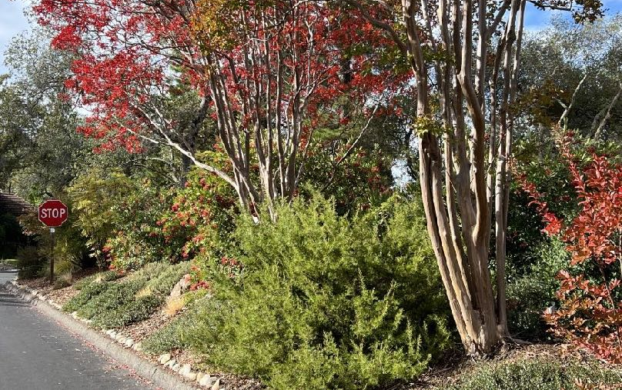
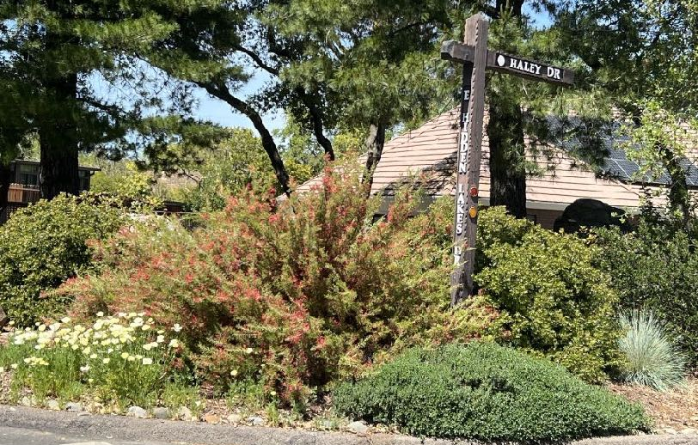
LOW WATER ZONES
ALONG STREET
Watered 1x week
Notes:
colorful LW plants in LW zones:
1. FALL: flowering hedgerow increases privacy plus habiitat;
Designed around existing Crape myrtles; Added grevillea, toyon, manzanita and ceanothus
2. SPRING: Designed around existing oak trees to increase privacy;
Added grevillea, ceanothus, manzanita, teucrium and poppies

Slide 35
Assessing your landscape
Researching your trees
Preparing a base plan
Downsizing your thirsty lawn
Designing irrigation zones
Selecting water-wise plants!
SUMMARY
DESIGN A
WATER-WISE
GARDEN BY:

Slide 36
RESOURCES
California Center for Urban Horticulture
https://ccuh.ucdavis.edu
UC Davis Arboretum and Public Garden
https://arboretum.ucdavis.edu/sustainable-gardening-toolkit
California Native Plant Society
https://www.calscape.org
Placer County Water Agency
https://www.pcwa.net/smart-water-use/fire-wise-landscaping
Notes:
All these resources can be found on the Handout

Slide 37
MASTER
GARDENER
PRESENTATIONS
Examples
Composting
Removing lawn
Improving water efficiency
California native plants
Pollinator-friendly gardening
Growing edibles: fruit trees, veggies
Integrated Pest Management
Notes:
What Do You Wish to Learn?
We welcome new ideas!
Please note on Evaluation Form your top preferences

Slide 38
Thank You!
Any Questions?
Master Gardener Hotline: (530) 889-7388
Master Gardener Website: pcmg.ucanr.edu
Evaluations, please!
Notes:
Really appreciate your time & this opportunity to share what I’ve learned
Hope you’re all very successful in creating your own water wise gardens

