Slide 1
Window Shopper Purchasing
There isn't a separate Window Shopper role in Aggie Enterprise like in Aggie Buy . All users who want to create a requisition must be assigned the standard campus purchasing role. These users must also set up their Requisition Preferences, even if they aren’t going to complete the cart checkout/document submission process, but they are not required to complete the Billing section (the PPM Project and Favorite Charge Accounts fields can be left blank).

Slide 2
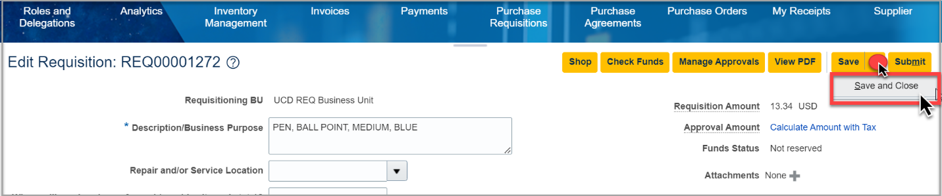
Window Shopper Purchasing
Add items to the shopping cart. See Catalog Shopping, up through step 1 of the "Completing
Catalog Purchase/Checkout Process".
On the checkout screen, click Save and Close

Slide 3
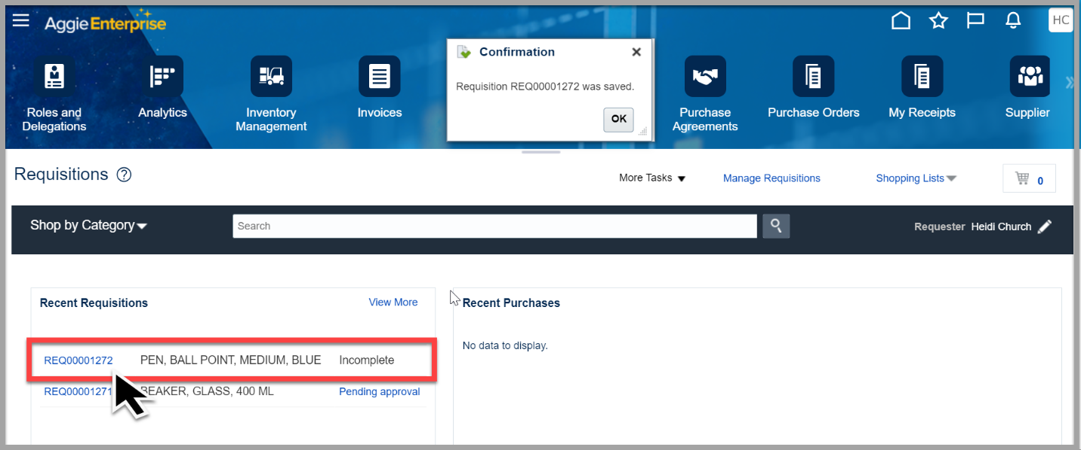
Window Shopper Purchasing
On the requisitions screen, under Recent Requisitions, click the link of the Requisition that you saved.

Slide 4
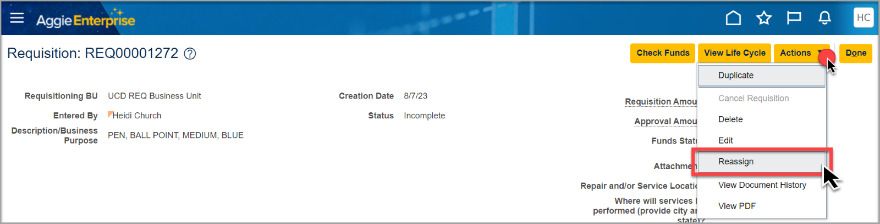
Window Shopper Purchasing
In the upper-right corner of the window, click Actions, and then choose Reassign.

Slide 5
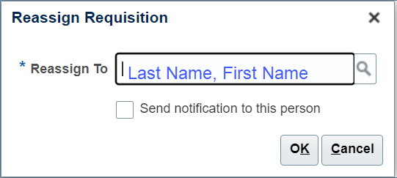
Window Shopper Purchasing
In the Reassign Requisition dialog box, type the name of the Aggie Enterprise user who will be completing the Requisition on behalf of the window shopper. The format is last name, first_name.

Slide 6
Window Shopper Purchasing
After the name has been entered, select Send notification to this person, and click OK.
A notification is sent to the reassigned user, and that user can then access and complete the requisition on behalf of the window shopper.
The window shopper (Entered By user) will receive a system/email notification when the requisition has been fully approved, and when the purchase order has been issued for the request. See the Notifications for more information on how the email and system notifications work in Aggie Enterprise.

