Slide 1
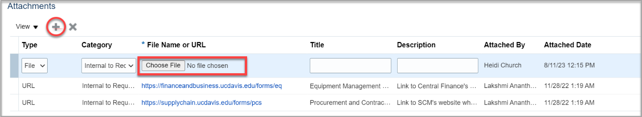
Attachments in SCM
Add Attachments to Requisitions
Click + to attach documentation at the header level of the Requisition or on the individual line item.

Slide 2
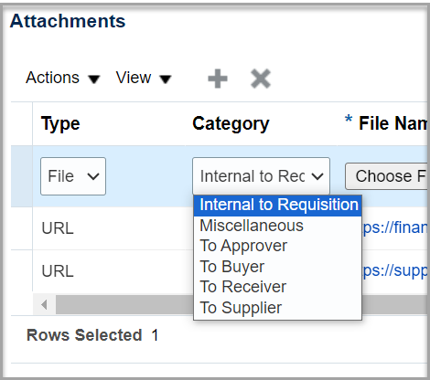
Attachments in SCM
Add Attachments to Requisitions
In the Category field, identify the accessibility of the attachment:
  Internal to Requisition: Attachment remains on Requisition but does not transfer over to the associated Purchase Order.
  Miscellaneous: Anyone with access to the Requisition can view the attachment, and it transfers over to the associated Purchase Order.
  To Approver, To Buyer, To Receiver, To Supplier: Selecting one of these options will include the attachment in the approval notification. To ensure an attachment is transmitted to the supplier, be sure to set the Category type To Supplier.

Slide 3
Attachments in SCM
Determine the Forms to Use
Do you need?
VRA
SRS
Capital Asset Form
Confirming Order
Conflict of Interest
COS
Independent Contractor Pre-Hire
Small Business Waiver
Sole Source and Price Reasonableness Form

Slide 4
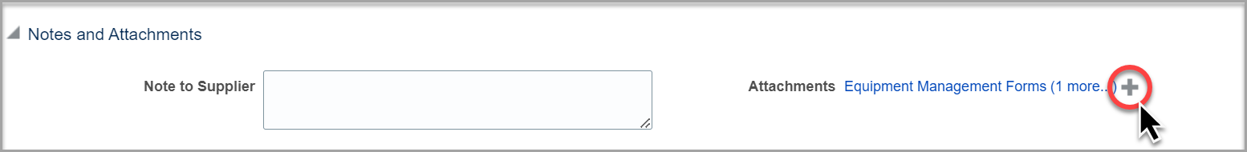
Attachments in SCM
Delete an Incorrect Attachment
If a document is attached in error, it can be deleted and removed from the Requisition prior to the Requisition being submitted.
To delete a document, click the “+” sign under Notes and Attachments to view all attachments. Select the line of the document you want to delete, then click Actions and Delete.

Slide 5
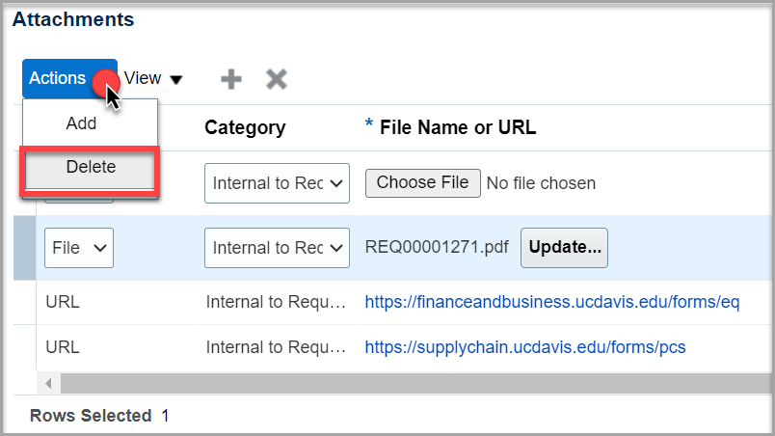
Attachments in SCM
Once the Requisition is submitted, the attachment cannot be removed by an approver, but an approver can reject and return the Requisition to the initiator, and the initiator can then delete/remove the inadvertent attachment.

