Slide 1
Blanket Purchase Orders
A Blanket Purchase Order is an agreement for an ongoing need, generally for a year or longer. This was previously known as a Purchase Agreement of Blanket Type in the Kuali Financial System. It is requested by a specific department for use by that department to fulfill a specific purchasing need that isn’t met with an existing university purchasing agreement. The Quantity-Based Requisition or Fixed Price Requisition document is used to request the establishment of a departmental purchase agreement with an outside supplier.

Slide 2
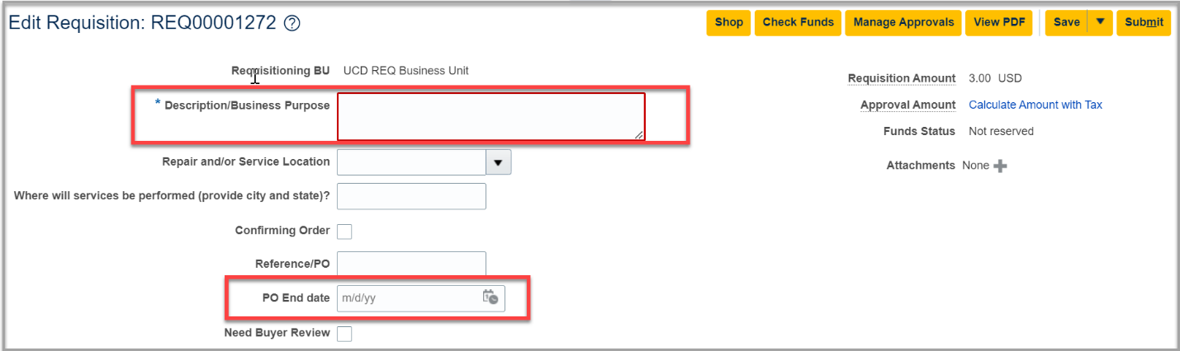
Blanket Purchase Orders
In the Item Description or Description/Business Purpose field, identify that it is a Blanket Purchase Order request, including any specific terms or conditions for the blanket request, as well as the estimated dollar amount to be spent on the blanket request.
Enter the appropriate date in the PO End Date field, the date on which the Blanket PO should expire. By default, the Start Date will be the date the Purchase Order is fully approved and open, unless a note has been added to the Requisition, advising of an alternate Start Date.
*NOTE: Your End Date should be the date for the amount you are encumbering not the date for the length of the agreement. You will amend the Requisition to add the next year and then change the end date.

Slide 3
Blanket Purchase Orders
Identify all goods and/or services that will be part of the agreement.
The number of Requisition Lines and dollar amounts entered in the Requisition is to be based on how each department would like to manage the associated purchasing encumbrances. Initiators can:
Enter one line for the full dollar amount expected to be spent for the life of the blanket order. This option encumbers all funds at one time. For an award this could be an option, You will want to work with the PI to determine best option.
Enter multiple lines, with each representing a different year for the blanket PO. This option still encumbers all funds at one time but provides the ability to break out and amend each line separately if needed. For general support funds you will only want to encumber funds that will be spent in that fiscal year.

Slide 4
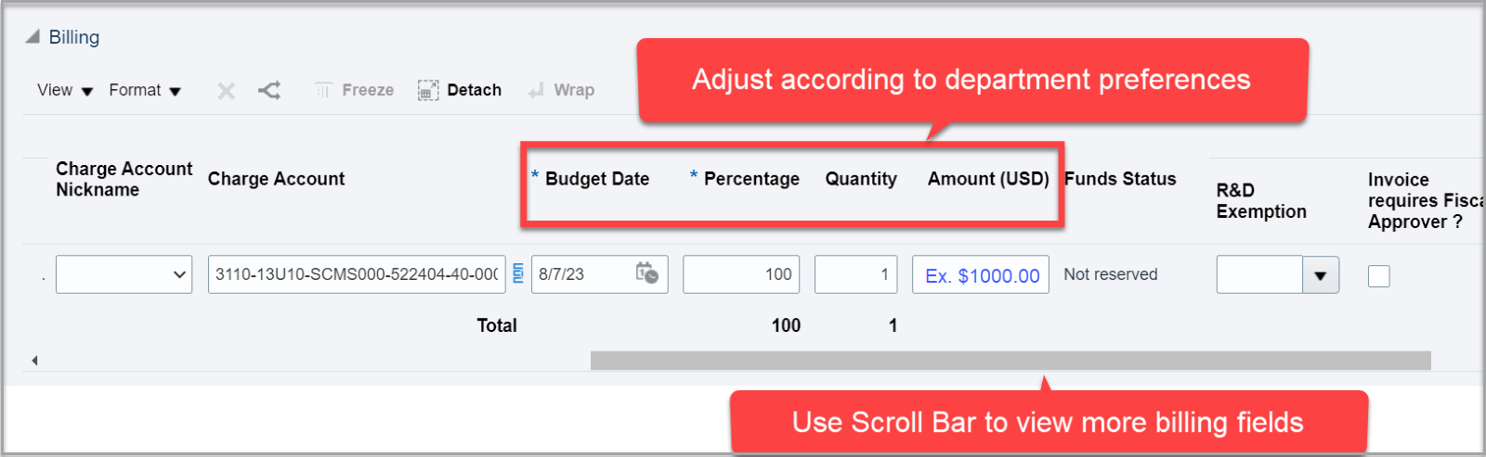
Blanket Purchase Orders
Enter one line with the dollar amount expected to be spent through a specific period (for example, through the end of the fiscal year). This option would encumber only these funds. To then add funds for additional years, initiators can:
Create an amendment on the existing Requisition and increase the funding on the existing line, or
Create an Add new line to existing PO document to add a new line to the existing Purchase Order with the new amount for the new period.

Slide 5
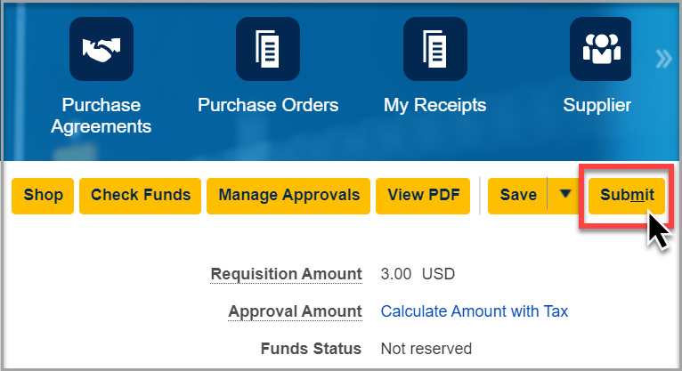
Blanket Purchase Orders
Click Submit to submit the Requisition for the Blanket Purchase Order request. After that occurs, the Buyer in Procurement & Contracting Services will create a Purchase Order that can be used to purchase against the blanket order.

Slide 6
Blanket Purchase Orders
Departments then make purchases against the Blanket Purchase Order by citing the PO number when contacting the supplier.
Things to Remember:
When adding the next year onto an agreement verify with requestor that the agreement is still needed.
Verify that the CoA has not changed.
Verify that there is no change to SOW, items or vendor contact.

