Slide 1
Salary Cost Transfer (SCT) Redesign
Go-Live November 13th 2023

Slide 2
Salary Cost Transfer Redesign – Agenda
New SCT Tool Overview
Old DR tool vs New SCT Tool comparison
SCT New Page Unrestricted Funds
  Search Page/New SCT Entry Page
  New SCT Inquiry Page
Unrestricted Funds SCT Demo
SCT New Pages Restricted Funds
SCT Dates to Remember
Questions

Slide 3
Salary Cost Transfer Redesign – Overview
Salary Cost Transfer (SCT) Redesign
Unrestricted Funds
Funds without any restrictions on spending
Redistribution of funds from one FAU to another without special edits
Restricted Funds
Restricted Funds should not be charged over the fund limit
SCT needs special rules to capture over / under the cap funding
SCT Life Cycle:
  Initiated → Submitted / Needs Approval → Approved → Processing → Complete → Posted to Labor Ledger

Slide 4
Salary Cost Transfer Redesign – A Comparison
Feature / Data / Process | Direct Retro (DR) Tool | Salary Cost Transfer (SCT) Tool
Transaction Search | By Employee and Earnings range | By Employee, earnings end date, pay end date, and optionally FAU and earnings code
Transaction Search | Transaction is for all lines in Paycheck | You can select and perform SCT for specific lines (no longer need to include all pay lines)
Entry page | By Paycheck Separate old and new data sections Separate restricted / MCOP worksheet No Ability to save the transaction without validations | By Earnings End Date Old and new data with a single section. The fields on the SCT page will change depending on the type of funding (Unrestricted, Restricted) Ability to save the transaction without Validations

Slide 5
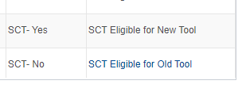
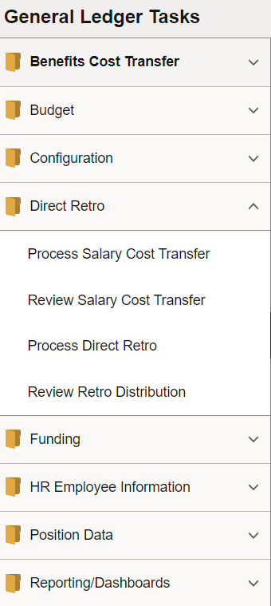
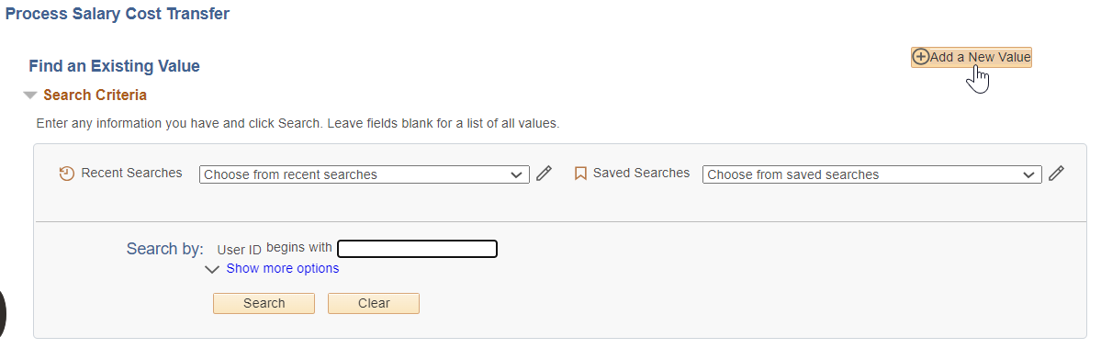


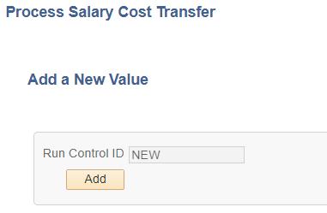

Salary Cost Transfer and Direct Retro – Eligibility and Navigation
New tool: For earning after October 2021 that never had any DR performed
Existing (old) direct retro module:
  For expenses paid prior to October 2021
  If there is a direct retro performed must also use direct retro

Slide 6
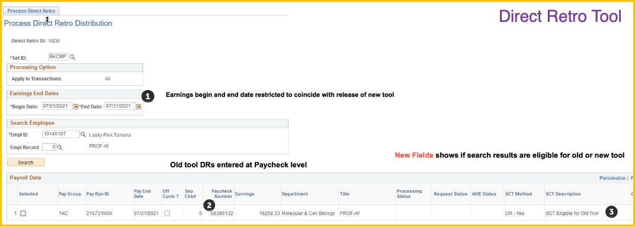
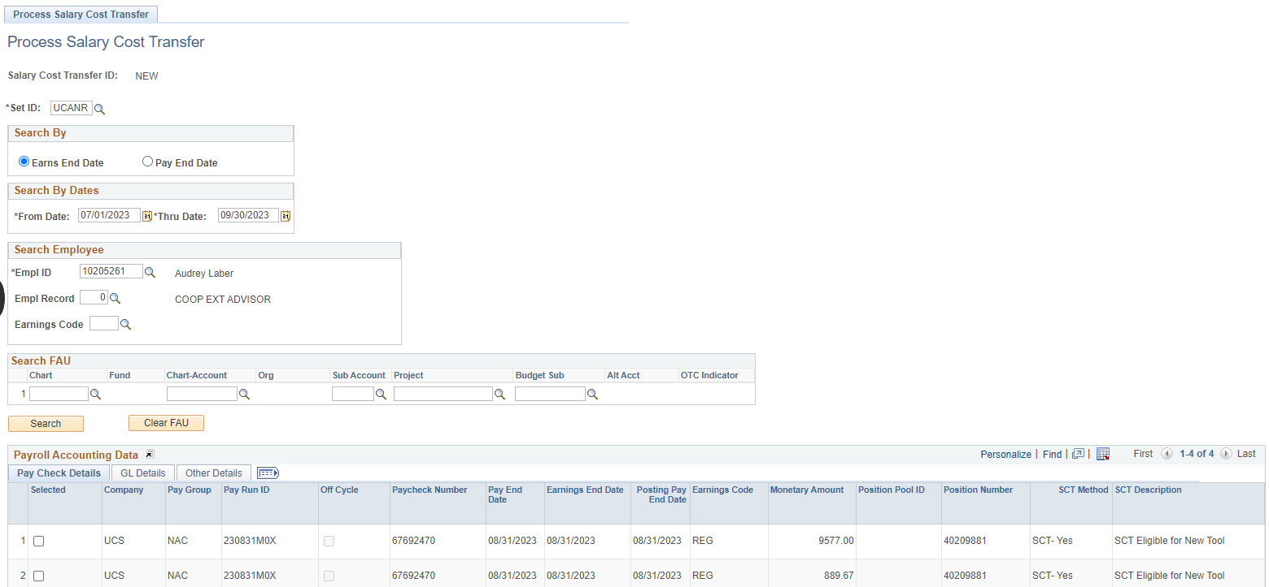
Direct Retro vs New Salary Cost Transfer – Search Page
New SCT tool allows search by earnings or pay end date ranges
Optional search criteria includes earnings code and FAUs
Both the old and new SCT tool search results display eligibility for transacting in the old vs new tool

Slide 7
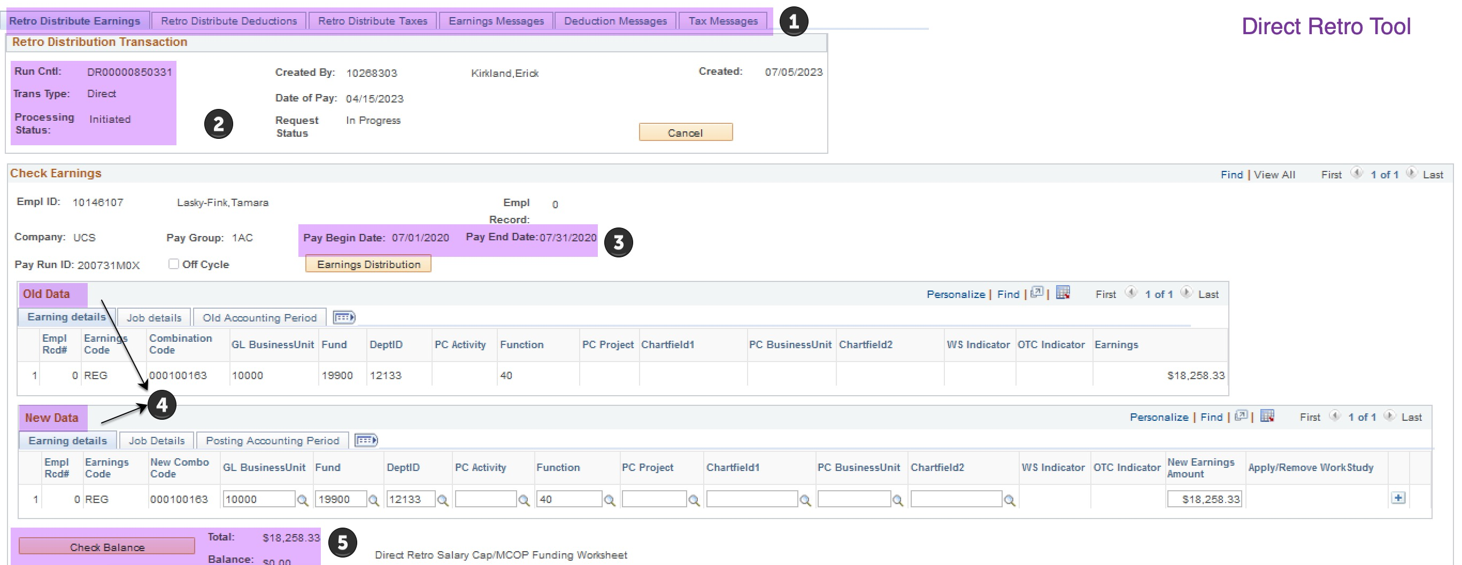
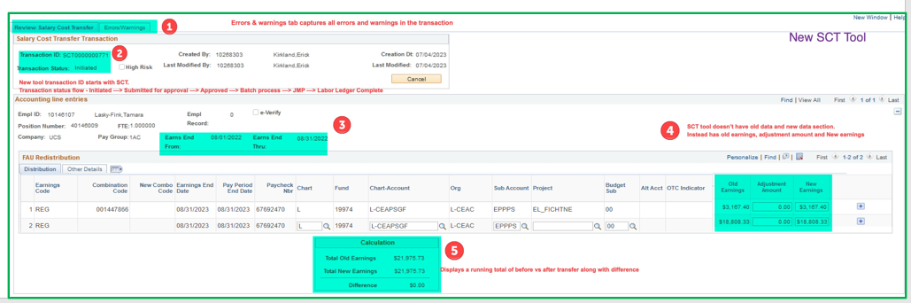
Direct Retro vs New Salary Cost Transfer – Entry Page
Main SCT entry page has only 2 tabs for earnings entry and errors / warnings
Each transaction ID is unique and starts with SCT and goes thru a status change until its complete.
Selected earnings period are grouped by earnings begin and end date
Adjustments to payroll earnings are driven by old amount, adjustment amount and New amount instead of old vs new data section
Display of total old and new earnings with difference

Slide 8
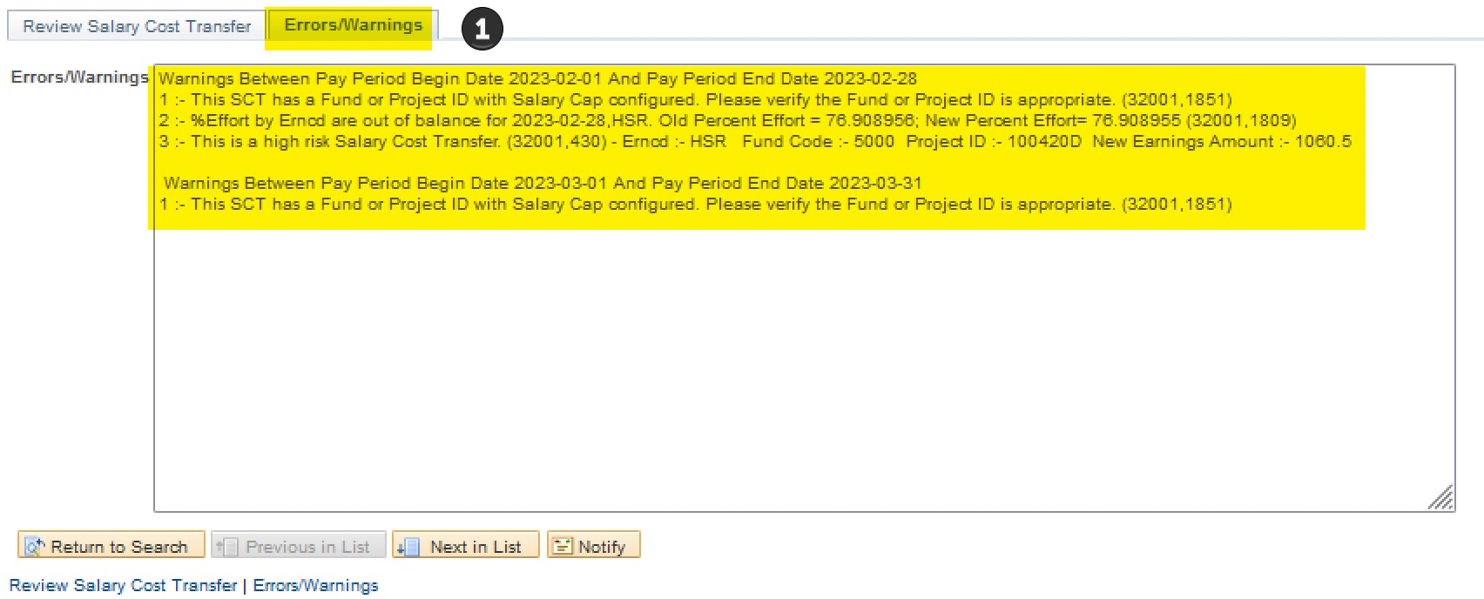
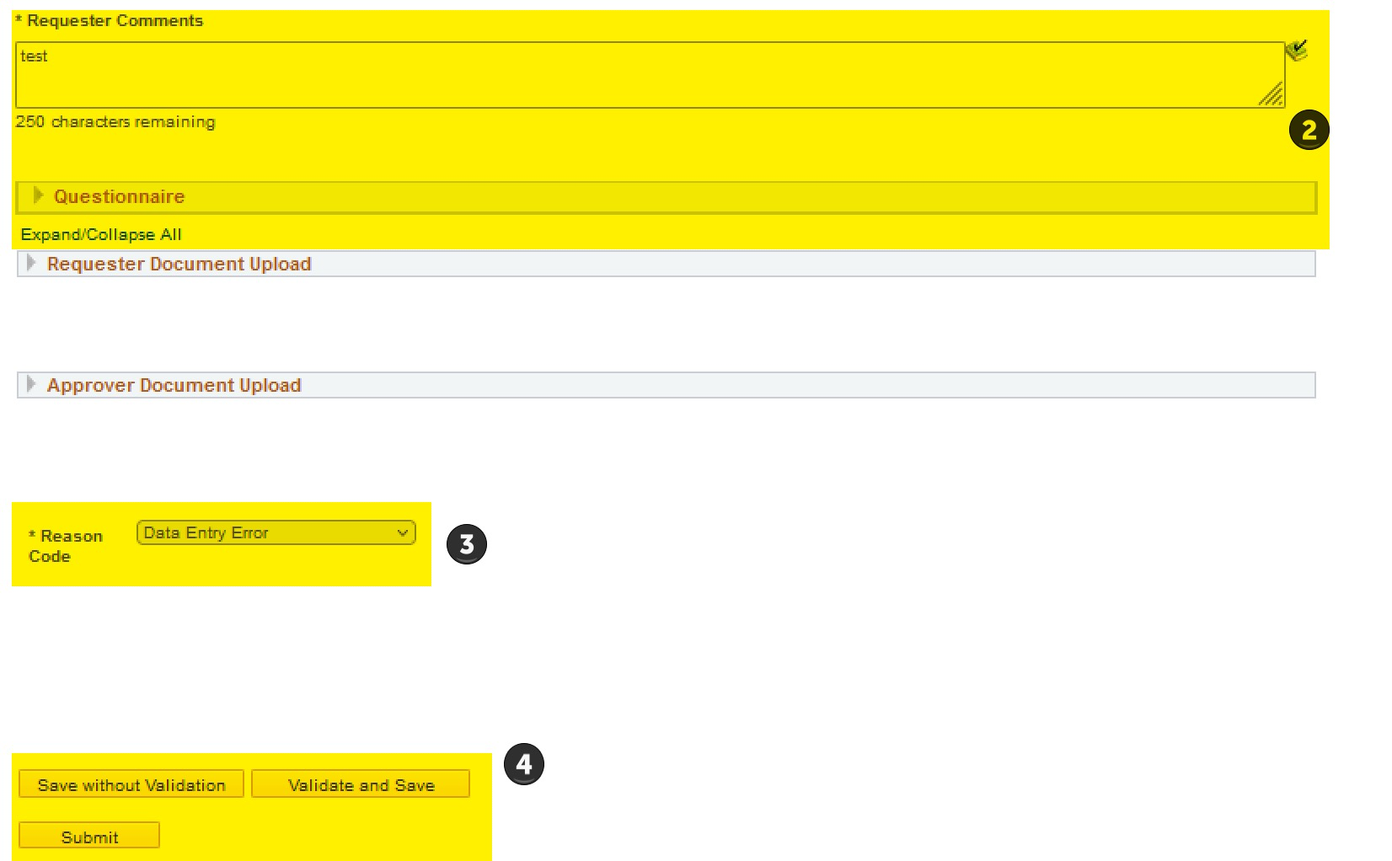
New SCT – Errors/ Warnings & other Fields, Buttons
Second tab on the SCT entry page displays and stores all errors and earnings at the same time, if any, during validate or submit
SCT requester comments and questionnaire
All SCTs require a reason code for submission
Save without validation allows a user to save a transaction in the middle of entry without business rules validation
Validate and save triggers all business rules validation
Submit triggers all business rules validation and if successful sends the SCT for approval

Slide 9
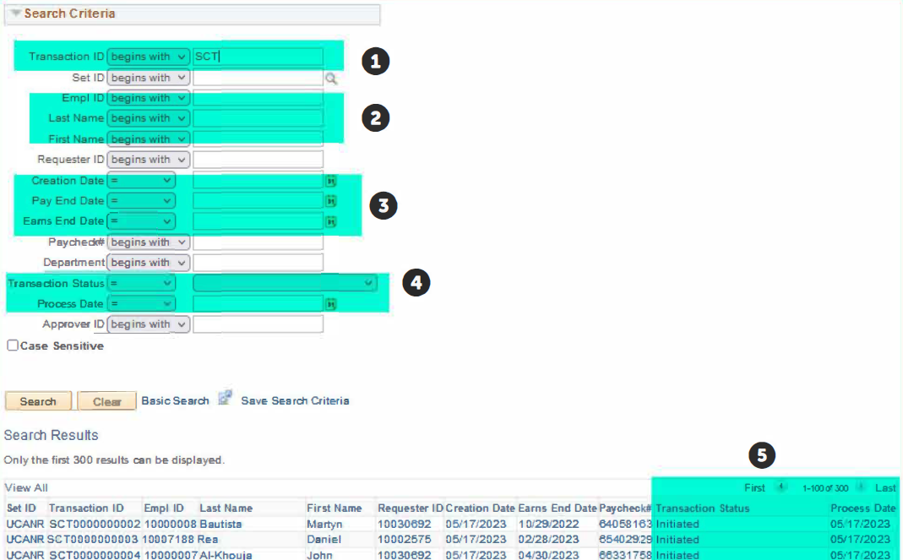
Review SCT Inquiry Page
Search by transaction ID if known
Search by employee ID or name
Use different date type fields including SCT creation date or earnings period
Search by SCT transaction status or last process date
Search results driven by security access and displays the transaction status and last batch process date. When status is LL complete the process date denotes when the transaction was sent to campus GL

Slide 10
Live Demo in UCPath

Slide 11
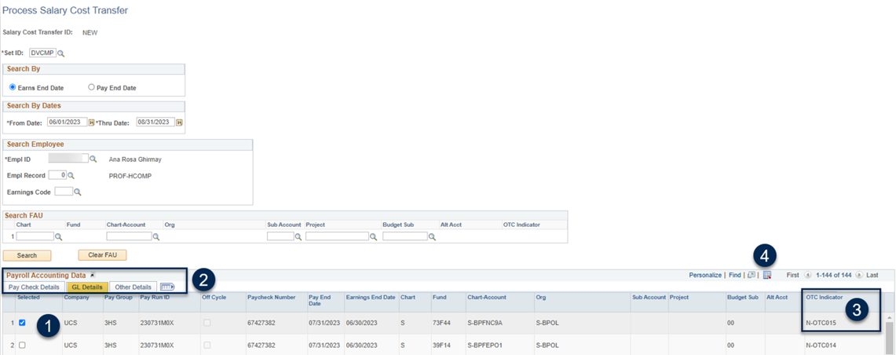
New SCT Restricted Funds: Search Page

Slide 12
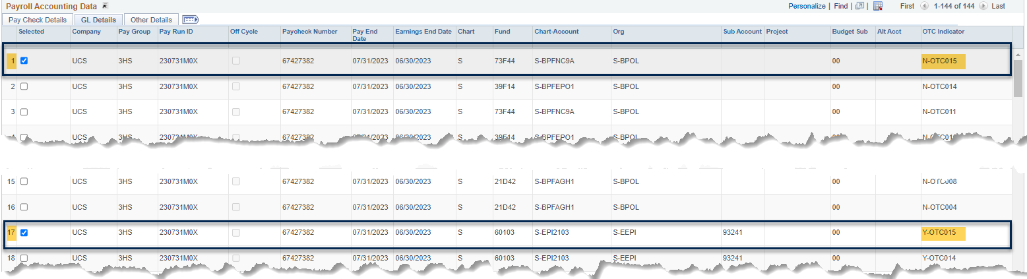
New SCT Restricted Funds: Search Page
Select the earnings line(s) you want to transact on. If you select an N-OTC line it will automatically select the corresponding Y-OTC line.
These lines may be far apart and require scrolling to locate the corresponding line.
See below N-OTC is line 1 while Y-OTC is line 17.

Slide 13
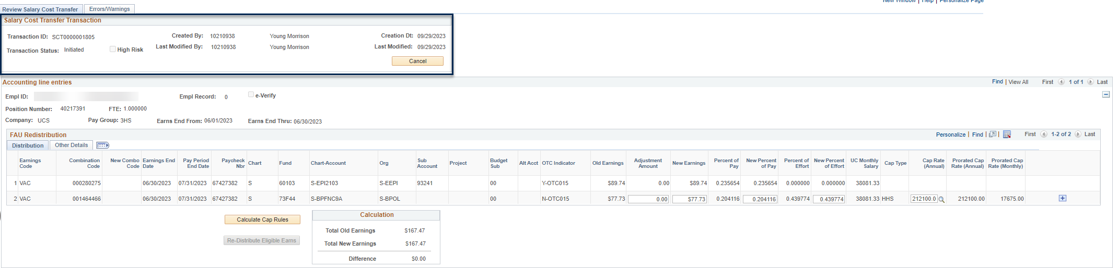
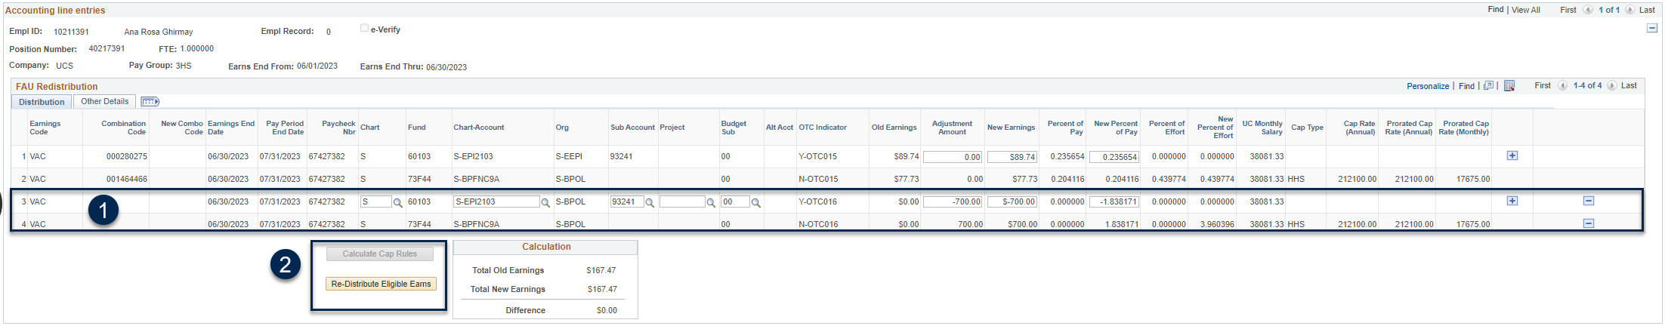
New SCT Restricted Funds: Entry Page
Once you are done updating the N-OTC lines, click on Calculate Cap Rules button to recalculate the over the cap amounts and open up the Y-OTC lines for updating.
Use the Re-distribute Eligible Earnings button to return to N-OTC lines, if necessary, after cap rules are calculated.

Slide 14
Salary Cost Transfer Redesign– Dates to Remember
Fully Approve Pending Funding Entry and Direct Retro transactions: 5:00 PM on November 3, 2023
  Please complete all the DR’s by November 2, 5pm. This will leave UC ANR Payroll team has one day time to approve the transactions
GL Module Transaction Freeze: November 6 – November 9
  Users will not be allowed to do any Direct Retro, Funding Entry, Benefit Cost Transfer, and Budget Distribution
Cutover Downtime: November 9 – November 12
SCT Tool Live: November 13, 2023

Slide 15
Questions

