Slide 1

Six Sure Ways To Project Success
4-H Leadership
Notes:
Hello & welcome to the Fresno County 4-H project planning event. I’m

Slide 2

Set Goals & Gather Resources
Identify your project goals
Meet with your Jr/Teen leaders
Select resource materials & publications
Create a project binder
Contact alumni members

Slide 3
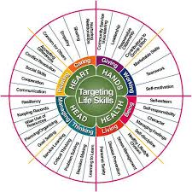
Create Plan For The Year
Select meeting days, times, & locations
Choose meeting topics
Incorporate a community service
Plan field trip meetings
Identify life skills & learning opportunities

Slide 4

Preparing Helpful Documents
Project syllabus
Sign in sheets
Year at a glance calendar
Member list
Code of conduct

Slide 5

Clarifying Expectations
As your leader I will….
Member responsibilities
Parental Support
Code of conduct review
Record Keeping

Slide 6

Encourage, Guide, & Motivate
Share project goals
Personal check ins
Assess star rankings
Recognize accomplishments
Praise, praise, praise

Slide 7

Year End Completion
Record books
Photo opportunities
Review goals
Plan year end party
Survey to members

