Slide 1
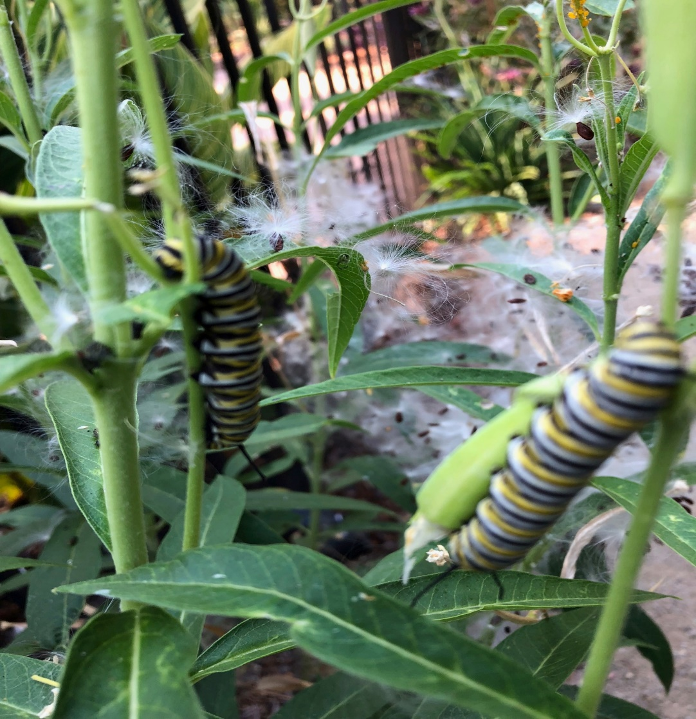
Pollinators Monarch butterfly life cycle
Notes:
Photo: Lynne Gold
Example od a Pollinator: Monarch caterpillar on Milkweed.

Slide 2
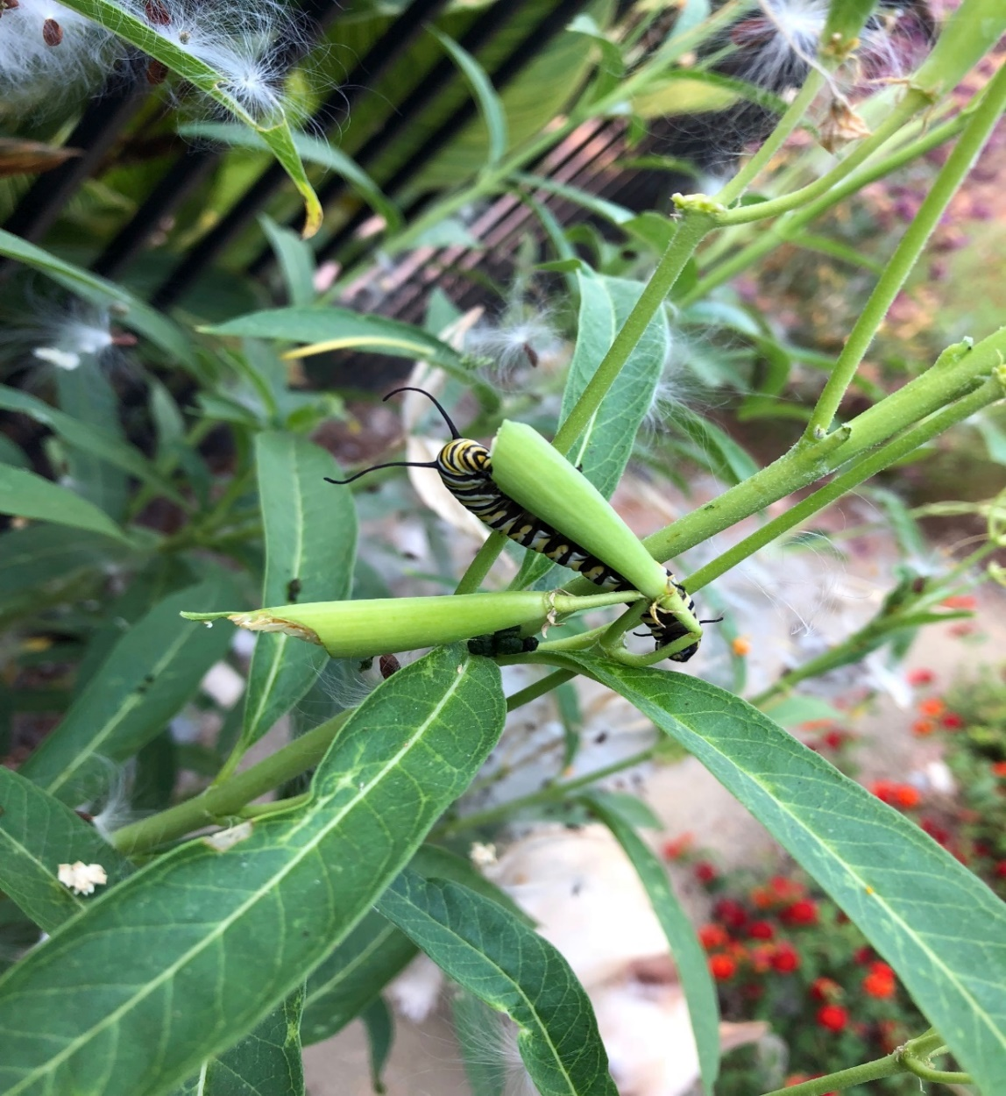
Pollinators
Notes:
Photo: Lynne Gold
Caterpillar feeding.

Slide 3
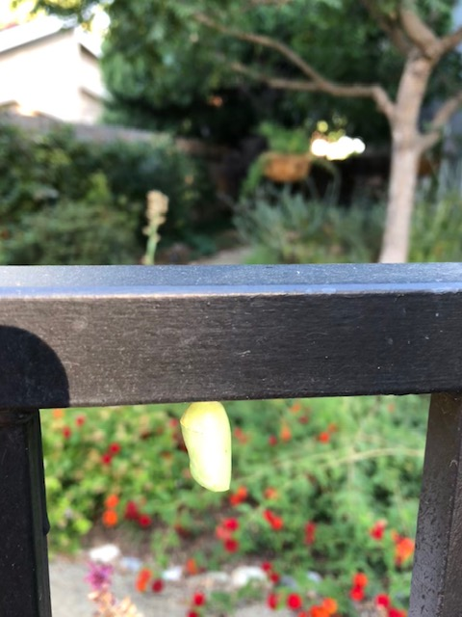
The Chrysalis
Notes:
Photo: Lynne Gold

Slide 4
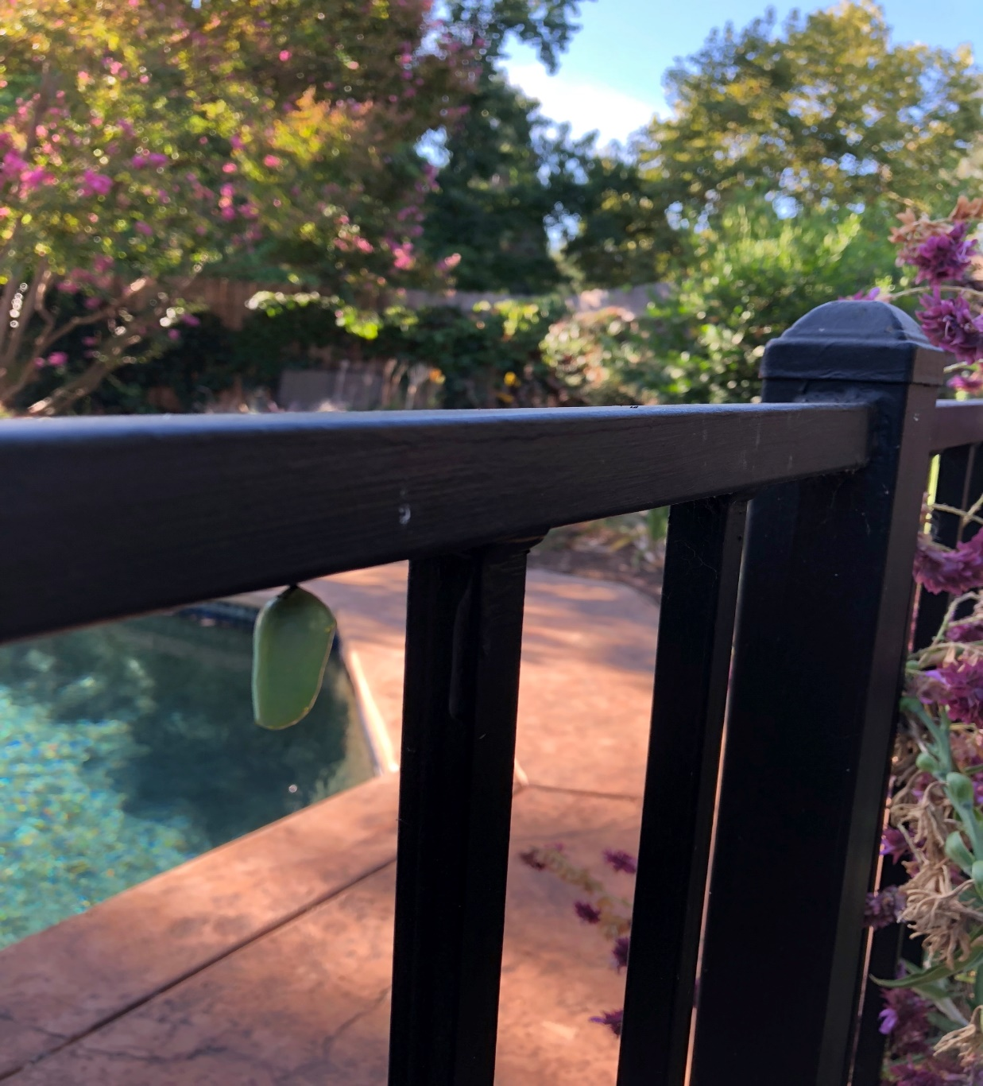
Chrysalis darkening
Notes:
Photo: Lynne Gold
Chrysalis with Asclepias on the right.

Slide 5
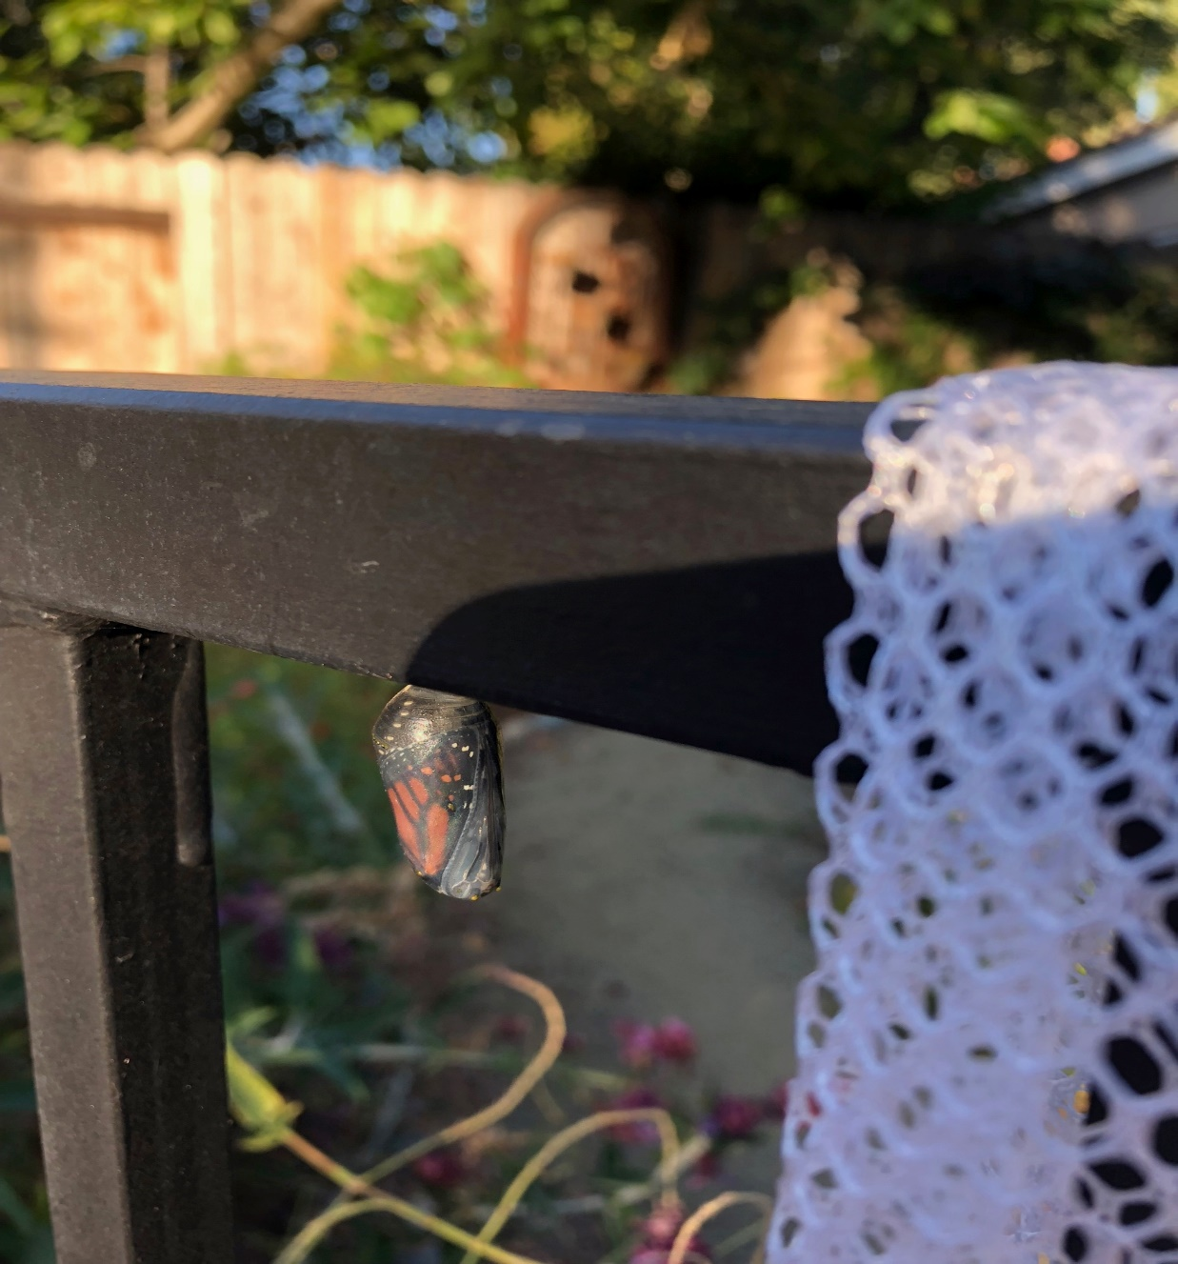
Monarch visible in Chrysalis
Notes:
Photo: Lynne Gold
Butterfly within chrysalis just before exiting.

Slide 6
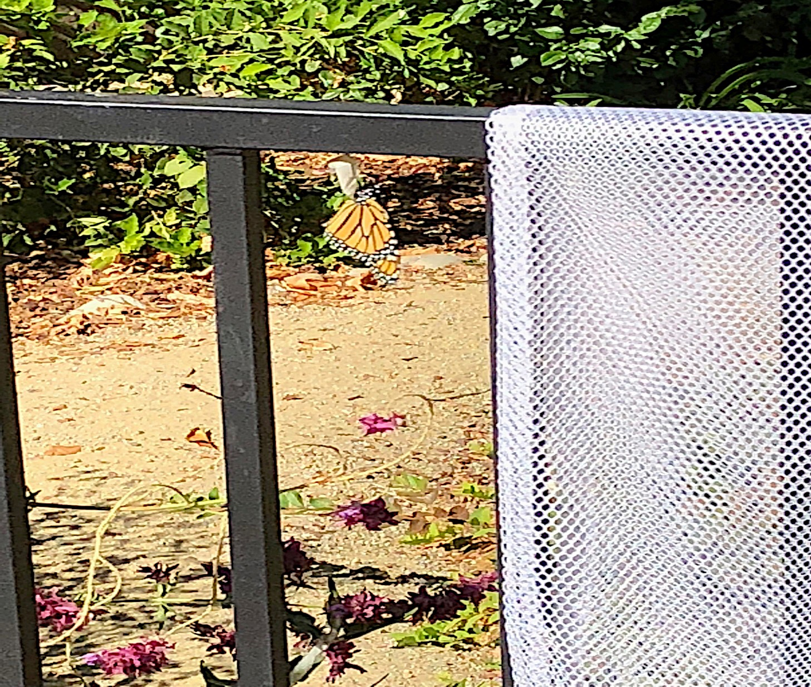
Monarch Eclosing
Notes:
Photo: Lynne Gold
Hatched and will spread wings

Slide 7
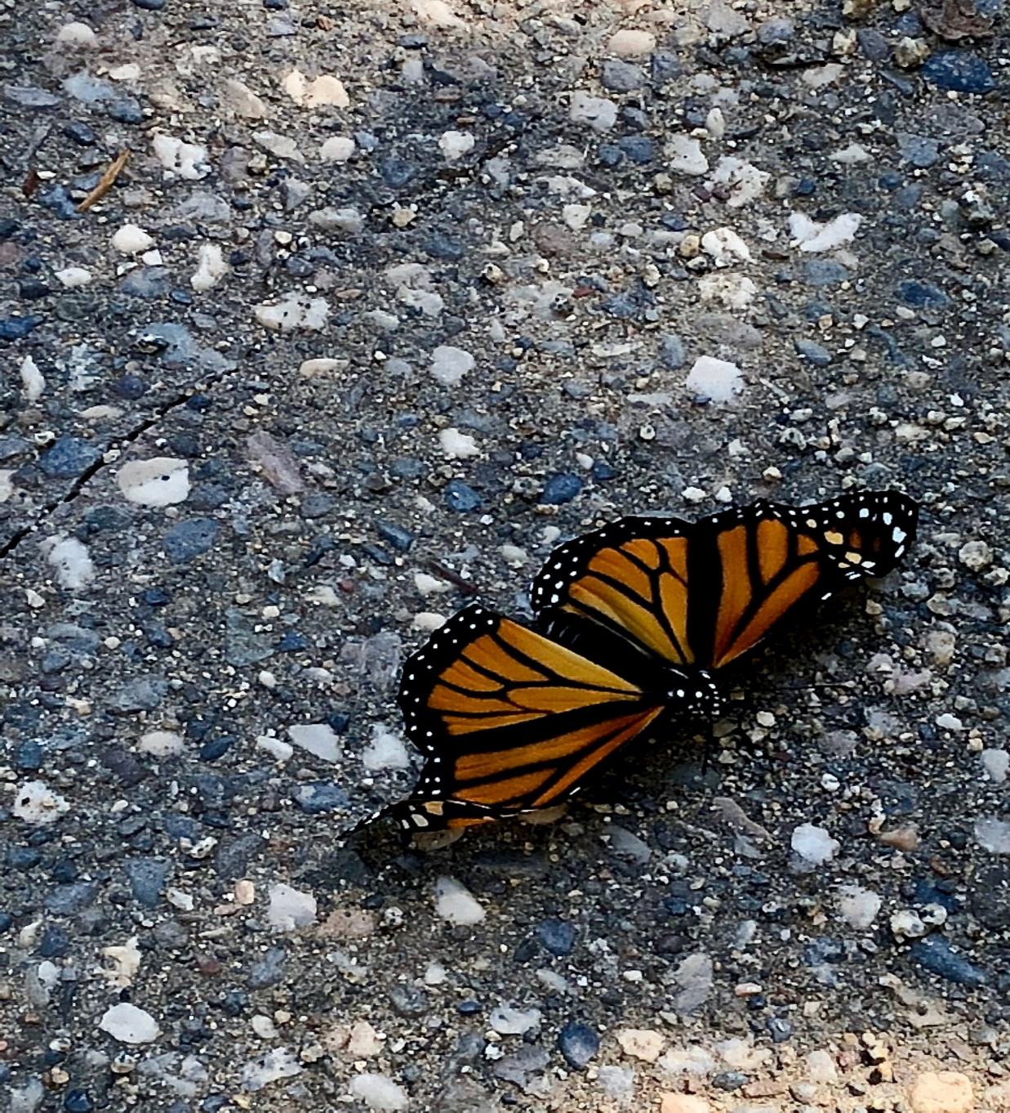
IT’S A GIRL
Notes:
Photo: Lynne Gold
Newly hatched from chrysalis.

