Slide 1
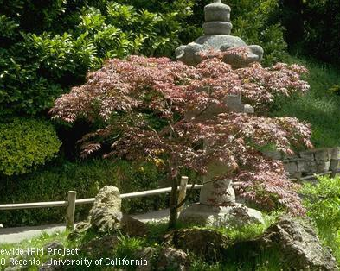
Japanese Maples
Presented by:
Kelly Warman
Notes:
Created: 2/1/2019
Created by: Kelly Warman
Audience: Homeowners
Publicity: Learn about the care, maintenance, and variety of Japanese Maples
Update History: for each update to the presentation include date, name of updater, explanation of update
(were additional slides added, were web links updated, etc.)

Slide 2
Who Are Master Gardeners?
Master Gardeners of Placer County
Extend research-based, sustainable gardening and composting information
Present accurate, impartial information to home gardeners
Encourage public to make informed gardening decisions

Slide 3
Who Are Master Gardeners?
Where to find us…
Online, in the Media, and Special Publications
Hotline: Call (530) 889-7388 or submit your questions online
Website: pcmg.ucanr.org
Facebook, Twitter, Instagram
Gold Country Media monthly column
Curious Gardener monthly newsletter, subscribe on website
Calendar and Gardening Guide
School and Community garden consulting

Slide 4
Who Are Master Gardeners?
Where to find us…
Workshops, Fairs and Festivals and Special Events
Speakers by Request
Workshops (various venues, check website)
Farmers’ Markets (seasonal: Auburn, Roseville)
Fairs and Festivals Booths (varies)
Garden Faire (April)
Mother’s Day Garden Tour (May)

Slide 5
Japanese Maples
Agenda:
History
Varieties
Planting & plant placement
Watering
Feeding
Mulching
Pruning
Trouble shooting
References

Slide 6
Japanese maples
History
Cultivated in Japan since 1600
Brought to England in 1820
Now cultivated worldwide

Slide 7
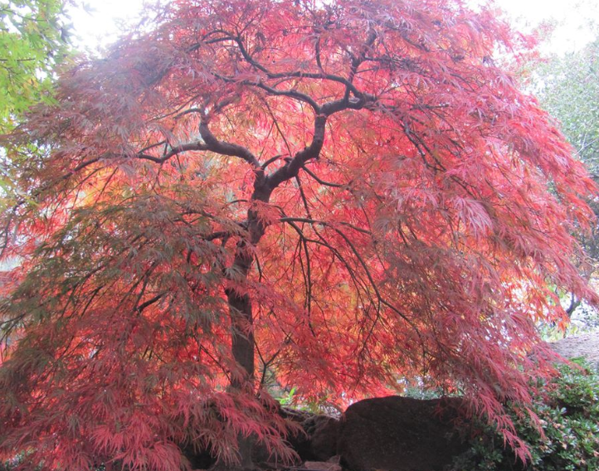
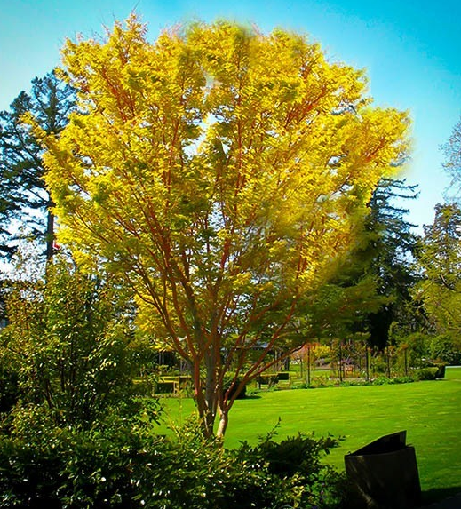
Stunning beauty has made Japanese maples popular worldwide

Slide 8
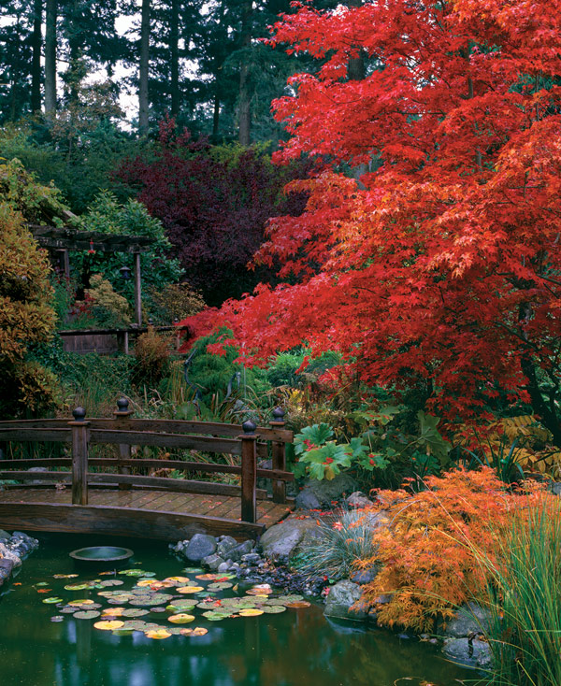

Slide 9
Japanese maples
Thrive in a wide range of environments…from rain forests in the Pacific Northwest to the warmer climates of California
Rarely grow to great heights so not classified as a shade tree
Can be long lived 100+ years
Typically slow growing…6 inches to 2 feet per year, depending on the variety and the environment
Generally like morning sun and filtered afternoon sun/shade, but can thrive in full sun (more on this later)

Slide 10
Japanese maples
Over a thousand of varieties exist…local nurseries have many varieties to meet your needs
Variety of sizes….from dwarf to 25ft
Variety of forms…
Upright
Weeping
Rounded or dome-shaped crowns
Pendulous & weeping branches
Dwarf, bonsai
Variety of leaf shapes & colors (even variegated)…many changing color in the fall

Slide 11
Japanese Maple variety attributes
Name | Leaf-colors: summer | Leaf-colors: fall | Form | Height (ft) | Spread (ft)
Bloodgood | red | crimson | upright | 20 | 20
Coral Bark | green | golden yellow | upright | 25 | 12
Lion’s Head | Green | gold, red | upright | 15 | 12
Purple Ghost | red | crimson | upright | 10 | 6
Inaba-shidare | purple-red | crimson | horizontal/ weeping | 10 | 15
Red Dragon | cherry-pink, red | crimson | round/weeping | 12 | 12
Crimson Queen | Red | crimson | weeping | 10 | 12
Garnet | red-orange | deep red | weeping | 12 | 12
Green Cascade | green | gold, orange, red | cascading | 5 | 8

Slide 12
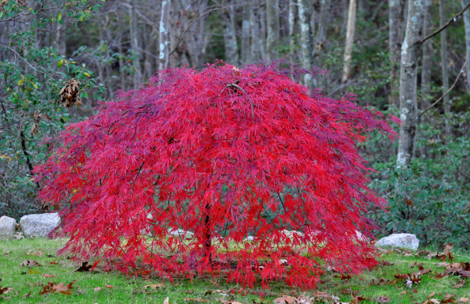
Weeping

Slide 13
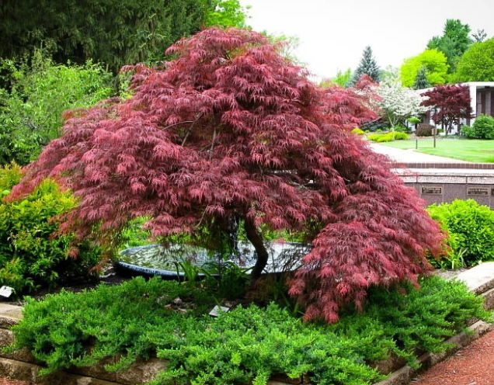
Weeping

Slide 14
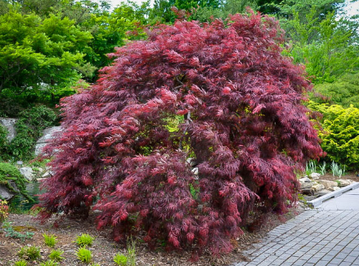
Weeping

Slide 15
Upright

Slide 16
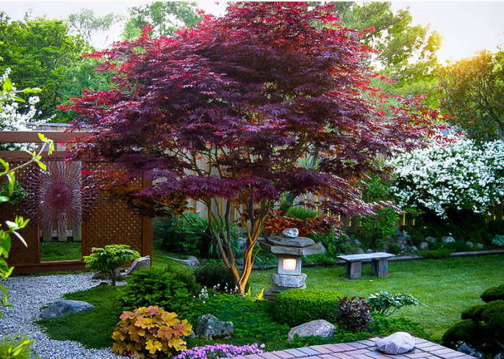
Upright

Slide 17
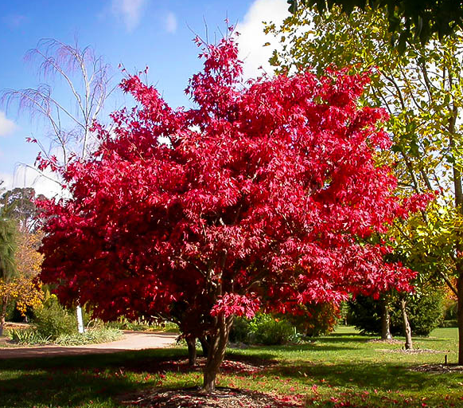
Upright

Slide 18
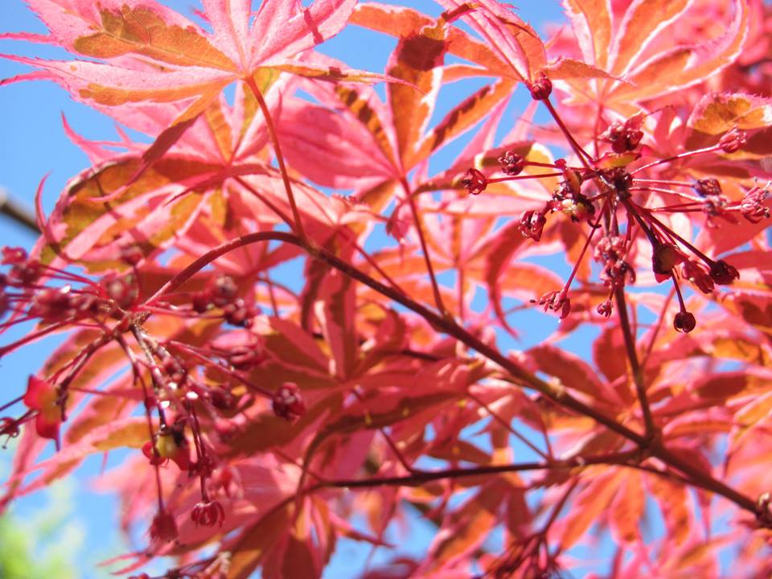
Japanese maple flowers
Flowers are monoecious (have both male and female flowers on the same plant) and are inconspicuous & small

Slide 19
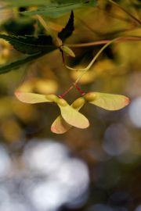
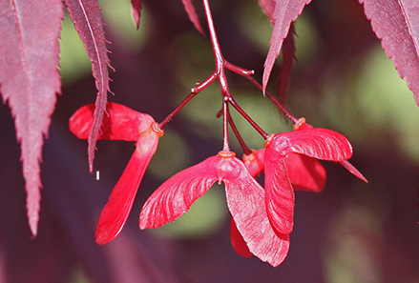
Japanese maple fruit
Fruit is called samaras, which are nutlets enclosed in a papery, fibrous tissue that’s in the shape of wings. They spin as they fall & are carried distance

Slide 20
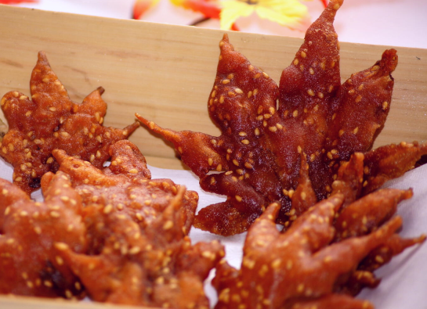
Japanese maples
Trivia
Fried maple leaves are a very popular snack in Osaka, and apparently have been for at least a thousand years. The city of Minoh is particularly famous for their fried leaves. The maple leaves are dipped in tempura batter and fried, which gives them their unique taste. Chefs in Minoh usually store their leaves in barrels of salt for one year, which makes them particularly tasty.

Slide 21
Japanese maples
GRAFTED? SEED? CUTTINGS?
Seedlings from seeds may not be exact clones of the parent
Trees can be grown from cuttings
Most in local nurseries are grafted onto a rootstock

Slide 22
Japanese maples
Nurseries use ‘Japanese Maple’ for several species
Acer palmatum (named because the leaf looks like a hand)
Acer japonicum
Acer shirasawanum
Plus other Acer (maple) species that are not native to Japan

Slide 23
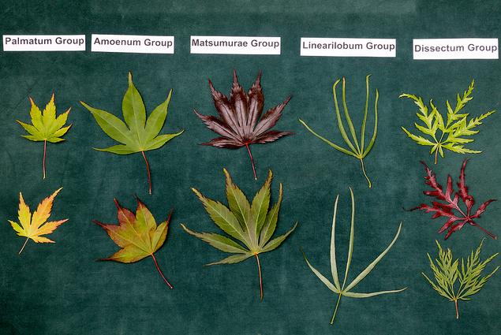
5 Basic leaf types of Acer palmatum

Slide 24
5 Basic leaf types of Acer palmatum
Palmatum group
Leaf lobes moderately to deeply divided 2/3 to 3/4 of the way to the leaf base and in some cases, almost to the base
Amoenum group
Leaf lobes shallowly to moderately divided, usually up to 2/3 of the way to the leaf base
Matsumurae group
Leaf lobes mostly very deeply divided more than ¾ of the way to the leaf base
Linearilobum group
Leaf lobes narrow, straplike, divided to the leaf base
Dissectum group
Leaf lobes very deeply divided and deeply dissected into sublobes

Slide 25
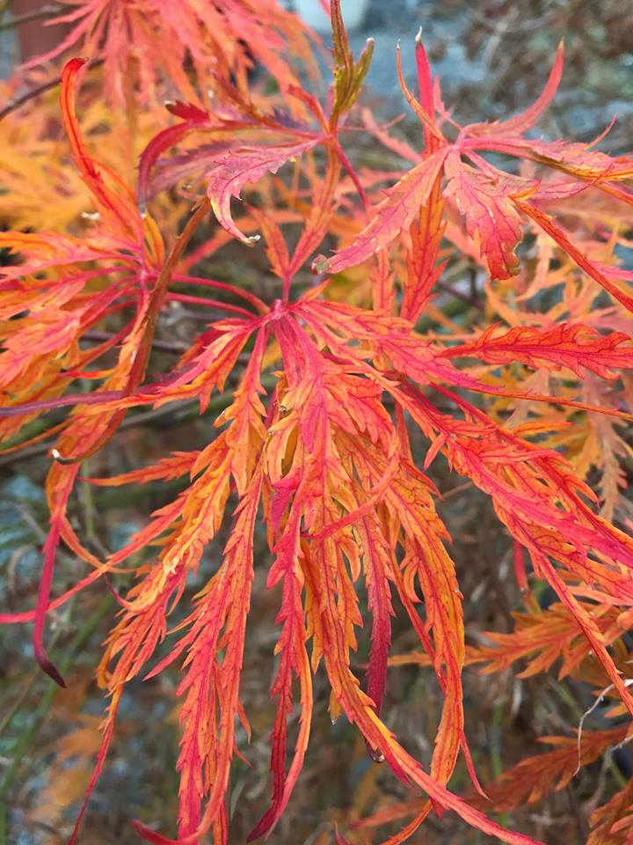
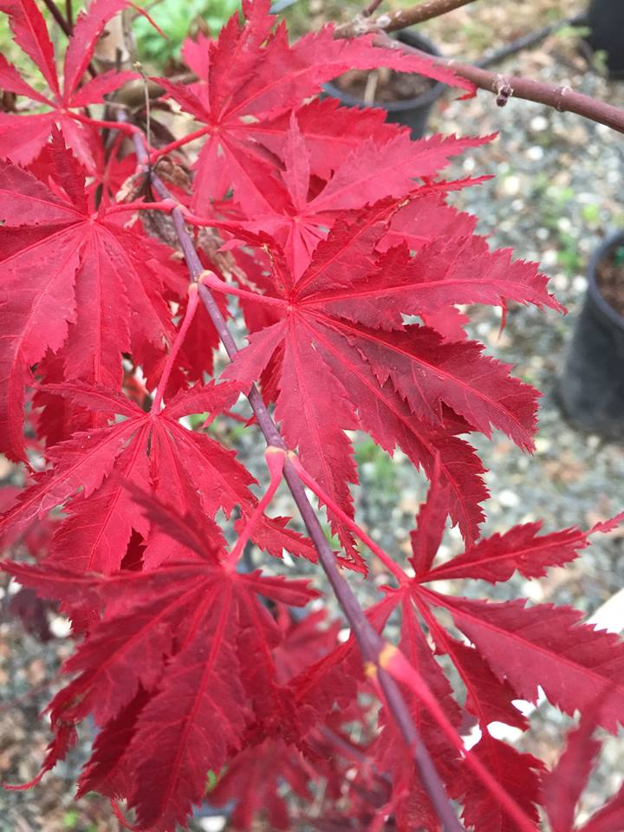
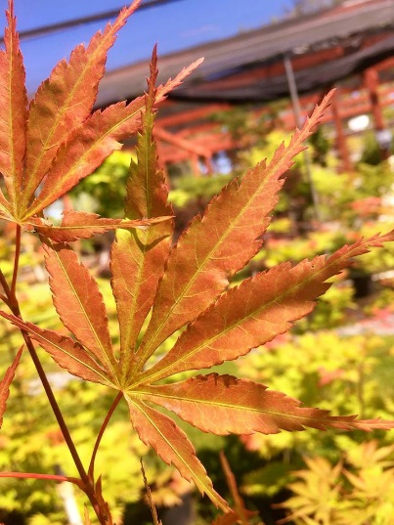
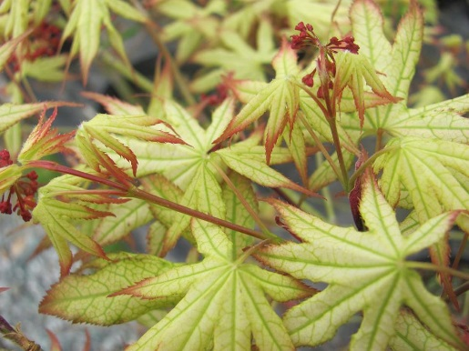
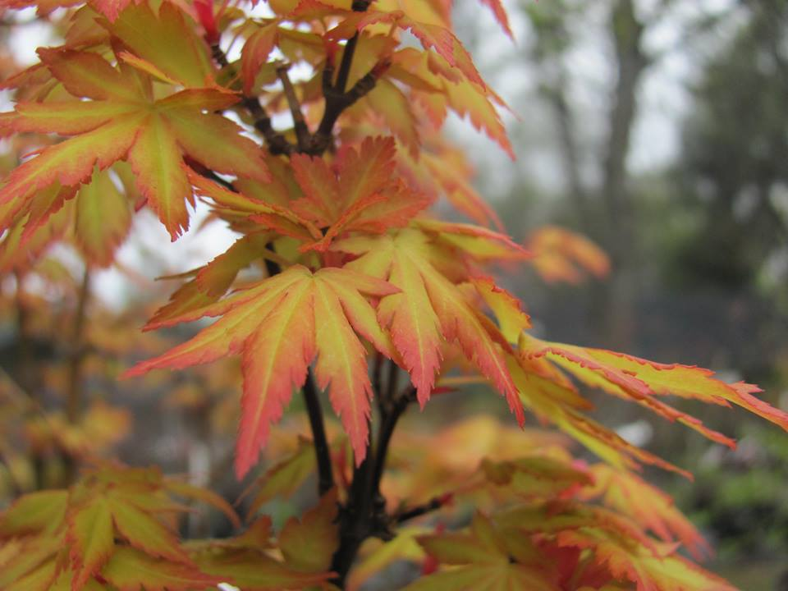
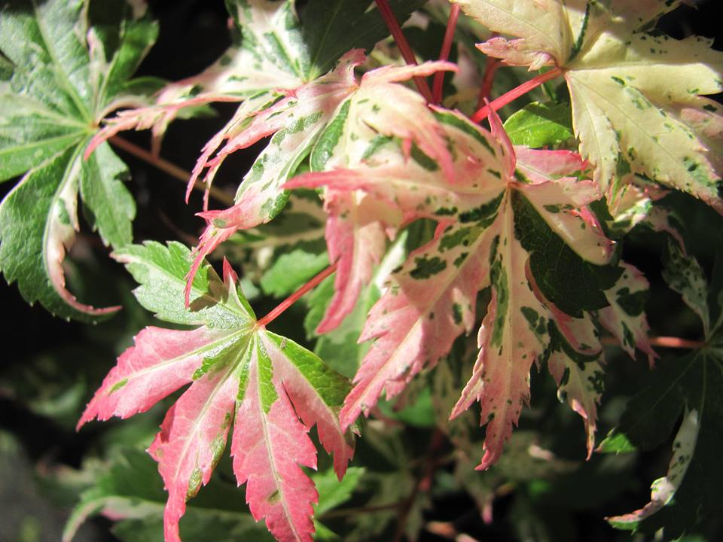
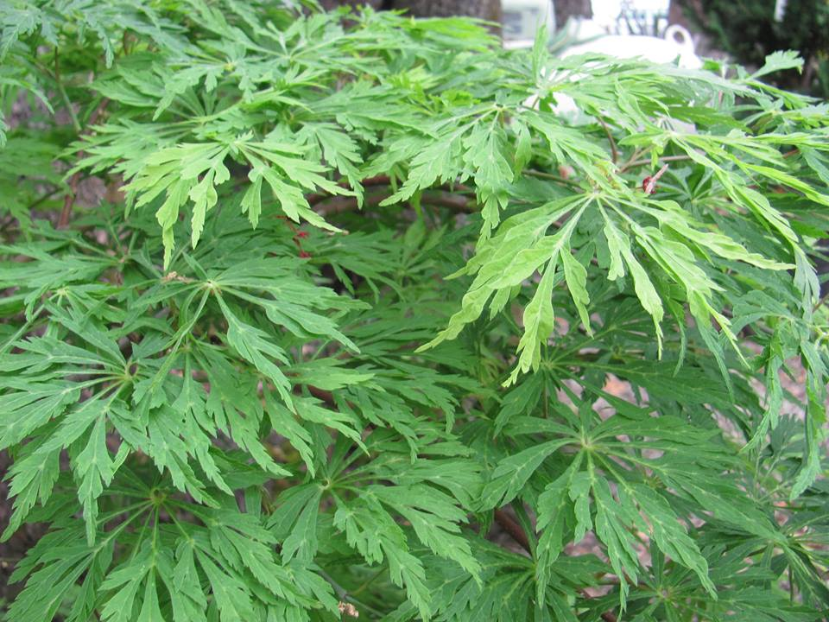
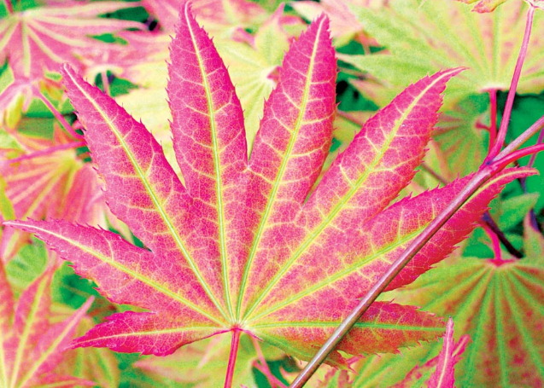
Leaf Types & Color

Slide 26
Site Location
They do not have a strong invasive root system which might damage boarders or walks. Root competition is not vicious so they are compatible with most other plants
Morning sun and afternoon filtered sunlight is best
If possible plant where not subject to hot afternoon sun, but they can survive in full sun
Plant the tree in either the fall to early spring, to allow the tree to develop a more extensive root system before summer
Plant the variety suited for the site
Consider the variety’s height and width at maturity

Slide 27
Soil
Slightly acidic is ideal, but will grow in slightly alkaline soil
Sandy loam with low to medium organic matter is ideal but they adapt to less than perfect conditions
Well drained soil….Japanese maples don’t do well in wet swampy location
May be grown beside streams if root zone has sufficient drainage

Slide 28
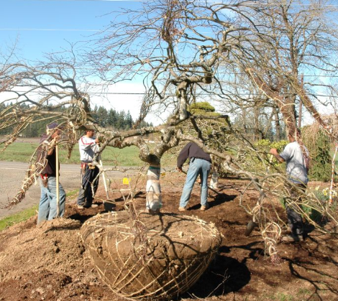
Planting
Dig hole slightly larger than root mass
Soil can be mixed with organic material such as composted conifer bark mulch, rhododendron or azalea planting mix or rose compost
Never use sawdust, wood chips, uncomposted bark (will use up the available soil nitrogen making it unavailable to the tree)
Planting hold deep enough so that the root collar of the plant is level with ground surface
Exception is tight heavy soils like clay – better if hole is shallow so the root system is partly above ground – when filling the hole mound soil up to the root collar to protect roots

Slide 29
Root system
Root system is predominately a fibrous root network that will stay mostly in the upper level of the soil
With age roots will go rather deep…deep irrigation helps this
It takes several years before the root system is established enough to compete with other vegetation for water & nutrients
Competition from grass roots is especially intense…so newly planted trees should be kept weed free for 2-3 years

Slide 30
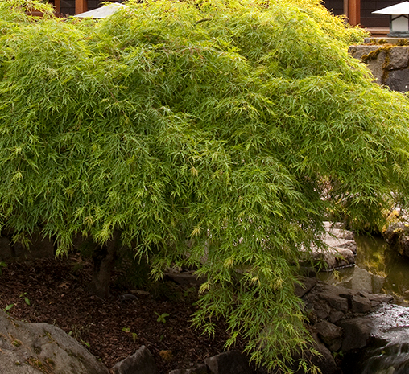
Water management is more important than soil!

Slide 31
Moisture Needs
WOCOLS (Water Use Classification of Landscape Species)
Medium water needs
Uniform moisture supply is key
Watering frequency depends on soil, sun exposure, wind, size of tree
Generally Japanese maples need frequent watering, especially the first few years….they need moist soil, not soggy soil
Check the soil a few days after watering….overwatering can kill plants, but Japanese maples do not like dry soil
In containers overwatering can be worse than under watering…water logged roots can’t breathe
Water deeply so roots are encouraged to grow deeply

Slide 32
Mulch, Mulch, Mulch!
Several purposes
Minimizes water loss during dry spells & helps keep the roots cooler
Maintains weed free conditions
Protects roots in prolonged freezing conditions
2-4” of mulch around the tree canopy…but not next to trunk
ideal course bark with average ¾” chip size…other types of organic mulch are ok
Add more mulch every 1-2 years

Slide 33
Feeding
Don’t need large amounts of fertilizer, generally little to none!
May apply to young trees to encourage growth
Use a balanced fertilizer such as for roses or an organic fertilizer….Test soil to see what is needed
Feed lightly…overfeeding can increase water needs, contribute to leaf burn, and may mask some characteristics (especially variegated forms….and odd-leaved forms may produce normal leaves)
Timing for fertilizer application is early spring, before leaves emerge
Never apply after early spring as this tends to delay hardening off of shoots in autumn, leaving them prone to frost & cold-wind damage
Mature trees do not need fertilizer

Slide 34
Pruning
Winter is a good time to prune because you can clearly see the tree structure
Avoid pruning late winter/early spring when the sap is starting to run…the sap leaves unsightly marks where you cut.
Light pruning can be done any time of the year
Many varieties do not need pruning…compact and dwarf J. maples are typically not pruned
Japanese maples are pruned for aesthetics so if you are happy with the way your tree looks you do not need to prune it

Slide 35
Pruning
Start with removal of dead twigs and branches.
Look at cross branches….if they pose a problem then prune them (if you like the look leave alone)
Thin interior branches to highlight the structure of the tree
Do not chop back branches to keep trees small. This destroys the tree’s shape and structure
Cuts should be made just beyond a pair of buds on the twig…this will produce two side shoots
Weeping tree branches that touch the ground may be trimmed if this bothers you but it is not necessary

Slide 36
Pruning
Some rules for all tree pruning:
Do not remove more than 1/3rd of the tree
When removing a larger limb cuts should be made just above the branch collar…never cut beyond the branch collar
Do not use tree-wound paint…allow the wound to dry out and this is the best way to reduce disease problems
Use sharp pruning tools…clean pruning wounds heal much more quickly than jagged torn wound created by blunt tools

Slide 37


Pruning
https://clackamascountymastergardeners.org/10-minute-university/

Slide 38
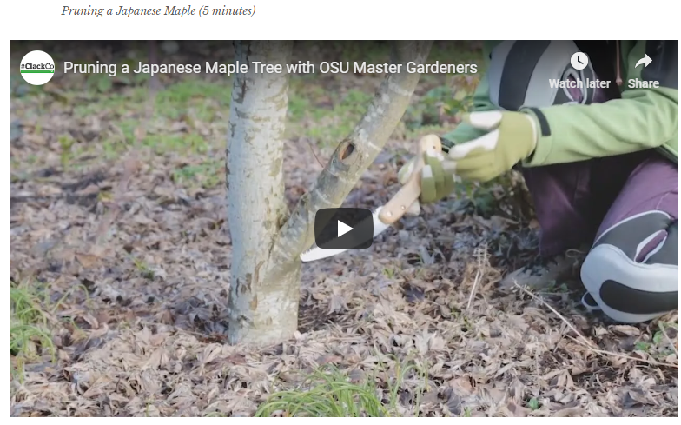
Pruning
https://clackamascountymastergardeners.org/10-minute-university/

Slide 39
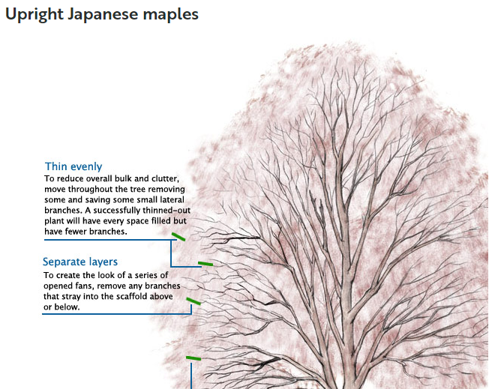
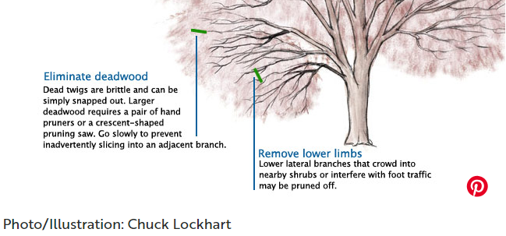
Pruning
Fine Gardening

Slide 40
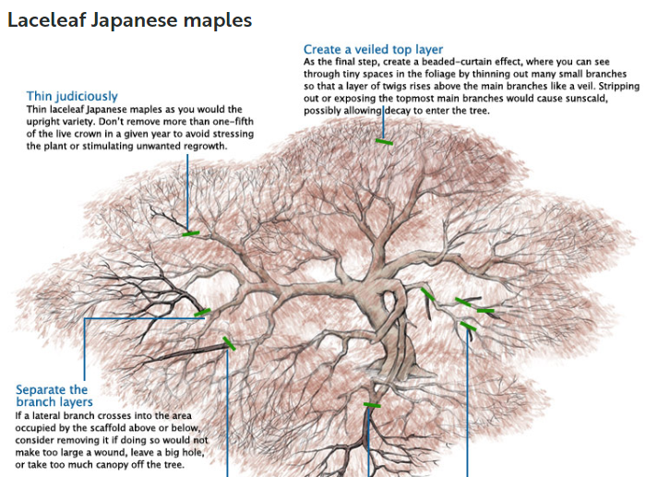

Pruning
Fine Gardening

Slide 41
Growing in containers
Full sized species are easily grown in tubs or large containers
Occasional directive shaping or pruning 1-2 times a year
Two requirements:
Planting mix must be open enough to allow good drainage & aeration (avoid waterlogged soil)
Faithful attention during growing season
Minimal fertilizer
Moderate watering
If very cold spell in winter wrap container in insulating material
Think twice about fat-bellied, globular, or small necked containers…when plant needs to be repotted in a couple years the only way to remove it is to break the pot

Slide 42
Which Japanese maple is right for your garden?
Zone: Most Japanese maples do well in zones 5 – 8.
They can be grown in higher zones, but can suffer from leaf scorch and require ample regular summer irrigation and protection from hot afternoon sun.
Local nurseries will have recommendations for varieties suited for our area.

Slide 43
Which Japanese maple is right for your garden?
Size and Form: Choosing the right one means knowing how you want to use it.
Japanese maples range from 2 to 30 feet tall in forms that can be weeping, rounded, dwarf, mounding, upright, or cascading.
Are you looking to create a grove of Japanese maples?
Maybe create a spotlight with a solitary specimen?
Do you want to fill a large container?
Or perhaps a taller Japanese maple as the main attraction?

Slide 44
Which Japanese maple is right for your garden?
Leaf Shape: Decide which type of foliage appeals to you.
Japanese maple foliage is primarily divided into two types: either palm-shaped (Acer palmatum), or delicate and lacy (Acer palmatum var. dissectum).
There are fans of both types, and the choice is often informed by the style of the garden or the surrounding structures.

Slide 45
Which Japanese maple is right for your garden?
Leaf Color: What color of foliage appeals most? With a range of foliage colors–red, green, orange, purple, white, and pink depending on the season–Japanese maples are among the most colorful of trees.
Some leaf out in brilliant reds in spring, change to green by summer, and finish the fall in yellows and oranges. Others start red and stay red till autumn. Do you want a sequence of changing color from spring to fall or do you just really love rich, dramatic red throughout the seasons?

Slide 46
Some of the most popular cultivars in our area
 | Height (ft) | Width (ft) | Description
Acer palmatum | 15-25 | 15-25 | This is a basic, un-grafted seedling form of a Japanese maple. It has broad green leaves and a mottled gray-green trunk. Fall color is yellow, orange and red.
Bloodgood | 15-18 | 15-18 | A perfect specimen of a red, upright Japanese maple with deep reddish purple foliage. Foliage retains deep color well into the summer Bright red fall color.
Crimson Queen | 9 | 9 | Beautiful weeping lace leaf type with striking burgundy foliage. Fall color is bright reddish purple.
Emperor One | 15-20 | 15-20 | An upright variety with bright red leaves. It’s comparable to Bloodgood, but grows slightly faster. Scarlet fall color.
Inaba Shidare | 8-10 | 4-6 | An elegant lace leaf specimen with unusually large leaves. Holds its deep reddish burgundy color through the summer. Crimson fall color.
Red Dragon | 4-6 | 3-4 | A dwarf form of weeping Japanese Maple with beautiful red lace like leaves. Does well in containers. Bright red fall color.
Sango Kaku | 20-25 | 18-20 | This beautiful maple has year round interest. Leaves emerge bright green in the spring, and turn yellow in the fall. Bright red bark is visible in the winter.
Seiryu | 10-12 | 10-12 | An unusual upright variety with delicate lace like leaves. Bright green leaves turn orange and gold in the fall.
Viridis | 4-6 | 8-12 | A beautiful example of weeping green lace leaf. Leaves emerge yellow green and have a showy yellow gold fall color.

Slide 47
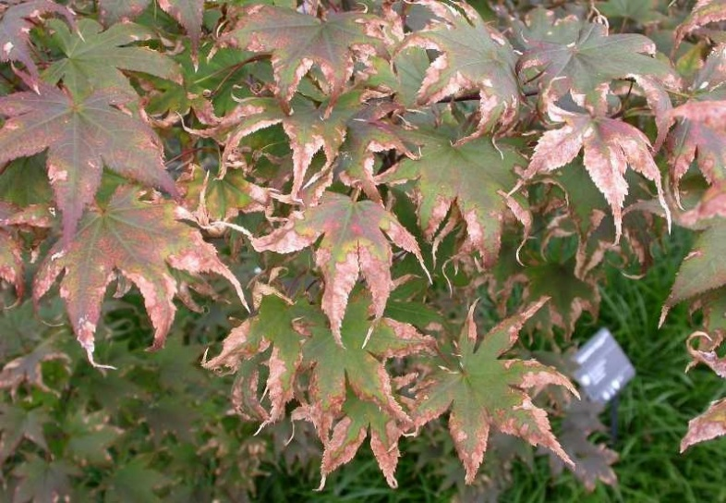
Common problem: Sunburned leaves
Japanese maples are sensitive to heat, strong sunlight, and low humidity
A ‘Sun tolerant” variety means more tolerant than other varieties
Causes:
Too much sun
Insufficient water
Immature root system
Solutions:
Plant in right location
Plant in either fall or early spring
If tree is already planted in full afternoon sun, expect crinkly leaves for several years until the tree has developed adequate root growth and pay attention to watering practices
Water deep enough to keep soil slightly moist & deep enough to roots are encouraged to grow deeply….don’t overwater (overwatering is the leading cause of Japanese maple death

Slide 48
Resources
Local nurseries
Eisley’s Nursery - Auburn
Lakes Nursery – Newcastle (largest selection of Japanese maples in northern Calif)…winter hours vary so call first
High Hand – Loomis
Green Acres – Rocklin
Wholesale Nurseries’ websites
Iseli (Oregon) – iselinursery.com
Don Schmidt Nursery (Oregon) – donschmidtnursery.com
Munn’s Nursery (Oregon) – munnsnursery.com
Monrovia – Monrovia.com
Mendocino Maples Nursery - mendocinomaples.com

Slide 49
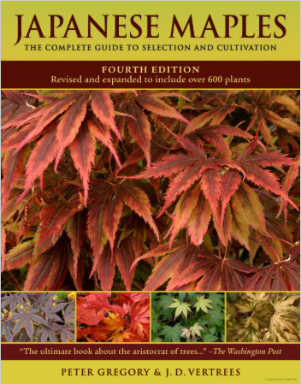
References
4th edition, 2009
In 1997 it was selected by the American Horticultural Society as one of the 75 Great American Garden Books

Slide 50
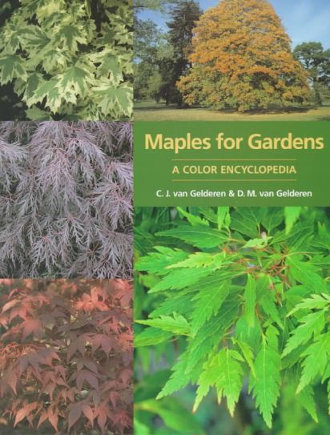
References
1999

Slide 51
Thank You!
Any Questions?
Master Gardener Hotline: (530) 889-7388
Master Gardener Website: pcmg.ucanr.org
Evaluations, please!
Kelly Warman

