Slide 1
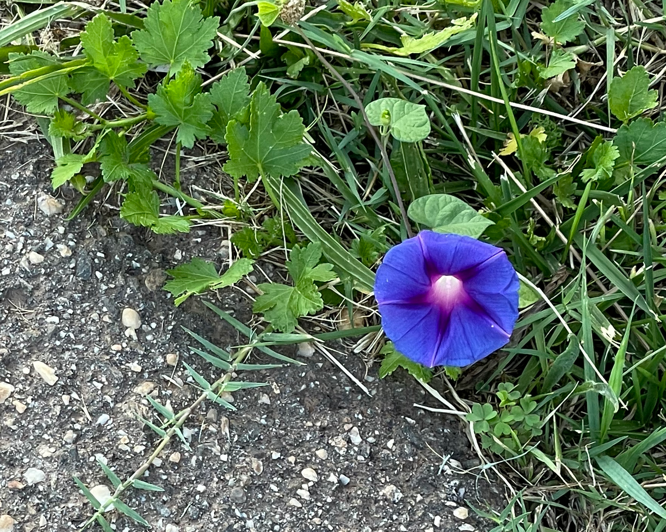
Wild Wanderers
Notes:
Created: 7/2021
Created by: Peggy Beltramo
Audience: Placer County Home Gardeners
Publicity: Watch out for plants that have a mind of their own about where they want to be—Thugs, Multipliers and Invasives. Warning: Don’t plant a pest!
Update History:
Photo: morning glory. Planted 8+ years ago. Still reseeding into beds—and roadside!

Slide 2
Who Are Master Gardeners?
Master Gardeners of Placer County
  Extend research-based, sustainable gardening and composting information
  Present accurate, impartial information to home gardeners
  Encourage public to make informed gardening decisions

Slide 3
Who Are Master Gardeners?
Where to find us…
Online, in the Media, and Special Publications
  Hotline: Call (530) 889-7388 or submit your questions online
  Website: pcmg.ucanr.org
  Facebook, Twitter, Instagram
  Gold Country Media monthly column
  Curious Gardener quarterly newsletter on our website
  Gardening Guide and Calendar

Slide 4
Who Are Master Gardeners?
Where to find us…
Workshops, Fairs and Festivals, and Special Events
  Speakers by Request
  Workshops (various venues, check website)
  Farmers’ Markets (seasonal: Auburn, Roseville)
  Fairs and Festivals Booths (varies)
  Garden Faire (April)
  Mother’s Day Garden Tour (May)

Slide 5
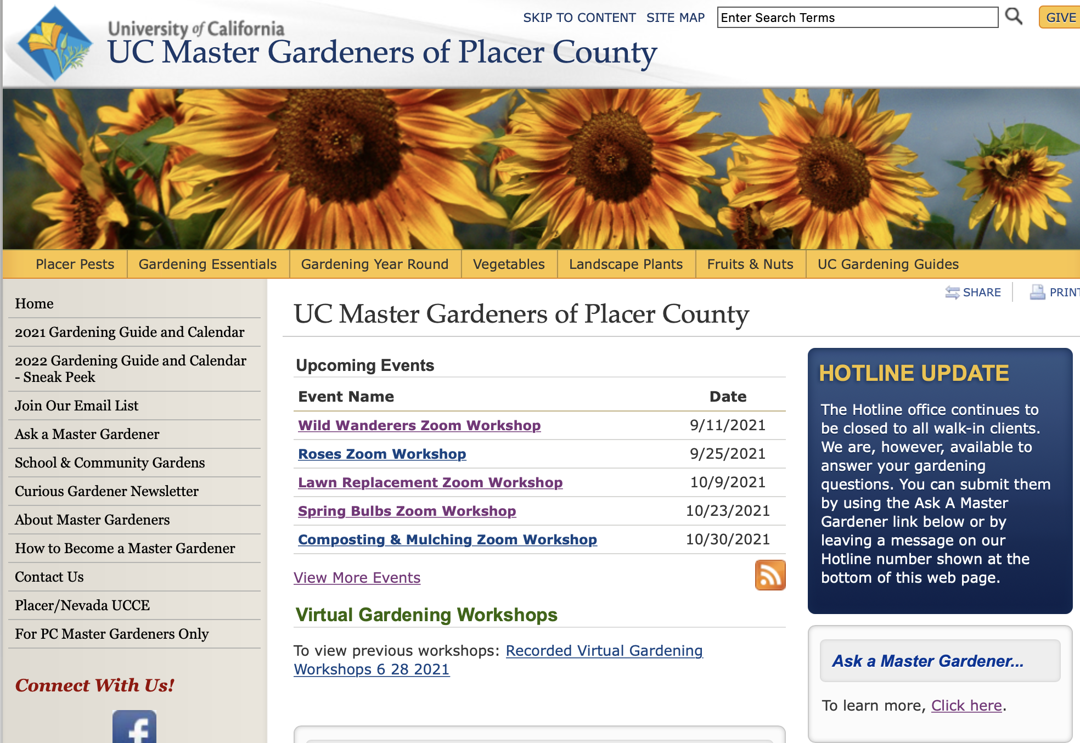
WEBSITE: pcmg.ucanr.org
Notes:
RED ARROW = banner. All are drop down menus with LOADS more information
BLUE ARROWS= upcoming and already recorded workshops. Wild Wanderers will be available in a day or two with handouts attached.
GREEN ARROWS = Ask a Question links—email or phone options.
YELLOW ARROW = Sign up for our quarterly newsletter.

Slide 6

WEBSITE: pcmg.ucanr.org
Notes:
YELLOW ARROW=2022 Gardening Guide and Calendar ccame out Sept. 7! Get it while it is hot!!
RED ARROW=Planting Guide is a free download. Find out when to start/transplant your veggies. Just because it is in the nursery, doesn’t mean it is the right temperature in your garden.

Slide 7
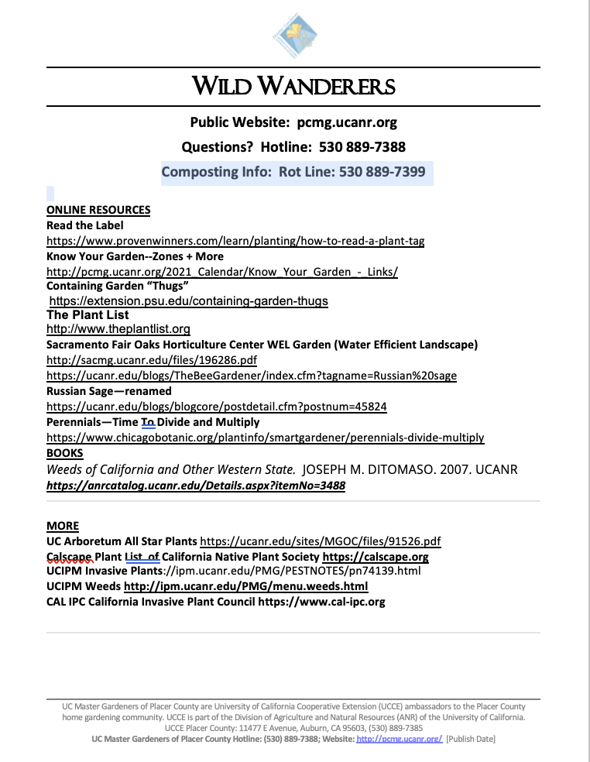
Your Handout
Notes:
Handouts available on You Tube with Zoom upload. In a couple of days…
Links are listd on thre handout, so you can relax and have the information after the presentation,

Slide 8
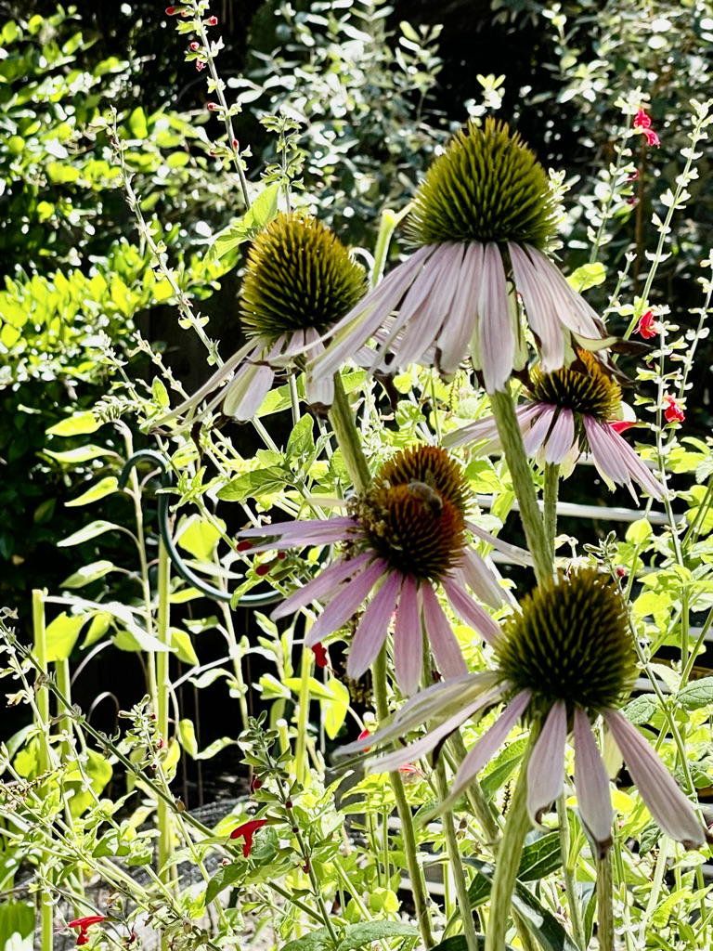
Agenda
“It Depends”
Read the Label
Plan for Trouble
Contain
Deadhead
Divide and Multiply
Weeds
Don’t Plant a Pest—Avoid Invasive Plants

Slide 9
“It Depends”
Learn about your new plant
Water needs
Light
Soil
Work involved--weeding, pruning, etc.
Annual vs. Perennial
Notes:
“It Depends”—the first thing Master Gardener Trainees learn!
Where you live. Zone info.(on handout) http://pcmg.ucanr.org/2021_Calendar/Know_Your_Garden_-_Links/
Water, Light, Soil, Willingness to Work (weed, prune, etc.)
Perennials are the darlings of many gardens. Unlike annuals that grow, flower, produce seeds, and die with the fall frost (including marigolds, zinnias, and cosmos), perennials typically return year after year.
https://www.chicagobotanic.org/plantinfo/smartgardener/perennials-divide-multiply

Slide 10
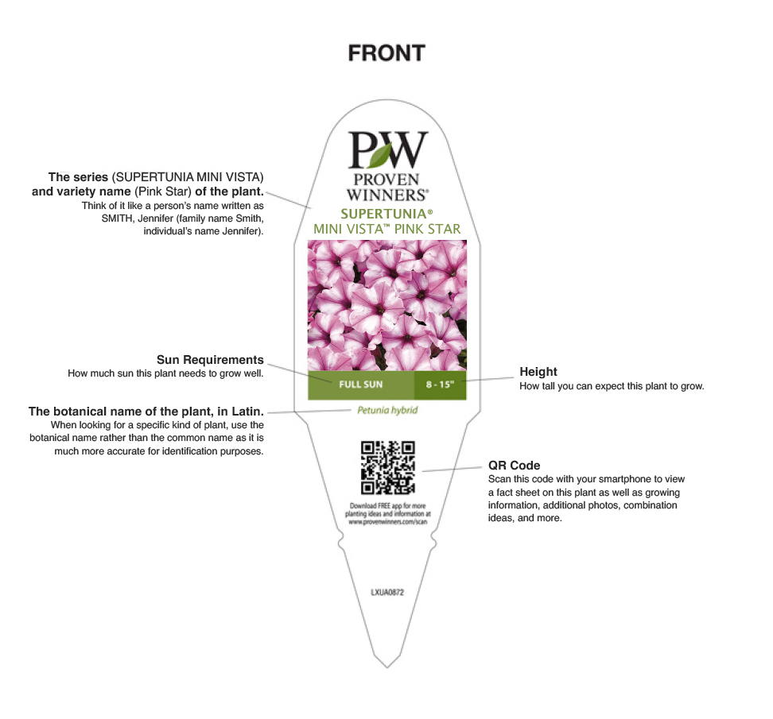
Read the Label
NAME
(including botanical name!)
Notes:
https://www.provenwinners.com/learn/planting/how-to-read-a-plant-tag
Botanical name—genus, specific epithet = species. Dwarf, low growing or TALL variety
When a plant whispers to you at the nursery, do you do your homework BEFORE you adopt it???
QR Code

Slide 11
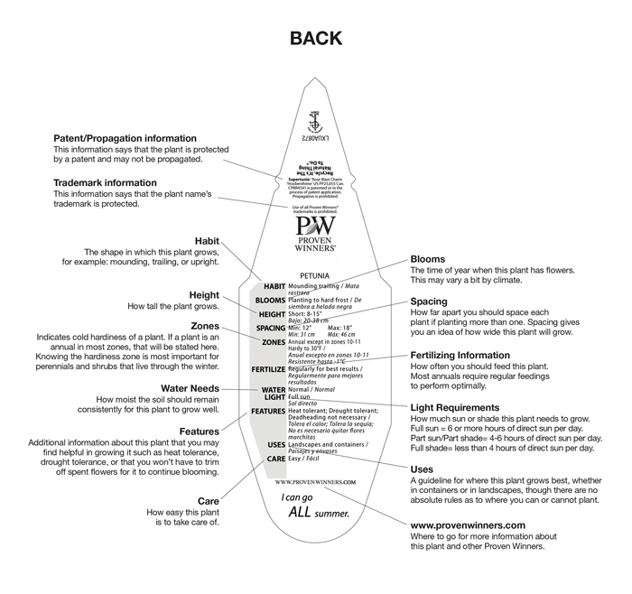
Read the Label
Many labels do not
include this much information.
Notes:
https://www.provenwinners.com/learn/planting/how-to-read-a-plant-tag

Slide 12
“It Depends”
Polite Plants
Self Seeders
Thugs (Aggressive Plants)
Multipliers
Weeds
Invasives
Notes:
Types of plants we will examine,..

Slide 13
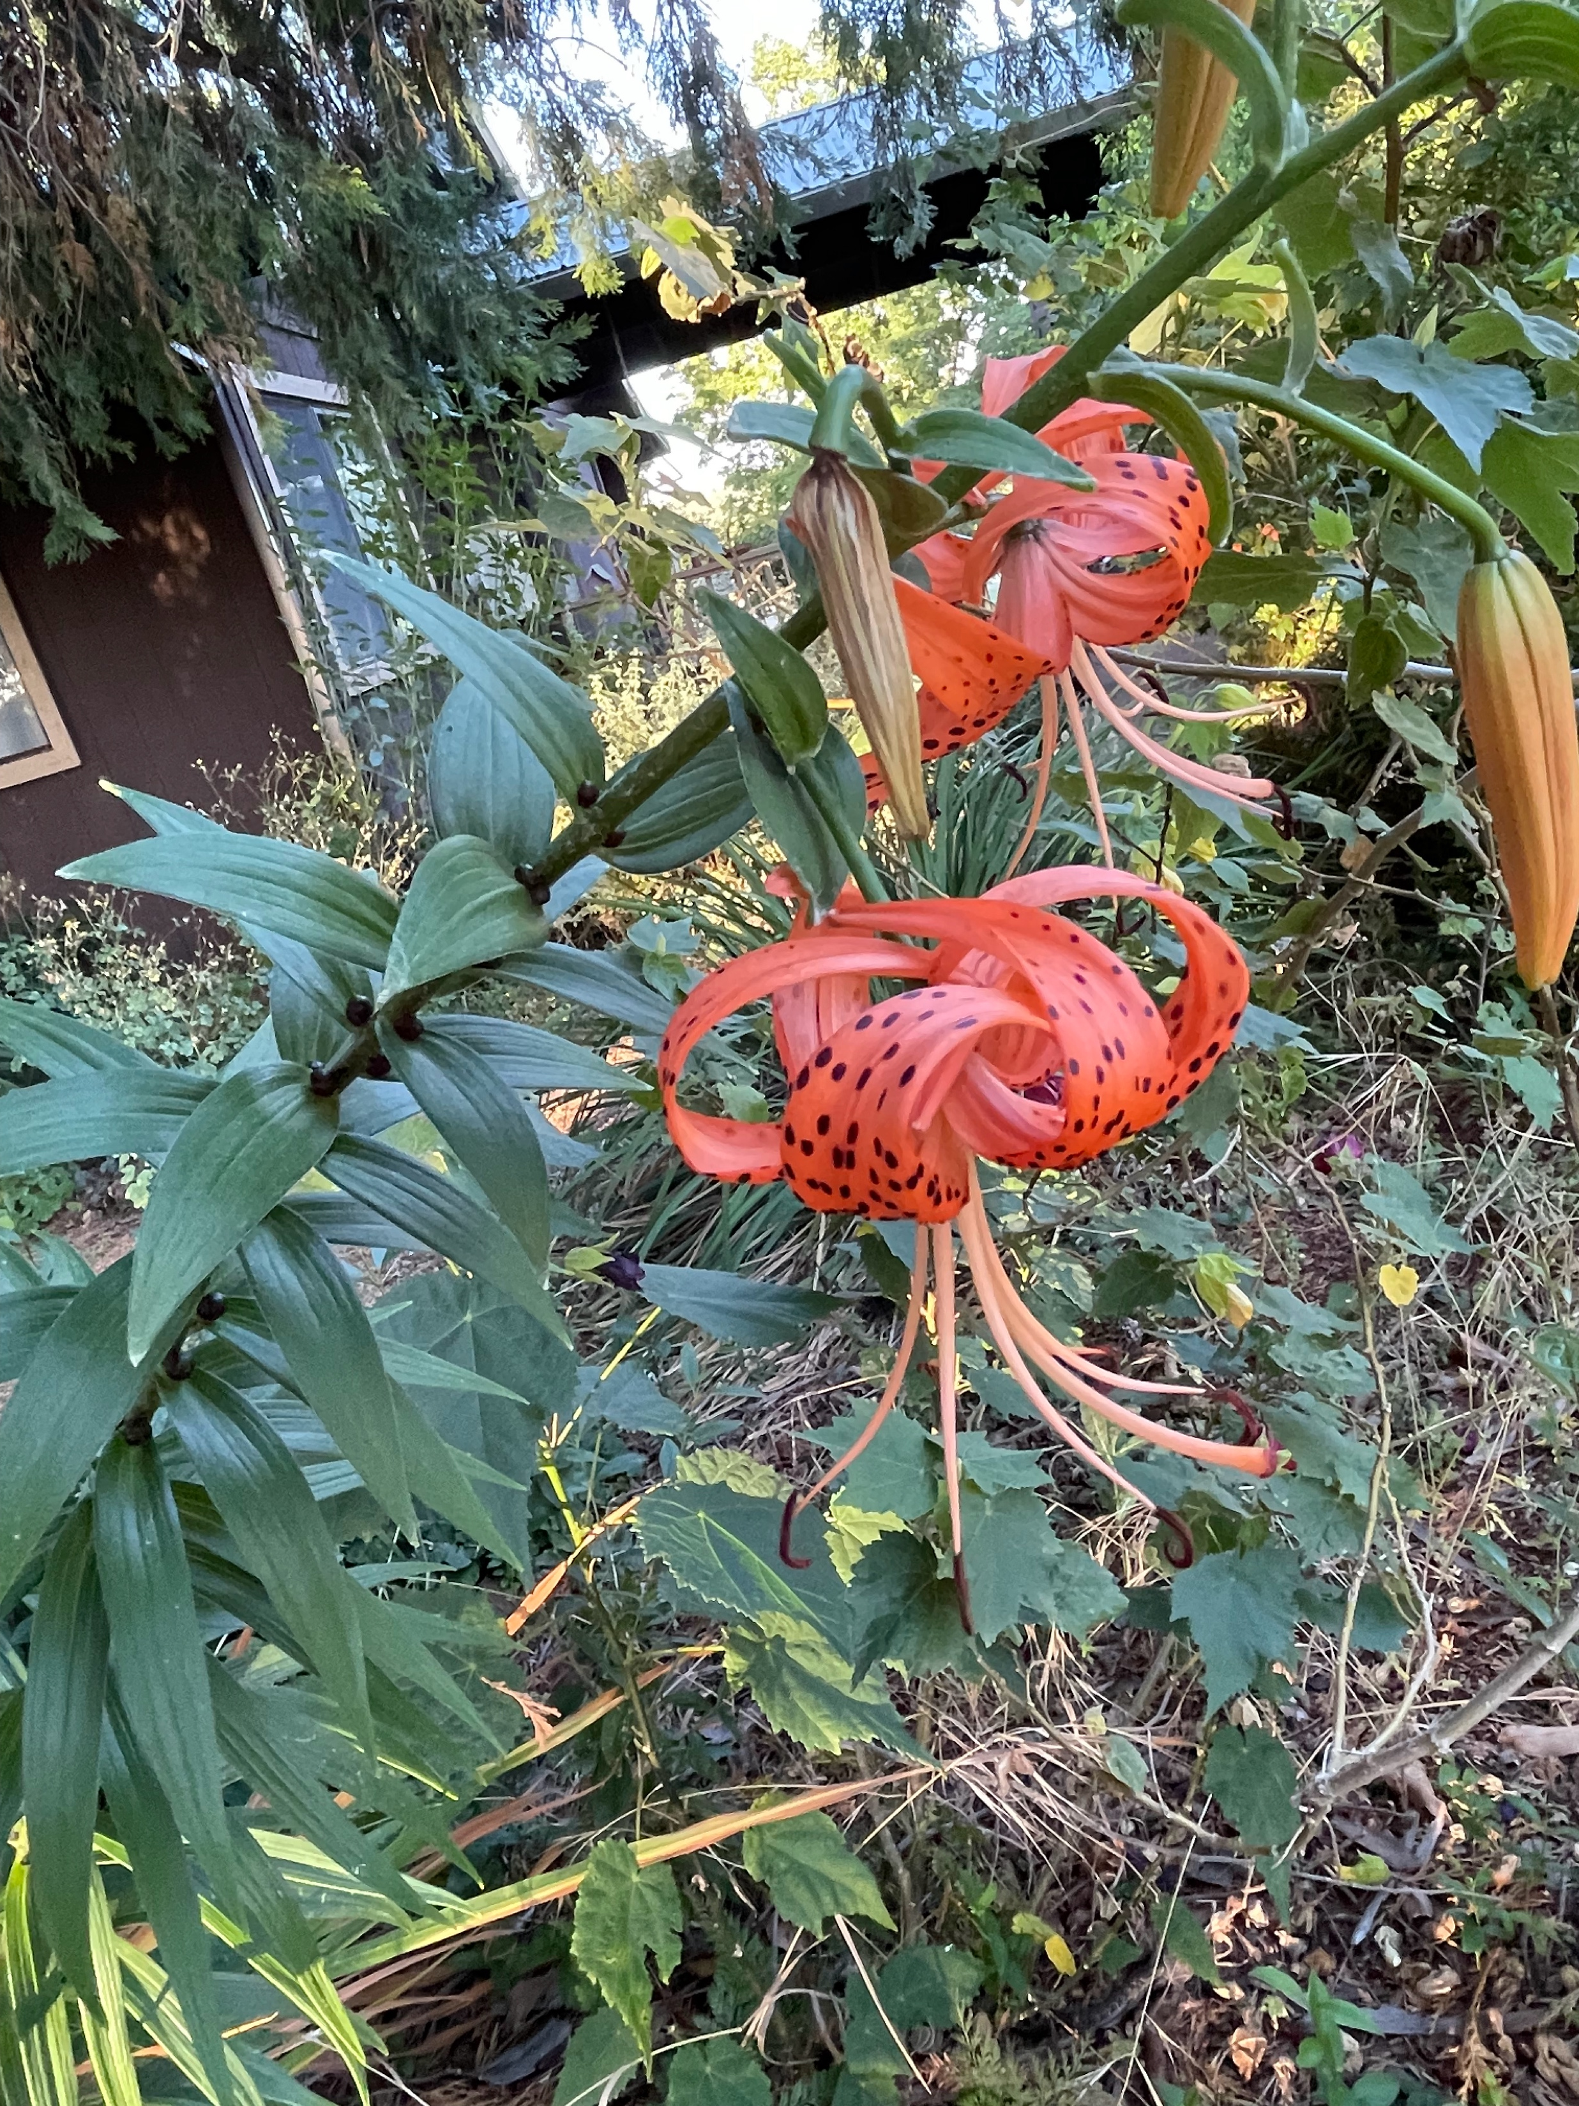
Polite Plants
Grow where they are planted
Do not push neighbors
No surprises
Gently reseed
Easy to remove extras
????
Oriental lily
Notes:
No problems. Stay where they are planted. Perform as advertised. Check the advertising—size vs. space available; etc. Be sure to note mature size. Gently reseed. Easy to remove extras

Slide 14
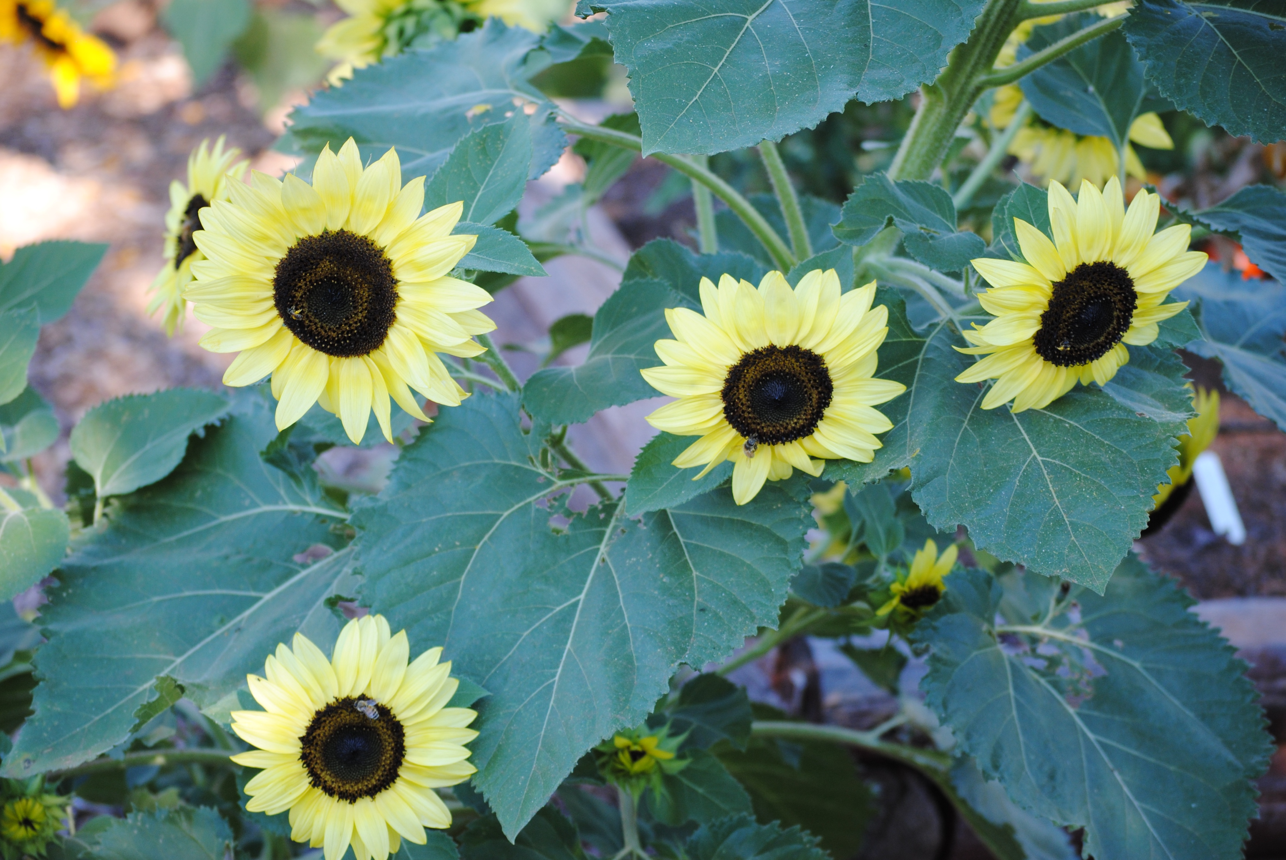
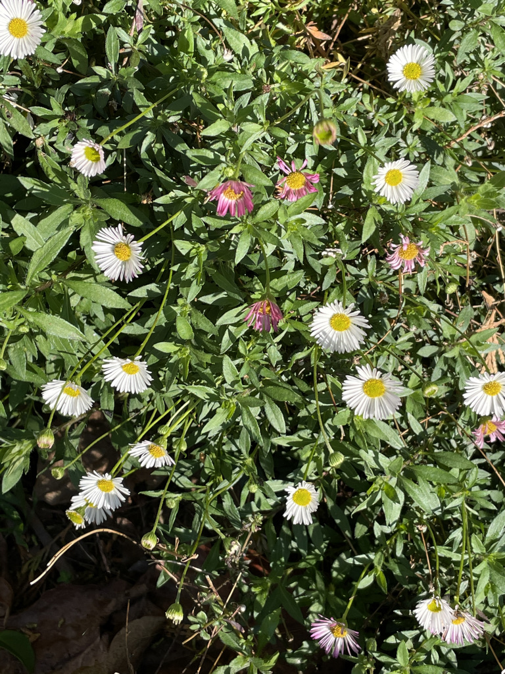
Self Seeders
Annuals that reseed
Perennials that drop seed nearby
BUT…Some seeders are thugs!
Sunflower
Santa Barbara Daisy
Notes:
Self seeding plants run the gamut from gently/few seeds (CA poppy in picture)to gazillions! (See the next page. Be forewarned)

Slide 15
Plant Pledge
If I see a plant that I’m curious about,
I will ask these questions:
Is this plant a vigorous spreader or aggressive? If so, is it easy to weed out?
Does this plant spread by underground runners?
Is this plant invasive? NO! NO! NO!
Is there a safe plant that is better?
Notes:
https://www.chicagobotanic.org/plantinfo/faq/aggressive_and_invasive_plants

Slide 16
Aggressive Plants
Spread faster than desired
Move into unwanted garden spaces
May be aggressive in one area and not another (e.g. sun vs. shade)
Learn how to contain their enthusiasm!
Notes:
https://www.chicagobotanic.org/plantinfo/faq/aggressive_and_invasive_plants

Slide 17
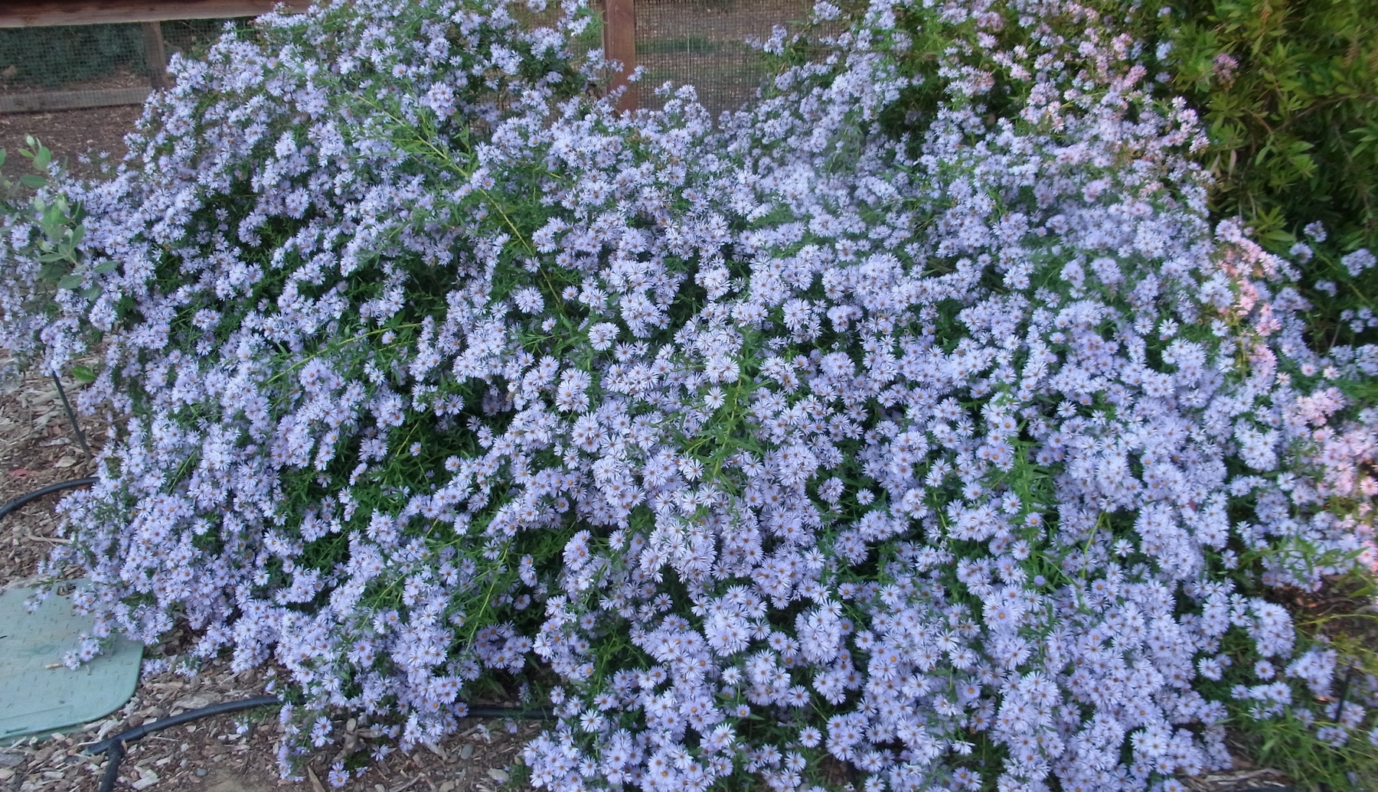
Size Matters!
Aster ‘Bill’s Big Blue’
Notes:
Aster 'Bill's Big Blue': Symphyotrichum 'Bill's Big Blue'. Give Bill some room! This selection can reach 5 to 6 feet in height and width. It will bloom through November. We divide Bill yearly. --Honeybee Haven
This vigorous aster is from the late Bay Area nurseryman Ed Carman. Sturdy, erect stems 4 ft. or more tall, clothed in narrow deep green leaves. Flowers profusely, late in the season with medium blue daisies. This beauty can really spread, forming broad clumps. Can be invasive. A wonderful late nectar source for bees and butterflies.
https://www.calfloranursery.com/plants/aster-bills-big-blue
Size now = more than 20’ x 20’!

Slide 18
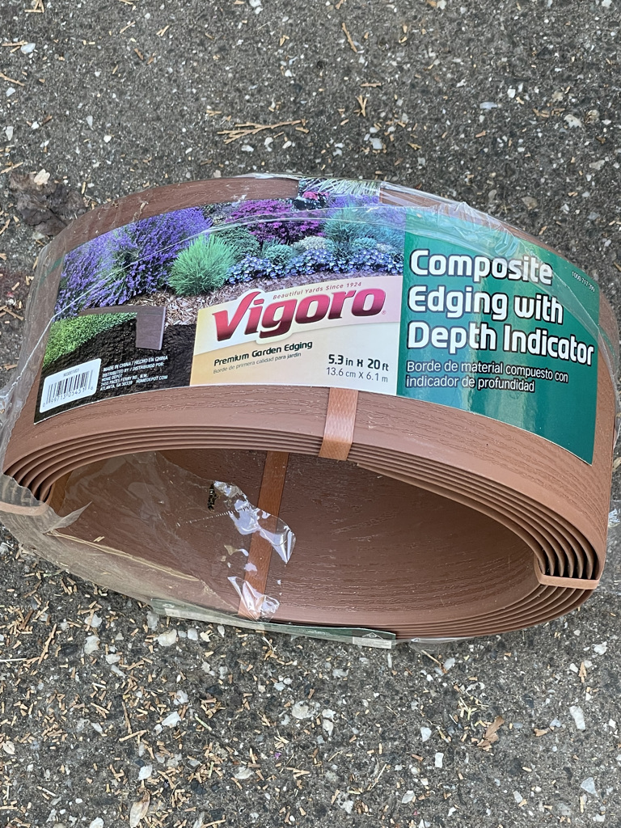
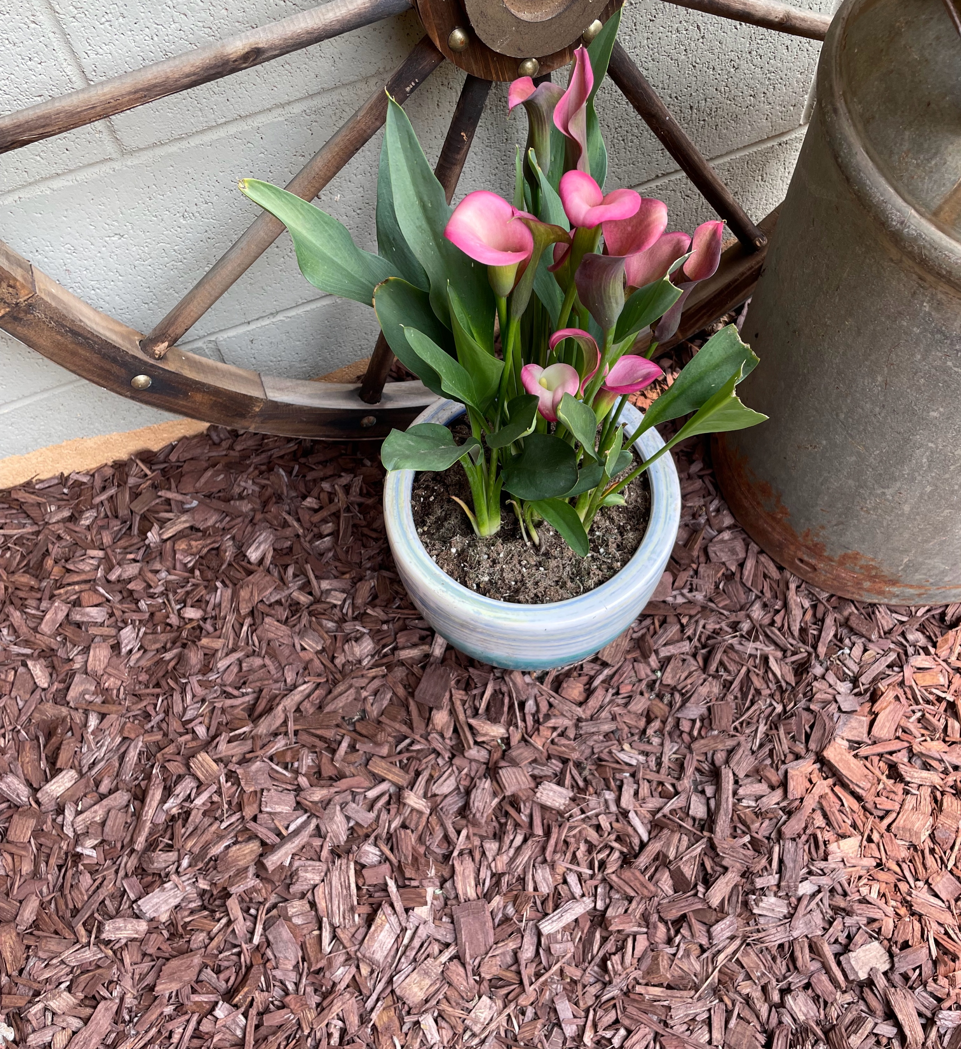
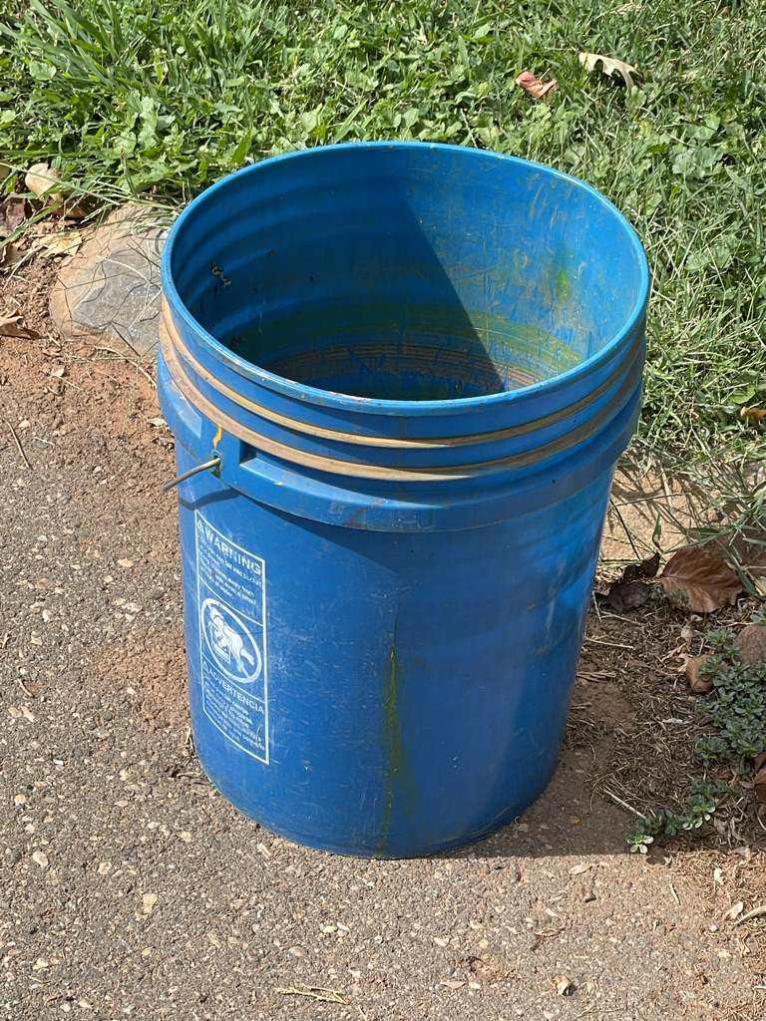
Contain Naughty Plants
Hardscape barriers (walls & walkways)
Pots
Plastic edging
Homemade corrals
A word about bamboo
Notes:
Plant near walkways, walls or other hardscape features..
Use plastic barrier material to corral plants. Make a corral from a large pot with the bottom removed, if it is deep enough to contain the roots (bamboo, for example!)
Plant in pots—warning!! Mint will invade through the bottom hole of the pot, if it is on soil. Place on a paver!!!
Bamboo--
The standard is 30-36" deep plastic 60-80 mil in thickness, leaving some above ground to prevent rhizomes from going over the top. I used to recommend 36" with 6" of the 35" above ground. A large running bamboo can send runners/rhizomes up to 20' away in one season so if someone is battling bamboo from a neighbor's property, the plastic will have to extend a long way past the mother plant. And clumping bamboos do NOT send out crazy runners but they do need to be placed carefully because the root/rhizome mass is quite large (just like any other big plant). The American Bamboo Society is a good, reliable source of information for all things bamboo. https://www.bamboo.org/bamboo-planting-and-care/

Slide 19
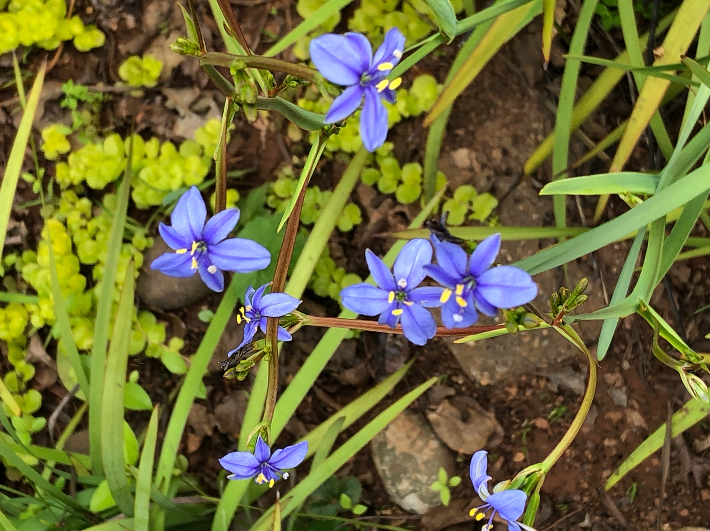
Nice, until it’s not!
Aristea ecklonii
Notes:
Beautiful flowers. Lived politely, until it wasn’t. At least 3 or 4 years with no noticed problem—then BANG!

Slide 20
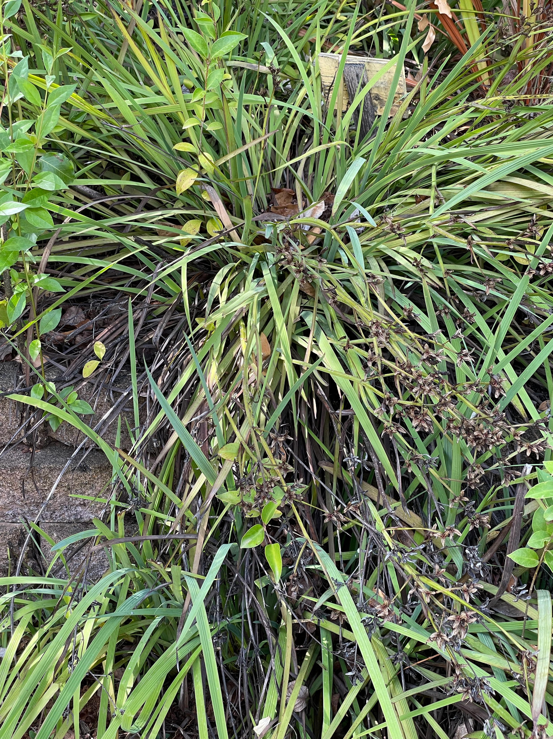
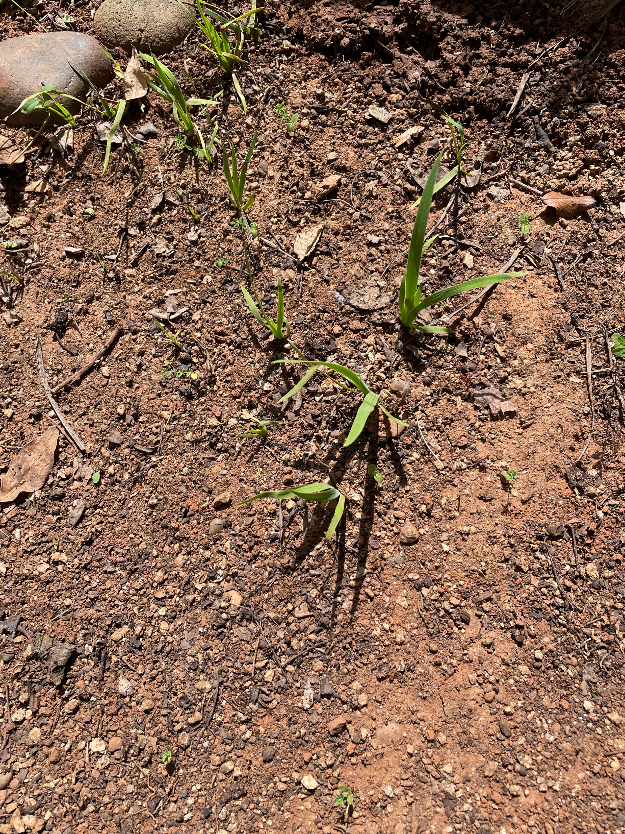
Plan for Trouble
Restrain the Thugs
Contain or deadhead?
Notes:
Lovely along pathways and beside water features. A natural for our Pacific Coast weather! Hardy to 20 degrees. Reseeds!
Restrain? Know your Enemy—deadhead!!!

Slide 21
Know Your Relatives
Lamiaceae = Mint famiy (Square stem)
Aromatic herbs for cooking--Economic Importance
Mentha, mint, Ocimum, basil, Origanum, oregano, Rosmarinus, rosemary, Salvia, sage, Thymus, thyme
Ornamentals:
WEL Garden List
Weedy and pest species:
Lamium, dead-nettle
Prunella, self-heal
Notes:
Species of Lamiaceae contained within The Plant List belong to 250 plant genera
The Plant List. http://www.theplantlist.org
Mint Family Plants Sacramento Fair Oaks Horticulture Center WEL Garden (Water Efficient Landscape)
http://sacmg.ucanr.edu/files/196286.pdf

Slide 22
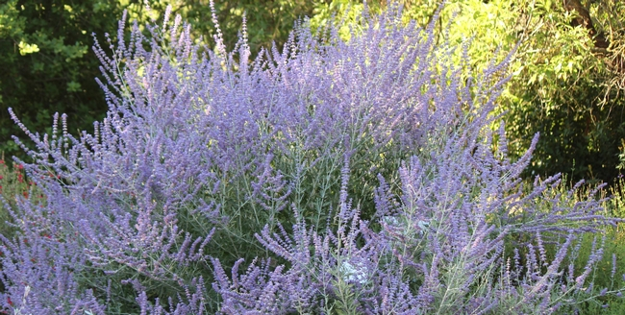
Know Your Relatives
Salvia yangii (Russian sage)
Newly named
Formerly Perovskia atriplicifolia
Notes:
https://ucanr.edu/blogs/blogcore/postdetail.cfm?postnum=45824

Slide 23
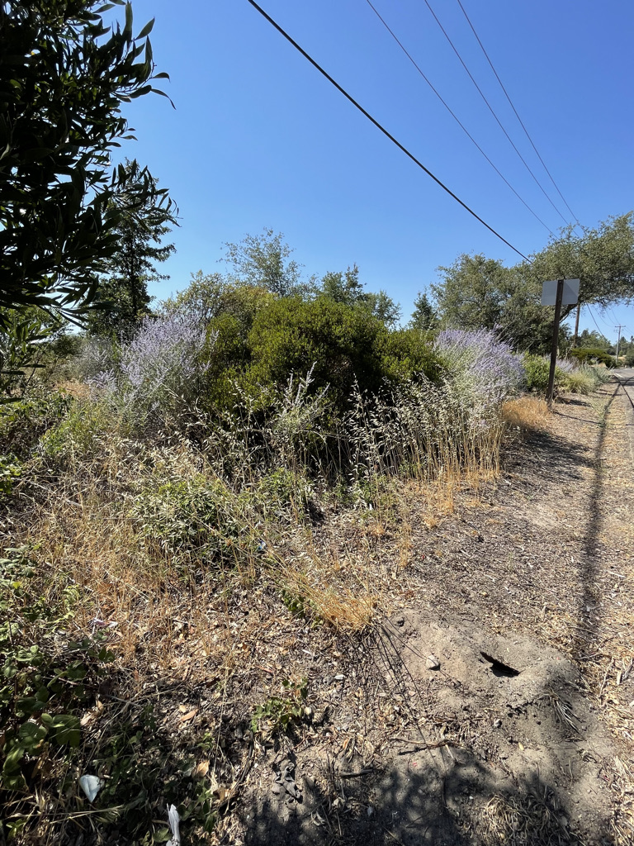
Is it a Pest?
Original planting
Seeded Plants
Notes:
Roadside along Auburn-Folsom Rd., Roseville.
a bit of a rampant spreader by underground rhizomes after a few years. It grows 3-5 ft. tall, spreads fairly fast and becomes robust with more rather than less irrigation.

Slide 24
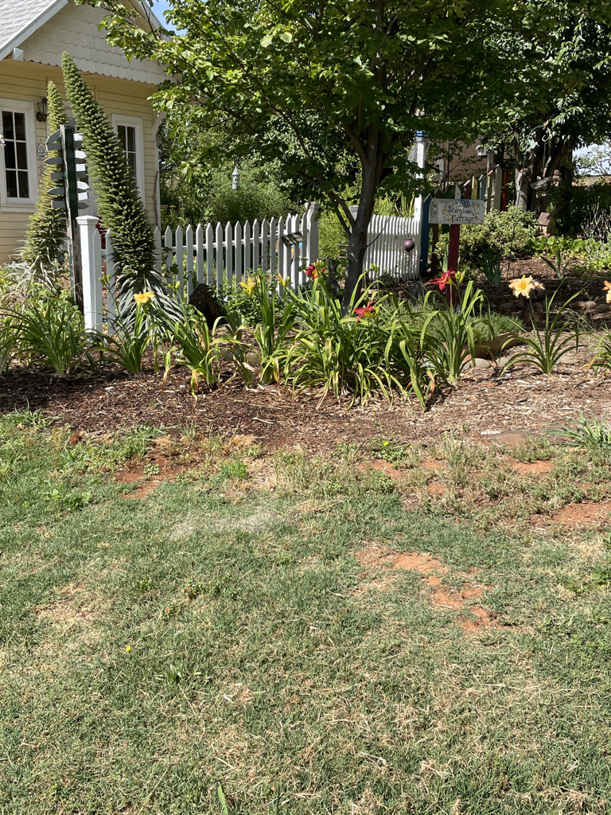
Divide and Multiply
In fall, it’s time to :
Divide and replant irises as well as other rhizomes, bulbs, corms and perennials.
Dig up and divide daylilies as they complete their bloom cycle.
Notes:
Perennials—Time To Divide and Multiply. https://www.chicagobotanic.org/plantinfo/smartgardener/perennials-divide-multiply
Bulbs, corms and tubers

Slide 25
Aggressive Thugs
Rhizomes (swollen underground stems)
Stolons (above-ground runners)
If they are described as “vigorous”
OR
Your neighbor has some to share—EVERY YEAR!
Watch out!!!
Notes:
Rhizomes (swollen underground stems) or stolons (above-ground runners)
vigorous. (Or when a fellow gardener has a lot of it to give away - every year.
https://www.thespruce.com/how-to-deal-with-plant-thugs-1403542
Plants that reach out and root at nodes are also risky
https://ucanr.edu/blogs/blogcore/postdetail.cfm?postnum=43789.

Slide 26
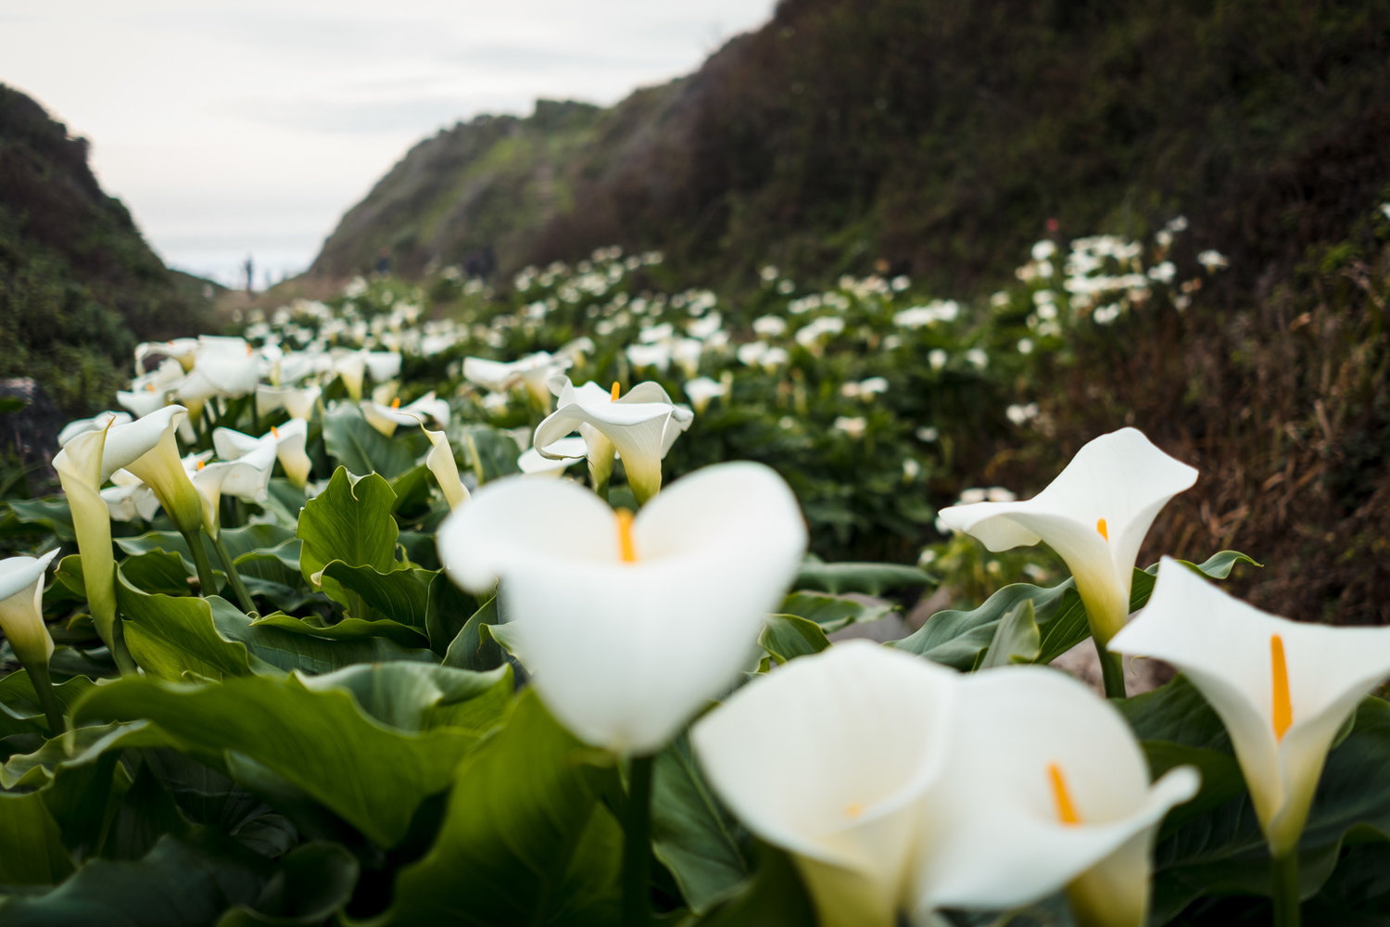
Calla Lily Valley, Big Sur
Notes:
LOOK WHAT CAN HAPPEN!
Calla Lily Valley, Garrapata State Park near Big Sur
https://montereyfarmgirl.com/?s=calla+lily

Slide 27
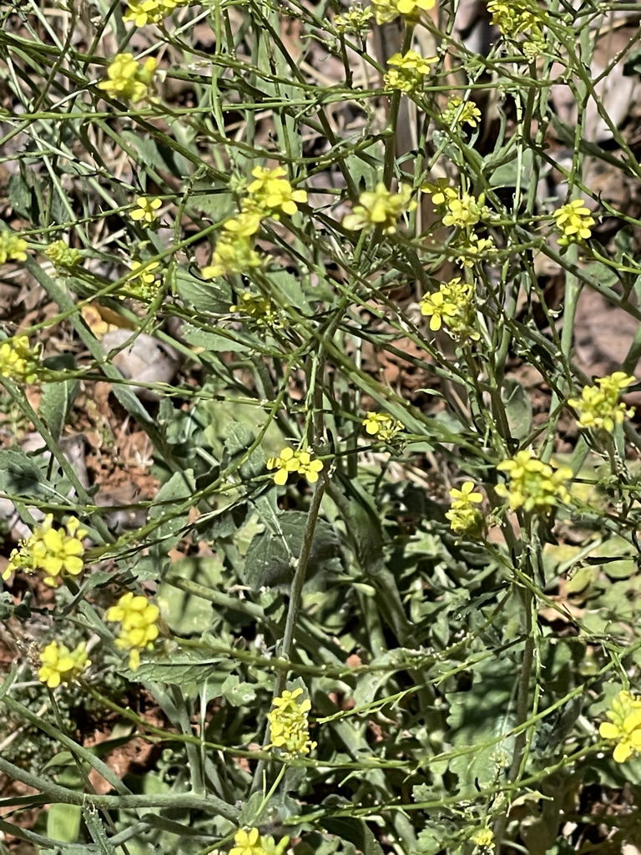
***What is a Weed?
a plant out of place and not intentionally sown
a plant growing where it is not wanted
a plant whose virtues have not yet been discovered.
(R.W.Emerson)
plants that are competitive, persistent, pernicious, and interfere negatively with human activity (Ross, et. al.)
Notes:
https://extension.psu.edu/introduce
https://ucanr.edu/blogs/blogcore/postdetail.cfm?postnum=24237tion-to-weeds-what-are-weeds-and-why-do-we-care
HISTORY OF WEEDS
https://ucanr.edu/blogs/blogcore/postdetail.cfm?postnum=17593

Slide 28
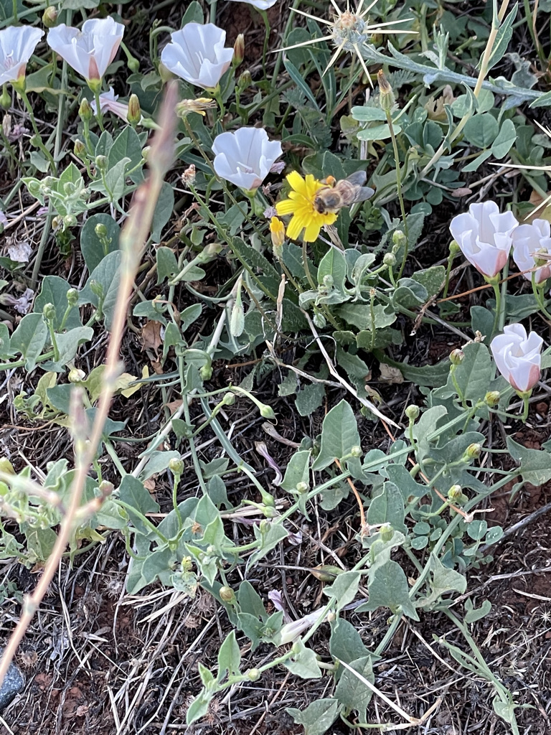
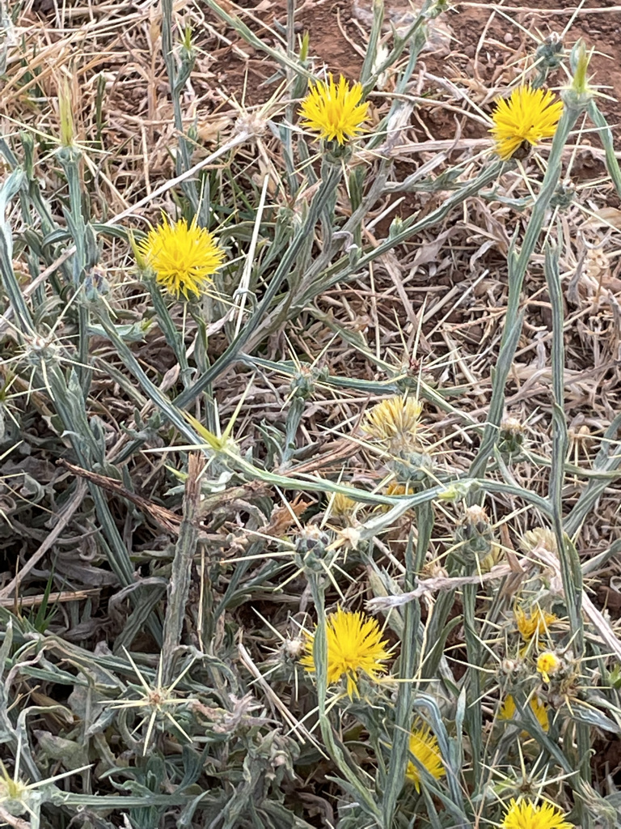
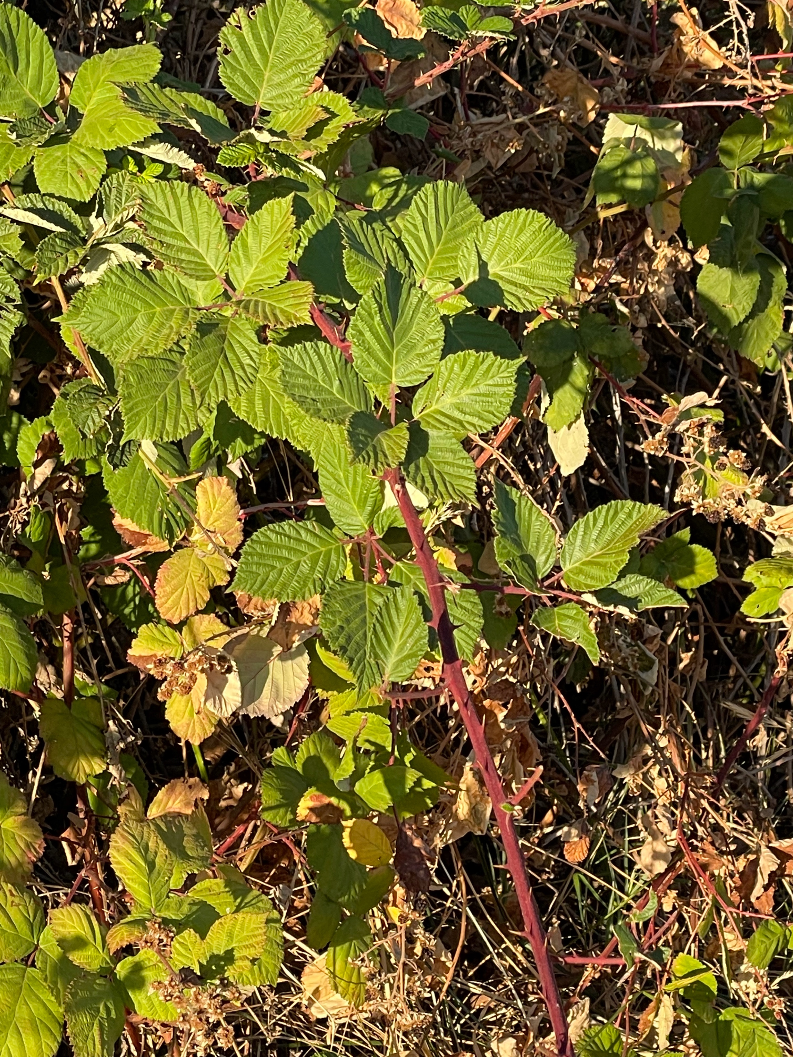
Weeds
Field bind weed
Star Thistle
Himalayan blackberry

Slide 29
Garden Escapees
“Naturalized” vs. invasive
Naturalized refers to:
naturally reproducing,
non-native plants
BUT do not invade areas dominated
by native vegetation.
Notes:
Many of our favorite garden plants came from somewhere else, but do not misbehave.

Slide 30
Invasive Plants
What is an invasive plant?
An invasive plant is a plant that is not native to the ecosystem under consideration, and whose introduction is likely to cause economic or environmental harm, or harm to human health.
---Plantright.org
Notes:
https://plantright.org
What's the problem?
Invasive plants harm California’s environment and economy in many ways. They can overtake crops or rangeland; harm wildlife by eliminating plants they need for food and shelter; clog waterways used for commerce or recreation; and increase fire hazards and flood risk.
What's the alternative?
There is no shortage of superior alternatives. The vast majority of garden plants are well behaved and will never become an invasive problem. Our plant list includes several suggested alternatives for each invasive plant.

Slide 31
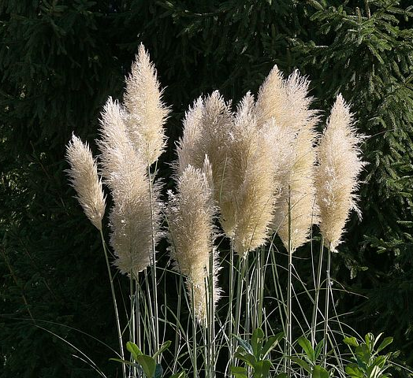
Invasive Plants
more adaptable to climate changes, facilitating naturalization and invasion
Invade natural areas, outcompeting native plants,
Actually alter growing conditions.
pampas grass
plantright.org
Notes:
Invasives are more adaptable
Aggressive vs. invasive. Thugs in your garden are aggressive plants.
Invasive plants invade natural areas, altering growing conditions ad supplanting native species.
)http://marinmg.ucanr.edu/PLANTS/PLANTS_TO_AVOID/)
There is growing concern that changing climate conditions will amplify the negative impacts of non-native invasive species and facilitate their expansion.
https://earthlab.uw.edu/2020/04/new-nw-casc-synthesis-explores-the-effects-of-climate-change-on-invasive-species-in-the-northwest/

Slide 32
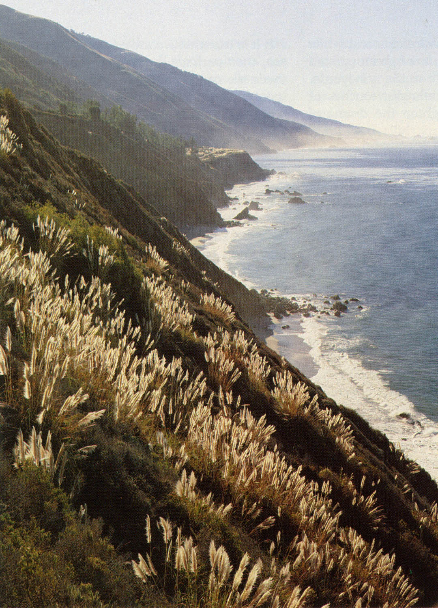
Pampas Grass
Big Sur coast
Los Padres National Forest
Photograph by Larry Ulrich
Notes:
Plantright organization. PPT. https://ucanr.edu/sites/master_gardener/files/53787.pdf

Slide 33
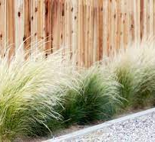
Invasive Plants
37% accidentally introduced
(by contamination)
Other 63%, intentionally introduced
Almost 80% came through the nursery industry as ornamental landscape species.
29 of these plants are listed on the California Department of Food and Agriculture noxious weed list,
Mexican feathergrass
Notes:
CAL IPC
In California, approximately 3% of the plant species growing in the wild are considered invasive, but they inhabit a much greater proportion of the landscape
37% contamination 63% intentionally added to landscapes, forage, food,etc.
80% of intentional introductions – ornamentals
Mexican Feathergrass
Working to Stop Distribution
PlantRight works with leaders in the nursery industry, conservation groups, plant scientists and professional landscapers to find cost-effective ways to stop the sale of invasive plants and Mexican feather grass is at the top of their list. PlantRight is currently working with one of the top growers of Mexican feather grass to stop the sale of 14,000 plants that are ready to ship to retailers. These 14,000 plants are capable of producing more than 980 million seeds each year.
PlantRight Recommended Alternatives:
Blue grama grass (Bouteloua gracilis 'Blonde Ambition')
Priarie dropseed (Sporobolus airoides)
Mexican deer grass (Muhlenbergia dubia)
Pink Muhly (Muhlenbergia capillaris, esp. 'White Cloud')
Autumn moor grass (Sesleria autumnalis)
UCIPM Pest Notes Invasive Plants
http://ipm.ucanr.edu/PMG/PESTNOTES/pn74139.html

Slide 34

Invasive Plants
At PlantRight our goal is to stop invasive plants before they have a chance to spread.
Identify
Locate
Educate
Collaborate
Notes:
Identify, Locate, Educate, Collaborate

Slide 35
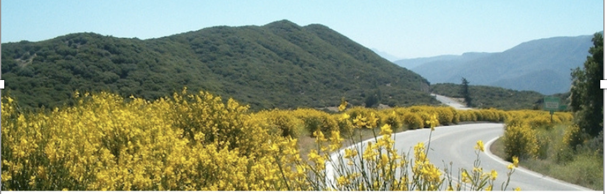
Invasive Plants
THE LIST
From our original invasive plant list of 19 species, just seven are still commonly available for retail sale in California.
Scotch broom
Notes:
https://plantright.org/about-invasive-plants/plant-list/

Slide 36
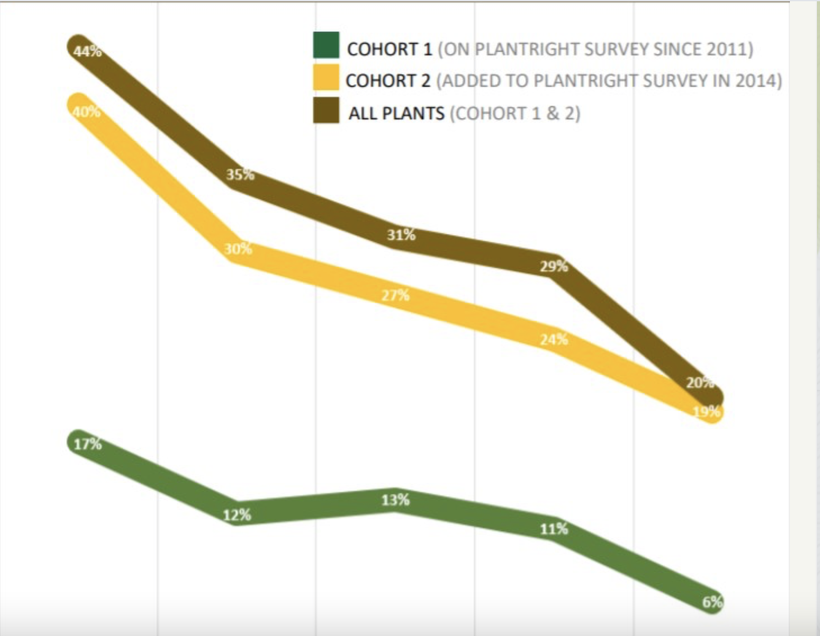
2021 PlantRight Survey Results
Big Box stores to ZERO %
2014 New plants added—still dropping, especially Mexican feathergrass
Original 4 plants—down to 6%
Notes:
Quick Results: Overall, invasive plants on PlantRight’s original list decreased to 6% of stores.
The percent of stores selling plants added to the invasive list in 2014 continued to decrease, driven by a continued drop in the sale of Mexican feathergrass (Stipa/Nassella tenuissima).
The sale of invasive plants at big-box stores continued to decline, dropping from 3% in 2016 to 0% this year. This continues the decline of sales at big-box stores that began in 2015 when Home Depot in California joined as a Retail Nursery Partner. Lowe's in California joined the partnership program in 2016.

Slide 37
Invasive Plants
Notes:
Identify, Locate, Educate, Collaborate

Slide 38
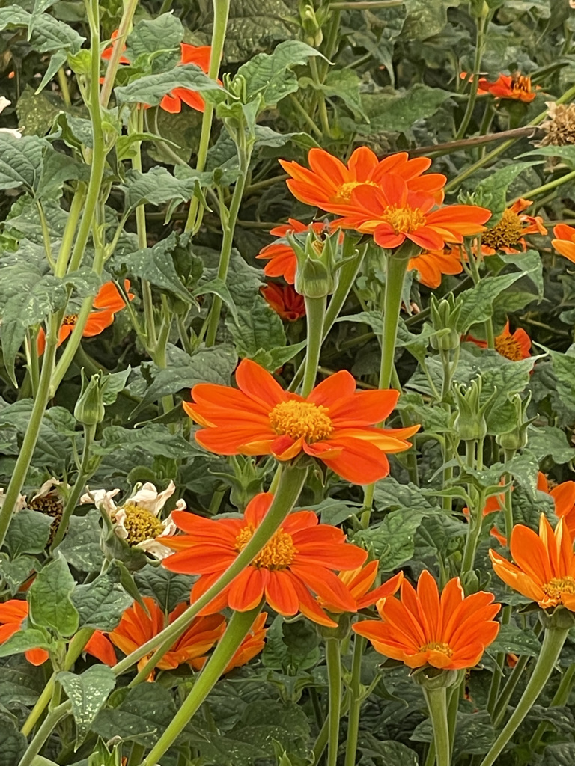
Let’s Recap
“It Depends”
Read the Label
Plan for Trouble
Contain
Deadhead
Divide and Multiply
Weeds
Don’t Plant a Pest—Avoid Invasive Plants
Tithonia rotundifolia
Notes:
Plan—monitor—be vigilant
Tithonia rotundifoloa Annual—great pollinator plant—60+ pollinators observed utilizing it.

Slide 39
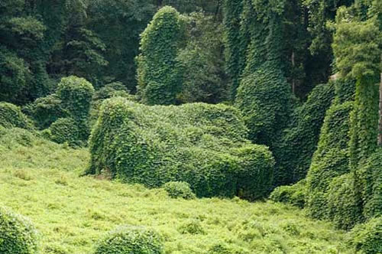
Let’s Not Make it Worse!
See the house????
Kudzu

Slide 40
Thank You!
Any Questions?
Master Gardener Hotline: (530) 889-7388
Rot Line: (530) 889-7399
Master Gardener Website: pcmg.ucanr.org
Notes:
World Flora Online http://www.worldfloraonline.org

Slide 41
Extra slides

Slide 42
“It Depends”
12 Outdoor Plants You Can't Kill - The Spruce
https://www.thespruce.com › ... › Plants & Flowers
Russian Sage harsh environment, tough-as-nails
Daffodils
Dead Nettle--spread quickly by shallow-rooted runners, but you can pull up extras
Catmint. bees delight in the nectar-rich violet blooms
Daylily. available cultivar number into the thousands
Feather Reed Grass adaptable to wet and dry soils
Sedums drought tolerant, mind their manners.
Butterfly Bush high risk of becoming invasive in California according to Cal-IPC.
False Indigo rocky rubble of construction, will do just fine.
Lady's Mantle. shade, dry soil, and competition for nutrients.
Lamb's Ears. Spreads moderately each year provide pass along plants to friends
Bee Balm-- “an assertive plant”
Notes:
Where you live
Soil
Water
Willingness to Work (weed,)

Slide 43
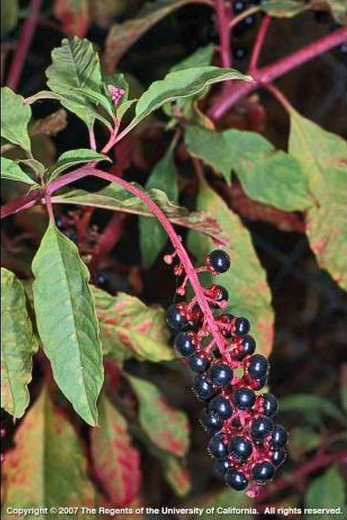
Title
American Pokeweed (Phytolacca americana)
Notes:
https://ucanr.edu/blogs/blogcore/postdetail.cfm?postnum=27983
https://www.fs.fed.us/wildflowers/plant-of-the-week/phytolacca_americana.shtml

Slide 44
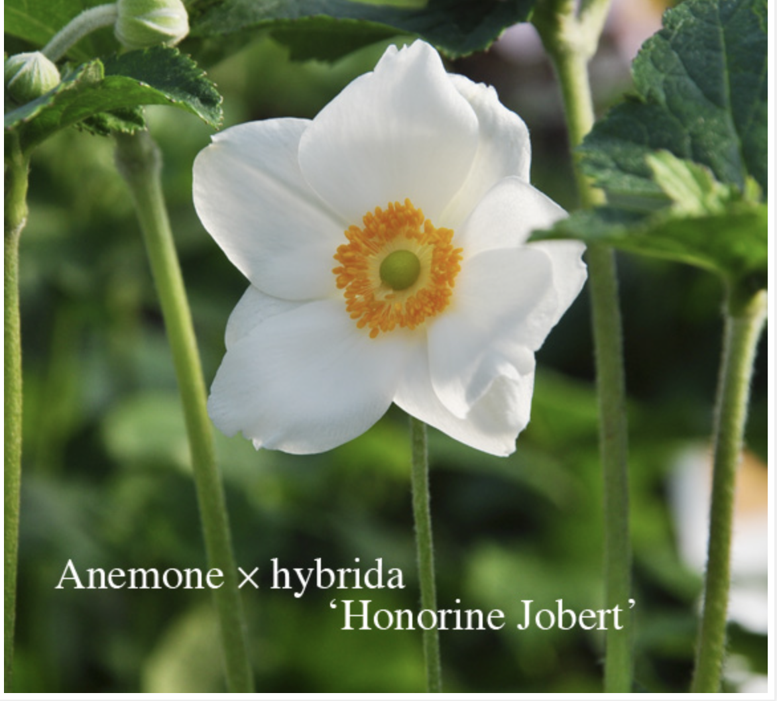
However, plants divide easily and also reproduce quickly from root cuttings. If you choose to divide yours, discard the woody parts and keep the younger, more tender roots. There are also often volunteer seedlings that can be dug and moved about or given away. Although it can take a few years for your plants to really become established, once they do, the roots tend to run by rhizomes and can become aggressive.
Notes:
https://www.thespruce.com/how-to-grow-anemone-honorine-jobert-4125828

