Slide 1
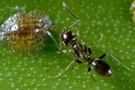
Controlling Ants in Your Home and Yard
Notes:
Created: Developed July 2021/approved
Created by: Brooke Moeller of Placer County Master Gardener(s) who created this originally
Audience: Home gardener
Publicity: Ants: Nobody likes them…..learn how to control ants in your home and garden
Update History: for each update to the presentation include date, name of updater, explanation of update
(were additional slides added, were web links updated, etc.)

Slide 2
Who Are Master Gardeners?
Master Gardeners of Placer County
Extend research-based, sustainable gardening and composting information
Present accurate, impartial information to home gardeners
Encourage public to make informed gardening decisions

Slide 3
Who Are Master Gardeners?
Where to find us…
Online, in the Media, and Special Publications
Hotline: Call (530) 889-7388 or submit your questions online
Website: pcmg.ucanr.org
Facebook, Twitter, Instagram
Gold Country Media monthly column
Curious Gardener quarterly newsletter on our website
Gardening Guide and Calendar

Slide 4
Who Are Master Gardeners?
Where to find us…
Workshops, Fairs and Festivals, and Special Events
Speakers by Request
Workshops (various venues, check website)
Farmers’ Markets (seasonal: Auburn, Roseville and Fowler Ranch)
Fairs and Festivals Booths (varies)
Garden Faire (April)
Mother’s Day Garden Tour (May)

Slide 5
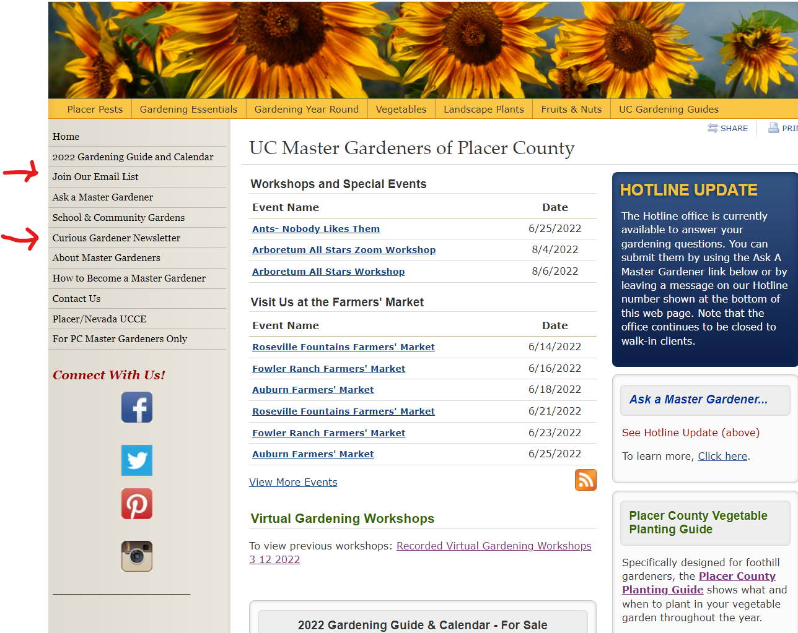

Slide 6
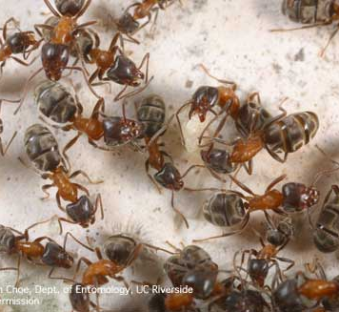
Agenda
Identification of common ants
Life Cycle and Habits
Management
Identify
Prevention
Cultural
Chemical

Slide 7
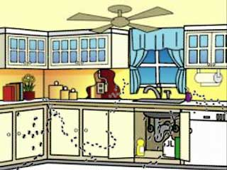
Overview
Ants are the most prevalent house and garden pests
Ants need water and food
Over 12,400 species worldwide
“Only 270” species in California
Notes:
Find ants wherever they can find food and water
In California there are about 270 species but there are less than a dozen that are considered an ‘important pest’

Slide 8
Integrated Pest Management
Notes:
An IPM approach encourages methods that provide long-term prevention or suppression of pest problems with minimum impact on human health, the environment and nontarget organisms.
A fundamental concept of IPM that a certain amount of disease or pest damage can be tolerated. It’s not feasible to think you can remove them completely.
Identification of the ant will help you select the right attack

Slide 9


One node
Identification- Two Types of ants: one node or two nodes
Ant’s body is constricted
Ant’s hind wings are smaller than its front wings
Winged female and worker ants have elbowed antennae
Thorax
Abdomen
Head
Two nodes
Notes:
Accurate identification of your pest will help provide more effective management of the pest
Winged forms of ants leave the nest in large numbers in warm weather to mate and form new colonies. They may be mistaken for winged termites (which also leave the nest to mate).
Ants have a constricted body, a thin waist.
Termites have a broad waist
Ants hind wings are smaller than its front wings. Shortly after they take flight, both termites and ants lose their wings
Termites do not have elbowed antennae
Ants are further classified as having one node or two.

Slide 10
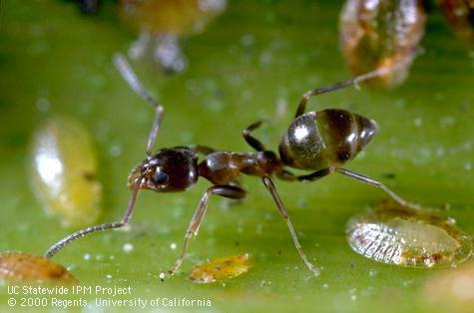
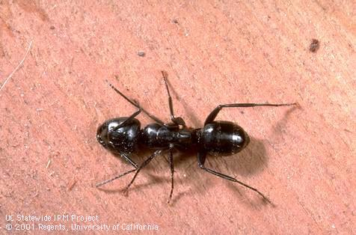
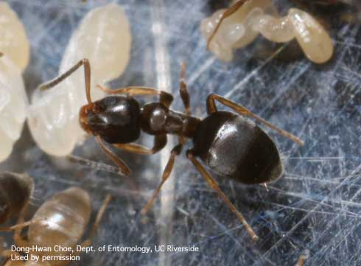
One node ants
Argentine ant
Likes sweets and proteins
Nests outdoors in shallow mounds
Carpenter ant
Likes sweets
Nests in tree stumps, firewood, deposits sawdust like frass outside nests
Odorous house ant
Likes sweets and sometimes proteins
Nests in shallow mounds in soil or debris or indoors in wall voids, around water pipes or heaters
Notes:
Argentine ant is about 1/8” and a dull brown; these are the ones we see the most of in our homes
Carpenter ant is large, workers vary from ¼ to ½” black or bicolored red and black., Also nests in hollow doors or window frames or fenceposts
Odorous house ant is 1/8 to 1/4 “, brownish black head, red thorax, and distinct odor when crushed

Slide 11
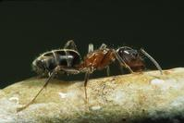
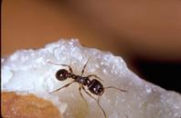
One node ants
Velvety tree ant
Likes sweets and insects
Nests in dead wood such as old tree limbs, stumps and logs
Two node ants
Pavement ant
Like sweets, proteins and grease
Nests in lawns, under stones or boards; builds mounds along sidewalks and foundations or near water
Notes:
Velvety tree ant: Workers range from 1/8 to ¼ “ brownish black head, red thorax, velvety black abdomen, very distinct odor when crushed
Pavement ant: about 3/16”, dark brown to black

Slide 12
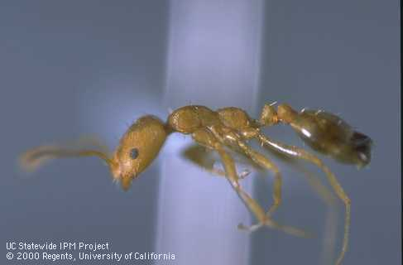
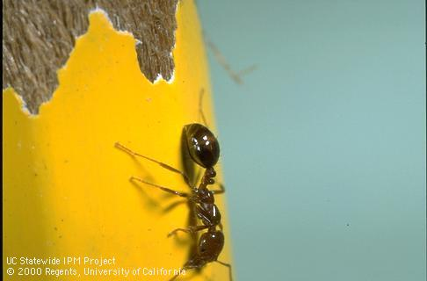
Two node ants
Pharaoh ant
Likes fats, proteins, sweets
Nests in wall or cabinet voids, behind baseboards or insulation or outdoors in debris
Red imported fire ant
Like sweets and proteins
Nests in mounds with multiple openings in soil or lawns, sometimes in buildings behind wall voids
Notes:
Pharoah: about 1/16” yellow or honey colored to orange
Red imported fire ant: workers vary from1/16 – 1/5” ; reddish with dark brown abdomen

Slide 13
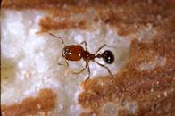
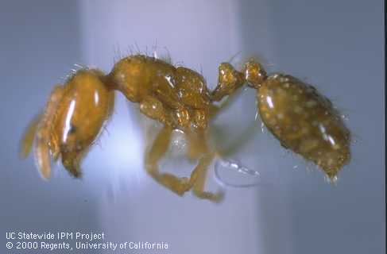
Southern fire ant
Likes proteins and sweets
Nests in small mounds with flattened, irregular craters in wood or under rocks
Thief ant
Likes greasy and fatty, sometimes sweets.
Steals food and ant larvae from other ant nests.
Nests outdoors in soil or under rocks or decaying wood, indoors behind wallboards or baseboards
Notes:
Southern fire ant: workers vary from 1/8 -1/4”, amber head and thorax, black abdomen, golden hairs cover body
Thief: 1/32: yellow to light brown

Slide 14
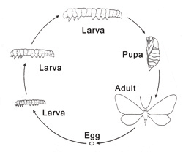
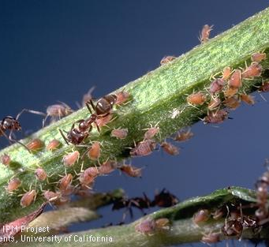
Life Cycle and Habits
Usually nest in soil, next to buildings or near food
Looking for food, water, and shelter
Queen lays eggs larvae pupate pupae transform into sterile female adult workers and dig out of the nest looking for food.
Subsequent broods add new chambers to the nest.
After a few years, the colony will produce winged male and female ants which will leave and form new colonies.
Notes:
Eggs hatch and larvae emerge, they become pupa and then adults. They will make nests near trees or plants that have honeydew-producing insects, such as aphids. As we discussed, ants have different preferences for food, but includes fruits, seeds, nuts, dead animals and sweets.

Slide 15
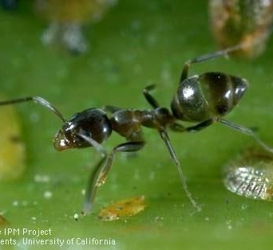
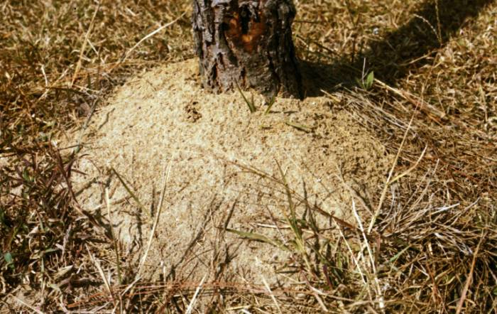
Damage
Very annoying!
Velvety tree ant bites
Scales and aphids might appear since ants protect them from their natural enemies.
Fire ant infestation should be reported
Placer County Agricultural Commissioner (530) 889-7372.
https://www.placer.ca.gov/1505/Agricultural-Commissioner
Photo: Utah State Univ Extension
Notes:
Other biting ants include red imported fire ants which have been found in Southern California.
Ants are attracted to honeydew that soft scales, mealybugs and aphids produce. You may notice more outbreaks of scales and aphids because protect them from their natural enemies
If you suspect fire ant infestation report it to your country agricultural commissioner.

Slide 16
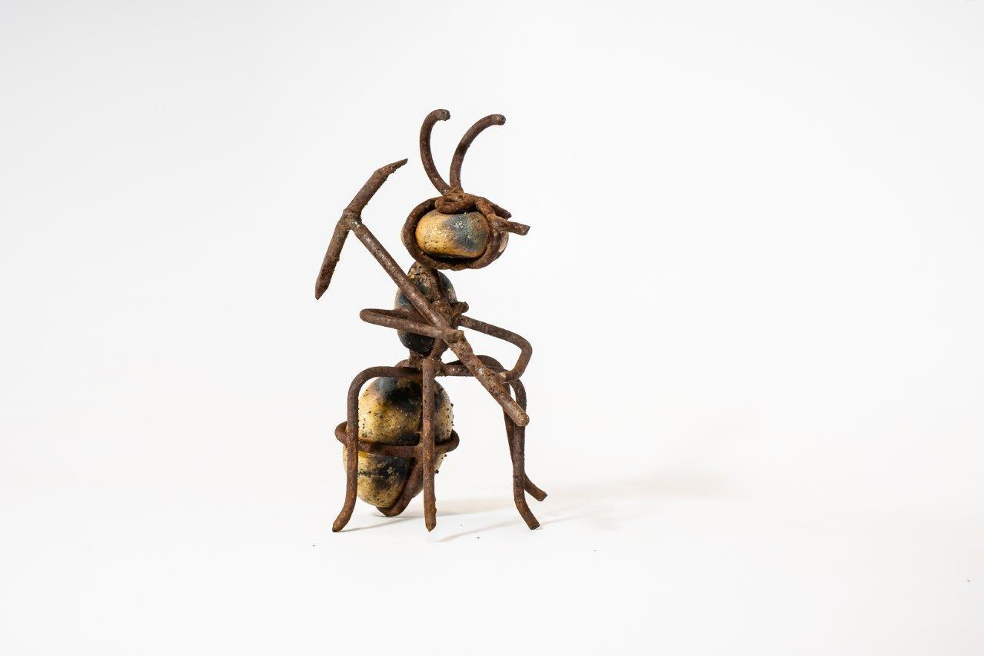
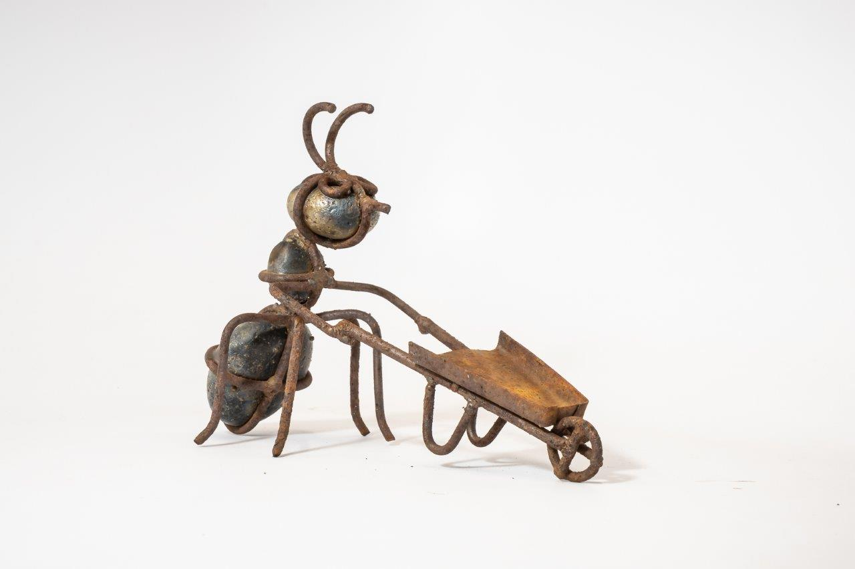
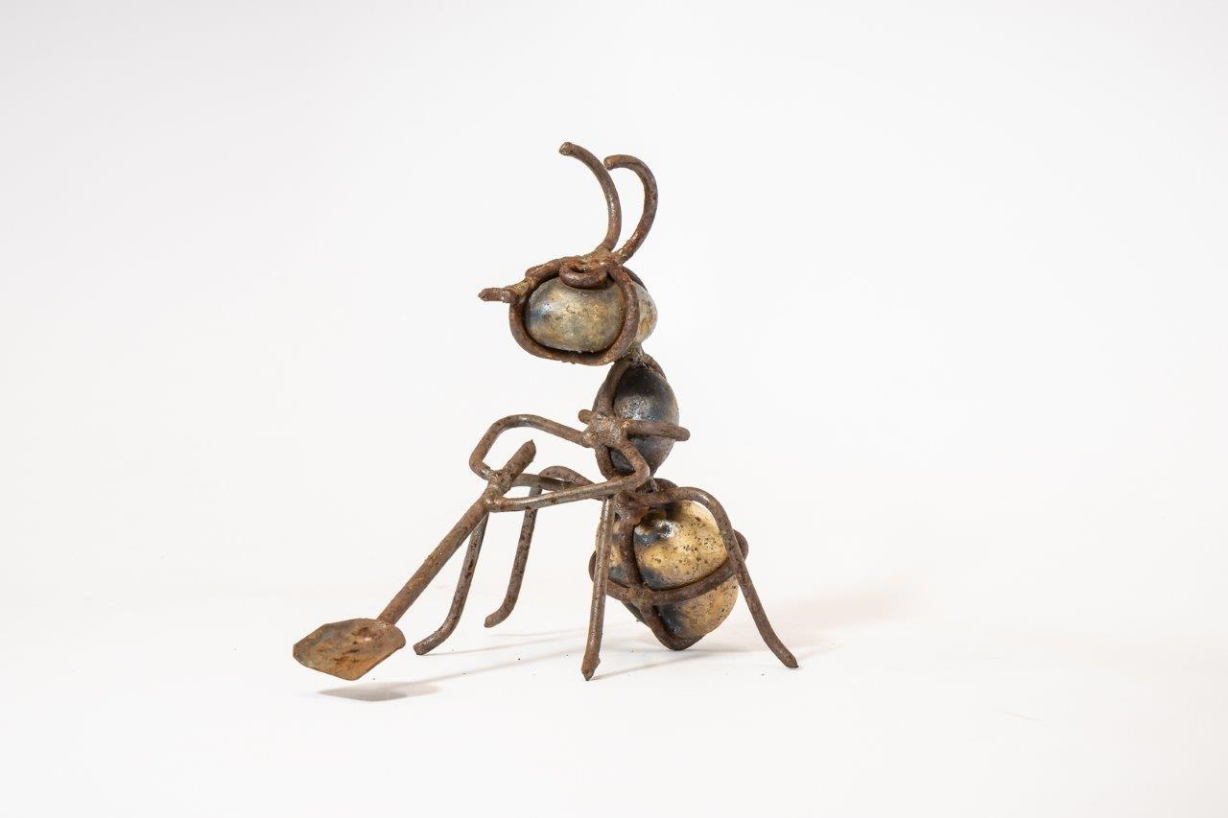
Ant survival strategy:
It’s cold outside. I want to come in.
It’s wet outside. I want to come in.
I’m hungry. I want to come in.
I’m thirsty. I want to come in.
Notes:
It doesn’t seem to matter; ants are never happy with their environment and want to come into our homes. They are looking for moisture and food.
But there are ways to get them under control.

Slide 17
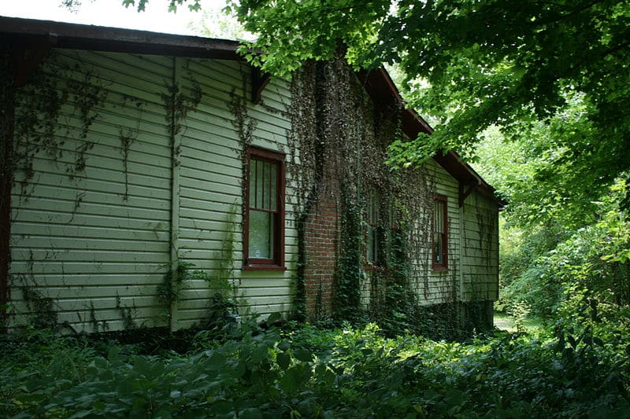
Why Ants Invade Your Home
Looking for food and water
Plants close to the foundation
Mulch next to house
Dripping water
Wood piles
Plants with sugary fruit
Food available in the kitchen (counter, trash, etc)
Photo courtesy of Lineage Tree Care
Notes:
Primary motivation is a source of food and water. When you have plants, mulch, wood piles next to your home, it’s an invitation to come in.
See how the plants growing next to the windows and the tree branches are touching the roof? All provide access to your home.

Slide 18
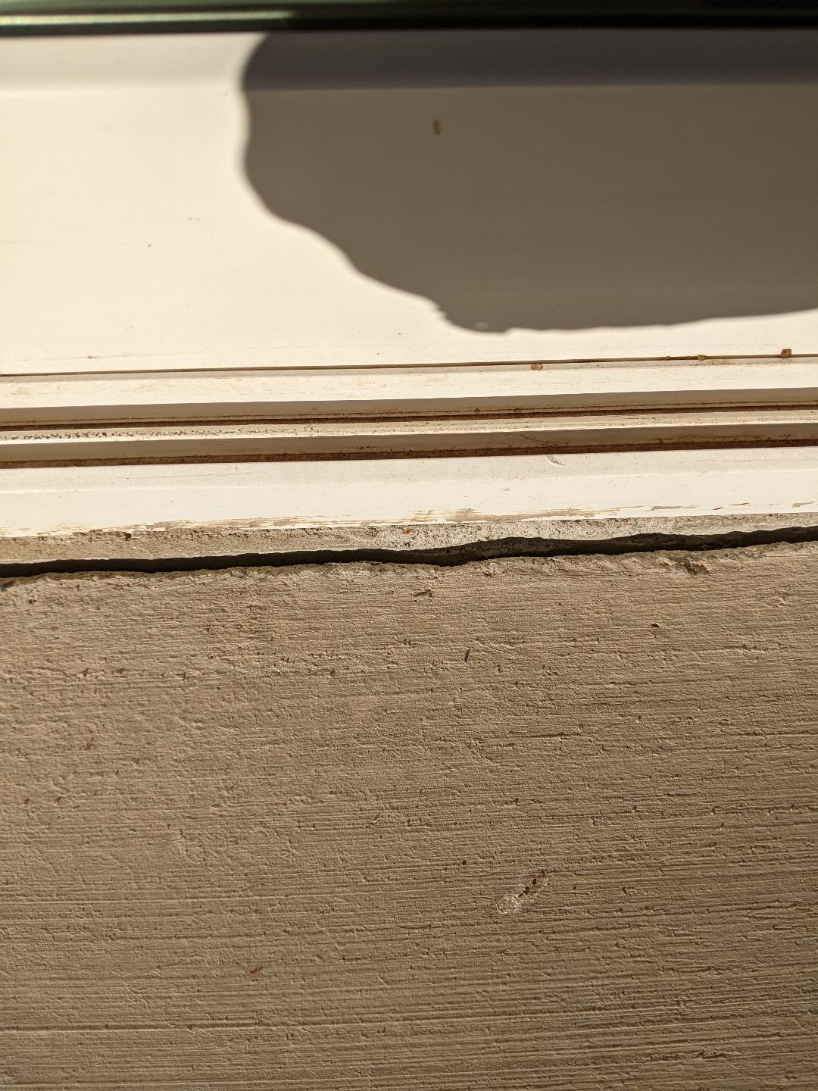
Prevention:
Monitor and Inspection
Look under sinks, cupboards, pipes and electrical wires
Outdoors, look for cracks or holes in the foundation
Try to locate entry point and nest
Seal openings with caulk
Notes:
Let’s talk about how to help prevent ants from coming into your home.
Regularly inspect your home for points of entry. Look for ants near attractive food and water sources. Look under sinks, cupboards and along pipes and electrical wires.
One or two ants are scouts looking for opportunities. If possible, follow them back to where they enter the building and to the nest if possible. Look indoor and outdoors for holes or cracks in foundations or walls.
Before caulking you may apply products containing silica aerogel (sometimes combined with pyrethrins) such as Evergreen Pyrethrum Dust into wall voids before sealing them up.
Late winter and spring are the best times to monitor for ants because they are less abundant and easier to mange

Slide 19
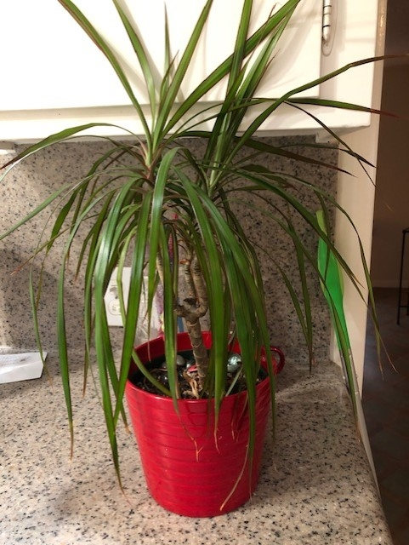
Cultural
Check plants for nesting places
Use petroleum jelly under the lip of trash can
Place pet dishes in a moat of water
Store attractive food items in closed containers (washed to remove residue)
Clean up grease and spills; remove garbage daily
Photo: A. Schellman/UCANR
Notes:
Look for indoor nesting places, such as potted plants. If ants are found in potted plants, remove the containers from the building, then place the pots for 20 or more minutes in a solution of insecticidal soap and water at a rate of 1 to 2 tablespoons of insecticidal soap per quart of water. Submerge so the surface of the soil is just covered by the water-soap solution.

Slide 20
Fair and Balanced
Ants add organic material to soil
Cultivate and aerate the soil
Create channels for water and roots
They eat aphids, mealybugs, scales and whiteflies
Need to manage the above so as not to attract ants

Slide 21
Controlling Ants Outdoors
Avoid planting trees and shrubs next to building
Keep grass and mulch several inches away from foundation
Fix leaky faucets
Pick up and remove fallen fruit

Slide 22
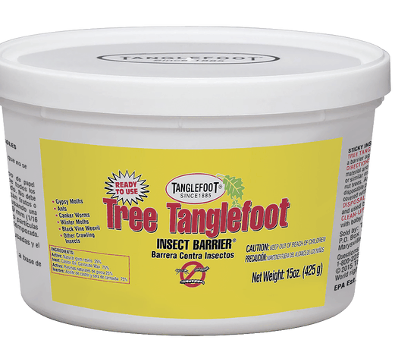
Controlling Ants Outdoors
Plant pest-resistant varieties, such as native plants
Squash, trap, wash off, or prune out pests
Add a sticky material as a barrier to bark
Pesticides should only be used when non-chemical methods are ineffective….and are reaching intolerable levels

Slide 23
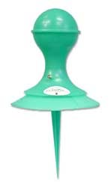
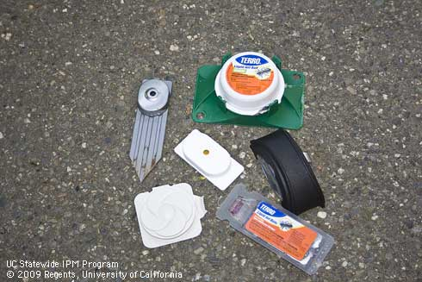
Insecticide Bait
0.5% - 1.0% borate most effective for Argentine ants
Slow acting so you need patience
May take up to 1-2 weeks to see decrease of ants
Pre-packaged baits are not effective for severe infestation
Fipronil Gel Bait may be useful indoors inside cabinets, small cracks or along trails
KM Ant Pro Liquid Bait Dispenser
Provides continuous access while keeping bait fresh
Notes:
Ant baits contain insecticides mixed with materials to attract ants. Ants take it back to the colony to share. They are slow acting to make sure the ants get back to the colony. When used properly they are safer and more effective than sprays. Ants may prefer certain types of bait. You may want to offer different types to see what they enjoy the most (sweet, protein etc).
Place baits where ants can find them easily but where they won’t be found by pets and children. Check stations to ensure they haven’t dried up.
Some pest control companies provide a perimeter spray. Perimeter treatments pose more rise of environmental upset than baits and are less effective than an IPM program.

Slide 24
Read and Follow Instructions
Poisonous
Pesticides move through water, soil resulting in contamination of creeks, lakes, rivers and ocean
Wear appropriate clothing and
Never allow them to get into drains or creeks or neighbor’s property
Dispose of properly
Notes:
Pesticide is any material (natural, organic, or synthetic) used to control, prevent, kill, suppress or repel pests. It includes insectides, herbicides, fungicides, etc.
Failure to follow label instructions is an illegal use of the pesticides
Used the least toxic product
Don’t place pesticides in trash until empty and don’t pour down sink, toilet or drains.. Never reuse or burn the container. Take to your local Household Hazardous Waste Collection site and follow all local regulations.

Slide 25

911- What’s Your Emergency?
Track to food source
Clean spills, pet food, remove garbage
Wipe trails with soapy water or window spray
Or Vacuum ants and then wipe
Locate opening and caulk or plug with petroleum jelly
Place bait outdoors at point of entry
Continue to clean as they reappear
Notes:
If you have an ant emergency, here’s what to do:
After placing bait outdoors, remember it may take a week or more for them to go away. Keep cleaning as they reappear.
Remember: do not use ant spray

Slide 26
In Conclusion
Identify the ant you want to control
Don’t try to eliminate ants, learn to manage them
Keep kitchen clean
Inspect house perimeter
Choose the right bait for your target ant

Slide 27
References
Ants Management Guidelines; UC ANR Publication 7411 Published October 2012
http://ipm.ucanr.edu/PMG/PESTNOTES/pn7411.html
Garden Chemicals: Safe Use & Disposal UC ANR Published Sept 2018
http://ipm.ucanr.edu/QT/gardenchemicalscard.html
Ants; Natter JR; Oregon State Univ –Extension Master Gardener Newsletter May 2020
https://blogs.oregonstate.edu/mgmetro/2020/05/05/ants

Slide 28
Resources
Quick Tips: Ants Published Sept 2018
http://ipm.ucanr.edu/QT/antscard.html
Pests in Gardens and Landscapes: Quick Tip for Scales:
http://ipm.ucanr.edu/QT/scalescard.html
Pests in Gardens and Landscapes: Quick Tip for Ants Link: http://ipm.ucanr.edu/QT/antscard.html
Pests in Gardens and Landscapes for Aphids http://ipm.ucanr.edu/PMG/PESTNOTES/pn7404.html

Slide 29
Thank You!
Any Questions?
Master Gardener Hotline: (530) 889-7388
Rot Line: (530) 889-7399
Master Gardener Website: pcmg.ucanr.org
Evaluations, please!

